Slide 1
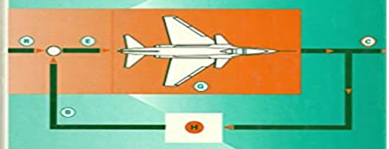
Bode Plots
Dr. Wazir Muhammad
Electrical Engineering Department
BUET, Khuzdar

