Slide 1
PROBABILITY DISTRIBUTION CURVE

Slide 2
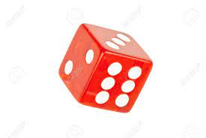
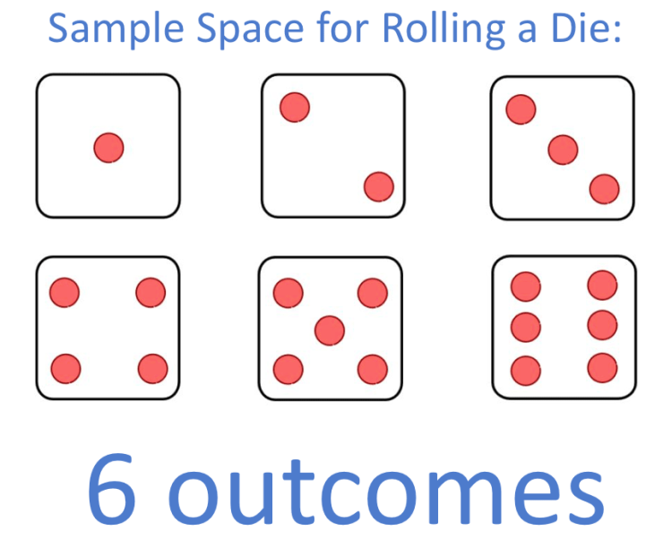

Q: Rolling a Die one time, calculate the Sample Space
SOLUTION
$${Outcomes of Die= 6}^{n}=6^{1}=6$$
Sample Space = $S=\{1,2,3,4,5,6\}$

Slide 3
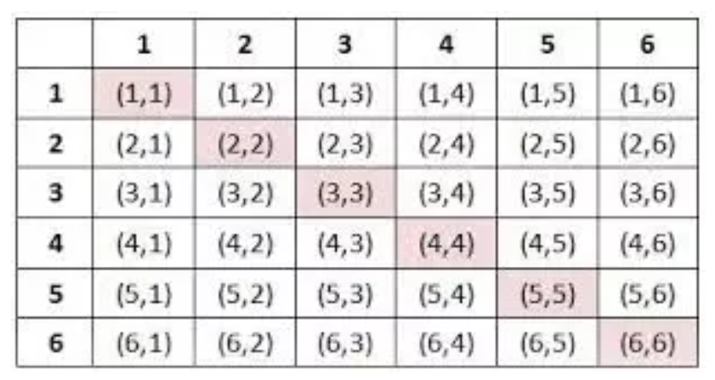

Q: Rolling a Die two times, calculate the Sample Space? OR
Rolling Two Die one time, calculate the Sample Space?
SOLUTION
DIE-1
$${Outcomes of Die= 6}^{n}=6^{2}=36$$
Sample Space = $S=$
DIE-2
When you first time die a roll result appear 1. second time roll a die also appear 1 = (1,1).

Slide 4

Q: When you Rolling a Die two times, find the Probability of that number having sum is 2?
SOLUTION
$${Outcomes of Die= 6}^{n}=6^{2}=36$$
DIE-1
Only one number (1) available in this table which is (1,1) = 1+1 = 2.
DIE-2
$$P\left(2\right)=\frac{1}{36}$$

Slide 5

Q: When you Rolling a Die two times, find the Probability of that number having sum is 3?
SOLUTION
$${Outcomes of Die= 6}^{n}=6^{2}=36$$
DIE-1
Only two numbers (2) available in this table which is (1,2) and (2,1) = 1+2 = 3 or 2+1 = 3.
DIE-2
$$P\left(3\right)=\frac{2}{36}$$

Slide 6

Q: When you Rolling a Die two times, find the Probability of that number having sum is 4?
SOLUTION
$${Outcomes of Die= 6}^{n}=6^{2}=36$$
DIE-1
Only three numbers (3) available in this table which is (1,3) , (3,1) and (2,2) = 1+3 =4, 3+1 =4, 2+2 = 4
DIE-2
$$P\left(4\right)=\frac{3}{36}$$

Slide 7
Probability Distribution
A Probability Distribution is the mathematical function that gives the probabilities of occurrence of different possible outcomes for an experiment.

Slide 8
12/36
11/36
10/36
9/36
8/36
7/36
6/36
5/36
4/36
3/36
2/36
1/36
Draw the Probability Distribution Curve of Rolling a Die two times, having sum is, 2,3, 4, …………?
P(2) P(4) P(6) P(8) P(10) P(12)

Slide 9
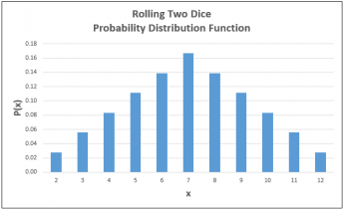
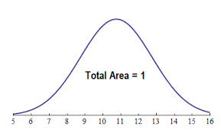
DIFFERENT FORMS OF PROBABILITY DISTRIBUTION CURVES

Slide 10
TYPES OF PROBABILITY DISTRIBUTION
Types of Probability Distribution
Discrete Type Probability Distribution
Continuous Type Probability Distribution
These Distributions values in between 0 and 1.
Binomial Distribution
Poisson Distribution
Normal Distribution

Slide 11
BINOMIAL DISTRIBUTION OR BERNOULLI TRIALS

Slide 12
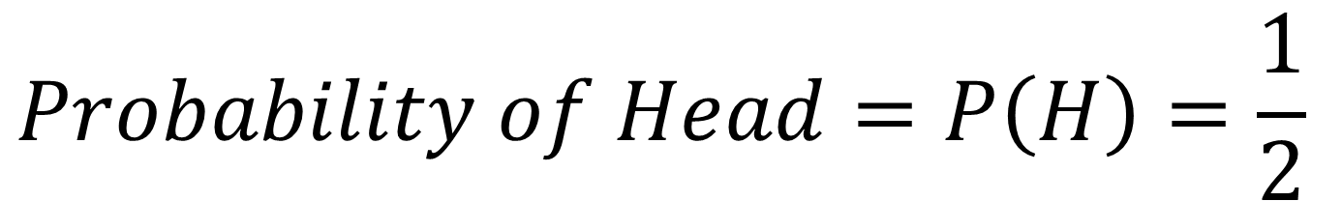
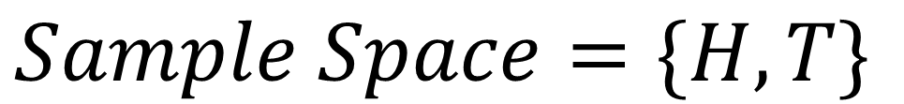
Q: A fair coin is tossed 1 times. What is the probability of obtaining head?
SOLUTION
$$Sample Space=\{H, T\}$$
$$Probability of Head=P\left(H\right)=\frac{1}{2}$$

Slide 13
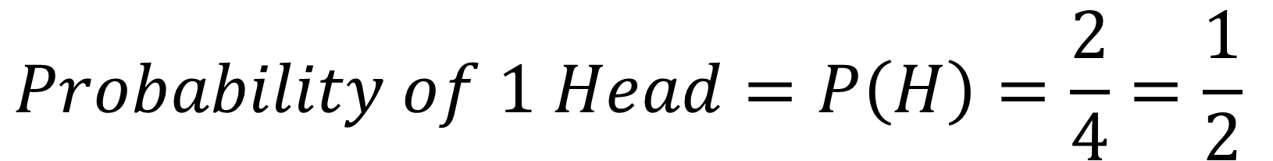
Q: A fair coin is tossed 2 times. What is the probability of obtaining 1 head?
SOLUTION
$$Sample Space=\{HH, HT, TH, TT\}$$
$$Probability of 1 Head=P\left(H\right)=\frac{2}{4}=\frac{1}{2}$$

Slide 14
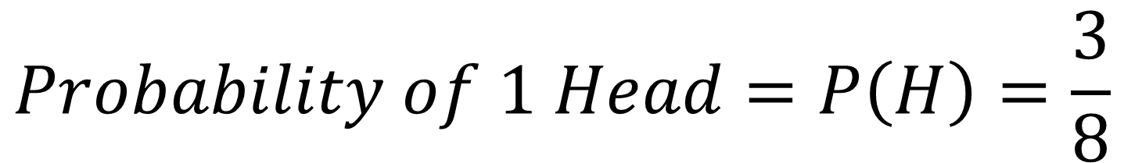
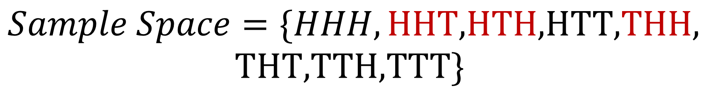
Q: A fair coin is tossed 3 times. What is the probability of obtaining 2 head?
SOLUTION
$$Sample Space=\{HHH,\text{HHT}\text{,}\text{HTH}\text{,}\text{HTT}\text{,}\text{THH}\text{,}$$
$$\text{THT}\text{,}\text{TTH}\text{,}\text{TTT}\}$$
$$Probability of 1 Head=P\left(H\right)=\frac{3}{8}$$

Slide 15
Q: A fair coin is tossed 6 times. What is the probability of obtaining 2 head?
SOLUTION: We can Solve but it takes more time, so Binomial Distribution Provide a solution to use a Formula to Calculate Probability of required heads.

Slide 16
Binomial Distribution
Binomial Distribution is used when number of samples are very large, then we apply Binomial Distribution Formula to Calculate the required Probability.

Slide 17
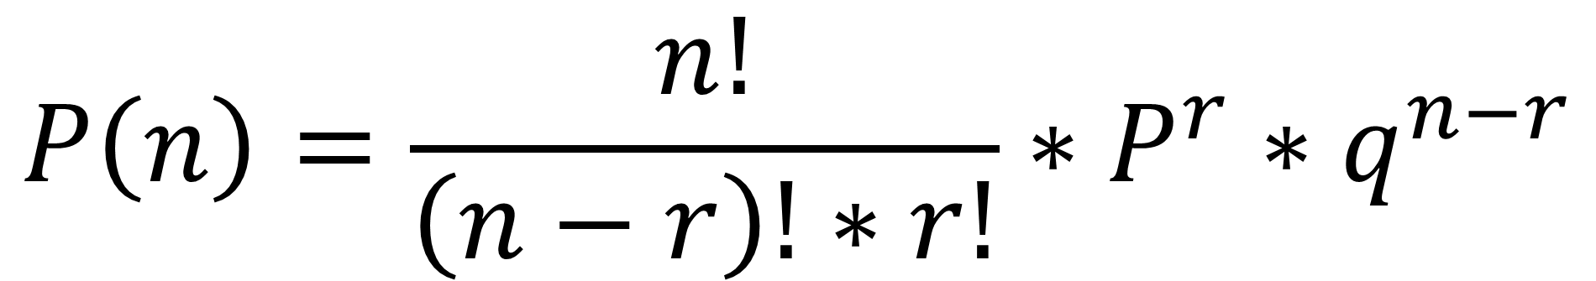
Formula of Binomial Distribution
$$P\left(n\right)=\frac{n!}{\left(n−r\right)!∗r!}∗P^{r}∗q^{n−r}$$

Slide 18

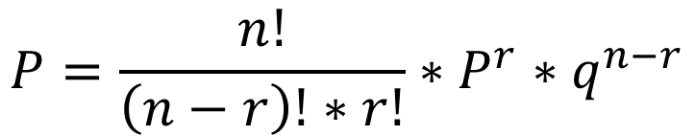

Q: A fair coin is tossed 3 times. What is the probability of obtaining 2 head? Apply Binomial Distribution
SOLUTION
$$tossed times=n=3$$
$$Obtaining Heads=r= 2$$
$$Always P is caculated on One Time tossed to Obtain Head=P=\frac{1}{2}$$
$$Similarly q is caculated as=1 −p=1 −\frac{1}{2}=\frac{1}{2}$$
$$P=\frac{n!}{\left(n−r\right)!∗r!}∗P^{r}∗q^{n−r}$$
$$P\left(2H\right)=\frac{3!}{\left(3−2\right)!∗2!}∗{\left(\frac{1}{2}\right)}^{2} ∗{\left(\frac{1}{2}\right)}^{3−2}=\frac{3∗2∗1}{\left(1\right)!∗2∗1}∗{\left(\frac{1}{2}\right)}^{2} ∗{\left(\frac{1}{2}\right)}^{1}=\frac{3}{8}Ans$$

Slide 19

Q: A fair coin is tossed 6 times. What is the probability of obtaining 2 head? Apply Binomial Distribution
SOLUTION
$$tossed times=n=6$$
$$Obtaining Heads=r= 2$$
$$Always P is caculated on One Time tossed to Obtain Head=P=\frac{1}{2}$$
$$Similarly q is caculated as=1 −p=1 −\frac{1}{2}=\frac{1}{2}$$
$$P=\frac{n!}{\left(n−r\right)!∗r!}∗P^{r}∗q^{n−r}$$
$$P\left(2H\right)=\frac{6!}{\left(6−2\right)!∗2!}∗{\left(\frac{1}{2}\right)}^{2} ∗{\left(\frac{1}{2}\right)}^{6−2}=\frac{6!}{\left(4\right)!∗2!}∗\left(\frac{1}{4}\right)∗{\left(\frac{1}{2}\right)}^{4}=\frac{15}{64} Ans$$

Slide 20
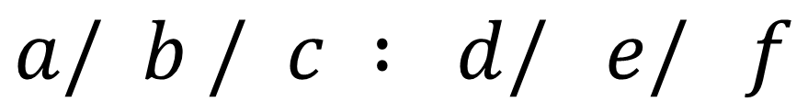

KENDALL’S NOTATIONS
$$a/ b / c : d/ e/ f$$
$$a=Arrival \{Followed by Poisson Distribution\}$$
$$b=Service \{Followed by Exponential Distribution\}$$
$$c=Number of Servers$$
$$d=Queue Discipline (FIRST COME FIRST SERVE, LCFS)$$
$$e=Length of Queue (∞,N)$$
$$f=Population Source (∞, N)$$

Slide 21
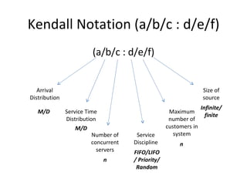

Slide 22
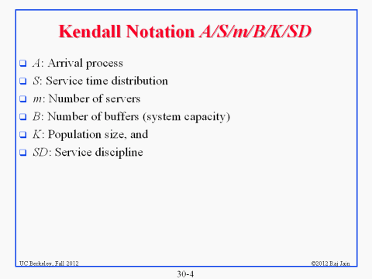

Slide 23
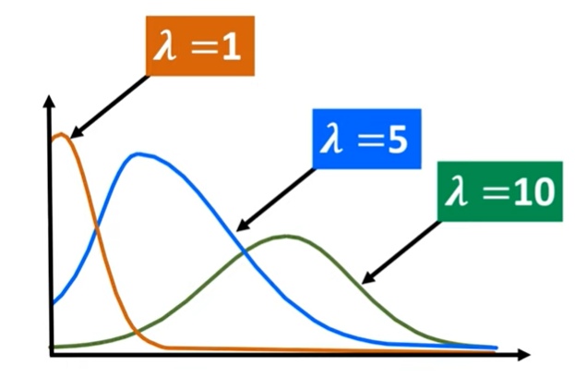

Slide 24
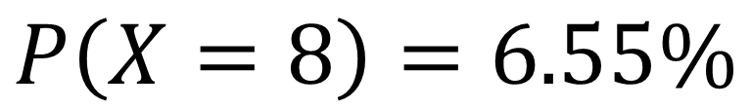
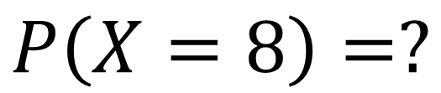
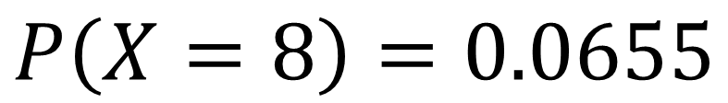
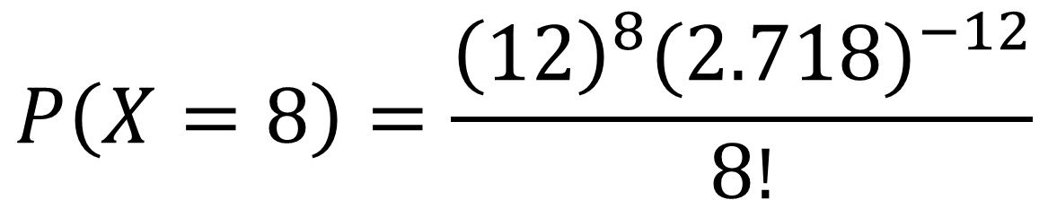
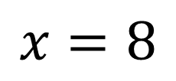
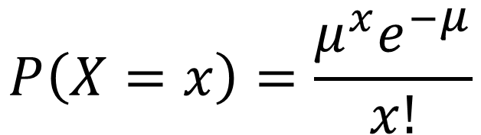
A small business receives an average 12 customers per day. (a) What is the probability that the business will receives exactly 8 customers in one day?
SOLUION
$$Average customers= μ= 12$$
$$x=8$$
$$P\left(X=8\right)=?$$
$$P\left(X=8\right)=0.0655$$
$$P\left(X=x\right)=\frac{μ^{x}e^{−μ}}{x!}$$
$$P\left(X=8\right)=6.55\%$$
$$P\left(X=8\right)=\frac{{\left(12\right)}^{8}{(2.718)}^{−12}}{8!}$$

