Slide 1

Microscopy
Microscopy is a process to use of Microscope is called Microscopy.
Microscopy is the technical field of using microscopes to view objects and areas of objects that cannot be seen with the naked eye.

Slide 2
https://www.youtube.com/watch?v=UTRzD0RBpkY

Slide 3
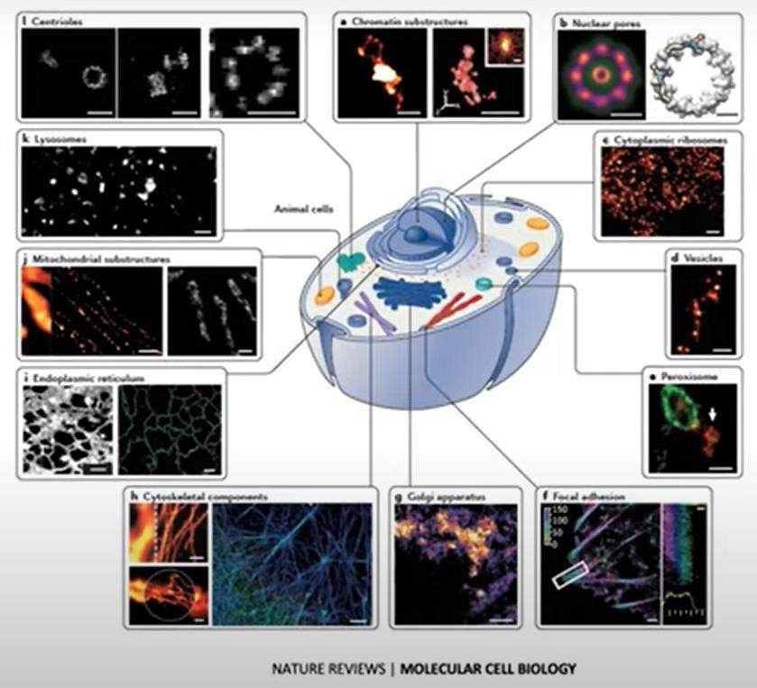
Superresolution microscopy , u know things are small inside the cell and superresolution microscopy
can help you seeing things litbit better

Slide 4
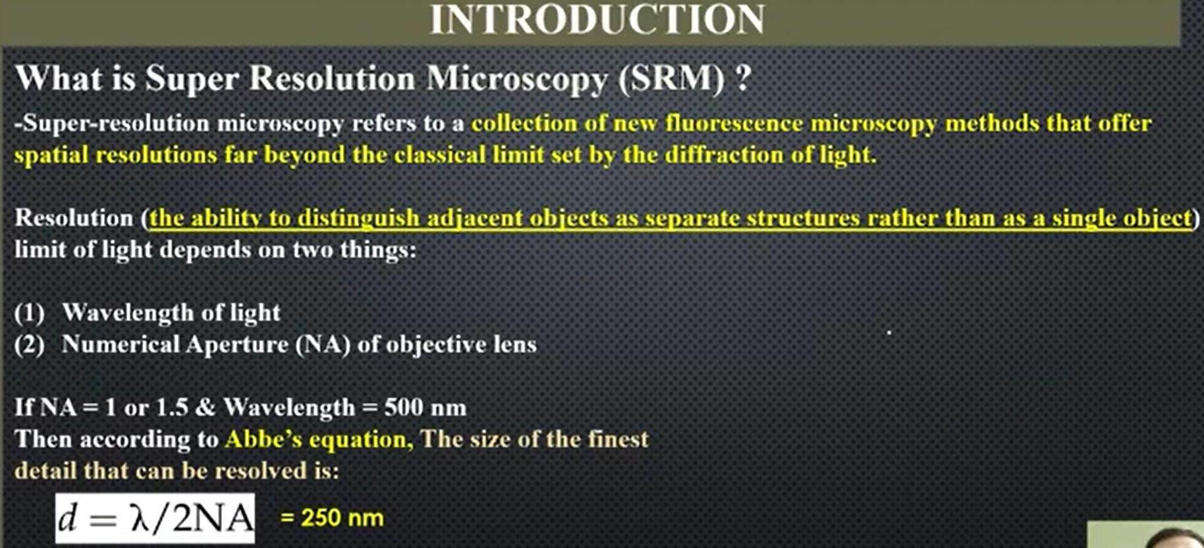
https://www.youtube.com/watch?v=430BDf3ILps

Slide 5
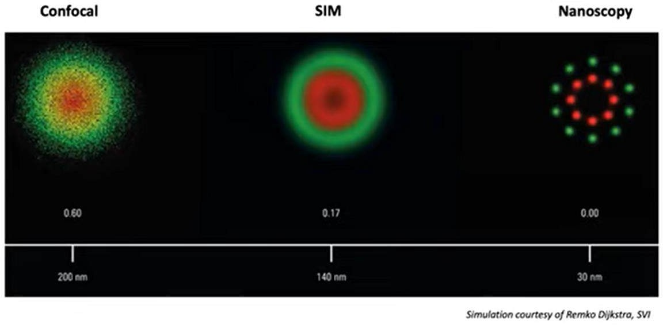

Slide 6
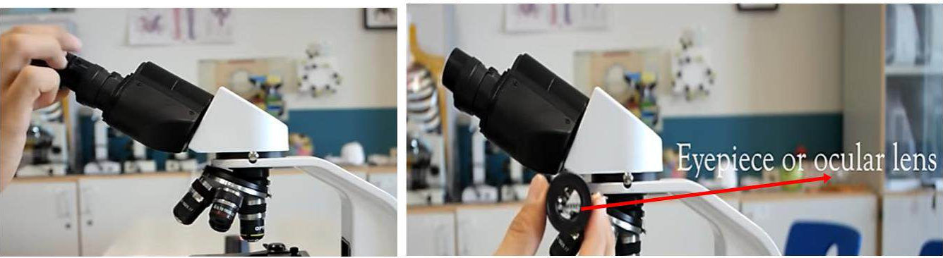
EYEPIECE OR OCULAR LENS
The eyepiece, or ocular lens, is the part of the microscope that magnifies the image produced by the microscope's objective so that it can be seen by the human eye.

Slide 7
Light chapter Understand From Physics Lense Chapter Understand From Physics
Chapter 12: Geometrical Optics
12.1: Reflection of Light (2 videos)
12.2: Spherical Mirrors (7 videos)
12.3: Image Location by Spherical Mirror Form (9 videos)
12.4: Refraction of Light (10 videos)
12.5: Total Internal Reflection (2 videos)
https://sabaq.pk/book-page.php?b=p&c=10&s=ph
Chapter 9: Physical Optics
9.1: Nature of Light (2 videos)
9.2: Wave Front (1 videos)
9.3: Huygen's Principle (1 videos)
9.4: Coherent sources (1 videos)
9.5: Interference of Light (2 videos)
. . .
Total Sections: 13
|
Total Videos: 30
View more

Slide 8
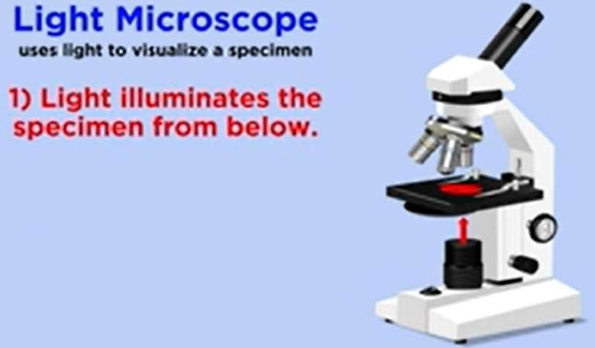
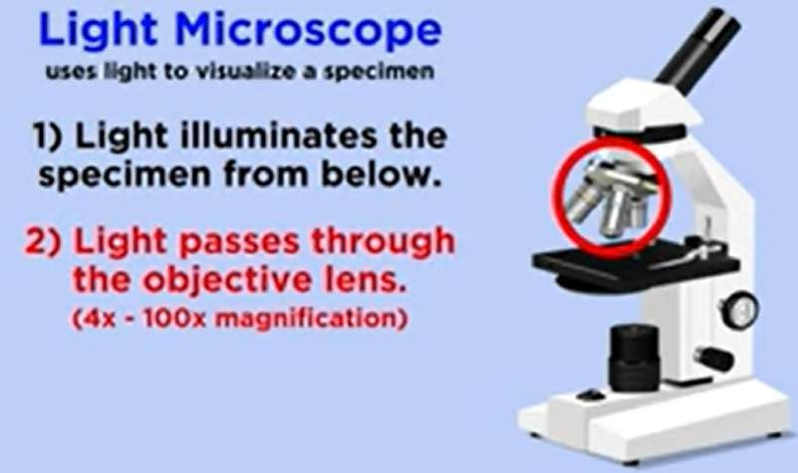
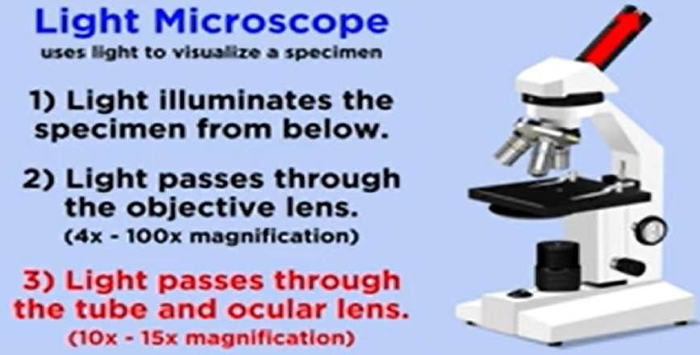

Slide 9
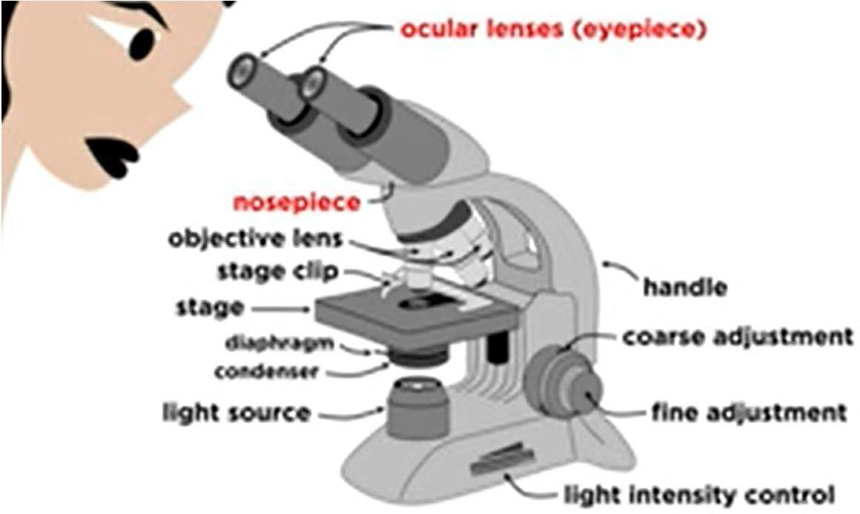
Light Microscopy OR Optical Microscopy
A light microscope is a tool that can identify, observe and magnify objects by transmitting light through a string of lenses.
A light microscope is a biology laboratory instrument or tool, that uses visible light to detect and magnify very small objects and enlarge them.

Slide 10
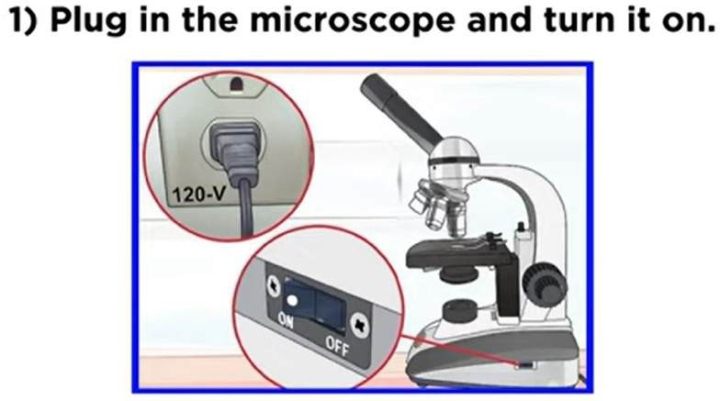
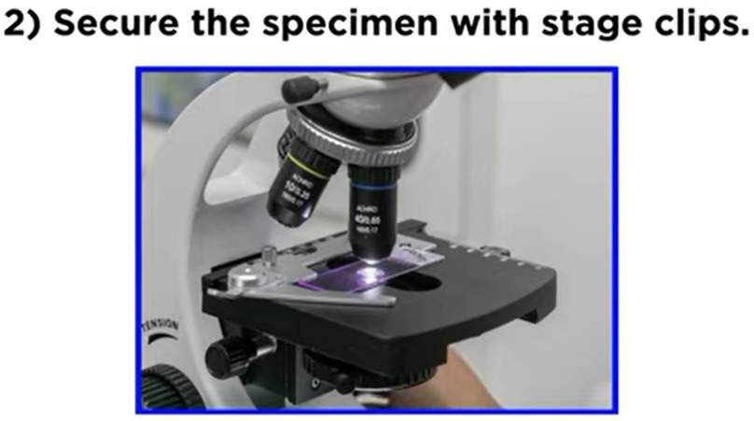
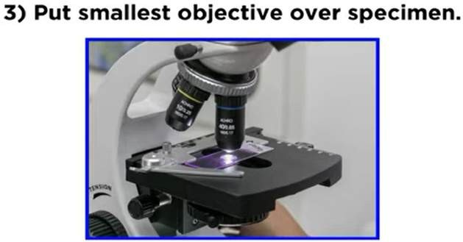
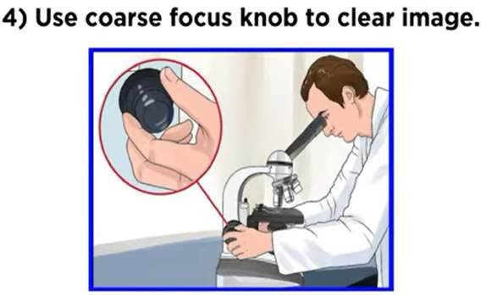
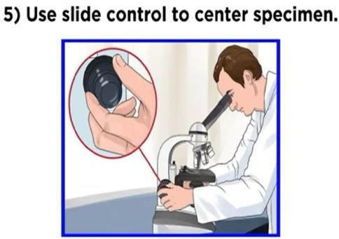

Slide 11
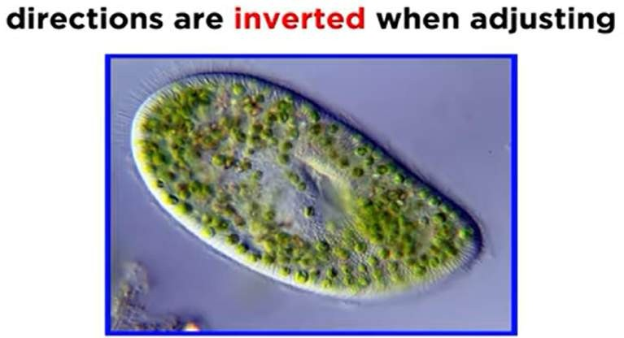
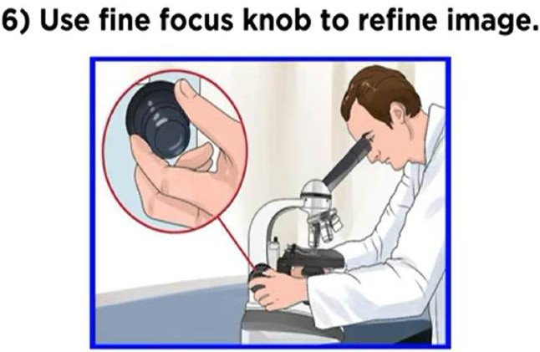
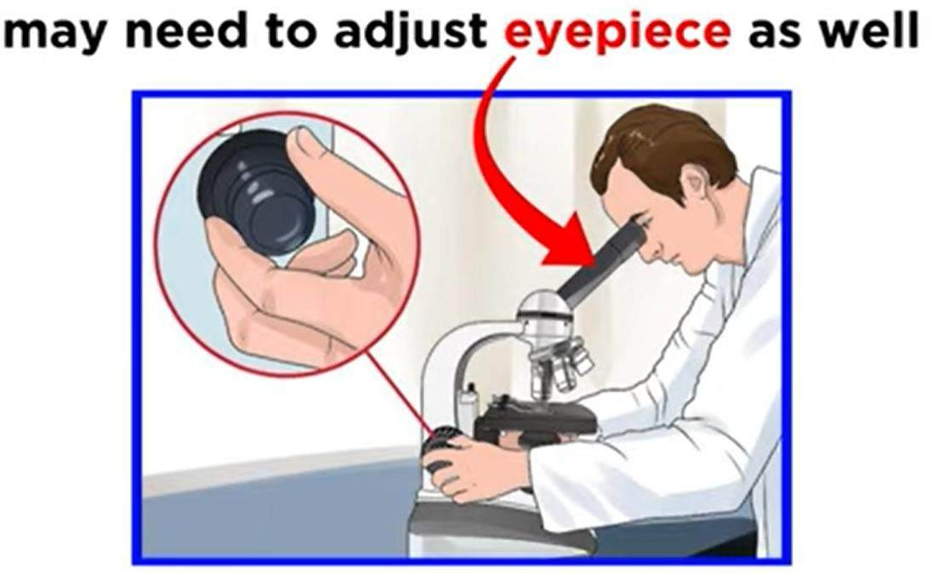
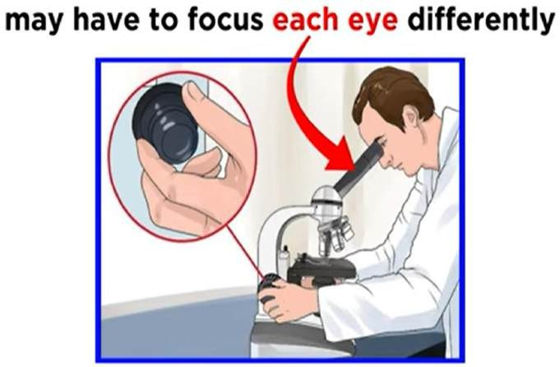

Slide 12
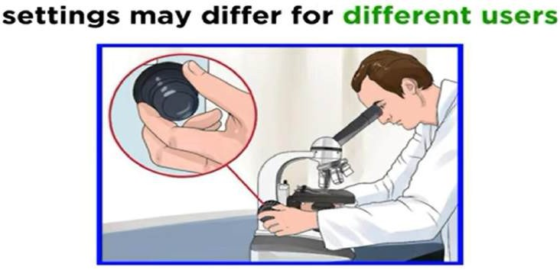
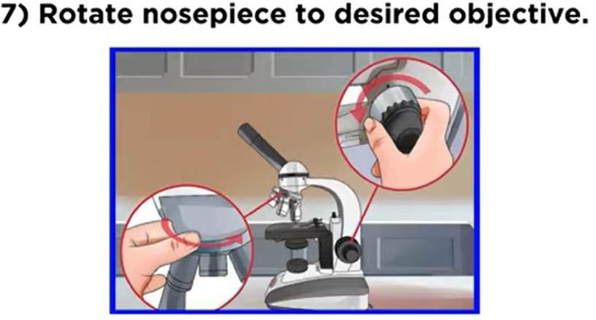
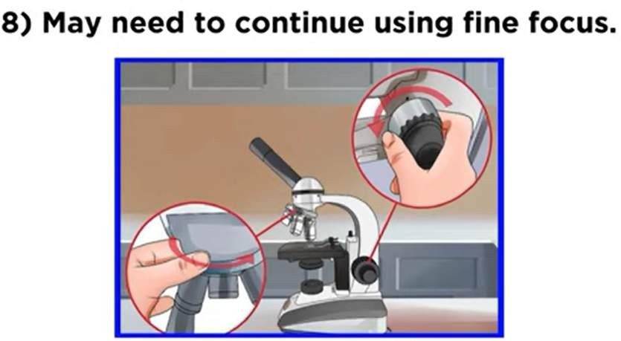
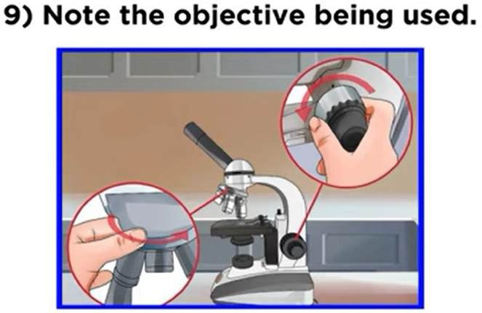

Slide 13
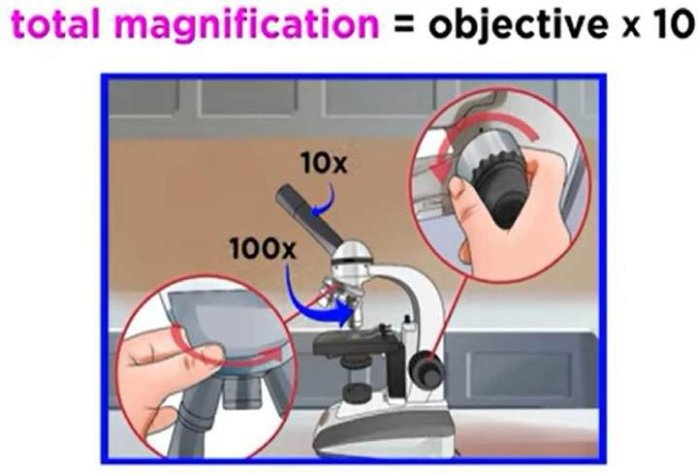
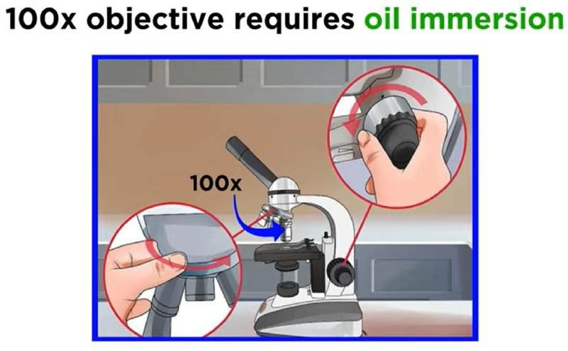
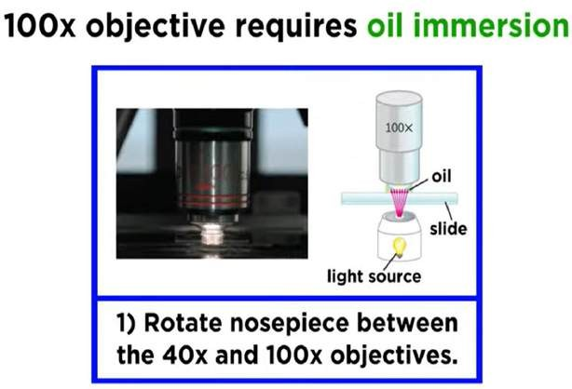
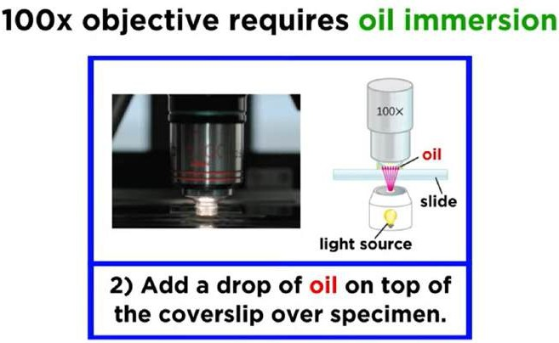

Slide 14
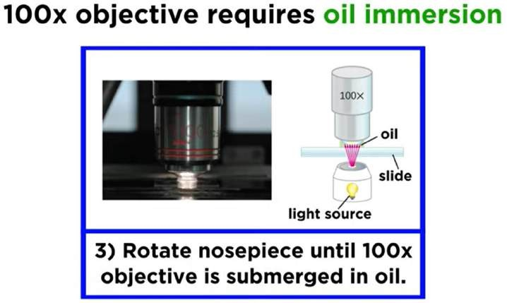
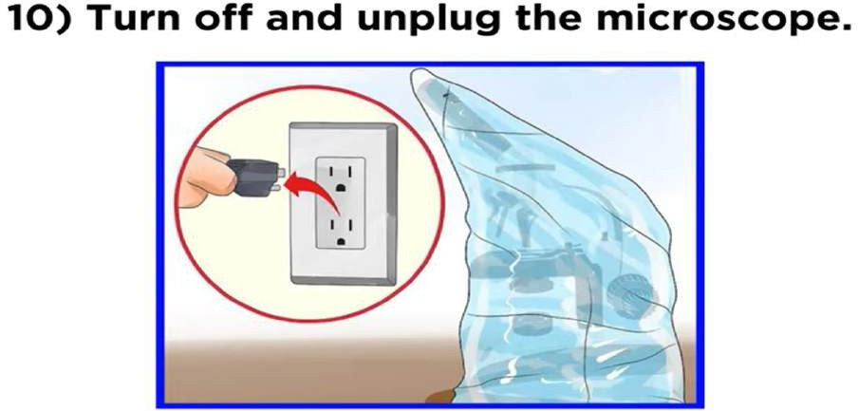
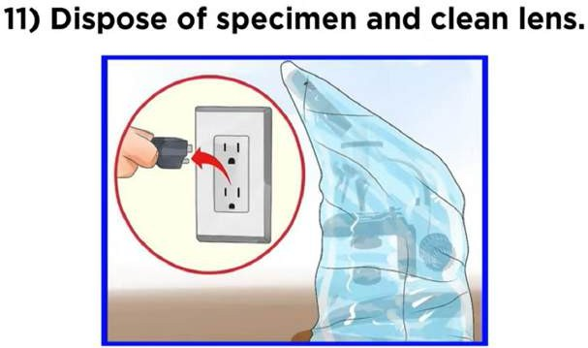
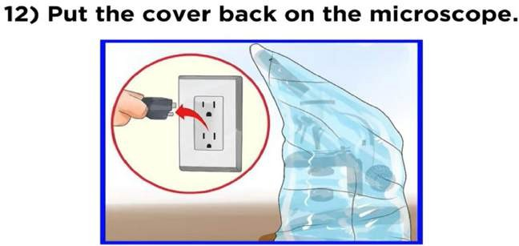

Slide 15
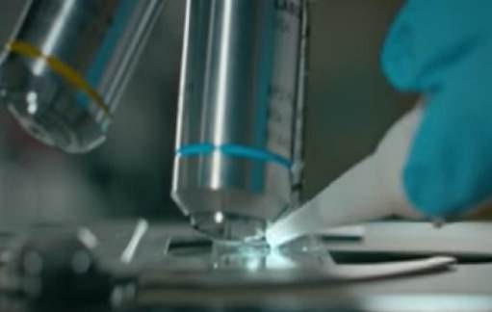
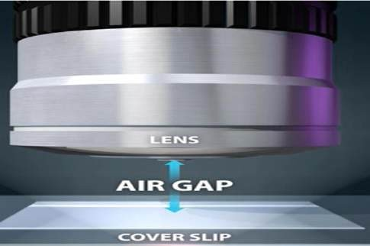
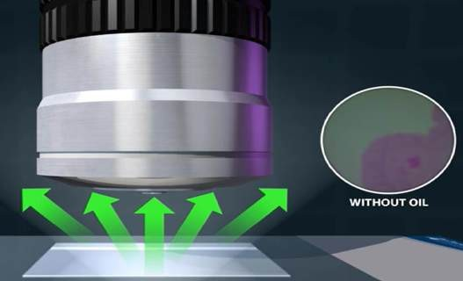
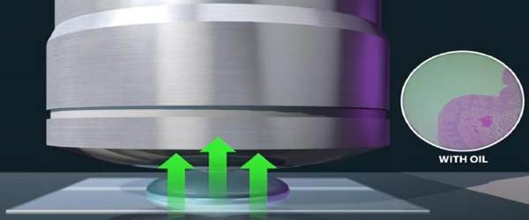
oil immersion
In light microscopy, oil immersion is a technique used to increase the resolving power of a microscope.
This is achieved by immersing both the objective lens and the specimen in a transparent oil of high refractive index, thereby increasing the numerical aperture of the objective lens.

Slide 16
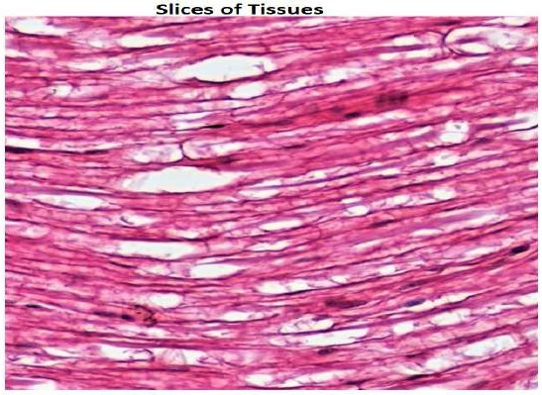
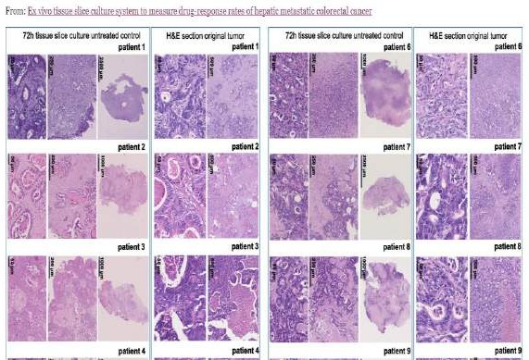
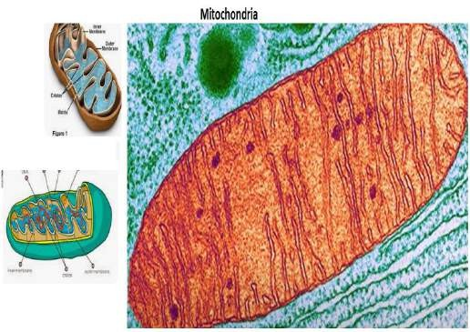
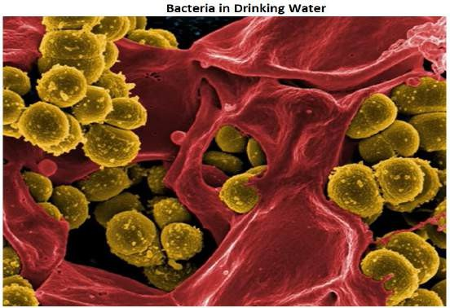
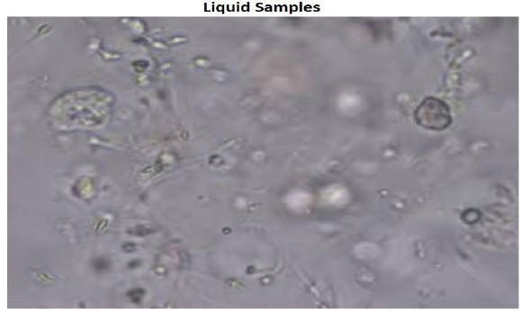
Uses of Light Microscopes
It used to study bacteria, Slices of tissue, Liquid Samples and some mitochondria.

Slide 17
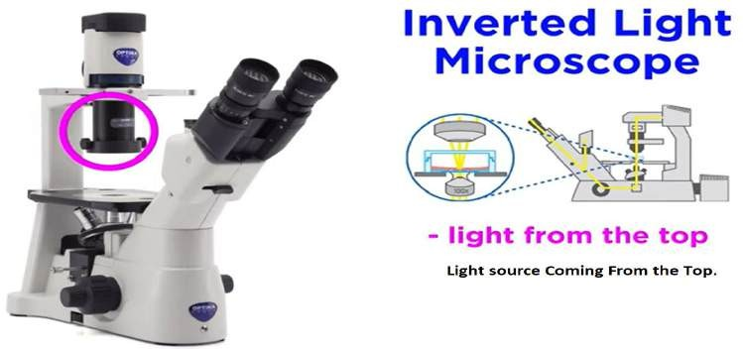
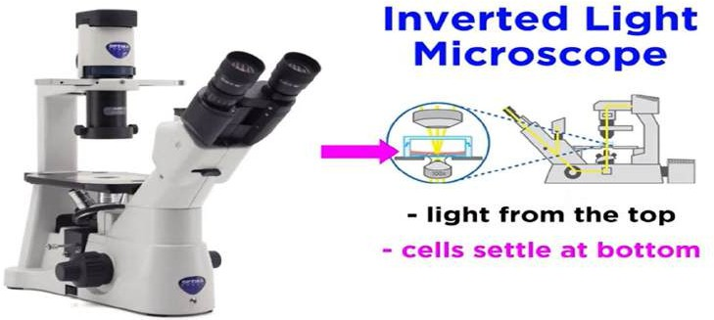
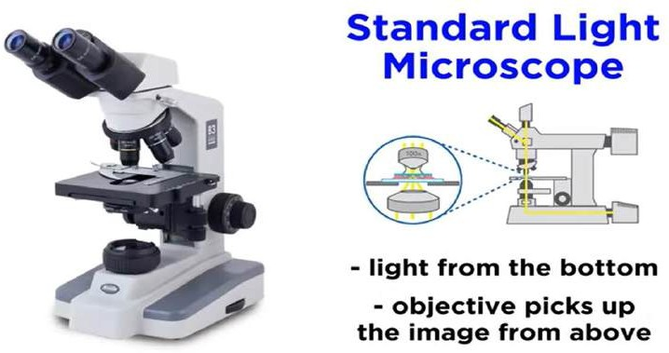
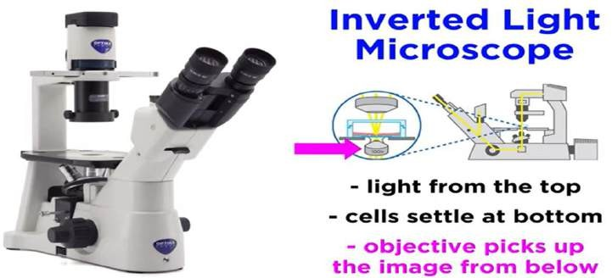

Slide 18
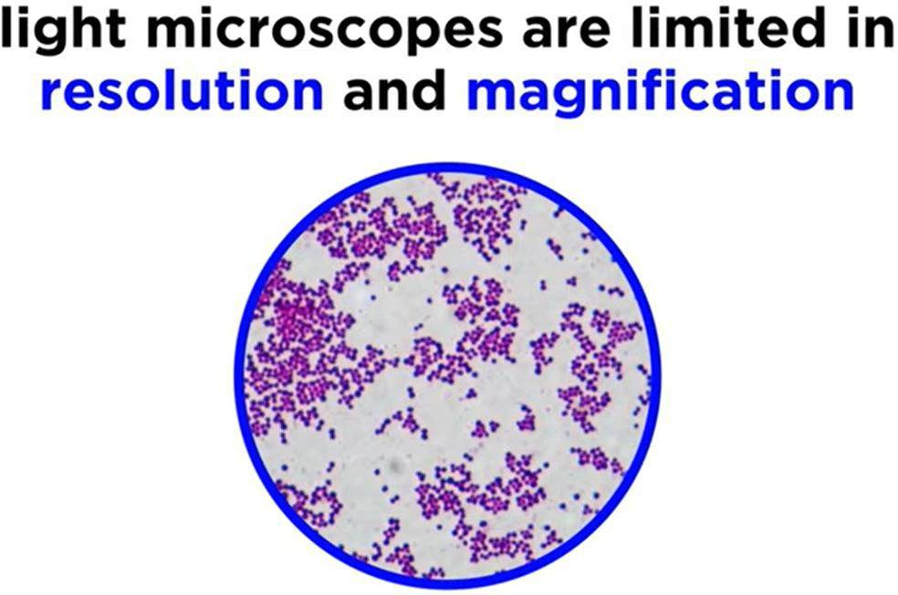

Slide 19
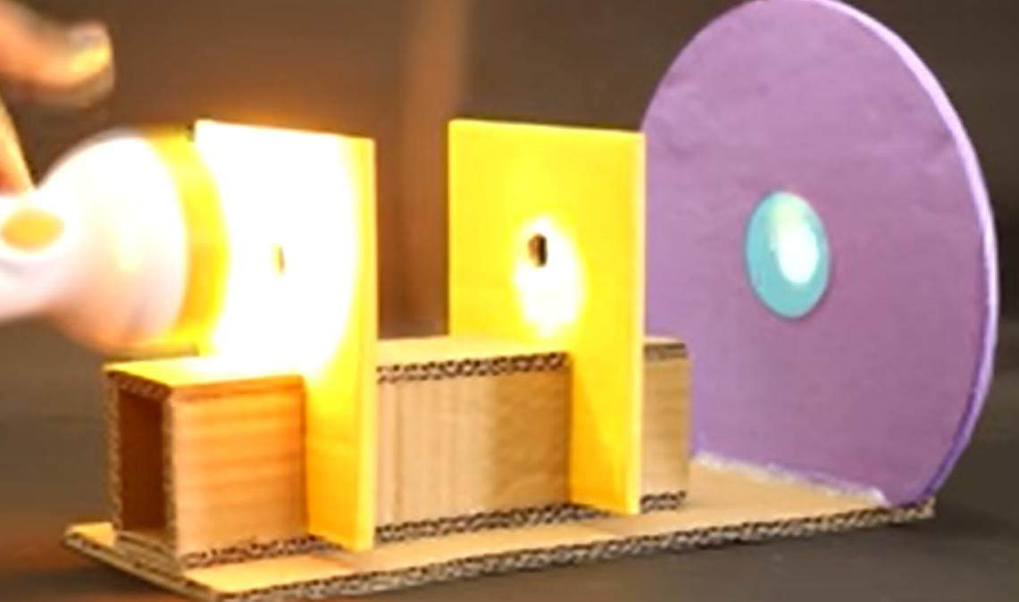
Light Travel In Straight Path (Rectilinear Propagation of Light)
Rectilinear Propagation of Light is the Principle that states that “Lights Travel in Straight Line” in a homogeneous medium as long a it is not reflected.

Slide 20
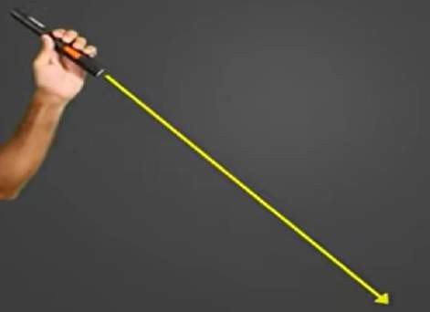
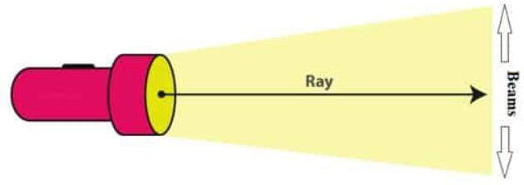
Single Ray Light

Slide 21
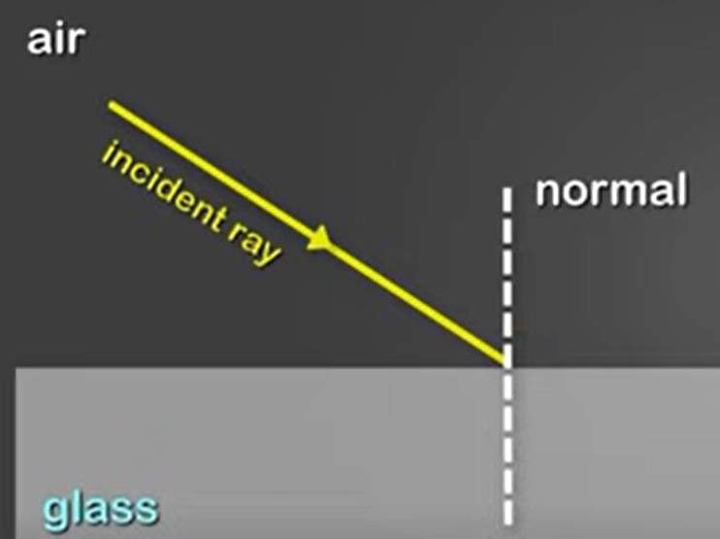
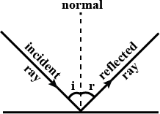
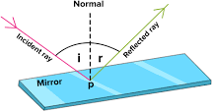
Draw a Perpendicular (Vertical Line) is known as Normal

Slide 22
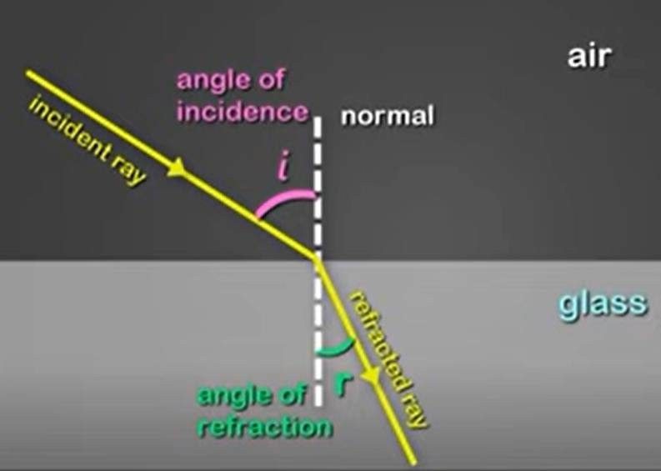




Refraction Of Light

Slide 23




Beam of Light

Slide 24

Optically Rarer (Air) and Optically Denser (Glass)

Slide 25


Optical Density Versus Normal Density

Slide 26






Slide 27


