Slide 1

Circuit Analysis Credit Hours = 3+1 Code NO: EE-121 by Dr. Wazir Muhammad Laghari Email: wazirlaghari@buetk.edu.pk
Biomedical Engineering Department
Balochistan University of Engineering and Technology, Khuzdar

Slide 2
NODAL ANALYSIS
Nodal Analysis or Node Voltage Mode is a systematic method used for analyzing circuits using node voltage as circuit variables.
Nodal analysis relies on the application of Kirchhoff's current law to create a series of node equations that can be solved for node voltages.
There are three laws that are used to define equations for voltage measured between each of the circuit nodes:

Slide 3
NODAL ANALYSIS
Ohm’s Law- It states that the current through a conductor between two points is directly proportional to the voltage across the two points.
Kirchhoff’s Voltage Law- It states that the algebraic sum of the potential differences in any loop must be equal to zero as: ΣV = 0. It is used for calculating current.
Kirchhoff’s Current Law- It is used for the calculation of voltage and states that all the currents entering and leaving a junction must be equal to zero as: ΣI_{in} =Σi_{out}.

Slide 4

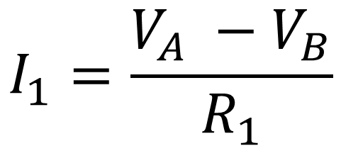
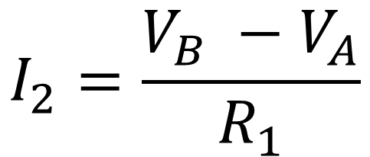
NODAL ANALYSIS (SIGN CONVENTIONS)
R₁
V_{A}
V_{B}
$$I_{1}=\frac{V_{A} −V_{B}}{R_{1}}$$
I₁
R₁
V_{A}
V_{B}
$$I_{2}=\frac{V_{B} −V_{A}}{R_{1}}$$
I₂
-
+
V = (-V₁)
-
+
V = (+V₁)

Slide 5
EXAMPLE: APPLY NODAL ANALYSIS TO FIND THE SET OF EQUATIONS
R₃
R₅
V_{A}
V_{B}
V₂
R₁
R₂
R₄
V₁
SOLUTION
Assuming all current moving outwards
Apply KCL to Node V_{A}
V₀ = 0
$$\frac{V_{A}−V_{B}}{R_{3}}+\frac{V_{A}−{(−V}_{1})}{R_{1}}+\frac{V_{A}−V_{0}}{R_{2}}=\frac{V_{A}−V_{B}}{R_{3}}+\frac{V_{A}+V_{1}}{R_{1}}+\frac{V_{A}−0}{R_{2}}=\frac{V_{A}−V_{B}}{R_{3}}+\frac{V_{A}+V_{1}}{R_{1}}+\frac{V_{A}}{R_{2}}=0$$
Apply KCL to Node V_{B}
$$\frac{V_{B}−V_{A}}{R_{3}}+\frac{V_{B}−{(+V}_{2})}{R_{5}}+\frac{V_{B}−V_{0}}{R_{4}}=\frac{V_{B}−V_{A}}{R_{3}}+\frac{V_{B}−V_{2}}{R_{5}}+\frac{V_{B}−0}{R_{4}}=\frac{V_{B}−V_{A}}{R_{3}}+\frac{V_{B}−V_{2}}{R_{5}}+\frac{V_{B}}{R_{4}}=0$$

Slide 6

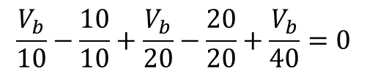
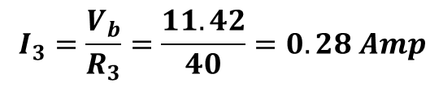


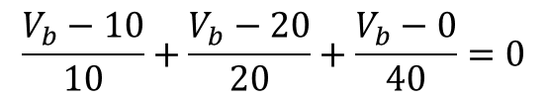



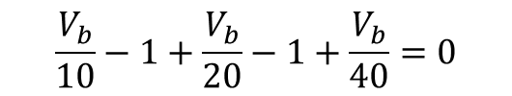

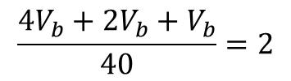
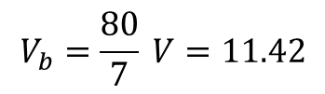
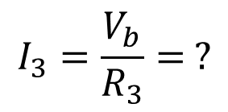



EXAMPLE: APPLY NODAL ANALYSIS TO FIND THE CURRENT I₃
V_{a}=10
V_{b}
$$R_{2}=20 Ω$$
$$I_{2}$$
V_{c} =20
$$I_{1}$$
$$R_{1}=10 Ω$$
SOLUTION
20V
$$I_{3}=\frac{V_{b}}{R_{3}}= ?$$
$$R_{3}=40 Ω$$
10V
Assuming all current moving outwards
Apply KCL to Node V_{b}
$$I_{3}$$
D
$$\frac{{V_{b}−V}_{a}}{R_{1}}+\frac{{V_{b}−V}_{c}}{R_{2}}+\frac{{V_{b}−V}_{0}}{R_{3}}=0$$
V₀ = 0
$$\frac{V_{b}}{10}−1+\frac{V_{b}}{20}−1+\frac{V_{b}}{40}=0$$
${4V}_{b}+{2V}_{b}+V_{b}=80$
$$\frac{V_{b}−10}{10}+\frac{V_{b}−20}{20}+\frac{V_{b}−0}{40}=0$$
$$\frac{V_{b}}{10}+\frac{V_{b}}{20}+\frac{V_{b}}{40}=2$$
$${7V}_{b}=80$$
$$V_{b}=\frac{80}{7} V=11.42$$
$$\frac{V_{b}}{10}−\frac{10}{10}+\frac{V_{b}}{20}−\frac{20}{20}+\frac{V_{b}}{40}=0$$
$$\frac{{4V}_{b}+{2V}_{b}+V_{b}}{40}=2$$
$$I_{3}=\frac{V_{b}}{R_{3}}=\frac{11.42}{40}=0.28 Amp$$

Slide 7
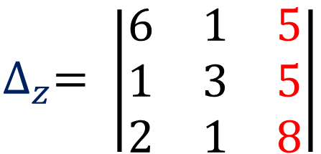
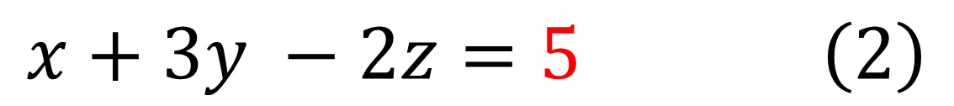
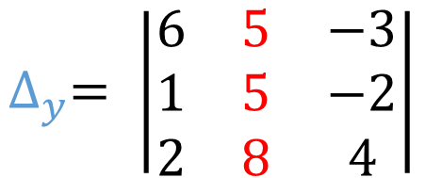
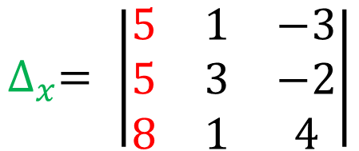
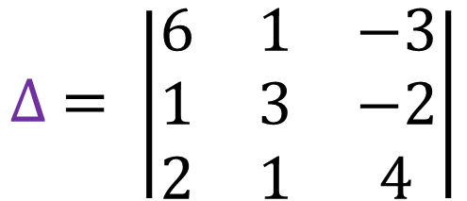
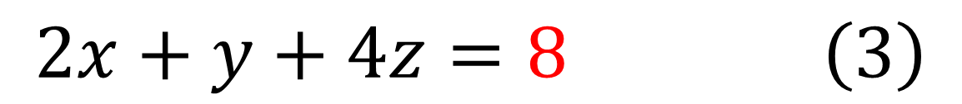
Q: Using Cramer’s rule, find x, y, z
$$6x+y −3z=5 \left(1\right)$$
$$x+3y −2z=5 \left(2\right)$$
$$2x+y+4z=8 \left(3\right)$$
SOLUTION
$$∆ = \left|\begin{matrix}6 & 1 & −3 \\ 1 & 3 & −2 \\ 2 & 1 & 4\end{matrix}\right|$$
$$∆_{x}= \left|\begin{matrix}5 & 1 & −3 \\ 5 & 3 & −2 \\ 8 & 1 & 4\end{matrix}\right|$$
$$∆_{y}= \left|\begin{matrix}6 & 5 & −3 \\ 1 & 5 & −2 \\ 2 & 8 & 4\end{matrix}\right|$$
$$∆_{z}= \left|\begin{matrix}6 & 1 & 5 \\ 1 & 3 & 5 \\ 2 & 1 & 8\end{matrix}\right|$$

Slide 8
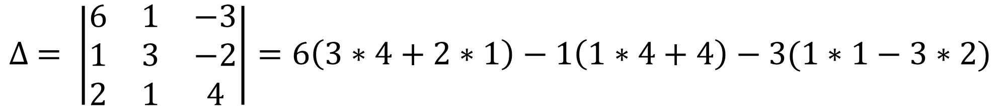
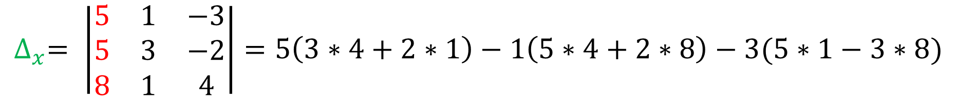
$$∆ = \left|\begin{matrix}6 & 1 & −3 \\ 1 & 3 & −2 \\ 2 & 1 & 4\end{matrix}\right|=6\left(3∗4+2∗1\right)−1\left(1∗4+4\right)−3(1∗1−3∗2)$$
$$∆ = 6\left(14\right)−1\left(8\right)−3\left(−5\right)=84 −8+15=91$$
$$∆_{x}= \left|\begin{matrix}5 & 1 & −3 \\ 5 & 3 & −2 \\ 8 & 1 & 4\end{matrix}\right|=5\left(3∗4+2∗1\right)−1\left(5∗4+2∗8\right)−3(5∗1−3∗8)$$
$$∆_{x}=5\left(14\right)−1\left(36\right)−3\left(−19\right)=70 −36+57=91$$

Slide 9
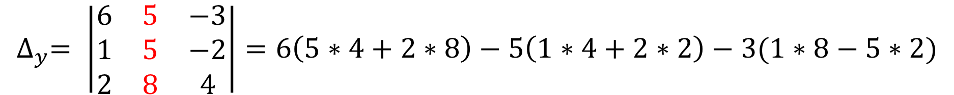
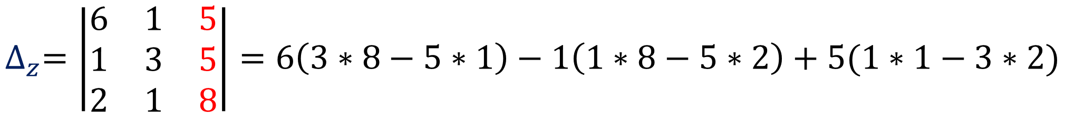
$$∆_{y}= \left|\begin{matrix}6 & 5 & −3 \\ 1 & 5 & −2 \\ 2 & 8 & 4\end{matrix}\right|=6\left(5∗4+2∗8\right)−5\left(1∗4+2∗2\right)−3(1∗8−5∗2)$$
$$∆_{y}=6\left(36\right)−5\left(8\right)−3\left(−2\right)=216 −40+6=182$$
$$∆_{z}=\left|\begin{matrix}6 & 1 & 5 \\ 1 & 3 & 5 \\ 2 & 1 & 8\end{matrix}\right|=6\left(3∗8−5∗1\right)−1\left(1∗8−5∗2\right)+5(1∗1−3∗2)$$
$$∆_{z}=6\left(19\right)−1\left(−2\right)+5\left(−5\right)=114+2 −25=91$$

Slide 10
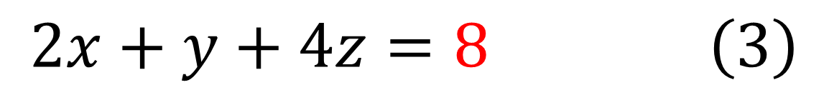
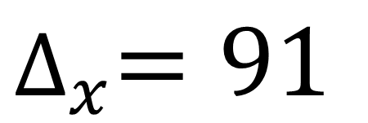
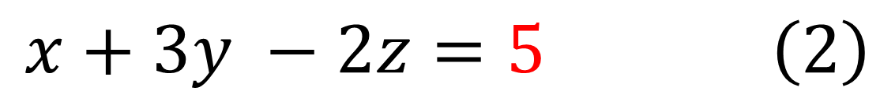
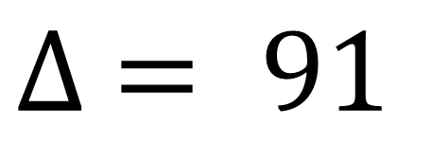
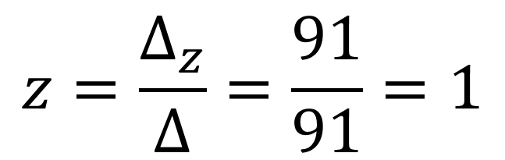
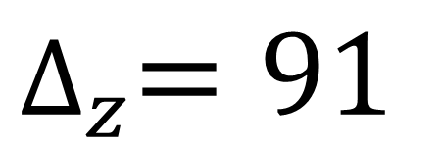
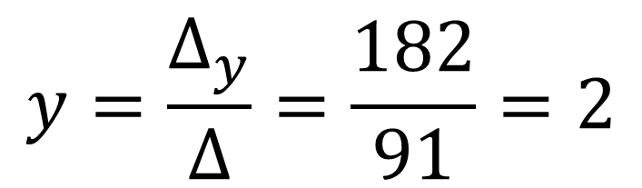
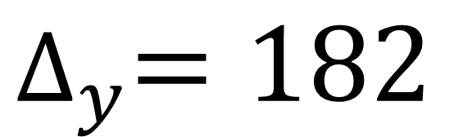
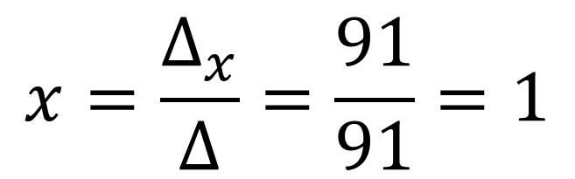
$$6x+y −3z=5 \left(1\right)$$
$$∆ = 91$$
$$x+3y −2z=5 \left(2\right)$$
$$2x+y+4z=8 \left(3\right)$$
$$∆_{x}=91$$
$$x=\frac{∆_{x}}{∆}=\frac{91}{91}=1$$
$$∆_{y}=182$$
$$y=\frac{∆_{y}}{∆}=\frac{182}{91}=2$$
$$∆_{z}=91$$
$$z=\frac{∆_{z}}{∆}=\frac{91}{91}=1$$

Slide 11
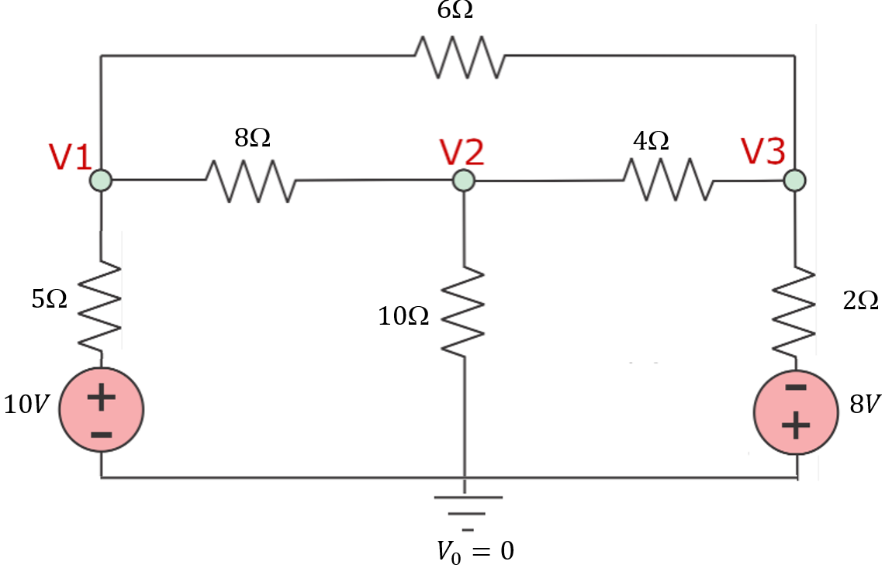
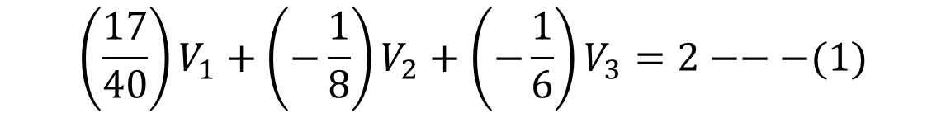
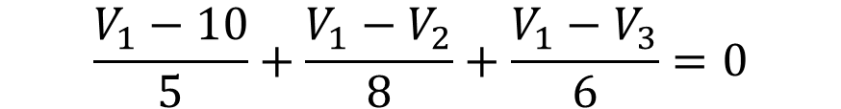
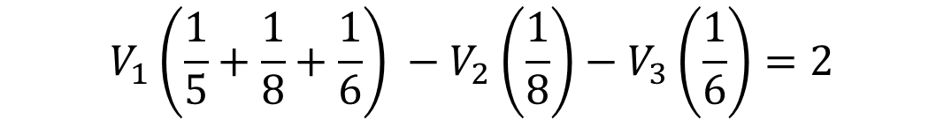
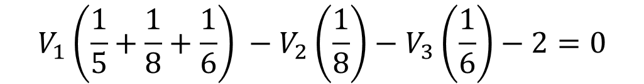
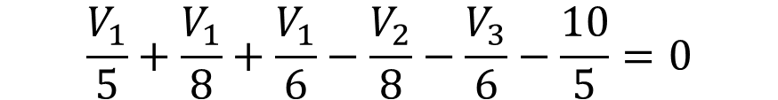
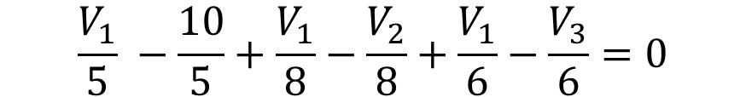
EXAMPLE: APPLY NODAL ANALYSIS TO FIND THE CURRENT I₃
Assuming all current moving outwards
Apply KCL to Node V₁
$$\frac{V_{1}−10}{5}+\frac{{V_{1}−V}_{2}}{8}+\frac{{V_{1}−V}_{3}}{6}=0$$
$$V_{1}\left(\frac{1}{5}+\frac{1}{8}+\frac{1}{6}\right) −V_{2}\left(\frac{1}{8}\right)−V_{3}\left(\frac{1}{6}\right)−2=0$$
$$\frac{V_{1}}{5} −\frac{10}{5}+\frac{V_{1}}{8}−\frac{V_{2}}{8}+\frac{V_{1}}{6}−\frac{V_{3}}{6}=0$$
$$V_{1}\left(\frac{1}{5}+\frac{1}{8}+\frac{1}{6}\right) −V_{2}\left(\frac{1}{8}\right)−V_{3}\left(\frac{1}{6}\right)=2$$
$$\frac{V_{1}}{5}+\frac{V_{1}}{8}+\frac{V_{1}}{6}−\frac{V_{2}}{8}−\frac{V_{3}}{6}−\frac{10}{5}=0$$
$$\left(\frac{17}{40}\right)V_{1}+\left(−\frac{1}{8}\right)V_{2}+\left(−\frac{1}{6}\right)V_{3}=2−−−(1)$$

Slide 12
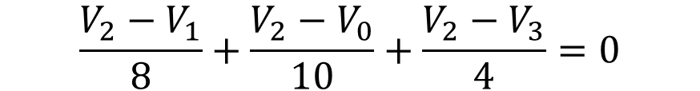
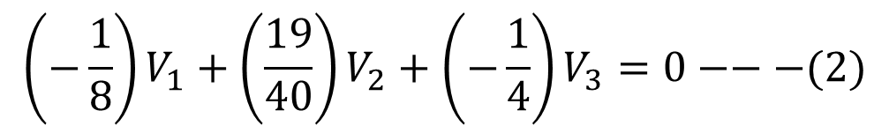
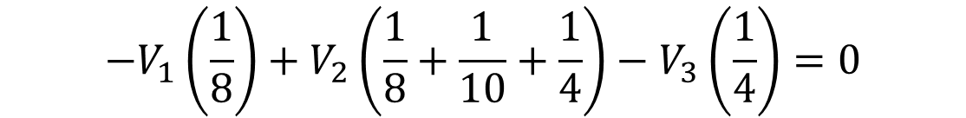
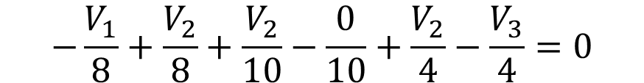
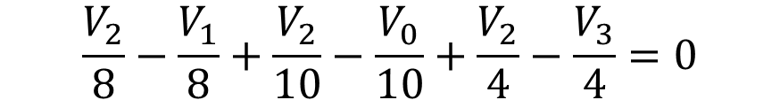
EXAMPLE: APPLY NODAL ANALYSIS TO FIND THE CURRENT I₃
Assuming all current moving outwards
Apply KCL to Node V₂
$$\frac{V_{2}−V_{1}}{8}+\frac{{V_{2}−V}_{0}}{10}+\frac{{V_{2}−V}_{3}}{4}=0$$
$$−V_{1}\left(\frac{1}{8}\right)+V_{2}\left(\frac{1}{8}+\frac{1}{10}+\frac{1}{4}\right)−V_{3}\left(\frac{1}{4}\right)=0$$
$$\frac{V_{2}}{8}−\frac{V_{1}}{8}+\frac{V_{2}}{10}−\frac{V_{0}}{10}+\frac{V_{2}}{4}−\frac{V_{3}}{4}=0$$
$$\left(−\frac{1}{8}\right)V_{1}+\left(\frac{19}{40}\right)V_{2}+\left(−\frac{1}{4}\right)V_{3}=0−−−(2)$$
$$−\frac{V_{1}}{8}+\frac{V_{2}}{8}+\frac{V_{2}}{10}−\frac{0}{10}+\frac{V_{2}}{4}−\frac{V_{3}}{4}=0$$

Slide 13
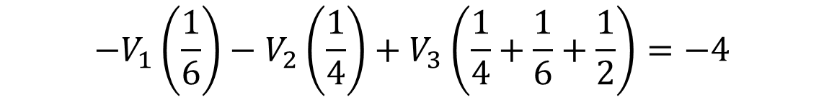
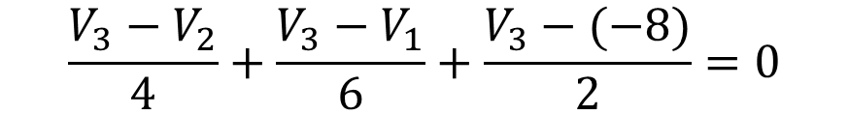
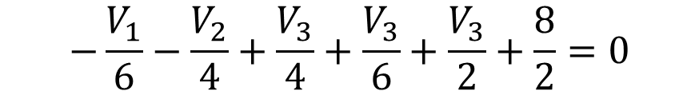
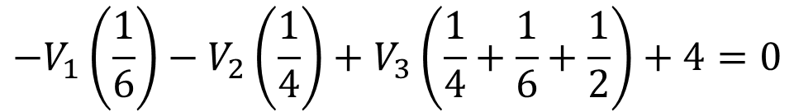
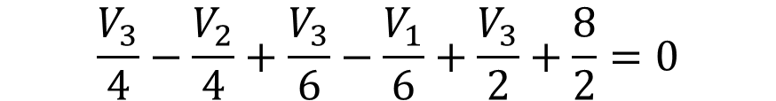
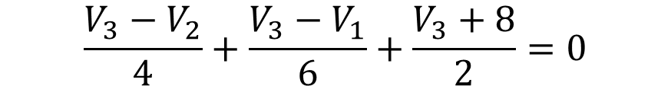
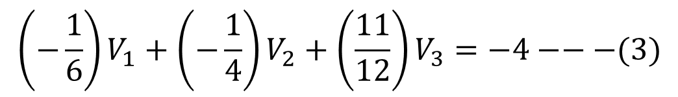
EXAMPLE: APPLY NODAL ANALYSIS TO FIND THE CURRENT I₃
Assuming all current moving outwards
Apply KCL to Node V₃
$$\frac{V_{3}−V_{2}}{4}+\frac{{V_{3}−V}_{1}}{6}+\frac{V_{3}−(−8)}{2}=0$$
$$\frac{V_{3}−V_{2}}{4}+\frac{{V_{3}−V}_{1}}{6}+\frac{V_{3}+8}{2}=0$$
$${−V}_{1}\left(\frac{1}{6}\right)−V_{2}\left(\frac{1}{4}\right)+V_{3}\left(\frac{1}{4}+\frac{1}{6}+\frac{1}{2}\right)+4=0$$
$$\frac{V_{3}}{4}−\frac{V_{2}}{4}+\frac{V_{3}}{6}−\frac{V_{1}}{6}+\frac{V_{3}}{2}+\frac{8}{2}=0$$
$${−V}_{1}\left(\frac{1}{6}\right)−V_{2}\left(\frac{1}{4}\right)+V_{3}\left(\frac{1}{4}+\frac{1}{6}+\frac{1}{2}\right)=−4$$
$$−\frac{V_{1}}{6}−\frac{V_{2}}{4}+\frac{V_{3}}{4}+\frac{V_{3}}{6}+\frac{V_{3}}{2}+\frac{8}{2}=0$$
$$\left(−\frac{1}{6}\right)V_{1}+\left(−\frac{1}{4}\right)V_{2}+\left(\frac{11}{12}\right)V_{3}=−4−−−(3)$$

Slide 14
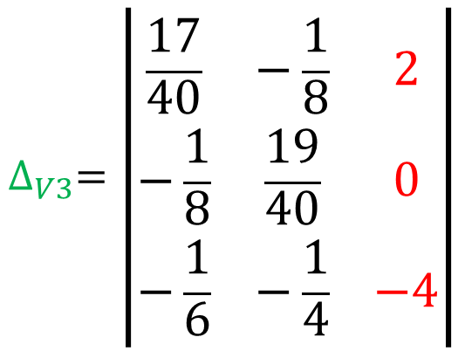
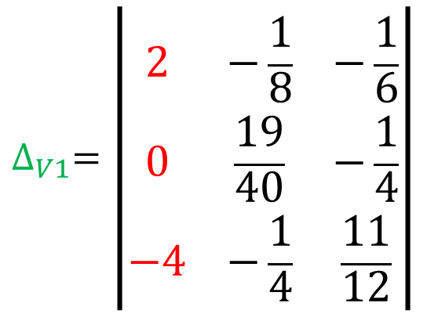
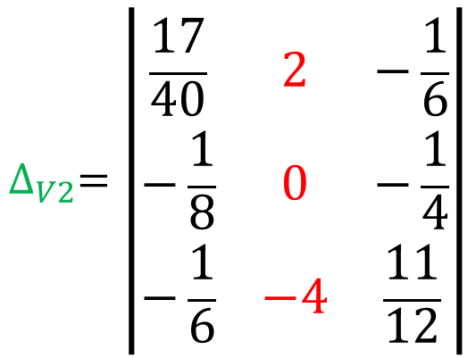




$$\left(\frac{17}{40}\right)V_{1}+\left(−\frac{1}{8}\right)V_{2}+\left(−\frac{1}{6}\right)V_{3}=2−−−(1)$$
$$∆ = \left|\begin{matrix}\frac{17}{40} & −\frac{1}{8} & −\frac{1}{6} \\ −\frac{1}{8} & \frac{19}{40} & −\frac{1}{4} \\ −\frac{1}{6} & −\frac{1}{4} & \frac{11}{12}\end{matrix}\right|$$
$$\left(−\frac{1}{8}\right)V_{1}+\left(\frac{19}{40}\right)V_{2}+\left(−\frac{1}{4}\right)V_{3}=0−−−(2)$$
$$\left(−\frac{1}{6}\right)V_{1}+\left(−\frac{1}{4}\right)V_{2}+\left(\frac{11}{12}\right)V_{3}=−4−−−(3)$$
$$∆_{V1}=\left|\begin{matrix}2 & −\frac{1}{8} & −\frac{1}{6} \\ 0 & \frac{19}{40} & −\frac{1}{4} \\ −4 & −\frac{1}{4} & \frac{11}{12}\end{matrix}\right|$$
$$∆_{V2}=\left|\begin{matrix}\frac{17}{40} & 2 & −\frac{1}{6} \\ −\frac{1}{8} & 0 & −\frac{1}{4} \\ −\frac{1}{6} & −4 & \frac{11}{12}\end{matrix}\right|$$
$$∆_{V3}=\left|\begin{matrix}\frac{17}{40} & −\frac{1}{8} & 2 \\ −\frac{1}{8} & \frac{19}{40} & 0 \\ −\frac{1}{6} & −\frac{1}{4} & −4\end{matrix}\right|$$

Slide 15
$$V_{1}\left(\frac{1}{5}+\frac{1}{8}+\frac{1}{6}\right) −V_{2}\left(\frac{1}{8}\right)−V_{3}\left(\frac{1}{6}\right)=2 ↔\left(\frac{51}{120}\right)V_{1}+\left(−\frac{1}{8}\right)V_{2}+\left(−\frac{1}{6}\right)V_{3}=2−−−(1)$$
$$−V_{1}\left(\frac{1}{8}\right)+V_{2}\left(\frac{1}{8}+\frac{1}{10}+\frac{1}{4}\right)−V_{3}\left(\frac{1}{4}\right)=0↔\left(−\frac{1}{8}\right)V_{1}+\left(\frac{19}{40}\right)V_{2}+\left(−\frac{1}{4}\right)V_{3}=0−−−(2)$$
$${−V}_{1}\left(\frac{1}{6}\right)−V_{2}\left(\frac{1}{4}\right)+V_{3}\left(\frac{1}{4}+\frac{1}{6}+\frac{1}{2}\right)=−4↔\left(−\frac{1}{6}\right)V_{1}+\left(−\frac{1}{4}\right)V_{2}+\left(\frac{11}{12}\right)V_{3}=−4−−−(3)$$
$$∆ = \left|\begin{matrix}6 & 1 & −3 \\ 1 & 3 & −2 \\ 2 & 1 & 4\end{matrix}\right|$$
$$∆_{x}= \left|\begin{matrix}5 & 1 & −3 \\ 5 & 3 & −2 \\ 8 & 1 & 4\end{matrix}\right|$$
$$∆_{y}= \left|\begin{matrix}6 & 5 & −3 \\ 1 & 5 & −2 \\ 2 & 8 & 4\end{matrix}\right|$$
$$∆_{z}= \left|\begin{matrix}6 & 1 & 5 \\ 1 & 3 & 5 \\ 2 & 1 & 8\end{matrix}\right|$$

Slide 16


SERIES RLC CIRCUIT

Slide 17


Slide 18



Slide 19

A series RLC circuit containing a resistance of 12Ω, an inductance of 0.15H and a capacitor of 100uF are connected in series across a 100V, 50Hz supply. Calculate the total circuit impedance, the circuits current, power factor and draw the voltage phasor diagram.

Slide 20



Slide 21



Slide 22


