Slide 1

Circuit Analysis Credit Hours = 3+1 Code NO: EE-121 by Dr. Wazir Muhammad Laghari Email: wazirlaghari@buetk.edu.pk
Biomedical Engineering Department
Balochistan University of Engineering and Technology, Khuzdar

Slide 2
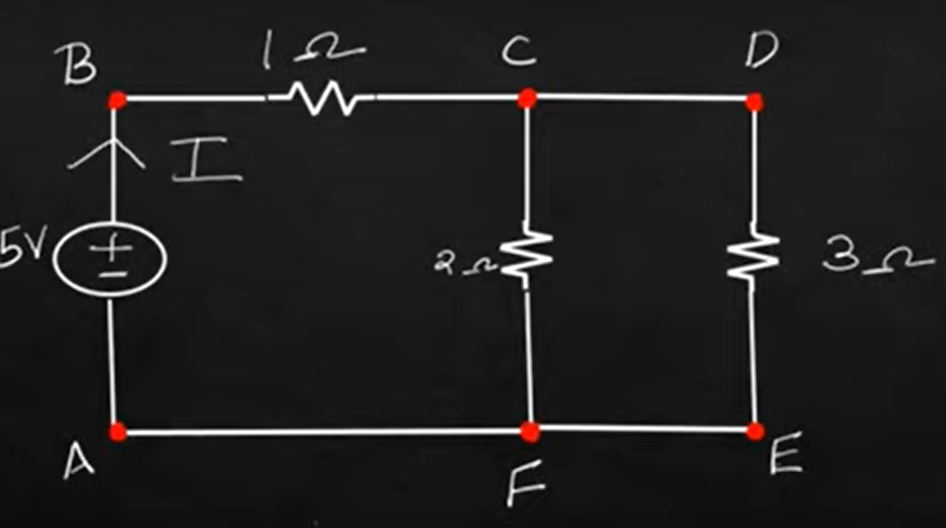
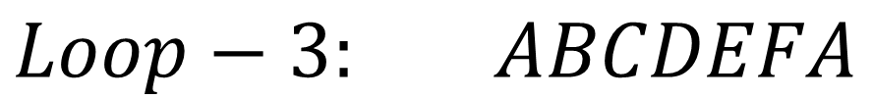

LOOP
Any closed path in the circuit is called as a Loop.
$$Loop−1: ABCFA$$
$$Loop−2: CDEF$$
$$Loop−3: ABCDEFA$$

Slide 3
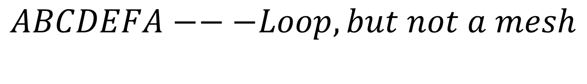
MESH
A Mesh is a loop with no other loop inside it.
Mesh : Is also a loop with a condition that it doesn’t have any inner loops in it.
$$ABCDEFA−−−Loop, but not a mesh$$
$$ABCFA −−−it is a mesh and also a Loop$$
$$CDEF −−−it is a mesh and also a Loop$$

Slide 4
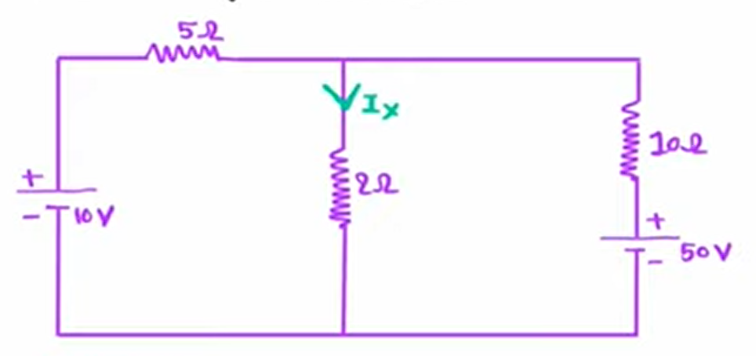
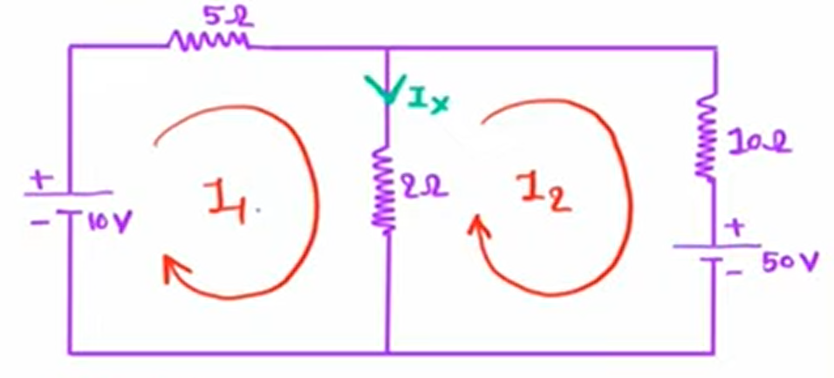
Q: Apply the Loop Analysis on the given below circuit, find the Current I_{x}
SOLUTION
Apply the Loop Current Direction

Slide 5
Q: Apply the Loop Analysis on the given below circuit, find the Current I_{x}
$$Loop−1:$$
$$10={5I}_{1}+2 (I_{1}−I_{2})$$
$$10={5I}_{1}+2I_{1}−2I_{2}$$
$$10={7I}_{1}−2I_{2}$$
$${7I}_{1}−2I_{2}=10 −−−−−(1)$$
$$Loop−2:$$
$$−50={2(I}_{2}−I_{1})+10I_{2}$$
$$−50=2I_{2}−2I_{1}+10I_{2}$$
$$−50=−2I_{1}+12I_{2}$$
$$−2I_{1}+12I_{2}=−50 −−−−−(2)$$

Slide 6
Apply Cramer's Rule, find the value of I₁ and I₂
$$7I_{1}−2I_{2}=10 \left(1\right)$$
$$−2I_{1}+12I_{2}=−50 \left(2\right)$$
SOLUTION
$$∆ = \left|\begin{matrix}7 & −2 \\ −2 & 12\end{matrix}\right|$$
$$∆_{I1}=\left|\begin{matrix}10 & −2 \\ −50 & 12\end{matrix}\right|$$
$$∆_{I2}= \left|\begin{matrix}7 & 10 \\ −2 & −50\end{matrix}\right|$$

Slide 7
$$∆ = \left|\begin{matrix}7 & −2 \\ −2 & 12\end{matrix}\right|=\left[(7)∗\left(12\right)−\left(−2\right)\left(−2\right)\right]=84 −4=80$$
$$∆_{I1}=\left|\begin{matrix}10 & −2 \\ −50 & 12\end{matrix}\right|=\left[\left(10\right)∗\left(12\right)−\left(−2\right)\left(−50\right)\right]=120 −100=20$$
$$∆_{I2}= \left|\begin{matrix}7 & 10 \\ −2 & −50\end{matrix}\right|=\left[\left(7\right)∗\left(−50\right)−\left(10\right)∗\left(−2\right)\right]=−350+20=−330$$
$$I_{1}=\frac{∆_{I1}}{∆}=\frac{20}{80}=0.25$$
$$I_{2}=\frac{∆_{I2}}{∆}=\frac{−330}{80}=−4.125$$
$$I_{x}=\left(I_{1}−I_{2}\right)=\left(0.25\right)−\left(−4.125\right)=0.25+4.125=4.375$$
Answer

Slide 8
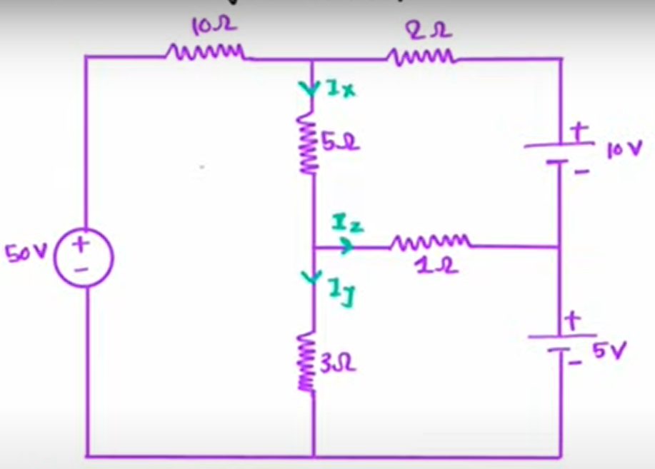
Q: Apply the Loop Analysis on the given below circuit, find the Current I_{x ,}I_{y ,}and I_{z}

Slide 9
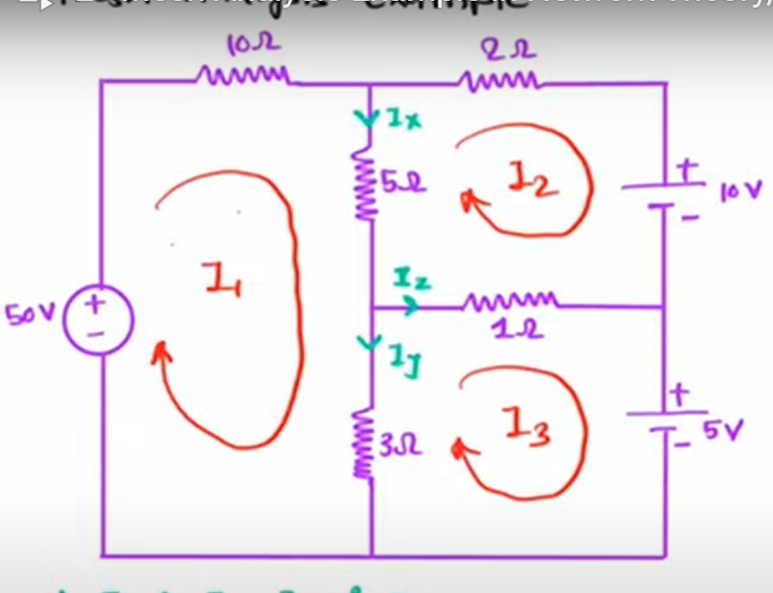
Q: Apply the Loop Analysis on the given below circuit, find the Current I_{x ,}I_{y ,}and I_{z}
SOLUTION
Apply the Loop Current Direction
$$Loop−1:$$
$$50={10I}_{1}+5 \left(I_{1}−I_{2}\right)+3 (I_{1}−I_{3})$$
$$50={10I}_{1}+5I_{1}−5I_{2}+3I_{1}−3I_{3}$$
$$50={18I}_{1}−5I_{2}−3I_{3}$$
$${18I}_{1}−5I_{2}−3I_{3}=50−−−−(1)$$

Slide 10
Q: Apply the Loop Analysis on the given below circuit, find the Current I_{x ,}I_{y ,}and I_{z}
$$Loop−2:$$
$$−10=1\left(I_{2}−I_{3}\right)+5\left(I_{2}−I_{1}\right)+2I_{2}$$
$$−10=I_{2}−I_{3}+{5I}_{2}−5I_{1}+2I_{2}$$
$$−10={−5I_{1}+8I}_{2}−I_{3}$$
${−5I_{1}+8I}_{2}−I_{3}=−10 −−−(2)$

Slide 11
Q: Apply the Loop Analysis on the given below circuit, find the Current I_{x ,}I_{y ,}and I_{z}
$$Loop−3:$$
$$−5=3\left(I_{3}−I_{1}\right)+1\left(I_{3}−I_{2}\right)$$
$$−5=3I_{3}−3I_{1}+I_{3}−I_{2}$$
$$−5=−3I_{1}−I_{2}+4I_{3}$$
$−3I_{1}−I_{2}+4I_{3}=−5 −−−(3)$

Slide 12
Q: Apply the Loop Analysis on the given below circuit, find the Current I_{x ,}I_{y ,}and I_{z}
Using Cramer’s rule, find I₁,I₂,and I₃
$${18I}_{1}−5I_{2}−3I_{3}=50−−−−(1)$$
${−5I_{1}+8I}_{2}−I_{3}=−10 −−−(2)$
$−3I_{1}−I_{2}+4I_{3}=−5 −−−(3)$
SOLUTION
$$∆_{I1}=\left|\begin{matrix}50 & −5 & −3 \\ −10 & 8 & −1 \\ −5 & −1 & 4\end{matrix}\right|$$
$$∆ = \left|\begin{matrix}18 & −5 & −3 \\ −5 & 8 & −1 \\ −3 & −1 & 4\end{matrix}\right|$$
$$∆_{I3}=\left|\begin{matrix}18 & −5 & 50 \\ −5 & 8 & −10 \\ −3 & −1 & −5\end{matrix}\right|$$
$$∆_{I2}=\left|\begin{matrix}18 & 50 & −3 \\ −5 & −10 & −1 \\ −3 & −5 & 4\end{matrix}\right|$$

Slide 13
Q: Apply the Loop Analysis on the given below circuit, find the Current I_{x ,}I_{y ,}and I_{z}
$$I_{1}=\frac{∆_{1}}{∆}=3.3 Amp$$
$$I_{2}=\frac{∆_{2}}{∆}=0.99 Amp$$
$$I_{3}=\frac{∆_{3}}{∆}=1.47 Amp$$
$$I_{x}=\left(I_{1}−I_{2}\right)=\left(3.3−0.99\right)= 2.31 Amp$$
$$I_{y}=\left(I_{1}−I_{3}\right)=\left(3.3−1.47\right)= 1.83 Amp$$
Answers
$$I_{z}=\left(I_{3}−I_{2}\right)=\left(1.47 −0.99\right)= 0.48 Amp$$

Slide 14
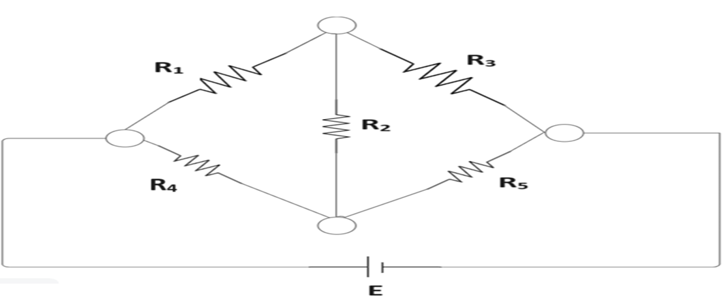
Q: Apply the Loop Analysis, Find the Number of Branches, Number of nodes and Number of Equations.

Slide 15
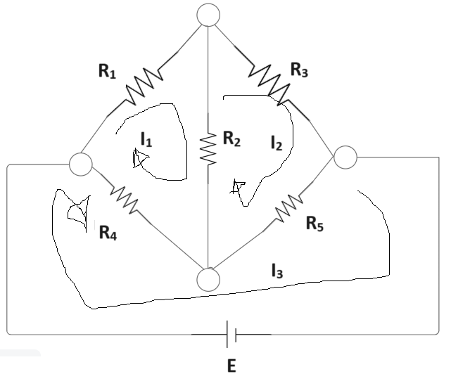
ASSIGN A DIRECTION OF LOOPs

Slide 16

FIND THE NUMBER OF BRANCHES
Number of branches means Number of Resistances, number of voltages sources, and number of current sources
$$No:of Branches=m=6$$

Slide 17

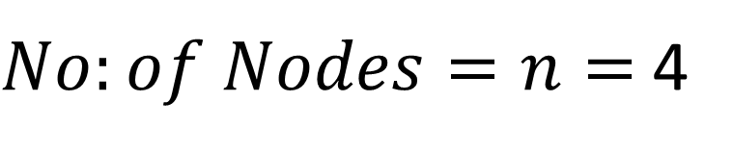
FIND THE NUMBER OF NODES
$$No:of Branches=m=6$$
$No:of Nodes=n=$4

Slide 18
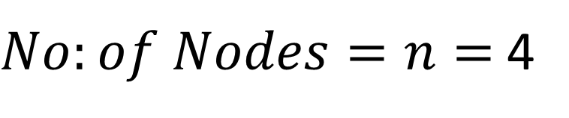

FIND THE NUMBER OF EQUATIONS
$$No:of Branches=m=6$$
$No:of Nodes=n=$4
$$No:of Equations=m −n+1=6−4+1=3$$

Slide 19
Complex Numbers and Phasors

Slide 20
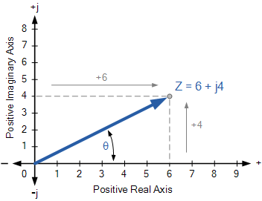

Slide 21
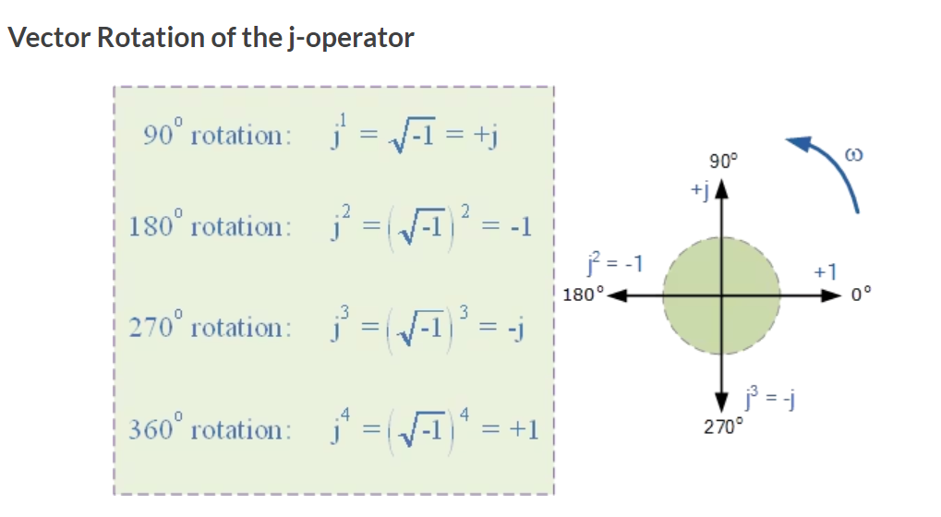

Slide 22
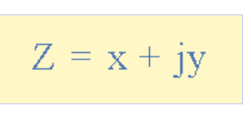
Complex Numbers using the Rectangular Form
Complex Number Format
Z – is the Complex Number representing the Vector
x – is the Real part or the Active component
y – is the Imaginary part or the Reactive component
j – is defined by $\sqrt{−1}$

Slide 23
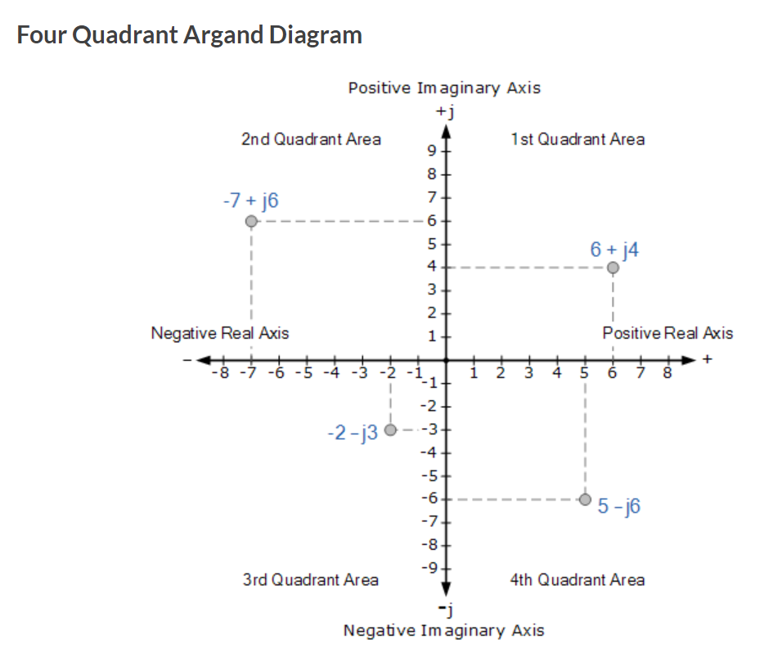

Slide 24
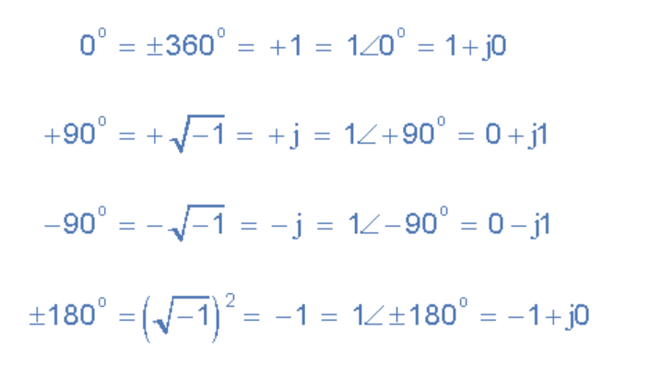

Slide 25
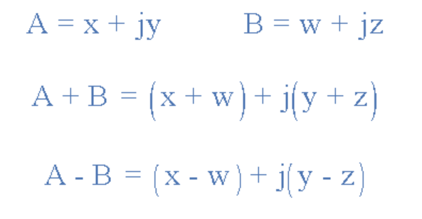
Complex Addition and Subtraction

Slide 26
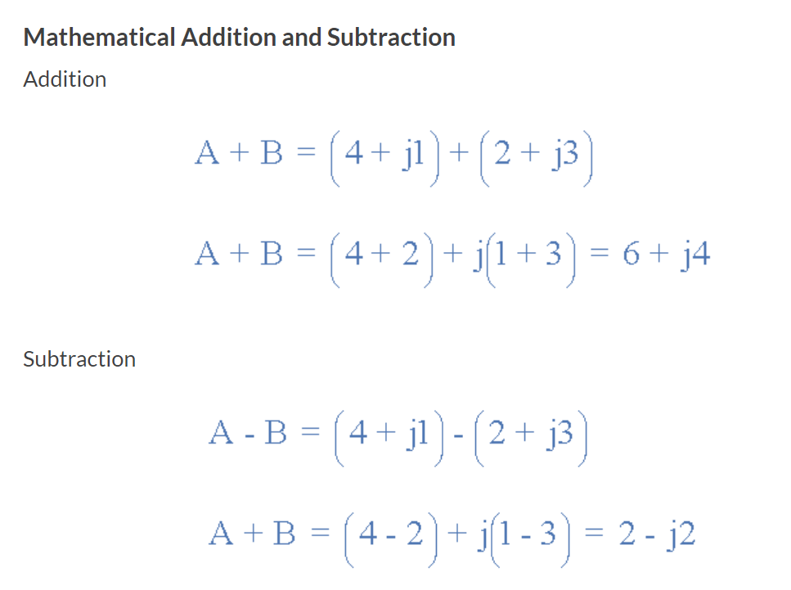
Example No1 as, A = 4 + j1 and B = 2 + j3 respectively. Determine the sum and difference of the two vectors in both rectangular ( a + jb ) form and graphically as an Argand Diagram.

Slide 27
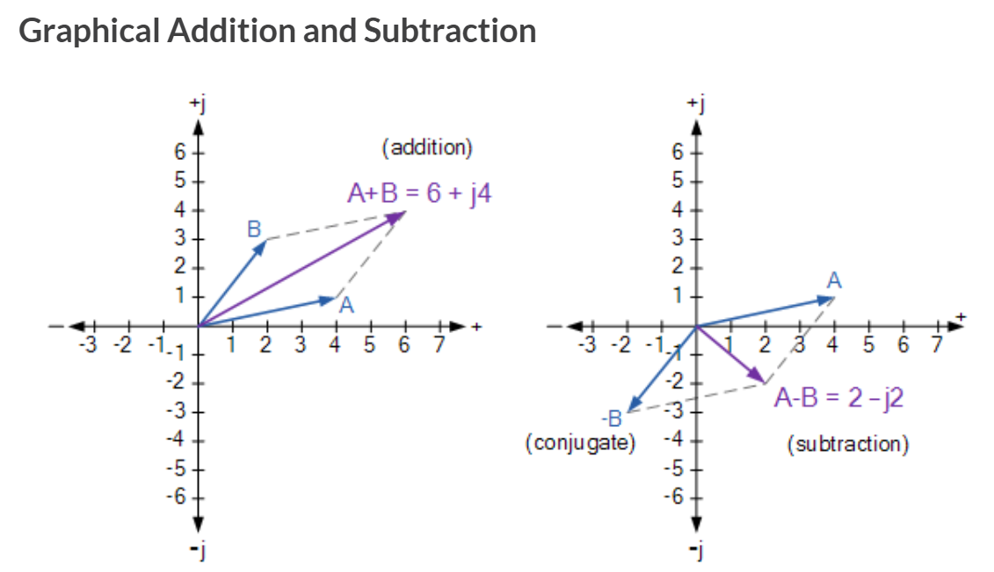

Slide 28
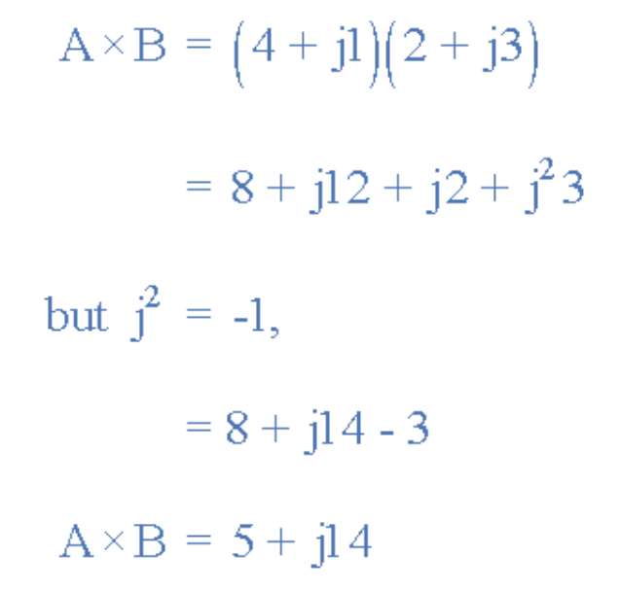
Multiplication and Division of Complex Numbers
Example: multiplying together our two vectors from above of A = 4 + j1 and B = 2 + j3 will give us the following result.

Slide 29
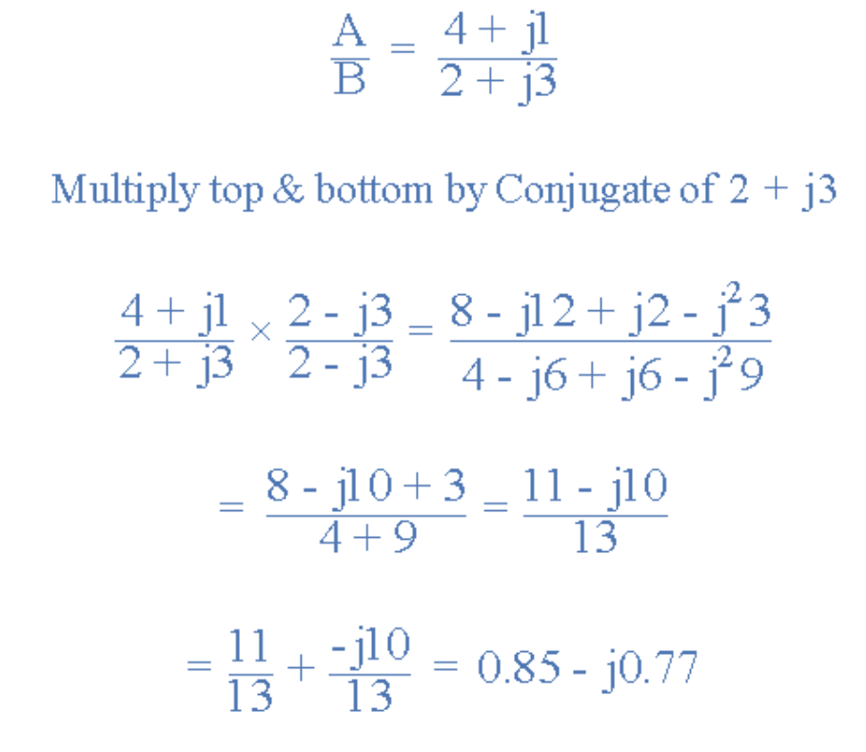

Slide 30
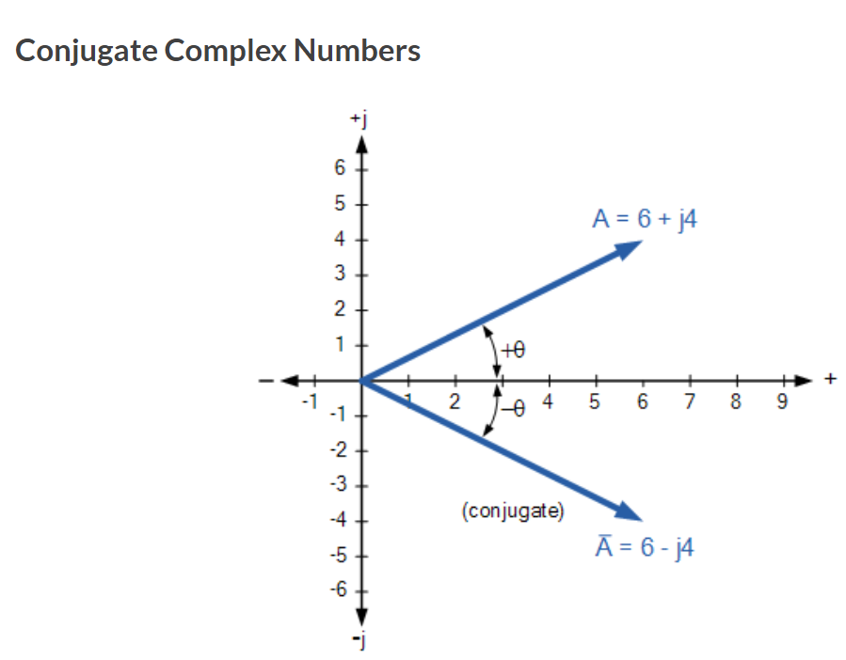
The Complex Conjugate
The Complex Conjugate, or simply Conjugate of a complex number is found by reversing the algebraic sign of the complex numbers imaginary number only while keeping the algebraic sign of the real number the same and to identify the complex conjugate of z the symbol z is used. For example, the conjugate of z = 6 + j4 is z = 6 – j4, likewise the conjugate of z = 6 – j4 is z = 6 + j4.

Slide 31
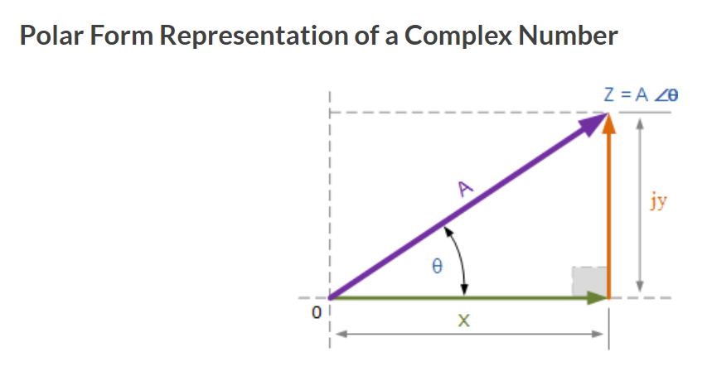
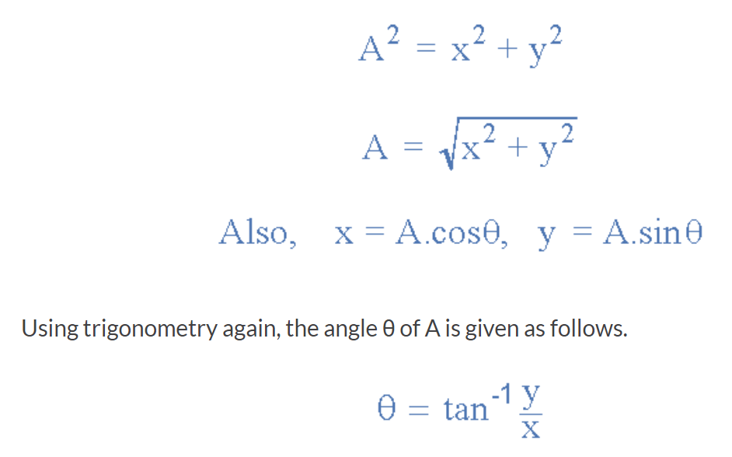
Complex Numbers using Polar Form

Slide 32
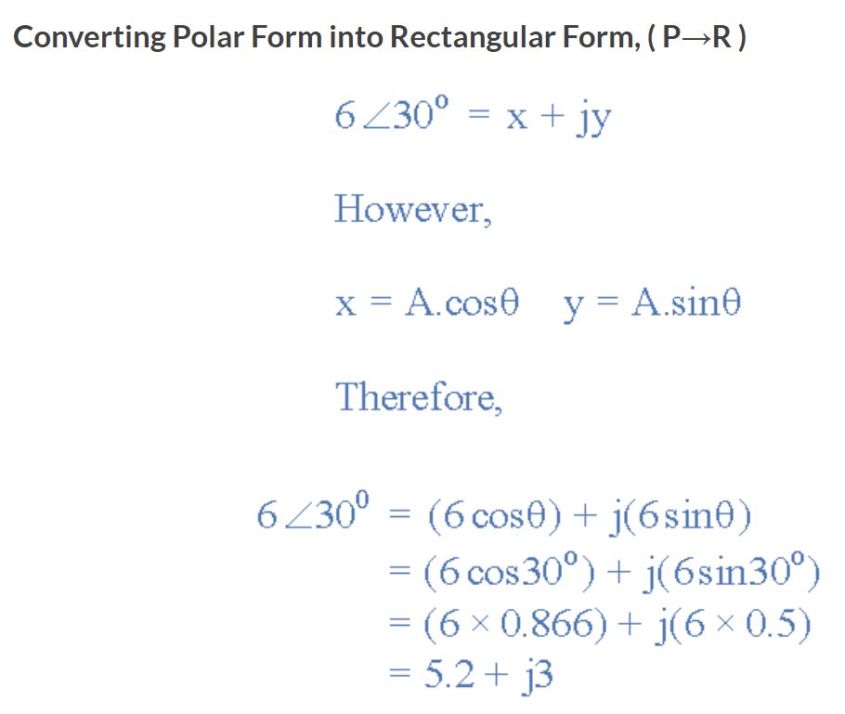

Slide 33
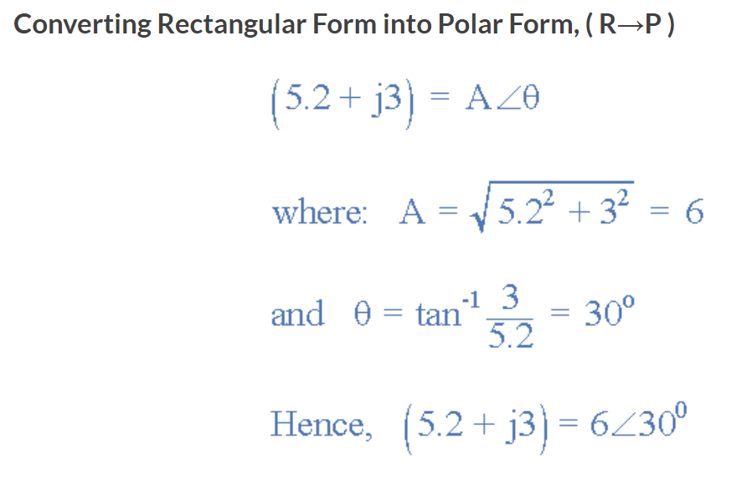

Slide 34
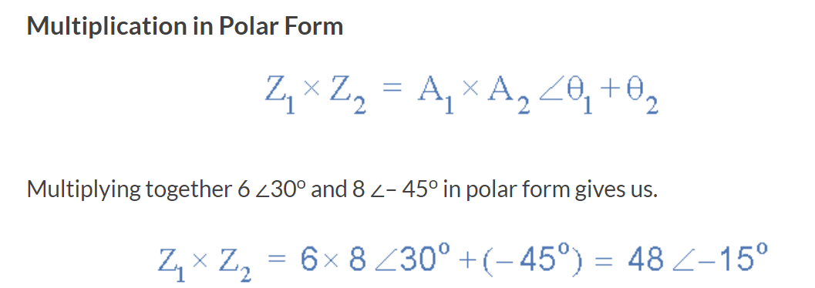

Slide 35
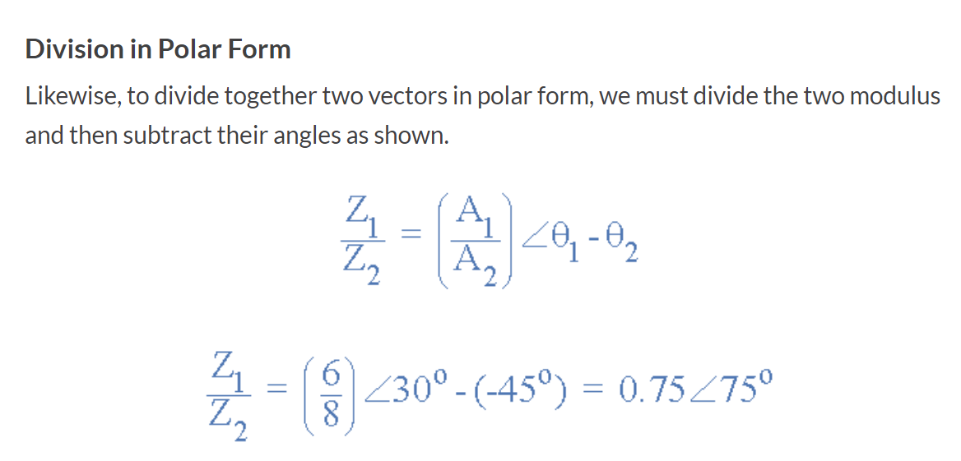

Slide 36
