Slide 1

Circuit Analysis Credit Hours = 3+1 Code NO: EE-121 by Dr. Wazir Muhammad Laghari Email: wazirlaghari@buetk.edu.pk
Biomedical Engineering Department
Balochistan University of Engineering and Technology, Khuzdar

Slide 2
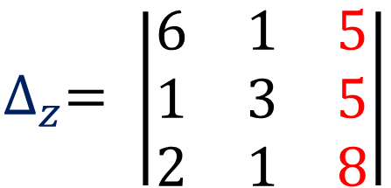
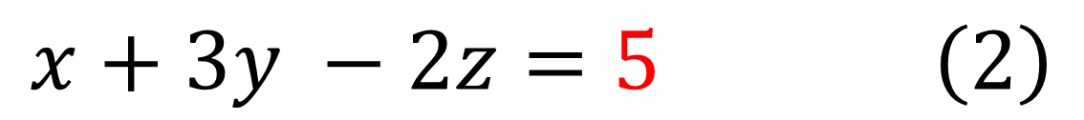
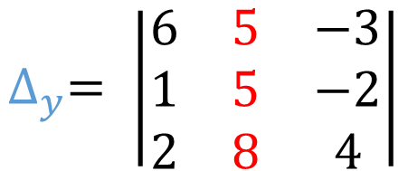
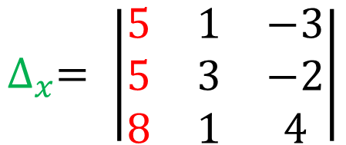
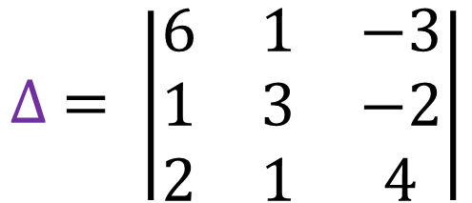
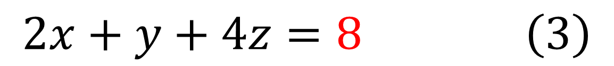
Q: Using Cramer’s rule, find x, y, z
$$6x+y −3z=5 \left(1\right)$$
$$x+3y −2z=5 \left(2\right)$$
$$2x+y+4z=8 \left(3\right)$$
SOLUTION
$$∆ = \left|\begin{matrix}6 & 1 & −3 \\ 1 & 3 & −2 \\ 2 & 1 & 4\end{matrix}\right|$$
$$∆_{x}= \left|\begin{matrix}5 & 1 & −3 \\ 5 & 3 & −2 \\ 8 & 1 & 4\end{matrix}\right|$$
$$∆_{y}= \left|\begin{matrix}6 & 5 & −3 \\ 1 & 5 & −2 \\ 2 & 8 & 4\end{matrix}\right|$$
$$∆_{z}= \left|\begin{matrix}6 & 1 & 5 \\ 1 & 3 & 5 \\ 2 & 1 & 8\end{matrix}\right|$$

Slide 3
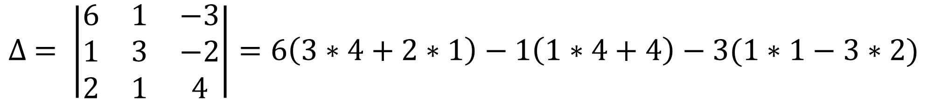
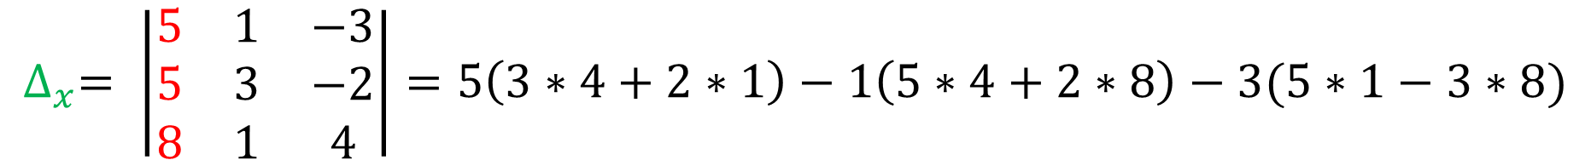
$$∆ = \left|\begin{matrix}6 & 1 & −3 \\ 1 & 3 & −2 \\ 2 & 1 & 4\end{matrix}\right|=6\left(3∗4+2∗1\right)−1\left(1∗4+4\right)−3(1∗1−3∗2)$$
$$∆ = 6\left(14\right)−1\left(8\right)−3\left(−5\right)=84 −8+15=91$$
$$∆_{x}= \left|\begin{matrix}5 & 1 & −3 \\ 5 & 3 & −2 \\ 8 & 1 & 4\end{matrix}\right|=5\left(3∗4+2∗1\right)−1\left(5∗4+2∗8\right)−3(5∗1−3∗8)$$
$$∆_{x}=5\left(14\right)−1\left(36\right)−3\left(−19\right)=70 −36+57=91$$

Slide 4
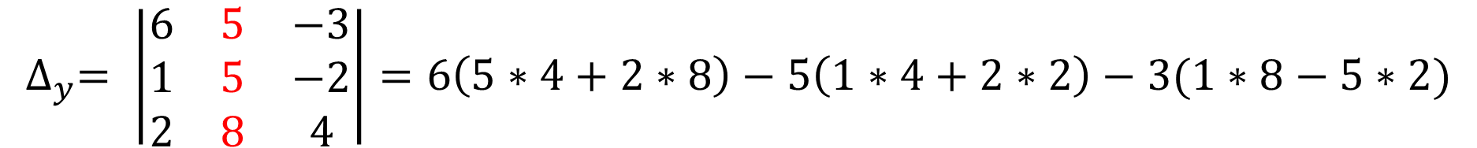
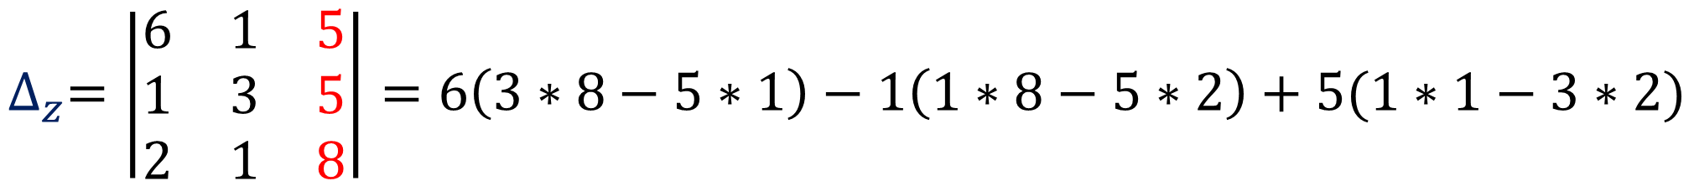
$$∆_{y}= \left|\begin{matrix}6 & 5 & −3 \\ 1 & 5 & −2 \\ 2 & 8 & 4\end{matrix}\right|=6\left(5∗4+2∗8\right)−5\left(1∗4+2∗2\right)−3(1∗8−5∗2)$$
$$∆_{y}=6\left(36\right)−5\left(8\right)−3\left(−2\right)=216 −40+6=182$$
$$∆_{z}=\left|\begin{matrix}6 & 1 & 5 \\ 1 & 3 & 5 \\ 2 & 1 & 8\end{matrix}\right|=6\left(3∗8−5∗1\right)−1\left(1∗8−5∗2\right)+5(1∗1−3∗2)$$
$$∆_{z}=6\left(19\right)−1\left(−2\right)+5\left(−5\right)=114+2 −25=91$$

Slide 5
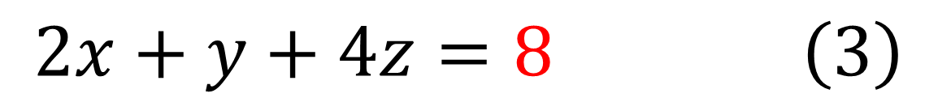
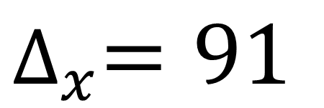
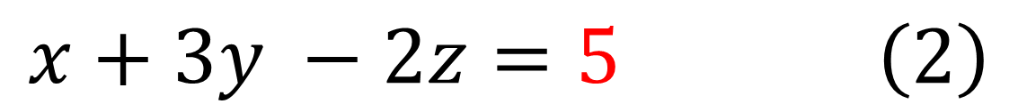
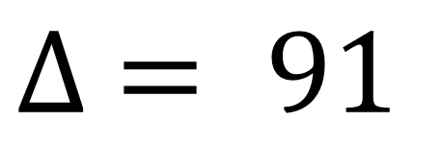
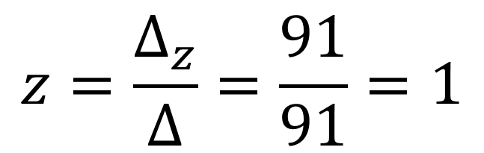
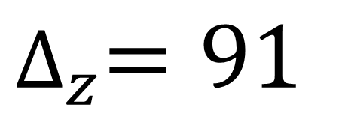
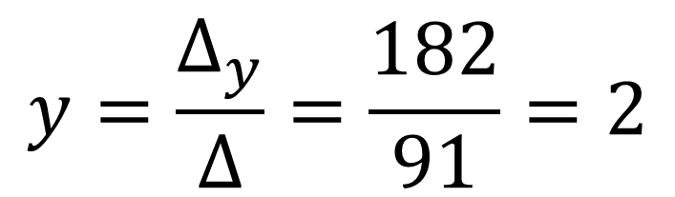
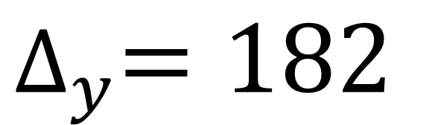
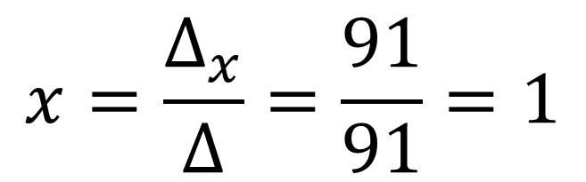
$$6x+y −3z=5 \left(1\right)$$
$$∆ = 91$$
$$x+3y −2z=5 \left(2\right)$$
$$2x+y+4z=8 \left(3\right)$$
$$∆_{x}=91$$
$$x=\frac{∆_{x}}{∆}=\frac{91}{91}=1$$
$$∆_{y}=182$$
$$y=\frac{∆_{y}}{∆}=\frac{182}{91}=2$$
$$∆_{z}=91$$
$$z=\frac{∆_{z}}{∆}=\frac{91}{91}=1$$

