Slide 1

Balochistan University of Engineering and Technology Khuzdar PEC Interim Visit November 19, 2022 Engr. Dr. Shamshad Ali chairmanelectro@buetk.edu.pk
Department of Electronic Engineering

Slide 2
Presentation Contents
Introduction
Criterion 1 – Program Educational Objectives (PEOs)
Criterion 2 – Program Learning Outcomes (PLOs)
Criterion 3 – Curriculum and Learning Process
Criterion 4 – Students
Criterion 5 – Faculty
Criterion 6 – Facilities and Infrastructure
Criterion 7 – Institutional Support and Financial Resources

Slide 3
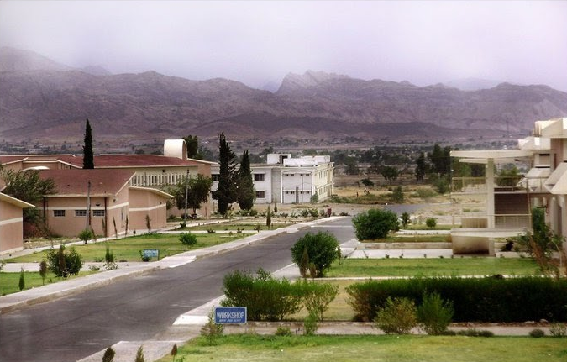
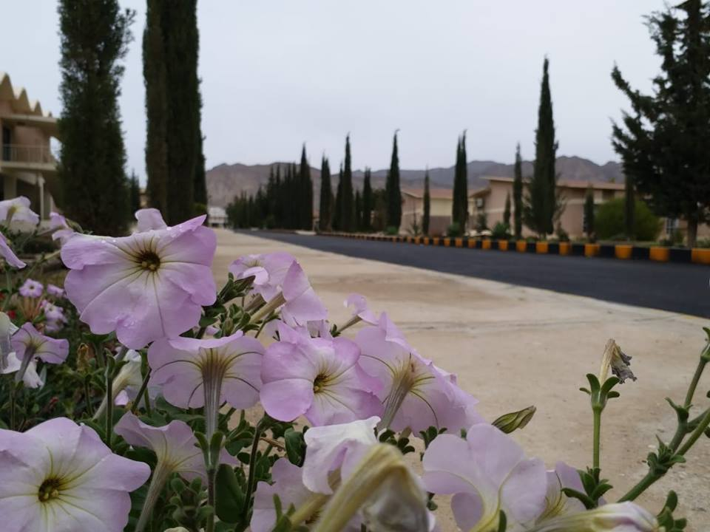
Introduction
Department of Electronic Engineering was established in 2019. (Received green signal from PEC after zero visit with allowed intake of 40 students)
Started its academic activities in 2019-2020.
The department has 9 dedicated faculty members including 4 PhDs.
There are 04 furnished classrooms and 08 dedicated/shared laboratories.
We offer quality engineering education and best learning environment within available resources.

Slide 4
Academic Organogram
Chairman
Overall Laboratory In charge
Faculty Members
Departmental Committees
Professor
Lab Engineer
DOBEC
Associate Professor
IAB
PREC
Lab Assistant
Assistant Professor
DCQIC
4
Lecturer
DEC
Lab Attendant
BoS

Slide 5
Electronic Engineering Accreditation Track
S.No | Year of PEC Accreditation Visit | Intake Batch | Decision
01 | 2019 | 2019 | Green signal to launch program

Slide 6
Departmental BOS
1 | Dr. Shamshad Ali | HoD | Chairman/Assistant Professor, Department of Electronic Engineering, BUET, Khuzdar
2 | Dr. Inayat Ali | Internal Member | Assistant Professor, Department of Electronic Engineering, BUET, Khuzdar
3 | Engr. Abid Mengal | Internal Member | Assistant Professor, Department of Electronic Engineering, BUET, Khuzdar
4 | Dr. Imran Sarwar | Internal Member | Assistant Professor, Department of Electronic Engineering, BUET, Khuzdar
5 | Dr. Muhammad Ayoob | External Member/ HoD | Head of Department, Department of Electronic Engineering, BUITEMS, Quetta.

Slide 7
Departmental OBE Committee
Dr. Shamshad Ali (Assistant Professor)
Dr. Imran Sarwar (Assistant Professor)
Engr. Muhammad Abid Mengal (Assistant Professor)
Dr. Haseeb Ashraf (Assistant Professor, IPFP)
Engr. Saifullah Memon (Lecturer)
Engr. Rayees Khan (Lecturer)

Slide 8
Departmental CQI Committee (DCQIC)
Dr. Shamshad Ali (Assistant Professor)
Dr. Zaffar Hayat Khan (Assistant Professor)
Dr. Imran Sarwar (Assistant Professor)
Engr. Muhammad Abid Mengal (Assistant Professor)
Engr. Saifullah Memon (Lecturer)

Slide 9
Course Review Committee
1 | Dr. Zafar Hayat Khan | 2019
2 | Engr. Rayees Khan
3 | Dr. Haseeb Asharaf | 2020
4 | Engr. Saifullah

Slide 10
Working of DCQIC
Departmental Continuous Quality
Improvement (DCQI) Committee
Indirect Assessment
Alumni Survey (PEO)
Employer Survey (PEO)
Exit Survey (PLO)
Employment database (PEO)
Internship Survey (PLO)
Course Evaluation Survey (CLO)
Direct Assessment
Course Based Assessment (CLO/PLO)
Analysis
Corrective
Actions

Slide 11
Criterion 1 – Program Educational Objectives

Slide 12
University Vision and Mission
Vision
To become a world class higher education Institute leading to socio economic development of the region and beyond
(Ref: Approved in 23rd meeting of Syndicate)
Mission Statement
To impart quality education and research with professional excellence on strong ethical foundation to serve the region and beyond
(Ref: Approved in 23rd meeting of Syndicate)
University Vision and Mission are well publicized and are available in Prospectus, on University Website http://www.buetk.edu.pk, Notice Boards, and Corridors

Slide 13

Department Vision and Mission
Department Vision and Mission
Vision of the Department
To become one of the most innovative and progressive department by offering a complete range of undergraduate and graduate courses in the development and evolution of Electronic Engineering.
(Ref: Approved in 1st BOS)
Mission of the Department
To ensure high-quality education and state of the art research skills for our graduates, to make them future pioneers of the society.
(Ref: Approved in 1st BOS)
Department Vision and Mission are well publicized and are available on University Website http://www.buetk.edu.pk, Notice Boards

Slide 14
Publishing of University / Department Vision/ Mission Statement and PEOs
Available on University Website http://www.buetk.edu.pk
Notice Boards

Slide 15
Vision and Mission Alignment
Vision and Mission Alignment
Department Vision and Mission |  | University Vision and Mission
 |  | Vision | Mission
DEE Vision | To become one of the most innovative and progressive department by offering a complete range of undergraduate and graduate courses in the development and evolution of Electronic Engineering. | To become a world class higher education Institute leading to socio economic development of the region and beyond | To impart quality education and research with professional excellence on strong ethical foundation to serve the region and beyond
DEE Mission | To ensure high-quality education and state of the art research skills for our graduates, to make them future pioneers of the society. |  | Innovation, Research, and Commercialization/ Moral Responsibilities

Slide 16
Program Educational Objectives
Program Educational Objectives
PEO-01: Graduates would be able to use their knowledge and analytical skills in the development of their career and profession.
PEO-02: Graduates would be able to contribute to the development of the society based on their expertise in technical knowledge and educational experience.
PEO-03: Graduates would be able to show leadership and excellence in leading society and mankind.
(Ref: Approved in 1st Meeting of BOS)
Program Educational Objectives are well publicized and are available on University Website http://www.buetk.edu.pk, Notice Boards, Corridors and Department Office

Slide 17
Mapping of PEOs with Department Vision and Mission
Vision and Mission of the Department |  | Program Educational Objectives (PEOs)
 |  | PEO_1 | PEO_2 | PEO_3
DEE Vision | To become one of the most innovative and progressive department by offering a complete range of undergraduate and graduate courses in the development and evolution of Electronic Engineering. | Graduates would be able to use their knowledge and analytical skills in the development of their career and profession. | Graduates would be able to contribute to the development of the society based on their expertise in technical knowledge and educational experience. | Graduates would be able to show leadership and excellence in leading society and mankind.
DEE Mission | To ensure high-quality education and state of the art research skills for our graduates, to make them future pioneers of the society.

Slide 18
Formulation & Approval Process of PEOs
Departmental OBE Committee (DOBEC)
Faculty Members
Industrial Advisory Board (IAB)
Formulation of Program Educational Objectives (PEOs) by Board of Studies (BoS)
Review of Program Educational Objectives (PEOs) by Board of Faculty (BoF)
Approval of Program Educational Objectives (PEOs) by Academic Council (AC)

Slide 19
Stakeholder’s Involvement in Review of PEOs
a.
Alumni
b.
Employer
c.
Faculty
d.
Industry
Stakeholders

Slide 20
Criterion 2 – Program Learning Outcome

Slide 21
Criterion 2 - Program Learning Outcomes
The Electronic Engineering Program has adopted the Twelve GA proposed by Pakistan Engineering Council (PEC) in its Accreditation Manuals released in 2019
The PLOs are well publicized and well-disseminated among students, faculty members and other stake holders
GAs encompass all graduate attribute as defined in EAB Accreditation Manual

Slide 22
Criterion 2 - Program Learning Outcomes
PLO_1: Engineering Knowledge
PLO_2: Problem Analysis
PLO_3: Design/ Development of Solutions
PLO_4: Investigation
PLO_5: Modern Tool Usage
PLO_6: Engineer and the Society
PLO_7: Environment and Sustainability
PLO_8: Ethics
PLO_9: Individual and Teamwork
PLO_10: Communication
PLO_11: Project Management
PLO_12: Lifelong Learning

Slide 23
Publishing of Program learning Outcomes
Available on University Website http://www.buetk.edu.pk
Notice Boards
Corridors
Department Office

Slide 24
PLO Mapping with PEOs
PLO Mappings with PEOs
PEC Graduate Attributes (as defined in Sec 3.2.2) | PEO_1 | PEO_2 | PEO_3
Engineering Knowledge | ֍ | ֍
Problem Analysis | ֍
Design/Development of Solutions | ֍
Investigation | ֍
Modern Tool Usage |  | ֍
The Engineer and Society |  | ֍ | ֍
Environment and Sustainability |  |  | ֍
Ethics | ֍ |  | ֍
Individual and Teamwork |  |  | ֍
Communication |  |  | ֍
Project Management |  |  | ֍
Lifelong Learning | ֍ |  | ֍

Slide 25
Mapping of Courses to PLOs
Semester No. | Course Code | Course Title | Level of Emphasis of PLO
 |  |  | 1 | 2 | 3 | 4 | 5 | 6 | 7 | 8 | 9 | 10 | 11 | 12
1 | HS-111 | Functional English |  |  |  |  |  |  |  |  |  | C2 A2
 | EE-120 | Basic Electrical Engineering | C1 | C3 |  |  | P3
 | NS-171 | Differential & Integral Calculus | C1 | C3
 | NS-122 | Electricity & Magnetism/Applied Physics | C1 C2 | C2 P3
 | CS-113 | Introduction to Computing | C1 C2 | P3 |  |  | P3
 | EL-104 | Electronic Engineering Drawing & Workshop | P1 |  |  |  | P2 P3
2 | EE-121 | Circuit Analysis | C1 C2 |  |  |  | P3
 | NS-227 | Differential Equations | C1 | C3
 | EL-103 | Basic Electronics | C2 | C4 |  |  | P3
 | ME-110 | Basic Mechanical Engineering | C2 | C3
 | CS-255 | Programming Languages | C2 |  | C2 |  | P3
 | HS-105 | Pakistan Studies |  |  |  |  |  | C4 | C4 |  |  |  |  | C1
3 | EL-233 | Electronic Devices and Circuits | C2 | C3 |  |  | P3
 | HS-325 | Communication Skills |  |  |  |  |  |  |  |  | C3 | C3 A2 |  | C3
 | TC-202 | Signals and Systems | C2 | C3 | C4 |  | P3
 | EE-382 | Electromagnetic Fields | C2 | C3
 | NS-272 | Linear Algebra and Geometry | C1 | C3

Slide 26
Mapping of Courses to PLOs
4 | EL-239 | Analog Integrated Circuits | C2 | C4 | C3 |  | P3
 | CS-216 | Data Structure & Algorithms | C2 | C2 | C4 |  | P3 P3
 | EE-223 | Instrumentation & Measurement | C2 C3 |  | C3 |  | P3
 | TC-201 | Digital Logic Design | C2 | C4 | C5 |  | P4
 | HS-205 | Islamic Studies |  |  |  |  |  | C2 |  | C2 |  |  |  | C2
5 | NS-331 | Probability and Statistics | C1 | C3
 | TC-212 | Digital Signal Processing | C2 | C3 | C5 |  | P3
 | MS-305 | Engineering Economics & Management |  |  |  |  |  | C2 | C3 |  |  |  | C4
 | EL-344 | Power Electronics | C2 | C2 | C3 | C4 | P4 |  |  |  | A3
 | TC-307 | Communication Systems | C2 | C2 | C4 |  | P3
6 | HS-214 | Academic Writing | C2 |  |  |  |  |  |  |  |  | C3
 | CS-430 | Microprocessor Programming & Interfacing | C2 |  | C4 |  | C3
 | EE-374 | Feedback Control Systems | C2 | C3 | C3 |  | P4 |  |  |  | A3
 | EL-301 | Industrial Electronics | C2 | C3 | C3 |  | P3 |  |  | A4
 | EE-246 | Electrical Machines | C2 | C4 |  |  | P4 |  |  | A1

Slide 27
Mapping of Courses to PLOs
7 | EE-312 | Elective (Artificial Intelligence) | C2, C3 | C4 | P4 |  | P4
 | NS-442 | Numerical Methods | C1 | C3
 | EL-408 | VLSI Systems Design | C3 | C4 | C3 |  | P3
 | HS-405 | Business Communication & Ethics |  |  |  |  |  |  |  | C5 |  | C3 C5
 | EL-401 | Electronic Engineering Project-I | C2 | C2 | C4 | C5 | C5 |  |  |  | A2 C2 | A2 C2 | A2 C2
8 | MS-304 | Entrepreneurship |  |  |  |  |  | A3 |  |  | A4 |  | C5
 | EL-412 | Elective II (Optoelectronics) | C1, C2 | C3 |  |  | P3
 | EL-512 | Embedded System Design | C2 |  | C3 A4 | C5 | P3
 | EL-402 | Electronic Engineering Project-II |  |  |  | C5 |  | C3 | C6 | A3 | A3 | C2 | A4 | C5
KSA | DOMAIN | Total Numbers | % age
Knowledge | Cognitive | 106 | 71.6
Skills | Psychomotor | 27 | 18.2
Attitude | Affective | 15 | 10.1

Slide 28
PLO Assessment Methods
Direct Assessment Methods | Indirect Assessment Methods
Final Examination Mid Term Examination Quizzes Assignments/ Presentation Final Year Design Project Laboratory Examination | Graduate/ Exit Survey

Slide 29
KPIs for PLO attainment
PLO (1 to 12) | Key Performance Indicators (KPI) | Assessment Tool
PLO Assessment | PLO attainment for an individual student is greater than 50% | Direct Assessment
 | PLO attainment for the cohort is greater than 50% | Direct Assessment
 | 50% students are satisfied with the teaching-learning and assessment methods | Graduating Student Survey

Slide 30
Criterion 3 – Curriculum and Learning Process

Slide 31
i. Curriculum Design
Curriculum Design
Domain | Knowledge Area | PEC/HEC Recommended |  | Institute's Program Breakup
 |  | Total Credits | Overall % | Total Credits | Overall %
Non-Engineering | Humanities | As per discipline specific NCRC guidelines | 25% – 35 % | 13 | 27.94
 | Management Sciences |  |  | 6
 | Natural Sciences |  |  | 19
Engineering | Computing | As per discipline specific NCRC guidelines | 65% – 75% | 13 | 72.06
 | Engineering Foundation |  |  | 29
 | Major Based Core (Breadth) |  |  | 48
 | Major Based Core (Depth)
 | Inter-Disciplinary Engineering Breadth (Electives) |  |  | 2
 | Senior Design Project |  |  | 6
 | Industrial Training (Summer) |  |  | 0
 |  | Total | 130 – 138 | 136 | 100

Slide 32
Lab Details
iv. Lab Details
There are 08 Dedicated/Shared Departmental Laboratories
S. No | Laboratories
1. | Electrical Machines Lab
2. | EL Workshop Lab
3. | Communication Systems Lab
4. | Instrumentation & Control Lab
5. | Power Electronics Lab
6. | Basic Electrical Engineering Lab
7. | Electronics Lab
8. | Computer Lab
Notes:
OK

Slide 33
Involvement of Industry in Curriculum Development/ Revision
vii. Involvement of Industry in Curriculum Development / Revision
Rigorous revision activity for the curriculum of the offered programs is done in the department.
The Industrial Advisory Board (IAB) is constituted in the department which includes experts from the industry and curriculum is discussed in detail.
The suggestions of IAB members are discussed in BoS. The recommendations of the BoS are directed towards the Board of Faculty (BoF) and Academic Council for final approval.
IAB members of DEE are:
S. No | Name | Designation | Affiliation
1 | Dr. Shamshad Ali | Chairman/ Assistant Professor | Department of Electronic Engineering, BUET, Khuzdar
2 | Engr. Rizwan Ahmed Ansari | Head of Network engineering | MTD Dept. K-electric Karachi
3 | Engr. Arfan Bhutto | Operation & maintenance lead | GAWPL (Gul Ahmed Wind Power Limited)
4 | Engr. Tarique Niaz | Assistant Manager | K-Electric Karachi
5 | Dr. Raza Haider | Chairman/ Professor | Department of Electrical Engineering, BUET, Khuzdar
6 | Dr. Ayaz Hussain | Dean FoS | Department of Electrical Engineering, BUET, Khuzdar
7 | Dr. Zafar Hayat | Assistant Professor | Department of Electronic Engineering, BUET, Khuzdar
8 | Engr. Naseer Ahmed | Engineering Manager | (PBC, HPT, Khuzdar)

Slide 34
Industrial Visits
ix. Learning through Internship Program
Sr. No. | Industrial Visit Place | Date
1 | Gatron Industries Limited | October 2022
2 | DG Cement / Universal Cables | October 2022

Slide 35
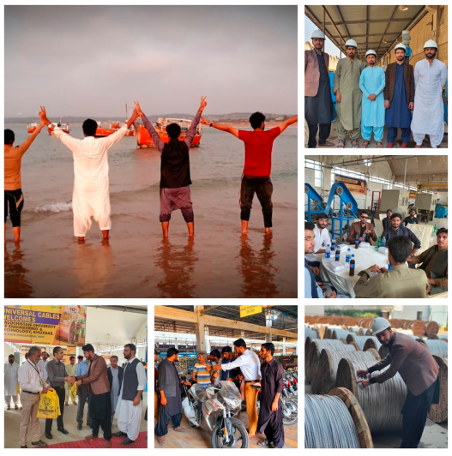
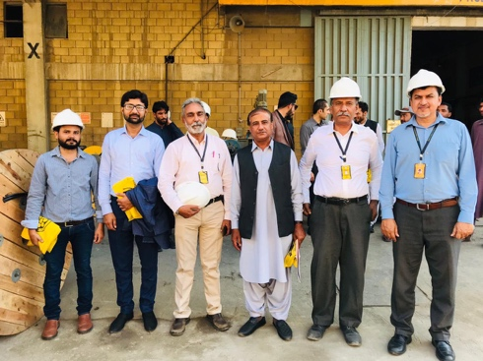
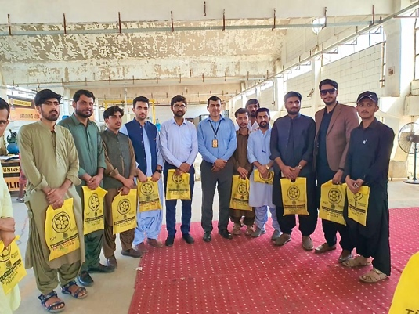
Industrial Visits
Industrial visit at Universal Cables

Slide 36
Internship Program/Organizations
LIEDA
FFC
Amreali Steels
Attock cement
DG Cement
Habibullah Power Plant, Quetta
NTC, Quetta
QESCO
NTDC, Quetta, Khuzdar
K-Electric
PTCL
PTV
Universal Cables

Slide 37
Criterion 4 – Students

Slide 38
Admission Criteria
Selection criteria
Intermediate (HSC)/ DAE Marks 40%
Matriculation 10%
Aptitude Test 50%
Allowed intake 40 students per batch

Slide 39
Annual Students Intake
ii. Annual Intake
Batch | Allowed Intake | Admitted | Currently Enrolled
2019 | 40 | 37 | 28
2020 | 40 | 20 | 16
Total 57 |  |  | 44

Slide 40
Manageable Class size and Lab Groups
Theory Class Size
40 students on average per section which is within allowed limit of PEC.
Laboratory Group Size
1-3 students per workstation for hardware-based lab
1 to 2 student per workstation for computer-based lab session

Slide 41
Course Files
Every Faculty member is preparing course file/s of assigned courses as per PEC guidelines consisting all required items including:
Copy of Academic Calendars
Course time table
Course description including contents, recommended text books, lecture breakdown, office hours for students, CLO with taxonomy levels and their mapping to PLOs
Teaching notes
Schedule of tests, assignments, midterm and final exam
Sample of best, worst, and average test/assignment along with their solution
Breakdown of laboratory experiments
Record of CLO assessment and attainments
Teacher course feedback form
Monthly attendance record
Record of makeup classes
Recommendations and suggestion

Slide 42
Criterion 5 – Faculty

Slide 43
Faculty Strength
Faculty Strength
 | Strength
Total Full Time Faculty | 09
Faculty on Study Leave | 02
Total Shared Faculty | 7
25 % of FTDF (counted as one-half) | 2
Total Faculty | 2+ 7 = 9
Total Students | 44
Student to teacher Ratio | 4.8 : 1

Slide 44
Faculty Qualification
Faculty Post | Qualification | Total
Assistant Professor | PhD | 4
Assistant Professor | MS | 1
Lecturer | MS | 4
 | TOTAL | 09

Slide 45
Faculty Details
1 | Engr. Dr. Shamshad ALi | Electro/13471 | Assistant Professor
2 | Engr. Dr Inayat Ali | Electro/16738 | Assistant Professor
3 | Engr. Dr. Zaffar Hayat Nawaz Khan | Electro/17488 | Assistant Professor
4 | Engr. Dr. Imran Sarwar | Elect/34379 | Assistant Professor
5 | Engr. Muhammad Abid | Elect/ 14532 | Assistant Professor
6 | Engr. Haseena Qadir | Elect/50084 | Lecturer
7 | Engr. Saifullah Memon | Electro/23144 | Lecturer
8 | Engr.Rayees Khan | Electro/45451 | Lecturer
9 | Engr. Shabnam Rehmat | Elect/67232 | Lab. Engr.
10 | Dr. Haseeb Ashraf | - | Assistant Professor (IPFP)

Slide 46
Faculty Training and Mentoring
Date | OBE Seminars & Workshops conducted for Faculty Training
12-2020 | OBE online session for the student of 2nd ,4th,6th,8th semester of fall 2020
15-6-2021 | OBE training session for Academic Heads
28-9-2021 | A one-day campus training on Outcome based Education (OBE) for faculty members, Lab Engrs, related staff
06-10-2021 | OBE Training of Head of Departments
23-02-2022 | A training regarding OBE for faculty Resource Persons:
17-3-2022 | A training regarding OBE for faculty for faculty and supporting staff of CSE
14-4-2022 | OBE training session for visiting faculty of BSD
25-10-2022 | OBE training session for newly appointed faculty members

Slide 47
Criterion 6 – Facilities and Infrastructure

Slide 48
Departmental Facilities
i. Facilities /Infrastructure
S. No. | Departmental Infrastructure | Quantity
1. | Classrooms | 4
2. | Laboratories | 8
3. | Departmental library/Shared | 1
4. | Faculty Rooms/Offices | 6
5. | Chairman Office | 1

Slide 49
Library Facilities
iii. Library Facilities
The programme of Electronic Engineering uses the facilities available at the Central Library. Copies of undergraduate projects are kept in the Central Library and in the departmental library of Electronic Engineering
Library | No. of Books
Campus Library | 38,496 approx. (Reference + Text)
Departmental Library/Shared | 479 ~500 (Textbook)

Slide 50
Provision of Sufficient Computing Facilities
Computing Facility
BUETK provides computing/printing facilities to all its faculty member. Students are free to use computing facility in departmental computing lab.
Internet and Wifi Facility
BUETK provides high tech centrally controller Wi-Fi network.
BUETK is the part of HEC-provided PERN (Pakistan Education & Research Network) with 46mbps bandwidth.
Software Licensing
BUETK-HEC-Microsoft alliance for Microsoft Software licenses, that includes Server and desktop operating systems licenses of Windows.
Microsoft Development tools for students and labs. Microsoft 365 cloud based complete portal including e-mail and office online for all the students & staff.

Slide 51
Provision of Consulting and Career Placement services
Center for Guidance, Career planning and placement provides the following services to students.
Guidance and counselling
Internship services
Job Placement services
Industrial tours
Organization of conferences, seminars and workshops
Project collaboration
Orientation for new batch (College to University transition of Student)

Slide 52
vi. Support Facilities
Support Services
Sports
Playground
Gym
Hockey Ground
Prayer Area
Cafeteria
Medical Facilities
24 hours ambulance service for students and staff
Health Insurance ( For Faculty and Staff)
Medical Clinic
Clinical pathological laboratory

Slide 53
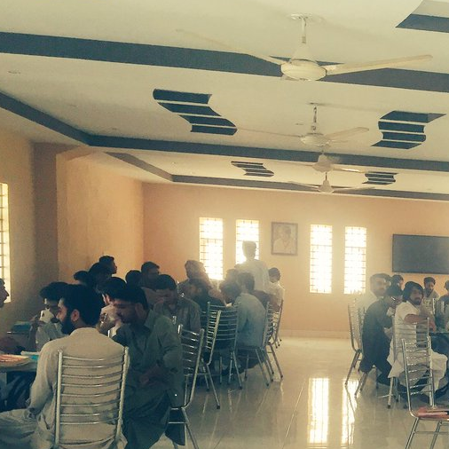
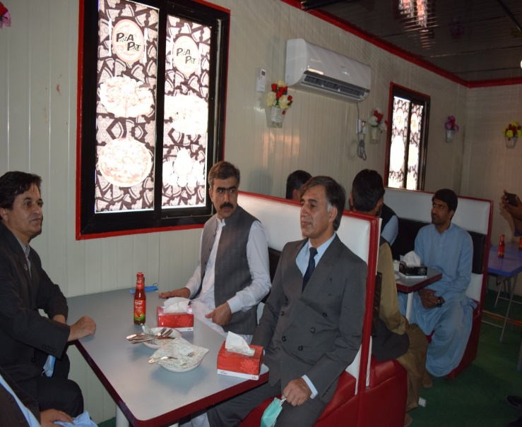
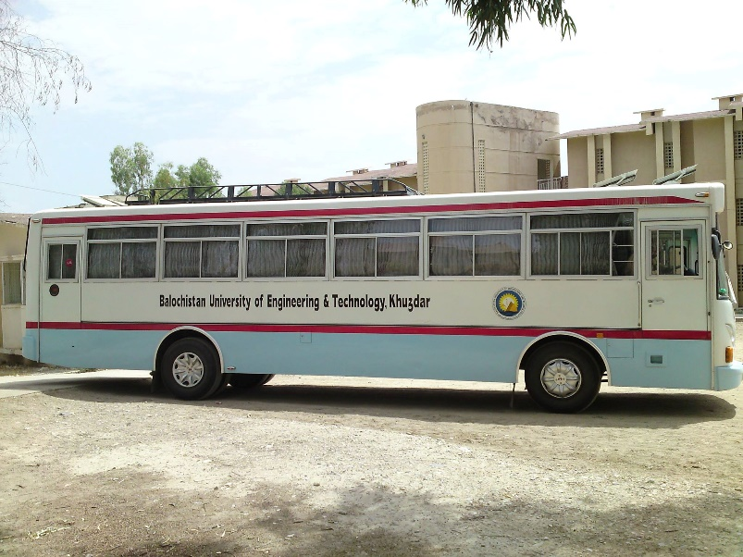
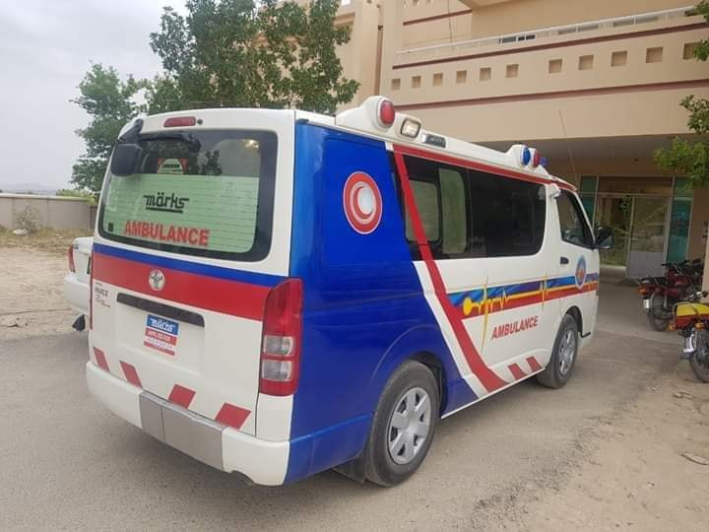
vi. Support Facilities
Support Services
BUET, Khuzdar Canteen
BUET Transport Facility
BUETK Papa gino/Pizza Shop
BUET, Khuzdar Medical Centre

Slide 54
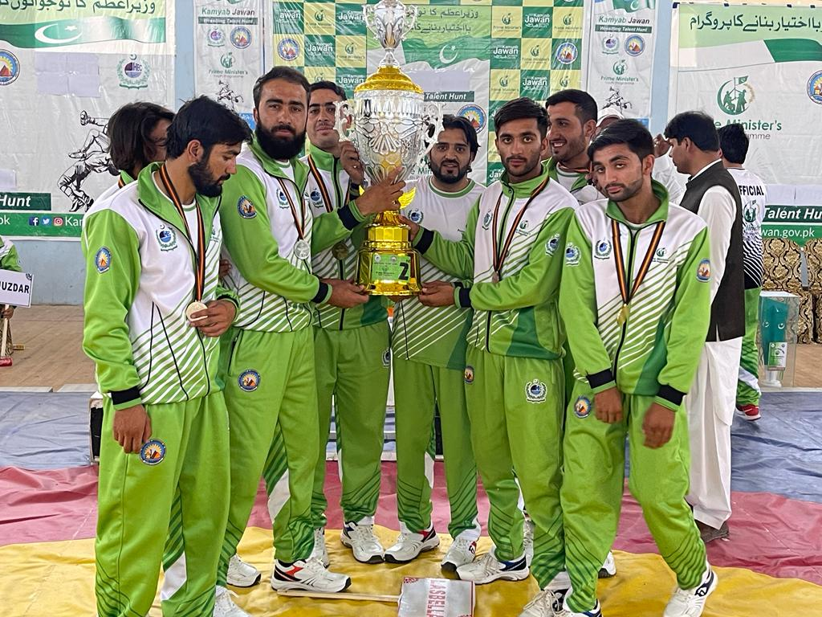
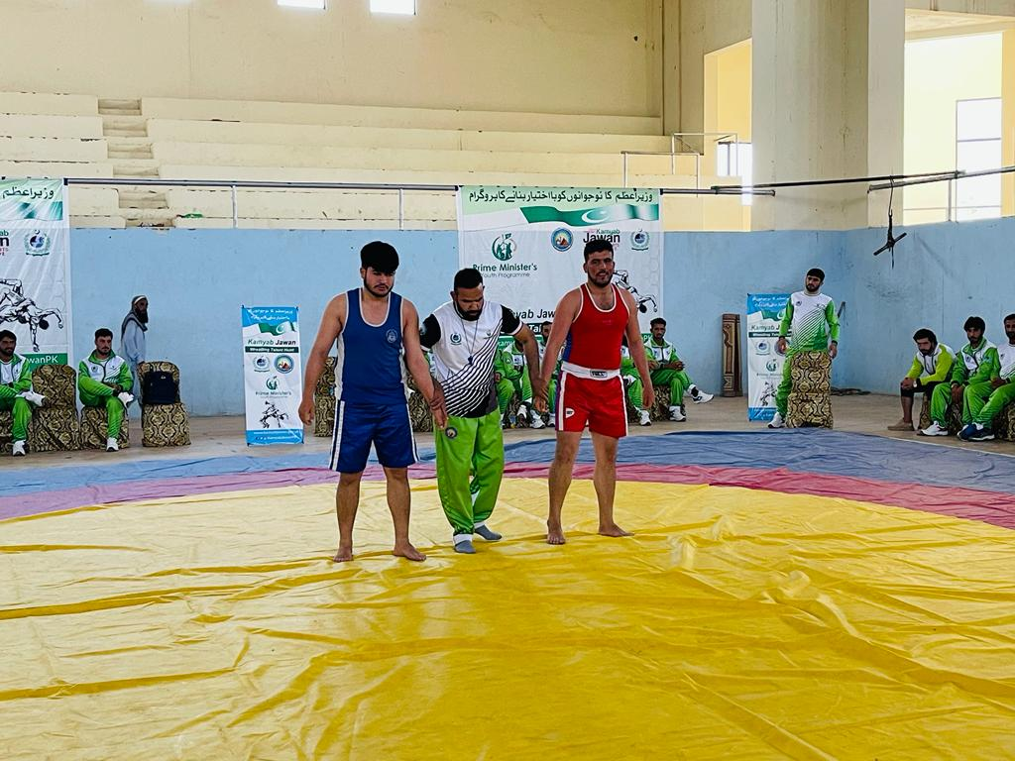
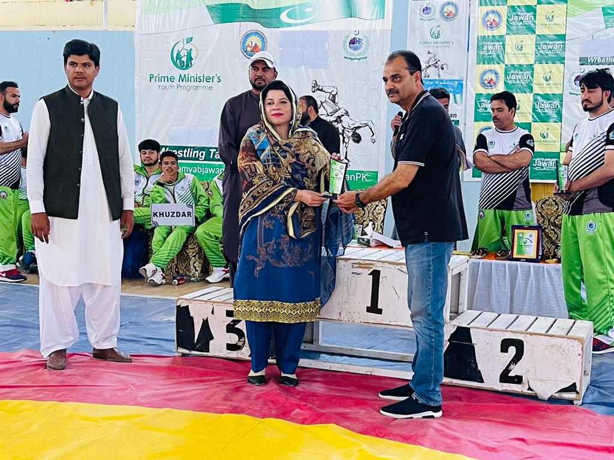
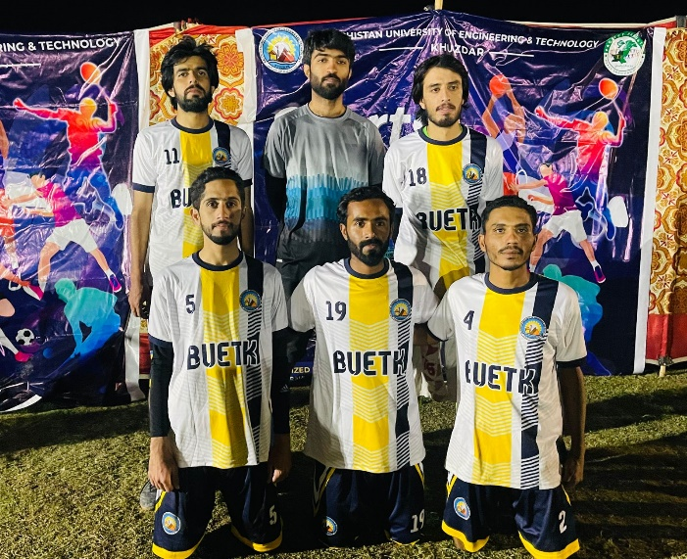
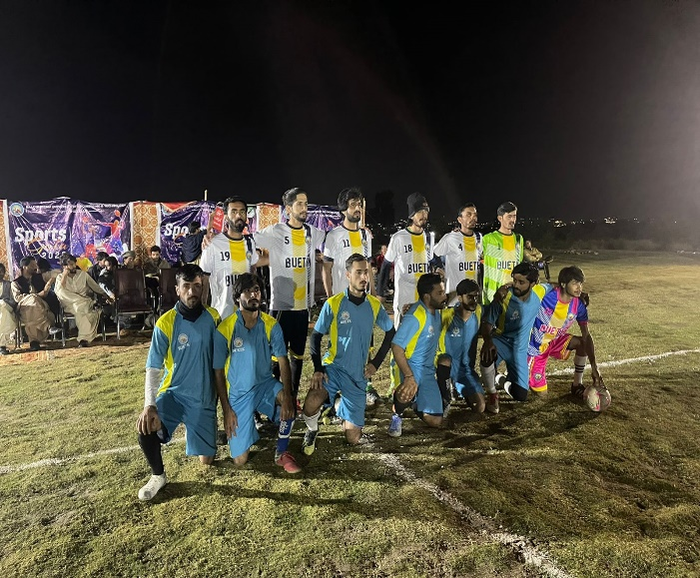
vi. Support Facilities
Support Services

Slide 55
Workplace safety (EHS)
Fire safety guidelines and precautions
Safety measures during earthquake and building evacuation guidelines
Lab Safety instructions
Environment Health and Safety Policy
Faculty and Staff have been trained
Sr. # | Training | Date
1 | Environment Health and Safety training | Nov 15, 2021

Slide 56
Criterion 7 – Institutional Support and Financial Resources

Slide 57
Institutional Financial Resources
1 | Operational Budget | 8.480 M
1.1 | Salaries | 8.480 M
2 | Development Budget | 30 M
2.1 | Civil Work | 15 M
2.2 | Laboratories | 9 M
2.3 | Teaching Aid | 3 M
2.4 | Furniture | 2 M
2.5 | Books and Journals | 1 M

Slide 58
Zero Visit Observations
S. | Parameters | Zero Visit Observation | Action taken
1 | Infrastructure | Labs and offices need some improvement | Further Improved
2 | Academic Program | It is recommended to revise the scheme of studies in line with B.E Electronic Engineering Program. | Revised and approved from BOS
3 | Teaching Faculty | Dedicated faculty may please be appointed for B.E Electronic Engineering program before Interim visit. | 2 PhDs and 3 lecturers have been appointed after zero visit.
4 | Laboratories and allied staff | Dedicated Lab for the course Basic Electronics must be established before interim visit Electronic device and circuit Lab is also recommended to be established before interim visit | Tender has been placed and is under process
5 |  | Number of students per station is very high | Managed to 1-3 students
6 |  | Lab manual must be prepared in line with OBE system. Extensive training to the concerned teachers and lab staff is highly needed | Lab manuals are being prepared according to OBE system OBE trainings have been arranged after zero visits
7 |  | Dedicated lab staff/Lab engineers must be appointed before the interim visit | Adequate staff to arrange lab
8 | Library | New Books for the proposed program should be added | Common books are available at Library and the order of new books is under process and submitted for the approval to the higher authority

