Slide 1
HIERARCHY OF ACADEMIC COUNCIL
DOBEC MEETING
IAB (INDUSTRIAL ADVISORY BOARD)
BOS (Board of Studies)
BOF (Board of Faculty)
University Senate
University Syndicate
Academic Council
Curriculum Revision

Slide 2
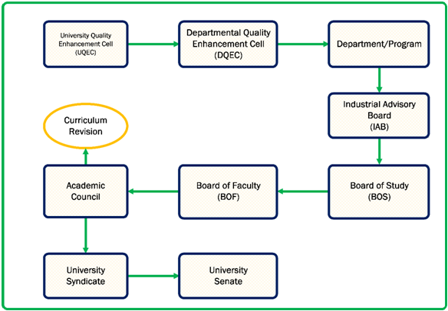
HIERARCHY OF ACADEMIC COUNCIL
DOBEC MEETING
IAB (INDUSTRIAL ADVISORY BOARD)

Slide 3
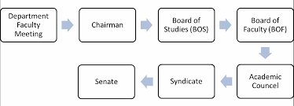

Slide 4
TERMINOLOG
PIET

Slide 5
The University QMS has been implemented at PIET which consists of Quality Enhancement Cell (QEC), Department Quality Enhancement Cell (DQEC), Industrial Advisory Board (IAB), Board of Studies (BOS), Board of Faculty, Academic Council, University Syndicate and University Senate.

