Slide 1
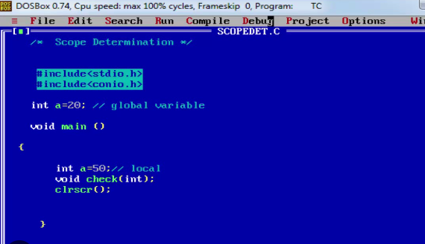
Global And Local Variable
#include <iostream>
int a = 100;
int main()
{
int b =5;
}
It is a Global Variable, and used in whole Program
It is used within these brackets { }

Slide 2
Variable in C++
A variable provides us with named storage that our programs can manipulate.
A variable definition tells the compiler where and how much storage to create for the variable.
Each variable in C++ has a specific type, which determines the size and layout of the variable's memory; the range of values that can be stored within that memory; and the set of operations that can be applied to the variable.
The name of a variable can be composed of letters, digits, and the underscore character. It must begin with either a letter or an underscore.

Slide 3
Types of Variable in C++
Classes
Bool
Data structures
Char
int
Reference
float
Double
void
Wchar_t
Enumeration
Pointer
Array

Slide 4
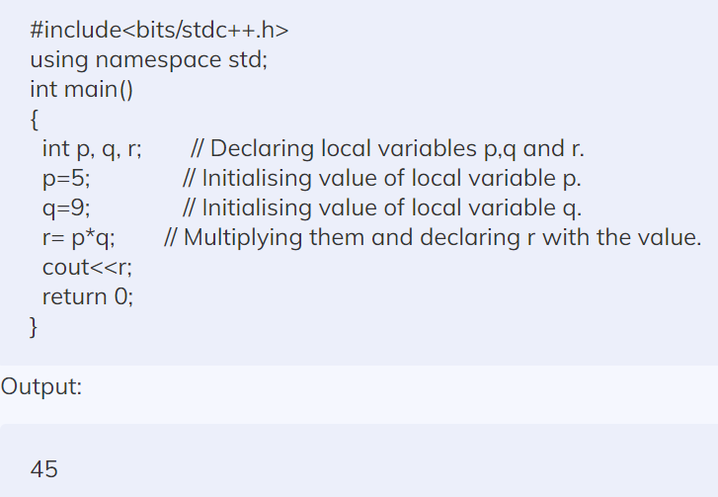
Write a C++ Program to initialize a Variable

Slide 5
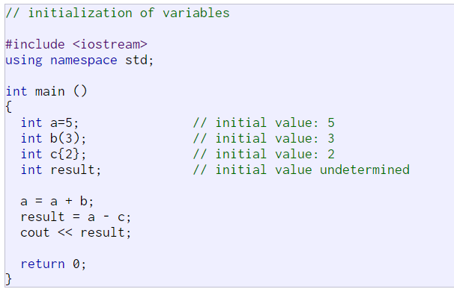
Write a C++ Program to initialize a Variable

Slide 6
Same Name of Global As Well As Local Variable
In case of same name of variable is used both for Global as well as Local, then program run it uses local value variable not a global value variable.
#include <iostream>
int a = 100;
int main()
{
int a =200;
c = 2*a;
cout<< (c);
}

Slide 7
If you wan to Use Global Variable with Local Variable having Same Name Method-1
#include <iostream>
int a = 100;
int main()
{
int a =200;
c = 2*a;
cout<< (c);
{
extern int a
d = 2*a ############ Value Print 200
cout<< (d);
}
}

Slide 8
If you wan to Use Global Variable with Local Variable having Same Name Method-2
#include <iostream>
int a = 100;
int main()
{
int a =200;
cout<<a; ##### Print the value of 100
cout<<::a ; ##### Print the value of 100
}
Scope Resolution Operator

Slide 9
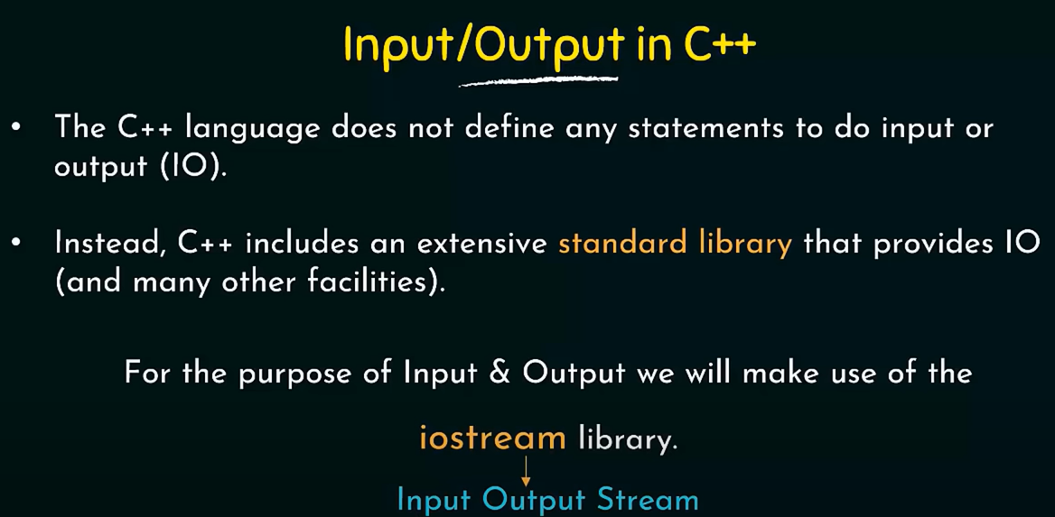

Slide 10
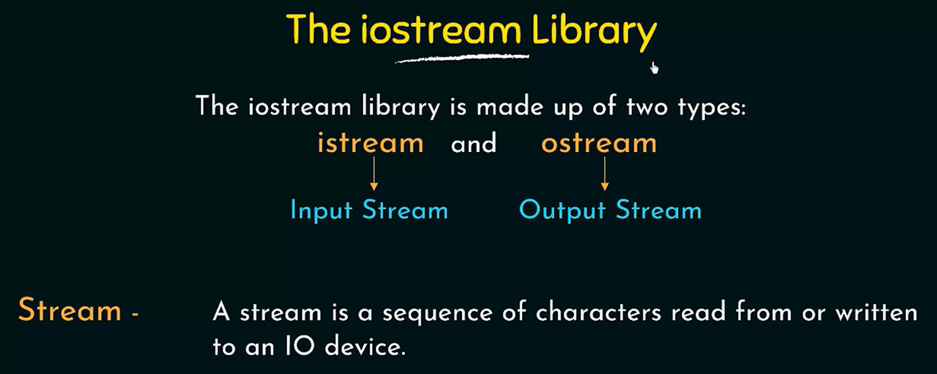

Slide 11
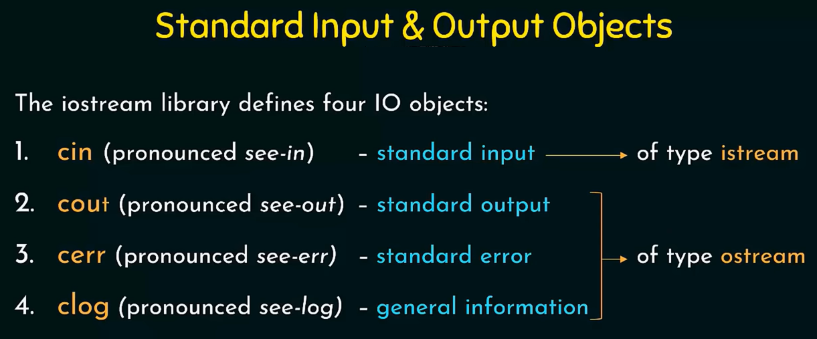

Slide 12
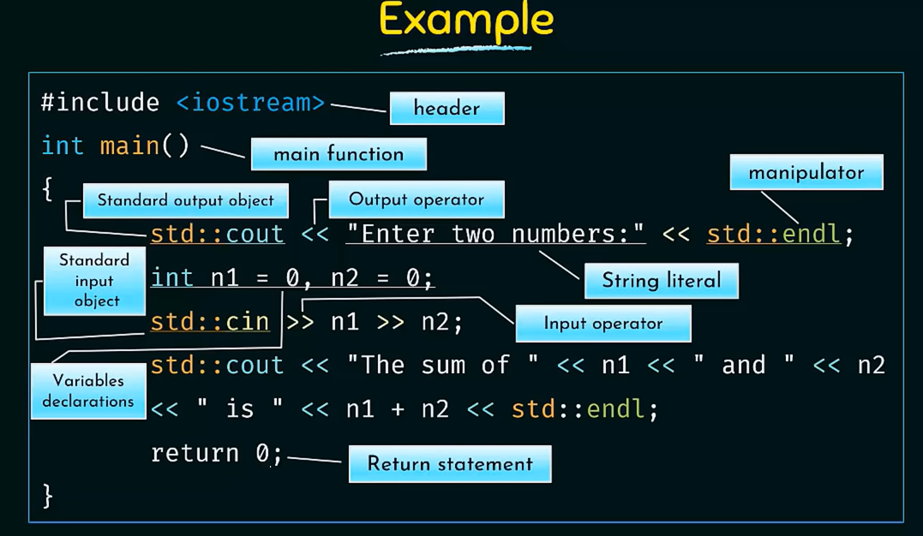

Slide 13
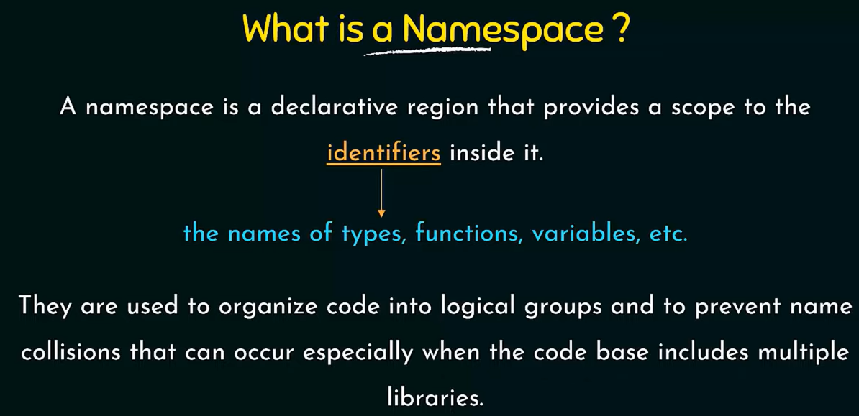

Slide 14
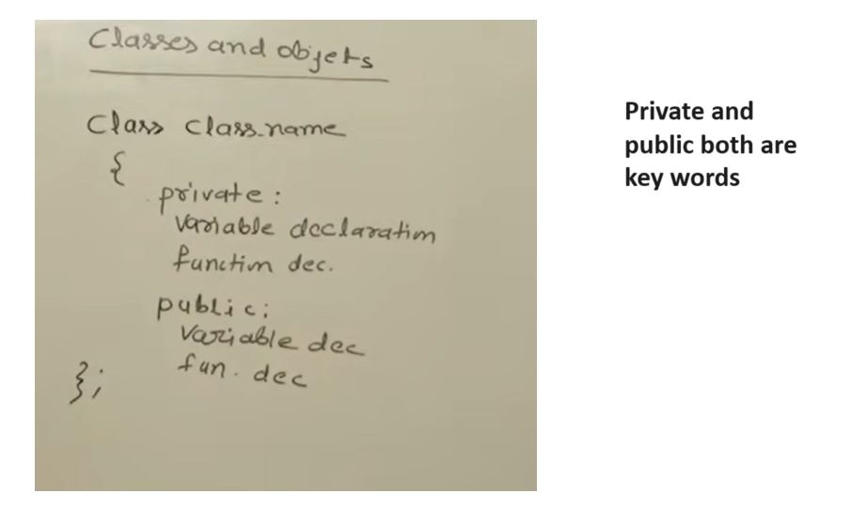

Slide 15
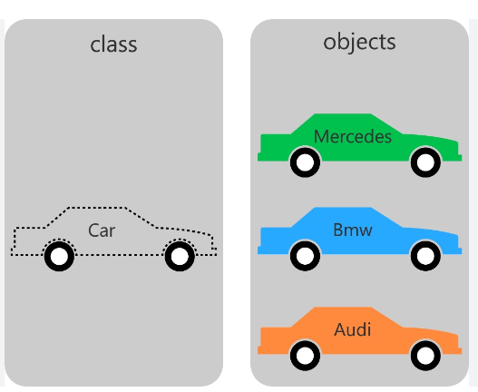
Class and Objects

Slide 16
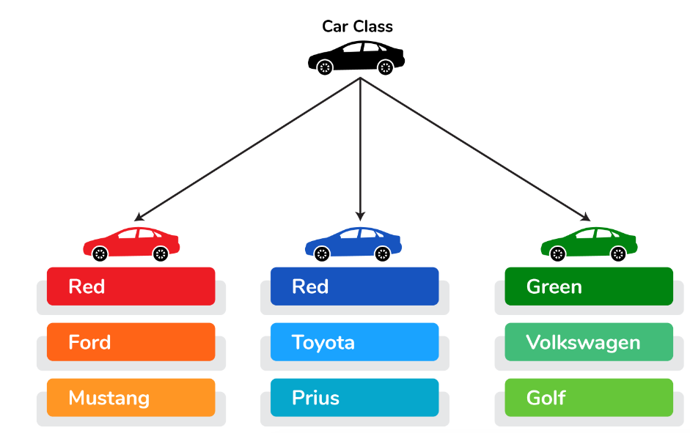

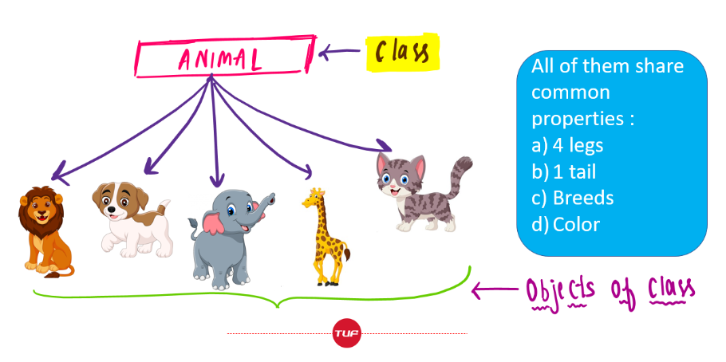
Class and Objects

Slide 17
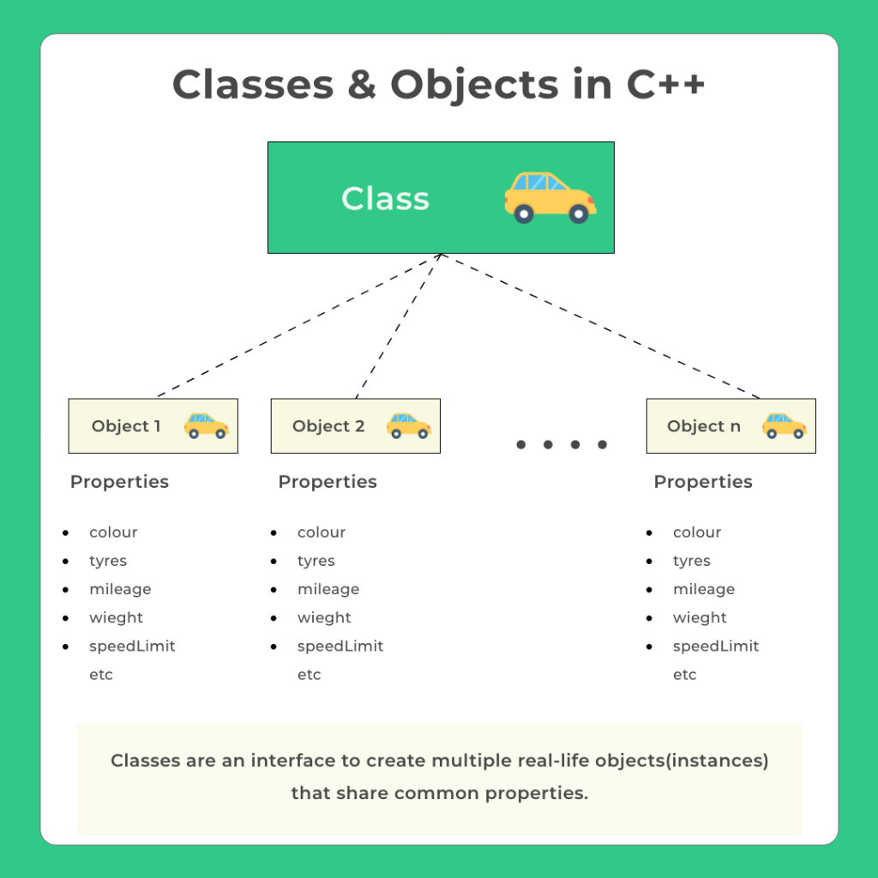
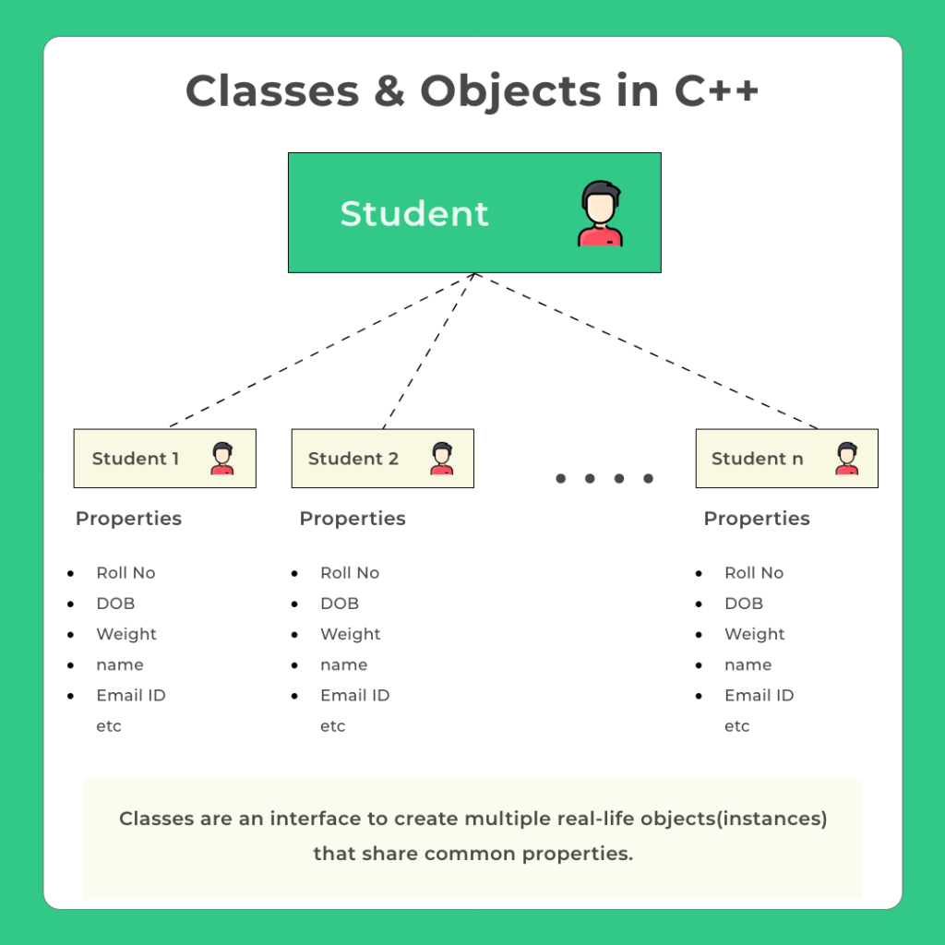
Class and Objects

Slide 18
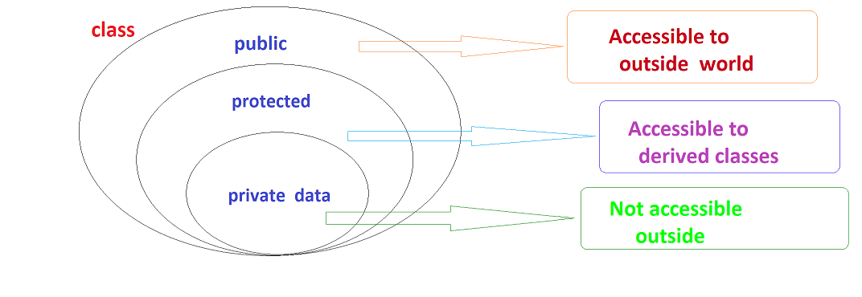

Slide 19
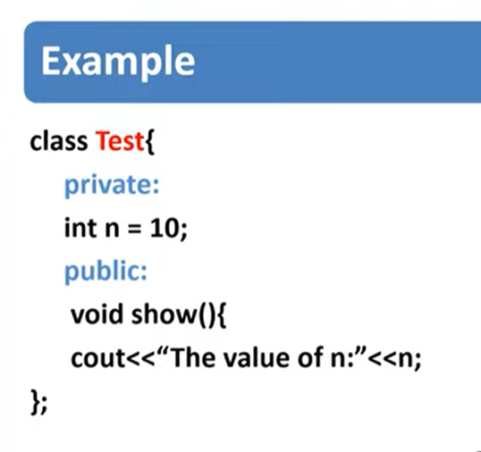
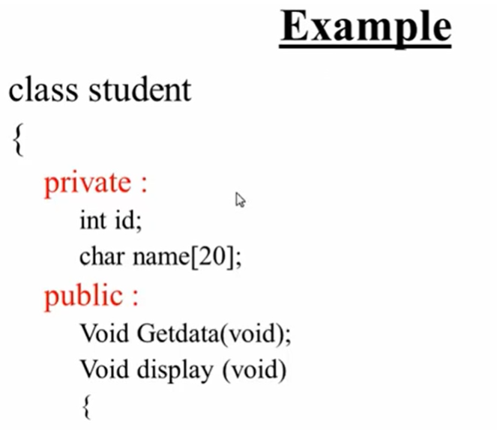

Slide 20
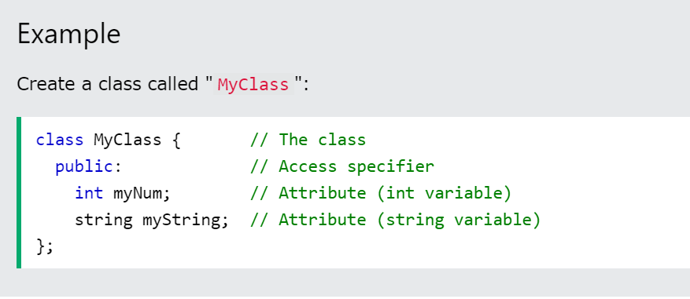

Slide 21
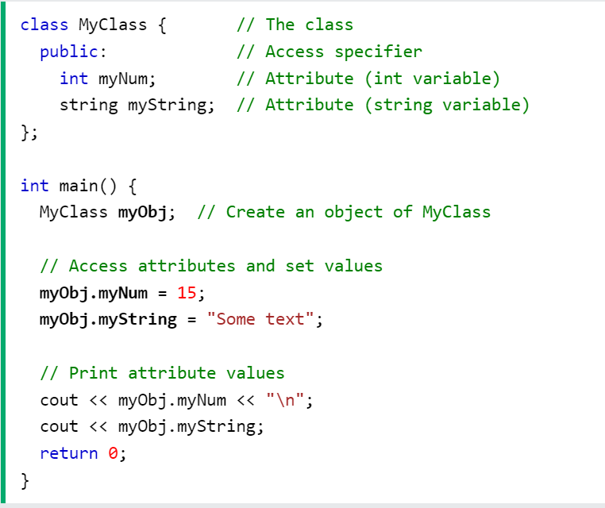

Slide 22
Multiple Objects
You can create multiple objects of one class:
Example
// Create a Car class with some attributes class Car { public: string brand; string model; int year; }; int main() { // Create an object of Car Car carObj1; carObj1.brand = "BMW"; carObj1.model = "X5"; carObj1.year = 1999; // Create another object of Car Car carObj2; carObj2.brand = "Ford"; carObj2.model = "Mustang"; carObj2.year = 1969; // Print attribute values cout << carObj1.brand << " " << carObj1.model << " " << carObj1.year << "\n"; cout << carObj2.brand << " " << carObj2.model << " " << carObj2.year << "\n"; return 0; }

Slide 23
Name of Items | Class | Object
Red |  | √
Blue |  | √
Color | √
Green |  | √
Apple |  | √
Mango |  | √
Orange |  | √
Fruit | √
Woman |  | √
Man |  | √
Human being | √

Slide 24
#include <iostream>
#include <string>
using namespace std;
// creating the class
class myClass { // This is the class
public: // This is an Access specifier
int Ageofstudent; // This is an Attribute
};
// creating the object of myclass
int main() {
myClass myobject;
// Accessing the attributes of the class
myobject.Ageofstudent = 10;
// printing the values
cout <<myobject.Ageofstudent << "\n";
return 0;
}

Slide 25
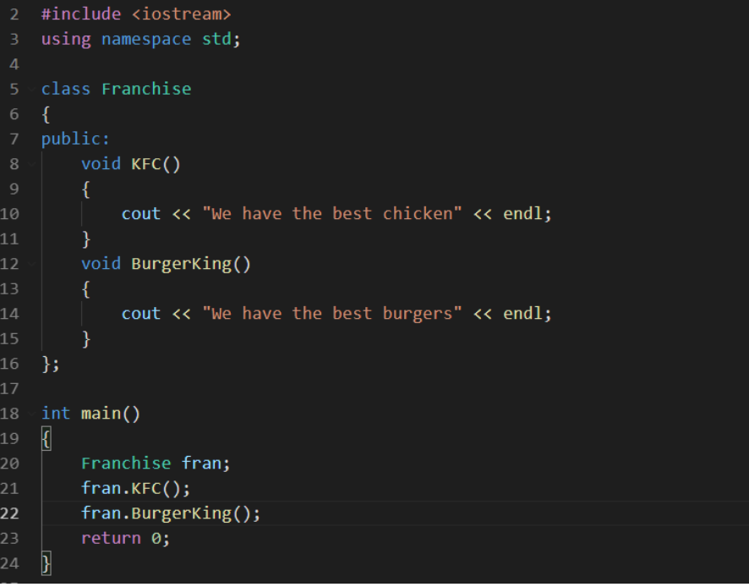
Q1: Find the Name of Class
Q2: Inside class how many functions are available?
Q3: What type of Access specifier is used either private or public?
Q4: Find the name of Object?

Slide 26
Q1: Find the Name of Class
Ans: Franchise
Q2: Inside class how many functions are available?
Ans: Two Functions, i.e., KFC and Burger.
Q3: What type of Access specifier is used either private or public?
Ans: Public
Q4: Find the name of Object?
Ans: Name of Object is fran

Slide 27
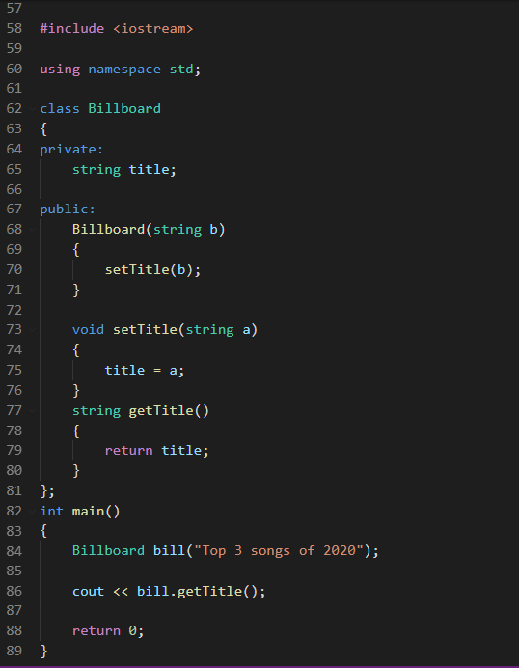

Slide 28
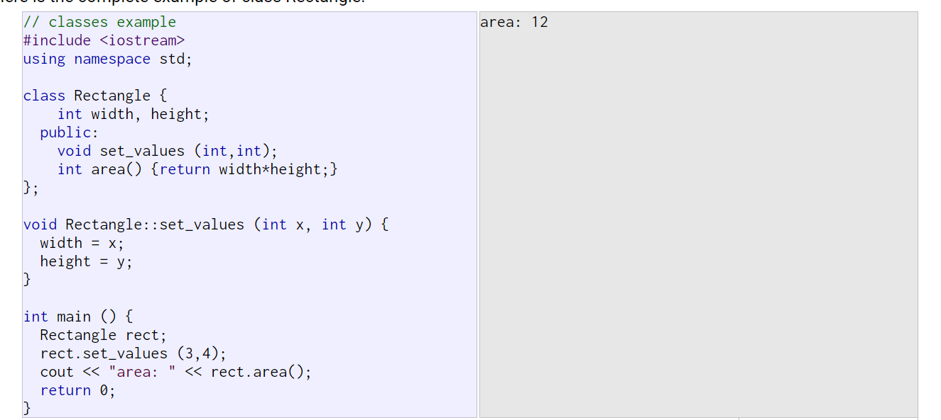

Slide 29
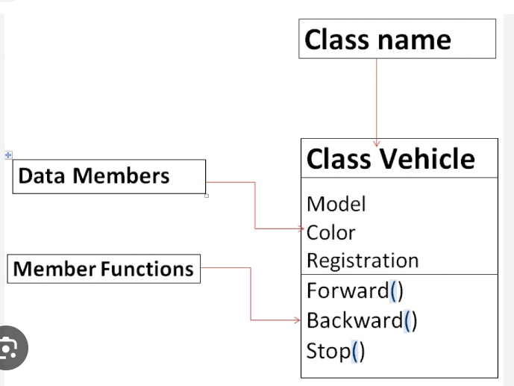
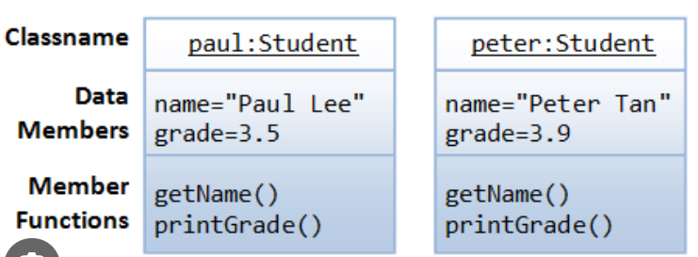
Data Members (Variables) and Member Functions

Slide 30
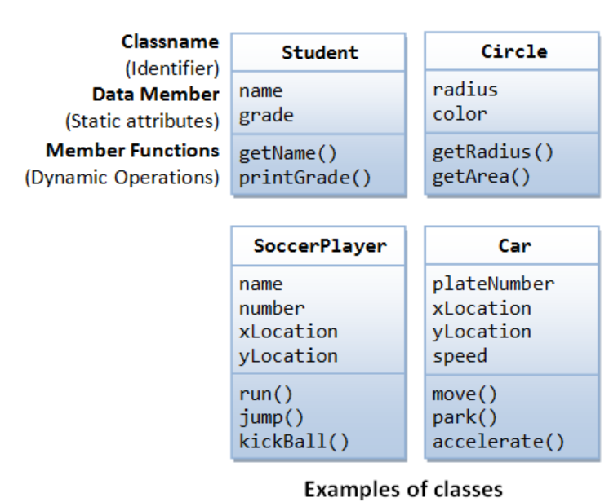
Data Members (Variables) and Member Functions

Slide 31
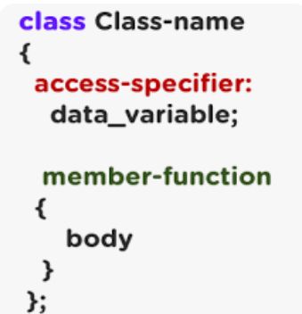
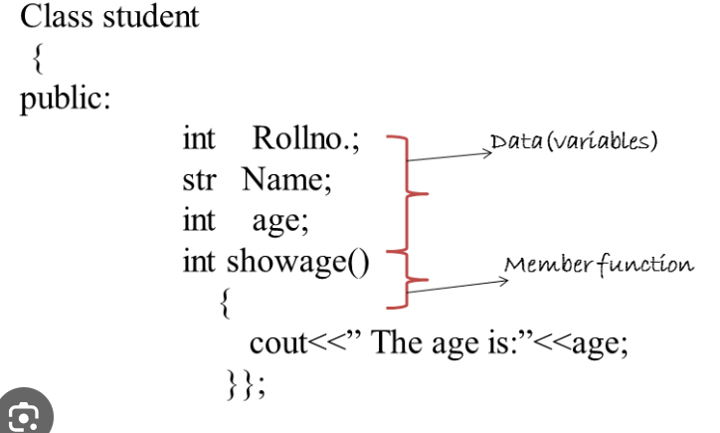
Data Members (Variables) and Member Functions

Slide 32
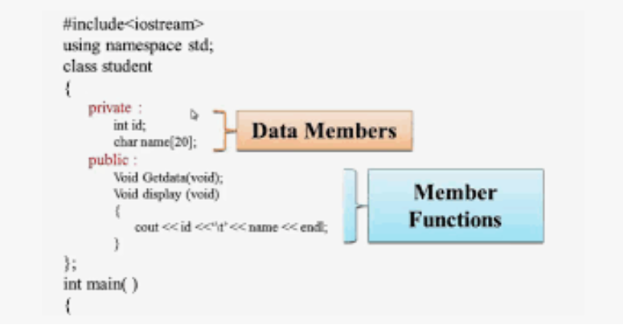
Data Members (Variables) and Member Functions

