Slide 1

Power System Protection Credit Hours = 3 Code NO: EE-503 by Dr. Wazir Muhammad Laghari Email: wazirlaghari@buetk.edu.pk
Electrical Engineering Department
Balochistan University of Engineering and Technology, Khuzdar

Slide 2
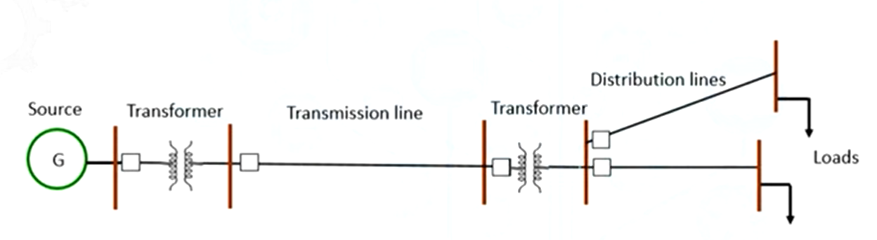
Normal Operation of Power System
Generally a simple power system having a generator, a transformer, a transmission line and then distribution line feeding load connecting through a transformer.
Normal Operation means Current Flow from Source to Load.

Slide 3
Interruption OR Disruption in Power Supply
Disruption means disturbance or problems which interrupt an event, activity, or process is called Disruption.
Disruption means loss of electric power supply to one or more consumers.
In case failure of any one of the component in the below system, than it is called as a Disruption in Power Supply to the load.
Such Disruption in power supply which creates problem in the reliability aspect of the supply system.

Slide 4
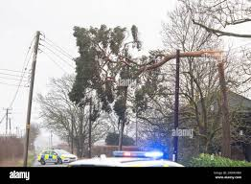
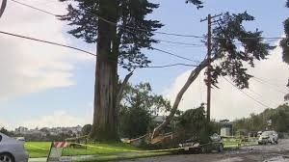
Scenario About Interruption OR Disruption in Power Supply
A general scenario about Power Interruption is a tree falling on a transmission line which results in a circuit to the ground and that leads to the fault current flowing from the generator to the ground through that path.
Such situation created an unwanted path for the flow of current, that leads to problem in providing the power supply to the loads.

Slide 5
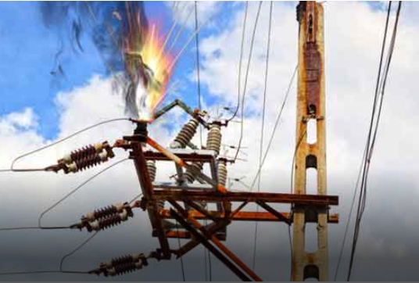
Faults in Power System
An electrical fault is an abnormal condition in a power system or equipment is called as a Fault.
A fault or fault current is any abnormal flow of electric current is called a Faults in Power System.
Fault in electrical equipment or apparatus is defined as an imperfection in the electrical circuit due to which current is deflected from the intended path.

Slide 6
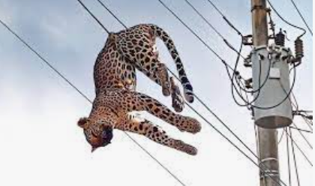
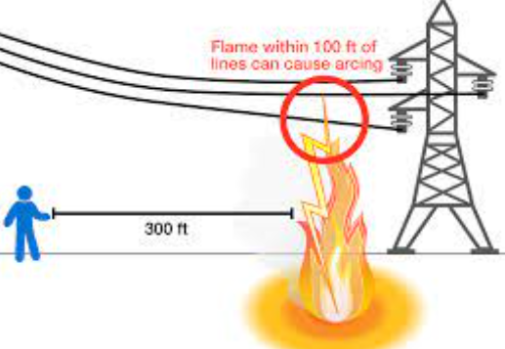
Reasons of Faults Occurring in Power System
Faults can occur for various reasons, including:
Animal coming in contact with the wire.
Equipment failure.
Environmental conditions.
Faulty wiring.
Flashover.
Human error.
Insulation failure.
Irregular operation.
Lightning strikes.
Overloaded circuits.
Power surges.
Smoke of Fires
Voltage fluctuations.

Slide 7
Types of Faults in Power System
Transient Fault.
Persistent Fault.
Active Fault.
Passive Fault.
Bolted Fault.
Overcurrent Fault.
Under Voltage Fault.
Reverse Power Fault.
Ground or Earth Fault.
Arc Fault.
Short Circuit Fault.
Open Circuit Fault.
Solid Fault
Overloading Fault
Incipient Fault
Overvoltage Fault
Power Swing Fault
Line-Line-Line (L-L-L) Fault
Symmetrical Fault
Line-Line-Line to Ground (L-L-L-G) Fault
Asymmetrical Fault
Single Line to Ground (L-G) Fault
Line to Line (L-L) Fault
Double Line to Ground (L-L-G) Fault
https://www.electricaltechnology.org/2022/09/faults-in-electrical-power-system.html

Slide 8
Transient Fault
A transient Fault or Temporary fault is a type of fault that only occurs for a short period of time and the system resumes its normal operation after a short duration of time.
The fault can be cleared on its own or by disconnecting the power supply momentarily.
These faults won’t permanently damage the electrical system.

Slide 9
Transient Fault
Overhead power lines experience transient fault very often.
Examples of transient faults are lightning strikes, bird contact, and conductor collision.
These faults affect the point of origin as well as the connected electrical circuit due to the fault current.
These faults do not interrupt the normal operation of the electrical system.

Slide 10
Persistent (Permanent OR Constant) Fault
Persistent or permanent faults are a type of fault that is present regardless of the disconnection of the power supply.
These faults do not clear on their own way but require other safety equipment to break the power supply and require human intervention to clear the fault.
Permanent faults mostly occur in underground cables.
Overhead lines experience permanent fault due to weather conditions, trees falling on power lines, sagging, etc.

Slide 11
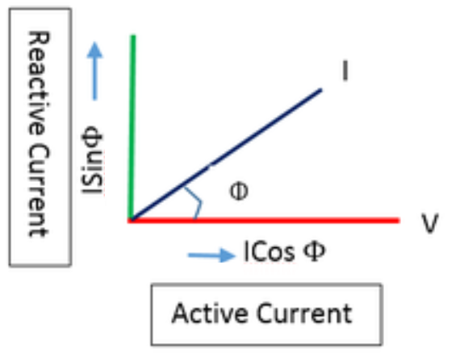
Active and Reactive Current
The active (component of) current is the component of current that is in phase with the applied voltage, and corresponds to the active power.
The reactive (component of) current is the component of current that is in quadrature (makes an angle of 90 degrees) with the applied voltage, and corresponds to the reactive power.

Slide 12
Active and Reactive Current
Active current, also known as real current or true current, refers to the flow of electrical energy that performs useful work in a circuit, such as powering devices or generating heat.
On the other hand, reactive current is the flow of electrical energy that does not perform useful work but is necessary for the operation of inductive or capacitive loads in a circuit.
Reactive power is required to establish and maintain the electric and magnetic fields of these loads.
Both active and reactive currents are important considerations in the design and analysis of electrical systems.

Slide 13
Active Fault
This fault occurs due to the unwanted flow of active current.
The active fault is a type of electrical fault when the current flow between two phase conductors or phase and ground conductor.
There are two types of active faults.
Solid Fault And Incipient Fault.

Slide 14
Solid Fault
The solid fault is a type of active fault that occurs due to the complete breakdown of the conductor insulation or breaking of the conductor itself. As a result, the conductors come into contact with each other.
Solid faults mostly occur in underground power cables and overhead power lines.
The solid fault must be removed as soon as possible as it can cause severe damage at the location of the fault and very heavy power loss.

Slide 15
Incipient (Initial OR Elementary) Fault
Incipient faults in underground cables fundamentally result from moisture, watering trees, or tracking (or electrical treeing (Partially discharge and treeing shape around the solid conductor).
Faults mainly occurring on the junctions of underground power cables commonly known as Incipient Fault.
These faults are initially minor Faults but they result in serious damage to the power system.

Slide 16
Passive Fault
The passive faults can’t be considered as real faults, it can be described as a condition that would make the system stress beyond its design capacity.
Some of the passive faults are described below:
Overloading.
Overvoltage.
Power Swing.

Slide 17
Overloading
Overloading is a condition when too many devices are connected to the same circuit and are operated at a same time, the wire draws a much large current (greater then its capacity) from mains is called overloading.
This causes heating in the circuit that can lead to sparking.
The overloading current damages the insulation over a period of time.
Transient or momentary overloads do not cause damage but continuous overloading can eventually create a short circuit.

Slide 18
Overvoltage
As the name suggests it is a condition in which the operating voltage rises above the nominal or the rated maximum voltage of the system.
The rise in voltage can be momentary as in a voltage spike or permanent.
The overvoltage cause a large current to flow in a circuit that heats up the wires.

Slide 19
Overvoltage
Similarly, overvoltage can damage electrical devices and components and sometimes cause an electrical fire.
Overvoltage can occur due to a lightning strike but that is transient in nature.
Switching on/off an inductive load can also cause an overvoltage spike in the connected electrical system.
Huge current changes can also create voltage spikes.

Slide 20
Power Swing
In an electrical system, the amount of power generation and power consumption at any point in time is equal.
Suddenly increase or decrease in load, the power generation has to be adjusted.
But due to inertia, the power generation cannot be instantly adjusted.
Therefore the power oscillates (varies continuously) throughout the network. This situation is called a power swing.

Slide 21
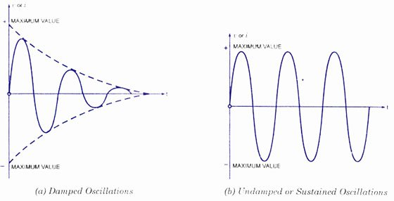
Power Swing
These power oscillations are normally damped.
These power swings can cause the malfunction (Error or Fault) of a protective relay.
Therefore, the relay operation must be blocked by detecting the condition first.
This oscillation can cause instability in the power grid and may lead to potential blackouts if not properly managed.

Slide 22
Bolted Fault
A bolted Fault is a short circuit fault between all the phase conductors and the earth conductor as if connected by a metal bar.
It has zero fault resistance and maximum possible fault current.
A bolted fault is highly unlikely to occur but it is deliberately introduced in a system to test and select appropriate protection devices.

Slide 23
Overcurrent Fault
Overcurrent fault is the sudden increase in the current that occurs due to a short circuit or corona discharge between live conductors.
It is similar to an active fault.
Overcurrent may occur due to overloading of the power source.
In order to avoid this fault overcurrent relays, circuit breakers and fuses are used.

Slide 24
Undervoltage Fault
In under voltage fault, the voltage decreases below the operating range.
It occurs due to the failure of the alternator field or due to the increased voltage drop across the machine or due to heavy load on a utility transformer.
Undervoltage can damage or reduce the life of the equipment.
For such faults, Undervoltage protection relay is used that continuously monitors the voltage and breaks the supply in the event of Undervoltage.

Slide 25
Reverse Power Fault
In an electrical system, there can be more than one power source running at a same time such as a generator in parallel with other utilities.
In case the generator output falls which may happen due to the prime mover not supplying enough torque to the rotor, the generator will start to draw power from the bus bar and behave like a motor.
This is why it is also known as the motoring effect.
It can overload the other source and causes total power failure.
A reverse power protection relay which is a directional relay is used for protection against reverse power.

Slide 26
Ground OR Earth Fault
Ground or earth fault is a fault that occurs when an energized or live conductor comes into contact with the ground or earth conductor.
The current goes through an unintended path and returns to the ground.
It can occur due to insulation failure, overloading, or extreme weather conditions.
The fault results in a very large fault current that can damage the equipment and it can cause electrical shock to any person.
GFCI (Ground Fault Circuit Interrupter) is used for protection against ground fault.

Slide 27
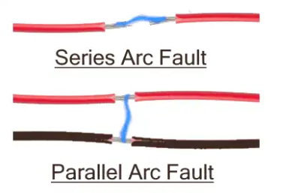
Arc Fault
An arc fault is a powerful electrical discharge between two or more than two conductors.
The arc can vary in strength depending on its current ratings and duration. It can generate enough heat to break the insulation and cause an electrical fire.
The arc also generates waveforms that can disrupt or destroy sensitive electronics equipment.
An arc fault can occur between two phase conductors or between a phase and earth conductors.
It can occur due to loose connections, overheated wires, worn insulation, corroded terminals, etc.
In order to protect against arc fault, AFCI (Arc Fault Circuit Interrupter) is used.

Slide 28
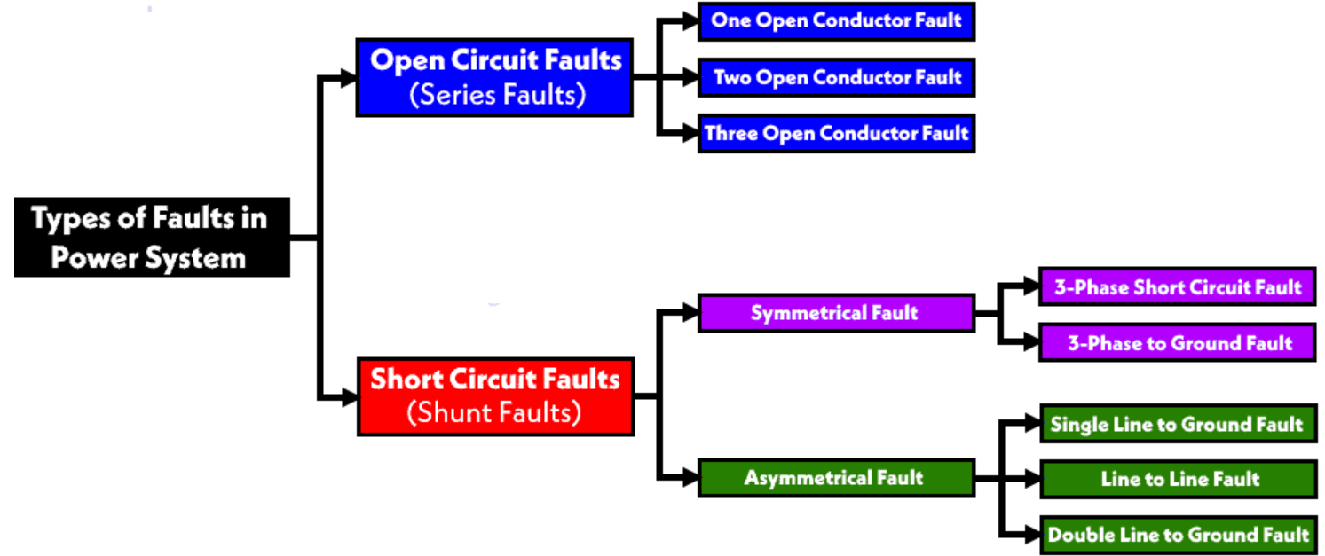

Slide 29
Open Circuit Fault
It is a series of faults that occur due to damaged or broken conductors.
Open Circuit Fault occurs due to failure in one or more than one phase conductors.
The connected circuit experiences an imbalance in the current flowing through it and causes equipment failure.
Open circuit faults can be classified into types:
One Open Conductor Fault.
Two Open Conductors Fault.
Three Open Conductors Fault.

Slide 30
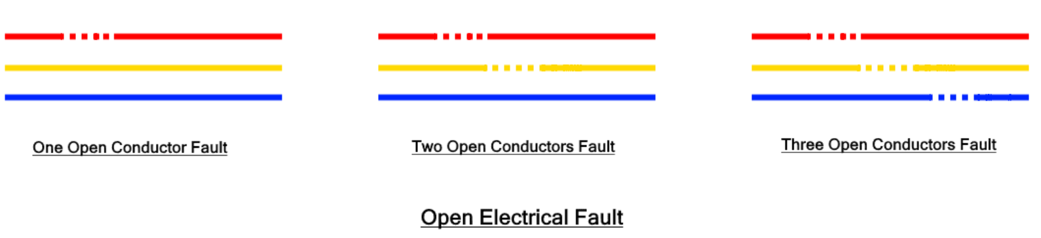
Open Circuit Fault

Slide 31
Open Circuit Fault
An open circuit fault is an asymmetrical fault that causes an imbalance in the system except for the three open conductor faults.
The phase conductor may break due to loose joints, trees falling over the power lines in extreme weather conditions, fuse breaking in one or more than one phase, circuit breaker breaking in one phase, etc.
Suppose in a typical electrical power system, a single or two phases break, and the remaining phase conductors take the load current of the broken phases.
Therefore the current flowing through the intact phases increase while there is no current through the broken phases creating imbalance.

Slide 32
Open Circuit Fault
And the other phases overload causing to rise in temperature.
The imbalanced current damages the connected equipment.
MPCB (motor protection circuit breaker) and overcurrent relays are used for the protection of motors and equipment against open circuit fault.
Open circuit faults are less severe compared to short circuit faults since a system can tolerate them for a longer period without facing any failure. But these faults must be removed as soon as possible as they can deteriorate the life span of the equipment.

Slide 33
Short Circuit Fault
A short circuit fault occurs when two or more than two phase conductor comes into contact with each other or with the ground conductor.
The impedance between these conductors falls to zero and a huge amount of current called short circuit current or fault current flows through the lines.
Short circuit fault is the most severe form of fault and it can cause severe damage to lines and equipment even if it stays for a very short duration.

Slide 34
Short Circuit Fault
The reason for short circuit fault is the breakdown of insulation due to aging, overloading, lines breaking on each other due to storms or falling trees in extreme weather conditions, and stress of heavy machinery upon underground power cables.
Fuse and circuit breakers are used for protection against short circuit fault.
Short circuit faults can be classified into asymmetrical and symmetrical faults.

Slide 35
Asymmetrical Fault
An asymmetrical fault is such a type of fault that causes an imbalance in the power system.
Such fault creates asymmetrical currents in the circuit that has a different magnitude and different phases.
Such fault occurs in a three-phase power system.
Asymmetrical faults are the most common type of faults in three-phase power systems which are relatively less severe as compared to a symmetrical faults.
There are three types of asymmetrical faults:
L-G Fault
L-L Fault
L-L-G Fault

Slide 36
Single Line to Ground (L-G) Fault
Such fault occurs when any one of the three phases is short-circuited or comes into contact with the ground.
There is a very small impedance between them called the fault impedance Z_{f} .
The phase conductor makes physical contact with the ground conductor or fell to the ground.
These faults are the most occurring type of fault in the phase power system with a 70 – 80% chance of occurrence.

Slide 37
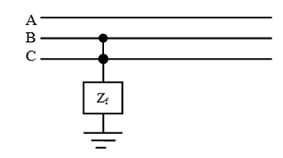
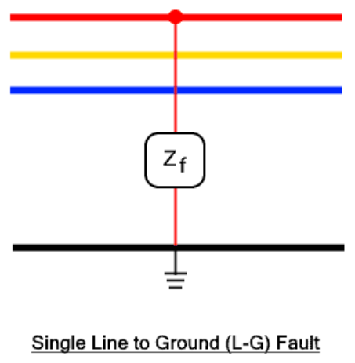
Single Line to Ground (L-G) Fault
And they are less severe as compared to other faults.
This fault occurs due to extreme weather conduction such as lightning, storms, and trees coming into contact with the power lines creating a short circuit with the ground.
In such a fault, the phase voltage drop while the phase current increases called a short circuit or fault current.

Slide 38
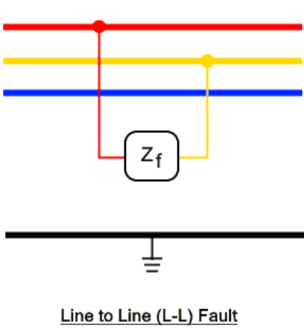
Line to Line (L-L) Fault
Therefore L-L fault is more severe than the L-G fault but less severe than other faults.
The probability of occurrence of L-L fault is about 15 – 20%

Slide 39
Line to Line (L-L) Fault
A line-to-line fault occurs when two phase conductors come into contact with each other by any means accidentally or intentionally.
The impedance between the shorted phase conductors is zero.
The fault current is larger as compared to the L-G fault due to the high potential difference between phases.

Slide 40
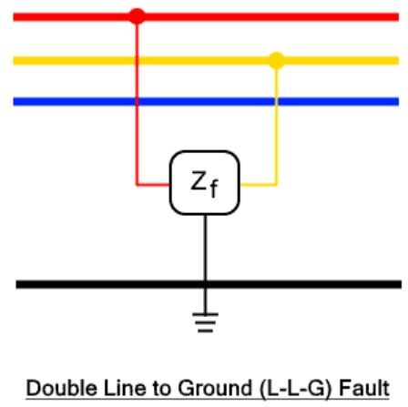
Double Line to Ground (L-L-G) Fault
Such fault occurs when any of the two phases come in contact with the ground.
The phase conductors are also shorted together as well as with the ground.
It is the most severe kind of asymmetrical fault with a very less chance of occurrence about 5 – 10%.

Slide 41
Double Line to Ground (L-L-G) Fault
Symmetrical fault or balanced fault occurs when all three phases of a power system are involved in the fault.
In other words, the electrical system remains balanced during such faults i.e. the fault current has a similar magnitude and has 120° phase difference.
The fault affects each phase equally.
The fault current is very large but the chance of occurrence is very low.
There are two types of symmetrical faults:
Line – line – line(L-L-L) Fault.
Line – line – line – ground (L-L-L-G) Fault.

Slide 42
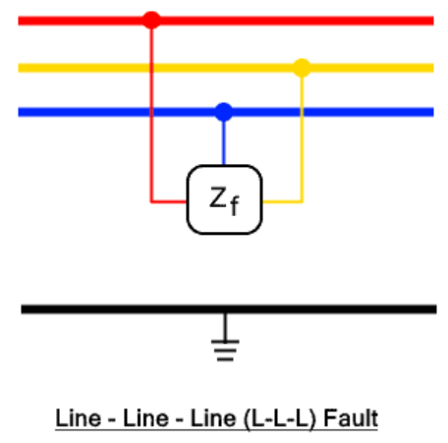
Line-Line-Line (L-L-L) Fault
Such symmetrical fault occurs when all three phases are shorted together.
They physically touch each other with zero impedance between them.
The fault current is similar in all three phases.
Thus known as symmetrical it balanced fault.
This type of fault is the most severe fault with a very large fault current and the lowest chance of occurrence with a probability below 1%.
The fault current is used for the rating of a circuit breaker.

Slide 43
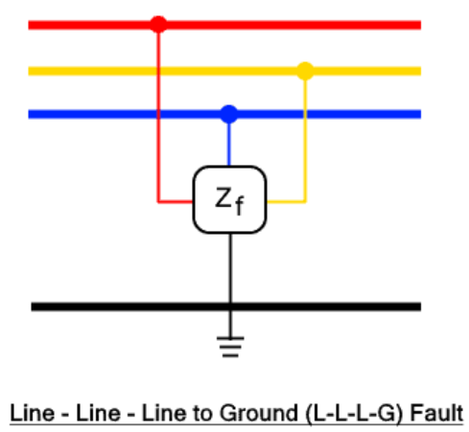
Line-Line-Line to Ground (L-L-L-G) Fault
Such fault occurs when all three phases are shorted together with the ground of the system.
The chance of occurrence of such fault is 2 – 3%.

Slide 44
Causes of Faults in Electrical Power System
Weather Condition:
Extreme weather conditions affect the power lines in many ways that lead to electrical faults. These causes include:
Lightning strike hitting the power lines.
Heavy rain in the monsoon season.
Storm, heavy wind and trees falling on the power lines.
Earthquake.
Flood.
Snowfall forms ice over the power lines.
Fire.
Such weather conditions can damage the generation, transmission, and appliances connected to a power system.

Slide 45
Causes of Faults in Electrical Power System
Equipment Failure:
Any kind of abnormality in any equipment, transmission cables, generation station, appliances, or loads connected in an electrical system can cause an electrical fault due to the following reasons.
Insulation failure of cables and windings in the motor.
Aging and degradation of conductor.
Malfunctioning.
Physical damage.

Slide 46
Causes of Faults in Electrical Power System
Human Error:
There are certain safety rules and regulations that must be followed when installing any power system.
However human error can still cause faults due to:
Installing devices and components of improper ratings.
Improper maintenance.
Switching circuit during its maintenance.
Human error can be reduced to a great extent by following electrical codes and allowing professionals to do their job.

Slide 47
Causes of Faults in Electrical Power System
Miscellaneous:
Here are some miscellaneous causes for the electrical fault:
The air ionizes due to the particles in the smoke of fire surrounding the overhead lines. The ions create a conducting path between the lines creating sparks between them. The flashover is a very common failure in insulators where it loses its insulating capacity.
Stress on power lines: the mechanical stress such as bending, flexing, and thermal stress acting on power lines causes electrical failure.

Slide 48
Causes of Faults in Electrical Power System
Miscellaneous:
Switching surges: Due to sudden switching of a circuit breaker, voltage surges are created in the circuit that causes overvoltage
Accidents: any accidents involving vehicles hitting the utility pole.
Birds shorting the power lines.
Strings and snakes shorting the power lines.
Chemical pollution corrodes and reduces the life of conductors.

Slide 49
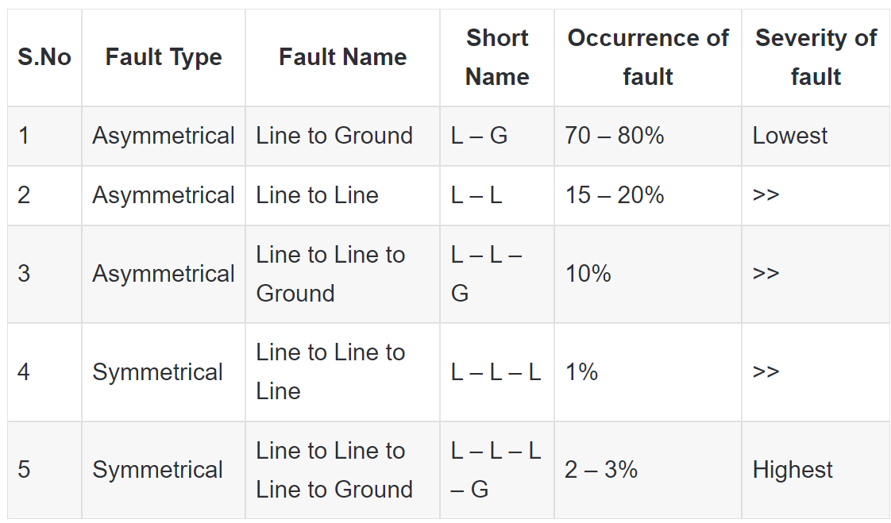
Severity And Occurrence of Faults

