Slide 1
























Slide 2


































Slide 3



















































Slide 4




















Slide 5






































Slide 6









































Slide 7






























































Slide 8



















Slide 9

























Slide 17






























































Slide 18



















































Slide 19












































Slide 20










Slide 21




































































































Slide 22












































Slide 23
























Slide 24
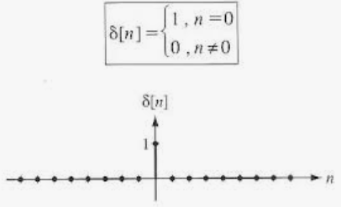
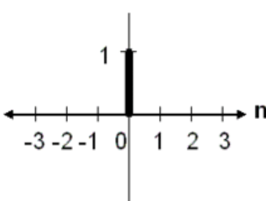

$Q:Find the Z−Transform of Delta δ$[n] Function
$$X\left(z\right)=Z\left[δ\text{[}\text{n}\text{]}\right]=\sum_{n=−∞}^{∞}{x[n]z^{−n}}=\sum_{n=−∞}^{∞}{δ\text{[}\text{n}\text{] }z^{−n}}=δ\text{[}\text{-2}\text{] }z^{−(−2)}+δ\text{[}\text{-1}\text{] }z^{−(−1)}+δ\text{[}\text{0}\text{] }z^{−(0)}+δ\text{[}\text{1}\text{] }z^{−(1)}+δ\text{[}\text{2}\text{] }z^{−(2)}$$
$$X\left(z\right)=Z\left[δ\text{[}\text{n}\text{]}\right]=\sum_{n=−∞}^{∞}{δ\text{[}\text{n}\text{] }z^{−n}}=0∗ z^{−\left(−2\right)}+0∗z^{−\left(−1\right)}+1∗ z^{−\left(0\right)}+0∗z^{−\left(1\right)}+0∗ z^{−(2)}$$
$$X\left(z\right)=Z\left[δ\text{[}\text{n}\text{]}\right]=0+0+1∗ 1+0+0=1$$
$$X\left(z\right)=Z\left[δ\text{[}\text{n}\text{]}\right]=1$$
Thus, Z-transform of the delta function is 1 ------------ Answer

Slide 25

$Q:Find the Z−Transform of Delta Aδ$[n] Function
$$X\left(z\right)=Z\left[Aδ\text{[}\text{n}\text{]}\right]=\sum_{n=−∞}^{∞}{x[n]z^{−n}}= \sum_{n=−∞}^{∞}{Aδ\text{[}\text{n}\text{] }z^{−n}}=Aδ\text{[}\text{-2}\text{] }z^{−(−2)}+Aδ\text{[}\text{-1}\text{] }z^{−(−1)}+Aδ\text{[}\text{0}\text{] }z^{−(0)}+Aδ\text{[}\text{1}\text{] }z^{−(1)}+Aδ\text{[}\text{2}\text{] }z^{−(2)}$$
$$X\left(z\right)=Z\left[Aδ\text{[}\text{n}\text{]}\right]=\sum_{n=−∞}^{∞}{Aδ\text{[}\text{n}\text{] }z^{−n}}=A∗0∗ z^{−\left(−2\right)}+A∗0∗z^{−\left(−1\right)}+A∗1∗ z^{−\left(0\right)}+A∗0∗z^{−\left(1\right)}+A∗0∗ z^{−(2)}$$
$$X\left(z\right)=Z\left[Aδ\text{[}\text{n}\text{]}\right]=0+0+A∗1∗ 1+0+0=A$$
$$X\left(z\right)=Z\left[Aδ\text{[}\text{n}\text{]}\right]=A$$
Thus, Z-transform of the delta function is A ------------ Answer

Slide 26























Slide 27























































Slide 28










































Slide 29






















































Slide 30



























Slide 31

























Slide 32














































Slide 33


















































Slide 34


















































