Slide 1
FFT Algorithm
Dr. Wazir Muhammad
Chairman
BMED
BUET, Khuzdar

Slide 2
Fast Fourier Transform (FFT)
The Fast Fourier Transform (FFT) is a highly efficient algorithm for computing the Discrete Fourier Transform (DFT) and its inverse.
It transforms a sequence of data from the time domain into the frequency domain.
This capability is essential in various fields, including engineering, audio processing, and medical imaging.

Slide 3
Applications of Fast Fourier Transform (FFT)
Signal Processing
FFT is widely used to analyze audio signals, allowing for tasks such as noise reduction and audio compression.
By transforming audio data into the frequency domain, engineers can manipulate specific frequency ranges to enhance sound quality or reduce file sizes.
Image Processing
In imaging applications, FFT helps in compressing images and enhancing features by analyzing spatial frequencies.
This technique is fundamental in medical imaging technologies like MRI and CT scans
Communications
FFT plays a vital role in digital communications, including antenna communications and GPS systems, by enabling efficient modulation and demodulation of signals.
Scientific Computing
The algorithm is employed in solving partial differential equations (PDEs), making it invaluable for simulations in physics and engineering

Slide 4
Q: Can we apply FFT on odd (3,5,7,9) point DFT?
Ans: No, Because it can not create. pairs

Slide 5
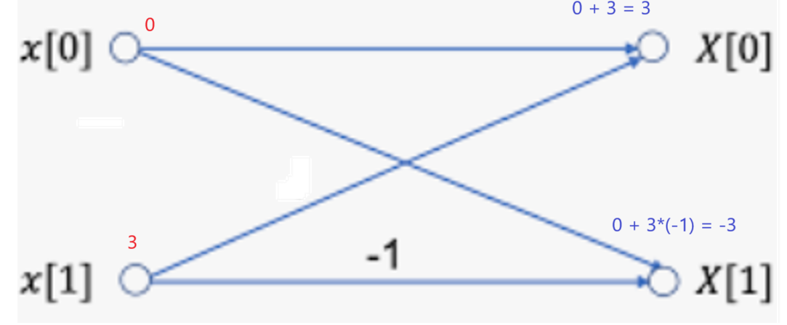

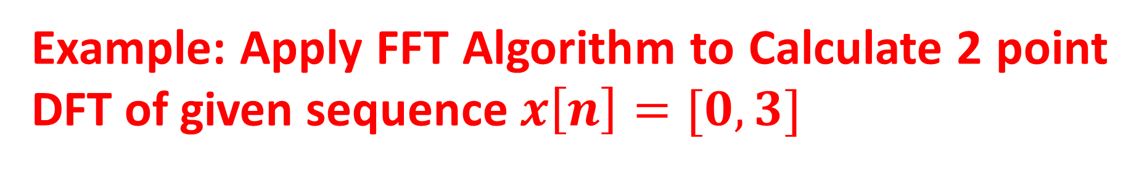
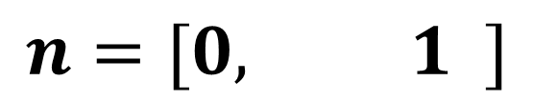
Example: Apply FFT Algorithm to Calculate 2 point DFT of given sequence $x\left[n\right]=[0, 3]$
SOLUTION
$$x\left[n\right]=[0, 3]$$
$$n=[0, 1 ]$$
$$X\left[k\right]=\left[X\left(0\right), X\left(1\right)\right]=\left[3, −3\right] Answer$$

Slide 6
Bit Reversal Order
S.NO | Input |  | Output | Bit Reversal | New S.NO
0 | 0 | 0 | 00 | 00 | 0
1 | 0 | 1 | 01 | 10 | 2
2 | 1 | 0 | 10 | 01 | 1
3 | 1 | 1 | 11 | 11 | 3
S.NO | Input |  | Output | Bit Reversal | New S.NO
X(0) | 0 | 0 | 00 | 00 | X(0)
X(1) | 0 | 1 | 01 | 10 | X(2)
X(2) | 1 | 0 | 10 | 01 | X(1)
X(3) | 1 | 1 | 11 | 11 | X(3)

Slide 7
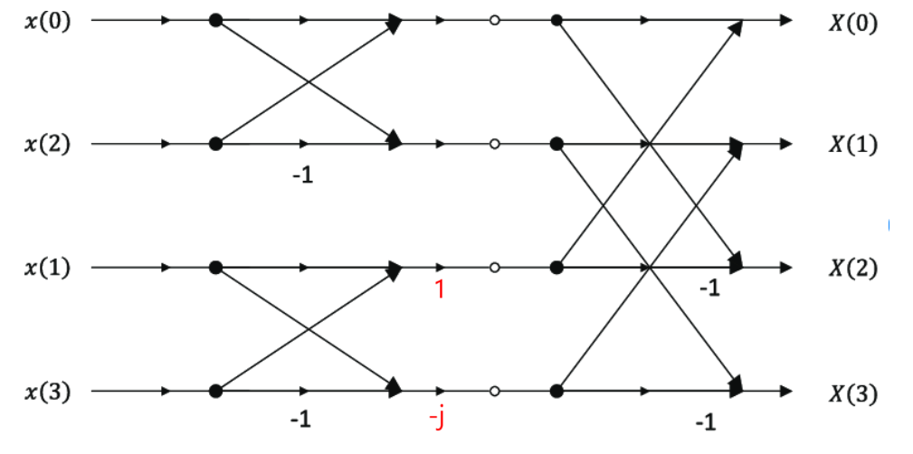
4-POINT DFT BUTTERFLY GRAPH

Slide 8
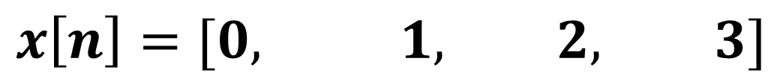
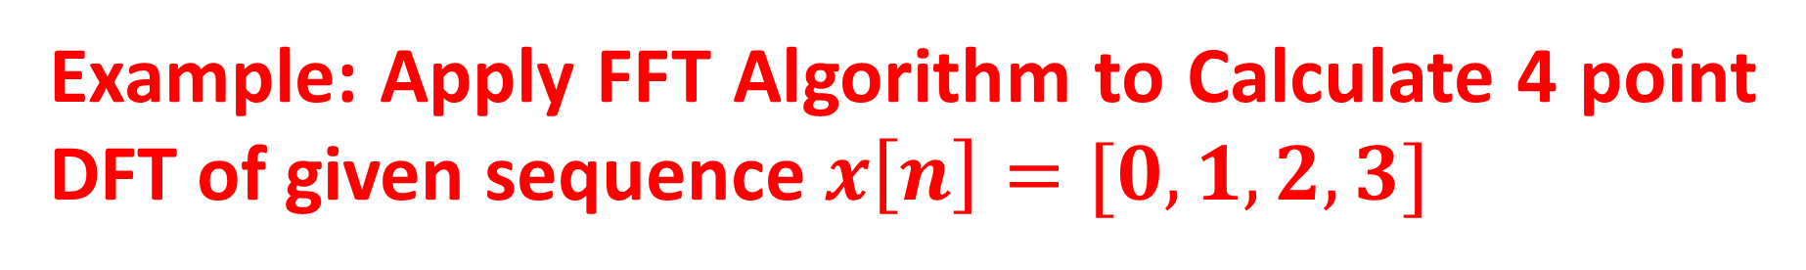
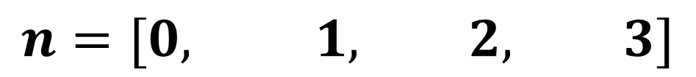
Example: Apply FFT Algorithm to Calculate 4 point DFT of given sequence $x\left[n\right]=[0, 1,2,3]$
SOLUTION
$$x\left[n\right]=[0, 1, 2, 3]$$
$$n=[0, 1, 2, 3]$$

Slide 9
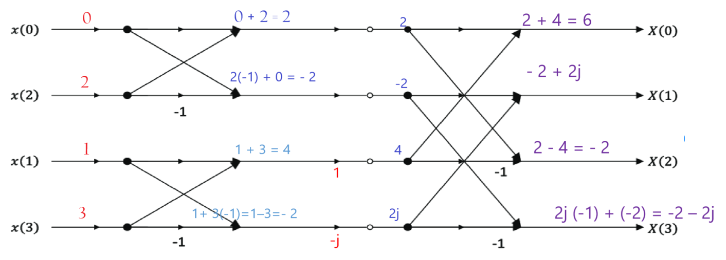
$$X\left[k\right]=\left[X\left(0\right), X\left(1\right), X\left(2\right), X(3)\right]=\left[6, −2+2j, −2, −2−2j\right] Answer$$

Slide 10
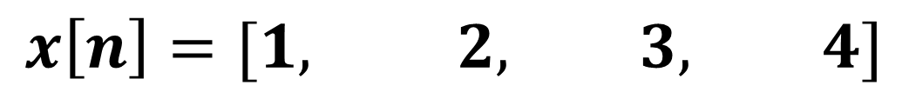
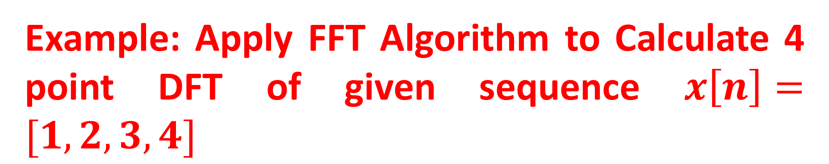
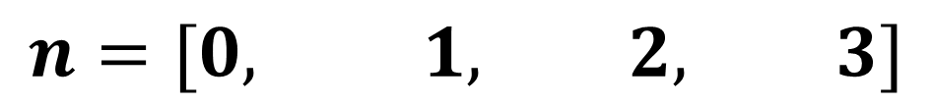
Example: Apply FFT Algorithm to Calculate 4 point DFT of given sequence $x\left[n\right]=[1,2,3,4]$
SOLUTION
$$x\left[n\right]=[1, 2, 3, 4]$$
$$n=[0, 1, 2, 3]$$

Slide 11
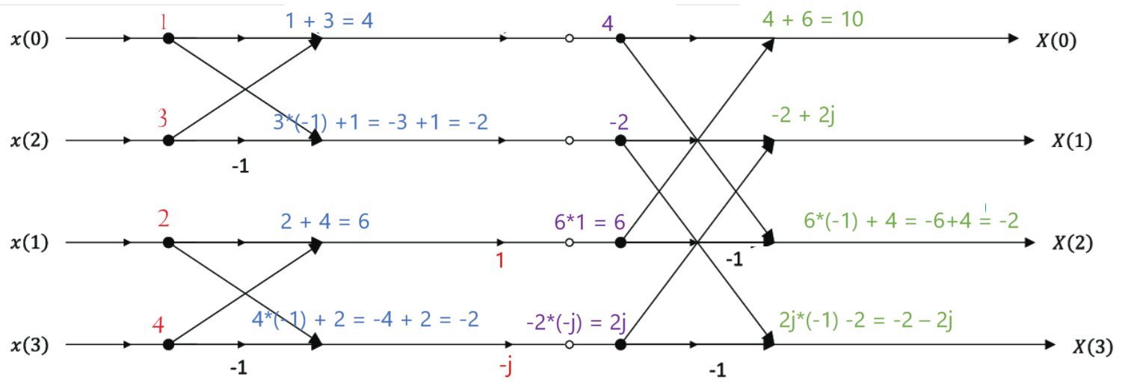
$$X\left[k\right]=\left[X\left(0\right), X\left(1\right), X\left(2\right), X(3)\right]=\left[10, −2+2j, −2, −2−2j\right] Answer$$

Slide 12
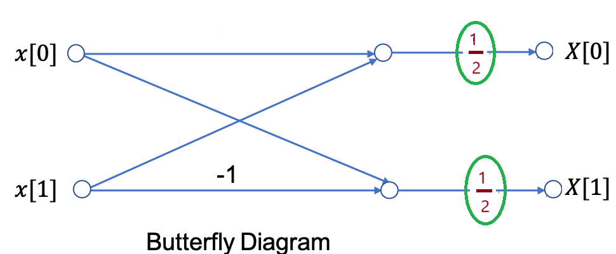
2-POINT IVERSE FAST FOURIER (IFFT) TRANSFORM BUTTERFLY DIAGRAM

Slide 13
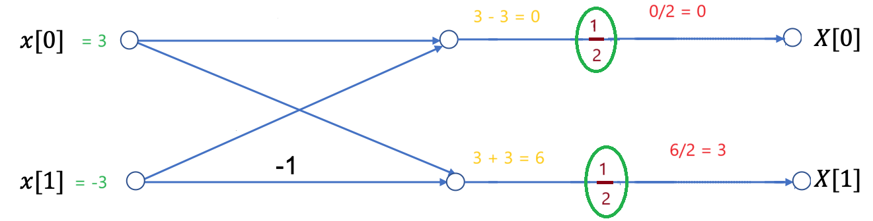

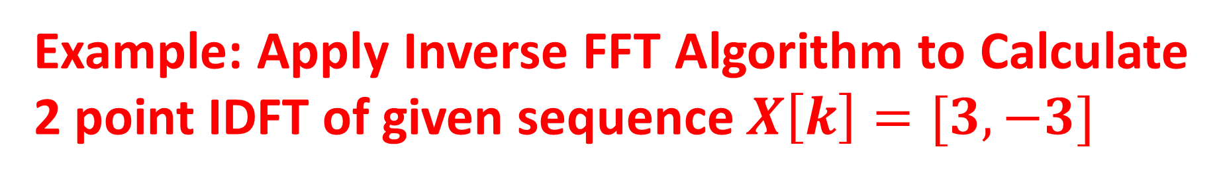
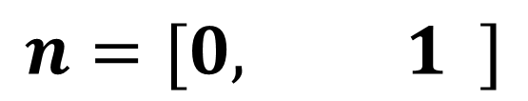
Example: Apply Inverse FFT Algorithm to Calculate 2 point IDFT of given sequence $X\left[k\right]=[3, −3]$
SOLUTION
$$x\left[n\right]=[3, −3]$$
$$n=[0, 1 ]$$
$$x\left[n\right]=\left[x\left(0\right), x\left(1\right)\right]=\left[0, 3\right] Answer$$

Slide 14
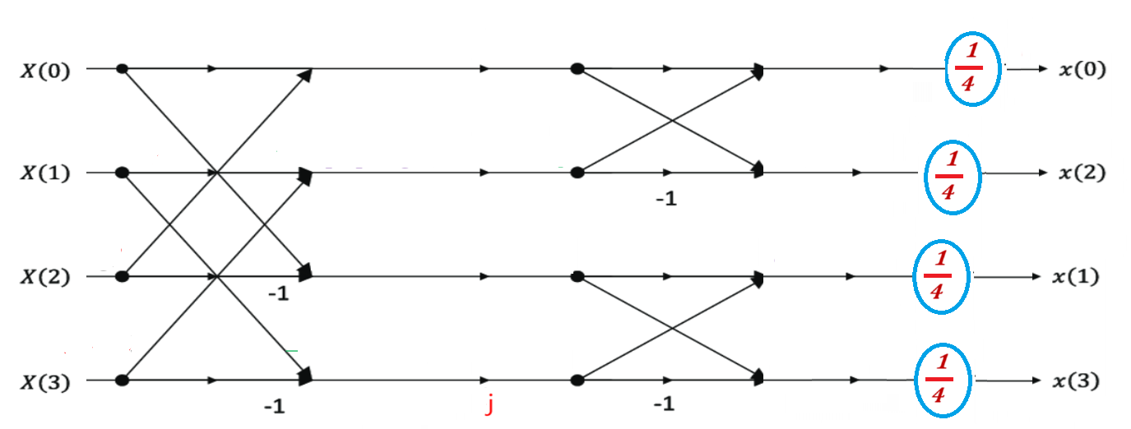
4-Point-Inverse Fast Fourier Transform (IFFT)
4-Point-FFT | 4-Point-IFFT
Stage 1 than Stage 2 | Stage 2 than Stage 1
Apply Bit Reversal on Input Side | Apply Bit Reversal on Output Side
-j | +j
Final Output multiply with 1 | Final Output multiply with 1/N (1/4)

Slide 15
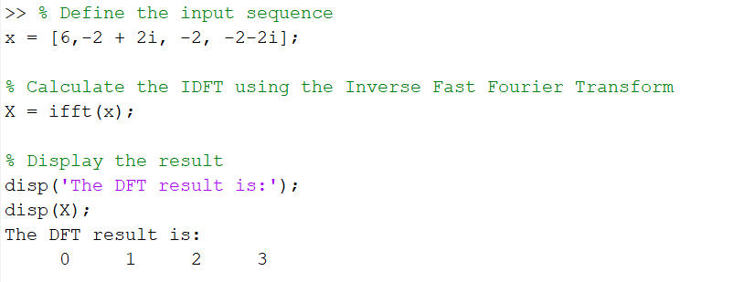
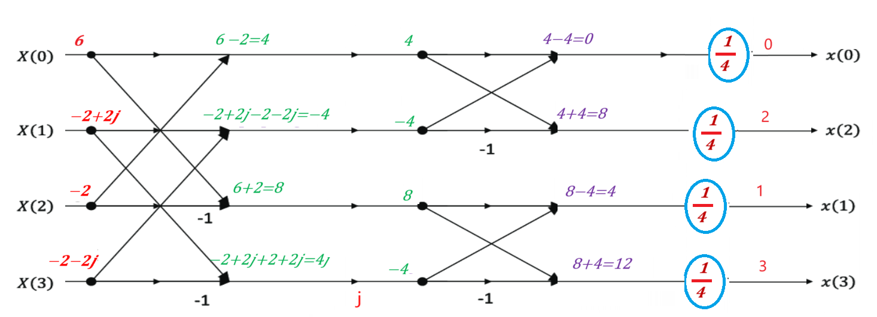

Example: Apply Inverse FFT Algorithm to Calculate 4 point IDFT of given sequence $X\left[k\right]=[6, −2+2j, −2, −2−2j]$
SOLUTION
$$X\left[k\right]=[6, −2+2j, −2, −2−2j]$$
$$k=[0, 1, 2, 3]$$
$$x(n) =\left[x\left(0\right), x\left(1\right), x\left(2\right), x(3)\right]=\left[0, 1, 2, 3\right] Answer$$

Slide 16
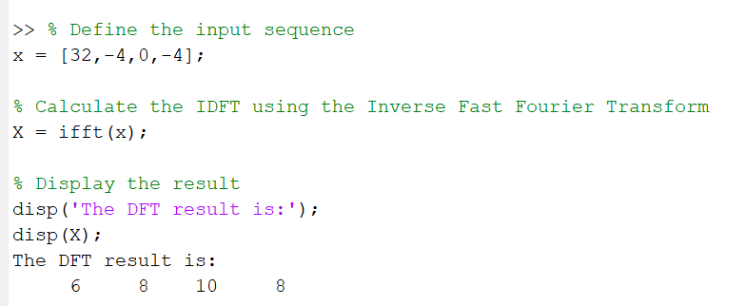
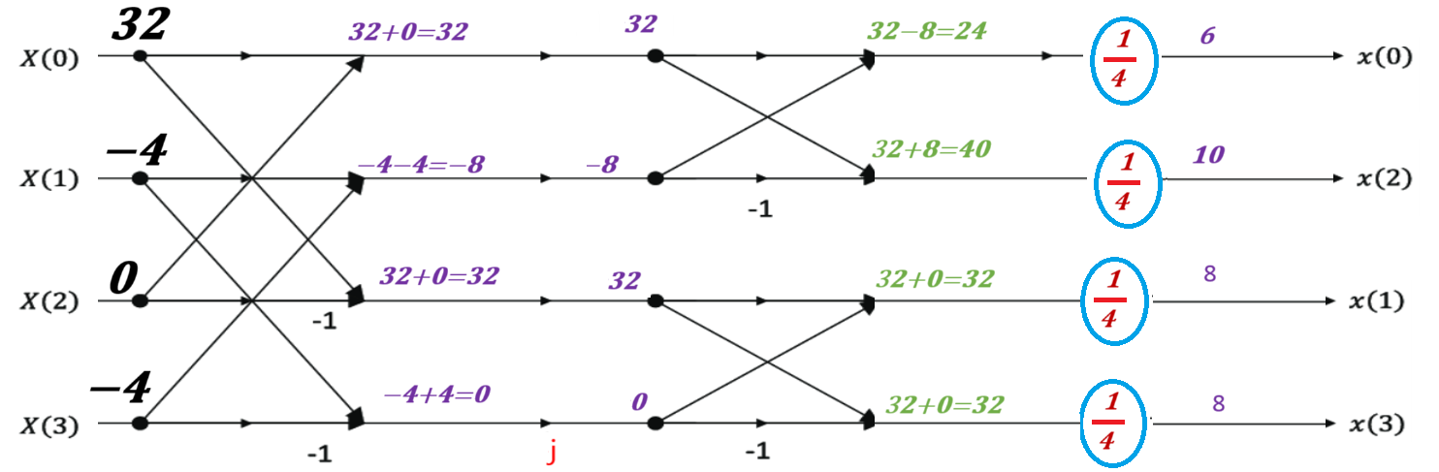
Example: Apply Inverse FFT Algorithm to Calculate 4 point IDFT of given sequence $X\left[k\right]=[32, −4, 0, −4]$
SOLUTION
$$X\left[k\right]=[32, −4, 0 , −4]$$
$$k=[0, 1, 2, 3]$$
$$x(n) =\left[x\left(0\right), x\left(1\right), x\left(2\right), x(3)\right]=\left[6, 8, 10, 8\right] Answer$$

