Slide 1
DFT Discrete Fourier Transform

Slide 2
Finite And Infinite Sequence
Finite Sequence | Infinite Sequence
It is a sequence having a last term is known as Finite Sequence. | It is a sequence having no last term is known as Infinite Sequence.
100, 99, 98, 97 | 3,6,12,24,48, …
12, 15, 17, 19, 21, . . . , 27 | 3, 5, 7, 9, 11, …
100, 99, 98, 97 | 3,6,12,24,48, …
5, 5, 5, 5 | 1, -1, 1, -1, . . .

Slide 3
Q: Is the sequence (-9, -6, -3, 0, . . . , -21)
SOLUTION
$$Sequence=\left(−9, −6, −3, , 0, 3, 6, 9, 12, 15, 18, 21\right)$$
Sequence have 11 items, so sequence is finite

Slide 4
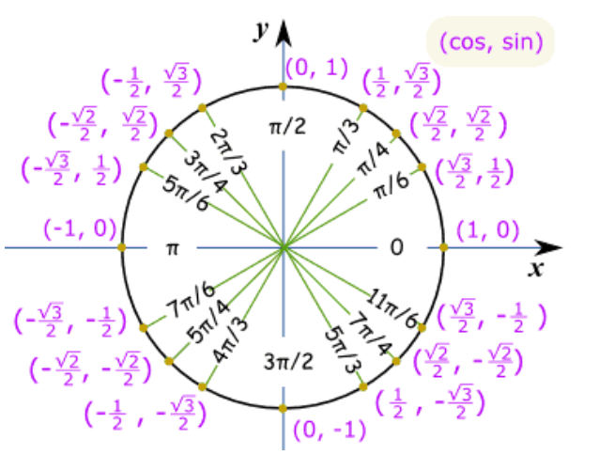

Slide 5
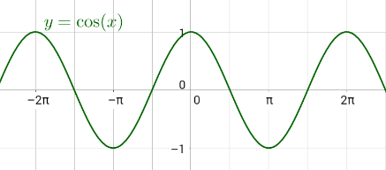
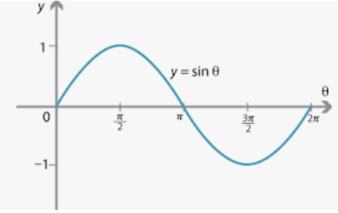



Euler’s Formula
$$e^{jθ}=cosθ+jsinθ (A)$$
$$Put θ= π in equation (A)$$
$$e^{jπ}=−1+j0=−1$$
OR
$$e^{−jπ}=\cos\left(−π\right)+jsin\left(−π\right)=cosπ−jsinπ=\left(−1\right)−j\left(0\right)=−1$$

Slide 6
Difference Between Z and DFT Transformation
The Z-transform and the Discrete Fourier Transform (DFT) are both mathematical tools used in signal processing.
Z Transform used for both Finite and Infinite length of sequence.
DFT is specifically designed for finite-length sequences.

Slide 7
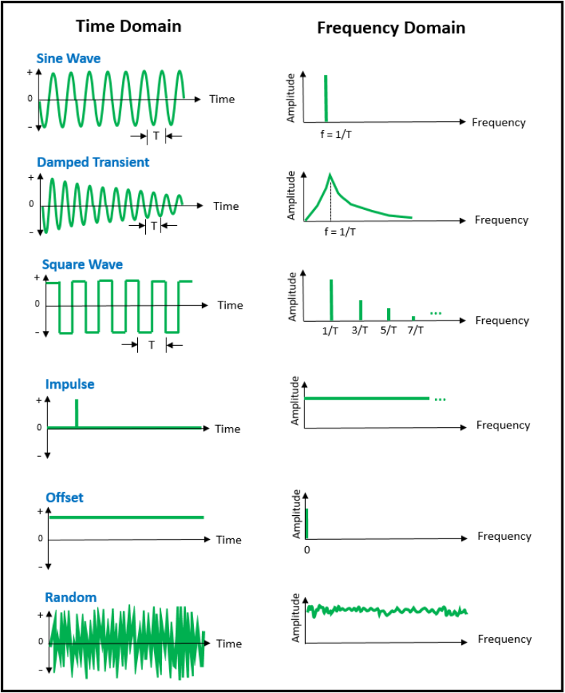
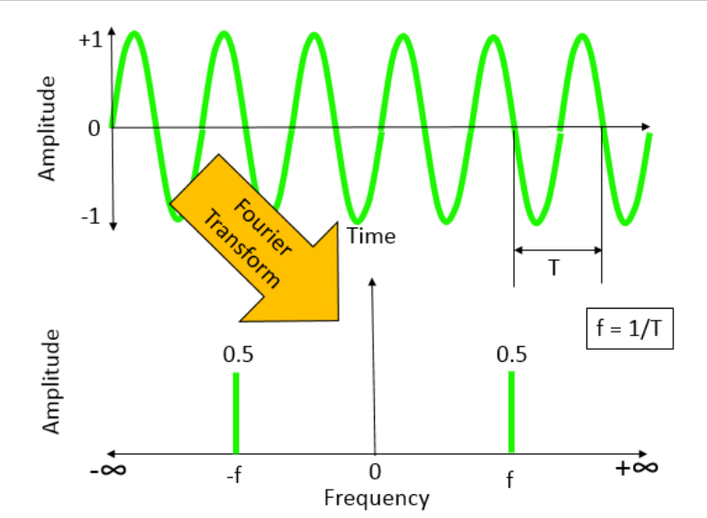
Shapes of Signals in Time Domain and in Frequency Domain

Slide 8
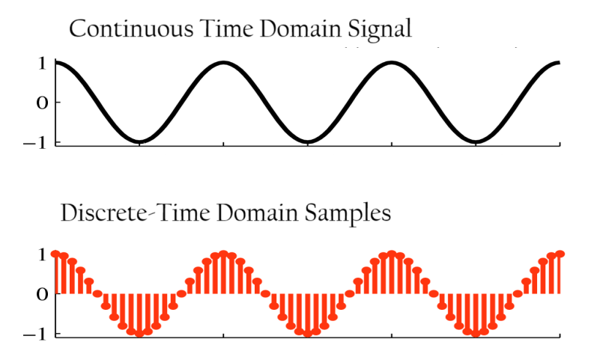
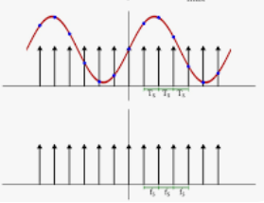
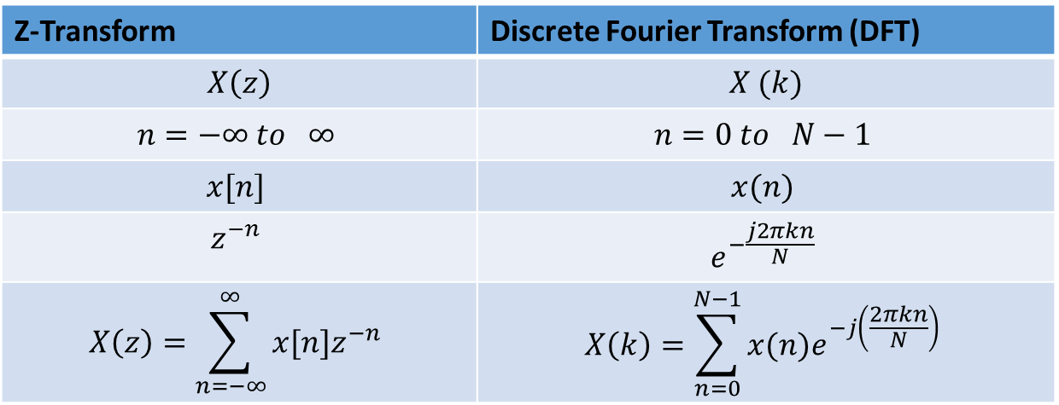
Discrete Fourier Transform (DFT)
The Discrete Fourier Transform (DFT) is primarily used to convert a sequence of discrete time-domain samples into their corresponding frequency-domain representation.
Z-Transform | Discrete Fourier Transform (DFT)
$$X\left(z\right)$$ | $$X (k)$$
$$n=−∞ to ∞$$ | $$n=0 to N−1$$
$$x[n]$$ | $$x(n)$$
$$z^{−n}$$ | $$e^{−\frac{j2πkn}{N}}$$
$$X\left(z\right)=\sum_{n=−∞}^{∞}{x[n]z^{−n}}$$ | $$X\left(k\right)=\sum_{n=0}^{N−1}{x(n)e^{−j\left(\frac{2πkn}{N}\right)}}$$

Slide 9
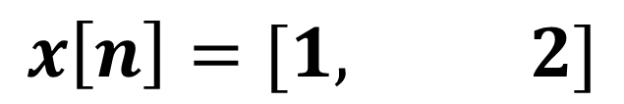
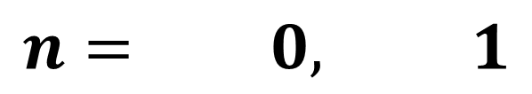

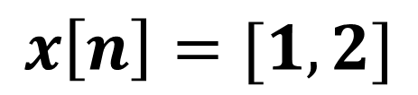
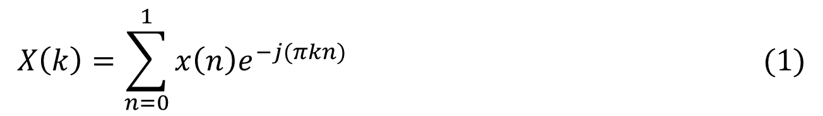
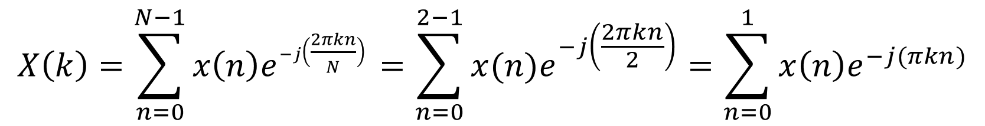
Example: Calculate the 2-point Discrete Fourier Transform (DFT) of given sequence $x\left[n\right]=[1,2]$
$$x\left[n\right]=[1,2]$$
SOLUTION
$$x\left[n\right]=[1, 2]$$
X(0) = 1
X(1) = 2
$$n= 0, 1$$
STEP:-1: Check Length of Sequence is = N = 2, then value of k is also two, k = 0, 1
$$X\left(k\right)=\sum_{n=0}^{N−1}{x\left(n\right)e^{−j\left(\frac{2πkn}{N}\right) }=\sum_{n=0}^{2−1}{x(n)e^{−j\left(\frac{2πkn}{2}\right)}}=\sum_{n=0}^{1}{x\left(n\right)e^{−j(πkn)}}}$$
$$X\left(k\right)=\sum_{n=0}^{1}{x\left(n\right)e^{−j(πkn)} (1)}$$

Slide 10
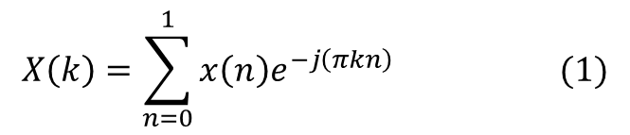
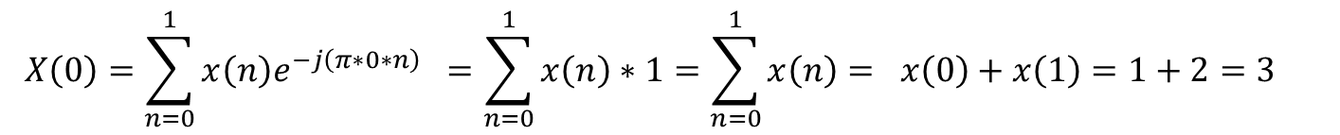
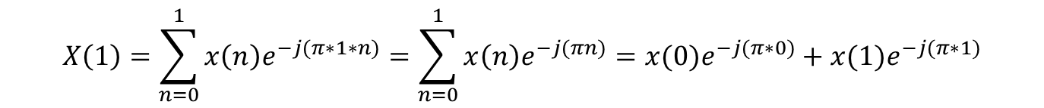
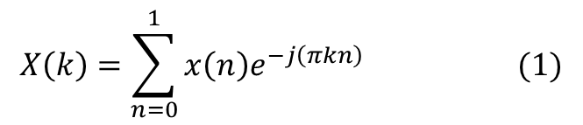
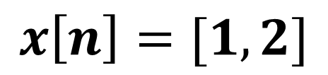
$$x\left[n\right]=[1,2]$$
STEP:-2: Put k = 0 in equation (1)
$$X\left(k\right)=\sum_{n=0}^{1}{x\left(n\right)e^{−j\left(πkn\right)} (1)}$$
X(0) = 1
X(1) = 2
$$X\left(0\right)=\sum_{n=0}^{1}{x\left(n\right)e^{−j\left(π∗0∗n\right)} }=\sum_{n=0}^{1}{x\left(n\right)∗1=\sum_{n=0}^{1}{x\left(n\right)= x\left(0\right)+x\left(1\right)=1+2=3 }}$$
STEP:-2: Put k = 1 in equation (1)
$$X\left(k\right)=\sum_{n=0}^{1}{x\left(n\right)e^{−j\left(πkn\right)} (1)}$$
$$X\left(1\right)=\sum_{n=0}^{1}{x\left(n\right)e^{−j(π∗1∗n)}=\sum_{n=0}^{1}{x\left(n\right)e^{−j(πn)}=x(0)e^{−j(π∗0)}+x(1)e^{−j(π∗1)}}}$$
$$X\left(1\right)=x\left(0\right)e^{−j(π∗0)}+x\left(1\right)e^{−j(π∗1)}=1∗1+2∗e^{−j(π)}=1+2e^{−j(π)}$$
$$X\left(1\right)=1+2e^{−jπ}=1+2 \left(−1\right)=1 −2=−1$$
$$X\left[k\right]=\left[X\left(0\right), X\left(1\right)\right]=\left[3, −1\right] Answer$$

Slide 11
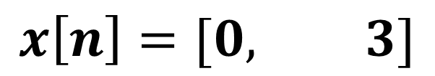
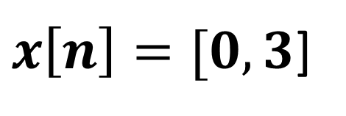

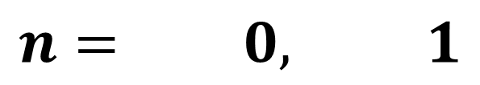
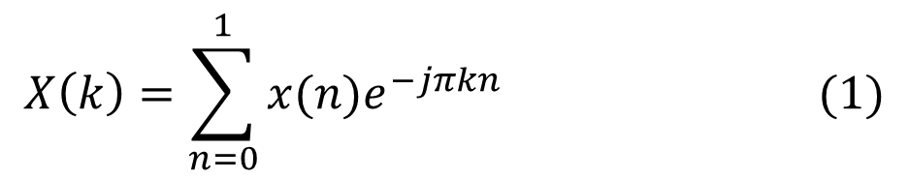
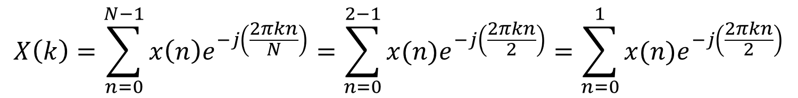
Example: Calculate the 2-point Discrete Fourier Transform (DFT) of given sequence $x\left[n\right]=[0,3]$
$x\left[n\right]=[0,3$]
SOLUTION
$$x\left[n\right]=[0, 3]$$
X(0) = 0
X(1) = 3
$$n= 0, 1$$
STEP:-1: Check Length of Sequence is = N = 2, then value of k is also two, k = 0, 1
$$X\left(k\right)=\sum_{n=0}^{N−1}{x\left(n\right)e^{−j\left(\frac{2πkn}{N}\right)}=\sum_{n=0}^{2−1}{x(n)e^{−j\left(\frac{2πkn}{2}\right)}}=\sum_{n=0}^{1}{x(n)e^{−j\left(\frac{2πkn}{2}\right)}}}$$
$$X\left(k\right)=\sum_{n=0}^{1}{x(n)e^{−jπkn}} (1)$$

Slide 12

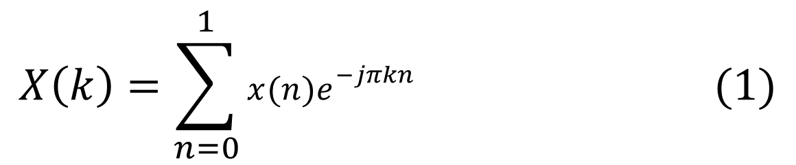
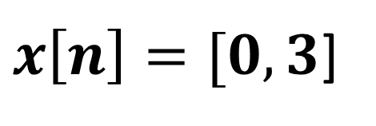
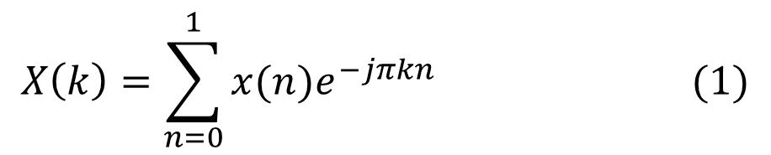
$x\left[n\right]=[0,3$]
STEP:-2: Put k = 0 in equation (1)
$$X\left(k\right)=\sum_{n=0}^{1}{x(n)e^{−jπkn}} (1)$$
X(0) = 0
X(1) = 3
$$X\left(0\right)=\sum_{n=0}^{1}{x(n)e^{−jπkn}}=\sum_{n=0}^{1}{x(n)e^{0}}=\sum_{n=0}^{1}{x\left(n\right)∗1=\sum_{n=0}^{1}{x\left(n\right)=x\left(0\right)+x\left(1\right)=0 +3=3}}$$
STEP:-2: Put k = 1 in equation (1)
$$X\left(k\right)=\sum_{n=0}^{1}{x(n)e^{−jπkn}} (1)$$
$$X\left(1\right)=\sum_{n=0}^{1}{x(n)e^{−jπkn}}=\sum_{n=0}^{1}{x(n)e^{−jπ∗1∗n}}=\sum_{n=0}^{1}{x(n)e^{−jπn}}$$
$$X\left(1\right)=x\left(0\right)e^{0}+x\left(1\right)e^{−jπ∗1}= x\left(0\right)∗1+x\left(1\right)e^{−jπ}$$

Slide 13
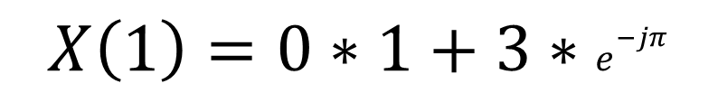
$x\left[n\right]=[0,3$]
$$X\left(1\right)=x\left(0\right)e^{0}+x\left(1\right)e^{−jπ∗1}= x\left(0\right)∗1+x\left(1\right)e^{−jπ}$$
X(0) = 0
X(1) = 3
$$X\left(1\right)=0∗1+3∗e^{−jπ}$$
$$X\left(1\right)=3∗e^{−jπ}=3∗e^{−j\left(π\right)}=3\left(−1+j0\right)=−3$$
$$X\left[k\right]=\left[X\left(0\right), X\left(1\right)\right]=\left[3,−3\right] Answer$$

Slide 14
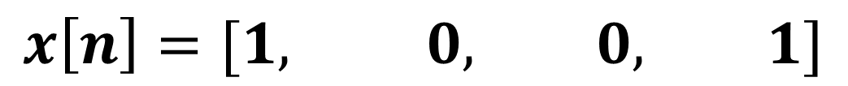
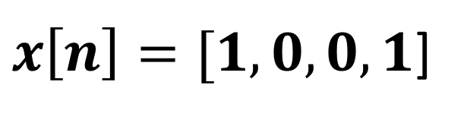

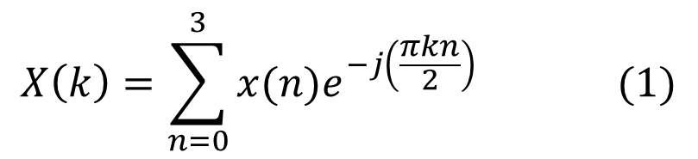
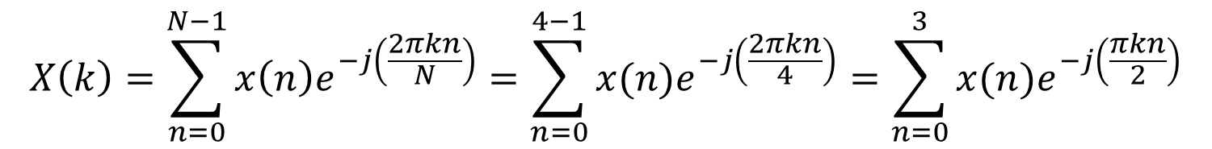
Example: Calculate the 4-point Discrete Fourier Transform (DFT) of given sequence $x\left[n\right]=[1,0,0,1]$
$x\left[n\right]=[1,0,0,1$]
SOLUTION
$$x\left[n\right]=[1, 0, 0, 1]$$
X(3) = 1
X(0) = 1
X(1) = 0
X(2) = 0
$$n= 0, 1, 2, 3$$
STEP:-1: Check Length of Sequence is = N = 4, then value of k is also two, k = 0, 1,2,3
$$X\left(k\right)=\sum_{n=0}^{N−1}{x\left(n\right)e^{−j\left(\frac{2πkn}{N}\right)}=\sum_{n=0}^{4−1}{x(n)e^{−j\left(\frac{2πkn}{4}\right)}}=\sum_{n=0}^{3}{x(n)e^{−j\left(\frac{πkn}{2}\right)}}}$$
$$X\left(k\right)=\sum_{n=0}^{3}{x(n)e^{−j\left(\frac{πkn}{2}\right)}} (1)$$

Slide 15
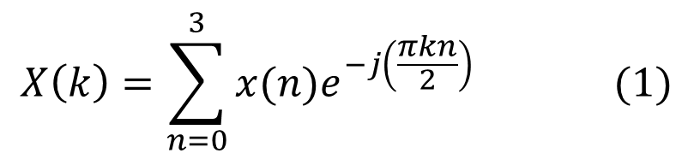
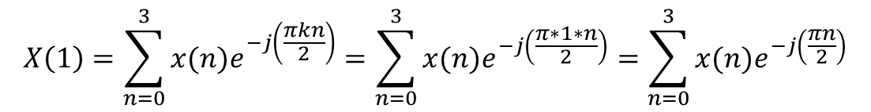
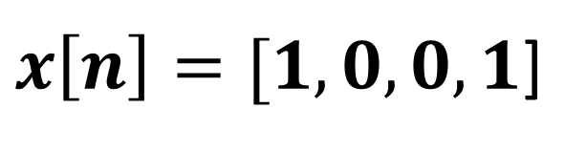
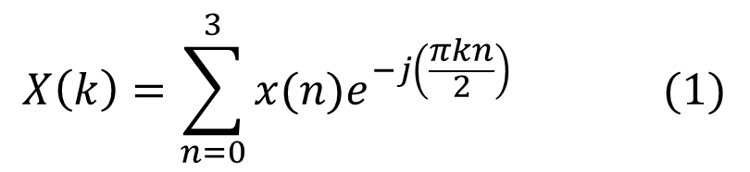
STEP:-2: Put k = 0 in equation (1)
$x\left[n\right]=[1,0,0,1$]
$$X\left(k\right)=\sum_{n=0}^{3}{x(n)e^{−j\left(\frac{πkn}{2}\right)}} (1)$$
X(3) = 1
X(0) = 1
X(1) = 0
X(2) = 0
$$X\left(0\right)=\sum_{n=0}^{3}{x(n)e^{−j\left(\frac{πkn}{2}\right)}}=\sum_{n=0}^{3}{x(n)e^{0}}=\sum_{n=0}^{3}{x\left(n\right)∗1=\sum_{n=0}^{3}{x\left(n\right)=x\left(0\right)∗1+x\left(1\right)∗1+x\left(2\right)∗1+x\left(3\right)∗1}}$$
$$X\left(0\right)=1∗1+0∗1+0∗1+1∗1=1+1=2$$
STEP:-2: Put k = 1 in equation (1)
$$X\left(k\right)=\sum_{n=0}^{3}{x(n)e^{−j\left(\frac{πkn}{2}\right)}} (1)$$
$$X\left(1\right)=\sum_{n=0}^{3}{x(n)e^{−j\left(\frac{πkn}{2}\right)}}=\sum_{n=0}^{3}{x(n)e^{−j\left(\frac{π∗1∗n}{2}\right)}}=\sum_{n=0}^{3}{x(n)e^{−j\left(\frac{πn}{2}\right)}}$$
$$X\left(1\right)=x\left(0\right)e^{0}+x\left(1\right)e^{−j\left(\frac{π∗1}{2}\right) }+x\left(2\right)e^{−j\left(\frac{π∗2}{2}\right) }+x\left(3\right)e^{−j\left(\frac{π∗3}{2}\right) }$$

Slide 16
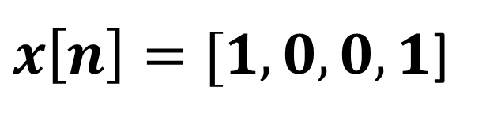
$$X\left(1\right)=x\left(0\right)e^{0}+x(1)e^{−j\left(\frac{π∗1}{2}\right) }+x\left(2\right)e^{−j\left(\frac{π∗2}{2}\right) }+x\left(3\right)e^{−j\left(\frac{π∗3}{2}\right) }$$
$x\left[n\right]=[1,0,0,1$]
$$X\left(1\right)=x\left(0\right)e^{0}+x\left(1\right)e^{−j\left(\frac{π}{2}\right) }+x\left(2\right)e^{−j\left(π\right) }+x\left(3\right)e^{−j\left(\frac{3π}{2}\right) }$$
X(3) = 1
X(0) = 1
X(1) = 0
X(2) = 0
$$X\left(1\right)=1∗1+0∗e^{−j\left(\frac{π}{2}\right) }+0∗e^{−j\left(π\right) }+1∗e^{−j\left(\frac{3π}{2}\right) }$$
$$X\left(1\right)=1+0+0+e^{−j\left(\frac{3π}{2}\right) }=1+(0−j) =1−j$$

Slide 17
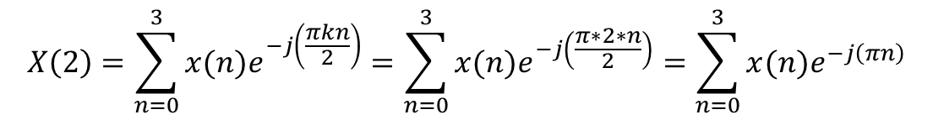
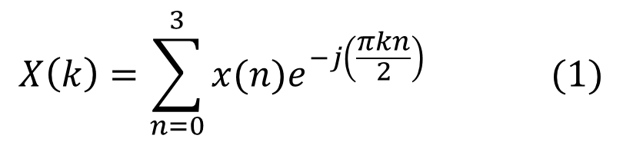
STEP:-2: Put k = 2 in equation (1)
$x\left[n\right]=[1,0,0,1$]
$$X\left(k\right)=\sum_{n=0}^{3}{x(n)e^{−j\left(\frac{πkn}{2}\right)}} (1)$$
X(3) = 1
X(0) = 1
X(1) = 0
X(2) = 0
$$X\left(2\right)=\sum_{n=0}^{3}{x(n)e^{−j\left(\frac{πkn}{2}\right)}}=\sum_{n=0}^{3}{x(n)e^{−j\left(\frac{π∗2∗n}{2}\right)}}=\sum_{n=0}^{3}{x(n)e^{−j\left(πn\right)}}$$
$$X\left(2\right)=x\left(0\right)e^{0}+x\left(1\right)e^{−j\left(π∗1\right)}+x\left(2\right)e^{−j\left(π∗2\right)}+x\left(3\right)e^{−j\left(π∗3\right)}$$
$$X\left(2\right)=1∗1+0∗e^{−j\left(π\right)}+0∗e^{−j\left(2π\right)}+1∗e^{−j\left(3π\right)}$$
$X\left(2\right)=1+0+0+1∗e^{−3j\left(π\right)}=1+[−1+j∗0$]
$X\left(2\right)=1+\left[−1+0\right]=1 −1=0$

Slide 18
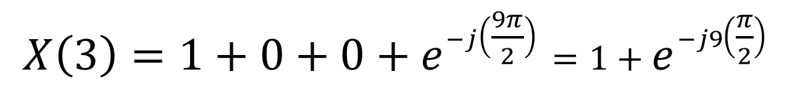
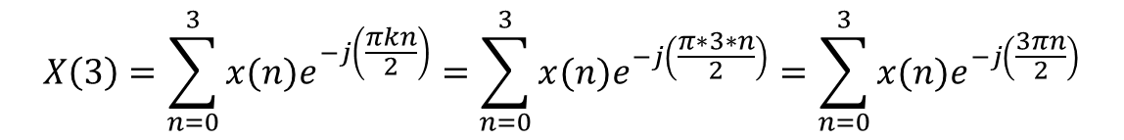
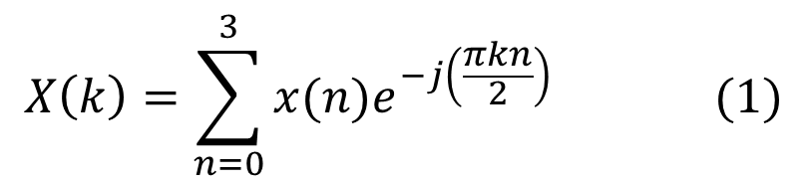
STEP:-2: Put k = 3 in equation (1)
$x\left[n\right]=[1,0,0,1$]
$$X\left(k\right)=\sum_{n=0}^{3}{x(n)e^{−j\left(\frac{πkn}{2}\right)}} (1)$$
X(3) = 1
X(0) = 1
X(1) = 0
X(2) = 0
$$X\left(3\right)=\sum_{n=0}^{3}{x(n)e^{−j\left(\frac{πkn}{2}\right)}}=\sum_{n=0}^{3}{x(n)e^{−j\left(\frac{π∗3∗n}{2}\right)}}=\sum_{n=0}^{3}{x(n)e^{−j\left(\frac{3πn}{2}\right)}}$$
$$X\left(3\right)=x\left(0\right)e^{0}+x\left(1\right)e^{−j\left(\frac{3π∗1}{2}\right)}+x\left(2\right)e^{−j\left(\frac{3π∗2}{2}\right)}+x\left(3\right)e^{−j\left(\frac{3π∗3}{2}\right)}$$
$$X\left(3\right)=1∗1+0∗e^{−j\left(\frac{3π}{2}\right)}+0∗e^{−j\left(\frac{6π}{2}\right) }+1∗e^{−j\left(\frac{9π}{2}\right)}$$
$$X\left(3\right)=1+0+0+e^{−j\left(\frac{9π}{2}\right)}=1+e^{−j9\left(\frac{π}{2}\right)}$$
$$X\left(3\right)=1+\left[0+1j\right]=1+j$$
$$X\left[k\right]=\left[X\left(0\right),X\left(1\right),X\left(2\right),X\left(3\right)\right]=\left[2, 1−j, 0, 1+j\right] Answer$$

