Slide 1
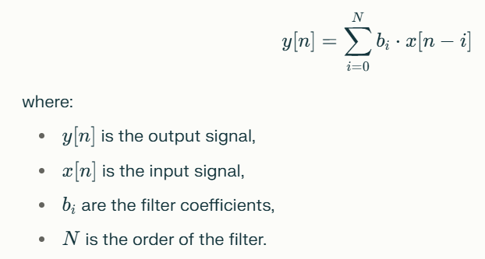
FIR Filter
FIR (Finite Impulse Response) filters are a fundamental class of digital filters widely used in signal processing applications due to their unique properties and advantages.
An FIR filter is characterized by a finite-duration impulse response, meaning that its output settles to zero after a specific period.
This is in contrast to Infinite Impulse Response (IIR) filters, which can produce outputs that continue indefinitely due to internal feedback.
The mathematical representation of an FIR filter for a causal discrete-time system can be expressed as:

Slide 2
Properties of FIR Filter
Stability: FIR filters are inherently stable since their output depends solely on a finite number of input values, preventing issues associated with feedback loops.
Linear Phase Response: FIR filters can be designed to have a linear phase response, which preserves the waveform shape of signals in the passband, making them ideal for applications where phase distortion is critical.
Ease of Design: Designing FIR filters is generally straightforward, as they can be implemented using simple algorithms involving multipliers and adders.

Slide 3
Applications of FIR Filter
FIR filters are utilized in various applications including:
Signal Processing: Used for filtering out unwanted noise or frequencies from signals.
Image Processing: Applied in tasks such as image smoothing and edge detection.
Communications: Employed in modulating and demodulating signals to ensure data integrity.

Slide 4
Advantages And Disadvantages of FIR Filter
Advantages:
Always stable and easy to implement.
Can achieve exact linear phase characteristics.
Suitable for real-time processing due to their predictable behavior.
Disadvantages:
Typically require a higher order (more coefficients) than IIR filters to achieve similar performance levels, leading to increased computational complexity.

Slide 5
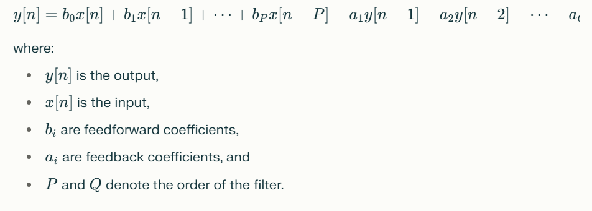
IIR Filter
IIR (Infinite Impulse Response) filters are a crucial class of digital filters used in Digital Signal Processing (DSP).
Their defining characteristic is that their impulse response extends indefinitely, meaning they can respond to an input signal over an infinite duration.
An IIR filter's output at any time n depends not only on the current and past input values but also on past output values, creating a feedback loop.
The general form of the difference equation for an IIR filter can be represented as:

Slide 6
Key Features of IIR Filter
Feedback Mechanism: The inclusion of feedback allows IIR filters to have a more complex response and enables them to achieve sharper transitions in frequency response with fewer coefficients compared to FIR filters.
Computational Efficiency: IIR filters typically require fewer calculations (lower order) to achieve similar performance levels as FIR filters, making them suitable for applications where computational resources are limited.
Phase Response: IIR filters generally exhibit a nonlinear phase response, which can introduce phase distortion in applications sensitive to timing, such as audio processing.

Slide 7
Advantages And Disadvantages of IIR Filter
Advantages
Efficiency: Achieve desired filtering effects with fewer coefficients and lower computational load.
Analog Filter Approximation: Can closely approximate analog filter designs, making them useful in applications that require digital implementations of existing analog systems.
Disadvantages
Stability Issues: If not designed carefully, IIR filters can become unstable, leading to oscillations and unwanted noise in the output.
Nonlinear Phase Response: This can be problematic for applications requiring precise phase relationships.

Slide 8
Applications of IIR Filter
Applications
IIR filters are widely used in various fields including:
Audio Processing: For equalization and dynamic range compression.
Communications: In modulation and demodulation processes.
Control Systems: For filtering signals in feedback loops.

Slide 9
Wiener Filter
The Wiener filter is a statistical tool used in signal processing to minimize the mean square error (MSE) between an estimated signal and the true signal, particularly in the presence of noise.
It is especially effective for restoring signals or images that have been degraded by additive noise and blurring.

Slide 10
Key Characteristics of Wiener Filter
Optimal Linear Filter: The Wiener filter is considered the optimal linear filter for estimating a desired signal from a noisy observation. It operates under the assumption that both the signal and noise are stationary random processes.
Mean Square Error Minimization: The primary objective of the Wiener filter is to minimize the MSE between the estimated output and the actual desired output. This makes it particularly useful in applications where preserving signal integrity is critical.
Frequency Domain Application: The Wiener filter is often applied in the frequency domain. The process involves taking the Discrete Fourier Transform (DFT) of the noisy signal, applying the Wiener filter in the frequency domain, and then performing an inverse DFT to obtain the filtered signal.
Adaptive Nature: The Wiener filter can adapt its behavior based on local image characteristics, allowing for more effective noise reduction in low-detail regions while preserving details in high-variance areas, such as edges.

Slide 11
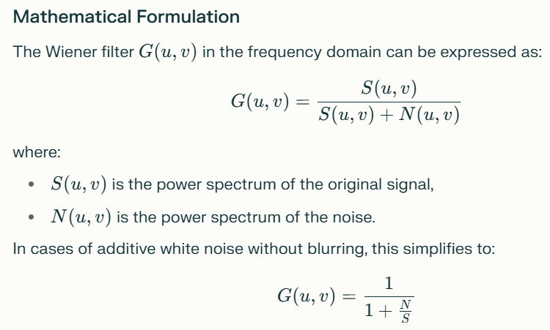
Key Characteristics of Wiener Filter

Slide 12
Applications And Limitations of Wiener Filter
Applications
Image Processing: Widely used for image denoising and restoration.
Audio Processing: Effective in reducing background noise from audio signals.
Communications: Utilized for channel equalization and echo cancellation.
Limitations
While powerful, Wiener filters have some limitations:
They cannot reconstruct frequency components that have been completely lost due to noise.
The performance heavily relies on accurate estimation of noise and signal statistics.

Slide 13
Bilinear Transformation
The bilinear transformation is a mathematical technique used to convert continuous-time systems represented in the Laplace domain into discrete-time systems in the Z-domain.
This transformation is particularly valuable in digital signal processing for designing digital filters based on analog prototypes.

Slide 14
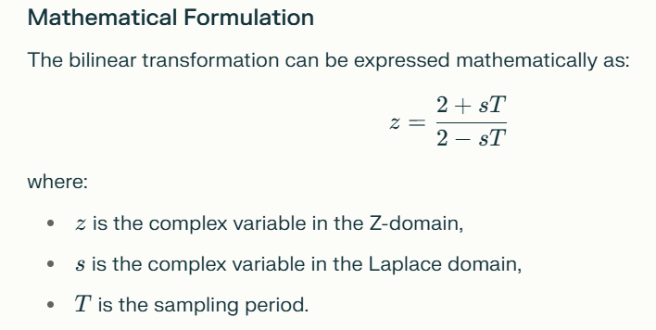
Key Features of Bilinear Transformation
Mapping: The bilinear transformation maps the entire s-plane (Laplace domain) to the z-plane (Z-domain), specifically mapping the imaginary axis of the s-plane onto the unit circle of the z-plane. This is crucial for maintaining stability and frequency characteristics during the transformation.
Frequency Warping: One of the notable effects of the bilinear transformation is frequency warping, which occurs because of the nonlinear mapping of frequencies. To compensate for this, a technique called frequency prewarping can be employed, allowing specific frequencies to be preserved during the transformation.
Stability Preservation: The bilinear transformation ensures that stable poles in the s-plane (those located in the left half-plane) map to stable poles in the z-plane (inside the unit circle). Conversely, unstable poles (in the right half-plane) map outside the unit circle, preserving system stability.

Slide 15
Applications of Bilinear Transformation
Digital Filter Design: The bilinear transformation is widely used to design digital filters from analog filter prototypes, enabling engineers to create effective filtering solutions for various applications.
Control Systems: It helps in converting continuous control systems into discrete equivalents for digital control implementations.

Slide 16
Difference Equation
A difference equation is a mathematical expression that relates the values of a discrete variable at different points, specifically focusing on the differences between successive values.
It serves as a fundamental concept in discrete mathematics and is widely used in various fields, including engineering, economics, and computer science.

Slide 17
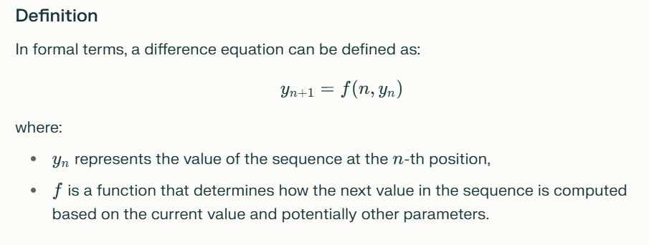
Difference Equation

Slide 18
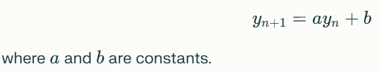

Types of Difference Equations
First-Order Difference Equations: These involve only the current and previous values of the sequence. An example is:
Higher-Order Difference Equations: These involve multiple previous values. For instance, a second-order difference equation can be expressed as:

Slide 19
Applications of Difference Equations
Difference equations are particularly useful in modeling systems where changes occur at discrete intervals rather than continuously. Common applications include:
Digital Signal Processing (DSP): Used to describe the behavior of digital filters.
Economics: Modeling dynamic systems such as population growth or economic indicators.
Control Systems: Implementing algorithms for discrete-time control systems.

Slide 20
Solution Methods of Difference Equations
There are systematic methods for solving difference equations, including:
Iterative Methods: Directly computing successive terms based on initial conditions.
Characteristic Equation Method: Applicable for linear constant-coefficient difference equations.
Z-Transform: A powerful tool for analyzing linear time-invariant systems in the Z-domain.

