Slide 1
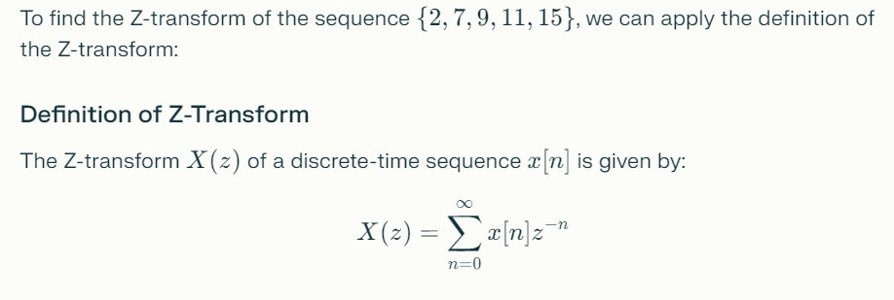
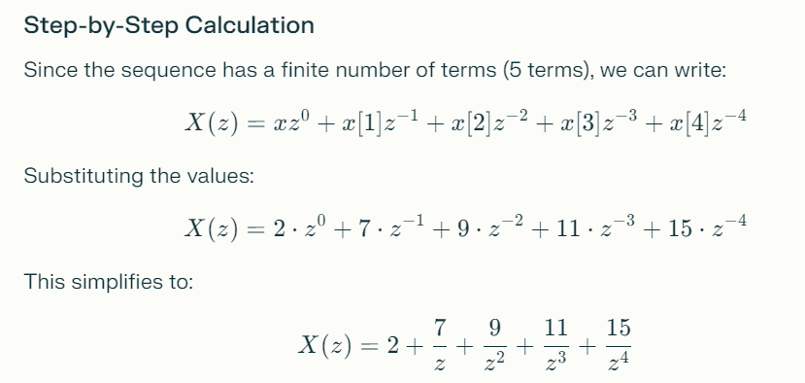

Slide 2
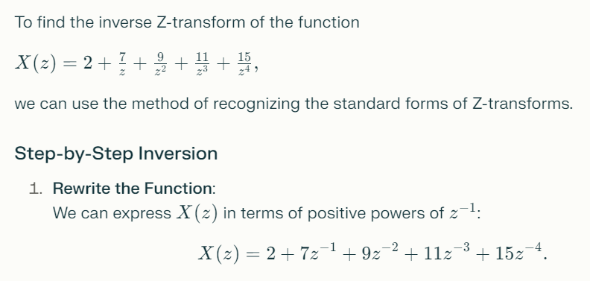
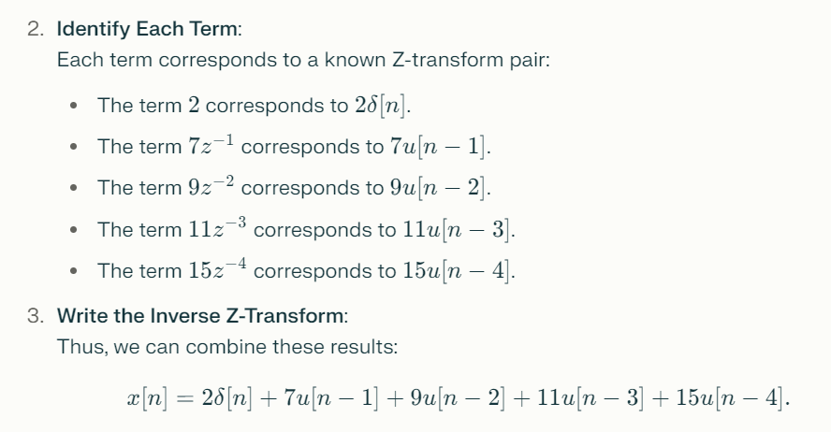

Slide 3
$$Q:Calculate the z−inverse of F\left(z\right)=\frac{5}{(z−2)(z−3)}$$
SOLUTION:
$$F\left(z\right)=\frac{5}{(z−2)(z−3)}=\frac{A}{z−2}+\frac{B}{z−3} (1)$$
$$\frac{5}{(z−2)(z−3)}=\frac{A \left(z−3\right)+B(z−2)}{(z−2)(z−3)}$$
$$5=\left[\left(z−2\right)\left(z−3\right)\right]∗\frac{A \left(z−3\right)+B(z−2)}{(z−2)(z−3)}$$
$$5=A \left(z−3\right)+B\left(z−2\right) (∗)$$
Put z – 3 = 0 than z = 3 in equation (*)
$$5=A \left(3−3\right)+B\left(3−2\right)$$
$$B=5$$

Slide 4
Again Put z – 2 = 0 than z = 2 in equation (*)
$$5=A \left(z−3\right)+B\left(z−2\right) (∗)$$
$$5=A \left(2−3\right)+B\left(2−2\right)$$
$$A=−5$$
x[n]=(5(3n)−5(2n))u[n]
Put the values of A and B in equation (1)
$$F\left(z\right)=\frac{5}{(z−2)(z−3)}=\frac{A}{z−2}+\frac{B}{z−3} (1)$$
$$F\left(z\right)=\frac{−5}{z−2}+\frac{5}{z−3}=−5 \left\{\frac{1}{z−2}\right\}+5 \left\{\frac{1}{z−3}\right\}$$
$$x[n]=−5 {\left(2\right)}^{n}u\left[n\right]+5{\left(3\right)}^{n} u[n]$$
$$x\left[n\right]=\left(−5 {\left(2\right)}^{n}+5{\left(3\right)}^{n} \right)u\left[n\right] Answer$$

Slide 5
























Slide 6























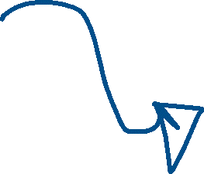










Slide 7















































Slide 8

























Slide 9






































Slide 10









































Slide 11






























































Slide 12



















Slide 13
























Slide 21


























































Slide 22



















































Slide 23












































Slide 24






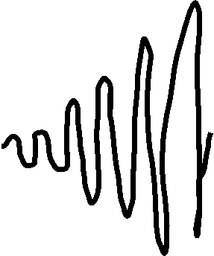



Slide 25




































































































Slide 26












































Slide 27
























Slide 28
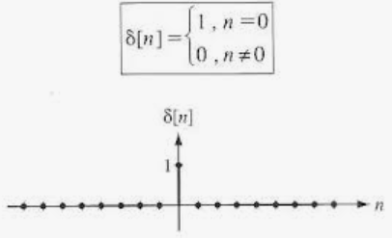
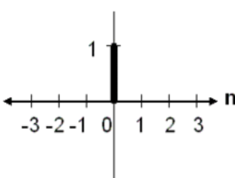

$Q:Find the Z−Transform of Delta δ$[n] Function
$$X\left(z\right)=Z\left[δ\text{[}\text{n}\text{]}\right]=\sum_{n=−∞}^{∞}{x[n]z^{−n}}=\sum_{n=−∞}^{∞}{δ\text{[}\text{n}\text{] }z^{−n}}=δ\text{[}\text{−2}\text{] }z^{−(−2)}+δ\text{[}\text{−1}\text{] }z^{−(−1)}+δ\text{[}\text{0}\text{] }z^{−(0)}+δ\text{[}\text{1}\text{] }z^{−(1)}+δ\text{[}\text{2}\text{] }z^{−(2)}$$
$$X\left(z\right)=Z\left[δ\text{[}\text{n}\text{]}\right]=\sum_{n=−∞}^{∞}{δ\text{[}\text{n}\text{] }z^{−n}}=0∗ z^{−\left(−2\right)}+0∗z^{−\left(−1\right)}+1∗ z^{−\left(0\right)}+0∗z^{−\left(1\right)}+0∗ z^{−(2)}$$
$$X\left(z\right)=Z\left[δ\text{[}\text{n}\text{]}\right]=0+0+1∗ 1+0+0=1$$
$$X\left(z\right)=Z\left[δ\text{[}\text{n}\text{]}\right]=1$$
Thus, Z-transform of the delta function is 1 ------------ Answer

Slide 29

$Q:Find the Z−Transform of Delta Aδ$[n] Function
$$X\left(z\right)=Z\left[Aδ\text{[}\text{n}\text{]}\right]=\sum_{n=−∞}^{∞}{x[n]z^{−n}}= \sum_{n=−∞}^{∞}{Aδ\text{[}\text{n}\text{] }z^{−n}}=Aδ\text{[}\text{−2}\text{] }z^{−(−2)}+Aδ\text{[}\text{−1}\text{] }z^{−(−1)}+Aδ\text{[}\text{0}\text{] }z^{−(0)}+Aδ\text{[}\text{1}\text{] }z^{−(1)}+Aδ\text{[}\text{2}\text{] }z^{−(2)}$$
$$X\left(z\right)=Z\left[Aδ\text{[}\text{n}\text{]}\right]=\sum_{n=−∞}^{∞}{Aδ\text{[}\text{n}\text{] }z^{−n}}=A∗0∗ z^{−\left(−2\right)}+A∗0∗z^{−\left(−1\right)}+A∗1∗ z^{−\left(0\right)}+A∗0∗z^{−\left(1\right)}+A∗0∗ z^{−(2)}$$
$$X\left(z\right)=Z\left[Aδ\text{[}\text{n}\text{]}\right]=0+0+A∗1∗ 1+0+0=A$$
$$X\left(z\right)=Z\left[Aδ\text{[}\text{n}\text{]}\right]=A$$
Thus, Z-transform of the delta function is A ------------ Answer

Slide 30























Slide 31























































Slide 32










































Slide 33






















































Slide 34





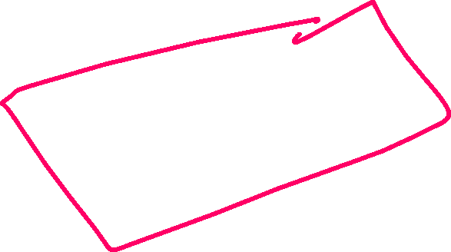





















Slide 35

























Slide 36














































Slide 37


















































Slide 38


















































