Slide 1
FIND DFT USING MATRIX METHOD

Slide 2
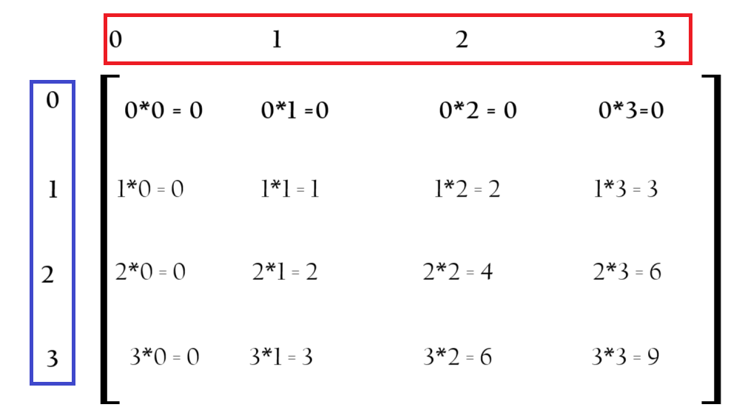
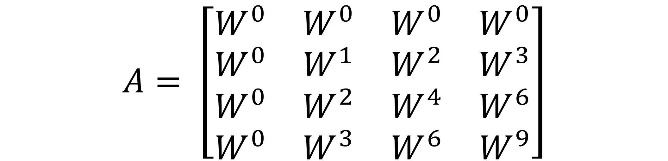
TWIDDLE FACTOR
$$A= \left[\begin{matrix}W^{0} & W^{0} & W^{0} & W^{0} \\ W^{0} & W^{1} & W^{2} & W^{3} \\ W^{0} & W^{2} & W^{4} & W^{6} \\ W^{0} & W^{3} & W^{6} & W^{9}\end{matrix}\right]$$

Slide 3
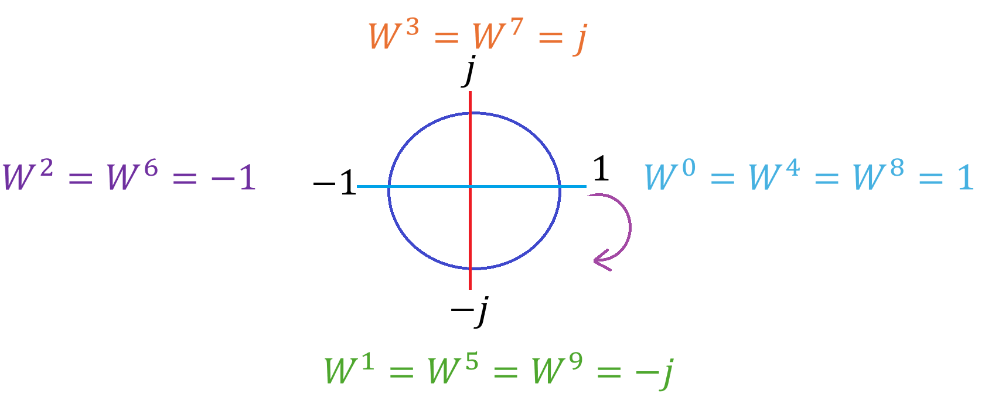

Slide 4
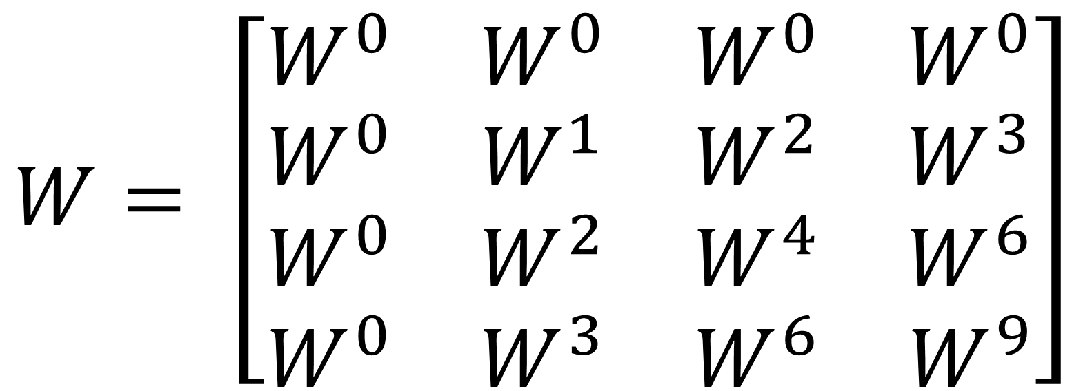
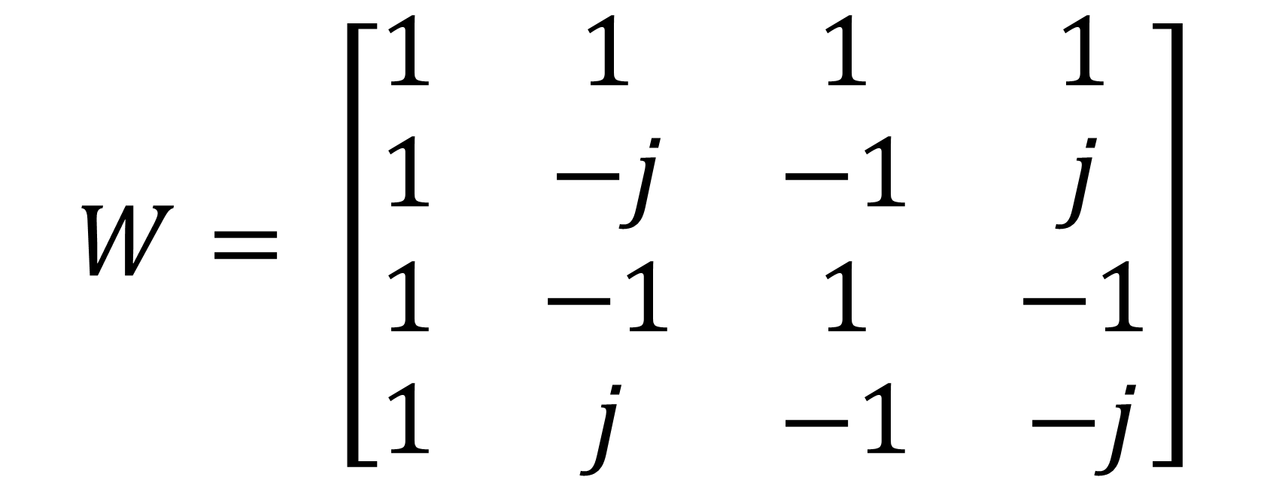
$$W= \left[\begin{matrix}W^{0} & W^{0} & W^{0} & W^{0} \\ W^{0} & W^{1} & W^{2} & W^{3} \\ W^{0} & W^{2} & W^{4} & W^{6} \\ W^{0} & W^{3} & W^{6} & W^{9}\end{matrix}\right]$$
$$W= \left[\begin{matrix}1 & 1 & 1 & 1 \\ 1 & −j & −1 & j \\ 1 & −1 & 1 & −1 \\ 1 & j & −1 & −j\end{matrix}\right]$$

Slide 5
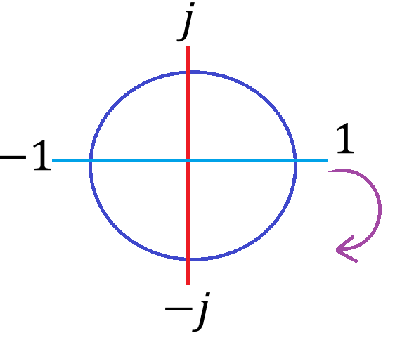


$$W^{0}=1$$
$$W^{1}=−j$$

Slide 6
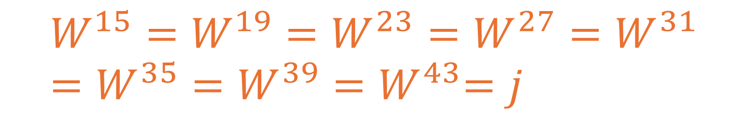

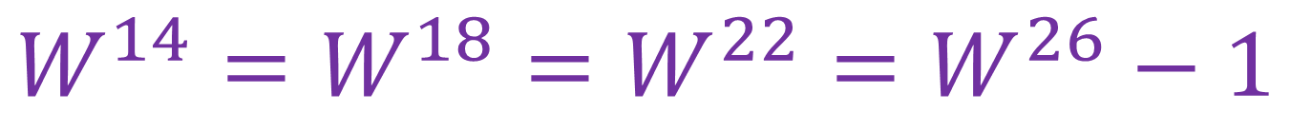



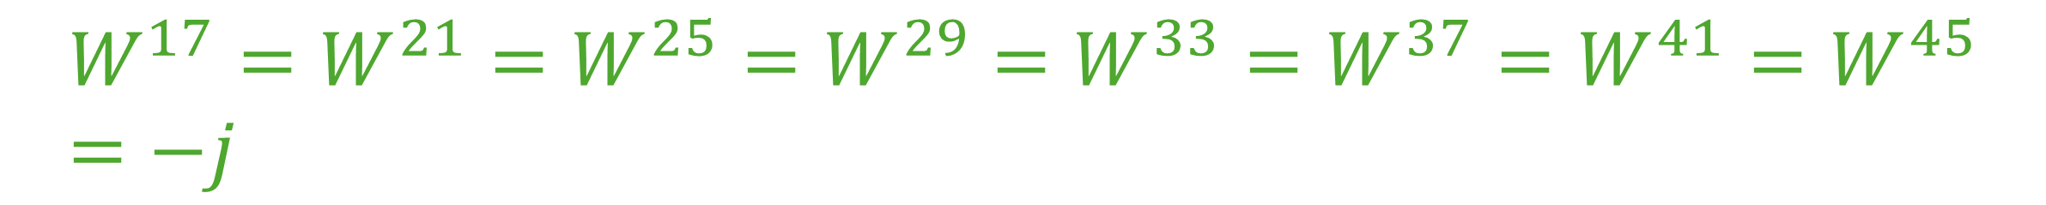

$$W^{3}=W^{7}=W^{11}=j$$
$$W^{15}=W^{19}=W^{23}=W^{27}=W^{31}=W^{35}=W^{39}{=W}^{43}=j$$
$${W^{0}=W^{4}=W}^{8}=W^{12}=1$$
$$W^{2}=W^{6}=W^{10}=−1$$
$${W^{16}=W^{20}=W}^{24}=W^{28}=W^{32}=1$$
$$W^{14}={W^{18}=W}^{22}=W^{26}−1$$
$${W^{36}=W}^{40}=W^{44}$$
$$W^{30}=W^{34}=W^{38}=W^{42}$$
$${W^{1}=W^{5}=W}^{9}=W^{13}=−j$$
$${W^{17}=W^{21}=W}^{25}=W^{29}=W^{33}={W^{37}=W}^{41}=W^{45}=−j$$

Slide 7




$$W^{3}=W^{7}=W^{11}=j$$
$${W^{0}=W^{4}=W}^{8}=W^{12}=1$$
$$W^{2}=W^{6}=W^{10}=−1$$
$${W^{1}=W^{5}=W}^{9}=−j$$

Slide 8
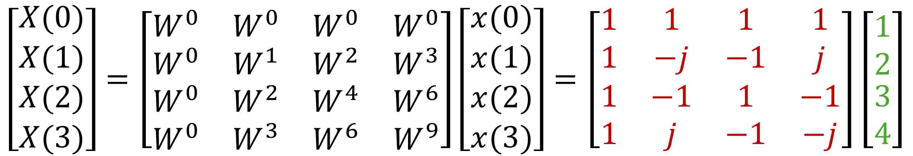
Q: Find the 4 point DFT of x(n) = {1,2,3,4}
SOLUTION
$$\left[\begin{matrix}X(0) \\ X(1) \\ \begin{aligned}X(2) \\ X(3)\end{aligned}\end{matrix}\right]=\left[\begin{matrix}W^{0} & W^{0} & W^{0} & W^{0} \\ W^{0} & W^{1} & W^{2} & W^{3} \\ W^{0} & W^{2} & W^{4} & W^{6} \\ W^{0} & W^{3} & W^{6} & W^{9}\end{matrix}\right]\left[\begin{matrix}x(0) \\ x(1) \\ \begin{aligned}x(2) \\ x(3)\end{aligned}\end{matrix}\right]=\left[\begin{matrix}1 & 1 & 1 & 1 \\ 1 & −j & −1 & j \\ 1 & −1 & 1 & −1 \\ 1 & j & −1 & −j\end{matrix}\right]\left[\begin{matrix}1 \\ 2 \\ \begin{aligned}3 \\ 4\end{aligned}\end{matrix}\right]$$
$$X\left(0\right)=1∗1+1∗2+1∗3+1∗4=1+2+3+4=10$$
$$X\left(1\right)=1∗1−j∗2−1∗3+j∗4=1−2j−3+4j=−2+2j$$
$$X\left(2\right)=1∗1−1∗2+1∗3−1∗4=1−2+3−4=−2$$
$$X\left(3\right)=1∗1+j∗2−1∗3−j∗4=1+2j−3−4j=−2−2j$$

Slide 9
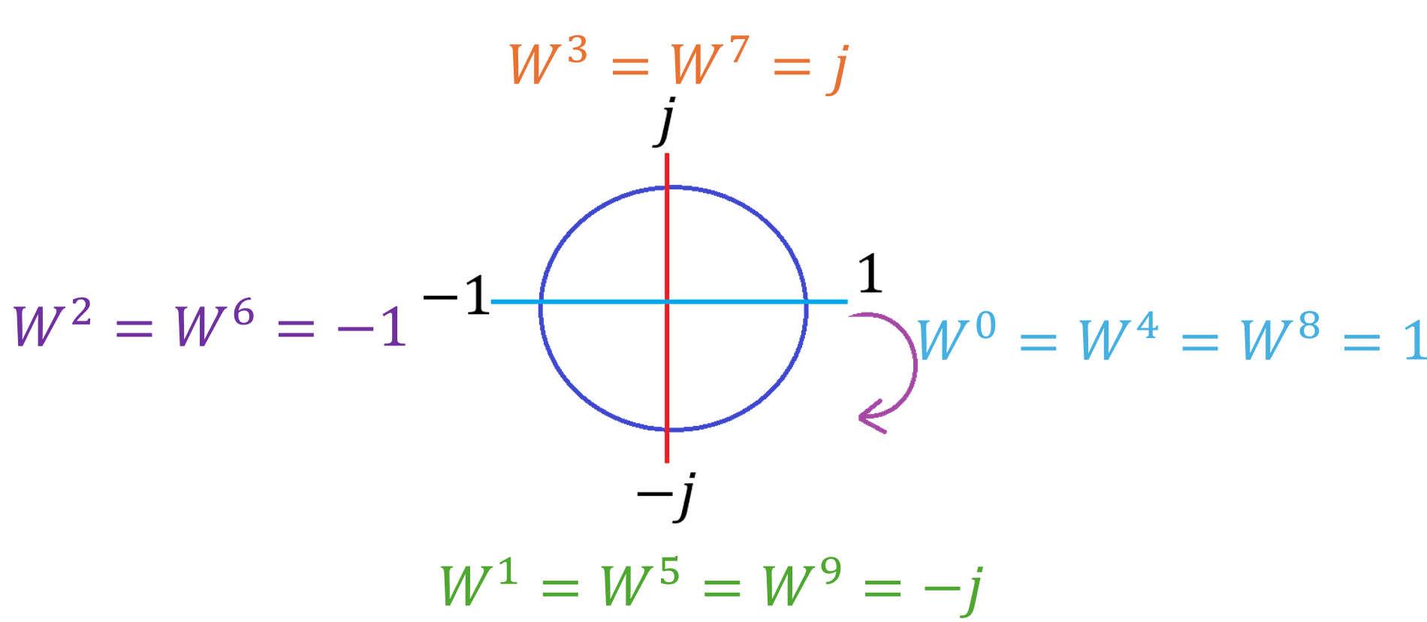
Q: Find the 8 point DFT of x(n) = {1,0,2,3,4,5,6,7}
SOLUTION
$$\left[\begin{matrix}X(0) \\ X(1) \\ \begin{aligned}X(2) \\ X(3)\end{aligned}\end{matrix}\right]=\left[\begin{matrix}W^{0} & W^{0} & W^{0} & W^{0} \\ W^{0} & W^{1} & W^{2} & W^{3} \\ W^{0} & W^{2} & W^{4} & W^{6} \\ W^{0} & W^{3} & W^{6} & W^{9}\end{matrix}\right]\left[\begin{matrix}x(0) \\ x(1) \\ \begin{aligned}x(2) \\ x(3)\end{aligned}\end{matrix}\right]=\left[\begin{matrix}1 & 1 & 1 & 1 \\ 1 & −j & −1 & j \\ 1 & −1 & 1 & −1 \\ 1 & j & −1 & −j\end{matrix}\right]\left[\begin{matrix}1 \\ 2 \\ \begin{aligned}3 \\ 4\end{aligned}\end{matrix}\right]$$
$$X\left(0\right)=1∗1+1∗2+1∗3+1∗4=1+2+3+4=10$$
$$X\left(1\right)=1∗1−j∗2−1∗3+j∗4=1−2j−3+4j=−2+2j$$
$$X\left(2\right)=1∗1−1∗2+1∗3−1∗4=1−2+3−4=−2$$
$$X\left(3\right)=1∗1+j∗2−1∗3−j∗4=1+2j−3−4j=−2−2j$$

Slide 10
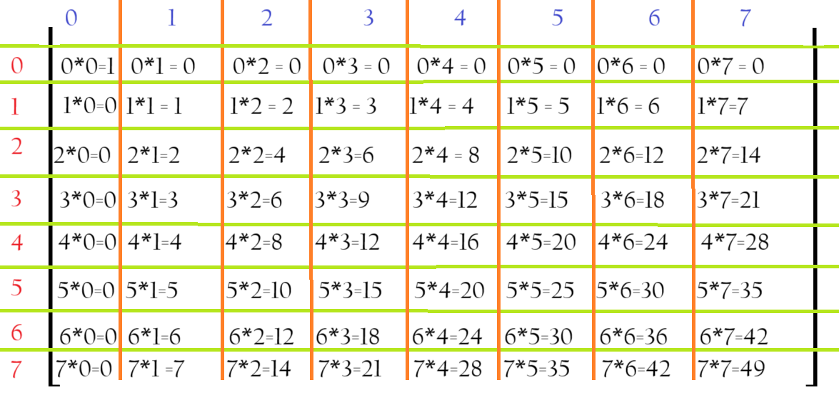
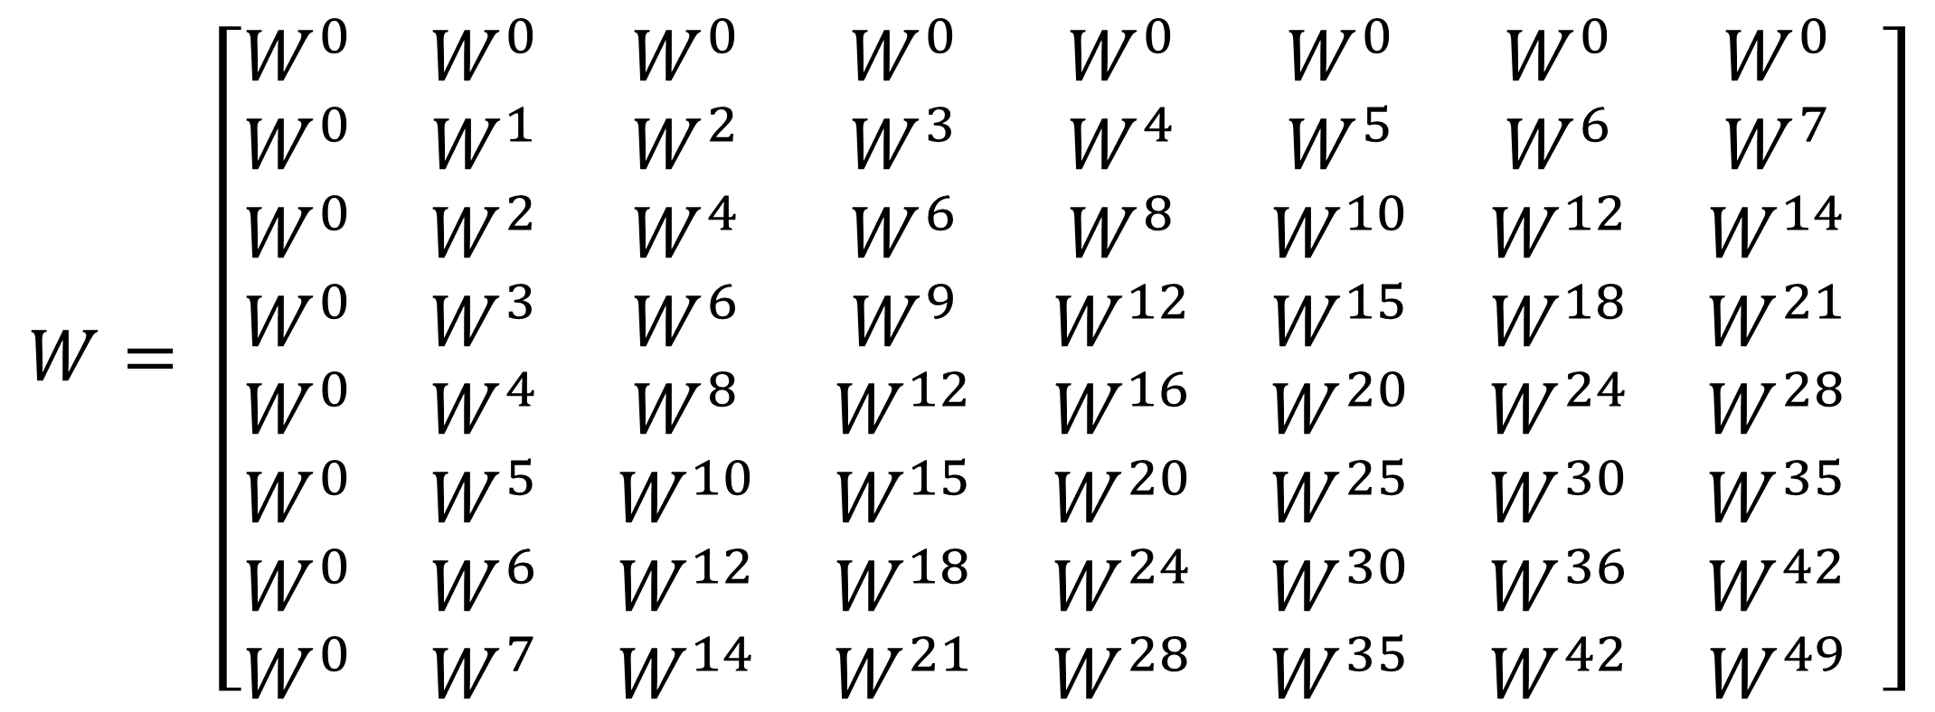
$$W= \left[\begin{matrix}W^{0} & W^{0} & W^{0} & W^{0} & W^{0} & W^{0} & W^{0} & W^{0} \\ W^{0} & W^{1} & W^{2} & W^{3} & W^{4} & W^{5} & W^{6} & W^{7} \\ W^{0} & W^{2} & W^{4} & W^{6} & W^{8} & W^{10} & W^{12} & W^{14} \\ W^{0} & W^{3} & W^{6} & W^{9} & W^{12} & W^{15} & W^{18} & W^{21} \\ W^{0} & W^{4} & W^{8} & W^{12} & W^{16} & W^{20} & W^{24} & W^{28} \\ W^{0} & W^{5} & W^{10} & W^{15} & W^{20} & W^{25} & W^{30} & W^{35} \\ W^{0} & W^{6} & W^{12} & W^{18} & W^{24} & W^{30} & W^{36} & W^{42} \\ W^{0} & W^{7} & W^{14} & W^{21} & W^{28} & W^{35} & W^{42} & W^{49}\end{matrix} \right]$$

Slide 11
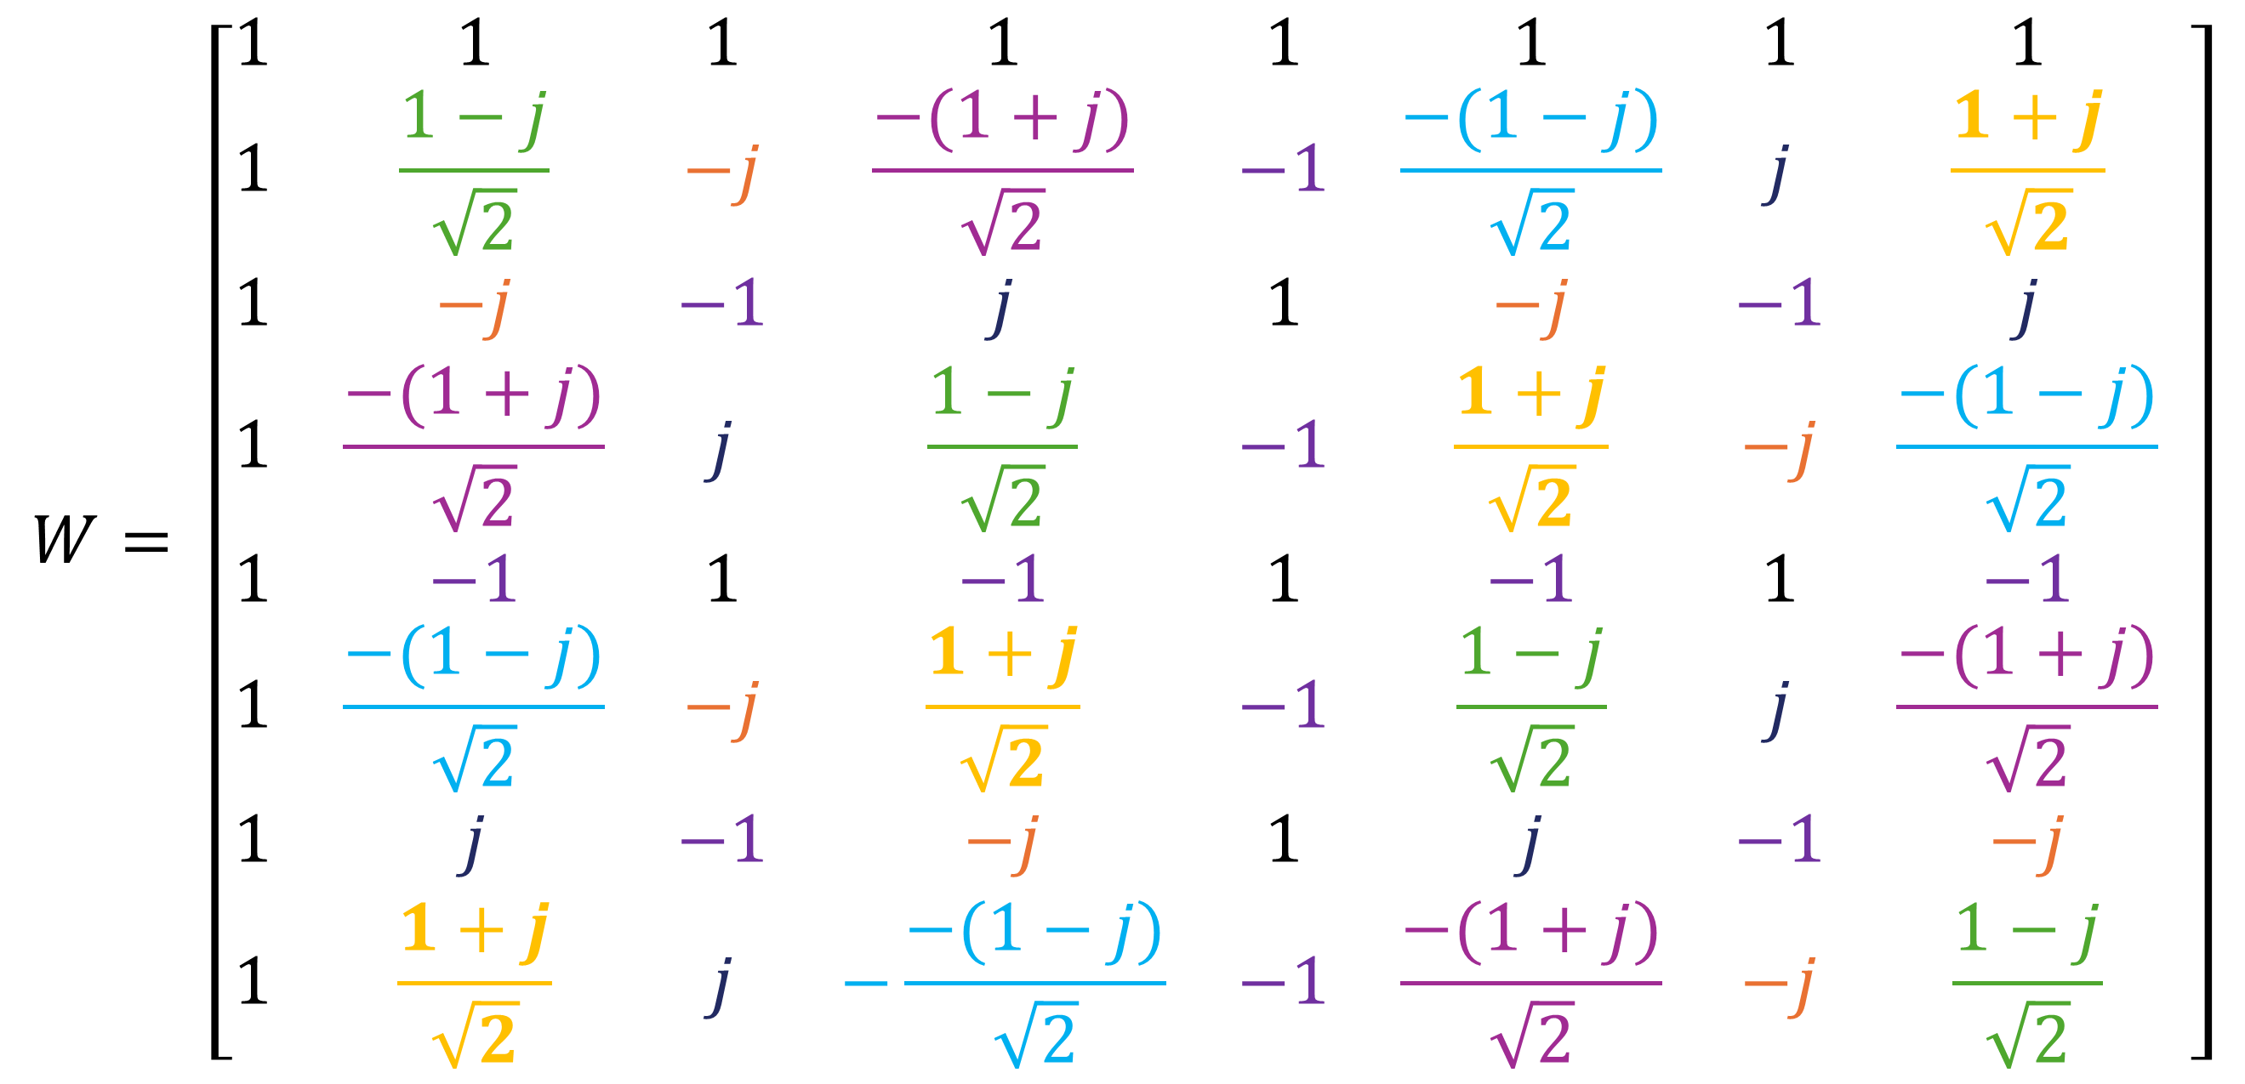
$$W= \left[\begin{matrix}1 & 1 & 1 & 1 & 1 & 1 & 1 & 1 \\ 1 & \frac{1−j}{\sqrt{2}} & −j & \frac{−(1+j)}{\sqrt{2}} & −1 & \frac{−(1−j)}{\sqrt{2}} & j & \frac{1+j}{\sqrt{2}} \\ 1 & −j & −1 & j & 1 & −j & −1 & j \\ 1 & \frac{−(1+j)}{\sqrt{2}} & j & \frac{1−j}{\sqrt{2}} & −1 & \frac{1+j}{\sqrt{2}} & −j & \frac{−(1−j)}{\sqrt{2}} \\ 1 & −1 & 1 & −1 & 1 & −1 & 1 & −1 \\ 1 & \frac{−(1−j)}{\sqrt{2}} & −j & \frac{1+j}{\sqrt{2}} & −1 & \frac{1−j}{\sqrt{2}} & j & \frac{−(1+j)}{\sqrt{2}} \\ 1 & j & −1 & −j & 1 & j & −1 & −j \\ 1 & \frac{1+j}{\sqrt{2}} & j & −\frac{−(1−j)}{\sqrt{2}} & −1 & \frac{−(1+j)}{\sqrt{2}} & −j & \frac{1−j}{\sqrt{2}}\end{matrix} \right]$$

Slide 12
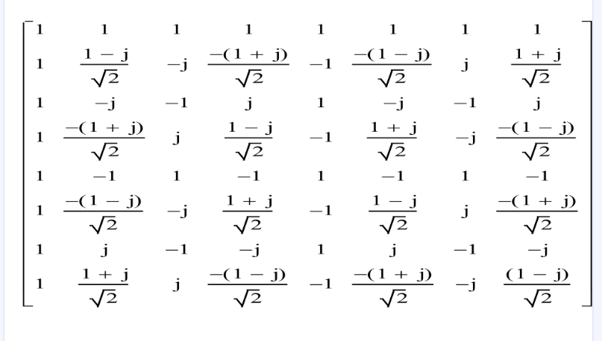

Slide 13
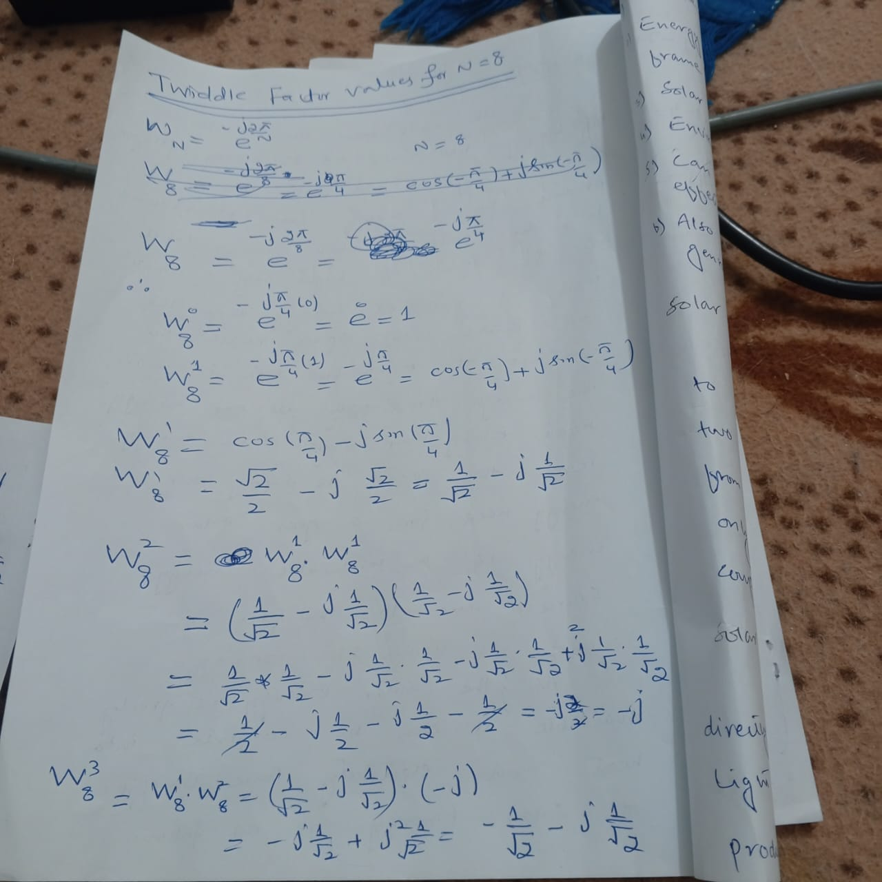

Slide 14
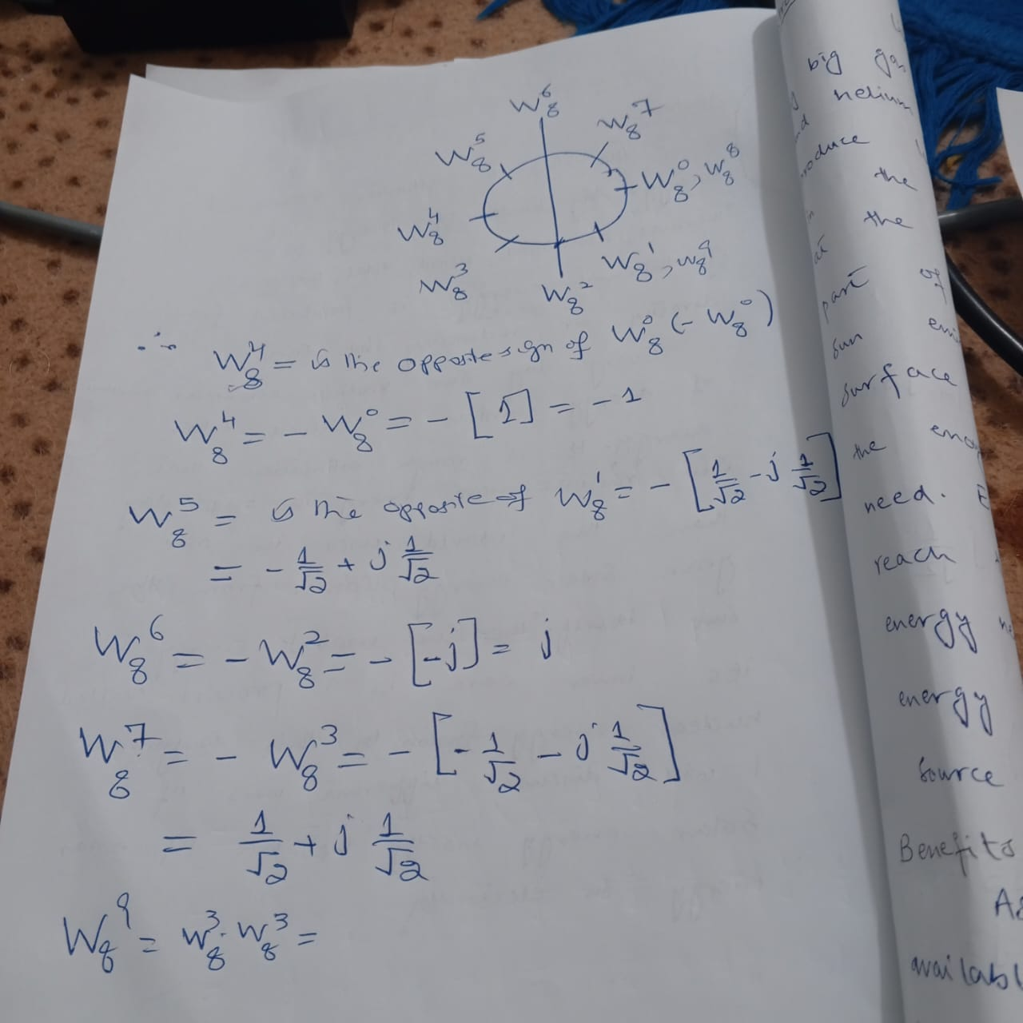

Slide 15
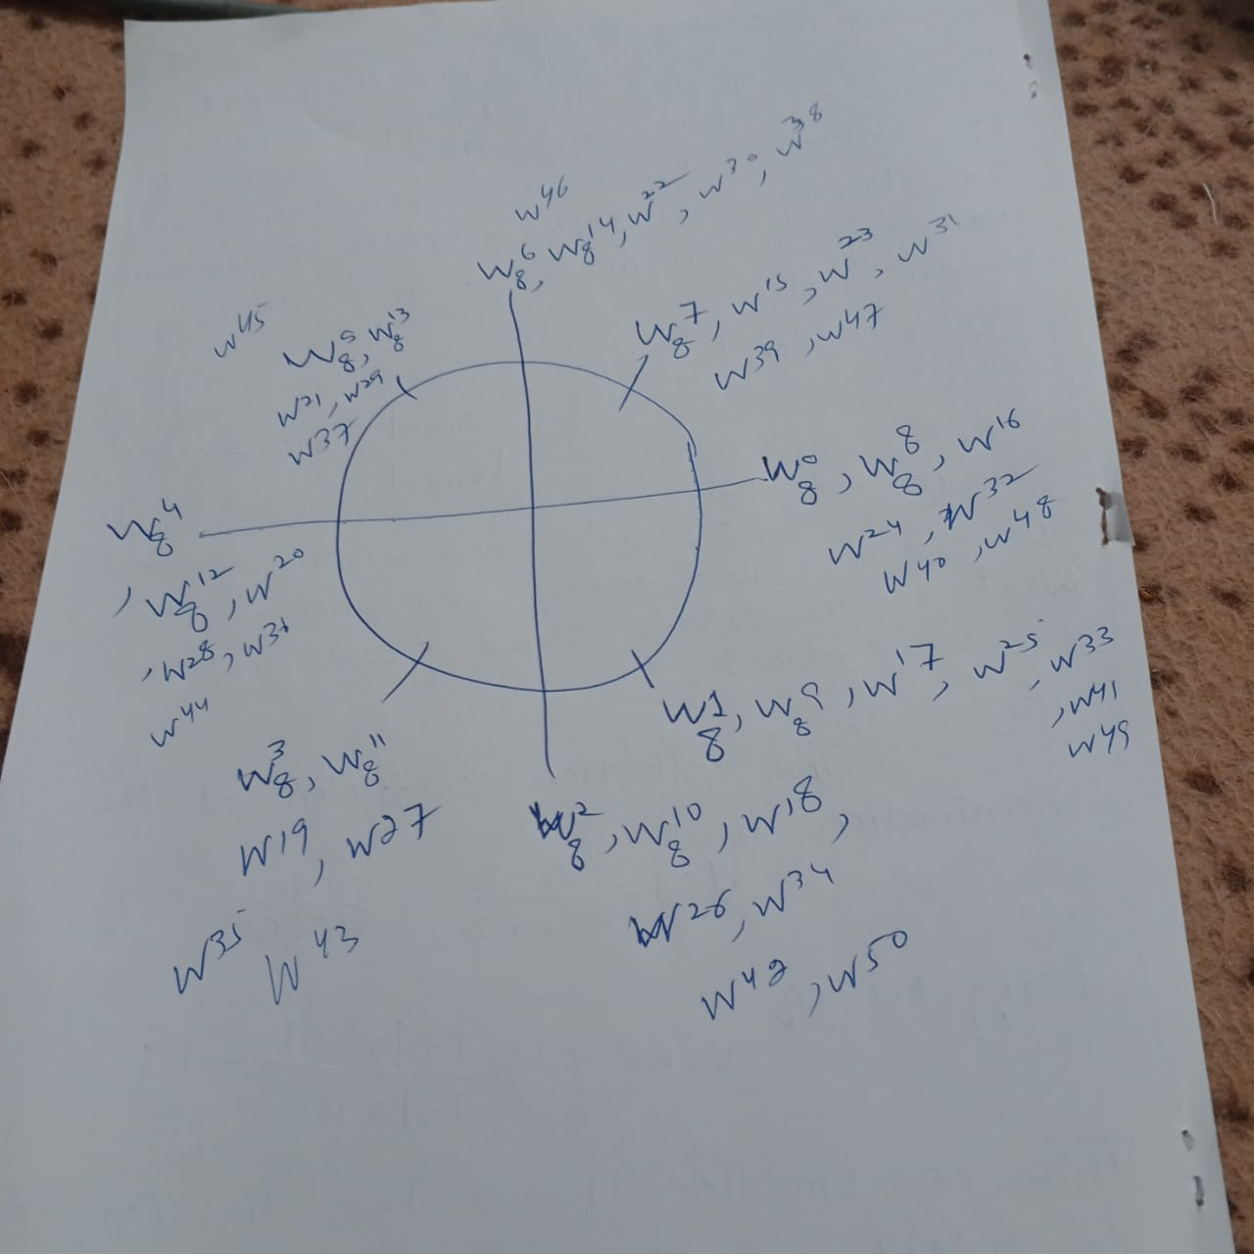

Slide 16
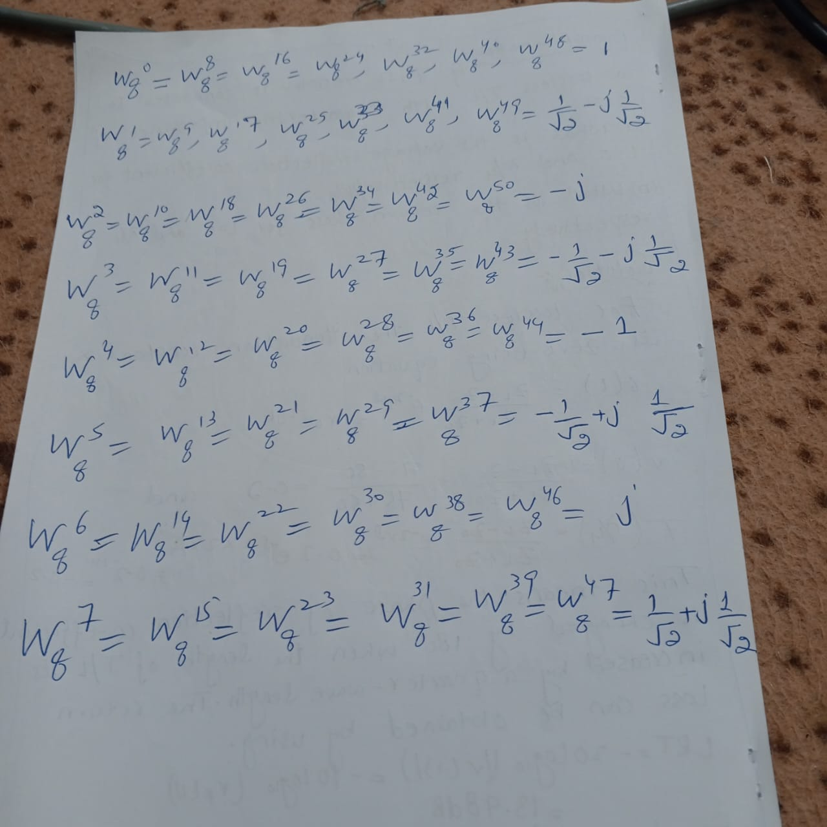

Slide 17
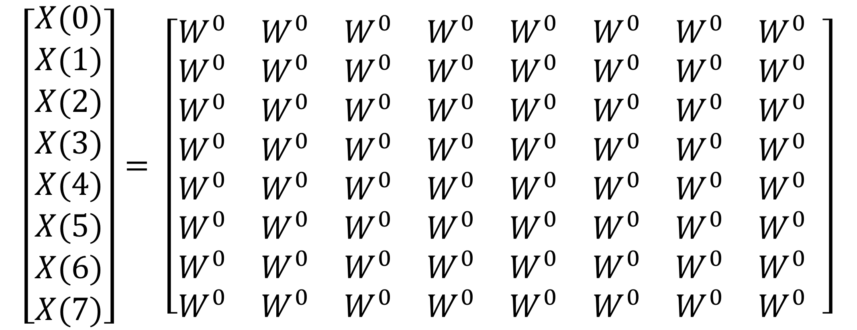
Q: Find the 8 point DFT of x(n) = {1,0,2,3,4,5,6,7}
SOLUTION
$$\left[\begin{matrix}X(0) \\ X(1) \\ \begin{aligned}X(2) \\ X(3) \\ X(4) \\ X(5) \\ X(6) \\ X(7)\end{aligned}\end{matrix}\right]= \left[\begin{matrix}W^{0} & W^{0} & W^{0} & W^{0} & W^{0} & W^{0} & W^{0} & W^{0} \\ W^{0} & W^{0} & W^{0} & W^{0} & W^{0} & W^{0} & W^{0} & W^{0} \\ W^{0} & W^{0} & W^{0} & W^{0} & W^{0} & W^{0} & W^{0} & W^{0} \\ W^{0} & W^{0} & W^{0} & W^{0} & W^{0} & W^{0} & W^{0} & W^{0} \\ W^{0} & W^{0} & W^{0} & W^{0} & W^{0} & W^{0} & W^{0} & W^{0} \\ W^{0} & W^{0} & W^{0} & W^{0} & W^{0} & W^{0} & W^{0} & W^{0} \\ W^{0} & W^{0} & W^{0} & W^{0} & W^{0} & W^{0} & W^{0} & W^{0} \\ W^{0} & W^{0} & W^{0} & W^{0} & W^{0} & W^{0} & W^{0} & W^{0}\end{matrix} \right]$$

