Slide 1
Pole Zero Diagram

Slide 2
Poles And Zeros Of Transfer Function
Zeros: Zeros of a Transfer Function are the frequencies (values of s) for which the numerator of the transfer function becomes zero.
Poles: Poles of a Transfer Function are the frequencies (values of s) for which the denominator of the transfer function becomes zero.

Slide 3



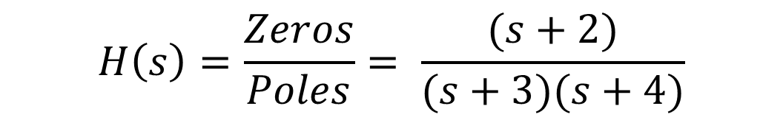
Q: Find the Poles And Zeros Of Transfer Function
$$H\left(s\right)=\frac{(s+2)}{(s+3)(s+4)}$$
$$Solution:$$
$$H\left(s\right)=\frac{Zeros}{Poles}= \frac{(s+2)}{(s+3)(s+4)}$$
$$Zeros:s=−2$$
$$Poles:s=−3, s=−4$$

Slide 4
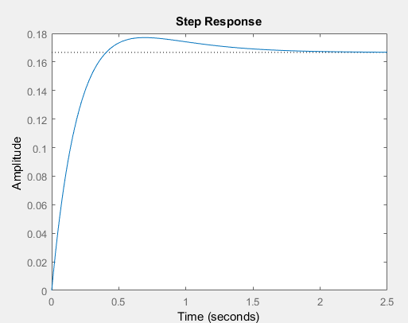
Q: Write the MATLAB Code Of Transfer Function
$$H\left(s\right)=\frac{(s+2)}{(s+3)(s+4)}$$
$$Solution:$$
$$H\left(s\right)=\frac{Zeros}{Poles}= \frac{(s+2)}{(s+3)(s+4)}=\frac{(s+2)}{(s^{2}+3s+4s+12)}=\frac{(s+2)}{(s^{2}+7s+12)}$$
>> numerator = [1 2];
>> denominator = [1 7 12];
>> sys = tf(numerator, denominator)
sys =
s + 2
--------------
s^2 + 7 s + 12
Continuous-time transfer function.
plot(sys)

Slide 5
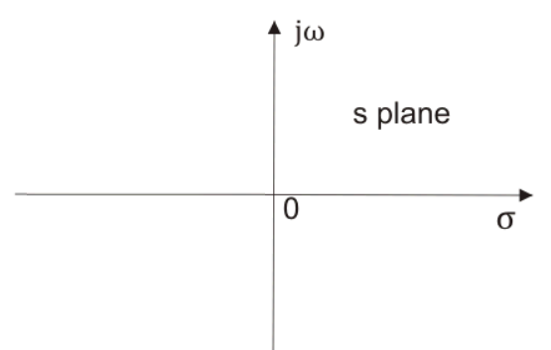
Pole-Zero Diagram
Plot on s-plane which represents the location of Poles and Zeros of a Transfer Function is called as Pole-Zero Diagram.
Poles are represented by ×
Zeros are represented by
X-axis is sigma-axis (real part of x)
Y-axis is the jω-axis which is the imaginary part of x

Slide 6


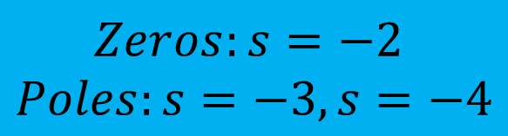
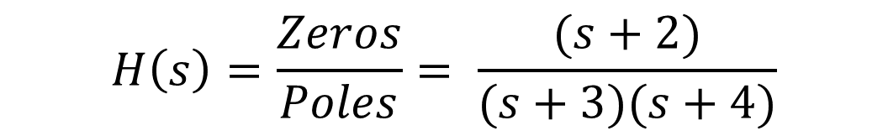
Q: Find the Poles And Zeros Of Transfer Function and Draw the Pole – Zero Diagram
$$H\left(s\right)=\frac{(s+2)}{(s+3)(s+4)}$$
$$Solution:$$
$$H\left(s\right)=\frac{Zeros}{Poles}= \frac{(s+2)}{(s+3)(s+4)}$$
$$Zeros:s=−2$$
$$Poles:s=−3, s=−4$$

Slide 7
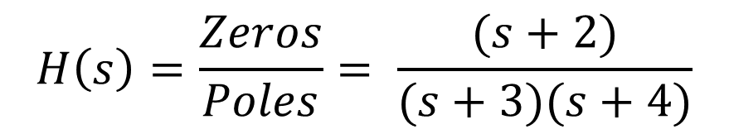
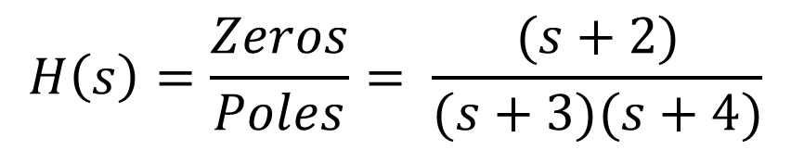




Q: Find the Poles And Zeros Of Transfer Function and Draw the Pole – Zero Diagram
$$jσ$$
$$H\left(s\right)=\frac{(s+2)}{(s+3)(s+4)}$$
$$H\left(s\right)=\frac{Zeros}{Poles}= \frac{(s+2)}{(s+3)(s+4)}$$
$$−σ$$
$$σ$$
-5 -4 -3 -2 -1
1 2 3 4 5
$$H\left(s\right)=\frac{Zeros}{Poles}= \frac{(s+2)}{(s+3)(s+4)}$$
$$Zeros:s=−2$$
$$Poles:s=−3, s=−4$$
$$−jσ$$

Slide 8




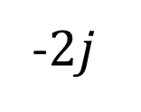


Q: Find the Poles And Zeros Of Transfer Function and Draw the Pole – Zero Diagram
$$jσ$$
$$H\left(s\right)=\frac{5s}{(s+1)(s^{2}+4s+8)}$$
$$2j$$
$$j$$
$$H\left(s\right)=\frac{Zeros}{Poles}= \frac{5s}{(s+1)(s^{2}+4s+8)}=\frac{5s}{(s+1)(s+2−2j)(s+2+2j)}$$
$$−σ$$
$$σ$$
-5 -4 -3 -2 -1
1 2 3 4 5
$$−j$$
-$2j$
$$Zeros:s=0$$
$$Poles:s=−1, \left(−2+2j\right), (2−2j)$$
$$−jσ$$

