Slide 1
DFT Discrete Fourier Transform

Slide 2
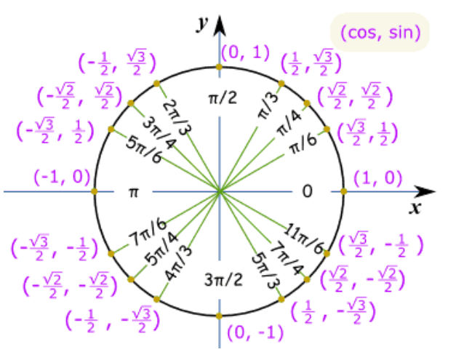
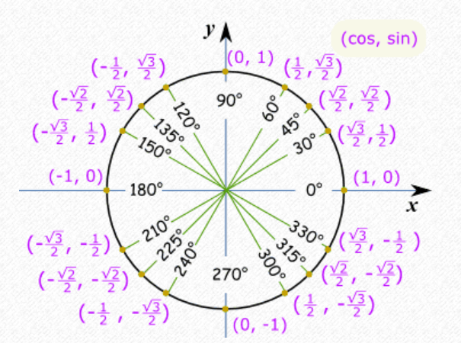

Slide 3
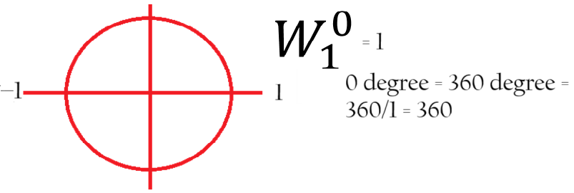
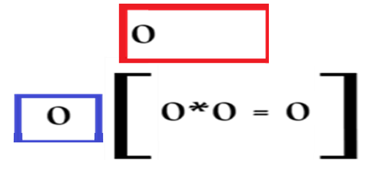
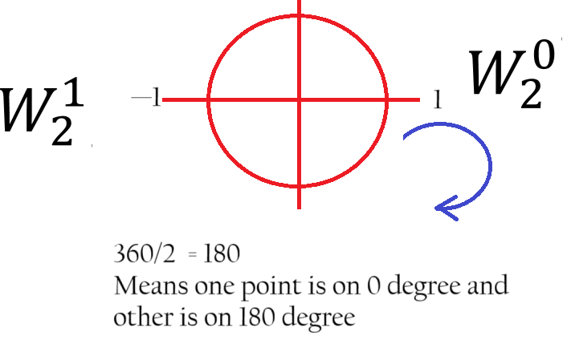
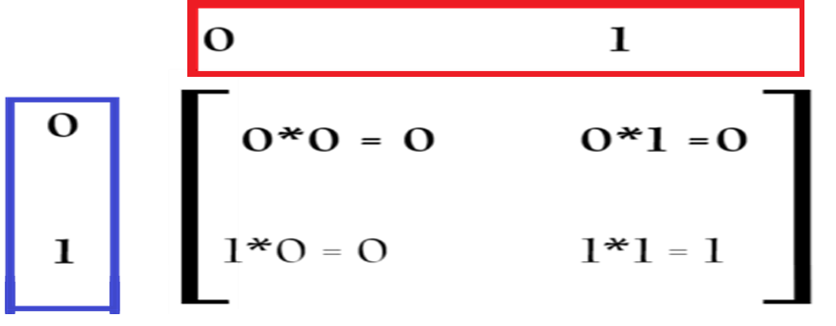

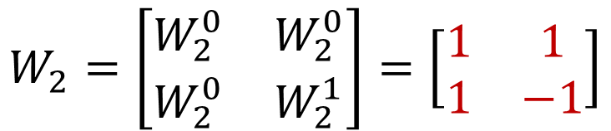
One-Point DFT
$$W_{1}=\left[W_{1}^{0}\right]=\left[1\right]$$
Two-Point DFT
$$W_{2}=\left[\begin{matrix}W_{2}^{0} & W_{2}^{0} \\ W_{2}^{0} & W_{2}^{1}\end{matrix}\right]=\left[\begin{matrix}1 & 1 \\ 1 & −1\end{matrix}\right]$$

Slide 4
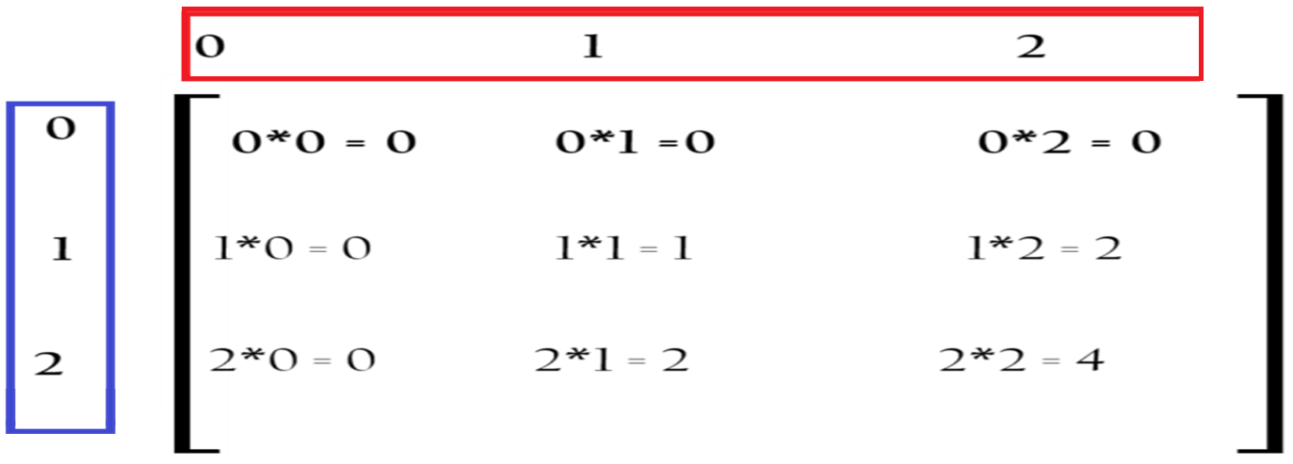
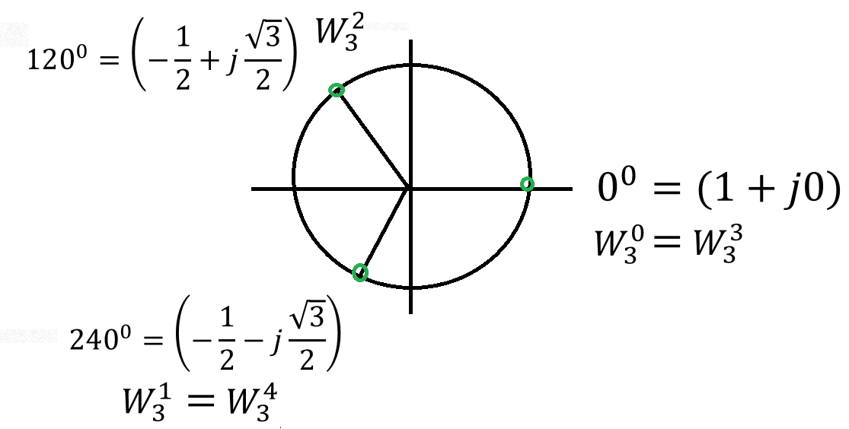
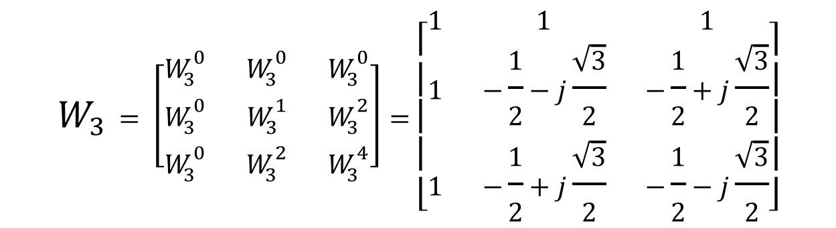
Three-Point DFT
$$W_{3}= \left[\begin{matrix}W_{3}^{0} & W_{3}^{0} & W_{3}^{0} \\ W_{3}^{0} & W_{3}^{1} & W_{3}^{2} \\ W_{3}^{0} & W_{3}^{2} & W_{3}^{4}\end{matrix}\right]=\left[\begin{matrix}1 & 1 & 1 \\ 1 & −\frac{1}{2}−j\frac{\sqrt{3}}{2} & −\frac{1}{2}+j\frac{\sqrt{3}}{2} \\ 1 & −\frac{1}{2}+j\frac{\sqrt{3}}{2} & −\frac{1}{2}−j\frac{\sqrt{3}}{2}\end{matrix}\right]$$

Slide 5
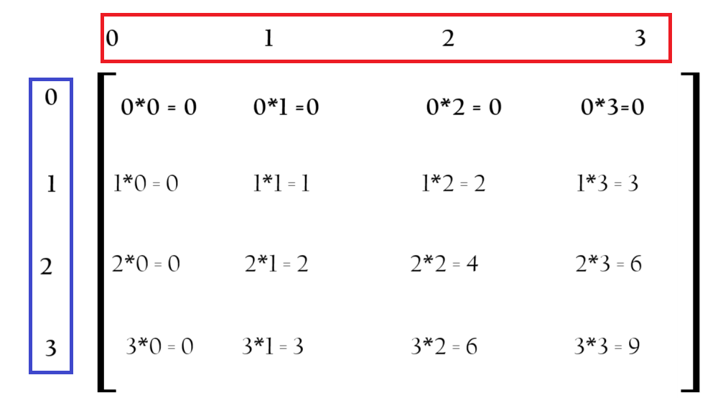
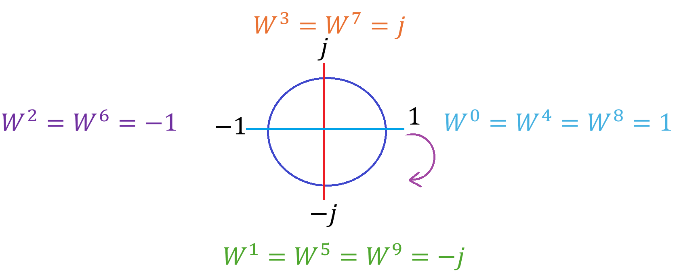
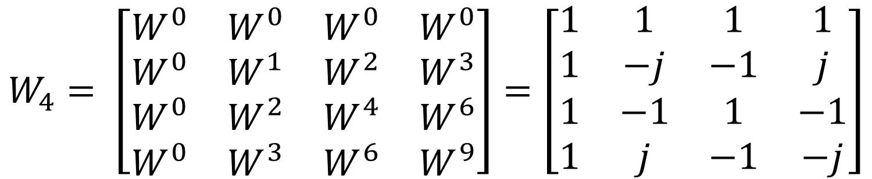
Four-Point DFT
$$W_{4}= \left[\begin{matrix}W^{0} & W^{0} & W^{0} & W^{0} \\ W^{0} & W^{1} & W^{2} & W^{3} \\ W^{0} & W^{2} & W^{4} & W^{6} \\ W^{0} & W^{3} & W^{6} & W^{9}\end{matrix}\right]=\left[\begin{matrix}1 & 1 & 1 & 1 \\ 1 & −j & −1 & j \\ 1 & −1 & 1 & −1 \\ 1 & j & −1 & −j\end{matrix}\right]$$

Slide 6
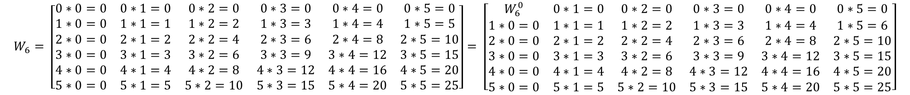
Six-Point DFT
$$W_{6}= \left[\begin{matrix}0∗0=0 & 0∗1=0 & 0∗2=0 & 0∗3=0 & 0∗4=0 & 0∗5=0 \\ 1∗0=0 & 1∗1=1 & 1∗2=2 & 1∗3=3 & 1∗4=4 & 1∗5=5 \\ 2∗0=0 & 2∗1=2 & 2∗2=4 & 2∗3=6 & 2∗4=8 & 2∗5=10 \\ 3∗0=0 & 3∗1=3 & 3∗2=6 & 3∗3=9 & 3∗4=12 & 3∗5=15 \\ 4∗0=0 & 4∗1=4 & 4∗2=8 & 4∗3=12 & 4∗4=16 & 4∗5=20 \\ 5∗0=0 & 5∗1=5 & 5∗2=10 & 5∗3=15 & 5∗4=20 & 5∗5=25\end{matrix}\right]= \left[\begin{matrix}W_{6}^{0} & 0∗1=0 & 0∗2=0 & 0∗3=0 & 0∗4=0 & 0∗5=0 \\ 1∗0=0 & 1∗1=1 & 1∗2=2 & 1∗3=3 & 1∗4=4 & 1∗5=6 \\ 2∗0=0 & 2∗1=2 & 2∗2=4 & 2∗3=6 & 2∗4=8 & 2∗5=10 \\ 3∗0=0 & 3∗1=3 & 3∗2=6 & 3∗3=9 & 3∗4=12 & 3∗5=15 \\ 4∗0=0 & 4∗1=4 & 4∗2=8 & 4∗3=12 & 4∗4=16 & 4∗5=20 \\ 5∗0=0 & 5∗1=5 & 5∗2=10 & 5∗3=15 & 5∗4=20 & 5∗5=25\end{matrix}\right]$$

Slide 7
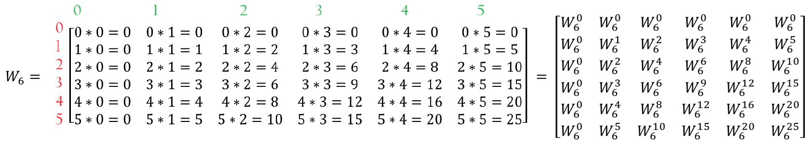
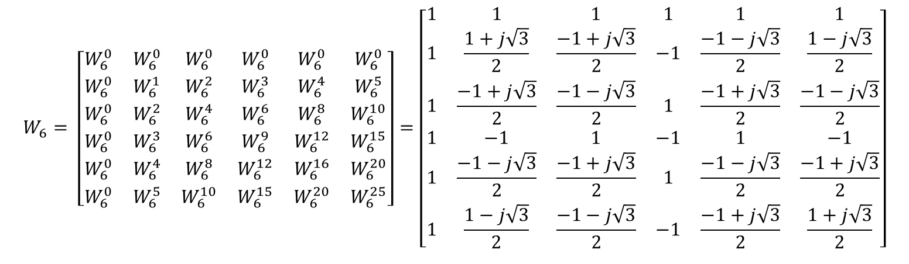
$$W_{6}= \left[\begin{matrix}W_{6}^{0} & W_{6}^{0} & W_{6}^{0} & W_{6}^{0} & W_{6}^{0} & W_{6}^{0} \\ W_{6}^{0} & W_{6}^{1} & W_{6}^{2} & W_{6}^{3} & W_{6}^{4} & W_{6}^{5} \\ W_{6}^{0} & W_{6}^{2} & W_{6}^{4} & W_{6}^{6} & W_{6}^{8} & W_{6}^{10} \\ W_{6}^{0} & W_{6}^{3} & W_{6}^{6} & W_{6}^{9} & W_{6}^{12} & W_{6}^{15} \\ W_{6}^{0} & W_{6}^{4} & W_{6}^{8} & W_{6}^{12} & W_{6}^{16} & W_{6}^{20} \\ W_{6}^{0} & W_{6}^{5} & W_{6}^{10} & W_{6}^{15} & W_{6}^{20} & W_{6}^{25}\end{matrix}\right]=\left[\begin{matrix}1 & 1 & 1 & 1 & 1 & 1 \\ 1 & \frac{1+j\sqrt{3}}{2} & \frac{−1+j\sqrt{3}}{2} & −1 & \frac{−1−j\sqrt{3}}{2} & \frac{1−j\sqrt{3}}{2} \\ 1 & \frac{−1+j\sqrt{3}}{2} & \frac{−1−j\sqrt{3}}{2} & 1 & \frac{−1+j\sqrt{3}}{2} & \frac{−1−j\sqrt{3}}{2} \\ 1 & −1 & 1 & −1 & 1 & −1 \\ 1 & \frac{−1−j\sqrt{3}}{2} & \frac{−1+j\sqrt{3}}{2} & 1 & \frac{−1−j\sqrt{3}}{2} & \frac{−1+j\sqrt{3}}{2} \\ 1 & \frac{1−j\sqrt{3}}{2} & \frac{−1−j\sqrt{3}}{2} & −1 & \frac{−1+j\sqrt{3}}{2} & \frac{1+j\sqrt{3}}{2}\end{matrix}\right]$$

Slide 8
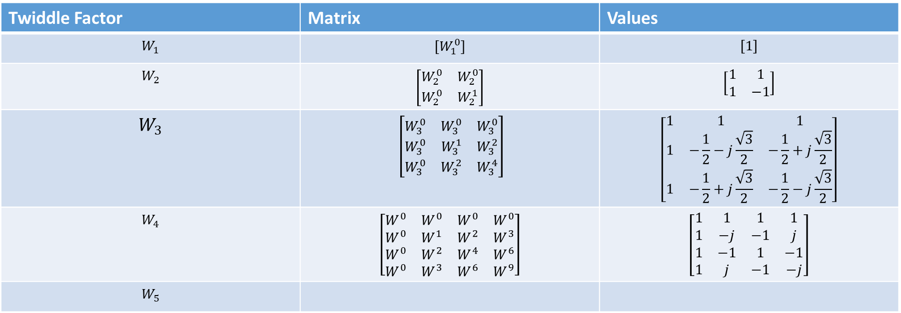
Twiddle Factor | Matrix | Values
$$W_{1}$$ | $$\left[W_{1}^{0}\right]$$ | $$\left[1\right]$$
$$W_{2}$$ | $$\left[\begin{matrix}W_{2}^{0} & W_{2}^{0} \\ W_{2}^{0} & W_{2}^{1}\end{matrix}\right]$$ | $$\left[\begin{matrix}1 & 1 \\ 1 & −1\end{matrix}\right]$$
$$W_{3}$$ | $$\left[\begin{matrix}W_{3}^{0} & W_{3}^{0} & W_{3}^{0} \\ W_{3}^{0} & W_{3}^{1} & W_{3}^{2} \\ W_{3}^{0} & W_{3}^{2} & W_{3}^{4}\end{matrix}\right]$$ | $$\left[\begin{matrix}1 & 1 & 1 \\ 1 & −\frac{1}{2}−j\frac{\sqrt{3}}{2} & −\frac{1}{2}+j\frac{\sqrt{3}}{2} \\ 1 & −\frac{1}{2}+j\frac{\sqrt{3}}{2} & −\frac{1}{2}−j\frac{\sqrt{3}}{2}\end{matrix}\right]$$
$$W_{4}$$ | $$\left[\begin{matrix}W^{0} & W^{0} & W^{0} & W^{0} \\ W^{0} & W^{1} & W^{2} & W^{3} \\ W^{0} & W^{2} & W^{4} & W^{6} \\ W^{0} & W^{3} & W^{6} & W^{9}\end{matrix}\right]$$ | $$\left[\begin{matrix}1 & 1 & 1 & 1 \\ 1 & −j & −1 & j \\ 1 & −1 & 1 & −1 \\ 1 & j & −1 & −j\end{matrix}\right]$$
$$W_{5}$$

Slide 9
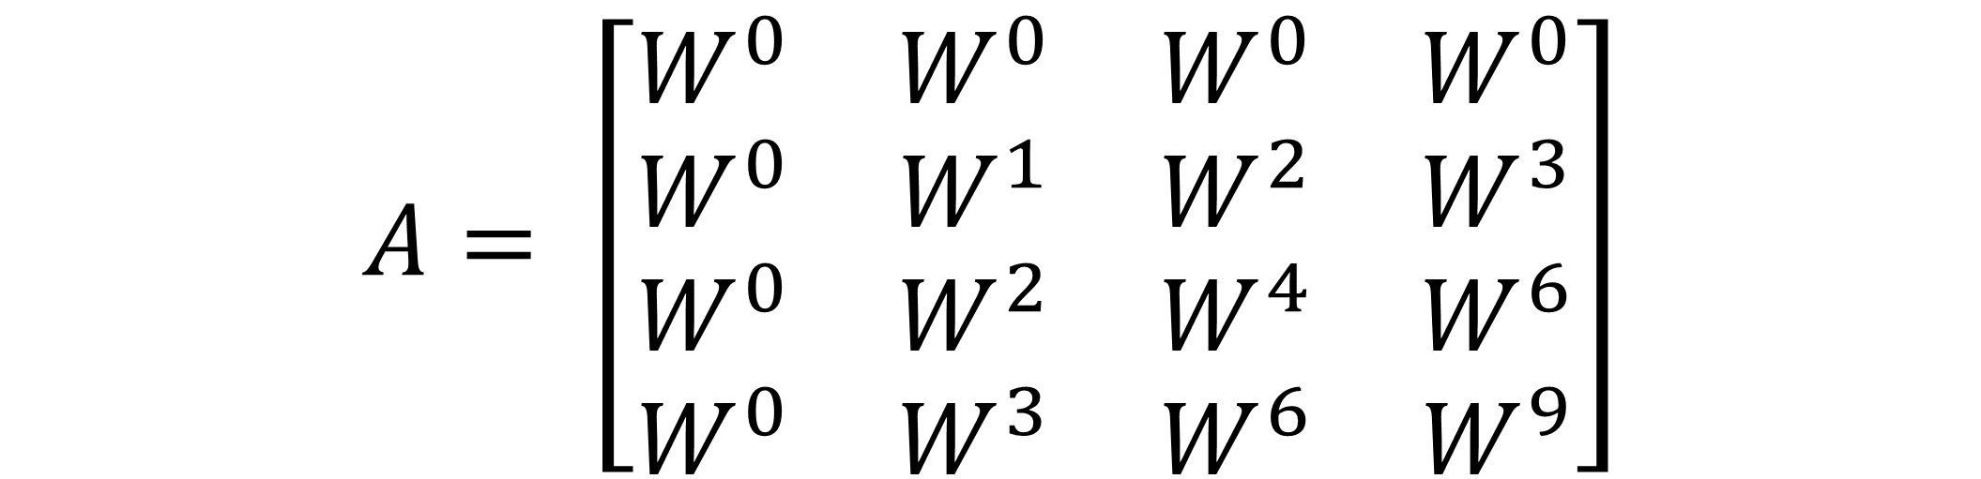
TWIDDLE FACTOR
$$A= \left[\begin{matrix}W^{0} & W^{0} & W^{0} & W^{0} \\ W^{0} & W^{1} & W^{2} & W^{3} \\ W^{0} & W^{2} & W^{4} & W^{6} \\ W^{0} & W^{3} & W^{6} & W^{9}\end{matrix}\right]$$

Slide 10
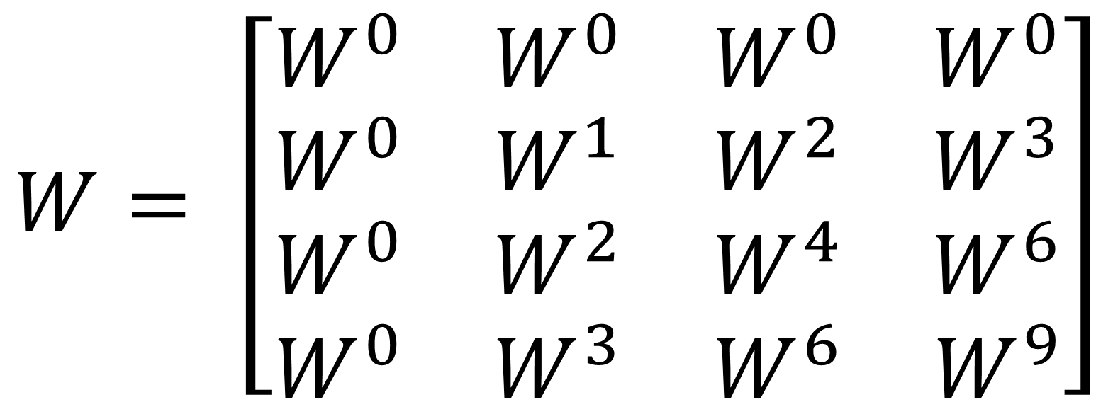
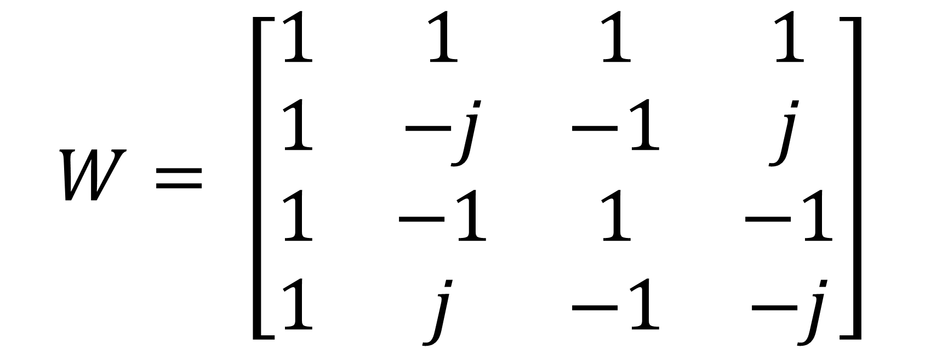
$$W= \left[\begin{matrix}W^{0} & W^{0} & W^{0} & W^{0} \\ W^{0} & W^{1} & W^{2} & W^{3} \\ W^{0} & W^{2} & W^{4} & W^{6} \\ W^{0} & W^{3} & W^{6} & W^{9}\end{matrix}\right]$$
$$W= \left[\begin{matrix}1 & 1 & 1 & 1 \\ 1 & −j & −1 & j \\ 1 & −1 & 1 & −1 \\ 1 & j & −1 & −j\end{matrix}\right]$$

Slide 11
Four-Point DFT
$$W_{3}= \left[\begin{matrix}W_{3}^{0} & W_{3}^{0} & W_{3}^{0} \\ W_{3}^{0} & W_{3}^{1} & W_{3}^{2} \\ W_{3}^{0} & W_{3}^{2} & W_{3}^{4}\end{matrix}\right]=\left[\begin{matrix}1 & 1 & 1 \\ 1 & −\frac{1}{2}−j\frac{\sqrt{3}}{2} & −\frac{1}{2}+j\frac{\sqrt{3}}{2} \\ 1 & −\frac{1}{2}+j\frac{\sqrt{3}}{2} & −\frac{1}{2}−j\frac{\sqrt{3}}{2}\end{matrix}\right]$$

Slide 12


Example: Calculate the 1-point Discrete Fourier Transform (DFT) of given sequence $x\left[n\right]=[5]$
$$W_{1}=\left[W_{1}^{0}\right]=\left[1\right]$$
$$\left[X(0)\right]=\left[W_{1}^{0}\right]\left[x(0)\right]=\left[1\right]\left[5\right]=5 Answer$$

Slide 13
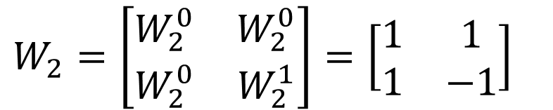
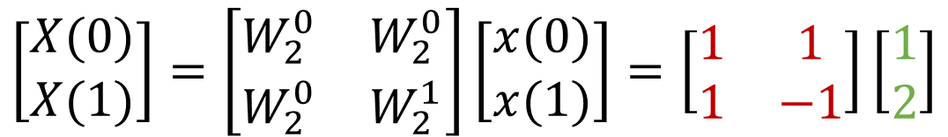
Q: Find the 2 point DFT of x(n) = {1,2}
SOLUTION
$$\left[\begin{aligned}X(0) \\ X(1)\end{aligned}\right]=\left[\begin{matrix}W_{2}^{0} & W_{2}^{0} \\ W_{2}^{0} & W_{2}^{1}\end{matrix}\right]\left[\begin{aligned}x(0) \\ x(1)\end{aligned}\right]=\left[\begin{matrix}1 & 1 \\ 1 & −1\end{matrix}\right]\left[\begin{aligned}1 \\ 2\end{aligned}\right]$$
$$W_{2}=\left[\begin{matrix}W_{2}^{0} & W_{2}^{0} \\ W_{2}^{0} & W_{2}^{1}\end{matrix}\right]=\left[\begin{matrix}1 & 1 \\ 1 & −1\end{matrix}\right]$$
$$X\left(0\right)=1∗1+1∗2=1+2=3$$
$$X\left(1\right)=1∗1−1∗2=1−2=−1$$
$$X\left[k\right]=\left[X\left(0\right), X\left(1\right)\right]=\left[3, −1\right] Answer$$

Slide 14

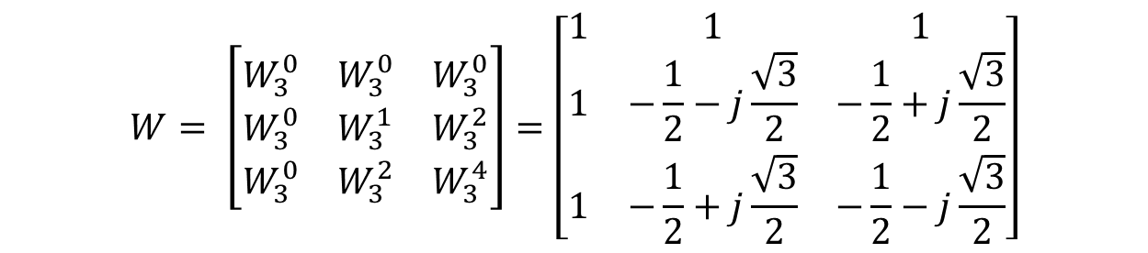
Example: Calculate the 3-point Discrete Fourier Transform (DFT) of given sequence $x\left[n\right]=[1,2,3]$
$$W= \left[\begin{matrix}W_{3}^{0} & W_{3}^{0} & W_{3}^{0} \\ W_{3}^{0} & W_{3}^{1} & W_{3}^{2} \\ W_{3}^{0} & W_{3}^{2} & W_{3}^{4}\end{matrix}\right]=\left[\begin{matrix}1 & 1 & 1 \\ 1 & −\frac{1}{2}−j\frac{\sqrt{3}}{2} & −\frac{1}{2}+j\frac{\sqrt{3}}{2} \\ 1 & −\frac{1}{2}+j\frac{\sqrt{3}}{2} & −\frac{1}{2}−j\frac{\sqrt{3}}{2}\end{matrix}\right]$$
$$\frac{360}{3}=120, so first point is on 0 degree, second point on$$
$$120 degree and third point on 240 degree$$

Slide 15
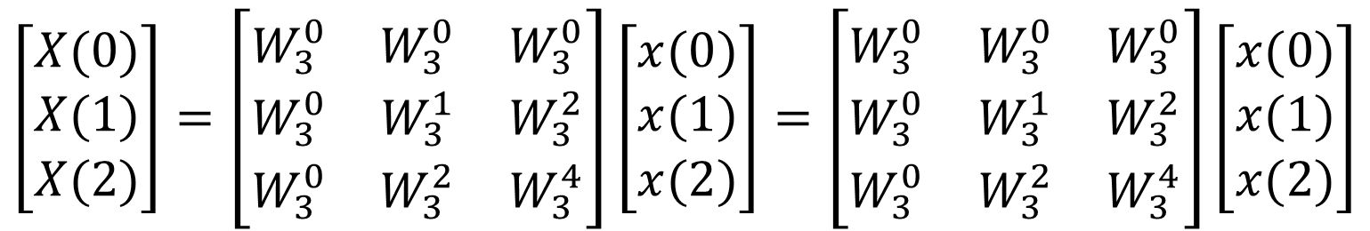
Q: Find the 3 point DFT of x(n) = {1,2,3}
SOLUTION
$$\left[\begin{aligned}X(0) \\ X(1) \\ X(2)\end{aligned}\right]=\left[\begin{matrix}W_{3}^{0} & W_{3}^{0} & W_{3}^{0} \\ W_{3}^{0} & W_{3}^{1} & W_{3}^{2} \\ W_{3}^{0} & W_{3}^{2} & W_{3}^{4}\end{matrix}\right]\left[\begin{aligned}x(0) \\ x(1) \\ x(2)\end{aligned}\right]=\left[\begin{matrix}W_{3}^{0} & W_{3}^{0} & W_{3}^{0} \\ W_{3}^{0} & W_{3}^{1} & W_{3}^{2} \\ W_{3}^{0} & W_{3}^{2} & W_{3}^{4}\end{matrix}\right]\left[\begin{aligned}x(0) \\ x(1) \\ x(2)\end{aligned}\right]$$

Slide 16
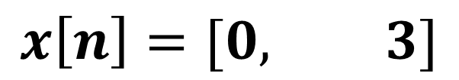
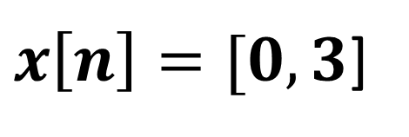

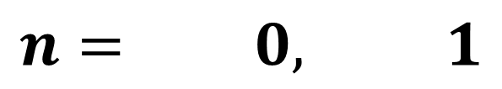
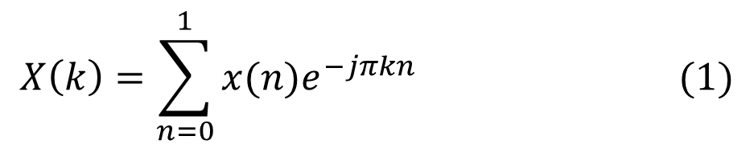
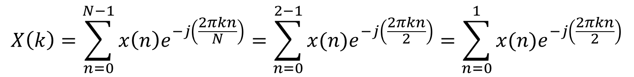
Example: Calculate the 2-point Discrete Fourier Transform (DFT) of given sequence $x\left[n\right]=[0,3]$
$x\left[n\right]=[0,3$]
SOLUTION
$$x\left[n\right]=[0, 3]$$
X(0) = 0
X(1) = 3
$$n= 0, 1$$
STEP:-1: Check Length of Sequence is = N = 2, then value of k is also two, k = 0, 1
$$X\left(k\right)=\sum_{n=0}^{N−1}{x\left(n\right)e^{−j\left(\frac{2πkn}{N}\right)}=\sum_{n=0}^{2−1}{x(n)e^{−j\left(\frac{2πkn}{2}\right)}}=\sum_{n=0}^{1}{x(n)e^{−j\left(\frac{2πkn}{2}\right)}}}$$
$$X\left(k\right)=\sum_{n=0}^{1}{x(n)e^{−jπkn}} (1)$$

Slide 17

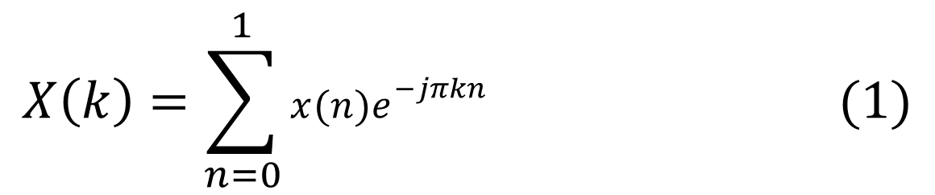
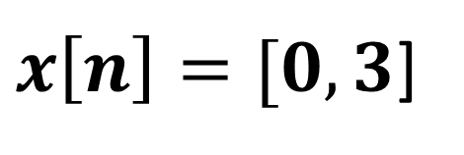
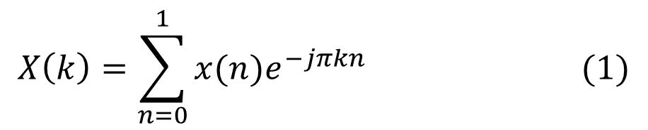
$x\left[n\right]=[0,3$]
STEP:-2: Put k = 0 in equation (1)
$$X\left(k\right)=\sum_{n=0}^{1}{x(n)e^{−jπkn}} (1)$$
X(0) = 0
X(1) = 3
$$X\left(0\right)=\sum_{n=0}^{1}{x(n)e^{−jπkn}}=\sum_{n=0}^{1}{x(n)e^{0}}=\sum_{n=0}^{1}{x\left(n\right)∗1=\sum_{n=0}^{1}{x\left(n\right)=x\left(0\right)+x\left(1\right)=0 +3=3}}$$
STEP:-2: Put k = 1 in equation (1)
$$X\left(k\right)=\sum_{n=0}^{1}{x(n)e^{−jπkn}} (1)$$
$$X\left(1\right)=\sum_{n=0}^{1}{x(n)e^{−jπkn}}=\sum_{n=0}^{1}{x(n)e^{−jπ∗1∗n}}=\sum_{n=0}^{1}{x(n)e^{−jπn}}$$
$$X\left(1\right)=x\left(0\right)e^{0}+x\left(1\right)e^{−jπ∗1}= x\left(0\right)∗1+x\left(1\right)e^{−jπ}$$

Slide 18
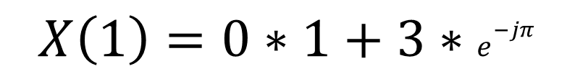
$x\left[n\right]=[0,3$]
$$X\left(1\right)=x\left(0\right)e^{0}+x\left(1\right)e^{−jπ∗1}= x\left(0\right)∗1+x\left(1\right)e^{−jπ}$$
X(0) = 0
X(1) = 3
$$X\left(1\right)=0∗1+3∗e^{−jπ}$$
$$X\left(1\right)=3∗e^{−jπ}=3∗e^{−j\left(π\right)}=3\left(−1+j0\right)=−3$$
$$X\left[k\right]=\left[X\left(0\right), X\left(1\right)\right]=\left[3,−3\right] Answer$$

Slide 19
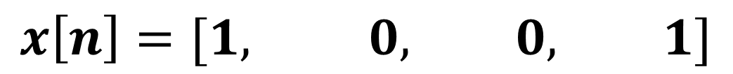
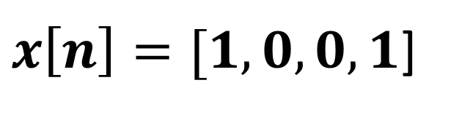

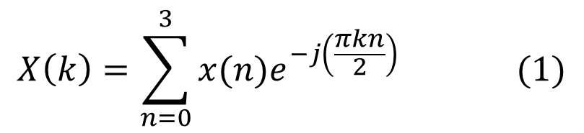
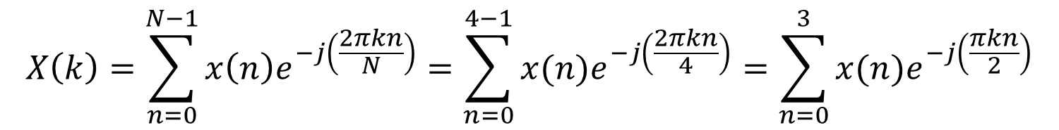
Example: Calculate the 4-point Discrete Fourier Transform (DFT) of given sequence $x\left[n\right]=[1,0,0,1]$
$x\left[n\right]=[1,0,0,1$]
SOLUTION
$$x\left[n\right]=[1, 0, 0, 1]$$
X(3) = 1
X(0) = 1
X(1) = 0
X(2) = 0
$$n= 0, 1, 2, 3$$
STEP:-1: Check Length of Sequence is = N = 4, then value of k is also four, k = 0, 1,2,3
$$X\left(k\right)=\sum_{n=0}^{N−1}{x\left(n\right)e^{−j\left(\frac{2πkn}{N}\right)}=\sum_{n=0}^{4−1}{x(n)e^{−j\left(\frac{2πkn}{4}\right)}}=\sum_{n=0}^{3}{x(n)e^{−j\left(\frac{πkn}{2}\right)}}}$$
$$X\left(k\right)=\sum_{n=0}^{3}{x(n)e^{−j\left(\frac{πkn}{2}\right)}} (1)$$

Slide 20
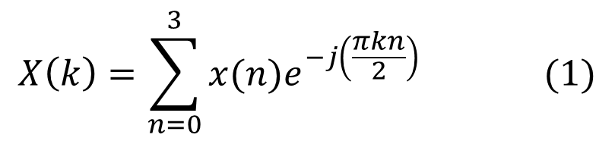
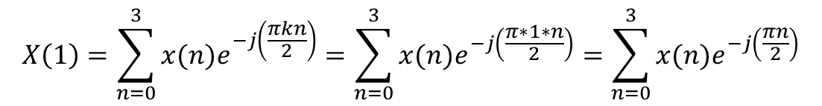
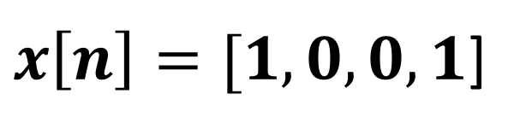
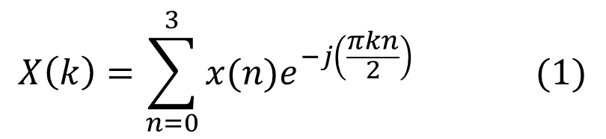
STEP:-2: Put k = 0 in equation (1)
$x\left[n\right]=[1,0,0,1$]
$$X\left(k\right)=\sum_{n=0}^{3}{x(n)e^{−j\left(\frac{πkn}{2}\right)}} (1)$$
X(3) = 1
X(0) = 1
X(1) = 0
X(2) = 0
$$X\left(0\right)=\sum_{n=0}^{3}{x(n)e^{−j\left(\frac{πkn}{2}\right)}}=\sum_{n=0}^{3}{x(n)e^{0}}=\sum_{n=0}^{3}{x\left(n\right)∗1=\sum_{n=0}^{3}{x\left(n\right)=x\left(0\right)∗1+x\left(1\right)∗1+x\left(2\right)∗1+x\left(3\right)∗1}}$$
$$X\left(0\right)=1∗1+0∗1+0∗1+1∗1=1+1=2$$
STEP:-2: Put k = 1 in equation (1)
$$X\left(k\right)=\sum_{n=0}^{3}{x(n)e^{−j\left(\frac{πkn}{2}\right)}} (1)$$
$$X\left(1\right)=\sum_{n=0}^{3}{x(n)e^{−j\left(\frac{πkn}{2}\right)}}=\sum_{n=0}^{3}{x(n)e^{−j\left(\frac{π∗1∗n}{2}\right)}}=\sum_{n=0}^{3}{x(n)e^{−j\left(\frac{πn}{2}\right)}}$$
$$X\left(1\right)=x\left(0\right)e^{0}+x\left(1\right)e^{−j\left(\frac{π∗1}{2}\right) }+x\left(2\right)e^{−j\left(\frac{π∗2}{2}\right) }+x\left(3\right)e^{−j\left(\frac{π∗3}{2}\right) }$$

Slide 21
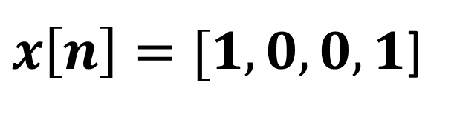
$$X\left(1\right)=x\left(0\right)e^{0}+x(1)e^{−j\left(\frac{π∗1}{2}\right) }+x\left(2\right)e^{−j\left(\frac{π∗2}{2}\right) }+x\left(3\right)e^{−j\left(\frac{π∗3}{2}\right) }$$
$x\left[n\right]=[1,0,0,1$]
$$X\left(1\right)=x\left(0\right)e^{0}+x\left(1\right)e^{−j\left(\frac{π}{2}\right) }+x\left(2\right)e^{−j\left(π\right) }+x\left(3\right)e^{−j\left(\frac{3π}{2}\right) }$$
X(3) = 1
X(0) = 1
X(1) = 0
X(2) = 0
$$X\left(1\right)=1∗1+0∗e^{−j\left(\frac{π}{2}\right) }+0∗e^{−j\left(π\right) }+1∗e^{−j\left(\frac{3π}{2}\right) }$$
$$X\left(1\right)=1+0+0+e^{−j\left(\frac{3π}{2}\right) }=1+(0−j) =1−j$$

Slide 22
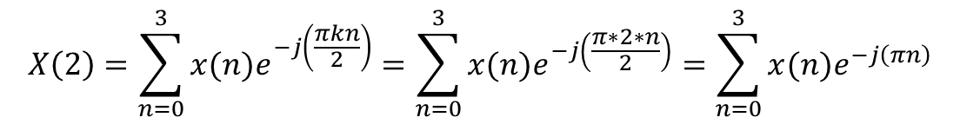
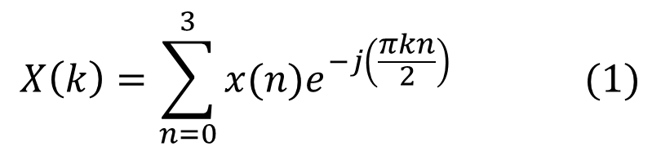
STEP:-2: Put k = 2 in equation (1)
$x\left[n\right]=[1,0,0,1$]
$$X\left(k\right)=\sum_{n=0}^{3}{x(n)e^{−j\left(\frac{πkn}{2}\right)}} (1)$$
X(3) = 1
X(0) = 1
X(1) = 0
X(2) = 0
$$X\left(2\right)=\sum_{n=0}^{3}{x(n)e^{−j\left(\frac{πkn}{2}\right)}}=\sum_{n=0}^{3}{x(n)e^{−j\left(\frac{π∗2∗n}{2}\right)}}=\sum_{n=0}^{3}{x(n)e^{−j\left(πn\right)}}$$
$$X\left(2\right)=x\left(0\right)e^{0}+x\left(1\right)e^{−j\left(π∗1\right)}+x\left(2\right)e^{−j\left(π∗2\right)}+x\left(3\right)e^{−j\left(π∗3\right)}$$
$$X\left(2\right)=1∗1+0∗e^{−j\left(π\right)}+0∗e^{−j\left(2π\right)}+1∗e^{−j\left(3π\right)}$$
$X\left(2\right)=1+0+0+1∗e^{−3j\left(π\right)}=1+[−1+j∗0$]
$X\left(2\right)=1+\left[−1+0\right]=1 −1=0$

Slide 23
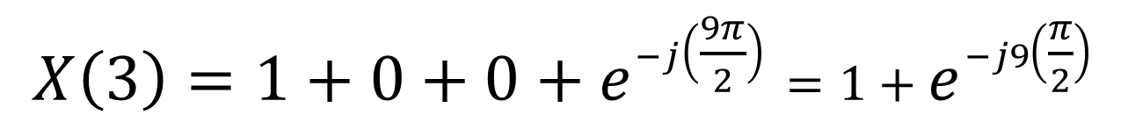
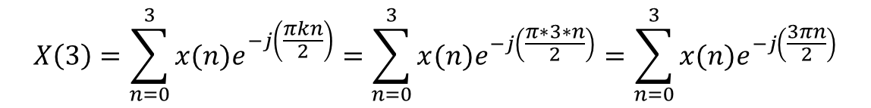
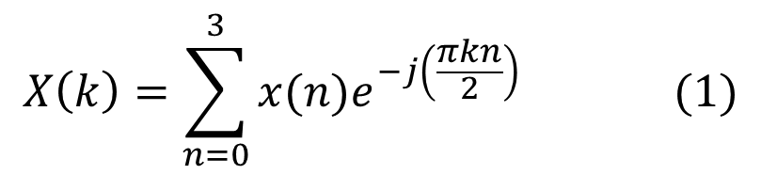
STEP:-2: Put k = 3 in equation (1)
$x\left[n\right]=[1,0,0,1$]
$$X\left(k\right)=\sum_{n=0}^{3}{x(n)e^{−j\left(\frac{πkn}{2}\right)}} (1)$$
X(3) = 1
X(0) = 1
X(1) = 0
X(2) = 0
$$X\left(3\right)=\sum_{n=0}^{3}{x(n)e^{−j\left(\frac{πkn}{2}\right)}}=\sum_{n=0}^{3}{x(n)e^{−j\left(\frac{π∗3∗n}{2}\right)}}=\sum_{n=0}^{3}{x(n)e^{−j\left(\frac{3πn}{2}\right)}}$$
$$X\left(3\right)=x\left(0\right)e^{0}+x\left(1\right)e^{−j\left(\frac{3π∗1}{2}\right)}+x\left(2\right)e^{−j\left(\frac{3π∗2}{2}\right)}+x\left(3\right)e^{−j\left(\frac{3π∗3}{2}\right)}$$
$$X\left(3\right)=1∗1+0∗e^{−j\left(\frac{3π}{2}\right)}+0∗e^{−j\left(\frac{6π}{2}\right) }+1∗e^{−j\left(\frac{9π}{2}\right)}$$
$$X\left(3\right)=1+0+0+e^{−j\left(\frac{9π}{2}\right)}=1+e^{−j9\left(\frac{π}{2}\right)}$$
$$X\left(3\right)=1+\left[0+1j\right]=1+j$$
$$X\left[k\right]=\left[X\left(0\right),X\left(1\right),X\left(2\right),X\left(3\right)\right]=\left[2, 1−j, 0, 1+j\right] Answer$$

