Slide 1
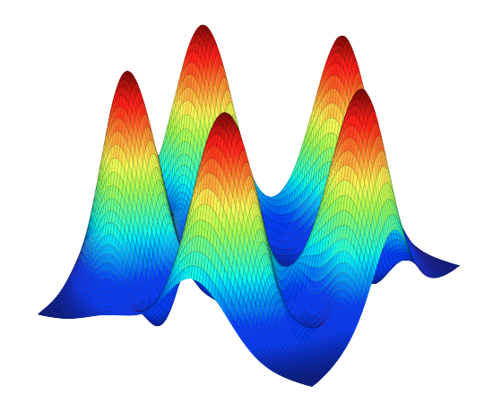
QuTiP: Quantum Toolbox in Python
an open-source framework for the dynamics of open quantum systems
http://code.google.com/p/qutip/
by
P.D. Nation
J.R. Johansson
(RIKEN)

Slide 2
Python and SCIPY
Python is a modern script language
  open source
  very easy to learn and use
  cross platform (Linux, Mac OS, etc.)
SCIPY is a collection of high-performance scientific libraries for python, including
  matrices, vectors, math functions, ode solvers, and much more
  close integration with matplotlib, a powerful graphics system for production-quality plots
The Python+SCIPY combination is a competitive alternative to propriety software for numerical calculations, such as MATLAB
  no license fees
  in widespread use in the computational physics communities
QuTiP uses the Python+SCIPY framework to provide an environment for the simulation of open quantum systems

Slide 3
Why use QuTiP?
Easy to use
Efficient
  Performance near that of compiled code: under the hood, it uses optimized low-level BLAS and LAPACK libraries for matrix operations, ARPACK for sparse matrices, etc.
  Built-in support for CPUs with multiple cores
Actively developed and easy to extend
Extensively tested
A large collection of quantum mechanics related functions
100% open source. No propriety software needed: no license fees
Well suited for running on clusters and supercomputers
Built-in quantum mechanics related plot functions:
  Bloch sphere, P-functions, Q-functions, Wigner functions, etc.
Closely resembles the Quantum Optics toolbox for MATLAB
  very easy to convert old programs using the QO toolbox to QuTiP

Slide 4
Features
System for easily creating
  Hamiltonians and Liouvillians
  wave functions and density matrices
  tracing out and combining components of quantum systems
Functions for calculating
  Expectation values, entanglement metrics, entropy, fidelity, ...
  Wigner function, P functions, Q functions, ...
ODE solvers for the Schrödinger and master equations
Monte-Carlo stochastic wave function solvers
Diagonalization, exponentiation, steady state solvers
Calculating correlation functions using the quantum regression theorem
Can do anything that the Quantum Optics toolbox can do, and more
  Arbitrarily time-dependent Hamiltonians and Liouvillians
  Visualization in Bloch spheres

Slide 5
Basics
Installation
  Vary depending on platform
  See instructions on the project web page for details:
  → http://code.google.com/p/qutip
Importing the QuTiP environment
  In the beginning of the program:
  1: #!/usr/bin/python
  2: from qutip import *
  Or directly from the interactive python prompt:
  >> from qutip import *

Slide 6
Quantum objects
The Qobj class is used for representing all quantum objects:
  operators, states, Hamiltonians and Liouvillians
  maintains information about the size and structure of the quantum objects
Qobj instances can be created
  manually, using the Qobj constructor that takes an array as argument:
  From a large library of predefined operators and states (see the following slides)
Operations on quantum objects:
  Arithmetic operation: plus, minus, multiplication and division with a C number, as overloaded operators:
>> psi = Qobj([[1], [0]])
>> print psi
Quantum object: dims = [[2], [1]], shape = [2, 1]
Qobj data =
[[1]
[0]]
>> sigma_z = Qobj([[0, 1], [1, 0]])
>> print sigma_z
Quantum object: dims = [[2], [2]], shape = [2, 2]
Qobj data =
[[0 1]
[1 0]]
>> psi_up = Qobj([[0], [1]])
>> psi_down = Qobj([[1], [0]])
>> psi = (psi_up + psi_down) / sqrt(2)
>> print psi
Quantum object: dims = [[2], [1]], shape = [2, 1]
Qobj data =
[[ 0.70710678]
[ 0.70710678]]

Slide 7
States and density matrices
>> print fock(4, 1)
Quantum object: dims = [[4], [1]], shape = [4, 1]
Qobj data =
[[ 0.]
[ 1.]
[ 0.]
[ 0.]]
>> print fock_dm(4, 1)
Quantum object: dims = [[4], [4]], shape = [4, 4]
Qobj data =
[[ 0. 0. 0. 0.]
[ 0. 1. 0. 0.]
[ 0. 0. 0. 0.]
[ 0. 0. 0. 0.]]
>> rho=tensor([fock_dm(2,0),fock_dm(2,1)])
>> print ptrace(rho,0)
Quantum object: dims = [[2], [2]], shape = [2, 2]
Qobj data =
[[ 1. 0.]
[ 0. 0.]]
>> print ptrace(rho,1)
Quantum object: dims = [[2], [2]], shape = [2, 2]
Qobj data =
[[ 0. 0.]
[ 0. 1.]]
Predefined states (N = size of the Hilbert space)
  Fock states
    fock(N, n) ← wave function
    fock_dm(N, n) ← density matrix
    n = the fock state number
  Coherent states
    coherent(N, alpha) ← wave function
    coherent_dm(N, alpha) ← density matrix
  Thermal states
    thermal_dm(N, n) ← density matrix
    n = average number of photons
Superposition states
  With simple arithmetic syntax:
  >> psi = ( psi1 + psi2 ) / sqrt(2)
Tensor combine states
  >> tensor([list of quantum states …])
Combined objects keeps track of its underlying structure
>> print tensor([fock(2,0), qeye()])
Quantum object: dims = [[2, 2], [2, 2]], shape = [4, 4]
...
So that they easily can be decomposed again, by doing a partial trace:
  >> rho_sub = ptrace(tensor([fock_dm(2,0), fock_dm(2)], 1)
  Quantum object: dims = [[2], [2]], shape = [2, 2]

Slide 8
Operators
Predefined operators
(N = number of states in the Hilbert space)
  Paul spin matrices
    sigmax(), sigmay() and sigmaz()
    sigmap() and sigmam()
  Creation and annihilation operators
    create(N), destroy(N)
  Identity operator
    qeye(N)
Tensor combine operators
  tensor([list of operators, …])
Combined objects keeps track of its underlying structure
>> print tensor([sigmax(), qeye()])
Quantum object: dims = [[2, 2], [2, 2]], shape = [4, 4]
...
>> print tensor([sigmax(), sigmax()])
Quantum object: dims = [[2, 2], [2, 2]], shape = [4, 4]
Qobj data =
[[ 0. 0. 0. 1.]
[ 0. 0. 1. 0.]
[ 0. 1. 0. 0.]
[ 1. 0. 0. 0.]]
>> print tensor([sigmax(), qeye(2)])
Quantum object: dims = [[2, 2], [2, 2]], shape = [4, 4]
Qobj data =
[[ 0. 0. 1. 0.]
[ 0. 0. 0. 1.]
[ 1. 0. 0. 0.]
[ 0. 1. 0. 0.]]

Slide 9
Hamiltonian: examples
Two-qubit Hamiltonian:
Jaynes-Cumings Hamiltonian:
>> sz1 = tensor([sigmaz(), qeye()])
>> sz2 = tensor([qeye(), sigmaz()])
>> sxsx = tensor([sigmax(), sigmax()])
>> H = sz1 + sz2 + 0.1 * sxsx
>> print H
Quantum object: dims = [[2, 2], [2, 2]], shape = [4, 4]
Qobj data =
[[ 2. 0. 0. 0.1]
[ 0. 0. 0.1 0. ]
[ 0. 0.1 0. 0. ]
[ 0.1 0. 0. -2. ]]
>> N = 10; w = 1; eps = 1; g = 0.01
>> a = tensor([destroy(N), qeye(2)])
>> sz = tensor([qeye(N), sigmaz()])
>> sm = tensor([qeye(N), sigmam()])
>> H = w * a.dag() * a + eps * sz + g * (a.dag() * sm + a * sm.dag())
>> print H
Quantum object: dims = [[10, 2], [10, 2]], shape = [20, 20]
Qobj data =
...

Slide 10
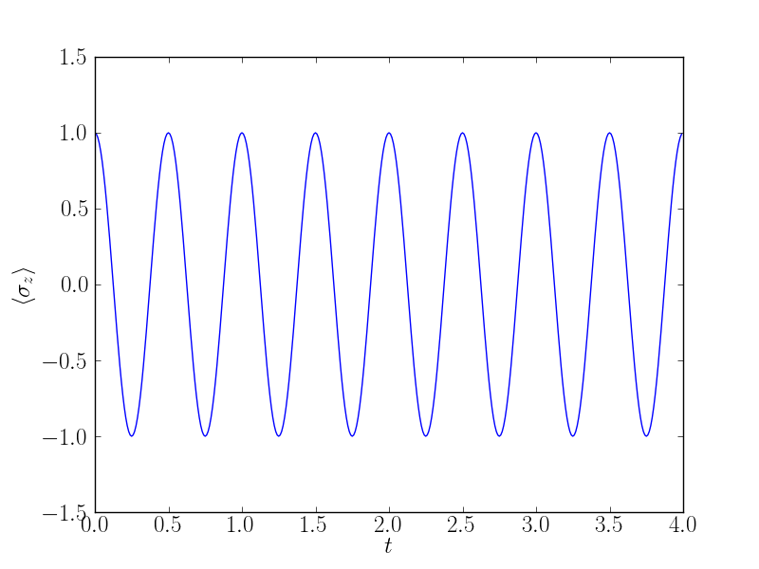
Unitary time evolution
ODE solver for the Schrödinger equation:
  expt_vals = ode_solve(H, psi0, tlist, [], expt_op_list)
    H = a Hamiltonian
    psi0 = an initial wave function
    tlist = a list of times at which to store the results
    expt_op_list = list of operators for which to calculate the expectation value for, at the times specified in tlist
Example:
>> H = 2 * pi * sigmax()
>> psi0 = fock(2, 0) # |0> state
>> tlist = arange(0.0, 4.0, 0.01)
>> expt_sz = ode_solve(H, psi0, tlist,[], [sigmaz()])
>> plot(tlist, expt_sz[0])
>> show()

Slide 11
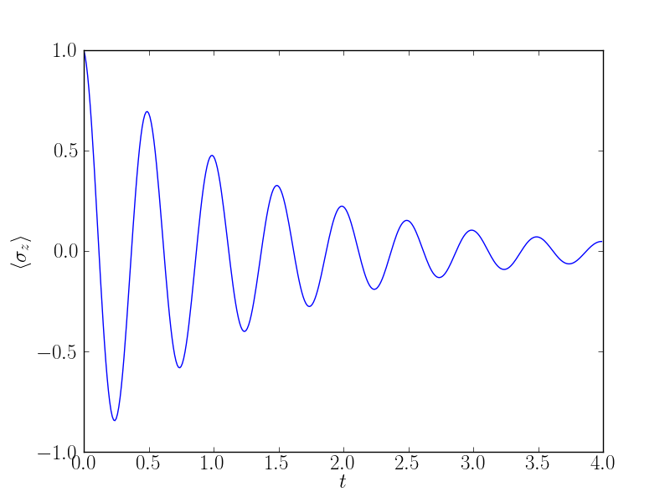
Dissipation: Master equation
ODE solver for the master equation:
  expt_vals = ode_solve(H, psi0, tlist, c_op_list, expt_op_list)
    H = a Hamiltonian
    psi0 = an initial wave function
    tlist = a list of times at which to store the results
    c_op_list = list of collapse operators
    expt_op_list = list of operators for which to calculate the expectation value for, at the times specified in tlist
Example:
>> H = 2 * pi * sigmax()
>> psi0 = fock(2, 0) # |0> state
>> gamma1 = 1.0
>> c_ops = [sqrt(gamma1) * sigmam()] # relaxation
>> expt_ops = [sigmaz()]
>> tlist = arange(0.0, 4.0, 0.01)
>> expt_sz = ode_solve(H, psi0,tlist,c_ops,expt_ops)
>> plot(tlist, expt_sz[0])

Slide 12
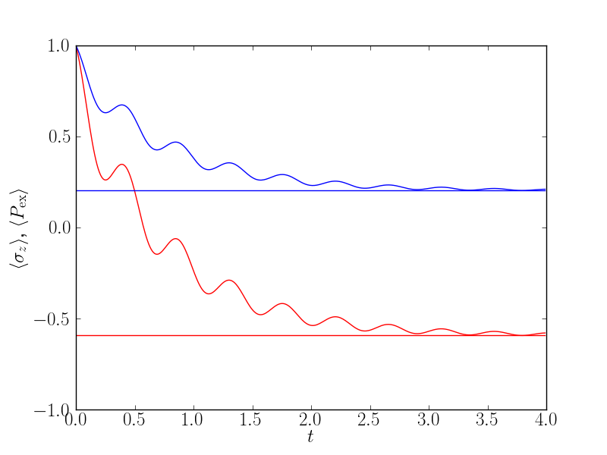
Dissipation: Steady state
Finding the steady state of a open quantum system:
  rho_ss = steadystate(H, c_op_list)
    H = a Hamiltonian
    c_op_list = list of collapse operators
    rho_ss = the steady state density matrix
Example:
>> H = 2 * pi * (1.0 * sigmaz() + 0.5 * sigmax())
>> sm = sigmam()
>> g1 = 1.0 # rate
>> n_th = 0.25 # temperature factor
>> c_op_list = [sqrt(g1*(n_th+1)) * sm, sqrt(g1*n_th) * sm.dag()]
>> rho_ss = steadystate(H, c_op_list)
>> print "<sigma_z>_ss =", expect(sigmaz(), rho_ss)
<sigma_z>_ss = -0.592826392093
>> print "<P_ex>_ss =", expect(sm.dag() * sm, rho_ss)
<P_ex>_ss = 0.203586803953

Slide 13
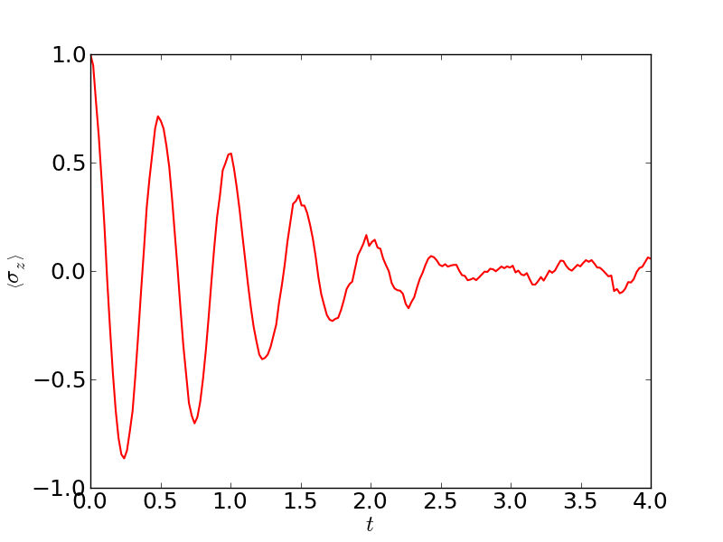
Dissipation: Monte-Carlo solver
Stochastic wavefunction Monte-Carlo solver
  expt_vals = mcsolve(H, psi0, tlist, ntraj, c_op_list, expt_op_list)
    H = a Hamiltonian
    psi0 = an initial wave function
    tlist = a list of times at which to store the results
    ntraj = number of monte carlo trajectories
    c_op_list = list of collapse operators
    expt_op_list = list of operators for which to calculate the expectation value for, at the times specified in tlist
>> H = 2 * pi * sigmax()
>> psi0 = fock(2, 0) # |0> state
>> gamma1 = 1.0
>> c_ops = [sqrt(gamma1) * sigmam()] # relaxation
>> expt_ops = [sigmaz()]
>> tlist = arange(0.0, 4.0, 0.01)
>> ntraj = 100
>> expt_sz = mcsolve(H, psi0,tlist,ntraj,c_ops,expt_ops)
>> plot(tlist, expt_sz[0])

Slide 14
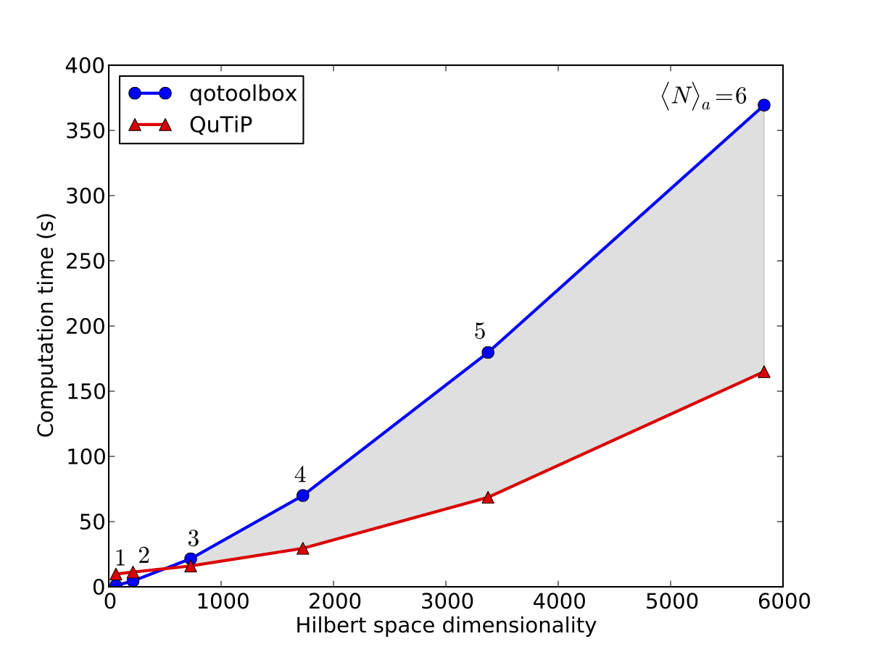
Monte-Carlo solver: Performance

Slide 15
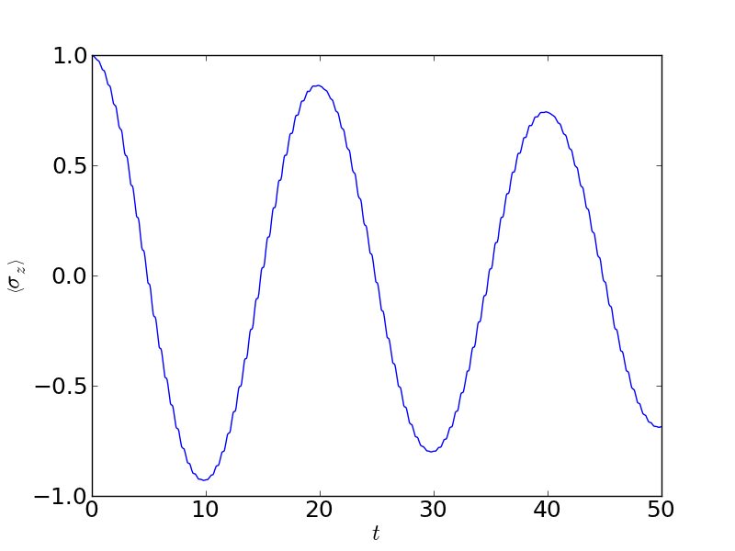
Time-dependent Hamiltonian
ODE solver for the time-dependent master equation:
  expt_vals = ode_solve(H_func, psi0, tlist, c_list, e_list, H_param)
    H _func = a callback function returning the Hamiltonian at a time t
    psi0 = an initial wave function
    tlist = a list of times at which to store the results
    c_list = list of collapse operators
    e_list = list of operators for which to calculate the expectation value for
    H_args = arguments for the function H_func(t) that calculates the Hamiltonian
Example: Rabi oscillations with damping
>> def H_t(t, args):
>> H0 = args[0]
>> H1 = args[1]
>> w = args[2]
>> return H0 + H1 * sin(w * t)
>>
>> H0 = - 2*pi * 1.0/2.0 * sigmaz()
>> H1 = - 2*pi * 0.05 * sigmax()
>> H_args = (H0, H1, 2*pi*1.0)
>> psi0 = fock(2, 0) # |0> state
>> clst = [sqrt(0.01) * sigmam()] # relaxation
>> tlst = arange(0.0, 50.0, 0.01)
>> expt_sz = ode_solve(H_t,psi0,tlst,clst,[sigmaz()],H_args)

Slide 16
Conclusions
Introduced QuTiP:
  an open-source framework for the time evolution of open quantum systems
Described how to setup simple calculations
Described the main solvers for quantum evolution
  Master equation, Monte-Carlo, steadystate, time-dependent solver
Feel free to try it out. It's free!
  http://code.google.com/p/qutip

