Slide 1
Laplace Transform of Any Constant Integer

Slide 2


$$Q:Calculate the Laplace Transform of f\left(t\right)=1$$
SOLUTION
$$F\left(s\right)= \int_{0}^{∞}{e^{−st}∗f\left(t\right)dt=\int_{0}^{∞}{e^{−st}∗1dt=\int_{0}^{∞}{e^{−st}dt=(\frac{e^{−st}}{−s}{) ⏐}_{0}^{∞}=}}}−\frac{1}{s}(e^{−s∗∞}−e^{−s∗0})$$
$$\int{e^{ax}dx=\frac{e^{ax}}{a}}$$
$$F\left(s\right)= −\frac{1}{s}\left(e^{−s∗∞}−e^{−s∗0}\right)=−\frac{1}{s}\left(0−1\right)=\frac{1}{s} −−−Answer$$
$$Q:Calculate the Laplace Transform of f\left(t\right)=2$$
$$\int{e^{−ax}dx=\frac{e^{−ax}}{−a}}$$
SOLUTION
$$F\left(s\right)= \int_{0}^{∞}{e^{−st}∗f\left(t\right)dt=\int_{0}^{∞}{e^{−st}∗2dt=2∗\int_{0}^{∞}{e^{−st}dt=2∗(\frac{e^{−st}}{−s}{) ⏐}_{0}^{∞}=}}}−\frac{2}{s}(e^{−s∗∞}−e^{−s∗0})$$
$$F\left(s\right)= −\frac{2}{s}\left(e^{−s∗∞}−e^{−s∗0}\right)=−\frac{2}{s}\left(0−1\right)=\frac{2}{s} −−−Answer$$

Slide 3
Laplace Transform of Exponential Function

Slide 4


$$Q:Calculate the Laplace Transform of f\left(t\right)=e^{−2t}$$
SOLUTION
$$F\left(s\right)= \int_{0}^{∞}{e^{−st}∗f\left(t\right)dt=}\int_{0}^{∞}{e^{−st}∗e^{−2t}dt=\int_{0}^{∞}{e^{−st−2t}dt=\int_{0}^{∞}{e^{−(s+2)t}dt}}}$$
$$\int{e^{ax}dx=\frac{e^{ax}}{a}}$$
$$F\left(s\right)=(\frac{e^{−(s+2)t}}{−(s+2)}{) ⏐}_{0}^{∞}=−\frac{1}{(s+2)}\left(e^{−∞}−e^{∗0}\right)=−\frac{1}{(s+2)}\left(0−1\right)=\frac{1}{s+2} −−−Answer$$
$$Q:Calculate the Laplace Transform of f\left(t\right)=e^{−3t}$$
$$\int{e^{−ax}dx=\frac{e^{−ax}}{−a}}$$
SOLUTION
$$F\left(s\right)= \int_{0}^{∞}{e^{−st}∗f\left(t\right)dt=}\int_{0}^{∞}{e^{−st}∗e^{−3t}dt=\int_{0}^{∞}{e^{−st−3t}dt=\int_{0}^{∞}{e^{−(s+3)t}dt}}}$$
$$F\left(s\right)=(\frac{e^{−(s+3)t}}{−(s+3)}{) ⏐}_{0}^{∞}=−\frac{1}{(s+3)}\left(e^{−∞}−e^{∗0}\right)=−\frac{1}{(s+3)}\left(0−1\right)=\frac{1}{s+3} −−−Answer$$

Slide 5
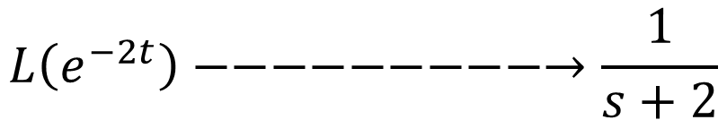

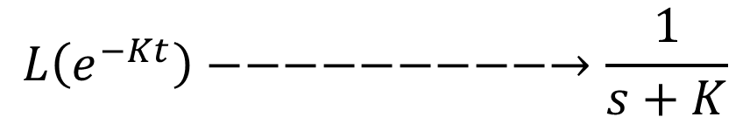
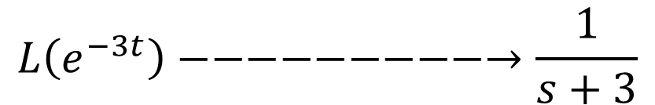
$$Q:Calculate the Laplace Transform of f\left(t\right)=e^{−Kt}$$
SOLUTION
$$F\left(s\right)= \int_{0}^{∞}{e^{−st}∗f\left(t\right)dt=}\int_{0}^{∞}{e^{−st}∗e^{−Kt}dt=\int_{0}^{∞}{e^{−st−Kt}dt=\int_{0}^{∞}{e^{−(s+K)t}dt}}}$$
$$\int{e^{ax}dx=\frac{e^{ax}}{a}}$$
$$F\left(s\right)=(\frac{e^{−(s+K)t}}{−(s+K)}{) ⏐}_{0}^{∞}=−\frac{1}{(s+K)}\left(e^{−∞}−e^{∗0}\right)=−\frac{1}{(s+K)}\left(0−1\right)=\frac{1}{s+K} −−−Answer$$
$$General Formula$$
$$\int{e^{−ax}dx=\frac{e^{−ax}}{−a}}$$
$$L\left(e^{−2t}\right)−−−−−−−−−→\frac{1}{s+2}$$
$$L\left(e^{−3t}\right)−−−−−−−−−→\frac{1}{s+3}$$
$$L\left(e^{−Kt}\right)−−−−−−−−−→\frac{1}{s+K}$$

Slide 6
$$Q:Calculate the Laplace Transform of f\left(t\right)=e^{2t}$$
SOLUTION
$$F\left(s\right)= \int_{0}^{∞}{e^{−st}∗f\left(t\right)dt=}\int_{0}^{∞}{e^{−st}∗e^{2t}dt=\int_{0}^{∞}{e^{−st+2t}dt=\int_{0}^{∞}{e^{−(s−2)t}dt}}}$$
$$F\left(s\right)=(\frac{e^{−(s−2)t}}{−(s−2)}{) ⏐}_{0}^{∞}=−\frac{1}{(s−2)}\left(e^{−∞}−e^{∗0}\right)=−\frac{1}{(s−2)}\left(0−1\right)=\frac{1}{s−2} −−−Answer$$
$$Q:Calculate the Laplace Transform of f\left(t\right)=e^{3t}$$
SOLUTION
$$F\left(s\right)= \int_{0}^{∞}{e^{−st}∗f\left(t\right)dt=}\int_{0}^{∞}{e^{−st}∗e^{3t}dt=\int_{0}^{∞}{e^{−st+3t}dt=\int_{0}^{∞}{e^{−(s−3)t}dt}}}$$
$$F\left(s\right)=(\frac{e^{−(s−3)t}}{−(s−3)}{) ⏐}_{0}^{∞}=−\frac{1}{(s−3)}\left(e^{−∞}−e^{∗0}\right)=−\frac{1}{(s−3)}\left(0−1\right)=\frac{1}{s−3} −−−Answer$$

Slide 7
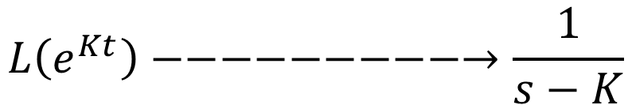
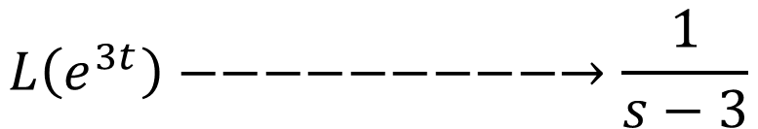
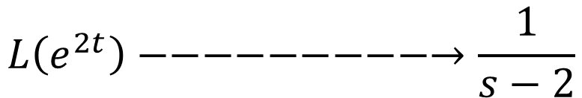
$$Q:Calculate the Laplace Transform of f\left(t\right)=e^{Kt}$$
SOLUTION
$$F\left(s\right)= \int_{0}^{∞}{e^{−st}∗f\left(t\right)dt=}\int_{0}^{∞}{e^{−st}∗e^{Kt}dt=\int_{0}^{∞}{e^{−st+Kt}dt=\int_{0}^{∞}{e^{−(s−K)t}dt}}}$$
$$F\left(s\right)=(\frac{e^{−(s−K)t}}{−(s−K)}{) ⏐}_{0}^{∞}=−\frac{1}{(s−K)}\left(e^{−∞}−e^{∗0}\right)=−\frac{1}{(s−K)}\left(0−1\right)=\frac{1}{s−K} −−−Answer$$
$$General Formula$$
$$L\left(e^{2t}\right)−−−−−−−−−→\frac{1}{s−2}$$
$$L\left(e^{3t}\right)−−−−−−−−−→\frac{1}{s−3}$$
$$L\left(e^{Kt}\right)−−−−−−−−−→\frac{1}{s−K}$$

Slide 8
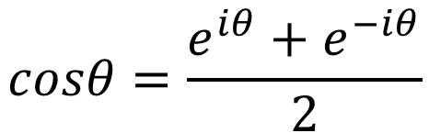
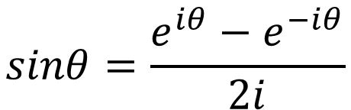
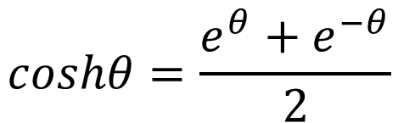
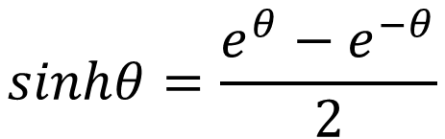
Laplace Transform of Trigonometric Function
Euler’s Identity
$$sinθ=\frac{e^{iθ}−e^{−iθ}}{2i}$$
$$sinhθ=\frac{e^{θ}−e^{−θ}}{2}$$
$$cosθ=\frac{e^{iθ}+e^{−iθ}}{2}$$
$$coshθ=\frac{e^{θ}+e^{−θ}}{2}$$

Slide 9
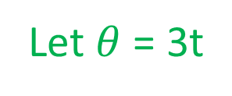
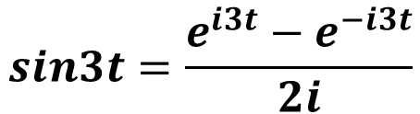
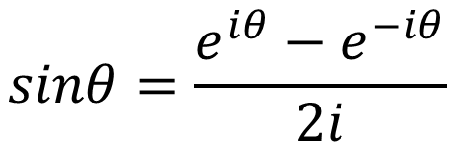
$$Q:Calculate the Laplace Transform of f\left(t\right)=sin3t$$
$$sinθ=\frac{e^{iθ}−e^{−iθ}}{2i}$$
SOLUTION
Let $θ$ = 3t
$$sin3t=\frac{e^{i3t}−e^{−i3t}}{2i}$$
$$F\left(s\right)=L\left(sin3t\right)=L\left(\frac{e^{i3t}−e^{−i3t}}{2i}\right)=\frac{1}{2i}\left[L\left(e^{i3t}\right)−L\left(e^{−i3t}\right)\right]=\frac{1}{2i} [\frac{1}{s−i3} −\frac{1}{s+i3}]$$
$$F\left(s\right)=L\left(sin3t\right)=\frac{1}{2i} \left[\frac{s+i3−s+i3}{\left(s−i3\right)\left(s+i3\right)}\right]=\frac{1}{2i} \left[\frac{6i}{s^{2}−i^{2}3^{2}}\right]=\frac{3}{s^{2}+3^{2}} −−−Answer$$

Slide 10

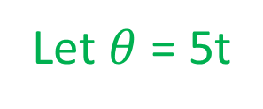
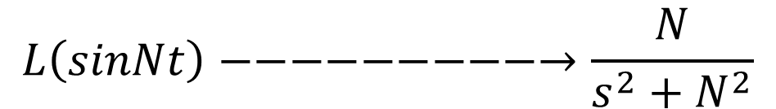
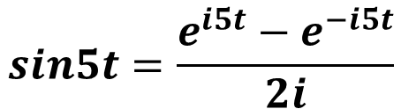
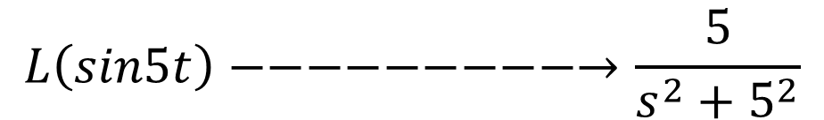
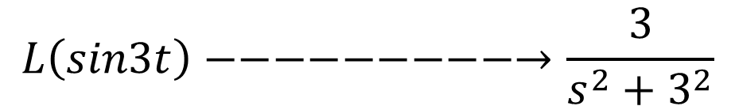
$$Q:Calculate the Laplace Transform of f\left(t\right)=sin5t$$
$$sinθ=\frac{e^{iθ}−e^{−iθ}}{2i}$$
SOLUTION
Let $θ$ = 5t
$$sin5t=\frac{e^{i5t}−e^{−i5t}}{2i}$$
$$F\left(s\right)=L\left(sin5t\right)=L\left(\frac{e^{i5t}−e^{−i5t}}{2i}\right)=\frac{1}{2i}\left[L\left(e^{i5t}\right)−L\left(e^{−i5t}\right)\right]=\frac{1}{2i} [\frac{1}{s−i5} −\frac{1}{s+i5}]$$
$$F\left(s\right)=L\left(sin5t\right)=\frac{1}{2i} \left[\frac{s+i5−s+i5}{\left(s−i5\right)\left(s+i5\right)}\right]=\frac{1}{2i} \left[\frac{10i}{s^{2}−i^{2}5^{2}}\right]=\frac{5}{s^{2}+5^{2}} −−−Answer$$
$$General Formula$$
$$L\left(sin3t\right)−−−−−−−−−→\frac{3}{s^{2}+3^{2}}$$
$$L\left(sin5t\right)−−−−−−−−−→\frac{5}{s^{2}+5^{2}}$$
$$L\left(sinNt\right)−−−−−−−−−→\frac{N}{s^{2}+N^{2}}$$

Slide 11
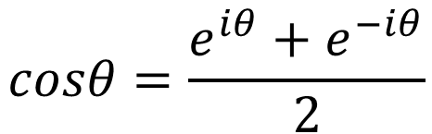
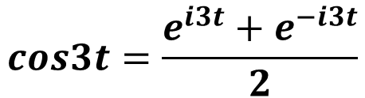
$$Q:Calculate the Laplace Transform of f\left(t\right)=cos3t$$
$$cosθ=\frac{e^{iθ}+e^{−iθ}}{2}$$
SOLUTION
Let $θ$ = 3t
$$cos3t=\frac{e^{i3t}+e^{−i3t}}{2}$$
$$F\left(s\right)=L\left(cos3t\right)=L\left(\frac{e^{i3t}+e^{−i3t}}{2}\right)=\frac{1}{2}\left[L\left(e^{i3t}\right)+L\left(e^{−i3t}\right)\right]=\frac{1}{2} [\frac{1}{s−i3}+\frac{1}{s+i3}]$$
$$F\left(s\right)=L\left(cos3t\right)=\frac{1}{2} \left[\frac{s+i3+s−i3}{\left(s−i3\right)\left(s+i3\right)}\right]=\frac{1}{2} \left[\frac{2s}{s^{2}−i^{2}3^{2}}\right]=\frac{s}{s^{2}+3^{2}} −−−Answer$$

Slide 12

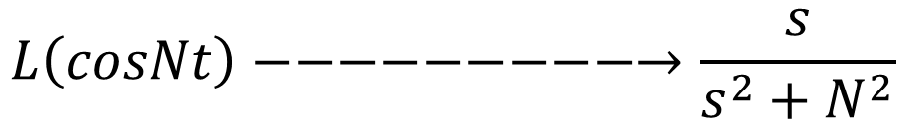
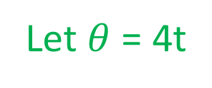
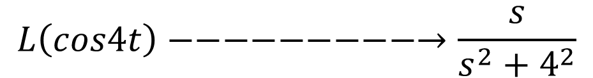
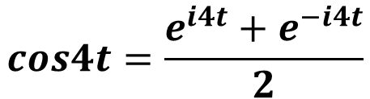
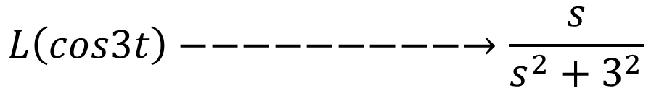
$$Q:Calculate the Laplace Transform of f\left(t\right)=cos4t$$
Let $θ$ = 4t
$$cosθ=\frac{e^{iθ}+e^{−iθ}}{2}$$
SOLUTION
$$cos4t=\frac{e^{i4t}+e^{−i4t}}{2}$$
$$F\left(s\right)=L\left(cos4t\right)=L\left(\frac{e^{i4t}+e^{−i4t}}{2}\right)=\frac{1}{2}\left[L\left(e^{i4t}\right)+L\left(e^{−i4t}\right)\right]=\frac{1}{2} [\frac{1}{s−i4}+\frac{1}{s+i4}]$$
$$F\left(s\right)=L\left(cos4t\right)=\frac{1}{2} \left[\frac{s+i4+s−i4}{\left(s−i4\right)\left(s+i4\right)}\right]=\frac{1}{2} \left[\frac{2s}{s^{2}−i^{2}4^{2}}\right]=\frac{s}{s^{2}+4^{2}} −−−Answer$$
$$General Formula$$
$$L\left(cos3t\right)−−−−−−−−−→\frac{s}{s^{2}+3^{2}}$$
$$L\left(cos4t\right)−−−−−−−−−→\frac{s}{s^{2}+4^{2}}$$
$$L\left(cosNt\right)−−−−−−−−−→\frac{s}{s^{2}+N^{2}}$$

Slide 13
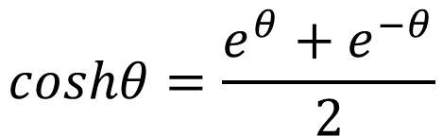
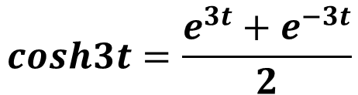
$$Q:Calculate the Laplace Transform of f\left(t\right)=cosh3t$$
$$coshθ=\frac{e^{θ}+e^{−θ}}{2}$$
SOLUTION
Let $θ$ = 3t
$$cosh3t=\frac{e^{3t}+e^{−3t}}{2}$$
$$F\left(s\right)=L\left(cosh3t\right)=L\left(\frac{e^{3t}+e^{−3t}}{2}\right)=\frac{1}{2}\left[L\left(e^{3t}\right)+L\left(e^{−3t}\right)\right]=\frac{1}{2} [\frac{1}{s−3}+\frac{1}{s+3}]$$
$$F\left(s\right)=L\left(cosh3t\right)=\frac{1}{2} \left[\frac{s+3+s−3}{\left(s−3\right)\left(s+3\right)}\right]=\frac{1}{2} \left[\frac{2s}{s^{2}−3^{2}}\right]=\frac{s}{s^{2}−3^{2}} −−−Answer$$

Slide 14

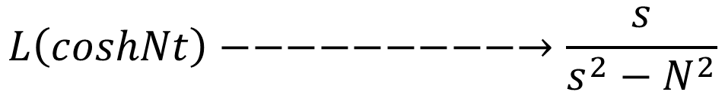

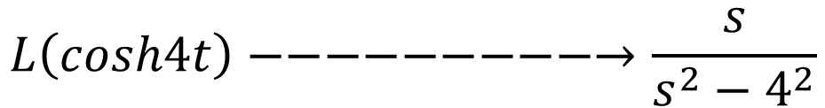
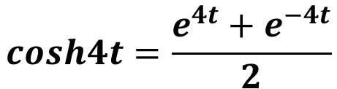
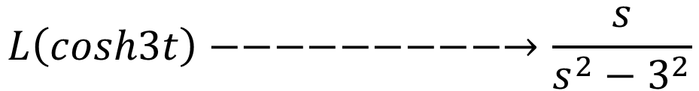
$$Q:Calculate the Laplace Transform of f\left(t\right)=cosh4t$$
$$coshθ=\frac{e^{θ}+e^{−θ}}{2}$$
Let $θ$ = 4t
$$cosh4t=\frac{e^{4t}+e^{−4t}}{2}$$
SOLUTION
$$F\left(s\right)=L\left(cosh4t\right)=L\left(\frac{e^{4t}+e^{−4t}}{2}\right)=\frac{1}{2}\left[L\left(e^{4t}\right)+L\left(e^{−4t}\right)\right]=\frac{1}{2} [\frac{1}{s−4}+\frac{1}{s+4}]$$
$$F\left(s\right)=L\left(cosh4t\right)=\frac{1}{2} \left[\frac{s+4+s−4}{\left(s−4\right)\left(s+4\right)}\right]=\frac{1}{2} \left[\frac{2s}{s^{2}−4^{2}}\right]=\frac{s}{s^{2}−4^{2}} −−−Answer$$
$$General Formula$$
$$L\left(cosh3t\right)−−−−−−−−−→\frac{s}{s^{2}−3^{2}}$$
$$L\left(cosh4t\right)−−−−−−−−−→\frac{s}{s^{2}−4^{2}}$$
$$L\left(coshNt\right)−−−−−−−−−→\frac{s}{s^{2}−N^{2}}$$

Slide 15
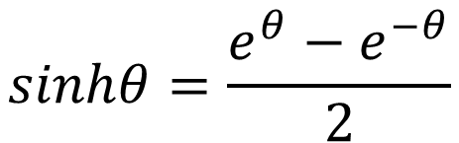
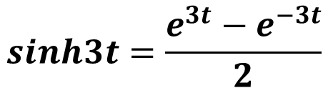
$$Q:Calculate the Laplace Transform of f\left(t\right)=sinh3t$$
$$sinhθ=\frac{e^{θ}−e^{−θ}}{2}$$
SOLUTION
Let $θ$ = 3t
$$sinh3t=\frac{e^{3t}−e^{−3t}}{2}$$
$$F\left(s\right)=L\left(sinh3t\right)=L\left(\frac{e^{3t}−e^{−3t}}{2}\right)=\frac{1}{2}\left[L\left(e^{3t}\right)−L\left(e^{−3t}\right)\right]=\frac{1}{2} [\frac{1}{s−3}−\frac{1}{s+3}]$$
$$F\left(s\right)=L\left(sinh3t\right)=\frac{1}{2} \left[\frac{s+3−s+3}{\left(s−3\right)\left(s+3\right)}\right]=\frac{1}{2} \left[\frac{6}{s^{2}−3^{2}}\right]=\frac{3}{s^{2}−3^{2}} −−−Answer$$

Slide 16
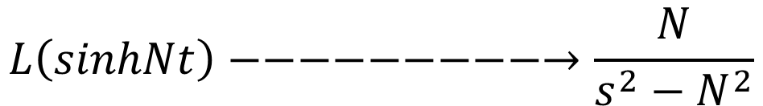

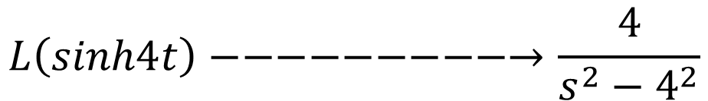
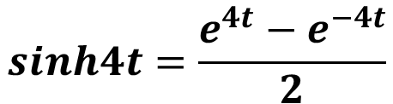
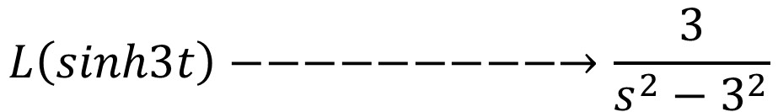
$$Q:Calculate the Laplace Transform of f\left(t\right)=sinh4t$$
$$sinhθ=\frac{e^{θ}−e^{−θ}}{2}$$
Let $θ$ = 4t
SOLUTION
$$sinh4t=\frac{e^{4t}−e^{−4t}}{2}$$
$$F\left(s\right)=L\left(sinh4t\right)=L\left(\frac{e^{4t}−e^{−4t}}{2}\right)=\frac{1}{2}\left[L\left(e^{4t}\right)−L\left(e^{−4t}\right)\right]=\frac{1}{2} [\frac{1}{s−4}−\frac{1}{s+4}]$$
$$F\left(s\right)=L\left(sinh4t\right)=\frac{1}{2} \left[\frac{s+4−s+4}{\left(s−4\right)\left(s+4\right)}\right]=\frac{1}{2} \left[\frac{8}{s^{2}−4^{2}}\right]=\frac{4}{s^{2}−4^{2}} −−−Answer$$
$$General Formula$$
$$L\left(sinh3t\right)−−−−−−−−−→\frac{3}{s^{2}−3^{2}}$$
$$L\left(sinh4t\right)−−−−−−−−−→\frac{4}{s^{2}−4^{2}}$$
$$L\left(sinhNt\right)−−−−−−−−−→\frac{N}{s^{2}−N^{2}}$$

Slide 17
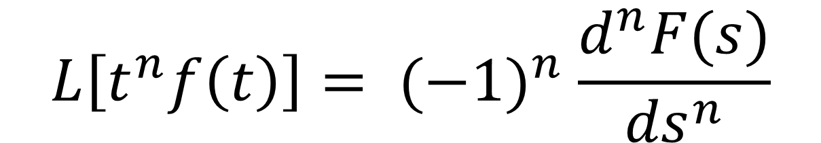
FREQUENCY DIFFERENTIATION PROPERTY
It is defined as Multiplication of t in time domain it is equivalent to differentiation in Frequency Domain.
$$L\left[t^{n}f\left(t\right)\right]= {(−1)}^{n} \frac{d^{n}F(s)}{{ds}^{n}}$$

Slide 18
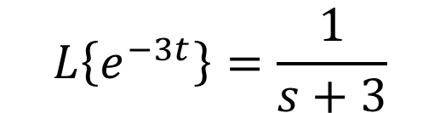
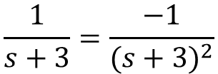
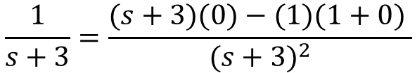
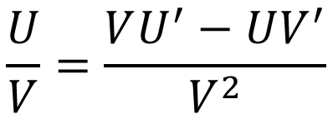
$$Q:Calculate the Laplace Transform of f\left(t\right)=t∗e^{−3t}.$$
SOLUTION
$$\frac{U}{V}=\frac{VU^{′}−UV^{′}}{V^{2}}$$
$$L\left\{e^{−3t}\right\}=\frac{1}{s+3}$$
$$\frac{1}{s+3}=\frac{(s+3)(0)−(1)(1+0) }{{(s+3)}^{2}}$$
Applying Frequency Differentiation Property
$$\frac{1}{s+3}=\frac{−1}{{(s+3)}^{2}}$$
$F\left(s\right)=L\{t∗e^{−3t}\}$ = ${\left(−1\right)}^{1} \frac{d}{ds}\left(\frac{1}{s+3}\right)$ = $−\frac{d}{ds}\left(\frac{1}{s+3}\right)$
$F\left(s\right)=L\{t∗e^{−3t}\}$ = $−∗\left\{\frac{−1}{{\left(s+3\right)}^{2}}\right\}=\frac{1}{{\left(s+3\right)}^{2}}−−−Answer$

Slide 19
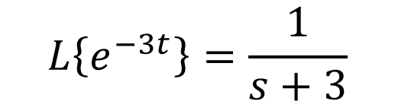
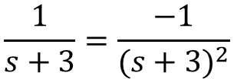
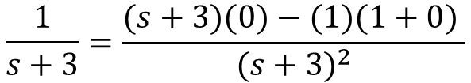
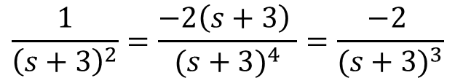



$$Q:Calculate the Laplace Transform of f\left(t\right)=t^{2}∗e^{−3t}.$$
$$\frac{U}{V}=\frac{VU^{′}−UV^{′}}{V^{2}}$$
SOLUTION
$$L\left\{e^{−3t}\right\}=\frac{1}{s+3}$$
$$\frac{1}{s+3}=\frac{(s+3)(0)−(1)(1+0) }{{(s+3)}^{2}}$$
Applying Frequency Differentiation Property
$$\frac{1}{s+3}=\frac{−1}{{(s+3)}^{2}}$$
$F\left(s\right)=L\{t^{2}∗e^{−3t}\}$ = ${\left(−1\right)}^{2}\frac{d^{2}}{{ds}^{2}}\left(\frac{1}{s+3}\right)$ = $\frac{d}{ds}\left(\frac{−1}{{\left(s+3\right)}^{2}}\right)\text{=}−\frac{d}{ds}\left(\frac{1}{{\left(s+3\right)}^{2}}\right)$
$F\left(s\right)=L\{t^{2}∗e^{−3t}\}$ $\text{=}−\frac{d}{ds}\left(\frac{1}{{\left(s+3\right)}^{2}}\right)$
$$\frac{1}{{\left(s+3\right)}^{2}}=\frac{{\left(s+3\right)}^{2}\left(0\right)−\left(1\right)2∗\left(s+3\right)∗1 }{{(s+3)}^{4}}$$
$$\frac{1}{{\left(s+3\right)}^{2}}=\frac{−2\left(s+3\right) }{{(s+3)}^{4}}=\frac{−2 }{{(s+3)}^{3}}$$
$F\left(s\right)=L\{t^{2}∗e^{−3t}\}$ $\text{=}−\frac{d}{ds}\left(\frac{1}{{\left(s+3\right)}^{2}}\right)=−\left\{\frac{−2 }{{\left(s+3\right)}^{3}}\right\}=\frac{2 }{{\left(s+3\right)}^{3}} −−−Answer$

Slide 20


$$Q:Calculate the Laplace Transform of f\left(t\right)=t^{3}∗e^{−3t}.$$
SOLUTION
$$\frac{U}{V}=\frac{VU^{′}−UV^{′}}{V^{2}}$$
$$L\left\{e^{−3t}\right\}=\frac{1}{s+3}$$
Applying Frequency Differentiation Property
$F\left(s\right)=L\{t^{3}∗e^{−3t}\}$ = ${\left(−1\right)}^{3}\frac{d^{3}}{{ds}^{3}}\left(\frac{1}{s+3}\right)$ = $\frac{d^{2}}{{ds}^{2}} \left(\frac{−1}{{\left(s+3\right)}^{2}}\right)\text{=}−\frac{d^{2}}{{ds}^{2}}\left(\frac{1}{{\left(s+3\right)}^{2}}\right)$
$F\left(s\right)=L\{t^{3}∗e^{−3t}\}$ = $−\frac{d^{2}}{{ds}^{2}}\left(\frac{1}{{\left(s+3\right)}^{2}}\right)=−\frac{d}{ds}\left(\frac{2}{{\left(s+3\right)}^{3}}\right)$
$$\frac{2}{{\left(s+3\right)}^{3}}=\frac{{\left(s+3\right)}^{3}∗0−2∗3{\left(s+3\right)}^{2}∗1}{{\left(s+3\right)}^{6}}=\frac{−6{\left(s+3\right)}^{2}}{{\left(s+3\right)}^{6}}=\frac{−6}{{\left(s+3\right)}^{4}}$$
$F\left(s\right)=L\{t^{3}∗e^{−3t}\}$ = $−\frac{d}{ds}\left(\frac{2}{{\left(s+3\right)}^{3}}\right)=−\left\{\frac{−6}{{\left(s+3\right)}^{4}}\right\}=\frac{6}{{\left(s+3\right)}^{4}} −−−Answer$

Slide 21





$$General Formula t multiply with exponential function$$
$$L\{t∗e^{−3t}\}−−−−−−−−−→\frac{1}{{\left(s+3\right)}^{2}}$$
$$L\{t^{2}∗e^{−3t}\}−−−−−−−−−→\frac{2 }{{\left(s+3\right)}^{3}}$$
$$L\{t^{3}∗e^{−3t}\}−−−−−−−−−→\frac{6}{{\left(s+3\right)}^{4}}$$
$$L\{t^{n}∗e^{−at}\}−−−−−−−−−→\frac{n!}{{\left(s+a\right)}^{n+1}}$$
$$L\{t^{2}∗sin2t\}−−−−−−−−−→\frac{2∗n!}{{\left(s+a\right)}^{n+1}}$$

Slide 22






$$Q:Calculate the Laplace Transform of f\left(t\right)=t^{2}sin2tu\left(t\right).$$
SOLUTION
$$L\left\{sin2t\right\}=\frac{2}{s^{2}+2^{2}}$$
Applying Frequency Differentiation Property
$F\left(s\right)=L\{t^{2}sin2t\}$ = ${\left(−1\right)}^{2}\frac{d^{2}}{{ds}^{2}}\left(\frac{2}{s^{2}+2^{2}}\right)$ = $\frac{d^{2}}{{ds}^{2}}\left(\frac{2}{s^{2}+4}\right)$
$$\frac{U}{V}=\frac{VU^{′}−UV^{′}}{V^{2}}$$
$$\frac{2}{s^{2}+4}=\frac{(s^{2}+4)(0)−(2)(2s+0) }{{(s^{2}+4)}^{2}}$$
$F\left(s\right)=L\{t^{2}sin2t\}$ = $\frac{d}{ds}\left(\frac{−4s }{{(s^{2}+4)}^{2}}\right)$
$$\frac{2}{s^{2}+4}=\frac{−4s }{{(s^{2}+4)}^{2}}$$

Slide 23







$F\left(s\right)=L\{t^{2}sin2t\}$ = $\frac{d}{ds}\left(\frac{−4s }{{(s^{2}+4)}^{2}}\right)$
$$\frac{U}{V}=\frac{VU^{′}−UV^{′}}{V^{2}}$$
$$\frac{−4s}{{(s^{2}+4)}^{2}}=\frac{{\left(s^{2}+4\right)}^{2}(−4)−(−4s)(2)(s^{2}+4)(2s) }{{(s^{2}+4)}^{4}}$$
$$\frac{−4s}{{(s^{2}+4)}^{2}}=\frac{\left(s^{2}+4\right)\left(−4\right)+16s^{2}}{{(s^{2}+4)}^{3}}$$
$$F\left(s\right)=L\left\{t^{2}sin2t\right\}=\frac{12s^{2}−16}{{(s^{2}+4)}^{3}} −−−Answer$$
$$\frac{−4s}{{(s^{2}+4)}^{2}}=\frac{−4s^{2}−16+16s^{2}}{{(s^{2}+4)}^{3}}$$
$$\frac{−4s}{{(s^{2}+4)}^{2}}=\frac{12s^{2}−16}{{(s^{2}+4)}^{3}}$$

Slide 24



SCALING PROPERTY
$$L\left[f\left(at\right)\right]=\frac{1}{a}F\left(\frac{s}{a}\right)−−−Scaling in Time Domain Then Compression in Frequency Domain$$
$$Q:Calculate the Laplace Transform of f\left(t\right)=sin2ωtu(t).$$
SOLUTION
$$L\left\{sinωt\right\}=\frac{ω}{s^{2}+ω^{2}}$$
$$L\left\{sin2ωt\right\}=\frac{1}{2}∗\frac{ω}{{\left(\frac{s}{2}\right)}^{2} +ω^{2}}=\frac{1}{2}∗\frac{ω}{\frac{s^{2}}{4}+ω^{2}}=\frac{1}{2}∗\frac{ω}{\frac{s^{2}+4ω^{2}}{4}}=\frac{ω}{\frac{s^{2}+4ω^{2}}{2}}$$
$$L\left\{sin2ωt\right\}=\frac{ω}{\frac{s^{2}+4ω^{2}}{2}}=ω ÷\frac{s^{2}+4ω^{2}}{2}=ω ×\frac{2}{s^{2}+4ω^{2}}= \frac{2ω}{s^{2}+4ω^{2}}$$

Slide 25

FREQUENCY SHIFTING PROPERTY
$$Q:Calculate the Laplace Transform of f\left(t\right)=e^{−at}cosωtu(t).$$
SOLUTION
$$L\left\{cosωt\right\}=\frac{s}{s^{2}+ω^{2}}$$
Applying Shifting property means change s with exponential value
$$L\left\{e^{at}∗f(t)\right\}=F\left(s−a\right) OR L\left\{e^{−at}∗f(t)\right\}=F\left(s+a\right)$$
$$L\left\{e^{−at}∗cosωt\right\}=\frac{s+a}{{(s+a)}^{2}+ ω^{2}} −−−Answer$$

Slide 26

FREQUENCY SHIFTING PROPERTY
$$Q:Calculate the Laplace Transform of f\left(t\right)=e^{−at}sinωtu(t).$$
SOLUTION
$$L\left\{sinωt\right\}=\frac{ω}{s^{2}+ω^{2}}$$
Applying Shifting property means change s with exponential value
$$L\left\{e^{at}∗f(t)\right\}=F\left(s−a\right) OR L\left\{e^{−at}∗f(t)\right\}=F\left(s+a\right)$$
$$L\left\{e^{−at}∗sinωt\right\}=\frac{ω}{{(s+a)}^{2}+ ω^{2}} −−−Answer$$

Slide 27

FREQUENCY SHIFTING PROPERTY
$$Q:Calculate the Laplace Transform of f\left(t\right)=e^{−2t}cos4t.$$
SOLUTION
$$L\left\{cos4t\right\}=\frac{s}{s^{2}+4^{2}}$$
Applying Shifting property means change s with exponential value
$$L\left\{e^{at}∗f(t)\right\}=F\left(s−a\right) OR L\left\{e^{−at}∗f(t)\right\}=F\left(s+a\right)$$
$$L\left\{e^{−2t}∗cos4t\right\}=\frac{s+2}{{(s+2)}^{2}+4^{2}}=\frac{s+2}{s^{2}+2∗s∗2+2^{2}+4^{2}}$$
$$L\left\{e^{−2t}∗cos4t\right\}=\frac{s+2}{s^{2}+4s+4+16}$$
$$L\left\{e^{−2t}∗cos4t\right\}=\frac{s+2}{s^{2}+4s+20} −−−Answer$$

Slide 28
Inverse Laplace Transform

Slide 29




$Q:Find the inverse Laplace transform of F\left(s\right)=\frac{3s+2}{s^{2}−3s+2}$
SOLUTION
$$F\left(s\right)=\frac{3s+2}{s^{2}−3s+2}=\frac{3s+2}{(s−1)(s−2)}$$
$$\frac{3s+2}{(s−1)(s−2)}=\frac{A}{s−1}+\frac{B}{s−2}−−−(1)$$
$$\frac{3s+2}{(s−1)(s−2)}=\frac{A\left(s−2\right)+B(s−1)}{(s−1)(s−2)}$$
$$3s+2=\left(s−1\right)\left(s−2\right)∗\left[\frac{A\left(s−2\right)+B\left(s−1\right)}{\left(s−1\right)\left(s−2\right)}\right]$$

Slide 30

$$3s+2=\left(s−1\right)\left(s−2\right)∗\left[\frac{A\left(s−2\right)+B\left(s−1\right)}{\left(s−1\right)\left(s−2\right)}\right]$$
$$3s+2=A\left(s−2\right)+B\left(s−1\right)−−−−(2)$$
Let s -2 = 0 then s = 2, so put in equation (2)
$$3∗2+2=A\left(2−2\right)+B\left(2−1\right)$$
$$8=0+B\left(1\right)$$
$$B= 8$$
Again, Let s -1 = 0 then s = 1, so put in equation (2)
$$3∗1+2=A\left(1−2\right)+B\left(1−1\right)$$
$$A= −5$$

Slide 31



Put the value of A and B in equation (1)
$$\frac{3s+2}{(s−1)(s−2)}=\frac{A}{s−1}+\frac{B}{s−2}−−−(1)$$
$$\frac{3s+2}{(s−1)(s−2)}=\frac{−5}{s−1}+\frac{8}{s−2}=−5\left\{\frac{1}{s−1}\right\}+8\left\{\frac{1}{s−2}\right\}$$
$$\frac{3s+2}{(s−1)(s−2)}=−5\left\{e^{1t}\right\}+8\left\{e^{2t}\right\}$$
$$\frac{3s+2}{(s−1)(s−2)}=−5e^{t}+8e^{2t}−−−Answer$$

