Slide 1
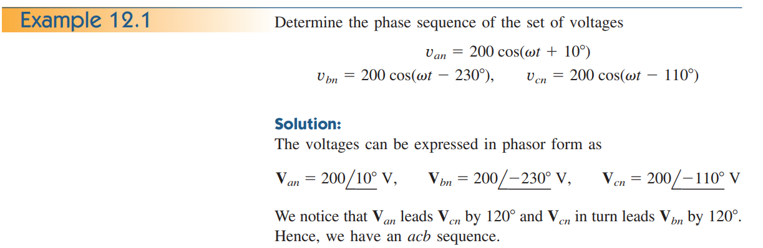
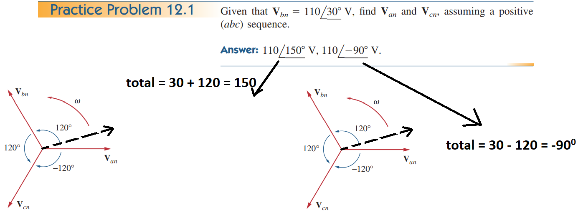

Slide 2
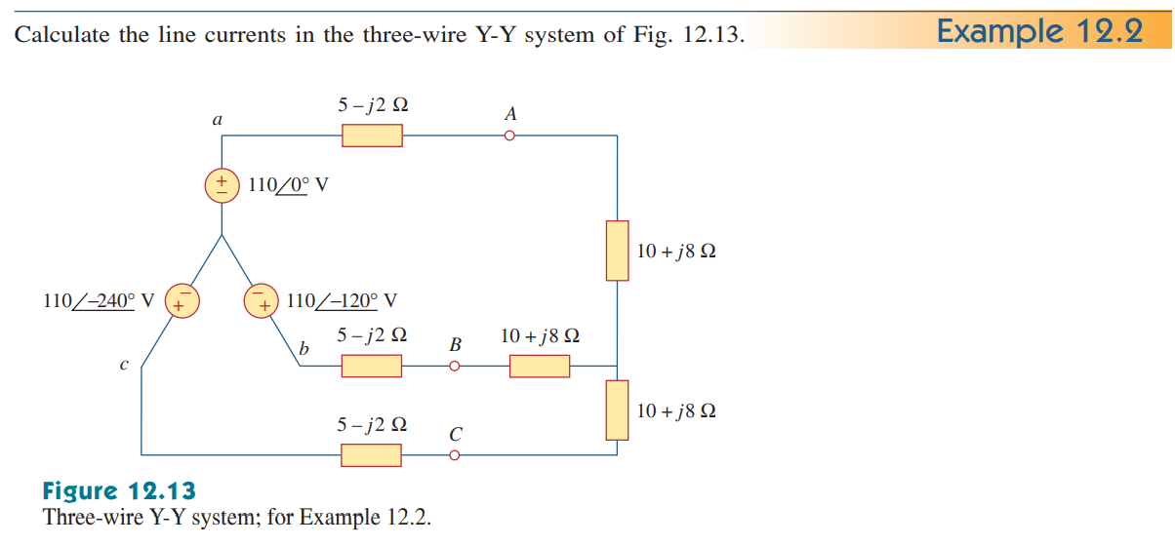


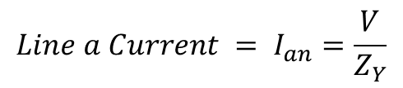
$Line Currents=I_{a}$, $I_{b}$, $I_{c}$ = ?
$$I=\frac{V}{Z}$$
n
$$Line a Current = I_{an}=\frac{V}{Z_{Y}}$$
$Z_{Y}=\left(5−j2\right)+\left(10+j8\right)=$ 15 + j6 = 16.155$<{21.8}^{0}$
$Line a Current = I_{an}=\frac{V}{Z_{Y}}=\frac{110<0}{\text{16.155}<{21.8}^{0}}=6.81<$-${21.8}^{0}$

Slide 3
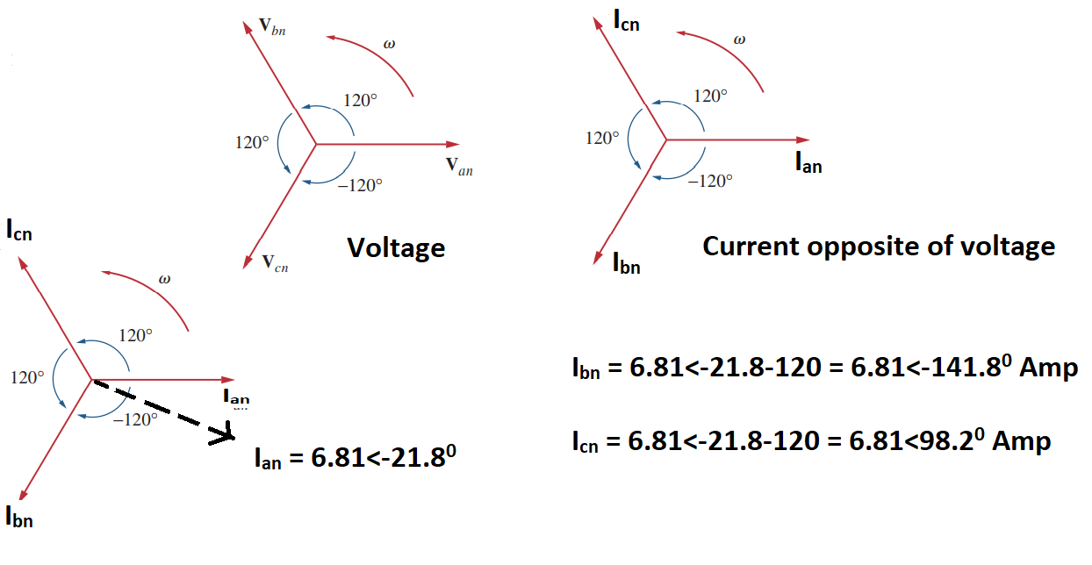

Slide 4
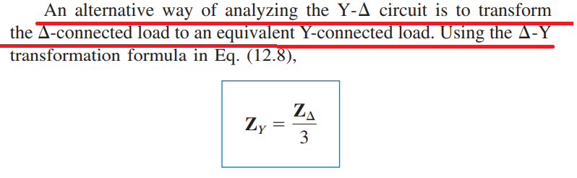
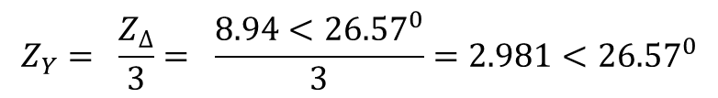


$$Star−Delta (Source Side Star AND Load Side DELTA$$
$${Star Side Voltage= V}_{an}=100<{10}^{0}$$
$${Delat Connected Load Z}_{∆}=8+j4=\sqrt{{(8)}^{2}+ {(4)}^{2} }=8.94<{26.57}^{0}$$
$$Both Configurations are same, so we change Delta Load into Star Load= Z_{Y}= \frac{Z_{∆}}{3}$$
$$Z_{Y}= \frac{Z_{∆}}{3}= \frac{8.94<{26.57}^{0}}{3}=2.981<{26.57}^{0}$$
$$Now both sides are Star$$
$$Line a Curent= I_{a}=\frac{V_{an}}{Z_{Y}}=\frac{100<{10}^{0}}{2.981<{26.57}^{0}}=33.54<−{16.57}^{0}$$

Slide 5
