Slide 1
Types of Signals
Periodic Signal
Aperiodic Signal
Continuous Time Periodic Signals / Continuous Time Fourier Series / CTFS (Fourier Series)
Discrete Time Periodic Signals / Discrete Time Fourier Series / DTFS (Discrete Fourier Transform DFT)
Continuous Time Aperiodic Signals / Continuous Time Fourier Transform / CTFT (Fourier Transform FT)
Discrete Time Aperiodic Signals / Discrete Time Fourier Transform (Discrete Time Fourier Transform DTFT)

Slide 2
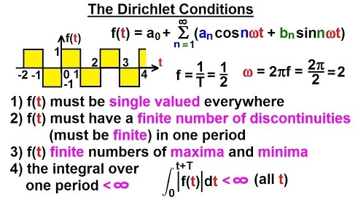

Slide 3
Amplitude
1
0.5
t
DC Coefficient /DC Part

