Slide 1
TWO-PORT NETWORK

Slide 2
ONE PORT NETWORK
One port network is a two terminal electrical network in which, current enters through one terminal and leaves through another terminal. Example: Resistors, inductors and capacitors are the examples of one port network because each one has two terminals. One port network representation is shown in the following figure.
Here, the pair of terminals, 1 & 1’ represents a port. In this case, we are having only one port since it is a one port network.

Slide 3
TWO PORT NETWORK
It is an electrical network model with one pair of input terminals and one pair of output terminals. It is commonly used to model the voltage and current characteristics of complex electrical networks.

Slide 4
TWO PORT NETWORK PARAMETERS
There are various parameters needed to analyze a two-port network. The main two port network parameters are as under:
Impedance Parameters.
Admittance Parameters.
Hybrid Parameters.
Inverse Hybrid Parameters.
Transmission Parameters.
Inverse Transmission Parameters.

Slide 5
Impedance Parameters OR Z-Parameters OR Open Circuit Parameters

Slide 6
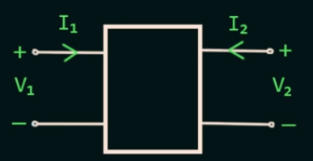

Z-Parameters OR Impedance Parameters
We know 4 Variables in Two Port Network I₁ ,I₂, V₁ and V₂
2 Variables are Independent and 2 Variables are Dependent.
I₁ is the current at Port 1 and I₂ is the current at Port 2
Similarly V₁ is the Voltage at Port1 and V₂ is the Voltage at Port 2.
$$V_{1}\text{ = }I_{1}Z_{11}\text{+ }{Z_{12}I}_{2}$$
$$V_{1}\text{ = }Z_{11}I_{1} \text{+ }{Z_{12}I}_{2}\text{ (}\text{1}\text{)}$$
$$V_{2}\text{ = }{I_{2}Z}_{22}\text{ + }Z_{21}I_{1}$$
${ V}_{2}\text{ =}Z_{21}I_{1}+ Z_{22}I_{2}$ (2)

Slide 7
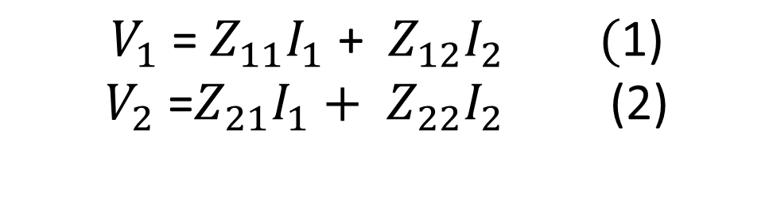
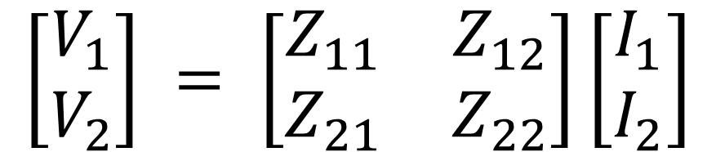

$$V_{1}\text{ = }Z_{11}I_{1} \text{+ }{Z_{12}I}_{2}\text{ (}\text{1}\text{)}$$
$$V_{2}\text{ =}Z_{21}I_{1}+ Z_{22}I_{2} \text{ (}\text{2}\text{)}$$
Convert equation (1) and (2) into matrix form
$$\left[\begin{aligned}V_{1} \\ V_{2}\end{aligned}\right] = \left[\begin{matrix}Z_{11} & Z_{12} \\ Z_{21} & Z_{22}\end{matrix}\right]\left[\begin{aligned}I_{1} \\ I_{2}\end{aligned}\right]$$
Voltage Matrix
Impedance Matrix
Current Matrix
$$\left[V\right] = \left[Z\right]\left[I\right]$$

Slide 8
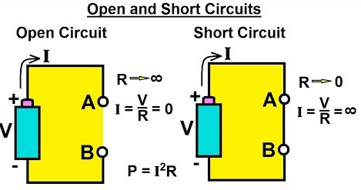
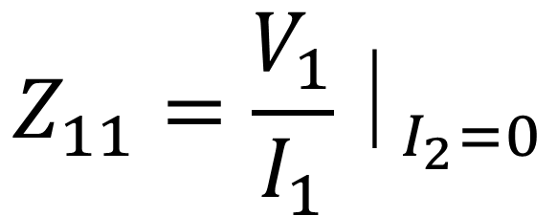
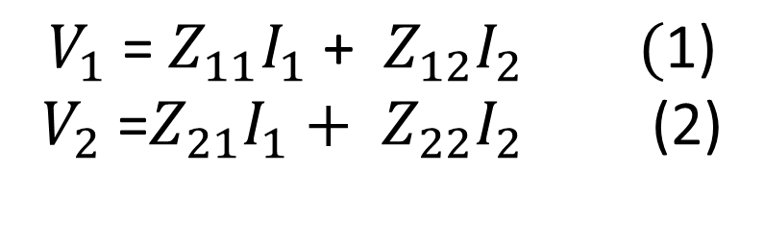
$$V_{1}\text{ = }Z_{11}I_{1} \text{+ }{Z_{12}I}_{2}\text{ (}\text{1}\text{)}$$
$$V_{2}\text{ =}Z_{21}I_{1}+ Z_{22}I_{2} \text{ (}\text{2}\text{)}$$
From equation (1) , If I₂ is equal to Zero than Z₁₁
$$Z_{11}=\frac{V_{1}}{I_{1}}⏐_{I_{2}=0}$$
V₁ divided by I₁ , when port 2 is open circuited
It is also called as Input Impedance with the output port open circuited

Slide 9
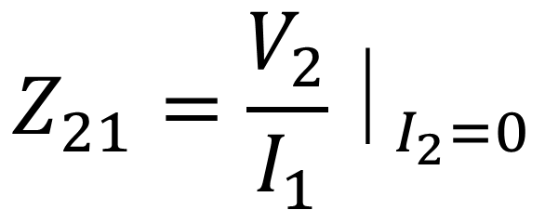
$$V_{1}\text{ = }Z_{11}I_{1} \text{+ }{Z_{12}I}_{2}\text{ (}\text{1}\text{)}$$
$$V_{2}\text{ =}Z_{21}I_{1}+ Z_{22}I_{2} \text{ (}\text{2}\text{)}$$
Similarly equation (2) , If I₂ is equal to Zero than Z₂₁
$$Z_{21}=\frac{V_{2}}{I_{1}}⏐_{I_{2}=0}$$
V₂ divided by I₁ , when port 2 is open circuited
It is also called as Forward Transfer Impedance with the output is port open circuited

Slide 10
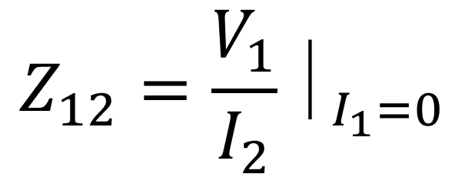
$$V_{1}\text{ = }Z_{11}I_{1} \text{+ }{Z_{12}I}_{2}\text{ (}\text{1}\text{)}$$
$$V_{2}\text{ =}Z_{21}I_{1}+ Z_{22}I_{2} \text{ (}\text{2}\text{)}$$
Similarly equation (1) , If I₁ is equal to Zero than Z₁₂
$$Z_{12}=\frac{V_{1}}{I_{2}}⏐_{I_{1}=0}$$
V₁ divided by I₂ , when port 1 is open circuited
It is also called as Open Circuit Inverse Transfer Impedance
It is also called as Reverse Transfer Impedance with the Input Port is Open Circuited

Slide 11
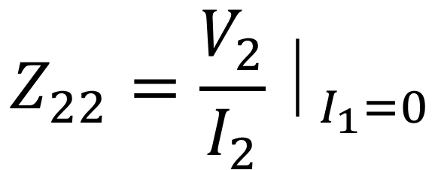
$$V_{1}\text{ = }Z_{11}I_{1} \text{+ }{Z_{12}I}_{2}\text{ (}\text{1}\text{)}$$
$$V_{2}\text{ =}Z_{21}I_{1}+ Z_{22}I_{2} \text{ (}\text{2}\text{)}$$
Similarly equation (2) , If I₁ is equal to Zero than Z₂₂
$$Z_{22}=\frac{V_{2}}{I_{2}}⏐_{I_{1}=0}$$
V₂ divided by I₂ , when port 1 is open circuited
It is also called as Output Impedance with the Input Port is Open Circuited

Slide 12
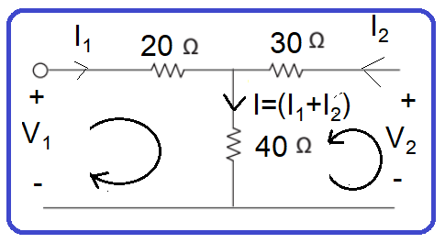


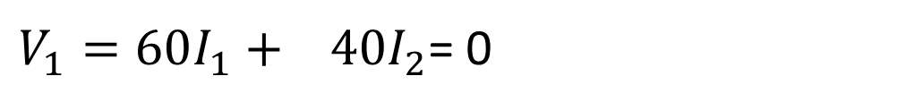

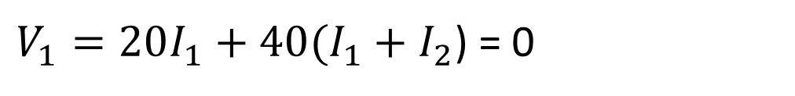

Q: Determine the Z-Parameter for the given circuit below
Solution: From Original Equation of Z-Parameters
$$V_{1}=Z_{11}I_{1}+ Z_{12}I_{2}$$
$$V_{2}=Z_{21}I_{1}+ Z_{22}I_{2}$$
Take Loop 1, so - to + = + and + to - = -
$V_{1}−20I_{1}−40(I_{1}+I_{2}$) = 0
$V_{1}=20I_{1}+40(I_{1}+I_{2}$) = 0
$V_{1}=60I_{1}+ 40I_{2}$= 0
$$Z_{11}=60,Z_{12}=40$$
$$V_{1}=Z_{11}I_{1}+ Z_{12}I_{2}$$

Slide 13




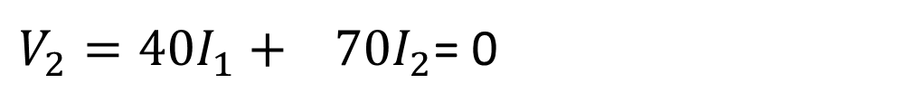
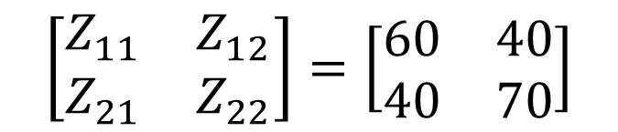
Original Equation of Z-Parameters
$$V_{1}=Z_{11}I_{1}+ Z_{12}I_{2}$$
$$V_{2}=Z_{21}I_{1}+ Z_{22}I_{2}$$
Take Loop 2, so - to + = + and + to - = -
$V_{2}−30I_{2}−40(I_{1}+I_{2}$) = 0
$V_{2}−30I_{2}−40I_{1} −40I_{2}$ = 0
$V_{2}−40I_{1}−70I_{2}$= 0
$$\left[\begin{matrix}Z_{11} & Z_{12} \\ Z_{21} & Z_{22}\end{matrix}\right]=\left[\begin{matrix}60 & 40 \\ 40 & 70\end{matrix}\right]$$
$V_{2}=40I_{1}+ 70I_{2}$= 0
$$Z_{21}=40,Z_{22}=70$$
$$V_{2}=Z_{21}I_{1}+ Z_{22}I_{2}$$

Slide 14



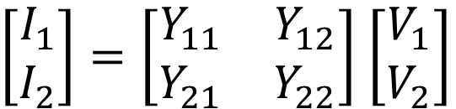


Admittance Parameters OR Y-Parameters OR Short Circuit Parameters
$$V_{1}=Z_{11}I_{1}+ Z_{12}I_{2}$$
$$V_{2}=Z_{21}I_{1}+ Z_{22}I_{2}$$
Simply Changes Voltages into currents, Currents into voltages and Impedances changes into Admittances
$$I_{1}=Y_{11}V_{1}+ Y_{12}V_{2}$$
$$I_{2}=Y_{21}V_{1}+ Y_{22}V_{2}$$
Convert into Matrix Form
$\left[\begin{matrix}I_{1} \\ I_{2}\end{matrix}\right]=\left[\begin{matrix}Y_{11} & Y_{12} \\ Y_{21} & Y_{22}\end{matrix}\right]$ $\left[\begin{matrix}V_{1} \\ V_{2}\end{matrix}\right]$
$\left[I\right]=\left[Y\right]$ $\left[V\right]$

Slide 15



Calculate Y₁₁ , so V₂ is zero, when voltage is zero means it is Shor Circuited
$$I_{1}=Y_{11}V_{1}+ Y_{12}V_{2}$$
$$I_{1}=Y_{11}V_{1}+0$$
$$I_{2}=Y_{21}V_{1}+ Y_{22}V_{2}$$
$$Y_{11}=\frac{I_{1}}{V_{1}}⏐_{V_{2=0}} Short Circuit Driving Point Input Admittance$$
$$Y_{21}=\frac{I_{2}}{V_{1}}⏐_{V_{2=0}} Short Circuit Forward Transfer Admittance$$
$$Y_{12}=\frac{I_{1}}{V_{2}}⏐_{V_{1=0}} Short Circuit Reverse Transfer Admittance$$
$$Y_{22}=\frac{I_{2}}{V_{2}}⏐_{V_{1=0}} Short Circuit Driving Point Output Admittance$$

Slide 16
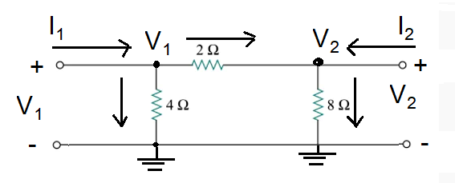


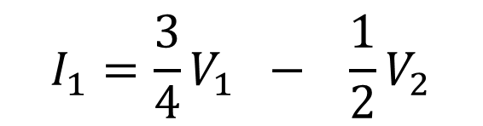


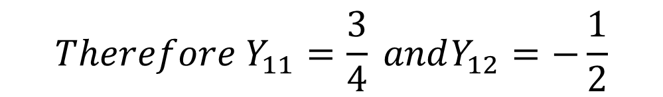
Q: Determine the Y-Parameter for the given circuit below
$$I_{1}=Y_{11}V_{1}+ Y_{12}V_{2}$$
$$I_{2}=Y_{21}V_{1}+ Y_{22}V_{2}$$
$$At Node No:1$$
$$I_{1}=\frac{{(V}_{1}−0)}{4}+\frac{{(V}_{1}−V_{2})}{2}=\frac{V_{1}}{4}+\frac{V_{1}}{2} −\frac{V_{2}}{2}=\left(\frac{1}{4}+\frac{1}{2}\right)V_{1}−\frac{1}{2}V_{2}=\frac{3}{4}V_{1}−\frac{1}{2}V_{2}$$
$$I_{1}=\frac{3}{4}V_{1} − \frac{1}{2}V_{2}$$
$${Therefore Y}_{11}=\frac{3}{4} andY_{12}=−\frac{1}{2}$$
$$I_{1}=Y_{11}V_{1}+ Y_{12}V_{2}$$

Slide 17
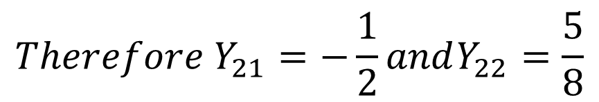



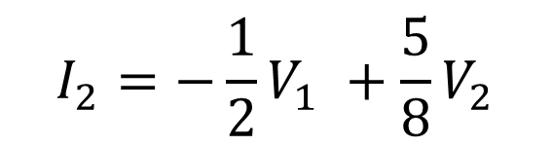

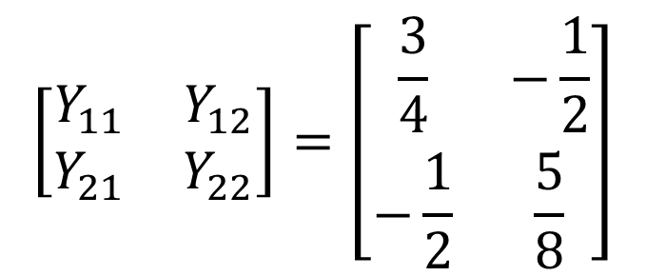
$$I_{1}=Y_{11}V_{1}+ Y_{12}V_{2}$$
$$At Node No:2$$
$$I_{2}=Y_{21}V_{1}+ Y_{22}V_{2}$$
$$I_{2}=\frac{{(V}_{2}−0)}{8}+\frac{{(V}_{2}−V_{1})}{2}=\frac{V_{2}}{8}+\frac{V_{2}}{2} −\frac{V_{1}}{2}=\left(\frac{1}{8}+\frac{1}{2}\right)V_{2}−\frac{1}{2}V_{1}=\frac{5}{8}V_{2}−\frac{1}{2}V_{1}$$
$$I_{2}=−\frac{1}{2}V_{1} +\frac{5}{8}V_{2}$$
$${Therefore Y}_{21}=−\frac{1}{2}andY_{22}=\frac{5}{8}$$
$$I_{1}= Y_{21}V_{1}+ Y_{22}V_{2}$$
$$\left[\begin{matrix}Y_{11} & Y_{12} \\ Y_{21} & Y_{22}\end{matrix}\right]=\left[\begin{matrix}\frac{3}{4} & −\frac{1}{2} \\ −\frac{1}{2} & \frac{5}{8}\end{matrix}\right]$$

Slide 18


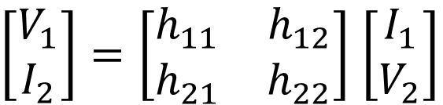


Hybrid-Parameters or h-Parameters
$$V_{1}=Z_{11}I_{1}+ Z_{12}I_{2}$$
$$V_{2}=Z_{21}I_{1}+ Z_{22}I_{2}$$
To generate the h-parameter, simply output side variables of current with voltage and voltage with currents only I₂ = V₂ , V₂ = I₂ and Z = h
$$V_{1}=h_{11}I_{1}+ h_{12}V_{2}$$
$$I_{2}=h_{21}I_{1}+ h_{22}V_{2}$$
Convert into Matrix Form
$\left[\begin{matrix}V_{1} \\ I_{2}\end{matrix}\right]=\left[\begin{matrix}h_{11} & h_{12} \\ h_{21} & h_{22}\end{matrix}\right]$ $\left[\begin{matrix}I_{1} \\ V_{2}\end{matrix}\right]$

Slide 19
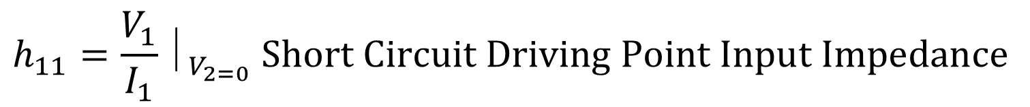

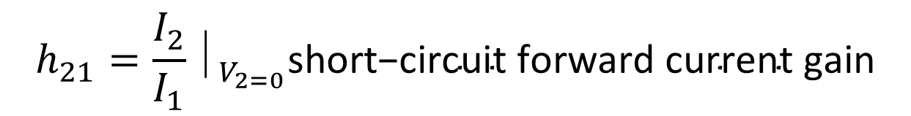

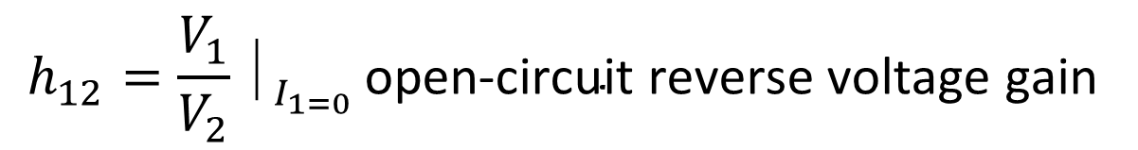
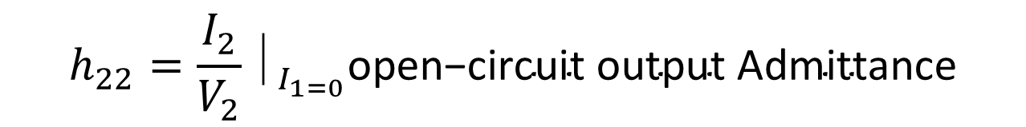
$$V_{1}=h_{11}I_{1}+ h_{12}V_{2}$$
$$I_{2}=h_{21}I_{1}+ h_{22}V_{2}$$
$$h_{11}=\frac{V_{1}}{I_{1}}⏐_{V_{2=0}} Short Circuit Driving Point Input Impedance$$
$$OR \text{ratio} \text{of} \text{input} \text{voltage} \text{to} \text{input} \text{current}\text{, }\text{at} \text{short} \text{circuited} \text{output} \text{port}$$
$$h_{22}=\frac{I_{2}}{V_{2}}⏐_{I_{1=0}}\text{open}\text{−}\text{circuit} \text{output} \text{Admittance}$$
$$h_{12}=\frac{V_{1}}{V_{2}}⏐_{I_{1=0} }\text{open}\text{−}\text{circuit} \text{reverse} \text{voltage} \text{gain}$$
$$h_{21}=\frac{I_{2}}{I_{1}}⏐_{V_{2=0}}\text{short}\text{−}\text{circuit} \text{forward} \text{current} \text{gain}$$

Slide 20
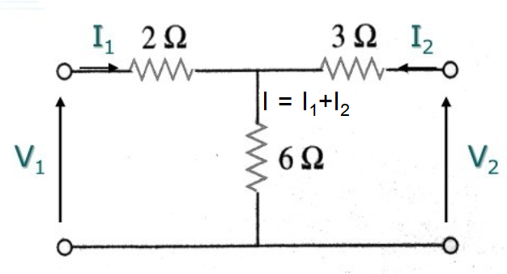
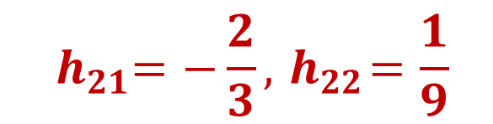
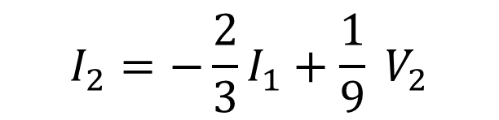
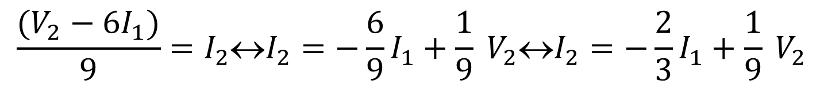




Q: Determine the h-Parameter for the given circuit below
$$V_{1}=h_{11}I_{1}+ h_{12}V_{2}$$
$$I_{2}=h_{21}I_{1}+ h_{22}V_{2}$$
$$At Node No:2$$
$V_{2}−3I_{2}−6\left(I_{1}+I_{2}\right)=0↔V_{2}=3I_{2}+6\left(I_{1}+I_{2}\right)↔V_{2}=6I_{1}+9I_{2}$ $V_{2}−6I_{1}=9I_{2}$
$$\frac{(V_{2}−6I_{1})}{9}=I_{2}↔I_{2}=−\frac{6}{9}I_{1}+\frac{1}{9} V_{2}↔I_{2}=−\frac{2}{3}I_{1}+\frac{1}{9} V_{2}$$
$$I_{2}=−\frac{2}{3}I_{1}+\frac{1}{9} V_{2}$$
$${ h}_{21}=−\frac{2}{3},{ h}_{22}=\frac{1}{9}$$
$$I_{2}={ h}_{21}I_{1}+ h_{22}V_{2}$$

Slide 21

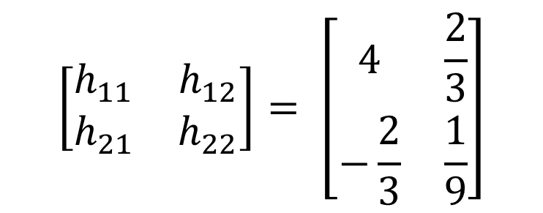

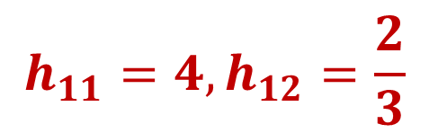



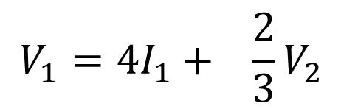
$$V_{1}=h_{11}I_{1}+ h_{12}V_{2}$$
$$I_{2}=h_{21}I_{1}+ h_{22}V_{2}$$
$$At Node No:1$$
$$V_{1}−2I_{1}−6\left(I_{1}+I_{2}\right)=0↔V_{1}=2I_{1}+6\left(I_{1}+I_{2}\right)↔V_{1}=2I_{1}+6I_{1}+6I_{2}$$
$$V_{1}=8I_{1}+ 6I_{2} −−−−−−(A)$$
Put the value of I₂
$V_{1}=8I_{1}+6(−\frac{2}{3}I_{1}+\frac{1}{9} V_{2})↔$ $V_{1}=8I_{1}−4I_{1}+\frac{2}{3}V_{2}↔ V_{1}=4I_{1}+\frac{2}{3}V_{2}$
$$V_{1}=4I_{1}+ \frac{2}{3}V_{2}$$
$$\left[\begin{matrix}h_{11} & h_{12} \\ h_{21} & h_{22}\end{matrix}\right]= \left[\begin{matrix}4 & \frac{2}{3} \\ −\frac{2}{3} & \frac{1}{9}\end{matrix}\right]$$
$$h_{11}=4,h_{12}=\frac{2}{3}$$
$$V_{1}=h_{11}I_{1}+ h_{12}V_{2}$$

Slide 22
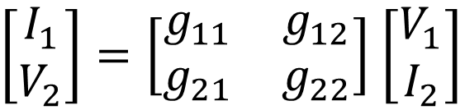


Inverse Hybrid or g-Parameters
$$V_{1}=Z_{11}I_{1}+ Z_{12}I_{2}$$
$$V_{2}=Z_{21}I_{1}+ Z_{22}I_{2}$$
To generate the inverse h-parameter, simply input side variables of current with voltage and voltage with currents only V₁ = I₁ and Z = g
$$I_{1}=g_{11}V_{1}+ g_{12}I_{2}$$
$$V_{2}=g_{21}V_{1}+ g_{22}I_{2}$$
Convert into Matrix Form
$\left[\begin{matrix}I_{1} \\ V_{2}\end{matrix}\right]=\left[\begin{matrix}g_{11} & g_{12} \\ g_{21} & g_{22}\end{matrix}\right]$ $\left[\begin{matrix}V_{1} \\ I_{2}\end{matrix}\right]$

Slide 23

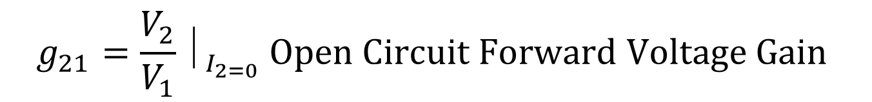
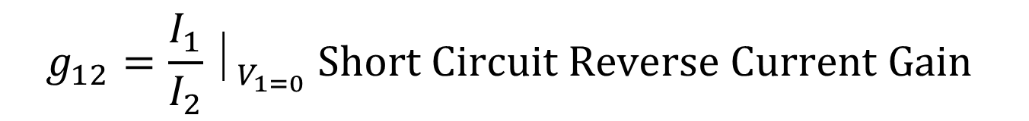
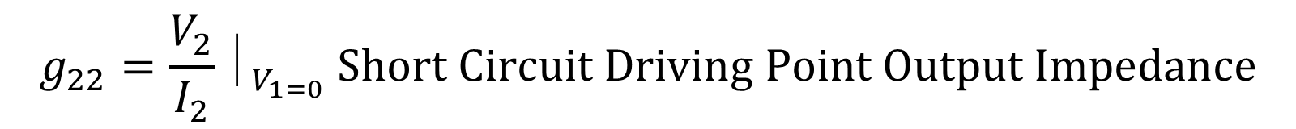

$$I_{1}=g_{11}V_{1}+ g_{12}I_{2}$$
$$V_{2}=g_{21}V_{1}+ g_{22}I_{2}$$
$$g_{11}=\frac{I_{1}}{V_{1}}⏐_{I_{2=0}} Open Circuit Driving Point Input Admittance$$
$$g_{22}=\frac{V_{2}}{I_{2}}⏐_{V_{1=0}} Short Circuit Driving Point Output Impedance$$
$$g_{12}=\frac{I_{1}}{I_{2}}⏐_{V_{1=0}} Short Circuit Reverse Current Gain$$
$$g_{21}=\frac{V_{2}}{V_{1}}⏐_{I_{2=0}} Open Circuit Forward Voltage Gain$$

Slide 24
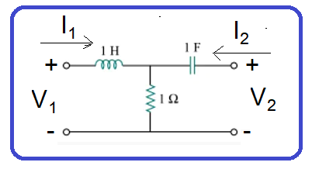
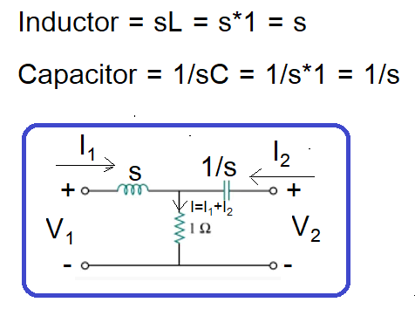


$$I_{1}=g_{11}V_{1}+ g_{12}I_{2}$$
$$V_{2}=g_{21}V_{1}+ g_{22}I_{2}$$
Circuit change into s-domain

Slide 25
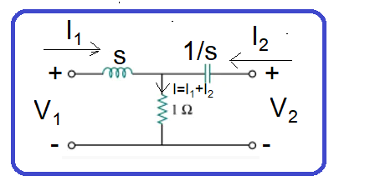
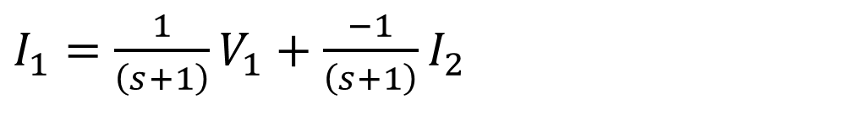

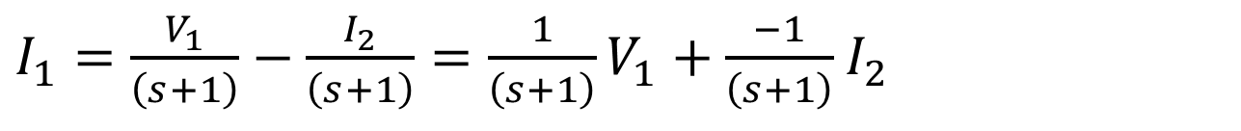

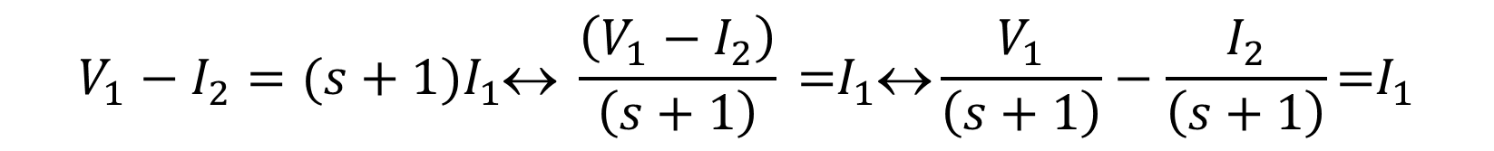


$$I_{1}=g_{11}V_{1}+ g_{12}I_{2}$$
$$V_{2}=g_{21}V_{1}+ g_{22}I_{2}$$
Branch-1
$V_{1} −sI_{1} −1\left(I_{1}+I_{2}\right)=0$↔ $V_{1}=sI_{1}+I_{1}+I_{2}\text{↔} V_{1}=({s+1)I}_{1}+I_{2}$
$$V_{1}−I_{2}=({s+1)I}_{1}\text{↔} \frac{\left(V_{1}−I_{2}\right)}{\left(s+1\right)}\text{ =}I_{1}\text{↔}\frac{V_{1}}{\left(s+1\right)}−\frac{I_{2}}{\left(s+1\right)}\text{=}I_{1}$$
$I_{1}=\frac{V_{1}}{\left(s+1\right)}−\frac{I_{2}}{\left(s+1\right)}=\frac{1}{\left(s+1\right)}V_{1}+\frac{−1}{\left(s+1\right)}$ $I_{2}$
$I_{1}=\frac{1}{\left(s+1\right)}V_{1}+\frac{−1}{\left(s+1\right)}$ $I_{2}$
$$g_{11}=\frac{1}{s+1},g_{12}=−\frac{1}{s+1}$$
$$I_{1}=g_{11}V_{1}+ g_{12}I_{2}$$

Slide 26
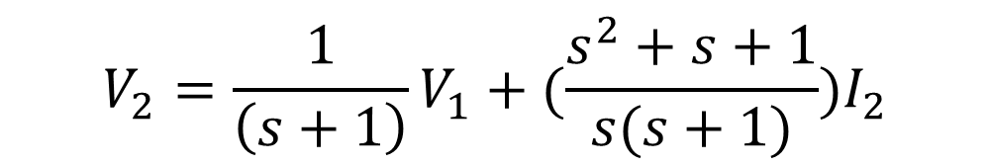

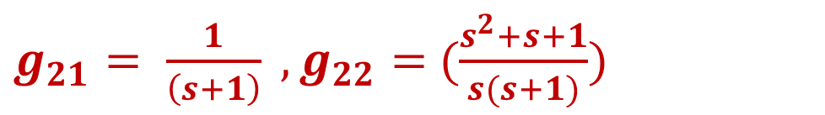
$$I_{1}=g_{11}V_{1}+ g_{12}I_{2}$$
Branch-2
$V_{2} −\frac{1}{s}I_{2} −1\left(I_{1}+I_{2}\right)=0$↔ $V_{2}=\frac{1}{s}I_{2}+I_{1}+I_{2}\text{↔} V_{2}=I_{1}+{(\frac{1}{s}+1)I}_{2}−−−(B)$
Put the Value of I₁ in eq (B)
$$V_{2}=\left\{\frac{1}{\left(s+1\right)}V_{1}+\frac{−1}{\left(s+1\right)} I_{2}\right\}+{\left(\frac{1}{s}+1\right)I}_{2}=\frac{V_{1}}{\left(s+1\right)}−\frac{I_{2}}{\left(s+1\right)}+{(\frac{1}{s}+1)I}_{2}$$
$V_{2}=\frac{1}{\left(s+1\right)}V_{1}+{(\frac{1}{s}+1−\frac{1}{\left(s+1\right)})I}_{2}$↔ $V_{2}=\frac{1}{\left(s+1\right)}V_{1}+{(\frac{s^{2}+s+1}{s(s+1)})I}_{2}$
$$V_{2}=\frac{1}{\left(s+1\right)}V_{1}+{(\frac{s^{2}+s+1}{s(s+1)})I}_{2}$$
$g_{21}= \frac{1}{\left(s+1\right)} ,g_{22}=$ $(\frac{s^{2}+s+1}{s(s+1)})$
$$V_{2}=g_{21}V_{1} + { g}_{22}I_{2}$$

Slide 27
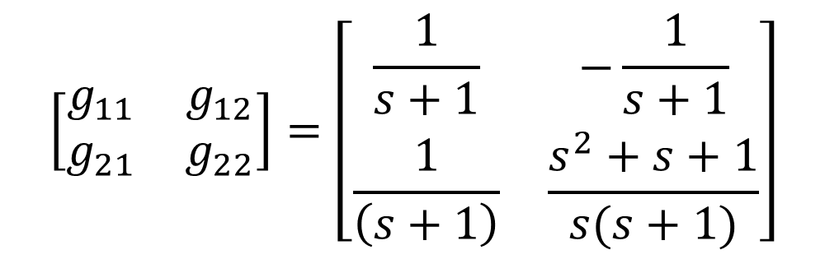
$$\left[\begin{matrix}g_{11} & g_{12} \\ g_{21} & g_{22}\end{matrix}\right]=\left[\begin{matrix}\frac{1}{s+1} & −\frac{1}{s+1} \\ \frac{1}{\left(s+1\right)} & \frac{s^{2}+s+1}{s(s+1)}\end{matrix}\right]$$

Slide 28

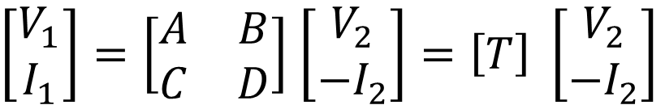



Transmission Parameters OR ABCD Parameters
$$V_{2}=Z_{21}I_{1}+ Z_{22}I_{2}$$
$$V_{1}=Z_{11}I_{1}+ Z_{12}I_{2}$$
Primary Current Replaced I₁ = Secondary Voltage V₂ and V₂ = I₁ other variables are same.
$$V_{1}=AV_{2}−BI_{2}$$
$$I_{1}=CV_{2} −DI_{2}$$
Convert into Matrix Form
Notice that in computing the transmission parameters, is used rather than the current is considered to be leaving the network, as shown in Fig. 19.31, as opposed to entering the network as in Fig. 19.1(b). This is done merely for conventional reasons; when you cascade two-ports (output to input), it is most logical to think of as leaving the two-port. It is also customary in the power industry to consider as leaving the two-port.
$\left[\begin{matrix}V_{1} \\ I_{1}\end{matrix}\right]=\left[\begin{matrix}A & B \\ C & D\end{matrix}\right]$ $\left[\begin{matrix}V_{2} \\ {−I}_{2}\end{matrix}\right]=\left[T\right] \left[\begin{matrix}V_{2} \\ {−I}_{2}\end{matrix}\right]$

Slide 29
Transmission Parameters OR ABCD Parameters
The transmission parameters equations provide a measure of how a circuit transmits voltage and current from a source to a load.
They are useful in the analysis of transmission lines (such as cable and fiber) because they express sending-end variables (V₁ and I₁ ) in terms of the receiving-end variables (V₂ and –I₂ ).
For this reason, they are called transmission parameters. They are also known as ABCD parameters. They are used in the design of telephone systems, microwave networks, and radars.

Slide 30
Transmission Parameters OR ABCD Parameters
A and D are dimensionless, B is in ohms, and C is in siemens. Since the transmission parameters provide a direct relationship between input and output variables, they are very useful in cascaded networks.

Slide 31
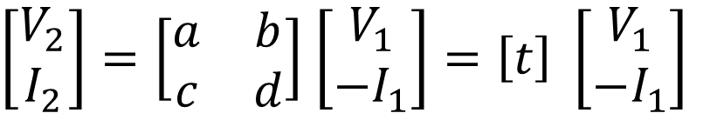


Inverse Transmission Parameters OR abcd Parameters
$$V_{2}=Z_{21}I_{1}+ Z_{22}I_{2}$$
$$V_{1}=Z_{11}I_{1}+ Z_{12}I_{2}$$
V₁ = V₂ ,
I₁ = V₁ ,
I₂ = I₁
V₂ = I₂
$$V_{2}=aV_{1}−bI_{1}$$
$$I_{2}=cV_{1} −dI_{1}$$
Convert into Matrix Form
Notice that in computing the transmission parameters, is used rather than the current is considered to be leaving the network, as shown in Fig. 19.31, as opposed to entering the network as in Fig. 19.1(b). This is done merely for conventional reasons; when you cascade two-ports (output to input), it is most logical to think of as leaving the two-port. It is also customary in the power industry to consider as leaving the two-port.
$\left[\begin{matrix}V_{2} \\ I_{2}\end{matrix}\right]=\left[\begin{matrix}a & b \\ c & d\end{matrix}\right]$ $\left[\begin{matrix}V_{1} \\ {−I}_{1}\end{matrix}\right]=\left[t\right] \left[\begin{matrix}V_{1} \\ {−I}_{1}\end{matrix}\right]$

Slide 32
Inverse Transmission Parameters OR abcd Parameters

