Slide 1








Slide 2
Linear Control Systems
Dr. Muhammad Ilyas
Assistant Professor
BUET Khuzdar

Slide 3
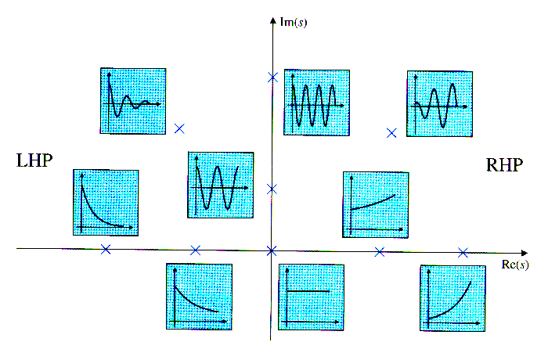
Stability of a Control System
Stable
Unstable
A LTI system is stable if ALL poles of its transfer
function are in the LHP (∀p_{i}, Re[p_{i}]<0)

Slide 4
Stability of a Control System
Any Root(s) in RHP = Unstable
All Root(s) in LHP = Stable
Roots on jω axis = ?
Types of roots?
Simple
Repeated
Marginally Stable or Limitedly Stable
Unstable

Slide 5
Routh-Hurwitz Stability Criterion
Determines how many root of the characteristics eq. lie in the Right Half Plane (s-plane)
Also determines all the roots on jω-axis, so their multiplicity can be found out
The polynomial coefficients are arranged in an array called ‘Routh array’

Slide 6



RH Criterion Algorithm
Given the general form of characteristics eq.
Form Routh array as per follows:
- First column: Starting from highest power
of s (n), decrement n and write all s untill s⁰
⁻ First row: Starting with highest power s^{n},
write the coefficients of alternate powers of s
- Second row: Starting with 2nd highest power
s^{n-1}, write the coefficients of alternate powers of s

Slide 7
RH Criterion Algorithm
Routh array constructed so far !

Slide 8




RH Criterion Algorithm
- Other rows: Fill other variables as below
Values??

Slide 9
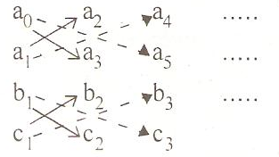
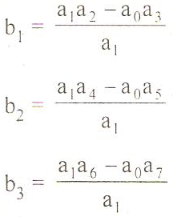
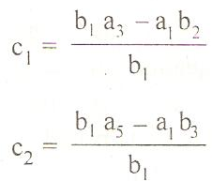

RH Criterion Algorithm
Considering the coefficients of previous two rows

Slide 10
Comments on RH Criterion
If an element in a row is missing, it is regarded as zero
There will be only two entries in s² row and one element each in s¹ and rows s⁰
The RH array is constructed until s⁰ row is computed
RH criterion tells us whether the system is stable or unstable. It does not give any indication of the exact location of roots

Slide 11
RH Criterion Algorithm
For a system to be stable, it is necessary and sufficient condition that there is NO sign change in the first column of Routh array
If there is ANY sign change in the first column, the system is unstable. The number of roots of the characteristic eq. lying in the RHP is given by the number of sign changes of entries in the first column
Stable/Unstable Check !
No. of roots causing instability

Slide 12
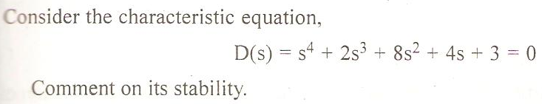
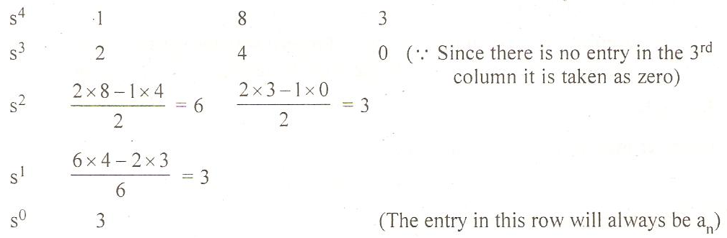
Example 1: RH Criterion
Considering the entries in the first column; 1,2,6,3,3. Since there is no sign change, thus the system is stable.

Slide 13
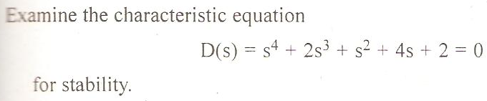
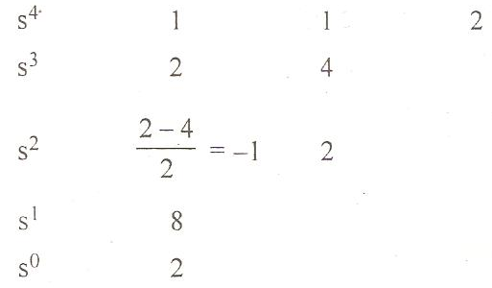
Example 2: RH Criterion
Considering the entries in the first column; 1,2,-1,8,2 Since there are sign changes, so the system is unstable. There are two sign changes (+2 to -1 and -1 to +8). This implies that two (out of 4) roots lie in RHP of s-plane.

Slide 14

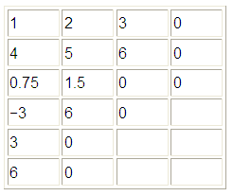
Example 3: RH Criterion
In the first column, there are two sign changes (0.75 → −3, and −3 → 3), thus the system is unstable and has two roots (out of 5) in RHP.

Slide 15
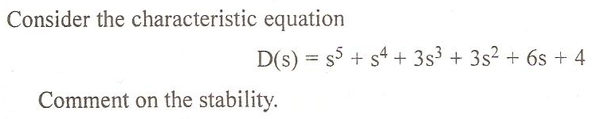
Example 4: RH Criterion
Special Case-I:
First entry in a particular row turn out to be zero.
Two methods exists to tackle this special case:
1st Method:
i) Replace the zero in that row by ε
ii) Proceed with the construction of the table
iii)Consider/analyze the entries of the first column by letting ε→0

Slide 16
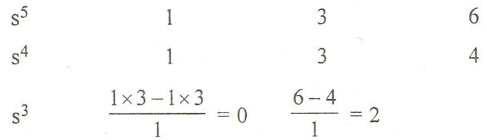
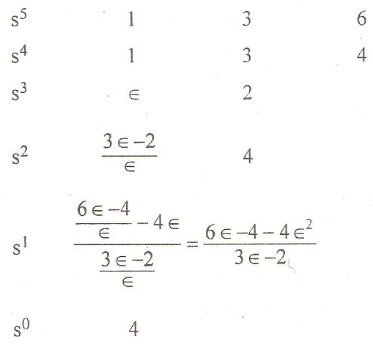
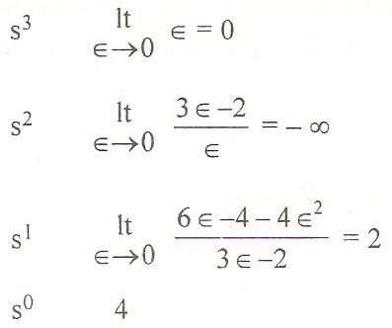
Example 4: RH Criterion
First Method
Letting ε→0 in first column

Slide 17
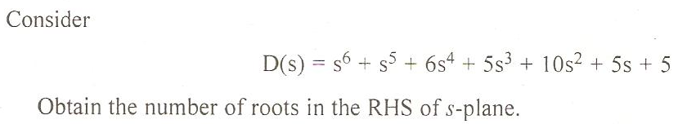
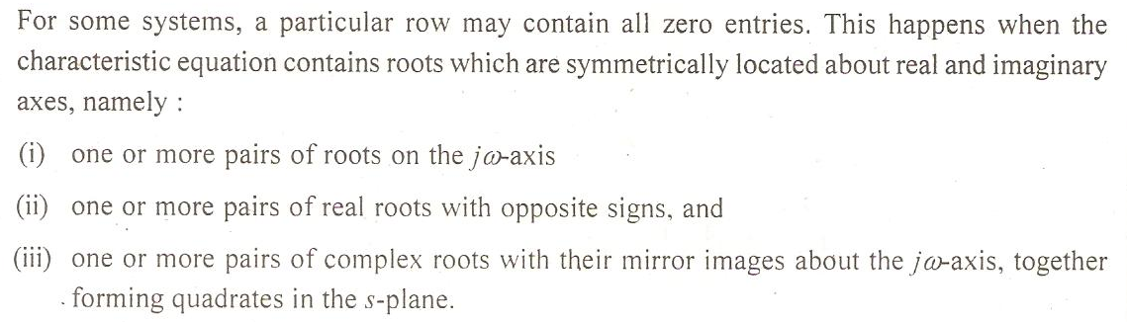
Example 5: RH Criterion
Special Case-II:
A row contains all zero entries
Solution:

Slide 18
Stability of a Control System
Roots in RHP = Unstable
Roots in LHP = Stable
Roots on jω axis = ?
Simple roots (multiplicity n=1), Repeated roots (n>1)
Examples: f(s) = (s-1)/(s-2) and g(s) = 1/(s-2)²
Types of roots?
Simple
Repeated
Marginally Stable or Limitedly Stable
Unstable

Slide 19
Example 5: RH Criterion
Solution:
The polynomial whose coefficients are the entries in the row ABOVE the row of zeros is called “auxiliary polynomial”
The row of zeros is replaced with the coefficients of the differential of the aux. polynomial

Slide 20
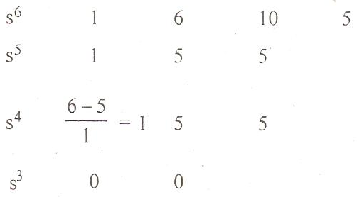
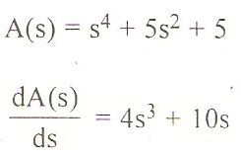
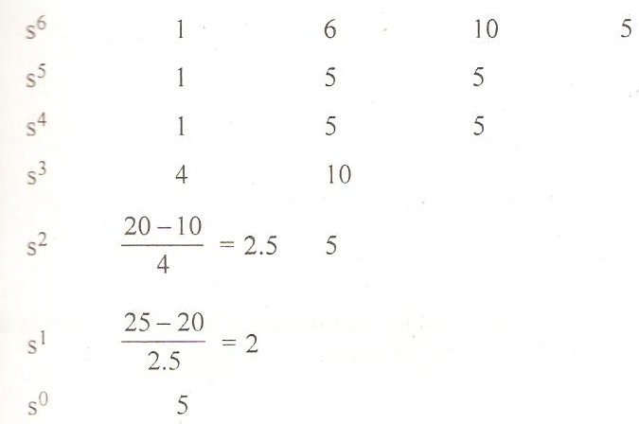
Example 5: RH Criterion

Slide 21
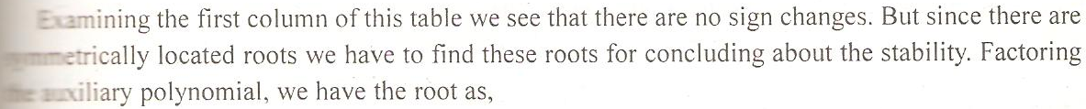
Example 5: RH Criterion

Slide 22
Thanks
Dr.muhammad ilyas
Office: control and instrumentation lab - EE Deptt.

