Slide 1
Laplace Transform of Any Constant Integer

Slide 2


$$Q:Calculate the Laplace Transform of f\left(t\right)=1$$
SOLUTION
$$F\left(s\right)= \int_{0}^{∞}{e^{−st}∗f\left(t\right)dt=\int_{0}^{∞}{e^{−st}∗1dt=\int_{0}^{∞}{e^{−st}dt=(\frac{e^{−st}}{−s}{) ⏐}_{0}^{∞}=}}}−\frac{1}{s}(e^{−s∗∞}−e^{−s∗0})$$
$$\int{e^{ax}dx=\frac{e^{ax}}{a}}$$
$$F\left(s\right)= −\frac{1}{s}\left(e^{−s∗∞}−e^{−s∗0}\right)=−\frac{1}{s}\left(0−1\right)=\frac{1}{s} −−−Answer$$
$$Q:Calculate the Laplace Transform of f\left(t\right)=2$$
$$\int{e^{−ax}dx=\frac{e^{−ax}}{−a}}$$
SOLUTION
$$F\left(s\right)= \int_{0}^{∞}{e^{−st}∗f\left(t\right)dt=\int_{0}^{∞}{e^{−st}∗2dt=2∗\int_{0}^{∞}{e^{−st}dt=2∗(\frac{e^{−st}}{−s}{) ⏐}_{0}^{∞}=}}}−\frac{2}{s}(e^{−s∗∞}−e^{−s∗0})$$
$$F\left(s\right)= −\frac{2}{s}\left(e^{−s∗∞}−e^{−s∗0}\right)=−\frac{2}{s}\left(0−1\right)=\frac{2}{s} −−−Answer$$

Slide 3
Laplace Transform of Exponential Function

Slide 4


$$Q:Calculate the Laplace Transform of f\left(t\right)=e^{−2t}$$
SOLUTION
$$F\left(s\right)= \int_{0}^{∞}{e^{−st}∗f\left(t\right)dt=}\int_{0}^{∞}{e^{−st}∗e^{−2t}dt=\int_{0}^{∞}{e^{−st−2t}dt=\int_{0}^{∞}{e^{−(s+2)t}dt}}}$$
$$\int{e^{ax}dx=\frac{e^{ax}}{a}}$$
$$F\left(s\right)=(\frac{e^{−(s+2)t}}{−(s+2)}{) ⏐}_{0}^{∞}=−\frac{1}{(s+2)}\left(e^{−∞}−e^{∗0}\right)=−\frac{1}{(s+2)}\left(0−1\right)=\frac{1}{s+2} −−−Answer$$
$$Q:Calculate the Laplace Transform of f\left(t\right)=e^{−3t}$$
$$\int{e^{−ax}dx=\frac{e^{−ax}}{−a}}$$
SOLUTION
$$F\left(s\right)= \int_{0}^{∞}{e^{−st}∗f\left(t\right)dt=}\int_{0}^{∞}{e^{−st}∗e^{−3t}dt=\int_{0}^{∞}{e^{−st−3t}dt=\int_{0}^{∞}{e^{−(s+3)t}dt}}}$$
$$F\left(s\right)=(\frac{e^{−(s+3)t}}{−(s+3)}{) ⏐}_{0}^{∞}=−\frac{1}{(s+3)}\left(e^{−∞}−e^{∗0}\right)=−\frac{1}{(s+3)}\left(0−1\right)=\frac{1}{s+3} −−−Answer$$

Slide 5
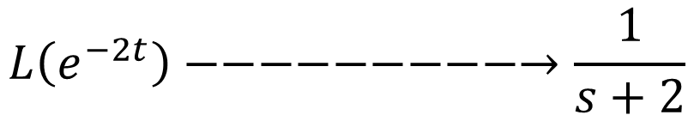

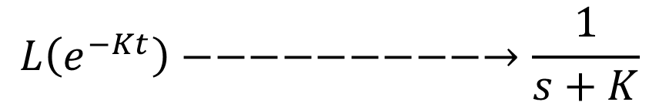
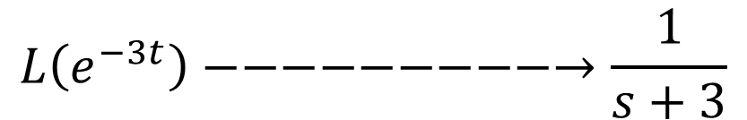
$$Q:Calculate the Laplace Transform of f\left(t\right)=e^{−Kt}$$
SOLUTION
$$F\left(s\right)= \int_{0}^{∞}{e^{−st}∗f\left(t\right)dt=}\int_{0}^{∞}{e^{−st}∗e^{−Kt}dt=\int_{0}^{∞}{e^{−st−Kt}dt=\int_{0}^{∞}{e^{−(s+K)t}dt}}}$$
$$\int{e^{ax}dx=\frac{e^{ax}}{a}}$$
$$F\left(s\right)=(\frac{e^{−(s+K)t}}{−(s+K)}{) ⏐}_{0}^{∞}=−\frac{1}{(s+K)}\left(e^{−∞}−e^{∗0}\right)=−\frac{1}{(s+K)}\left(0−1\right)=\frac{1}{s+K} −−−Answer$$
$$General Formula$$
$$\int{e^{−ax}dx=\frac{e^{−ax}}{−a}}$$
$$L\left(e^{−2t}\right)−−−−−−−−−→\frac{1}{s+2}$$
$$L\left(e^{−3t}\right)−−−−−−−−−→\frac{1}{s+3}$$
$$L\left(e^{−Kt}\right)−−−−−−−−−→\frac{1}{s+K}$$

Slide 6
$$Q:Calculate the Laplace Transform of f\left(t\right)=e^{2t}$$
SOLUTION
$$F\left(s\right)= \int_{0}^{∞}{e^{−st}∗f\left(t\right)dt=}\int_{0}^{∞}{e^{−st}∗e^{2t}dt=\int_{0}^{∞}{e^{−st+2t}dt=\int_{0}^{∞}{e^{−(s−2)t}dt}}}$$
$$F\left(s\right)=(\frac{e^{−(s−2)t}}{−(s−2)}{) ⏐}_{0}^{∞}=−\frac{1}{(s−2)}\left(e^{−∞}−e^{∗0}\right)=−\frac{1}{(s−2)}\left(0−1\right)=\frac{1}{s−2} −−−Answer$$
$$Q:Calculate the Laplace Transform of f\left(t\right)=e^{3t}$$
SOLUTION
$$F\left(s\right)= \int_{0}^{∞}{e^{−st}∗f\left(t\right)dt=}\int_{0}^{∞}{e^{−st}∗e^{3t}dt=\int_{0}^{∞}{e^{−st+3t}dt=\int_{0}^{∞}{e^{−(s−3)t}dt}}}$$
$$F\left(s\right)=(\frac{e^{−(s−3)t}}{−(s−3)}{) ⏐}_{0}^{∞}=−\frac{1}{(s−3)}\left(e^{−∞}−e^{∗0}\right)=−\frac{1}{(s−3)}\left(0−1\right)=\frac{1}{s−3} −−−Answer$$

Slide 7
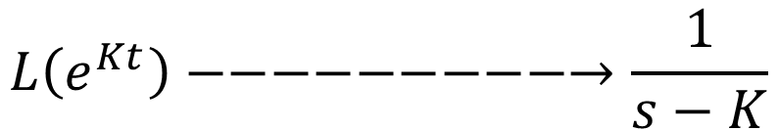
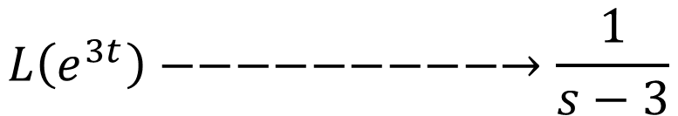
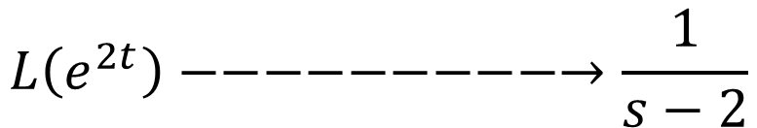
$$Q:Calculate the Laplace Transform of f\left(t\right)=e^{Kt}$$
SOLUTION
$$F\left(s\right)= \int_{0}^{∞}{e^{−st}∗f\left(t\right)dt=}\int_{0}^{∞}{e^{−st}∗e^{Kt}dt=\int_{0}^{∞}{e^{−st+Kt}dt=\int_{0}^{∞}{e^{−(s−K)t}dt}}}$$
$$F\left(s\right)=(\frac{e^{−(s−K)t}}{−(s−K)}{) ⏐}_{0}^{∞}=−\frac{1}{(s−K)}\left(e^{−∞}−e^{∗0}\right)=−\frac{1}{(s−K)}\left(0−1\right)=\frac{1}{s−K} −−−Answer$$
$$General Formula$$
$$L\left(e^{2t}\right)−−−−−−−−−→\frac{1}{s−2}$$
$$L\left(e^{3t}\right)−−−−−−−−−→\frac{1}{s−3}$$
$$L\left(e^{Kt}\right)−−−−−−−−−→\frac{1}{s−K}$$

Slide 8
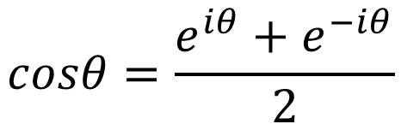
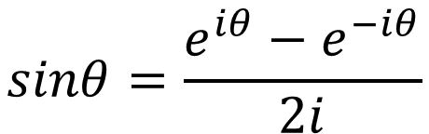
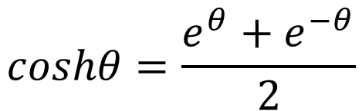
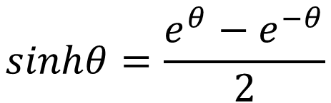
Laplace Transform of Trigonometric Function
Euler’s Identity
$$sinθ=\frac{e^{iθ}−e^{−iθ}}{2i}$$
$$sinhθ=\frac{e^{θ}−e^{−θ}}{2}$$
$$cosθ=\frac{e^{iθ}+e^{−iθ}}{2}$$
$$coshθ=\frac{e^{θ}+e^{−θ}}{2}$$

Slide 9
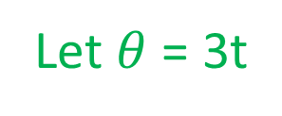
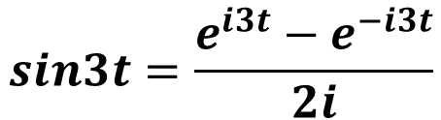
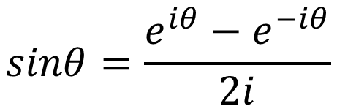
$$Q:Calculate the Laplace Transform of f\left(t\right)=sin3t$$
$$sinθ=\frac{e^{iθ}−e^{−iθ}}{2i}$$
SOLUTION
Let $θ$ = 3t
$$sin3t=\frac{e^{i3t}−e^{−i3t}}{2i}$$
$$F\left(s\right)=L\left(sin3t\right)=L\left(\frac{e^{i3t}−e^{−i3t}}{2i}\right)=\frac{1}{2i}\left[L\left(e^{i3t}\right)−L\left(e^{−i3t}\right)\right]=\frac{1}{2i} [\frac{1}{s−i3} −\frac{1}{s+i3}]$$
$$F\left(s\right)=L\left(sin3t\right)=\frac{1}{2i} \left[\frac{s+i3−s+i3}{\left(s−i3\right)\left(s+i3\right)}\right]=\frac{1}{2i} \left[\frac{6i}{s^{2}−i^{2}3^{2}}\right]=\frac{3}{s^{2}+3^{2}} −−−Answer$$

Slide 10

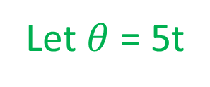
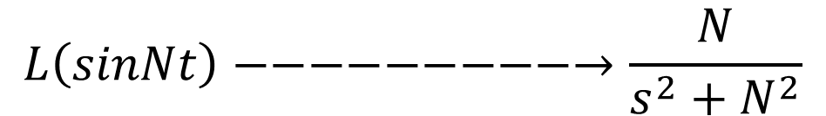
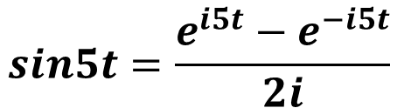
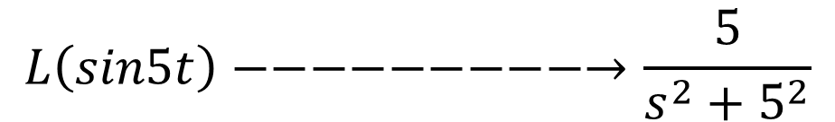
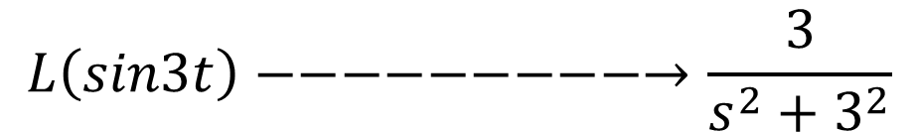
$$Q:Calculate the Laplace Transform of f\left(t\right)=sin5t$$
$$sinθ=\frac{e^{iθ}−e^{−iθ}}{2i}$$
SOLUTION
Let $θ$ = 5t
$$sin5t=\frac{e^{i5t}−e^{−i5t}}{2i}$$
$$F\left(s\right)=L\left(sin5t\right)=L\left(\frac{e^{i5t}−e^{−i5t}}{2i}\right)=\frac{1}{2i}\left[L\left(e^{i5t}\right)−L\left(e^{−i5t}\right)\right]=\frac{1}{2i} [\frac{1}{s−i5} −\frac{1}{s+i5}]$$
$$F\left(s\right)=L\left(sin5t\right)=\frac{1}{2i} \left[\frac{s+i5−s+i5}{\left(s−i5\right)\left(s+i5\right)}\right]=\frac{1}{2i} \left[\frac{10i}{s^{2}−i^{2}5^{2}}\right]=\frac{5}{s^{2}+5^{2}} −−−Answer$$
$$General Formula$$
$$L\left(sin3t\right)−−−−−−−−−→\frac{3}{s^{2}+3^{2}}$$
$$L\left(sin5t\right)−−−−−−−−−→\frac{5}{s^{2}+5^{2}}$$
$$L\left(sinNt\right)−−−−−−−−−→\frac{N}{s^{2}+N^{2}}$$

Slide 11
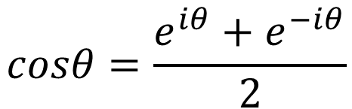
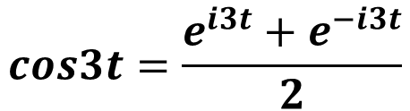
$$Q:Calculate the Laplace Transform of f\left(t\right)=cos3t$$
$$cosθ=\frac{e^{iθ}+e^{−iθ}}{2}$$
SOLUTION
Let $θ$ = 3t
$$cos3t=\frac{e^{i3t}+e^{−i3t}}{2}$$
$$F\left(s\right)=L\left(cos3t\right)=L\left(\frac{e^{i3t}+e^{−i3t}}{2}\right)=\frac{1}{2}\left[L\left(e^{i3t}\right)+L\left(e^{−i3t}\right)\right]=\frac{1}{2} [\frac{1}{s−i3}+\frac{1}{s+i3}]$$
$$F\left(s\right)=L\left(cos3t\right)=\frac{1}{2} \left[\frac{s+i3+s−i3}{\left(s−i3\right)\left(s+i3\right)}\right]=\frac{1}{2} \left[\frac{2s}{s^{2}−i^{2}3^{2}}\right]=\frac{s}{s^{2}+3^{2}} −−−Answer$$

Slide 12

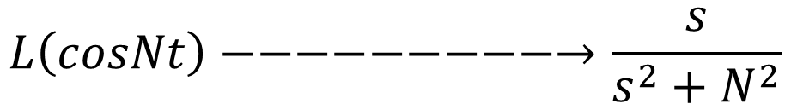
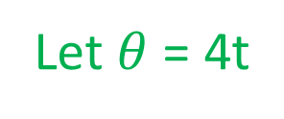
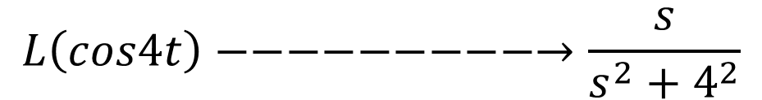
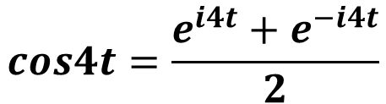
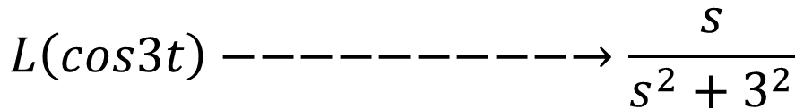
$$Q:Calculate the Laplace Transform of f\left(t\right)=cos4t$$
Let $θ$ = 4t
$$cosθ=\frac{e^{iθ}+e^{−iθ}}{2}$$
SOLUTION
$$cos4t=\frac{e^{i4t}+e^{−i4t}}{2}$$
$$F\left(s\right)=L\left(cos4t\right)=L\left(\frac{e^{i4t}+e^{−i4t}}{2}\right)=\frac{1}{2}\left[L\left(e^{i4t}\right)+L\left(e^{−i4t}\right)\right]=\frac{1}{2} [\frac{1}{s−i4}+\frac{1}{s+i4}]$$
$$F\left(s\right)=L\left(cos4t\right)=\frac{1}{2} \left[\frac{s+i4+s−i4}{\left(s−i4\right)\left(s+i4\right)}\right]=\frac{1}{2} \left[\frac{2s}{s^{2}−i^{2}4^{2}}\right]=\frac{s}{s^{2}+4^{2}} −−−Answer$$
$$General Formula$$
$$L\left(cos3t\right)−−−−−−−−−→\frac{s}{s^{2}+3^{2}}$$
$$L\left(cos4t\right)−−−−−−−−−→\frac{s}{s^{2}+4^{2}}$$
$$L\left(cosNt\right)−−−−−−−−−→\frac{s}{s^{2}+N^{2}}$$

Slide 13
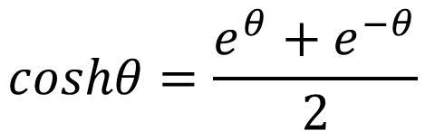
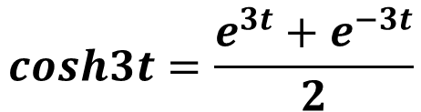
$$Q:Calculate the Laplace Transform of f\left(t\right)=cosh3t$$
$$coshθ=\frac{e^{θ}+e^{−θ}}{2}$$
SOLUTION
Let $θ$ = 3t
$$cosh3t=\frac{e^{3t}+e^{−3t}}{2}$$
$$F\left(s\right)=L\left(cosh3t\right)=L\left(\frac{e^{3t}+e^{−3t}}{2}\right)=\frac{1}{2}\left[L\left(e^{3t}\right)+L\left(e^{−3t}\right)\right]=\frac{1}{2} [\frac{1}{s−3}+\frac{1}{s+3}]$$
$$F\left(s\right)=L\left(cosh3t\right)=\frac{1}{2} \left[\frac{s+3+s−3}{\left(s−3\right)\left(s+3\right)}\right]=\frac{1}{2} \left[\frac{2s}{s^{2}−3^{2}}\right]=\frac{s}{s^{2}−3^{2}} −−−Answer$$

Slide 14

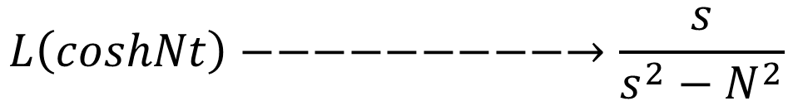

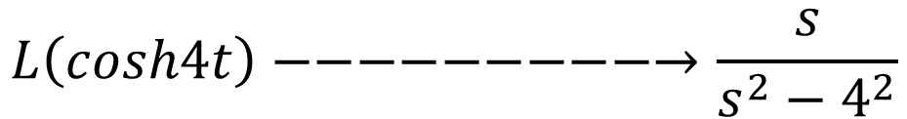
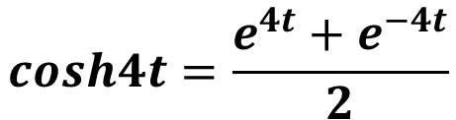
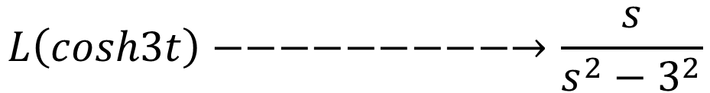
$$Q:Calculate the Laplace Transform of f\left(t\right)=cosh4t$$
$$coshθ=\frac{e^{θ}+e^{−θ}}{2}$$
Let $θ$ = 4t
$$cosh4t=\frac{e^{4t}+e^{−4t}}{2}$$
SOLUTION
$$F\left(s\right)=L\left(cosh4t\right)=L\left(\frac{e^{4t}+e^{−4t}}{2}\right)=\frac{1}{2}\left[L\left(e^{4t}\right)+L\left(e^{−4t}\right)\right]=\frac{1}{2} [\frac{1}{s−4}+\frac{1}{s+4}]$$
$$F\left(s\right)=L\left(cosh4t\right)=\frac{1}{2} \left[\frac{s+4+s−4}{\left(s−4\right)\left(s+4\right)}\right]=\frac{1}{2} \left[\frac{2s}{s^{2}−4^{2}}\right]=\frac{s}{s^{2}−4^{2}} −−−Answer$$
$$General Formula$$
$$L\left(cosh3t\right)−−−−−−−−−→\frac{s}{s^{2}−3^{2}}$$
$$L\left(cosh4t\right)−−−−−−−−−→\frac{s}{s^{2}−4^{2}}$$
$$L\left(coshNt\right)−−−−−−−−−→\frac{s}{s^{2}−N^{2}}$$

Slide 15
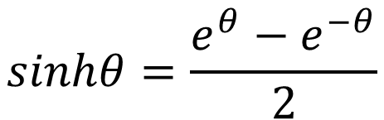
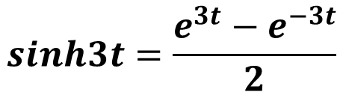
$$Q:Calculate the Laplace Transform of f\left(t\right)=sinh3t$$
$$sinhθ=\frac{e^{θ}−e^{−θ}}{2}$$
SOLUTION
Let $θ$ = 3t
$$sinh3t=\frac{e^{3t}−e^{−3t}}{2}$$
$$F\left(s\right)=L\left(sinh3t\right)=L\left(\frac{e^{3t}−e^{−3t}}{2}\right)=\frac{1}{2}\left[L\left(e^{3t}\right)−L\left(e^{−3t}\right)\right]=\frac{1}{2} [\frac{1}{s−3}−\frac{1}{s+3}]$$
$$F\left(s\right)=L\left(sinh3t\right)=\frac{1}{2} \left[\frac{s+3−s+3}{\left(s−3\right)\left(s+3\right)}\right]=\frac{1}{2} \left[\frac{6}{s^{2}−3^{2}}\right]=\frac{3}{s^{2}−3^{2}} −−−Answer$$

Slide 16
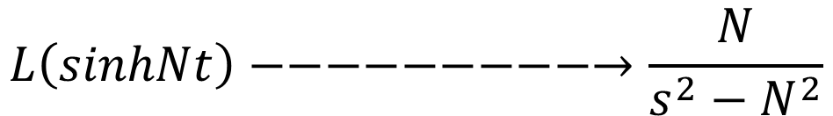

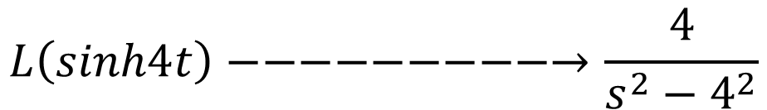
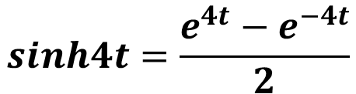
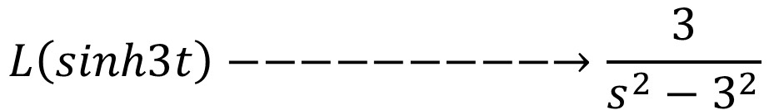
$$Q:Calculate the Laplace Transform of f\left(t\right)=sinh4t$$
$$sinhθ=\frac{e^{θ}−e^{−θ}}{2}$$
Let $θ$ = 4t
SOLUTION
$$sinh4t=\frac{e^{4t}−e^{−4t}}{2}$$
$$F\left(s\right)=L\left(sinh4t\right)=L\left(\frac{e^{4t}−e^{−4t}}{2}\right)=\frac{1}{2}\left[L\left(e^{4t}\right)−L\left(e^{−4t}\right)\right]=\frac{1}{2} [\frac{1}{s−4}−\frac{1}{s+4}]$$
$$F\left(s\right)=L\left(sinh4t\right)=\frac{1}{2} \left[\frac{s+4−s+4}{\left(s−4\right)\left(s+4\right)}\right]=\frac{1}{2} \left[\frac{8}{s^{2}−4^{2}}\right]=\frac{4}{s^{2}−4^{2}} −−−Answer$$
$$General Formula$$
$$L\left(sinh3t\right)−−−−−−−−−→\frac{3}{s^{2}−3^{2}}$$
$$L\left(sinh4t\right)−−−−−−−−−→\frac{4}{s^{2}−4^{2}}$$
$$L\left(sinhNt\right)−−−−−−−−−→\frac{N}{s^{2}−N^{2}}$$

Slide 17
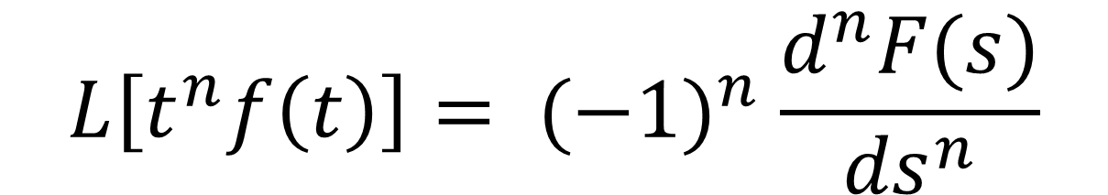
FREQUENCY DIFFERENTIATION PROPERTY
It is defined as Multiplication of t in time domain it is equivalent to differentiation in Frequency Domain.
$$L\left[t^{n}f\left(t\right)\right]= {(−1)}^{n} \frac{d^{n}F(s)}{{ds}^{n}}$$

Slide 18
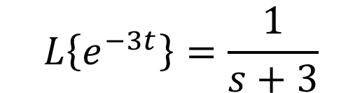
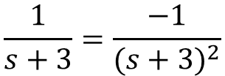
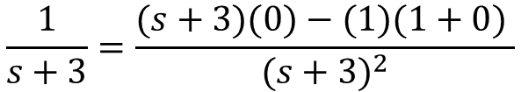
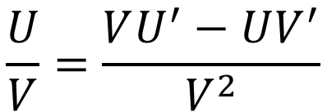
$$Q:Calculate the Laplace Transform of f\left(t\right)=t∗e^{−3t}.$$
SOLUTION
$$\frac{U}{V}=\frac{VU^{′}−UV^{′}}{V^{2}}$$
$$L\left\{e^{−3t}\right\}=\frac{1}{s+3}$$
$$\frac{1}{s+3}=\frac{(s+3)(0)−(1)(1+0) }{{(s+3)}^{2}}$$
Applying Frequency Differentiation Property
$$\frac{1}{s+3}=\frac{−1}{{(s+3)}^{2}}$$
$F\left(s\right)=L\{t∗e^{−3t}\}$ = ${\left(−1\right)}^{1} \frac{d}{ds}\left(\frac{1}{s+3}\right)$ = $−\frac{d}{ds}\left(\frac{1}{s+3}\right)$
$F\left(s\right)=L\{t∗e^{−3t}\}$ = $−∗\left\{\frac{−1}{{\left(s+3\right)}^{2}}\right\}=\frac{1}{{\left(s+3\right)}^{2}}−−−Answer$

Slide 19
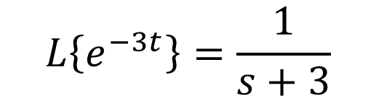
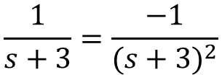
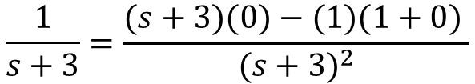
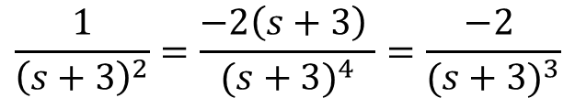



$$Q:Calculate the Laplace Transform of f\left(t\right)=t^{2}∗e^{−3t}.$$
$$\frac{U}{V}=\frac{VU^{′}−UV^{′}}{V^{2}}$$
SOLUTION
$$L\left\{e^{−3t}\right\}=\frac{1}{s+3}$$
$$\frac{1}{s+3}=\frac{(s+3)(0)−(1)(1+0) }{{(s+3)}^{2}}$$
Applying Frequency Differentiation Property
$$\frac{1}{s+3}=\frac{−1}{{(s+3)}^{2}}$$
$F\left(s\right)=L\{t^{2}∗e^{−3t}\}$ = ${\left(−1\right)}^{2}\frac{d^{2}}{{ds}^{2}}\left(\frac{1}{s+3}\right)$ = $\frac{d}{ds}\left(\frac{−1}{{\left(s+3\right)}^{2}}\right)\text{=}−\frac{d}{ds}\left(\frac{1}{{\left(s+3\right)}^{2}}\right)$
$F\left(s\right)=L\{t^{2}∗e^{−3t}\}$ $\text{=}−\frac{d}{ds}\left(\frac{1}{{\left(s+3\right)}^{2}}\right)$
$$\frac{1}{{\left(s+3\right)}^{2}}=\frac{{\left(s+3\right)}^{2}\left(0\right)−\left(1\right)2∗\left(s+3\right)∗1 }{{(s+3)}^{4}}$$
$$\frac{1}{{\left(s+3\right)}^{2}}=\frac{−2\left(s+3\right) }{{(s+3)}^{4}}=\frac{−2 }{{(s+3)}^{3}}$$
$F\left(s\right)=L\{t^{2}∗e^{−3t}\}$ $\text{=}−\frac{d}{ds}\left(\frac{1}{{\left(s+3\right)}^{2}}\right)=−\left\{\frac{−2 }{{\left(s+3\right)}^{3}}\right\}=\frac{2 }{{\left(s+3\right)}^{3}} −−−Answer$

Slide 20


$$Q:Calculate the Laplace Transform of f\left(t\right)=t^{3}∗e^{−3t}.$$
SOLUTION
$$\frac{U}{V}=\frac{VU^{′}−UV^{′}}{V^{2}}$$
$$L\left\{e^{−3t}\right\}=\frac{1}{s+3}$$
Applying Frequency Differentiation Property
$F\left(s\right)=L\{t^{3}∗e^{−3t}\}$ = ${\left(−1\right)}^{3}\frac{d^{3}}{{ds}^{3}}\left(\frac{1}{s+3}\right)$ = $\frac{d^{2}}{{ds}^{2}} \left(\frac{−1}{{\left(s+3\right)}^{2}}\right)\text{=}−\frac{d^{2}}{{ds}^{2}}\left(\frac{1}{{\left(s+3\right)}^{2}}\right)$
$F\left(s\right)=L\{t^{3}∗e^{−3t}\}$ = $−\frac{d^{2}}{{ds}^{2}}\left(\frac{1}{{\left(s+3\right)}^{2}}\right)=−\frac{d}{ds}\left(\frac{2}{{\left(s+3\right)}^{3}}\right)$
$$\frac{2}{{\left(s+3\right)}^{3}}=\frac{{\left(s+3\right)}^{3}∗0−2∗3{\left(s+3\right)}^{2}∗1}{{\left(s+3\right)}^{6}}=\frac{−6{\left(s+3\right)}^{2}}{{\left(s+3\right)}^{6}}=\frac{−6}{{\left(s+3\right)}^{4}}$$
$F\left(s\right)=L\{t^{3}∗e^{−3t}\}$ = $−\frac{d}{ds}\left(\frac{2}{{\left(s+3\right)}^{3}}\right)=−\left\{\frac{−6}{{\left(s+3\right)}^{4}}\right\}=\frac{6}{{\left(s+3\right)}^{4}} −−−Answer$

Slide 21





$$General Formula t multiply with exponential function$$
$$L\{t∗e^{−3t}\}−−−−−−−−−→\frac{1}{{\left(s+3\right)}^{2}}$$
$$L\{t^{2}∗e^{−3t}\}−−−−−−−−−→\frac{2 }{{\left(s+3\right)}^{3}}$$
$$L\{t^{3}∗e^{−3t}\}−−−−−−−−−→\frac{6}{{\left(s+3\right)}^{4}}$$
$$L\{t^{n}∗e^{−at}\}−−−−−−−−−→\frac{n!}{{\left(s+a\right)}^{n+1}}$$
$$L\{t^{2}∗sin2t\}−−−−−−−−−→\frac{2∗n!}{{\left(s+a\right)}^{n+1}}$$

Slide 22






$$Q:Calculate the Laplace Transform of f\left(t\right)=t^{2}sin2tu\left(t\right).$$
SOLUTION
$$L\left\{sin2t\right\}=\frac{2}{s^{2}+2^{2}}$$
Applying Frequency Differentiation Property
$F\left(s\right)=L\{t^{2}sin2t\}$ = ${\left(−1\right)}^{2}\frac{d^{2}}{{ds}^{2}}\left(\frac{2}{s^{2}+2^{2}}\right)$ = $\frac{d^{2}}{{ds}^{2}}\left(\frac{2}{s^{2}+4}\right)$
$$\frac{U}{V}=\frac{VU^{′}−UV^{′}}{V^{2}}$$
$$\frac{2}{s^{2}+4}=\frac{(s^{2}+4)(0)−(2)(2s+0) }{{(s^{2}+4)}^{2}}$$
$F\left(s\right)=L\{t^{2}sin2t\}$ = $\frac{d}{ds}\left(\frac{−4s }{{(s^{2}+4)}^{2}}\right)$
$$\frac{2}{s^{2}+4}=\frac{−4s }{{(s^{2}+4)}^{2}}$$

Slide 23







$F\left(s\right)=L\{t^{2}sin2t\}$ = $\frac{d}{ds}\left(\frac{−4s }{{(s^{2}+4)}^{2}}\right)$
$$\frac{U}{V}=\frac{VU^{′}−UV^{′}}{V^{2}}$$
$$\frac{−4s}{{(s^{2}+4)}^{2}}=\frac{{\left(s^{2}+4\right)}^{2}(−4)−(−4s)(2)(s^{2}+4)(2s) }{{(s^{2}+4)}^{4}}$$
$$\frac{−4s}{{(s^{2}+4)}^{2}}=\frac{\left(s^{2}+4\right)\left(−4\right)+16s^{2}}{{(s^{2}+4)}^{3}}$$
$$F\left(s\right)=L\left\{t^{2}sin2t\right\}=\frac{12s^{2}−16}{{(s^{2}+4)}^{3}} −−−Answer$$
$$\frac{−4s}{{(s^{2}+4)}^{2}}=\frac{−4s^{2}−16+16s^{2}}{{(s^{2}+4)}^{3}}$$
$$\frac{−4s}{{(s^{2}+4)}^{2}}=\frac{12s^{2}−16}{{(s^{2}+4)}^{3}}$$

Slide 24



SCALING PROPERTY
$$L\left[f\left(at\right)\right]=\frac{1}{a}F\left(\frac{s}{a}\right)−−−Scaling in Time Domain Then Compression in Frequency Domain$$
$$Q:Calculate the Laplace Transform of f\left(t\right)=sin2ωtu(t).$$
SOLUTION
$$L\left\{sinωt\right\}=\frac{ω}{s^{2}+ω^{2}}$$
$$L\left\{sin2ωt\right\}=\frac{1}{2}∗\frac{ω}{{\left(\frac{s}{2}\right)}^{2} +ω^{2}}=\frac{1}{2}∗\frac{ω}{\frac{s^{2}}{4}+ω^{2}}=\frac{1}{2}∗\frac{ω}{\frac{s^{2}+4ω^{2}}{4}}=\frac{ω}{\frac{s^{2}+4ω^{2}}{2}}$$
$$L\left\{sin2ωt\right\}=\frac{ω}{\frac{s^{2}+4ω^{2}}{2}}=ω ÷\frac{s^{2}+4ω^{2}}{2}=ω ×\frac{2}{s^{2}+4ω^{2}}= \frac{2ω}{s^{2}+4ω^{2}}$$

Slide 25

FREQUENCY SHIFTING PROPERTY
$$Q:Calculate the Laplace Transform of f\left(t\right)=e^{−at}cosωtu(t).$$
SOLUTION
$$L\left\{cosωt\right\}=\frac{s}{s^{2}+ω^{2}}$$
Applying Shifting property means change s with exponential value
$$L\left\{e^{at}∗f(t)\right\}=F\left(s−a\right) OR L\left\{e^{−at}∗f(t)\right\}=F\left(s+a\right)$$
$$L\left\{e^{−at}∗cosωt\right\}=\frac{s+a}{{(s+a)}^{2}+ ω^{2}} −−−Answer$$

Slide 26

FREQUENCY SHIFTING PROPERTY
$$Q:Calculate the Laplace Transform of f\left(t\right)=e^{−at}sinωtu(t).$$
SOLUTION
$$L\left\{sinωt\right\}=\frac{ω}{s^{2}+ω^{2}}$$
Applying Shifting property means change s with exponential value
$$L\left\{e^{at}∗f(t)\right\}=F\left(s−a\right) OR L\left\{e^{−at}∗f(t)\right\}=F\left(s+a\right)$$
$$L\left\{e^{−at}∗sinωt\right\}=\frac{ω}{{(s+a)}^{2}+ ω^{2}} −−−Answer$$

Slide 27

FREQUENCY SHIFTING PROPERTY
$$Q:Calculate the Laplace Transform of f\left(t\right)=e^{−2t}cos4t.$$
SOLUTION
$$L\left\{cos4t\right\}=\frac{s}{s^{2}+4^{2}}$$
Applying Shifting property means change s with exponential value
$$L\left\{e^{at}∗f(t)\right\}=F\left(s−a\right) OR L\left\{e^{−at}∗f(t)\right\}=F\left(s+a\right)$$
$$L\left\{e^{−2t}∗cos4t\right\}=\frac{s+2}{{(s+2)}^{2}+4^{2}}=\frac{s+2}{s^{2}+2∗s∗2+2^{2}+4^{2}}$$
$$L\left\{e^{−2t}∗cos4t\right\}=\frac{s+2}{s^{2}+4s+4+16}$$
$$L\left\{e^{−2t}∗cos4t\right\}=\frac{s+2}{s^{2}+4s+20} −−−Answer$$

Slide 28
Inverse Laplace Transform

Slide 29




$Q:Find the inverse Laplace transform of F\left(s\right)=\frac{3s+2}{s^{2}−3s+2}$
SOLUTION
$$F\left(s\right)=\frac{3s+2}{s^{2}−3s+2}=\frac{3s+2}{(s−1)(s−2)}$$
$$\frac{3s+2}{(s−1)(s−2)}=\frac{A}{s−1}+\frac{B}{s−2}−−−(1)$$
$$\frac{3s+2}{(s−1)(s−2)}=\frac{A\left(s−2\right)+B(s−1)}{(s−1)(s−2)}$$
$$3s+2=\left(s−1\right)\left(s−2\right)∗\left[\frac{A\left(s−2\right)+B\left(s−1\right)}{\left(s−1\right)\left(s−2\right)}\right]$$

Slide 30

$$3s+2=\left(s−1\right)\left(s−2\right)∗\left[\frac{A\left(s−2\right)+B\left(s−1\right)}{\left(s−1\right)\left(s−2\right)}\right]$$
$$3s+2=A\left(s−2\right)+B\left(s−1\right)−−−−(2)$$
Let s -2 = 0 then s = 2, so put in equation (2)
$$3∗2+2=A\left(2−2\right)+B\left(2−1\right)$$
$$8=0+B\left(1\right)$$
$$B= 8$$
Again, Let s -1 = 0 then s = 1, so put in equation (2)
$$3∗1+2=A\left(1−2\right)+B\left(1−1\right)$$
$$A= −5$$

Slide 31



Put the value of A and B in equation (1)
$$\frac{3s+2}{(s−1)(s−2)}=\frac{A}{s−1}+\frac{B}{s−2}−−−(1)$$
$$\frac{3s+2}{(s−1)(s−2)}=\frac{−5}{s−1}+\frac{8}{s−2}=−5\left\{\frac{1}{s−1}\right\}+8\left\{\frac{1}{s−2}\right\}$$
$$\frac{3s+2}{(s−1)(s−2)}=−5\left\{e^{1t}\right\}+8\left\{e^{2t}\right\}$$
$$\frac{3s+2}{(s−1)(s−2)}=−5e^{t}+8e^{2t}−−−Answer$$

Slide 32
Transfer Function
Transfer Function is the ratio of Laplace Transform of output to the Laplace Transform of input, when all initial conditions are assumed to be zero.
Transfer Function gives the relationship between the Input and the Output

Slide 33




Find the Transfer Function of RL Circuit
$$Apply KVL from input side$$
$$V_{i}=R∗i+L\frac{di}{dt}−−−−−−−−−−−−−−(1)$$
$$Apply KVL from output side$$
$$V_{o}=L\frac{di}{dt} −−−−−−−−−−−−−−(2)$$

Slide 34







Find the Transfer Function of RL Circuit
$Apply Laplace Transform$ on equation (1)
$$V_{i}\left(s\right)=R∗I\left(s\right)+sLI\left(s\right)=\left(R+sL\right)I(s)$$
$Apply Laplace Transform$ on equation (2)
$$V_{o}(s)=sLI(s)$$
$$Transfer Function=\frac{Output}{Input}=\frac{V_{o}\left(s\right)}{V_{i}\left(s\right)}=\frac{sLI(s)}{\left(R+sL\right)I(s)}$$
$$V_{i}=R∗i+L\frac{di}{dt}−−−−−−−(1)$$
$$Transfer Function=\frac{Output}{Input}=\frac{sL}{\left(R+sL\right)}=\frac{sL}{R+sL}$$
$$V_{o}=L\frac{di}{dt} −−−−−−−−−(2)$$

Slide 35





Find the Transfer Function of RL Circuit
$$Transfer Function=\frac{Output}{Input}=\frac{sL}{R+sL}$$
$$If I written in Time Constant Format, so Tao \left(τ\right) than$$
$$R divided with Numerator and Denominator$$
$$Transfer Function=\frac{\frac{sL}{R}}{\frac{R+sL}{R}}=\frac{s.\frac{L}{R}}{1+s.\frac{L}{R}}$$
$$V_{i}=R∗i+L\frac{di}{dt}−−−−−−−(1)$$
$$\frac{L}{R}= \left(τ\right)$$
$$V_{o}=L\frac{di}{dt} −−−−−−−−−(2)$$
$$Transfer Function=\frac{sτ}{1+sτ}$$

Slide 36



Find the Transfer Function of RC Circuit
$$Apply KVL from input side$$
$$V_{i}=R∗i+\frac{1}{C}\int{idt −−−−−−−−−−−(1)}$$
$$Apply KVL from output side$$
$$V_{o}=\frac{1}{C}\int{idt −−−−−−−−−−−(2)}$$

Slide 37






Find the Transfer Function of RC Circuit
$Apply Laplace Transform$ on equation (1)
$$V_{i}\left(s\right)=R∗I\left(s\right)+\frac{1}{sC}I\left(s\right)=\left[R+\frac{1}{sC}\right]I\left(s\right)−(3)$$
$Apply Laplace Transform$ on equation (2)
$$V_{o}\left(s\right)=\frac{1}{sC}I\left(s\right)−−−−−−−−−−−−−(4)$$
$$Transfer Function=\frac{Output}{Input}=\frac{V_{o}\left(s\right)}{V_{i}\left(s\right)}=\frac{\frac{1}{sC}I\left(s\right)}{\left[R+\frac{1}{sC}\right]I\left(s\right)}$$
$$V_{i}=R∗i+\frac{1}{C}\int{idt −−−−−−−(1)}$$
$$V_{o}=\frac{1}{C}\int{idt −−−−−−−−−(2)}$$
$Transfer Function=\frac{\frac{I\left(s\right)}{sC}}{\left[\frac{RsC+1}{sC}\right]I\left(s\right)}$ $=\frac{\frac{I\left(s\right)}{sC}}{\frac{I(s)RsC+I(s)}{sC}}=\frac{I\left(s\right)}{sC}∗$ $\frac{sC}{I(s)RsC+I(s)}$

Slide 38

Find the Transfer Function of RC Circuit
$Transfer Function=\frac{\frac{I\left(s\right)}{sC}}{\left[\frac{RsC+1}{sC}\right]I\left(s\right)}$ $=\frac{\frac{I\left(s\right)}{sC}}{\frac{I(s)RsC+I(s)}{sC}}=\frac{I\left(s\right)}{sC}∗$ $\frac{sC}{I(s)RsC+I(s)}$
$Transfer Function=\frac{I(s)}{I\left(s\right)[RsC+1]}$ $=\frac{1}{ [RsC+1]}$ $=\frac{1}{RsC+1}$
$$If I written in Time Constant Format, so Tao (τ)=RsC$$
$$Transfer Function=\frac{1}{τ+1}$$

Slide 39


Find the Transfer Function of CR Circuit
Convert Time Domain CKT into S-Domain

Slide 40


Find the Transfer Function of RC Circuit
$$Total Opposition=\frac{1}{sC}+R$$
$$Volatge Acroos R, we used VDSR V_{o}\left(s\right)=\frac{V_{i}\left(s\right) ∗R}{Total Opposition}$$
$$V_{o}\left(s\right)=\frac{V_{i}\left(s\right) ∗R}{\frac{1}{sC}+R}$$

Slide 41



Find the Transfer Function of RC Circuit
$$V_{o}\left(s\right)=\frac{V_{i}\left(s\right) ∗R}{\frac{1}{sC}+R}$$
$$\frac{V_{o}\left(s\right)}{V_{i}\left(s\right)}=\frac{R}{\frac{1}{sC}+R}=\frac{R}{\frac{1+sCR}{sC}}=R ÷\frac{1+sCR}{sC}$$
$$\frac{V_{o}\left(s\right)}{V_{i}\left(s\right)}=R ×\frac{sC}{1+sCR}=\frac{RsC}{RsC+1}$$
$$Transfer Function=H\left(s\right)=\frac{Output}{Input}=\frac{V_{o}\left(s\right)}{V_{i}\left(s\right)}=R ×\frac{sC}{1+sCR}=\frac{RsC}{RsC+1}$$

Slide 42



Find the Transfer Function of RLC Circuit
$$E_{i}\left(t\right)=Ri\left(t\right)+L\frac{di\left(t\right)}{dt}+\frac{1}{c}\int{i\left(t\right)dt−−−−−−−−−(1)}$$
$$E_{o}\left(t\right)=\frac{1}{c}\int{i\left(t\right)dt} −−−−−−−−−−−−−−−−−−−(2)$$

Slide 43






Find the Transfer Function of RLC Circuit
$Apply Laplace Transform$ on equation (1)
$$E_{i}\left(s\right)=R∗I\left(s\right)+sLI\left(s\right)+\frac{1}{sc}I\left(s\right)$$
$Apply Laplace Transform$ on equation (2)
$$E_{o}\left(s\right)=\frac{1}{sc}I\left(s\right)$$
$$E_{i}\left(t\right)=Ri\left(t\right)+L\frac{di\left(t\right)}{dt}+\frac{1}{c}\int{i\left(t\right)dt−−−−(1)}$$
$$E_{o}\left(t\right)=\frac{1}{c}\int{i\left(t\right)dt} −−−−−−−−−−−(2)$$
$$Transfer Function=\frac{Output}{Input}=\frac{E_{o}\left(s\right)}{E_{i}\left(s\right)}=\frac{\frac{1}{sC}I\left(s\right)}{\left[R∗I\left(s\right)+sLI\left(s\right)+\frac{1}{sc}I\left(s\right)\right]}$$
$$Transfer Function=\frac{Output}{Input}=\frac{E_{o}\left(s\right)}{E_{i}\left(s\right)}=\frac{\frac{1}{sC}I\left(s\right)}{\left[R+sL+\frac{1}{sc}\right]I(s)}=\frac{\frac{1}{sC}}{\left[R+sL+\frac{1}{sc}\right]}=\frac{\frac{1}{sC}}{\left[\frac{RsC+s^{2}LC+1}{sC}\right]}$$

Slide 44


Find the Transfer Function of RLC Circuit
$$Transfer Function=\frac{Output}{Input}=\frac{E_{o}\left(s\right)}{E_{i}\left(s\right)}=\frac{\frac{1}{sC}I\left(s\right)}{\left[R+sL+\frac{1}{sc}\right]I(s)}=\frac{\frac{1}{sC}}{\left[R+sL+\frac{1}{sc}\right]}=\frac{\frac{1}{sC}}{\left[\frac{RsC+s^{2}LC+1}{sC}\right]}$$
$$Transfer Function=\frac{\frac{1}{sC}}{\left[\frac{RsC+s^{2}LC+1}{sC}\right]}=\frac{1}{sC} ∗\frac{sC}{{RsC+s}^{2}LC+1}=\frac{1}{LCs^{2}+RCs+1}$$

Slide 45

TABLE OF LAPLACE TRANSFORM
Time Domain | Laplace Domain
$$t$$ | $$s$$
$$i\left(t\right)$$ | $$I\left(s\right)$$
$$y\left(t\right)$$ | $$Y\left(s\right)$$
$$\frac{dy\left(t\right)}{dt}$$ | $$s.Y\left(s\right)−y(0^{−})$$
$$\frac{di\left(t\right)}{dt}$$ | $$s.I\left(s\right)−i(0^{−})$$
$$L\frac{di\left(t\right)}{dt}$$ | $$s.LI\left(s\right)−Li(0^{−})$$
$$\frac{d^{2}y\left(t\right)}{{dt}^{2}}$$ | $$s^{2}.Y\left(s\right)−sy\left(0^{−}\right)− y^{′}(0^{−})$$
$$\int{i\left(t\right)dt}$$ | $$\frac{1}{s}I(s)$$
$$\frac{1}{C}\int{i\left(t\right)dt}$$ | $$\frac{1}{sC}I(s)$$

Slide 46


Find The Transfer Function
Example: Find the Transfer Function of the System is given by:
$$\frac{d^{2}y\left(t\right)}{{dt}^{2}} +3.\frac{dy\left(t\right)}{dt}+2.y\left(t\right)=x\left(t\right) where:x\left(t\right)is the input \& y\left(t\right)is the output$$
Solution:
$$s^{2}.Y\left(s\right)−y\left(0^{−}\right)− y^{′}\left(0^{−}\right)+3.\left[s.Y\left(s\right)−y\left(0^{−}\right)\right]+2.Y\left(s\right)=X(s)$$
All initial conditions are zero
$$s^{2}.Y\left(s\right)+3s.Y\left(s\right) +2.Y\left(s\right)=X(s)$$
$${Y\left(s\right)[s}^{2}+3s +2] = X(s)$$
$$Y\left(s\right)=\frac{X\left(s\right)}{s^{2}+3s+2}$$
$$Transfer Function=\frac{Output}{Input}= \frac{Y\left(s\right)}{X(s)}=\frac{1}{s^{2}+3s+2} −−−Answer$$

Slide 47
Proper Transfer Function
A Transfer Function having Numerator Degree is less than or equal to Denominator (N ≤ D), than such type of Transfer Function is called as Proper Transfer Function.
$$H\left(s\right)=\frac{1}{(s+2)(s+3)} −−−−−−−−−\left(N<D\right)−−−It is Proper T.F$$
$$H\left(s\right)=\frac{s^{2}+1}{{2s}^{2}+5} −−−−−−−−−−(N≤D)−−−−−−It is Proper T.F$$

Slide 48
Strictly Proper Transfer Function
A Transfer Function having Numerator Degree is only less than Denominator (N < D), than such type of Transfer Function is called as Proper Transfer Function.
$$H\left(s\right)=\frac{s}{{3s}^{2}+4} −−−−−−−−−\left(N<D\right)−−−It is Strictly Proper T.F$$

Slide 49
Improper OR Not Proper Transfer Function
A Transfer Function having Numerator Degree is greater than Denominator (N>D), than such type of Transfer Function is called as Improper Transfer Function.
$$H\left(s\right)=\frac{{3s}^{2}+7}{s^{2}+2} −−−−−−−−−−(N>D)−−−−−It is Improper T.F$$

Slide 50
Poles And Zeros Of Transfer Function
Zeros: Zeros of a Transfer Function are the frequencies (values of s) for which the numerator of the transfer function becomes zero.
Poles: Poles of a Transfer Function are the frequencies (values of s) for which the denominator of the transfer function becomes zero.

Slide 51




Q: Find the Poles And Zeros Of Transfer Function
$$H\left(s\right)=\frac{(s+2)}{(s+3)(s+4)}$$
$$Solution:$$
$$H\left(s\right)=\frac{Zeros}{Poles}= \frac{(s+2)}{(s+3)(s+4)}$$
$$Zeros:s=−2$$
$$Poles:s=−3, s=−4$$

Slide 52

Q: Write the MATLAB Code Of Transfer Function
$$H\left(s\right)=\frac{(s+2)}{(s+3)(s+4)}$$
$$Solution:$$
$$H\left(s\right)=\frac{Zeros}{Poles}= \frac{(s+2)}{(s+3)(s+4)}=\frac{(s+2)}{(s^{2}+3s+4s+12)}=\frac{(s+2)}{(s^{2}+7s+12)}$$
>> numerator = [1 2];
>> denominator = [1 7 12];
>> sys = tf(numerator, denominator)
sys =
s + 2
--------------
s^2 + 7 s + 12
Continuous-time transfer function.
plot(sys)

Slide 53

Pole-Zero Diagram
Plot on s-plane which represents the location of Poles and Zeros of a Transfer Function is called as Pole-Zero Diagram.
Poles are represented by ×
Zeros are represented by
X-axis is sigma-axis (real part of x)
Y-axis is the jω-axis which is the imaginary part of x

Slide 54


Q: Find the Poles And Zeros Of Transfer Function and Draw the Pole – Zero Diagram
$$H\left(s\right)=\frac{(s+2)}{(s+3)(s+4)}$$
$$Solution:$$
$$H\left(s\right)=\frac{Zeros}{Poles}= \frac{(s+2)}{(s+3)(s+4)}$$
$$Zeros:s=−2$$
$$Poles:s=−3, s=−4$$

Slide 55






Q: Find the Poles And Zeros Of Transfer Function and Draw the Pole – Zero Diagram
$$jσ$$
$$H\left(s\right)=\frac{(s+2)}{(s+3)(s+4)}$$
$$H\left(s\right)=\frac{Zeros}{Poles}= \frac{(s+2)}{(s+3)(s+4)}$$
$$−σ$$
$$σ$$
-5 -4 -3 -2 -1
1 2 3 4 5
$$H\left(s\right)=\frac{Zeros}{Poles}= \frac{(s+2)}{(s+3)(s+4)}$$
$$Zeros:s=−2$$
$$Poles:s=−3, s=−4$$
$$−jσ$$

Slide 56







Q: Find the Poles And Zeros Of Transfer Function and Draw the Pole – Zero Diagram
$$jσ$$
$$H\left(s\right)=\frac{5s}{(s+1)(s^{2}+4s+8)}$$
$$2j$$
$$j$$
$$H\left(s\right)=\frac{Zeros}{Poles}= \frac{5s}{(s+1)(s^{2}+4s+8)}=\frac{5s}{(s+1)(s+2−2j)(s+2+2j)}$$
$$−σ$$
$$σ$$
-5 -4 -3 -2 -1
1 2 3 4 5
$$−j$$
-$2j$
$$Zeros:s=0$$
$$Poles:s=−1, \left(−2+2j\right), (2−2j)$$
$$−jσ$$

Slide 57



