Slide 1

Computational Methods in
Power System Analysis
Lecture-11 Solution of Simultaneous Algebraic Equations And Load Flow Studies
By
Dr. Wazir Muhammad Laghari
Electrical Engineering Department
BUET, Khuzdar

Slide 2
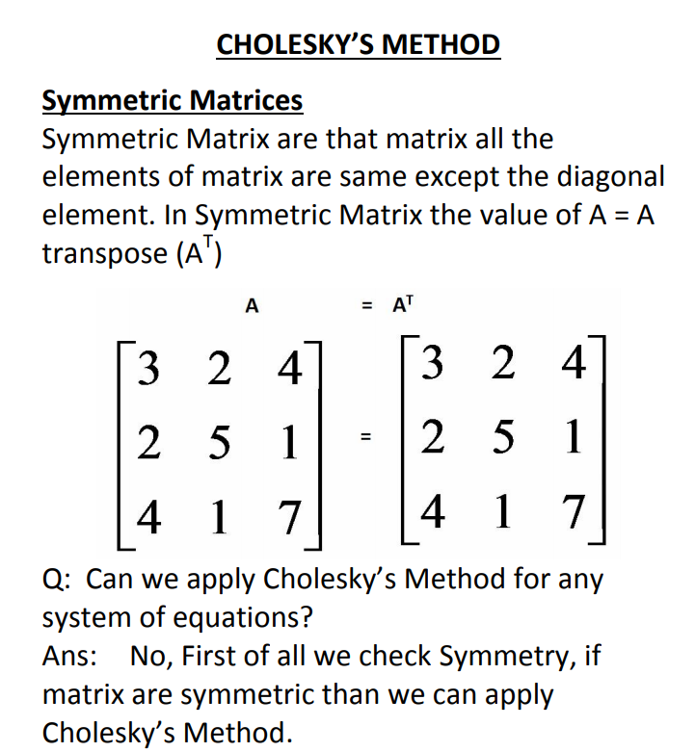
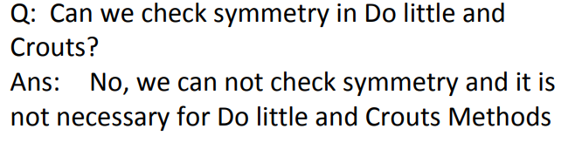

Slide 3
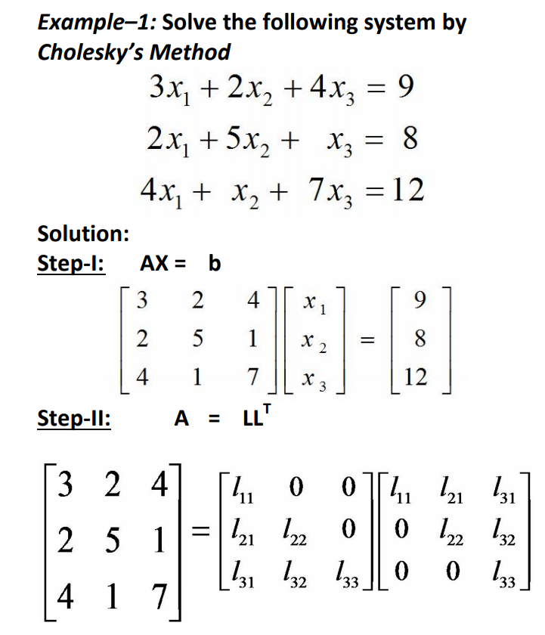




Slide 4
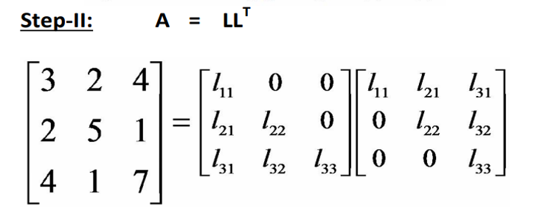
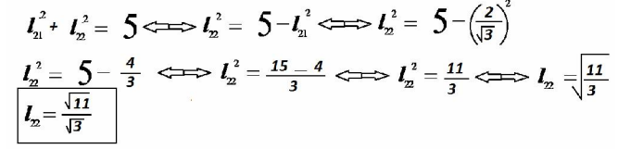
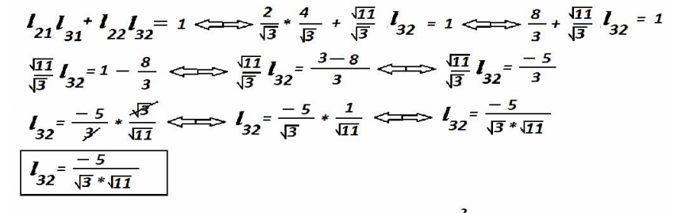
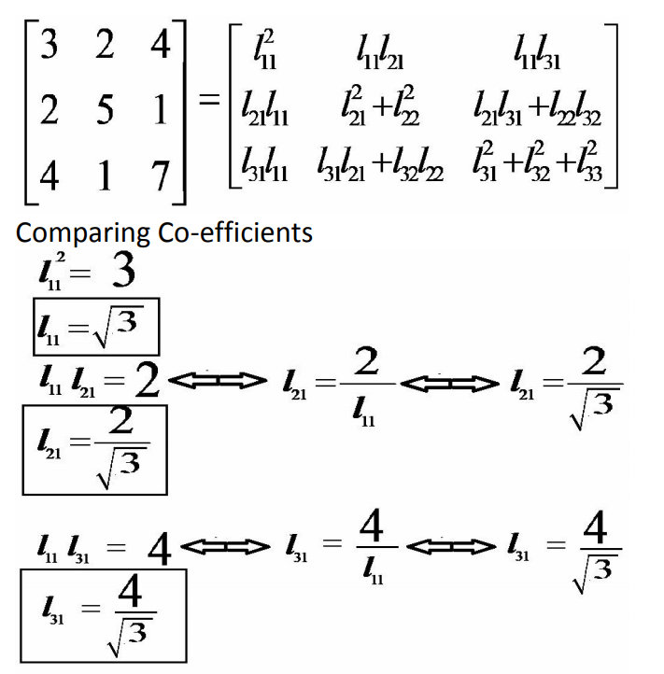
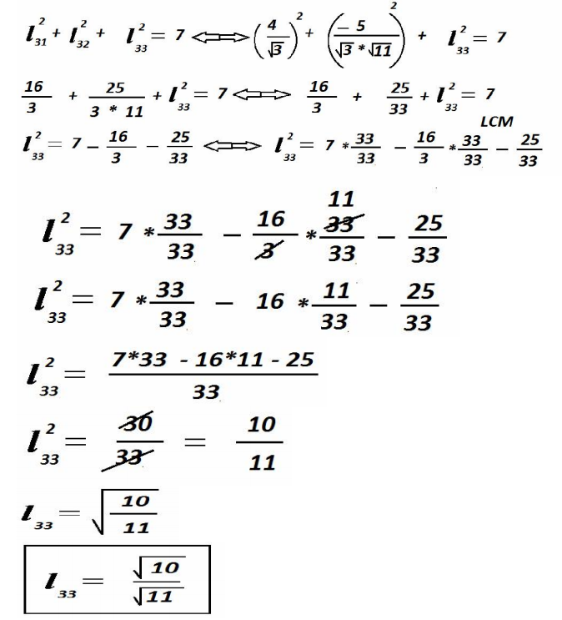

Slide 5
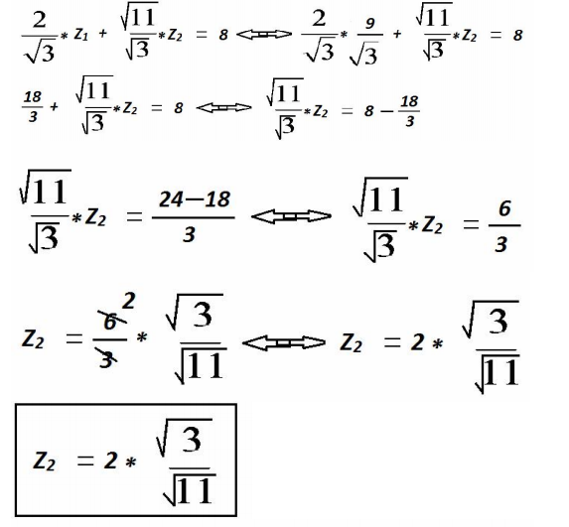
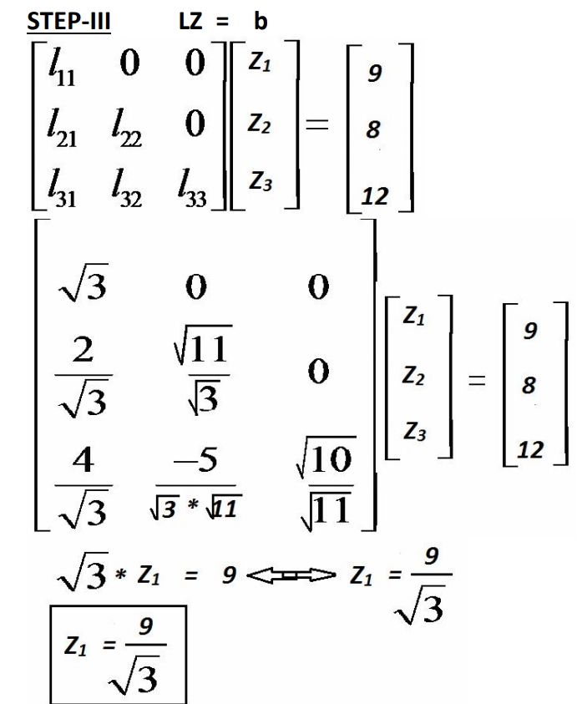
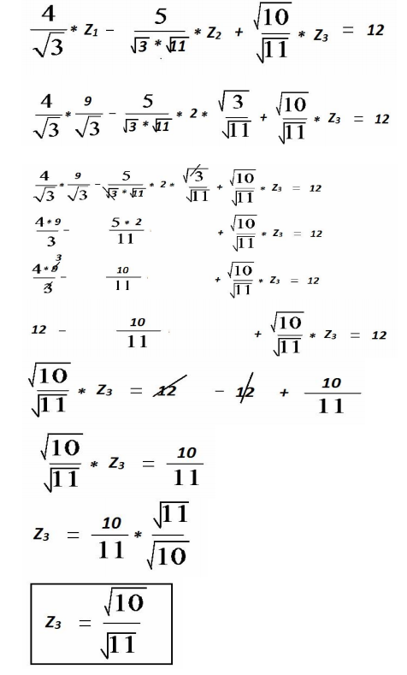

Slide 6
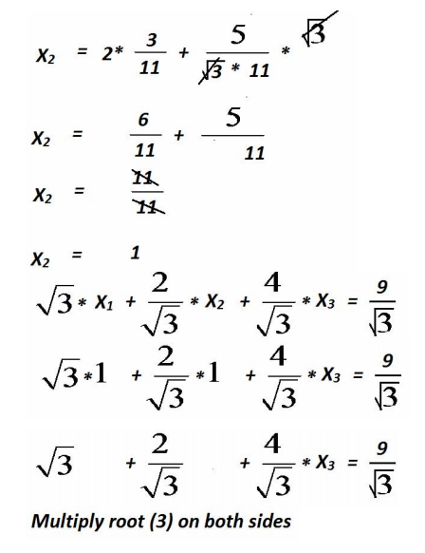
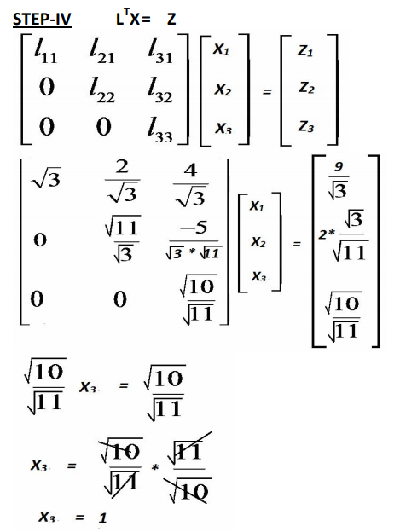
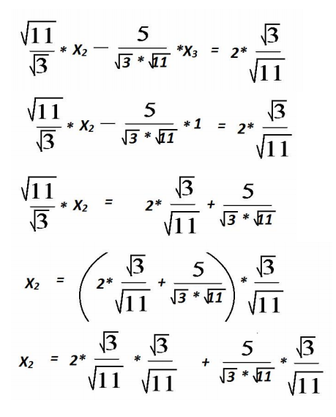
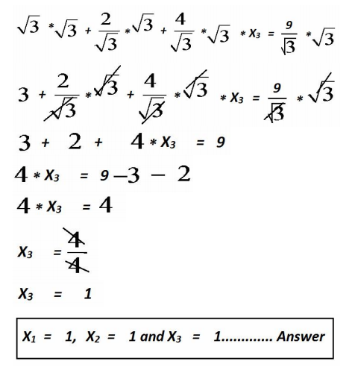

Slide 7
Newton Raphson Method
X_{n+1} = X_{n} – f(x_{n} )/ f’ (x_{n} )
Example: Apply newton Raphson Method, to find the real roots of equation
f(x) = 3x – cos(x) - 1
f’(x) = 3 + sin(x)

Slide 8
Newton Raphson Method
Value*(180/pi) = 57.2957 values in degree
f(x) = 3x – cos(x) - 1
f(0) = 3*0 – cos(0) - 1 = -Ve
f(1) = 3*1 – cos (57.2957) - 1 = +ve
x₀ = 0.6

Slide 9
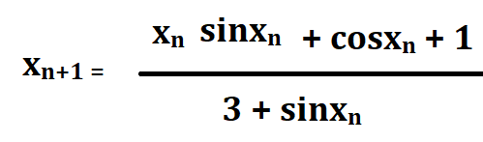
Newton Raphson Method
X_{n+1} = X_{n} – f(x_{n} )/ f’ (x_{n} )
X_{n+1} = X_{n} –{3x – cos(x) - 1}/ {3 + sin(x) }
-------------(A)
Put n = 0
x₁ = [x₀ *sinx₀ + cosx₀ + 1]/(3 + sinx₀)
x₁ = [0.6 *sin(0.6* 57.2957 ) + cos(0.6* 57.2957) + 1]/(3 + sin(0.6* 57.2957 ))
x₁ = 0.6071

Slide 10
Newton Raphson Method
Put n = 1
x₂ = [x₁ *sinx₁ + cosx₁ + 1]/(3 + sinx₁)
x₂ = [0.6071 *sin(0.6071* 57.2957) + cos(0.6071* 57.2957) + 1]/(3 + sin(0.6071* 57.2957))
x₂ = 0.6071

