Slide 1

Computational Methods in
Power System Analysis
Lecture-12 Load Flow Study (Gauss Sedial Method)
By
Dr. Wazir Muhammad Laghari
Electrical Engineering Department
BUET, Khuzdar

Slide 2





















Slide 3


























































Slide 4


























































Slide 5














Slide 6










































Slide 7

























Slide 8








































Slide 9
















































































Slide 10






































Slide 11
























































































Slide 12







































































Slide 13







































Slide 14
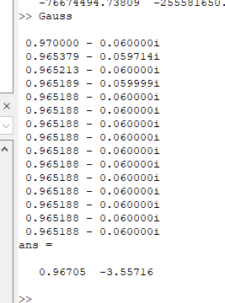



































%initial Guess
v2 = 1;
for m = 1:15
v2 = 1-(0.1i)*(0.6-0.3i)/conj(v2);
disp(v2)
endfor
[abs(v2) angle(v2)*180/pi]

Slide 15






































































































Slide 17





















































Slide 18

































































Slide 19








































































Slide 20
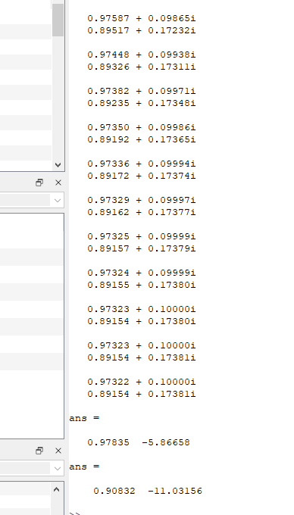





%Given Data
clc
v1 = 1;
s2 = 0.6 - 0.2i;
s3 = 0.4 + 0.3i;
%initial guess
v2 = 1;v3=1;
for m = 1:15
v2 = (conj(s2)/conj(v2) + 10i*v1+5i*v3)/15i;
v3 = (conj(s3)/conj(v3) +5i*v2)/5i;
disp([v2 v3]')
disp('')
end
[abs(v2) angle(v2)*180/pi]
[abs(v3) angle(v3)*180/pi]

Slide 21
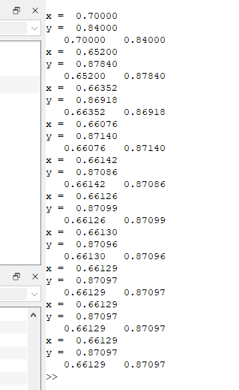


























































Slide 22
%initial guess
clc
x = 1;y = 1;
for m = 1:15
x = (4+3y)/10
y = (7-4x)/(5)
disp([x y])
endfor

Slide 23
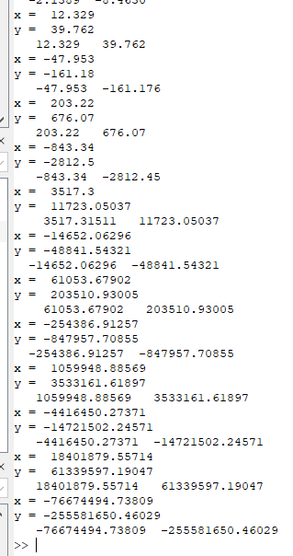

















































Slide 24
END

