Slide 1































Slide 2


















































B2 is purely load bus, because no generation here
B1 connected to B2 via transmission line, whose impedance is j0.1 PU
B1 also connected to B3
So we generating power on Bus B1 and B3

Slide 3
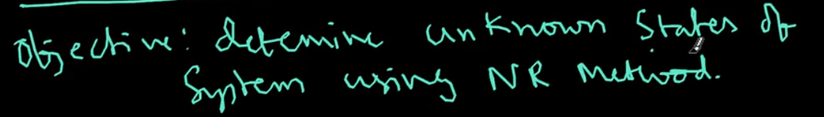
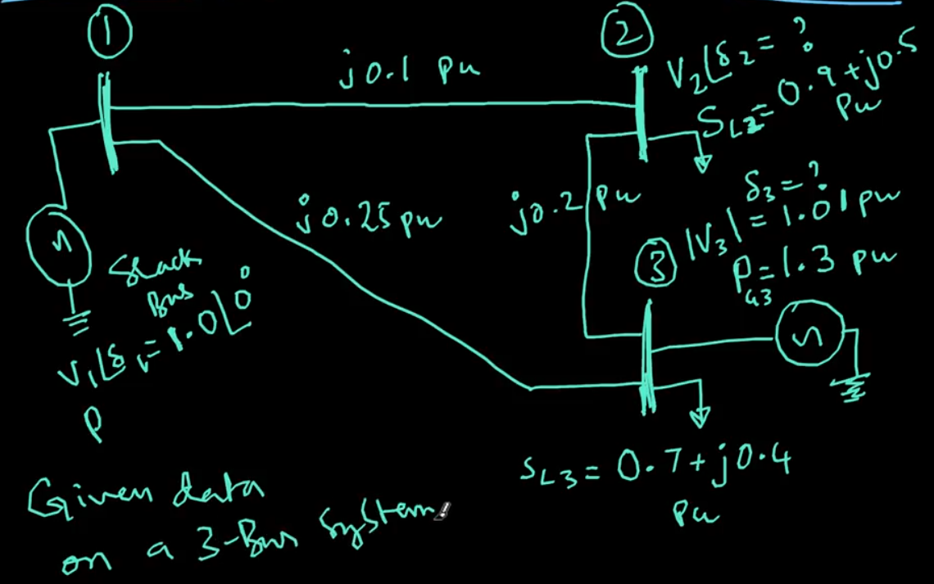
States means voltage magnitudes
So 3 Bus systems, so we have 6 states, like v1, v2, v3, angle (delta)1, delta 2 and delta 3, some given and some unknowns

Slide 4
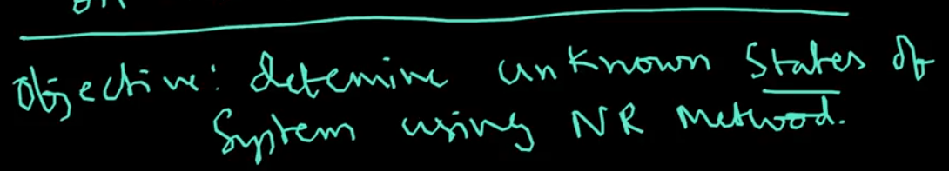
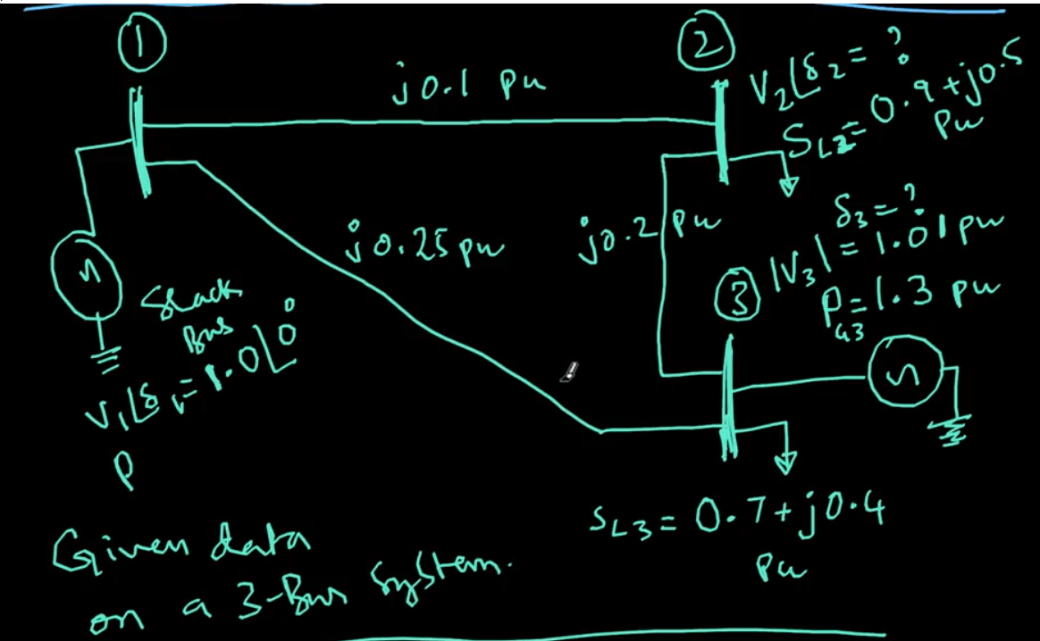

Slide 5
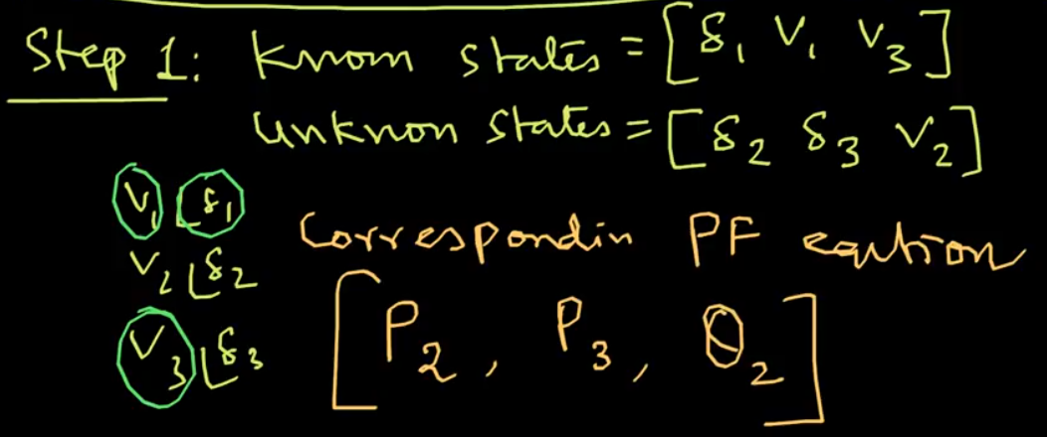
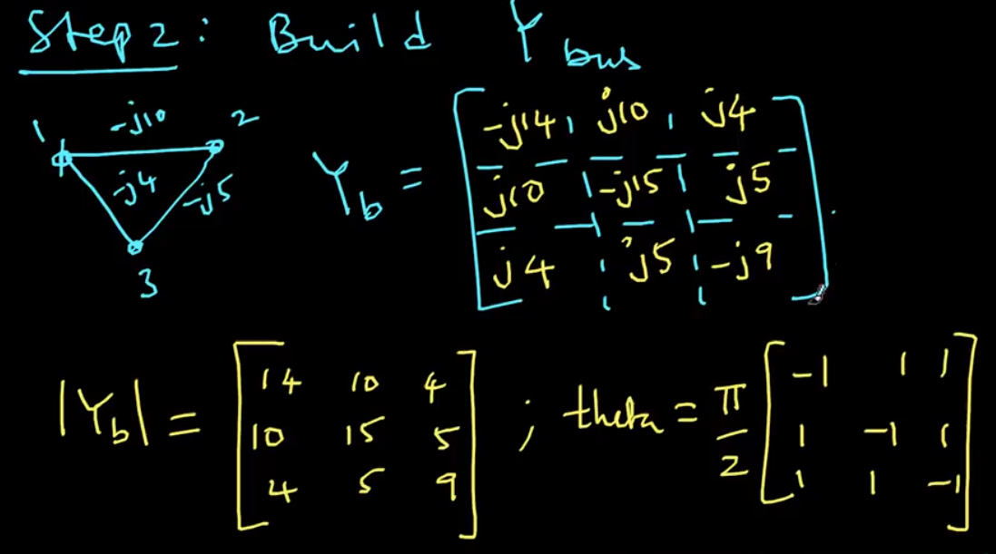

Slide 6
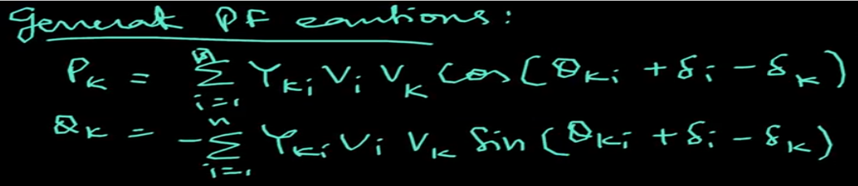
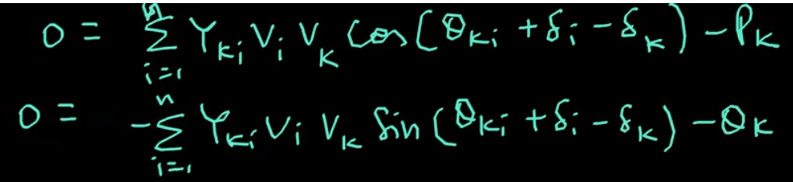
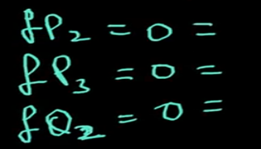
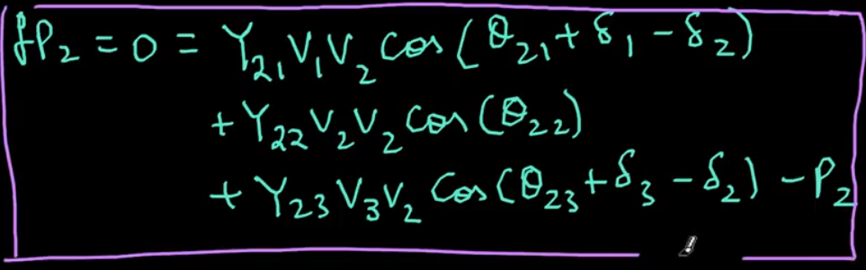
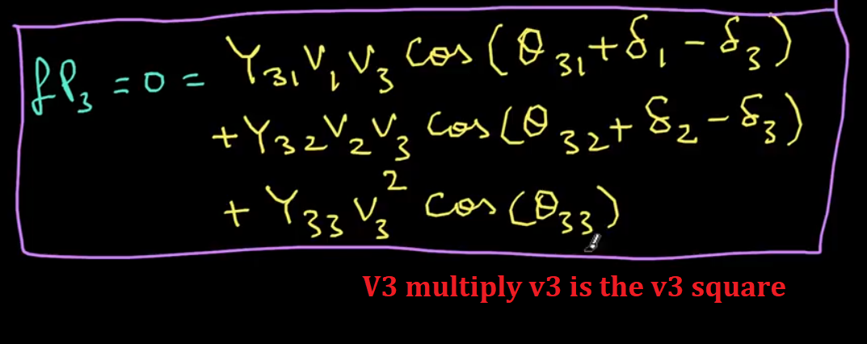
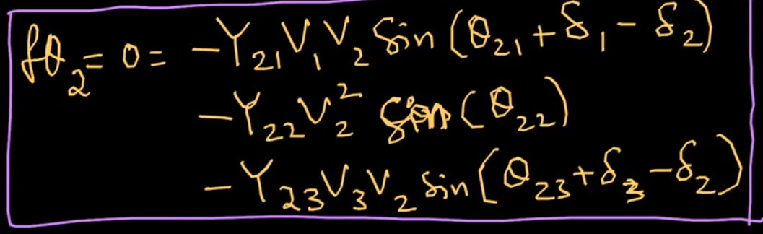
Put k = 2 and i = 1,2,3
Put k = 2 and i = 1,2,3
Put k = 3 and i = 1,2,3

Slide 7
