Slide 1

Computational Methods in Power System Analysis Credit Hours = 3 by Dr. Wazir Muhammad Laghari Lecturer Email: wazirlaghari@buetk.edu.pk
Electrical Engineering Department
Balochistan University of Engineering and Technology
Khuzdar

Slide 2
Lecture Tentative Plan
Lecture No | Description | Domain
Lecture: 01 | Matrix algebra Introduction, Basic concepts and definitions, Determinants, Matrix operations, Linear dependence and rank of a matrix and Linear equations | Cognitive + Psychomotor
Lecture: 02
Lecture: 03 | Incidence and network matrices Introduction, Graphs, Incidence matrices, Primitive network, Formation of network matrices by singular transformations, Formation of network matrices by nonsingular transformations and Example of formation of impedance and network matrices. | Cognitive
Lecture: 04
Lecture: 05 | Algorithms for formation of network matrices Introduction, Algorithm for formation of bus impedance matrix, Modification of the bus impedance matrix for changes in the network and Example of formation and modification of bus impedance matrix, Derivation of loop admittance matrix from bus impedance matrix, Example of derivation of loop admittance matrix from bus impedance matrix. | Cognitive + Psychomotor
Lecture: 06
Lecture: 07
Lecture: 08 | Three-phase networks Introduction, Three-phase network elements, Three-phase balanced network elements, Transformation matrices, Three-phase unbalanced network elements, Incidence and network matrices for three-phase networks, Algorithm for formation of three-phase bus impedance matrix, Modification of the three-phase bus impedance matrix for changes in the network and Example of formation and modification of three-phase network matrices. | Cognitive
Lecture: 09
Lecture: 10
Lecture: 11 | Short circuit studies Introduction, Short circuit calculations using Z­_{BUS}, Short circuit calculations for balanced three-phase network using Z_{BUS}, Example of short circuit calculations using Z_{BUS}, Short circuit calculations using Z_{LOOP} and Example of short circuit calculations using Z_{LOOP}. | Cognitive
Lecture: 12
Lecture: 13 | Solution of simultaneous algebraic equations Introduction, Direct methods for solution of linear algebraic equations, Example of solution of linear equations by direct methods, Iterative methods for solution of linear algebraic equations, Example of solution of linear equations by iterative methods, Methods for solution of nonlinear algebraic equations, Example of solution of nonlinear equations and Comparison of methods | Cognitive + Psychomotor
Lecture: 14
Lecture: 15 | Load Flow Studies Introduction, Power system equations, Solution techniques, Acceleration of convergence, Examples of load flow calculations, Voltage Controlled buses, Representation of transformers, Tie line control, Comparison of methods and Description of load flow program | Cognitive + Psychomotor
Lecture: 16
Lecture: 17 | Numerical solution of differential equations Introduction, Numerical methods for solution of differential equations, Solution of higher-order Transient stability studies Introduction, Swing equation, Machine equations, Power system equations, Solution techniques, Example of transient stability calculations. | Cognitive + Psychomotor
Lecture: 18

Slide 3
Table of Content
Matrix Algebra
Types of matrices
Square Matrix
Order of Square Matrix
Diagonal Matrix
Off-Diagonal or Non Diagonal Elements
Upper and Lower Triangular Matrix
Unity or Identity Matrix
Null Matrix
Transpose of a Matrix
Symmetric Matrix

Slide 4
Table of Content
Skew-Symmetric Matrix
Orthogonal Matrix
Conjugate Matrix
Hermitian Matrix
Skew-Hermitian Matrix
Real and Complex Matrix
Multiplication of Matrices
Unitary Matrix
MATLAB Programs of Different matrices
Determinant
Minors and Cofactors

Slide 5
Table of Content
Adjoint Matrix
Inverse Matrix

Slide 6
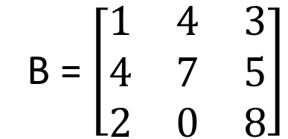
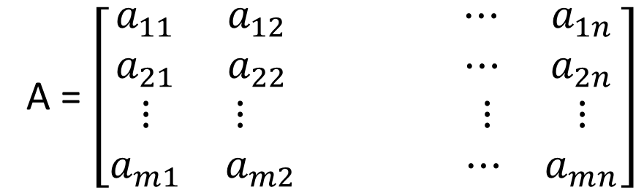
Matrix (Plural matrices)
An array of numbers in m rows and n columns is called a mxn matrix.
Matrices can have any number of rows and columns.
A matrix with m rows and n columns is called an m by n matrix.
A = $\left[\begin{matrix}a_{11} & a_{12} ⋯ & a_{1n} \\ a_{21} & a_{22} ⋯ & a_{2n} \\ ⋮ & ⋮ ⋮ & ⋮ \\ a_{m1} & a_{m2 } ⋯ & a_{mn}\end{matrix}\right]$
B = $\left[\begin{matrix}1 & 4 & 3 \\ 4 & 7 & 5 \\ 2 & 0 & 8\end{matrix}\right]$
B matrix has order 3 x 3

Slide 7
Create 4 rows and 5 columns matrix
>> a = [ 1 2 3 4 5; 2 3 4 5 6; 3 4 5 6 7; 4 5 6 7 8]
a =
1 2 3 4 5
2 3 4 5 6
3 4 5 6 7
4 5 6 7 8

Slide 8
Types of Matrices

Slide 9
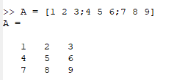
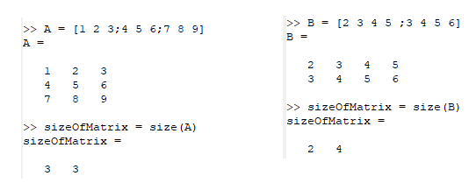

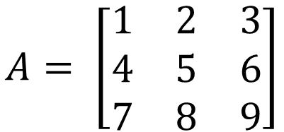
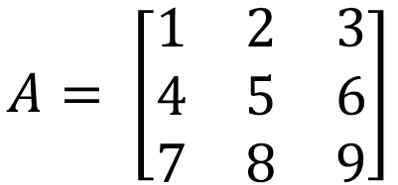
Square Matrix
A square matrix is a matrix that has the same number of rows and columns is known as square matrix.
$$B= \left[\begin{matrix}1 & 2 & 3 \\ 4 & 5 & 6 \\ 7 & 8 & 9 \\ 6 & 5 & 4\end{matrix}\right]$$
$$A= \left[\begin{matrix}1 & 2 & 3 \\ 4 & 5 & 6 \\ 7 & 8 & 9\end{matrix}\right]$$
A is square matrix B is not square matrix
Order of Square Matrix
Order of Square matrix is the number of rows or number of columns in Square matrix is known as Order of Square Matrix.
$$A= \left[\begin{matrix}1 & 2 & 3 \\ 4 & 5 & 6 \\ 7 & 8 & 9\end{matrix}\right]$$
A is 3 × 3 order of square matrix

Slide 10
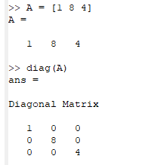
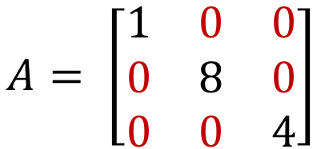
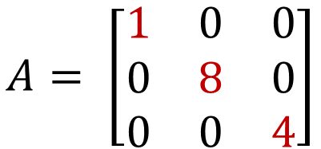
Diagonal Matrix
A diagonal matrix is a matrix in which the entries outside the main diagonal are all zero.
$$A= \left[\begin{matrix}1 & 0 & 0 \\ 0 & 8 & 0 \\ 0 & 0 & 4\end{matrix}\right]$$
Off-Diagonal Or Non Diagonal Elements
An Off-diagonal elements is the entries, which are outside the main
diagonal is known as Off-Diagonal Elements. Example Off-diagonal elements in matrix A is all values except 1, 8 and 4
$$A= \left[\begin{matrix}1 & 0 & 0 \\ 0 & 8 & 0 \\ 0 & 0 & 4\end{matrix}\right]$$

Slide 11

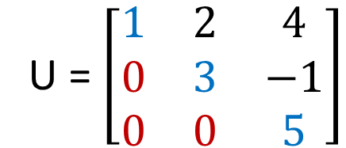
Upper And Lower Triangular Matrix
In Upper Triangular Matrix, the elements below the principal diagonal are zero is known as Upper Triangular Matrix.
In Lower Triangular Matrix, the elements above the principal diagonal are zero is known as Upper Triangular Matrix.
U = $\left[\begin{matrix}1 & 2 & 4 \\ 0 & 3 & −1 \\ 0 & 0 & 5\end{matrix}\right]$
Upper Triangular Matrix
>> A = ones(4)
A =
1 1 1 1
1 1 1 1
1 1 1 1
1 1 1 1
>> B = triu(A)
B =
1 1 1 1
0 1 1 1
0 0 1 1
0 0 0 1
>> A = ones(4)
A =
1 1 1 1
1 1 1 1
1 1 1 1
1 1 1 1
>> B = tril(A)
B =
1 0 0 0
1 1 0 0
1 1 1 0
1 1 1 1
Lower Triangular Matrix
L = $\left[\begin{matrix}1 & 0 & 0 \\ 2 & 3 & 0 \\ 4 & −1 & 5\end{matrix}\right]$

Slide 12



Unity or Identity Matrix
If all diagonal elements of a square matrix equal to one and all other elements are zero, the matrix is the unit or identity matrix.
$$U= \left[\begin{matrix}1 & 0 & 0 \\ 0 & 1 & 0 \\ 0 & 0 & 1\end{matrix}\right]$$
$$I= \left[\begin{matrix}1 & 0 & 0 \\ 0 & 1 & 0 \\ 0 & 0 & 1\end{matrix}\right]$$
Null Matrix
If all diagonal elements of a matrix are equal to zero, is called Null Matrix.
$$0= \left[\begin{matrix}0 & 0 & 0 \\ 0 & 0 & 0 \\ 0 & 0 & 0\end{matrix}\right]$$

Slide 13


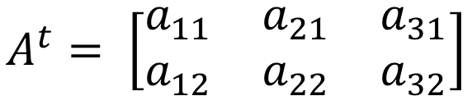

Transpose of a matrix
If the rows and columns of an m x n matrix are interchanged, the resultant n x m matrix is the transpose matrix and is designated by A^{t}.
$$A= \left[\begin{matrix}2 & 3 & 4 \\ 5 & 6 & 7 \\ 8 & 9 & 6\end{matrix}\right]$$
$$A=\left[\begin{matrix}a_{11} & a_{12} \\ a_{21} & a_{22} \\ a_{31} & a_{32}\end{matrix}\right]$$
$$A^{t}= \left[\begin{matrix}2 & 5 & 8 \\ 3 & 6 & 9 \\ 4 & 7 & 6\end{matrix}\right]$$
$$A^{t}= \left[\begin{matrix}a_{11} & a_{21} & a_{31} \\ a_{12} & a_{22} & a_{32}\end{matrix}\right]$$

Slide 14


Symmetric Matrix
The matrix of A equal to transpose of A, than it is called as Symmetric Matrix.
A = A^{t}
$$A^{t}= \left[\begin{matrix}1 & 5 & 3 \\ 5 & 2 & 6 \\ 3 & 6 & 4\end{matrix}\right]$$
$$A= \left[\begin{matrix}1 & 5 & 3 \\ 5 & 2 & 6 \\ 3 & 6 & 4\end{matrix}\right]$$
So matrix A is a symmetric matrix.

Slide 15
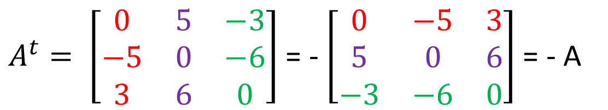

Skew-symmetric matrix
If A = -A^{t} for a square matrix, A is a skew-symmetric matrix.
Properties:
Diagonal elements are zero.
The corresponding off diagonal elements are equal but of opposite sign.
$$A= \left[\begin{matrix}0 & −5 & 3 \\ 5 & 0 & 6 \\ −3 & −6 & 0\end{matrix}\right]$$
$A^{t}= \left[\begin{matrix}0 & 5 & −3 \\ −5 & 0 & −6 \\ 3 & 6 & 0\end{matrix}\right]$ = - $\left[\begin{matrix}0 & −5 & 3 \\ 5 & 0 & 6 \\ −3 & −6 & 0\end{matrix}\right]$ = - A

Slide 16
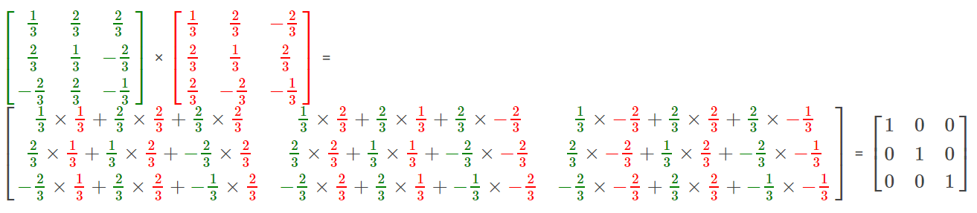

Orthogonal Matrix
$$A= \left[\begin{matrix}\frac{1}{3} & \frac{2}{3} & \frac{2}{3} \\ \frac{2}{3} & \frac{1}{3} & −\frac{2}{3} \\ −\frac{2}{3} & \frac{2}{3} & −\frac{1}{3}\end{matrix}\right]$$
A square matrix with real elements and satisfies:
A.A^{t} = I is called Orthogonal matrix

Slide 17
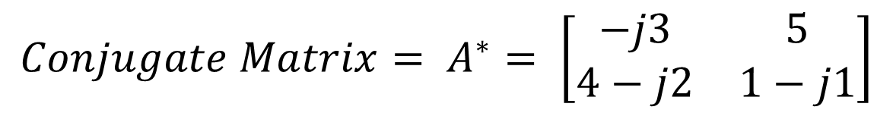
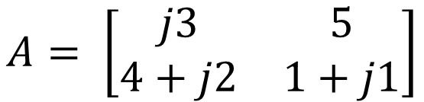
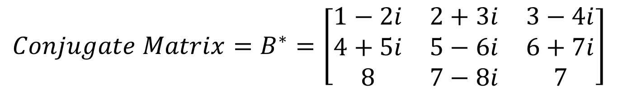
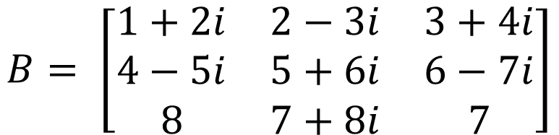
Conjugate Matrix
If all elements of a matrix are replaced by their conjugates (replace a + jb by a – jb), the resultant matrix is the conjugate and is denoted by A*.
$$A= \left[\begin{matrix}j3 & 5 \\ 4+j2 & 1+j1\end{matrix}\right]$$
$${Conjugate Matrix= A}^{∗}= \left[\begin{matrix}−j3 & 5 \\ 4−j2 & 1−j1\end{matrix}\right]$$
$$B= \left[\begin{matrix}1+2i & 2−3i & 3+4i \\ 4−5i & 5+6i & 6−7i \\ 8 & 7+8i & 7\end{matrix}\right]$$
$${Conjugate Matrix=B}^{∗}=\left[\begin{matrix}1−2i & 2+3i & 3−4i \\ 4+5i & 5−6i & 6+7i \\ 8 & 7−8i & 7\end{matrix}\right]$$

Slide 18
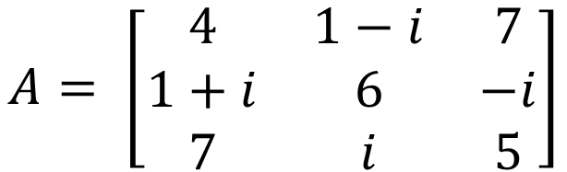

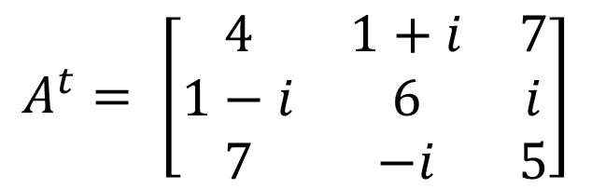
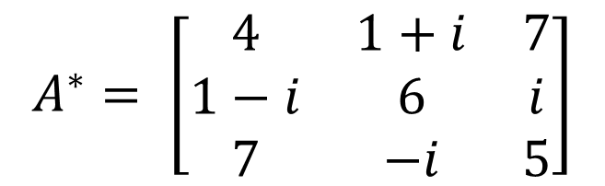
Hermitian Matrix
Hermitian Matrix is a matrix, which satisfies the following condition:
$$A^{∗}=A^{t}$$
$$A= \left[\begin{matrix}4 & 1−i & 7 \\ 1+i & 6 & −i \\ 7 & i & 5\end{matrix}\right]$$
$$A^{∗}= \left[\begin{matrix}4 & 1+i & 7 \\ 1−i & 6 & i \\ 7 & −i & 5\end{matrix}\right]$$
$$A^{t}= \left[\begin{matrix}4 & 1+i & 7 \\ 1−i & 6 & i \\ 7 & −i & 5\end{matrix}\right]$$
$${So it is hermitian matrix, because A}^{∗}=A^{t}$$

Slide 19
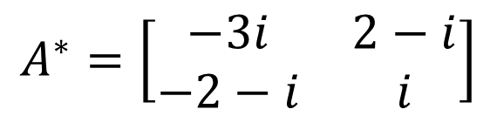
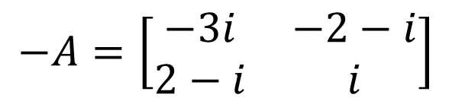
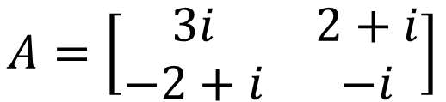
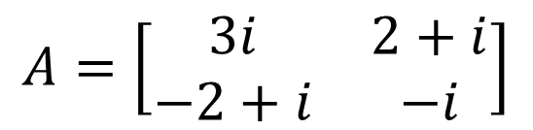
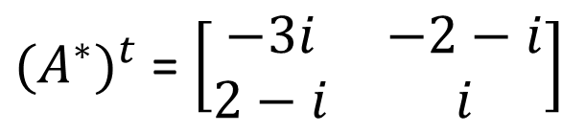

Skew-Hermitian Matrix
Skew-Hermitian Matrix is a matrix, which satisfies the following condition:
$${{(A}^{∗})}^{t}=−A$$
$$A=\left[\begin{matrix}3i & 2+i \\ −2+i & −i\end{matrix}\right]$$
$$A^{∗}=\left[\begin{matrix}−3i & 2−i \\ −2−i & i\end{matrix}\right]$$
$$A=\left[\begin{matrix}3i & 2+i \\ −2+i & −i\end{matrix}\right]$$
${{(A}^{∗})}^{t}$ = $\left[\begin{matrix}−3i & −2−i \\ 2−i & i\end{matrix}\right]$
$$−A=\left[\begin{matrix}−3i & −2−i \\ 2−i & i\end{matrix}\right]$$
$${{So this matrix is Skew−Hermitian matrix, because(A}^{∗})}^{t}=−A$$

Slide 20
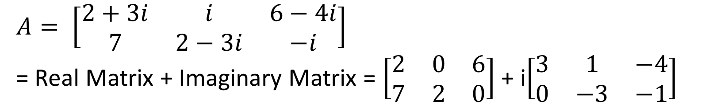
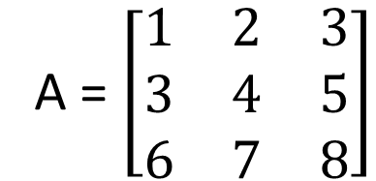
Real And Complex Matrix
A real matrix is a matrix whose elements consist entirely of real numbers.
A = $\left[\begin{matrix}1 & 2 & 3 \\ 3 & 4 & 5 \\ 6 & 7 & 8\end{matrix}\right]$
A Complex matrix is a matrix whose elements contain complex numbers.
$A= \left[\begin{matrix}2+3i & i & 6−4i \\ 7 & 2−3i & −i\end{matrix}\right]$
= Real Matrix + Imaginary Matrix = $\left[\begin{matrix}2 & 0 & 6 \\ 7 & 2 & 0\end{matrix}\right]$ + i$\left[\begin{matrix}3 & 1 & −4 \\ 0 & −3 & −1\end{matrix}\right]$

Slide 21
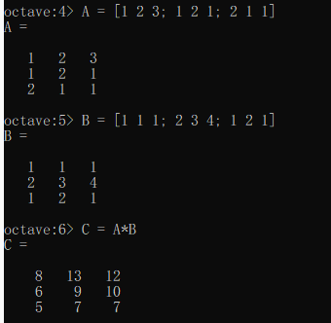
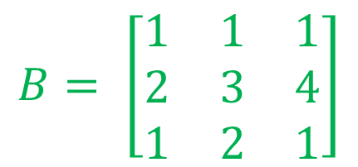
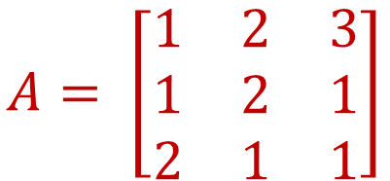
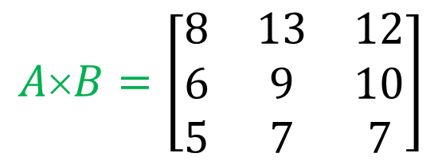
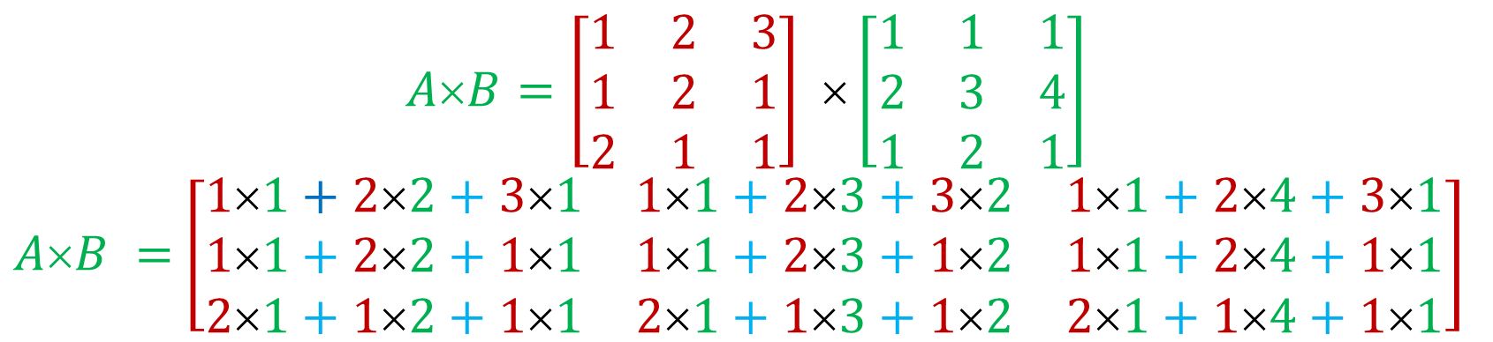
Multiplication of Matrices
$$A= \left[\begin{matrix}1 & 2 & 3 \\ 1 & 2 & 1 \\ 2 & 1 & 1\end{matrix}\right]$$
$$B= \left[\begin{matrix}1 & 1 & 1 \\ 2 & 3 & 4 \\ 1 & 2 & 1\end{matrix}\right]$$
$$A×B=\left[\begin{matrix}1 & 2 & 3 \\ 1 & 2 & 1 \\ 2 & 1 & 1\end{matrix}\right] ×\left[\begin{matrix}1 & 1 & 1 \\ 2 & 3 & 4 \\ 1 & 2 & 1\end{matrix}\right]$$
$AB =$ $\left[\begin{matrix}11+22+31 & 11+23+32 & 11+24+31 \\ 11+22+11 & 11+23+12 & 11+24+11 \\ 21+12+11 & 21+13+12 & 21+14+11\end{matrix}\right]$
$$A×B=\left[\begin{matrix}8 & 13 & 12 \\ 6 & 9 & 10 \\ 5 & 7 & 7\end{matrix}\right]$$

Slide 22
Unitary Matrix
Quiz No: 1
State and explain the properties of Unitary Matrix with one numerical example?
Online Submission last Date 9th May, 2020
Mode of Submission: Online
Format: Only Handwritten acceptable

Slide 23
Write a MATLAB Code/Programs of Different Matrices

Slide 24
Identity Matrix
Null or Empty Matrix
>> N = zeros(3,3)
N =
0 0 0
0 0 0
0 0 0
Transpose Matrix
>> A = [2 3 4;5 6 7;8 9 6]
A =
2 3 4
5 6 7
8 9 6
>> A'
ans =
2 5 8
3 6 9
4 7 6
I = eye(3)
I =
1 0 0
0 1 0
0 0 1

Slide 25
Symmetric Matrix
Skew-Symmetric Matrix
>> A = [1 5 3;5 2 6;3 6 4]
A =
1 5 3
5 2 6
3 6 4
>> tf = issymmetric(A)
tf = 1
>> A = [0 -5 3;5 0 6;-3 -6 0]
A =
0 -5 3
5 0 6
-3 -6 0
>> tf = issymmetric(A)
tf = 0

Slide 26
Check whether matrix is orthogonal or not
>> A=[2 4 6;4 6 8;2 6 8]
A =
2 4 6
4 6 8
2 6 8
>> B=A'
B =
2 4 2
4 6 6
6 8 8
>> C=A*B
C =
56 80 76
80 116 108
76 108 104
It is not orthogonal matrix

Slide 27
Conjugate Matrix
>> B = [1+2i 2-3i 3+4i;4-5i 5+6i 6-7i;8 7+8i 7]
B =
1 + 2i 2 - 3i 3 + 4i
4 - 5i 5 + 6i 6 - 7i
8 + 0i 7 + 8i 7 + 0i
>> C = conj(B)
C =
1 - 2i 2 + 3i 3 - 4i
4 + 5i 5 - 6i 6 + 7i
8 - 0i 7 - 8i 7 - 0i

Slide 28
Check whether matrix is Hermitian matrix or not
>> A =[4 1-i 7;1+i 6 -i;7 i 5]
A =
4 + 0i 1 - 1i 7 + 0i
1 + 1i 6 + 0i -0 - 1i
7 + 0i 0 + 1i 5 + 0i
>> A = ishermitian(A)
A = 1
>>B =[3i 2+i;-2+i -i]
B =
0 + 3i 2 + 1i
-2 + 1i -0 - 1i
>> B = ishermitian(A)
B = 0
Yes, it is Hermitian
No, it is not Hermitian

Slide 29
Multiplication of Two Matrices
>> A = [1 2 3;1 2 1;2 1 1]
1 2 3
1 2 1
2 1 1
>> B=[1 1 1;2 3 4;1 2 1]
1 1 1
2 3 4
1 2 1
>> C= A*B
8 13 12
6 9 10
5 7 7

Slide 30
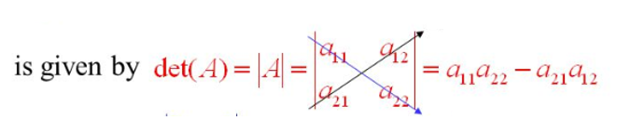
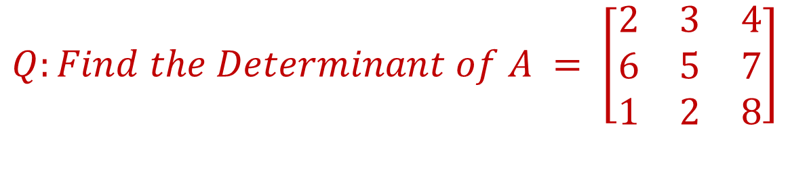
Determinant
Every square matrix can be associated with a real number called its determinant.
$$The determinant of the matrix A = \left[\begin{matrix}a_{11} & a_{12} \\ a_{21} & a_{22}\end{matrix}\right]$$
$$Q:Find the Determinant of A = \left[\begin{matrix}2 & 3 & 4 \\ 6 & 5 & 7 \\ 1 & 2 & 8\end{matrix}\right]$$
Solution
$\left|A\right|=2\left|\begin{matrix}5 & 7 \\ 2 & 8\end{matrix}\right|−$ $3\left|\begin{matrix}6 & 7 \\ 1 & 8\end{matrix}\right|$ + $4\left|\begin{matrix}6 & 5 \\ 1 & 2\end{matrix}\right|$ = 2 (40-14) – 3(48-7) + 4 (12-5) =52 -123 + 28 = -43 Answer

Slide 31
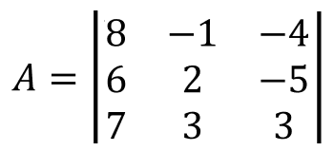
Find the Minors and Cofactors of the Second Column of given determinant
Minors Cofactors
Minor of 12 = $M_{12 }= \left|\begin{matrix}6 & −5 \\ 7 & 3\end{matrix}\right|$ = (18) –(-35) = 53 1+2 = 3 = odd = -53
Minor of 22 = $M_{12 }= \left|\begin{matrix}8 & −4 \\ 7 & 3\end{matrix}\right|$ = (24) –(-28) = 52 2+2 = 4 = even = 52
Minor of 32 = $M_{32 }= \left|\begin{matrix}8 & −4 \\ 6 & −5\end{matrix}\right|$ = (-40) –(-24) = -16 3+2 = 5 = odd = +16

Slide 32
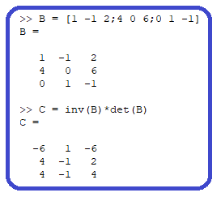
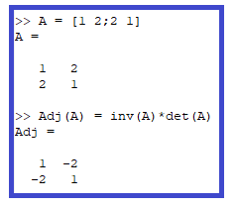
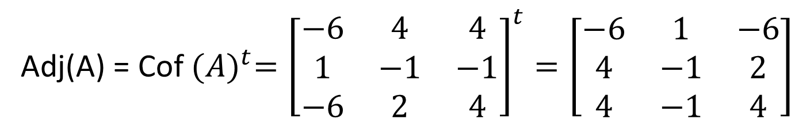

$$Find the Adjoint of the matrix$$
A = $\left[\begin{matrix}1 & −1 & 2 \\ 4 & 0 & 6 \\ 0 & 1 & −1\end{matrix}\right]$
Solution
Cof ($a_{11})= + \left|\begin{matrix}0 & 6 \\ 1 & −1\end{matrix}\right|=−6$, Cof ($a_{12})=− \left|\begin{matrix}4 & 6 \\ 0 & −1\end{matrix}\right|=4,$Cof ($a_{13})= + \left|\begin{matrix}4 & 0 \\ 0 & 1\end{matrix}\right|=4$
Cof ($a_{21})=− \left|\begin{matrix}−1 & 2 \\ 1 & −1\end{matrix}\right|=1$, Cof ($a_{22})=+ \left|\begin{matrix}1 & 2 \\ 0 & −1\end{matrix}\right|=−1,$Cof ($a_{23})=− \left|\begin{matrix}1 & −1 \\ 0 & 1\end{matrix}\right|=−1$
Cof ($a_{31})=+ \left|\begin{matrix}−1 & 2 \\ 0 & 6\end{matrix}\right|=−6$, Cof ($a_{32})=− \left|\begin{matrix}1 & 2 \\ 4 & 6\end{matrix}\right|=2,$Cof ($a_{33})=+ \left|\begin{matrix}1 & −1 \\ 4 & 0\end{matrix}\right|=4$
Adj(A) = Cof ${(A)}^{t}={\left[\begin{matrix}−6 & 4 & 4 \\ 1 & −1 & −1 \\ −6 & 2 & 4\end{matrix}\right]}^{t}=\left[\begin{matrix}−6 & 1 & −6 \\ 4 & −1 & 2 \\ 4 & −1 & 4\end{matrix}\right]$

Slide 33






Inverse Matrix
$A^{−1}=\frac{1}{\left|A\right|}$* (Adjoint of A)
Q: Find the inverse of A = $\left[\begin{matrix}1 & −1 & 2 \\ 4 & 0 & 6 \\ 0 & 1 & −1\end{matrix}\right]$
Solution
$\left|A\right|$ = -2
Adj(A) = $\left[\begin{matrix}−6 & 1 & −6 \\ 4 & −1 & 2 \\ 4 & −1 & 4\end{matrix}\right]$
$A^{−1}=\frac{1}{\left|A\right|}$* (Adjoint of A) = $\frac{1}{−2}∗\left[\begin{matrix}−6 & 1 & −6 \\ 4 & −1 & 2 \\ 4 & −1 & 4\end{matrix}\right]$ = $\left[\begin{matrix}3 & −\frac{1}{2} & 3 \\ −2 & \frac{1}{2} & −1 \\ −2 & \frac{1}{2} & −2\end{matrix}\right]$

Slide 34

Computational Methods in
Power System Analysis
Lecture-3 Incidence and network matrices
By
Dr. Wazir Muhammad Laghari
Electrical Engineering Department
BUET, Khuzdar

Slide 35

Introduction
The formulation of a suitable mathematical model is the first step in the analysis of an electrical network.
The model must describe the characteristics of individual network components as well as the relations that govern the interconnection of these elements.
A network matrix equation provides a convenient mathematical model for a digital computer solution.
The elements of a network matrix depend on the selection of the independent variables, which can be either currents or voltages. Correspondingly, the elements of the network matrix will be impedances or admittances.
The electrical characteristics of the individual network components can be presented conventionally in the form of a primitive network matrix. This matrix, while adequately describing the characteristics of each component, does not provide any information pertaining to the network connections. It is necessary, therefore to transfer the primitive network matrix into a network matrix that describes the performance of the interconnected network.

Slide 36

Graph And Subgraph
A Graph shows the geometrical interconnection of the element of a network. OR
A Graph is a set of points, called nodes or vertices, which are interconnected by a set of lines called edges.
A Subgraph is any subset of the graph.
node 2
node 3
node 1
edge
edge
node 5
node 4

Slide 37

Example: Find the Vertices and Edges of the graph given below:
B
2
1
4
3
A
C
Vertices = V = {A, B, C}
Edges = E = {(A,B), (B,C), (C,A)} OR
Edges = E = {(B,A), (C,B), (A,C)}

Slide 38

Connected And Disconnected Graph
A graph is said to be connected if there is a path between every pair of vertex.
A graph is said to be disconnected if at least two vertices of the graph are not connected by a path.

Slide 39


Rank of Graph
A rank of a graph is n-1, where n is the number of node in the graph.
A graph whose vertices and edges are subsets of another graph is known as Subgraph.
Subgraph
Graph G Subgraph of G

Slide 40
Oriented Graph
If each element of the connected graph is assigned a direction, than it is called Oriented Graph.
2
2
1
4
1
4
3
3
Simple Graph Oriented Graph

