Slide 1

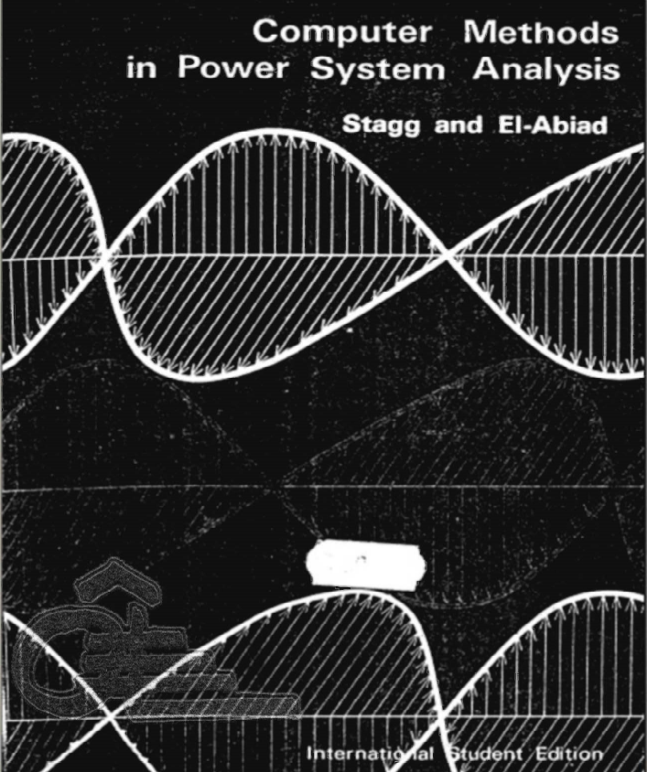
Computer Methods in Power System Analysis by Stagg and El-Abiad
By
Dr. Wazir Muhammad Laghari
Electrical Engineering Department
BUET, Khuzdar

Slide 2
Lecture Tentative Plan
Lecture 1 presents a brief introduction and impact of computes on power system engineering and the advantages of digital computation.
Lecture 2 covers the basic principles of matrix algebra and provides sufficient background in matrix theory.
Lecture 3, presents the techniques for describing the geometric structure of a network and outline the transformations required to derive network matrices (Single phase).
Lecture 4 presents algorithms which can be used in an alternative method for the formation of certain network matrices (for single phase).
Lecture 5 extends these methods for three-phase representation.
Lecture 6 discuss an application of network matrices to short circuit calculations.
Lecture 7 contains a brief introduction to the solution of linear and non-linear simultaneous algebraic equations.
Lecture 8 discuss the formulation and solution of the load flow problem.
Lecture 9 introduces methods for the numerical solution of the differential equations that are required for transient stability studies.
Lecture 10 covers the formulation and solution techniques employed in transient studies and presents procedures for the detailed representation of synchronous and induction machines, exciter and governor systems, and the distance relays.

Slide 3
Importance of Computers
The development of computer technology has provided the following advantages to power system engineering:
More efficient and economic means of performing routine engineering calculations required in the planning, design, and operation of a power system.
Better utilization of engineering talent by relieving the engineer from tedious hand calculations and permitting him to spend more time on technical work.
The ability to perform more effective engineering studies by applying calculating procedures to obtain a number of alternate solutions for a particular problem to provide a broad base for engineering decisions.
The capability of performing studies which were not possible because of the volume of calculations involved.

Slide 4
Orientation of Engineering Problems to Computers
The process of applying a computer to the solution of engineering problems involves a number of distinct steps. These steps are:
Problem definition
Mathematical formulation
Selection of solution technique
Program design
Programming
Program verification
Application

Slide 5
END

