Slide 1
Lecture-2a Matrix algebra

Slide 2
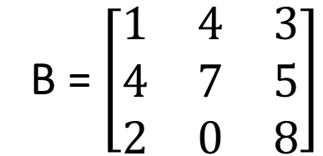
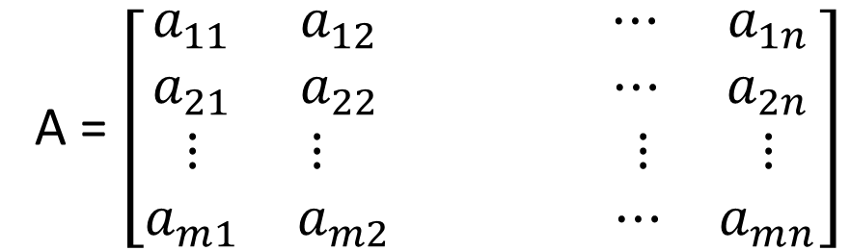
Matrix (Plural matrices)
An array of numbers in m rows and n columns is called a mxn matrix.
Matrices can have any number of rows and columns.
A matrix with m rows and n columns is called an m by n matrix.
A = $\left[\begin{matrix}a_{11} & a_{12} ⋯ & a_{1n} \\ a_{21} & a_{22} ⋯ & a_{2n} \\ ⋮ & ⋮ ⋮ & ⋮ \\ a_{m1} & a_{m2 } ⋯ & a_{mn}\end{matrix}\right]$
B = $\left[\begin{matrix}1 & 4 & 3 \\ 4 & 7 & 5 \\ 2 & 0 & 8\end{matrix}\right]$
B matrix has order 3 x 3

Slide 3
Types of Matrices

Slide 4

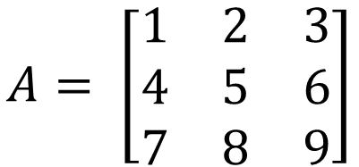
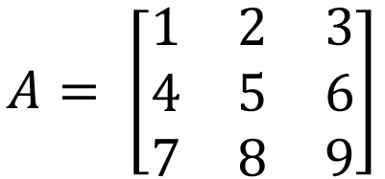
Square Matrix
A square matrix is a matrix that has the same number of rows and columns is known as square matrix.
$$B= \left[\begin{matrix}1 & 2 & 3 \\ 4 & 5 & 6 \\ 7 & 8 & 9 \\ 6 & 5 & 4\end{matrix}\right]$$
$$A= \left[\begin{matrix}1 & 2 & 3 \\ 4 & 5 & 6 \\ 7 & 8 & 9\end{matrix}\right]$$
A is square matrix B is not square matrix
Order of Square Matrix
Order of Square matrix is the number of rows or number of columns in Square matrix is known as Order of Square Matrix.
$$A= \left[\begin{matrix}1 & 2 & 3 \\ 4 & 5 & 6 \\ 7 & 8 & 9\end{matrix}\right]$$
A is 3 × 3 order of square matrix

Slide 5
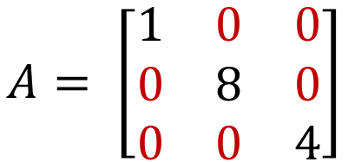
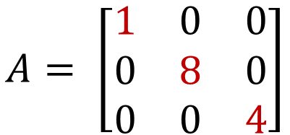
Diagonal Matrix
A diagonal matrix is a matrix in which the entries outside the main diagonal are all zero.
$$A= \left[\begin{matrix}1 & 0 & 0 \\ 0 & 8 & 0 \\ 0 & 0 & 4\end{matrix}\right]$$
Off-Diagonal Or Non Diagonal Elements
An Off-diagonal elements is the entries, which are outside the main
diagonal is known as Off-Diagonal Elements. Example Off-diagonal elements in matrix A is all values except 1, 8 and 4
$$A= \left[\begin{matrix}1 & 0 & 0 \\ 0 & 8 & 0 \\ 0 & 0 & 4\end{matrix}\right]$$

Slide 6

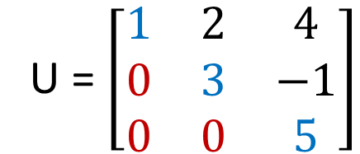
Upper And Lower Triangular Matrix
In Upper Triangular Matrix, the elements below the principal diagonal are zero is known as Upper Triangular Matrix.
In Lower Triangular Matrix, the elements above the principal diagonal are zero is known as Upper Triangular Matrix.
U = $\left[\begin{matrix}1 & 2 & 4 \\ 0 & 3 & −1 \\ 0 & 0 & 5\end{matrix}\right]$
Upper Triangular Matrix
L = $\left[\begin{matrix}1 & 0 & 0 \\ 2 & 3 & 0 \\ 4 & −1 & 5\end{matrix}\right]$
Lower Triangular Matrix

Slide 7



Unity or Identity Matrix
If all diagonal elements of a square matrix equal to one and all other elements are zero, the matrix is the unit or identity matrix.
$$U= \left[\begin{matrix}1 & 0 & 0 \\ 0 & 1 & 0 \\ 0 & 0 & 1\end{matrix}\right]$$
$$I= \left[\begin{matrix}1 & 0 & 0 \\ 0 & 1 & 0 \\ 0 & 0 & 1\end{matrix}\right]$$
Null Matrix
If all diagonal elements of a matrix are equal to zero, is called Null Matrix.
$$0= \left[\begin{matrix}0 & 0 & 0 \\ 0 & 0 & 0 \\ 0 & 0 & 0\end{matrix}\right]$$

Slide 8


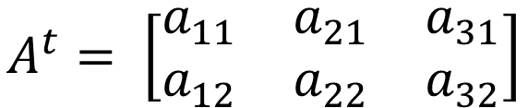

Transpose of a matrix
If the rows and columns of an m x n matrix are interchanged, the resultant n x m matrix is the transpose matrix and is designated by A^{t}.
$$A= \left[\begin{matrix}2 & 3 & 4 \\ 5 & 6 & 7 \\ 8 & 9 & 6\end{matrix}\right]$$
$$A=\left[\begin{matrix}a_{11} & a_{12} \\ a_{21} & a_{22} \\ a_{31} & a_{32}\end{matrix}\right]$$
$$A^{t}= \left[\begin{matrix}2 & 5 & 8 \\ 3 & 6 & 9 \\ 4 & 7 & 6\end{matrix}\right]$$
$$A^{t}= \left[\begin{matrix}a_{11} & a_{21} & a_{31} \\ a_{12} & a_{22} & a_{32}\end{matrix}\right]$$

Slide 9


Symmetric Matrix
The matrix of A equal to transpose of A, than it is called as Symmetric Matrix.
A = A^{t}
$$A^{t}= \left[\begin{matrix}1 & 5 & 3 \\ 5 & 2 & 6 \\ 3 & 6 & 4\end{matrix}\right]$$
$$A= \left[\begin{matrix}1 & 5 & 3 \\ 5 & 2 & 6 \\ 3 & 6 & 4\end{matrix}\right]$$
So matrix A is a symmetric matrix.

Slide 10
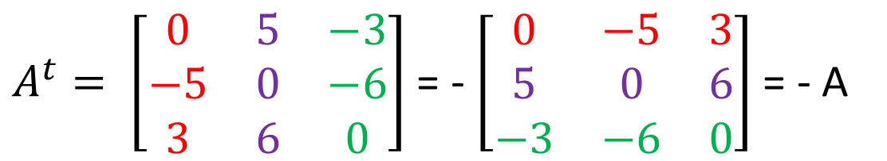

Skew-symmetric matrix
If A = -A^{t} for a square matrix, A is a skew-symmetric matrix.
Properties:
Diagonal elements are zero.
The corresponding off diagonal elements are equal but of opposite sign.
$$A= \left[\begin{matrix}0 & −5 & 3 \\ 5 & 0 & 6 \\ −3 & −6 & 0\end{matrix}\right]$$
$A^{t}= \left[\begin{matrix}0 & 5 & −3 \\ −5 & 0 & −6 \\ 3 & 6 & 0\end{matrix}\right]$ = - $\left[\begin{matrix}0 & −5 & 3 \\ 5 & 0 & 6 \\ −3 & −6 & 0\end{matrix}\right]$ = - A

Slide 11
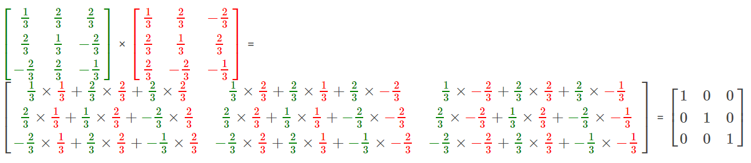

Orthogonal Matrix
$$A= \left[\begin{matrix}\frac{1}{3} & \frac{2}{3} & \frac{2}{3} \\ \frac{2}{3} & \frac{1}{3} & −\frac{2}{3} \\ −\frac{2}{3} & \frac{2}{3} & −\frac{1}{3}\end{matrix}\right]$$
A square matrix with real elements and satisfies:
A.A^{t} = I is called Orthogonal matrix

Slide 12
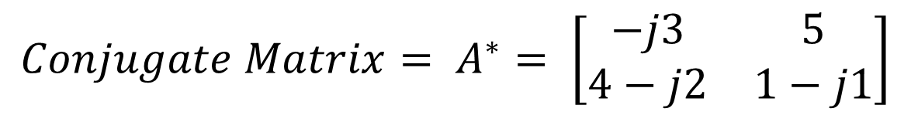
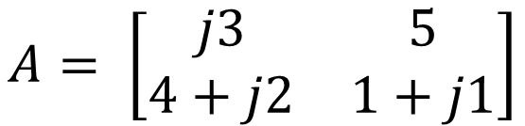
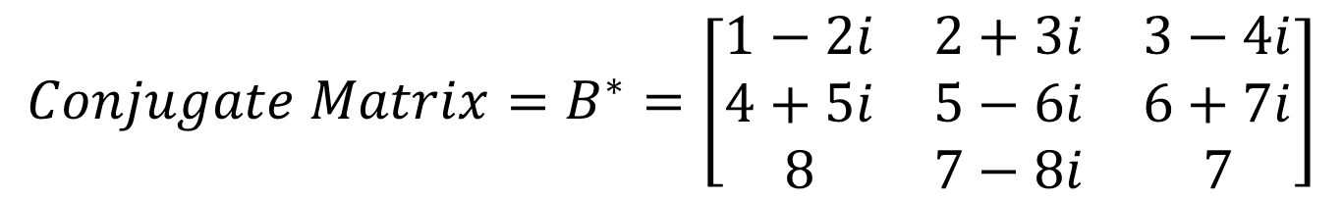
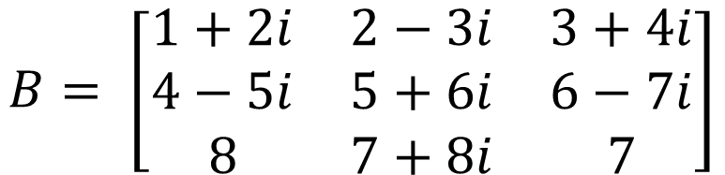
Conjugate Matrix
If all elements of a matrix are replaced by their conjugates (replace a + jb by a – jb), the resultant matrix is the conjugate and is denoted by A*.
$$A= \left[\begin{matrix}j3 & 5 \\ 4+j2 & 1+j1\end{matrix}\right]$$
$${Conjugate Matrix= A}^{∗}= \left[\begin{matrix}−j3 & 5 \\ 4−j2 & 1−j1\end{matrix}\right]$$
$$B= \left[\begin{matrix}1+2i & 2−3i & 3+4i \\ 4−5i & 5+6i & 6−7i \\ 8 & 7+8i & 7\end{matrix}\right]$$
$${Conjugate Matrix=B}^{∗}=\left[\begin{matrix}1−2i & 2+3i & 3−4i \\ 4+5i & 5−6i & 6+7i \\ 8 & 7−8i & 7\end{matrix}\right]$$

Slide 13
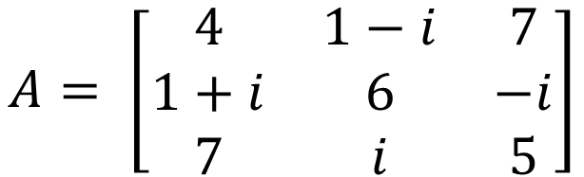

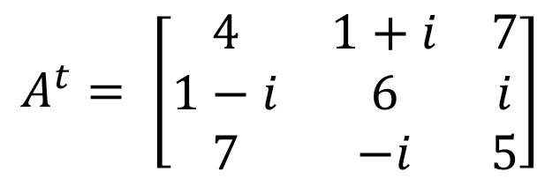
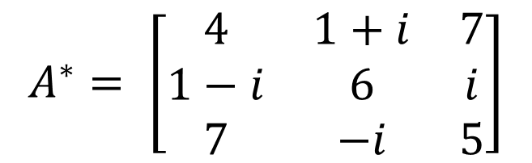
Hermitian Matrix
Hermitian Matrix is a matrix, which satisfies the following condition:
$$A^{∗}=A^{t}$$
$$A= \left[\begin{matrix}4 & 1−i & 7 \\ 1+i & 6 & −i \\ 7 & i & 5\end{matrix}\right]$$
$$A^{∗}= \left[\begin{matrix}4 & 1+i & 7 \\ 1−i & 6 & i \\ 7 & −i & 5\end{matrix}\right]$$
$$A^{t}= \left[\begin{matrix}4 & 1+i & 7 \\ 1−i & 6 & i \\ 7 & −i & 5\end{matrix}\right]$$
$${So it is hermitian matrix, because A}^{∗}=A^{t}$$

Slide 14
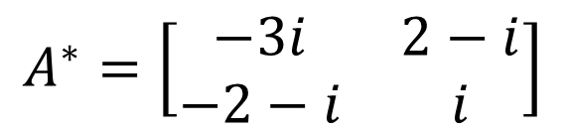
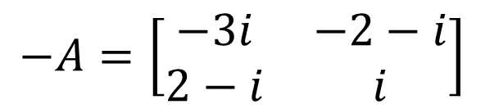
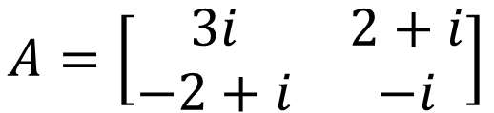
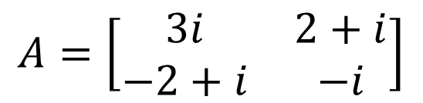
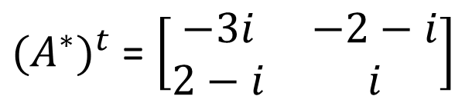

Skew-Hermitian Matrix
Skew-Hermitian Matrix is a matrix, which satisfies the following condition:
$${{(A}^{∗})}^{t}=−A$$
$$A=\left[\begin{matrix}3i & 2+i \\ −2+i & −i\end{matrix}\right]$$
$$A^{∗}=\left[\begin{matrix}−3i & 2−i \\ −2−i & i\end{matrix}\right]$$
$$A=\left[\begin{matrix}3i & 2+i \\ −2+i & −i\end{matrix}\right]$$
${{(A}^{∗})}^{t}$ = $\left[\begin{matrix}−3i & −2−i \\ 2−i & i\end{matrix}\right]$
$$−A=\left[\begin{matrix}−3i & −2−i \\ 2−i & i\end{matrix}\right]$$
$${{So this matrix is Skew−Hermitian matrix, because(A}^{∗})}^{t}=−A$$

Slide 15
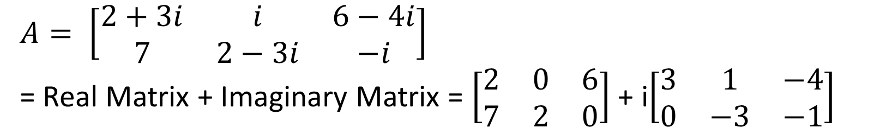
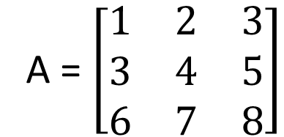
Real And Complex Matrix
A real matrix is a matrix whose elements consist entirely of real numbers.
A = $\left[\begin{matrix}1 & 2 & 3 \\ 3 & 4 & 5 \\ 6 & 7 & 8\end{matrix}\right]$
A Complex matrix is a matrix whose elements contain complex numbers.
$A= \left[\begin{matrix}2+3i & i & 6−4i \\ 7 & 2−3i & −i\end{matrix}\right]$
= Real Matrix + Imaginary Matrix = $\left[\begin{matrix}2 & 0 & 6 \\ 7 & 2 & 0\end{matrix}\right]$ + i$\left[\begin{matrix}3 & 1 & −4 \\ 0 & −3 & −1\end{matrix}\right]$

Slide 16
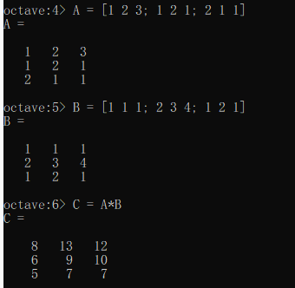
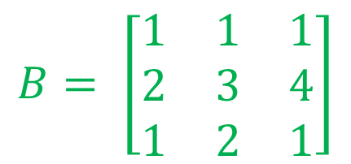
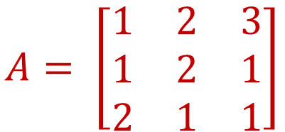
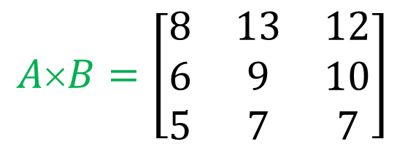
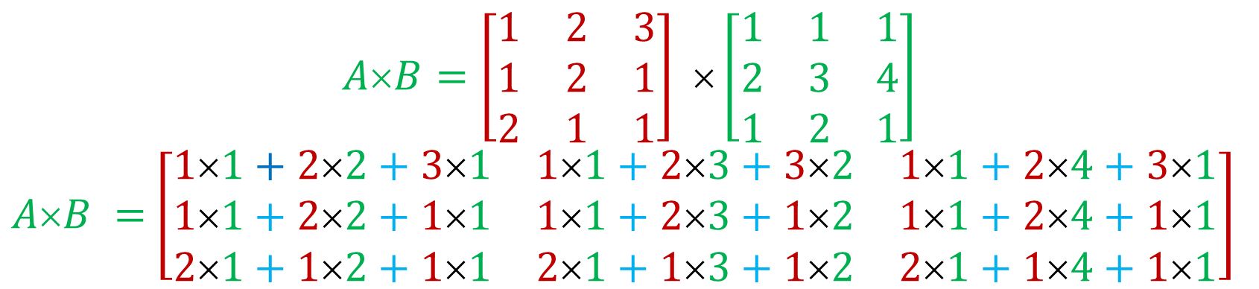
Multiplication of Matrices
$$A= \left[\begin{matrix}1 & 2 & 3 \\ 1 & 2 & 1 \\ 2 & 1 & 1\end{matrix}\right]$$
$$B= \left[\begin{matrix}1 & 1 & 1 \\ 2 & 3 & 4 \\ 1 & 2 & 1\end{matrix}\right]$$
$$A×B=\left[\begin{matrix}1 & 2 & 3 \\ 1 & 2 & 1 \\ 2 & 1 & 1\end{matrix}\right] ×\left[\begin{matrix}1 & 1 & 1 \\ 2 & 3 & 4 \\ 1 & 2 & 1\end{matrix}\right]$$
$AB =$ $\left[\begin{matrix}11+22+31 & 11+23+32 & 11+24+31 \\ 11+22+11 & 11+23+12 & 11+24+11 \\ 21+12+11 & 21+13+12 & 21+14+11\end{matrix}\right]$
$$A×B=\left[\begin{matrix}8 & 13 & 12 \\ 6 & 9 & 10 \\ 5 & 7 & 7\end{matrix}\right]$$

Slide 17
Unitary Matrix
Quiz No: 1
State and explain the properties of Unitary Matrix with one numerical example?
Online Submission last Date 9th May, 2020
Mode of Submission: Online
Format: Only Handwritten acceptable

Slide 18
Determinants

Slide 19
Write a MATLAB Code/Program to Create 4 rows and 5 columns matrix
>> v = [2 1 -1 -2 -5];
>> D = diag(v)
D =
Diagonal Matrix
2 0 0 0 0
0 1 0 0 0
0 0 -1 0 0
0 0 0 -2 0
0 0 0 0 -5
>> a = [ 1 2 3 4 5; 2 3 4 5 6; 3 4 5 6 7; 4 5 6 7 8]
a =
1 2 3 4 5
2 3 4 5 6
3 4 5 6 7
4 5 6 7 8

Slide 20
>> A = ones(4)
A =
1 1 1 1
1 1 1 1
1 1 1 1
1 1 1 1
>> B = triu(A)
B =
1 1 1 1
0 1 1 1
0 0 1 1
0 0 0 1
>> A = ones(4)
A =
1 1 1 1
1 1 1 1
1 1 1 1
1 1 1 1
>> B = tril(A)
B =
1 0 0 0
1 1 0 0
1 1 1 0
1 1 1 1
Lower Triangular Matrix
Upper Triangular Matrix

Slide 21
Identity Matrix
>> A = [2 3 4;5 6 7;8 9 6]
A =
2 3 4
5 6 7
8 9 6
>> A'
ans =
2 5 8
3 6 9
4 7 6
I = eye(3)
I =
1 0 0
0 1 0
0 0 1
Null or Empty Matrix
>> N = zeros(3,3)
N =
0 0 0
0 0 0
0 0 0

Slide 22
Write a MATLAB code whether matrix is symmetric or skew symmetric
>> A = [1 5 3;5 2 6;3 6 4]
A =
1 5 3
5 2 6
3 6 4
>> tf = issymmetric(A)
tf = 1
>> A = [0 -5 3;5 0 6;-3 -6 0]
A =
0 -5 3
5 0 6
-3 -6 0
>> tf = issymmetric(A)
tf = 0

Slide 23
Check whether matrix is orthogonal or not
>> A=[2 4 6;4 6 8;2 6 8]
A =
2 4 6
4 6 8
2 6 8
>> B=A'
B =
2 4 2
4 6 6
6 8 8
>> C=A*B
C =
56 80 76
80 116 108
76 108 104
It is not orthogonal matrix

Slide 24
Conjugate Matrix
>> B = [1+2i 2-3i 3+4i;4-5i 5+6i 6-7i;8 7+8i 7]
B =
1 + 2i 2 - 3i 3 + 4i
4 - 5i 5 + 6i 6 - 7i
8 + 0i 7 + 8i 7 + 0i
>> C = conj(B)
C =
1 - 2i 2 + 3i 3 - 4i
4 + 5i 5 - 6i 6 + 7i
8 - 0i 7 - 8i 7 - 0i

Slide 25
Check whether matrix is Hermitian matrix or not
>> A =[4 1-i 7;1+i 6 -i;7 i 5]
A =
4 + 0i 1 - 1i 7 + 0i
1 + 1i 6 + 0i -0 - 1i
7 + 0i 0 + 1i 5 + 0i
>> A = ishermitian(A)
A = 1
>>B =[3i 2+i;-2+i -i]
B =
0 + 3i 2 + 1i
-2 + 1i -0 - 1i
>> B = ishermitian(A)
B = 0

Slide 26
>> A = [1 2 3;1 2 1;2 1 1]
1 2 3
1 2 1
2 1 1
>> B=[1 1 1;2 3 4;1 2 1]
1 1 1
2 3 4
1 2 1
>> C= A*B
8 13 12
6 9 10
5 7 7

