Slide 1
Lecture-2b Matrix algebra
Dr. Wazir Muhammad Laghari
Electrical Engineering Department
BUET, Khuzdar, Balochistan

Slide 2
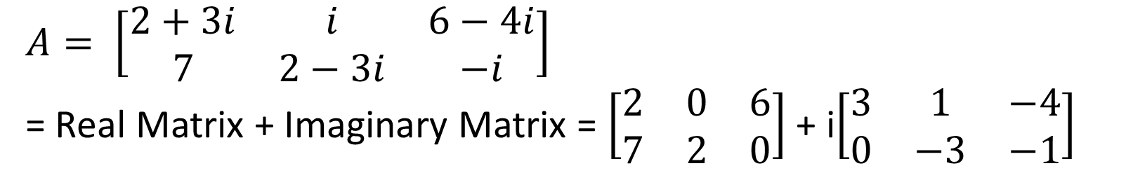
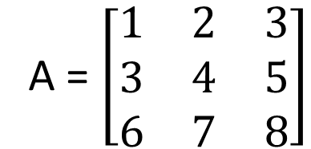
Real And Complex Matrix
A real matrix is a matrix whose elements consist entirely of real numbers.
A = $\left[\begin{matrix}1 & 2 & 3 \\ 3 & 4 & 5 \\ 6 & 7 & 8\end{matrix}\right]$
A Complex matrix is a matrix whose elements contain complex numbers.
$A= \left[\begin{matrix}2+3i & i & 6−4i \\ 7 & 2−3i & −i\end{matrix}\right]$
= Real Matrix + Imaginary Matrix = $\left[\begin{matrix}2 & 0 & 6 \\ 7 & 2 & 0\end{matrix}\right]$ + i$\left[\begin{matrix}3 & 1 & −4 \\ 0 & −3 & −1\end{matrix}\right]$

Slide 3
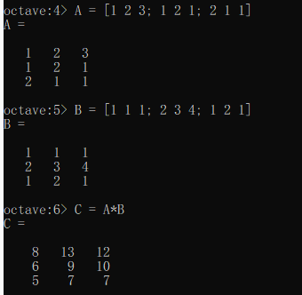
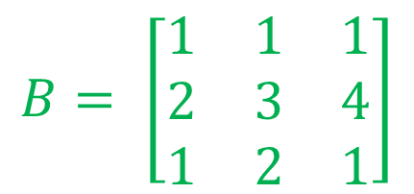
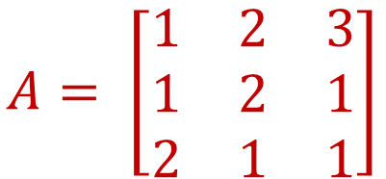
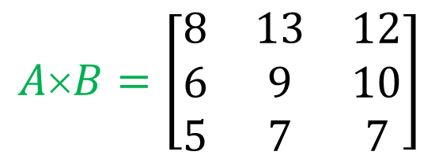
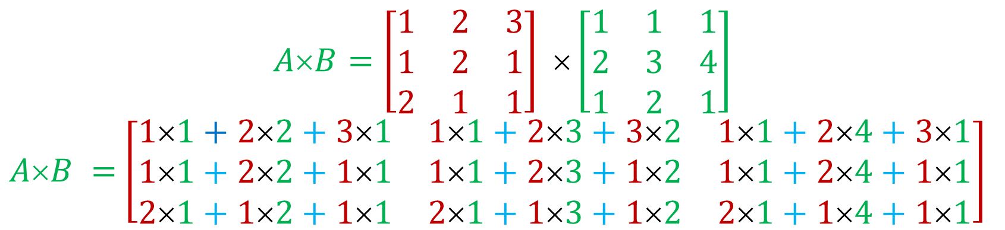
Multiplication of Matrices
$$A= \left[\begin{matrix}1 & 2 & 3 \\ 1 & 2 & 1 \\ 2 & 1 & 1\end{matrix}\right]$$
$$B= \left[\begin{matrix}1 & 1 & 1 \\ 2 & 3 & 4 \\ 1 & 2 & 1\end{matrix}\right]$$
$$A×B=\left[\begin{matrix}1 & 2 & 3 \\ 1 & 2 & 1 \\ 2 & 1 & 1\end{matrix}\right] ×\left[\begin{matrix}1 & 1 & 1 \\ 2 & 3 & 4 \\ 1 & 2 & 1\end{matrix}\right]$$
$AB =$ $\left[\begin{matrix}11+22+31 & 11+23+32 & 11+24+31 \\ 11+22+11 & 11+23+12 & 11+24+11 \\ 21+12+11 & 21+13+12 & 21+14+11\end{matrix}\right]$
$$A×B=\left[\begin{matrix}8 & 13 & 12 \\ 6 & 9 & 10 \\ 5 & 7 & 7\end{matrix}\right]$$

Slide 4
Unitary Matrix
Quiz No: 1
State and explain the properties of Unitary Matrix with one numerical example?
Online Submission last Date 9th May, 2020
Mode of Submission: Online
Format: Only Handwritten acceptable

Slide 5
Write a MATLAB Code/Programs of Different Matrices

Slide 6
Create 4 rows and 5 columns matrix
Create Diagonal
matrix
>> v = [2 1 -1 -2 -5];
>> D = diag(v)
D =
Diagonal Matrix
2 0 0 0 0
0 1 0 0 0
0 0 -1 0 0
0 0 0 -2 0
0 0 0 0 -5
>> a = [ 1 2 3 4 5; 2 3 4 5 6; 3 4 5 6 7; 4 5 6 7 8]
a =
1 2 3 4 5
2 3 4 5 6
3 4 5 6 7
4 5 6 7 8

Slide 7
Create Upper And Lower Triangular matrix
>> A = ones(4)
A =
1 1 1 1
1 1 1 1
1 1 1 1
1 1 1 1
>> B = triu(A)
B =
1 1 1 1
0 1 1 1
0 0 1 1
0 0 0 1
>> A = ones(4)
A =
1 1 1 1
1 1 1 1
1 1 1 1
1 1 1 1
>> B = tril(A)
B =
1 0 0 0
1 1 0 0
1 1 1 0
1 1 1 1
Lower Triangular Matrix
Upper
Triangular Matrix

Slide 8
Identity Matrix
Null or Empty Matrix
>> N = zeros(3,3)
N =
0 0 0
0 0 0
0 0 0
Transpose Matrix
>> A = [2 3 4;5 6 7;8 9 6]
A =
2 3 4
5 6 7
8 9 6
>> A'
ans =
2 5 8
3 6 9
4 7 6
I = eye(3)
I =
1 0 0
0 1 0
0 0 1

Slide 9
Symmetric Matrix
Skew-Symmetric Matrix
>> A = [1 5 3;5 2 6;3 6 4]
A =
1 5 3
5 2 6
3 6 4
>> tf = issymmetric(A)
tf = 1
>> A = [0 -5 3;5 0 6;-3 -6 0]
A =
0 -5 3
5 0 6
-3 -6 0
>> tf = issymmetric(A)
tf = 0

Slide 10
Check whether matrix is orthogonal or not
>> A=[2 4 6;4 6 8;2 6 8]
A =
2 4 6
4 6 8
2 6 8
>> B=A'
B =
2 4 2
4 6 6
6 8 8
>> C=A*B
C =
56 80 76
80 116 108
76 108 104
It is not orthogonal matrix

Slide 11
Conjugate Matrix
>> B = [1+2i 2-3i 3+4i;4-5i 5+6i 6-7i;8 7+8i 7]
B =
1 + 2i 2 - 3i 3 + 4i
4 - 5i 5 + 6i 6 - 7i
8 + 0i 7 + 8i 7 + 0i
>> C = conj(B)
C =
1 - 2i 2 + 3i 3 - 4i
4 + 5i 5 - 6i 6 + 7i
8 - 0i 7 - 8i 7 - 0i

Slide 12
Check whether matrix is Hermitian matrix or not
>> A =[4 1-i 7;1+i 6 -i;7 i 5]
A =
4 + 0i 1 - 1i 7 + 0i
1 + 1i 6 + 0i -0 - 1i
7 + 0i 0 + 1i 5 + 0i
>> A = ishermitian(A)
A = 1
>>B =[3i 2+i;-2+i -i]
B =
0 + 3i 2 + 1i
-2 + 1i -0 - 1i
>> B = ishermitian(A)
B = 0
Yes, it is Hermitian
No, it is not Hermitian

Slide 13
Multiplication of Two Matrices
>> A = [1 2 3;1 2 1;2 1 1]
1 2 3
1 2 1
2 1 1
>> B=[1 1 1;2 3 4;1 2 1]
1 1 1
2 3 4
1 2 1
>> C= A*B
8 13 12
6 9 10
5 7 7

Slide 14
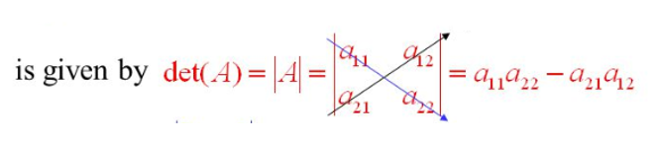
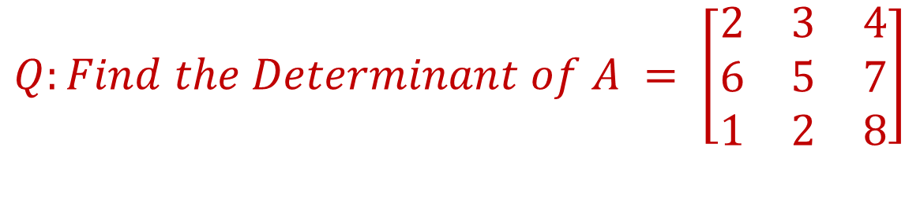
Determinant
Every square matrix can be associated with a real number called its determinant.
$$The determinant of the matrix A = \left[\begin{matrix}a_{11} & a_{12} \\ a_{21} & a_{22}\end{matrix}\right]$$
$$Q:Find the Determinant of A = \left[\begin{matrix}2 & 3 & 4 \\ 6 & 5 & 7 \\ 1 & 2 & 8\end{matrix}\right]$$
Solution
$\left|A\right|=2\left|\begin{matrix}5 & 7 \\ 2 & 8\end{matrix}\right|−$ $3\left|\begin{matrix}6 & 7 \\ 1 & 8\end{matrix}\right|$ + $4\left|\begin{matrix}6 & 5 \\ 1 & 2\end{matrix}\right|$ = 2 (40-14) – 3(48-7) + 4 (12-5) =52 -123 + 28 = -43 Answer

Slide 15
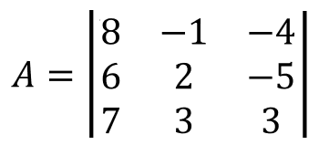
Find the Minors and Cofactors of the Second Column of given determinant
Minors Cofactors
Minor of 12 = $M_{12 }= \left|\begin{matrix}6 & −5 \\ 7 & 3\end{matrix}\right|$ = (18) –(-35) = 53 1+2 = 3 = odd = -53
Minor of 22 = $M_{12 }= \left|\begin{matrix}8 & −4 \\ 7 & 3\end{matrix}\right|$ = (24) –(-28) = 52 2+2 = 4 = even = 52
Minor of 32 = $M_{32 }= \left|\begin{matrix}8 & −4 \\ 6 & −5\end{matrix}\right|$ = (-40) –(-24) = -16 3+2 = 5 = odd = +16

Slide 16
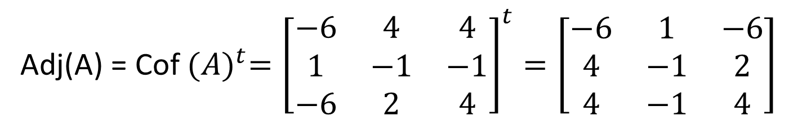
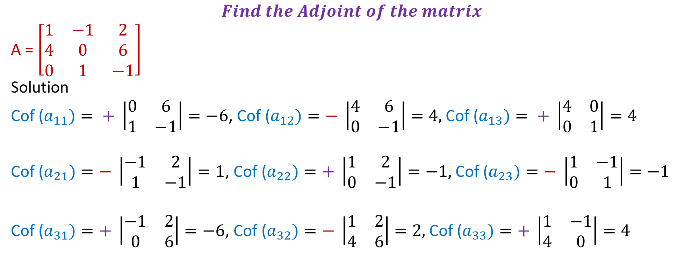
$$Find the Adjoint of the matrix$$
A = $\left[\begin{matrix}1 & −1 & 2 \\ 4 & 0 & 6 \\ 0 & 1 & −1\end{matrix}\right]$
Solution
Cof ($a_{11})= + \left|\begin{matrix}0 & 6 \\ 1 & −1\end{matrix}\right|=−6$, Cof ($a_{12})=− \left|\begin{matrix}4 & 6 \\ 0 & −1\end{matrix}\right|=4,$Cof ($a_{13})= + \left|\begin{matrix}4 & 0 \\ 0 & 1\end{matrix}\right|=4$
Cof ($a_{21})=− \left|\begin{matrix}−1 & 2 \\ 1 & −1\end{matrix}\right|=1$, Cof ($a_{22})=+ \left|\begin{matrix}1 & 2 \\ 0 & −1\end{matrix}\right|=−1,$Cof ($a_{23})=− \left|\begin{matrix}1 & −1 \\ 0 & 1\end{matrix}\right|=−1$
Cof ($a_{31})=+ \left|\begin{matrix}−1 & 2 \\ 0 & 6\end{matrix}\right|=−6$, Cof ($a_{32})=− \left|\begin{matrix}1 & 2 \\ 4 & 6\end{matrix}\right|=2,$Cof ($a_{33})=+ \left|\begin{matrix}1 & −1 \\ 4 & 0\end{matrix}\right|=4$
Adj(A) = Cof ${(A)}^{t}={\left[\begin{matrix}−6 & 4 & 4 \\ 1 & −1 & −1 \\ −6 & 2 & 4\end{matrix}\right]}^{t}=\left[\begin{matrix}−6 & 1 & −6 \\ 4 & −1 & 2 \\ 4 & −1 & 4\end{matrix}\right]$

Slide 17
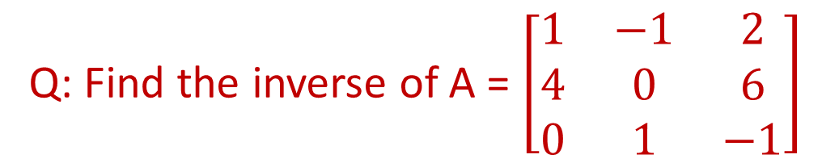

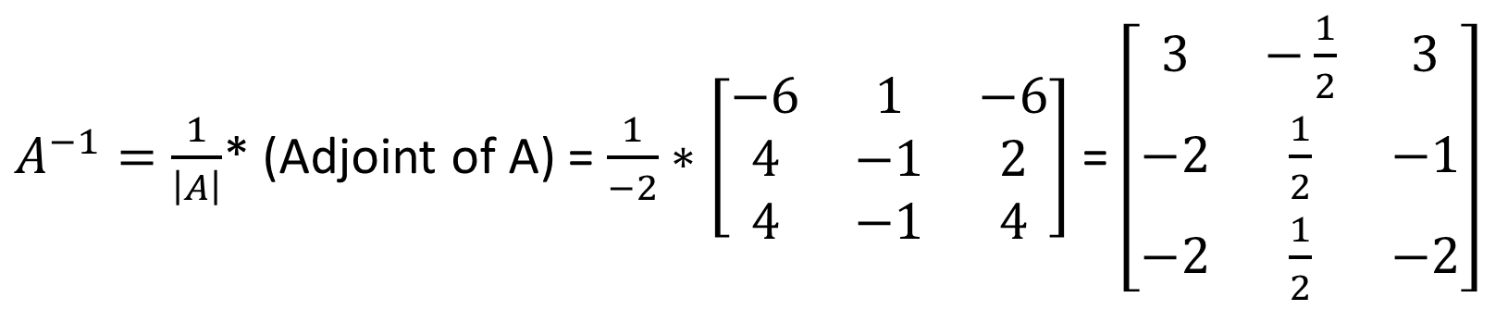
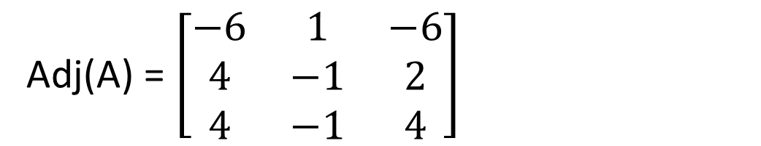
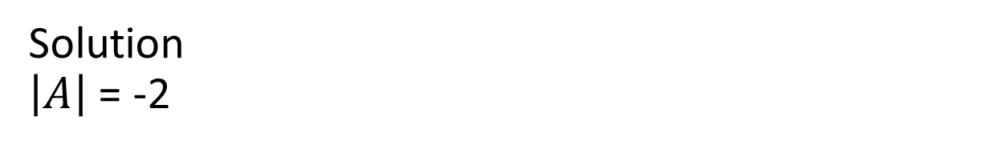
Inverse Matrix
$A^{−1}=\frac{1}{\left|A\right|}$* (Adjoint of A)
Q: Find the inverse of A = $\left[\begin{matrix}1 & −1 & 2 \\ 4 & 0 & 6 \\ 0 & 1 & −1\end{matrix}\right]$
Solution
$\left|A\right|$ = -2
Adj(A) = $\left[\begin{matrix}−6 & 1 & −6 \\ 4 & −1 & 2 \\ 4 & −1 & 4\end{matrix}\right]$
$A^{−1}=\frac{1}{\left|A\right|}$* (Adjoint of A) = $\frac{1}{−2}∗\left[\begin{matrix}−6 & 1 & −6 \\ 4 & −1 & 2 \\ 4 & −1 & 4\end{matrix}\right]$ = $\left[\begin{matrix}3 & −\frac{1}{2} & 3 \\ −2 & \frac{1}{2} & −1 \\ −2 & \frac{1}{2} & −2\end{matrix}\right]$

