Slide 1

Computational Methods in
Power System Analysis
Lecture-3 Incidence and network matrices
By
Dr. Wazir Muhammad Laghari
Electrical Engineering Department
BUET, Khuzdar

Slide 2
Contents
Degree of Node Or Vertex
Indegree And Outdegree of Node
Power System Networks Converted Into Graphs
Draw the oriented graph of power line diagram
Tree
Twigs
Links Or Chords
Cotree
Cut Vertex and Cut-sets

Slide 3
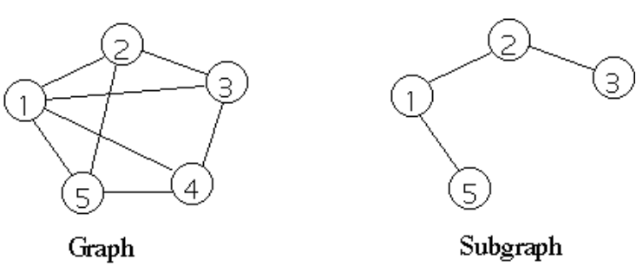
Graph And Subgraph
A Graph shows the geometrical interconnection of the element of a network. OR
A Graph is a set of points, called nodes or vertices, which are interconnected by a set of lines called edges.
A Subgraph is any subset of the graph.
node 2
node 3
node 1
edge
edge
node 5
node 4

Slide 4
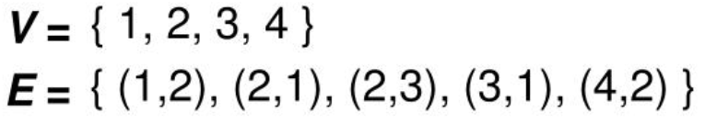
Example: Find the Vertices and Edges of the graph given below:
B
2
1
4
3
A
C
Vertices = V = {A, B, C}
Edges = E = {(A,B), (B,C), (C,A)} OR
Edges = E = {(B,A), (C,B), (A,C)}

Slide 5
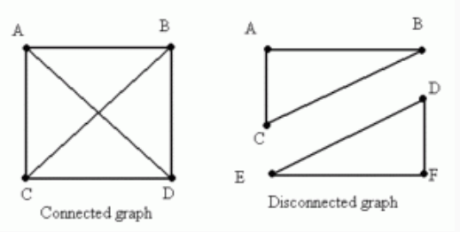
Connected And Disconnected Graph
A graph is said to be connected if there is a path between every pair of vertex.
A graph is said to be disconnected if at least two vertices of the graph are not connected by a path.

Slide 6
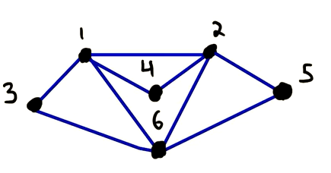
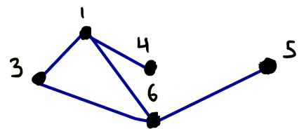
Rank of Graph
A rank of a graph is n-1, where n is the number of node in the graph.
A graph whose vertices and edges are subsets of another graph is known as Subgraph.
Subgraph
Graph G Subgraph of G

Slide 7
Oriented Graph
If each element of the connected graph is assigned a direction, than it is called Oriented Graph.
2
2
1
4
1
4
3
3
Simple Graph Oriented Graph

Slide 8
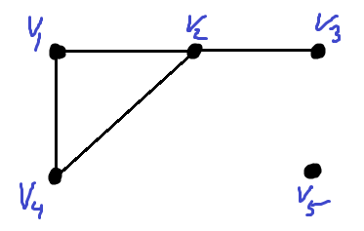


Degree of Node Or Vertex
It is the number of branches incident on it is called as Degree of Node.
Example: Find the Degree of each Node in the given graph?
a d
b c
e
$Degree of Node 1= V_{1}=$2
$Degree of Node 2= V_{2}=3$ $Degree of Node 3= V_{3} =1$
$Degree of Node 4= V_{4} =$2 $Degree of Node 5= V_{5} =$ 0
$Degree of Node a= V_{a}=$2
$Degree of Node b= V_{b}=$2 $Degree of Node c= V_{c} =3$
$Degree of Node d= V_{d} =$3 $Degree of Node e= V_{e} =$ 2

Slide 9
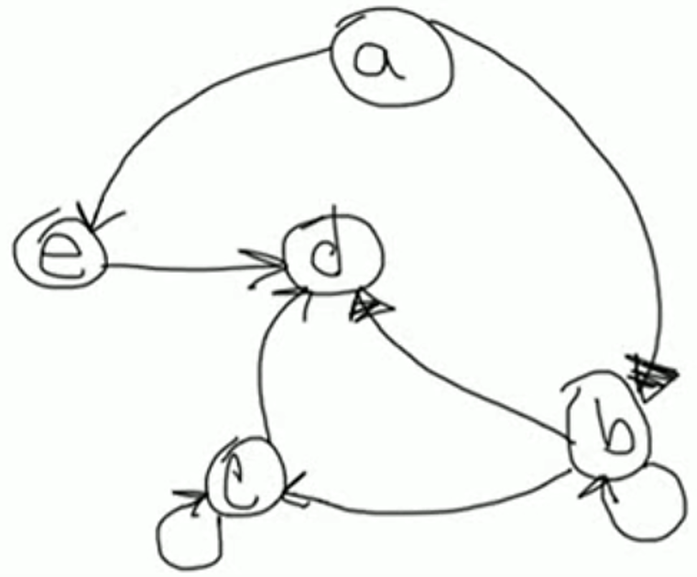
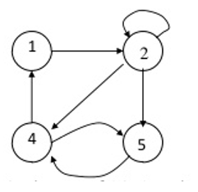
Indegree And Outdegree of Node
Number of edges entering a node is known as Indegree of Node.
Number of edges leaving a node is known as Outdegree of Node.
Example: Calculate the Indegree and Outdegree of each Node?
Nodes | Indegree | Outdegree
a | 0 | 2
b | 2 | 3
c | 2 | 2
d | 3 | 0
e | 1 | 1
Nodes | Indegree | Outdegree
1 | 1 | 1
2 | 2 | 3
4 | 2 | 2
5 | 2 | 1

Slide 10
Power System Networks Converted Into Graphs
Each elements R, L and C are converted in to simple line.
Each Node is converted into dots.
Voltage source is converted as a short circuit.
Current source is converted into an open circuit.

Slide 11
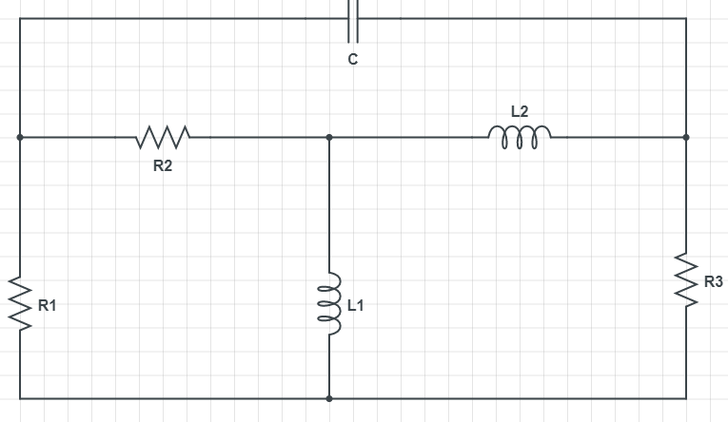
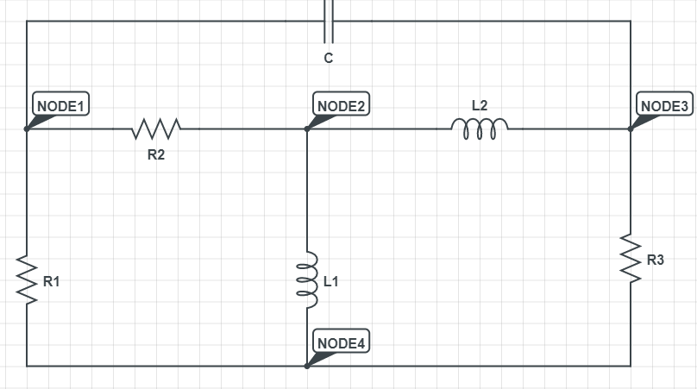
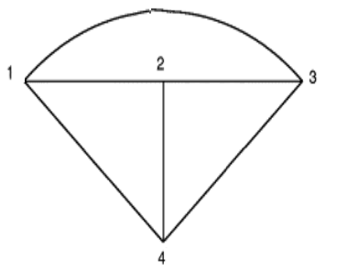
Q: Draw the plain graph of the network shown below

Slide 12
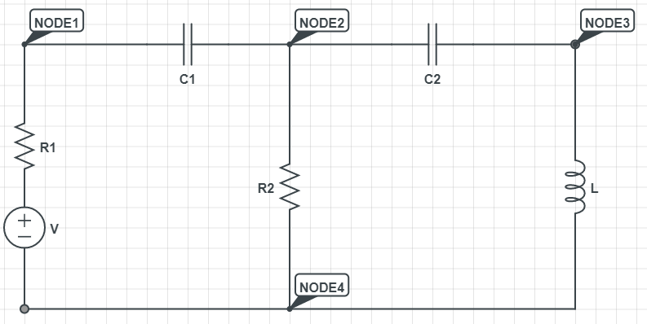
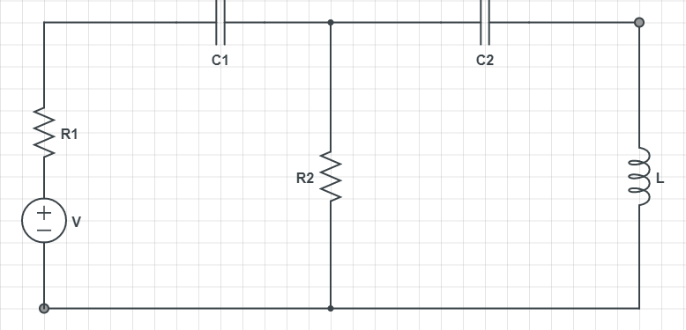
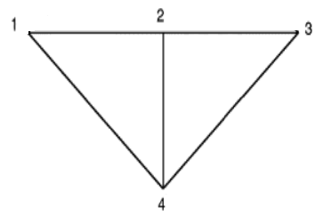
Q: Draw the plain graph of the network shown below

Slide 13
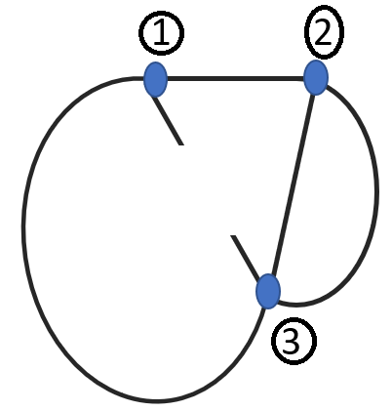
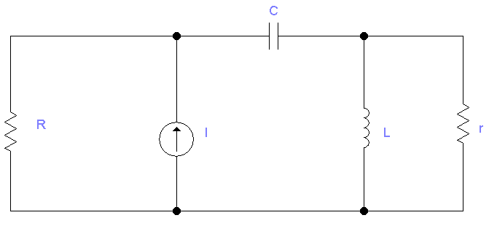
Q: Draw the plain graph of the network shown below

Slide 14
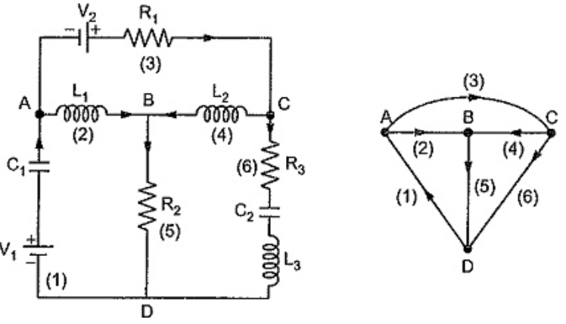
Q: Draw the oriented graph of the network shown below

Slide 15
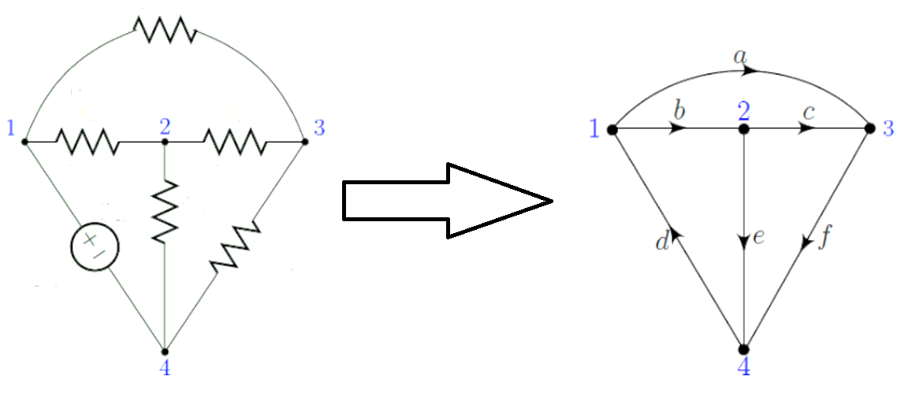
Q: Draw the oriented graph of the network shown below

Slide 16
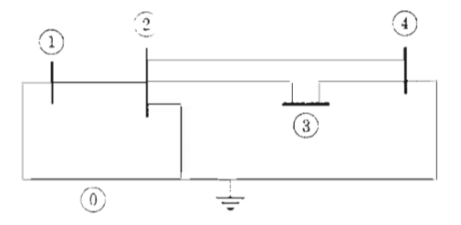
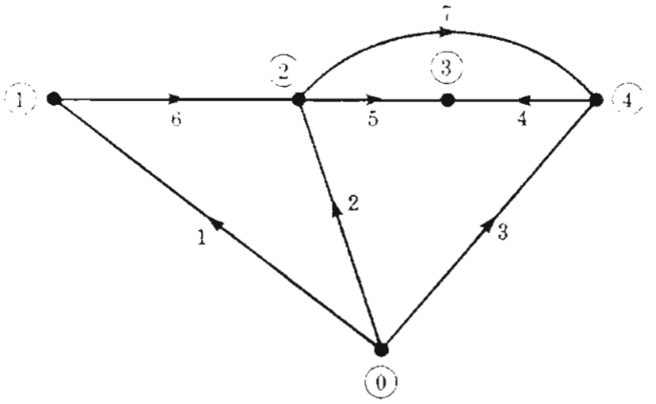
Question: Draw the oriented graph of power line diagram
1
Bus bar 1
Remember KCL, which states that sum of current entering a node is equal to sum of current leaving the node. BUS BAR is basically the practical example of that “NODE”.
BUS BAR connected to multiple feeder together.
1 2 3 4
OR
0

Slide 17
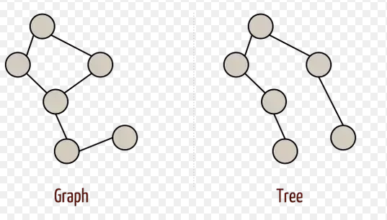
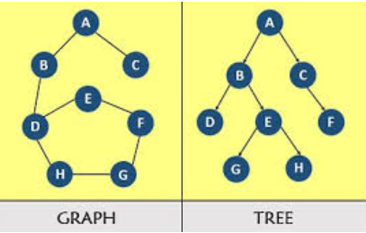

Tree
A Tree is a connected graph having no closed path. OR
A connected graph that has a single (unique) path between every pair of nodes is called Tree .
All nodes of connected graph present in a Tree.
No any closed loop in a Tree
$b=n −1$ ……………………………..(1) OR
$$1=n −b$$
Where, n is the number of nodes in a Tree and b is the number of branches in a Tree

Slide 18
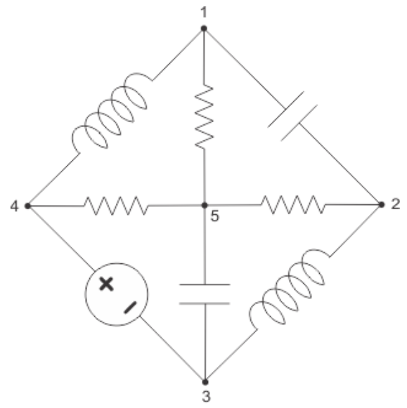
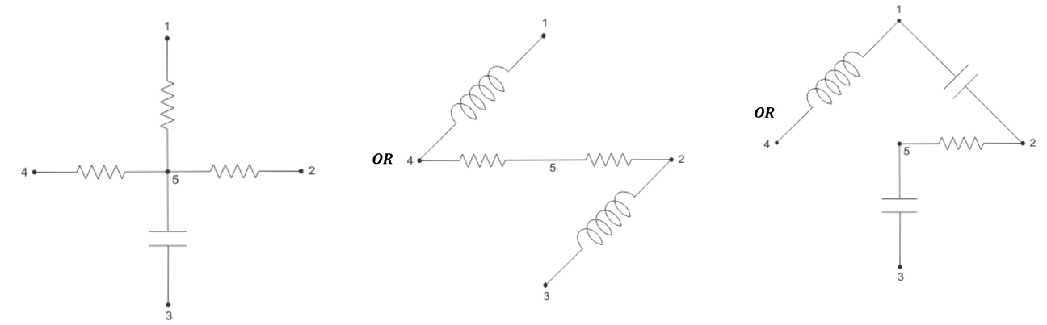

EXAMPLE: Draw the different forms of a Tree from a given circuit?
$$b=n −1$$
$$1=n −b$$
Where, n is the number of nodes in a Tree and b is the number of branches in a Tree
SOLUTION

Slide 19
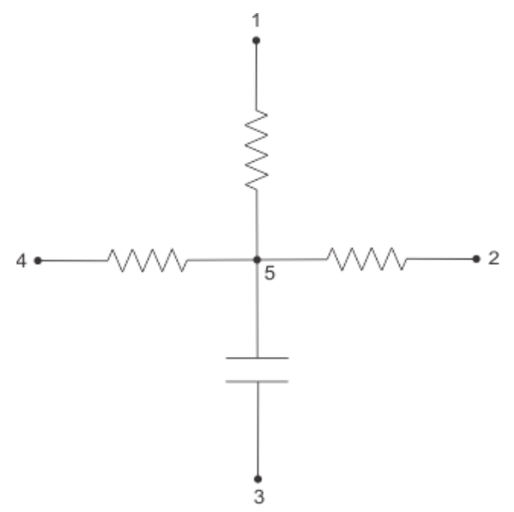
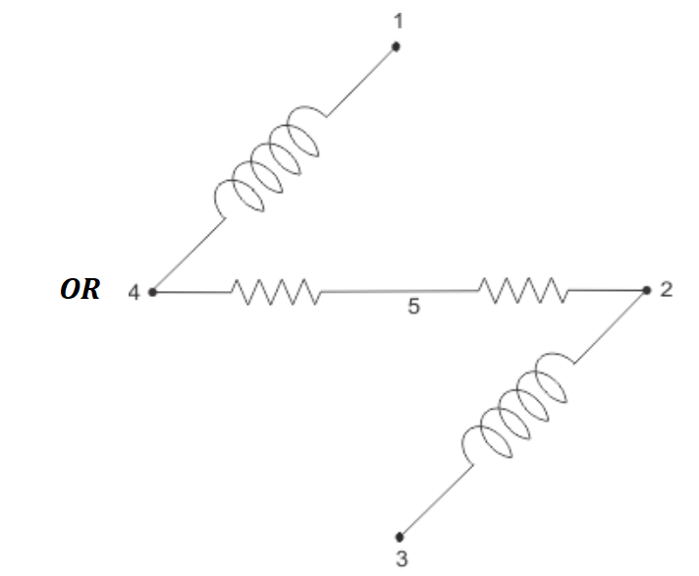
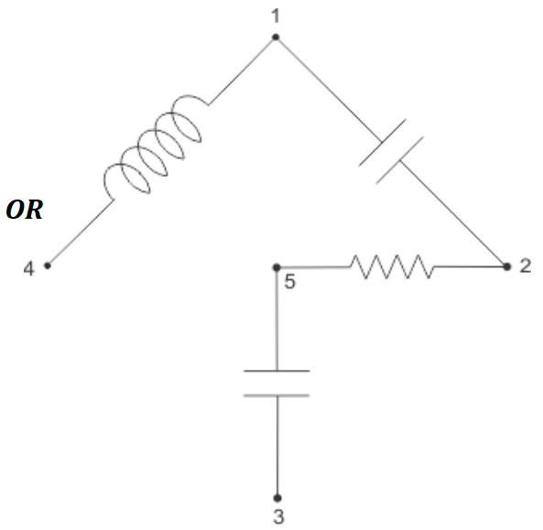
Twigs
Branches or edges of a Tree is known as Twigs.
EXAMPLE: Find the number of Twigs present in a Tree?
$$Number of Twigs=number of node − 1=5 −1=4$$

Slide 20
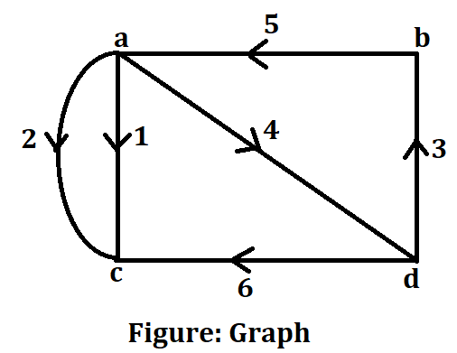
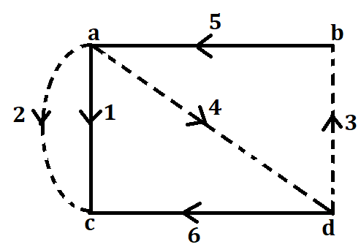
EXAMPLE: Draw the Tree of a given circuit and calculate the Twigs of Tree?
SOLUTION
$$Number of Twigs=number of node − 1=4 −1=3$$

Slide 21
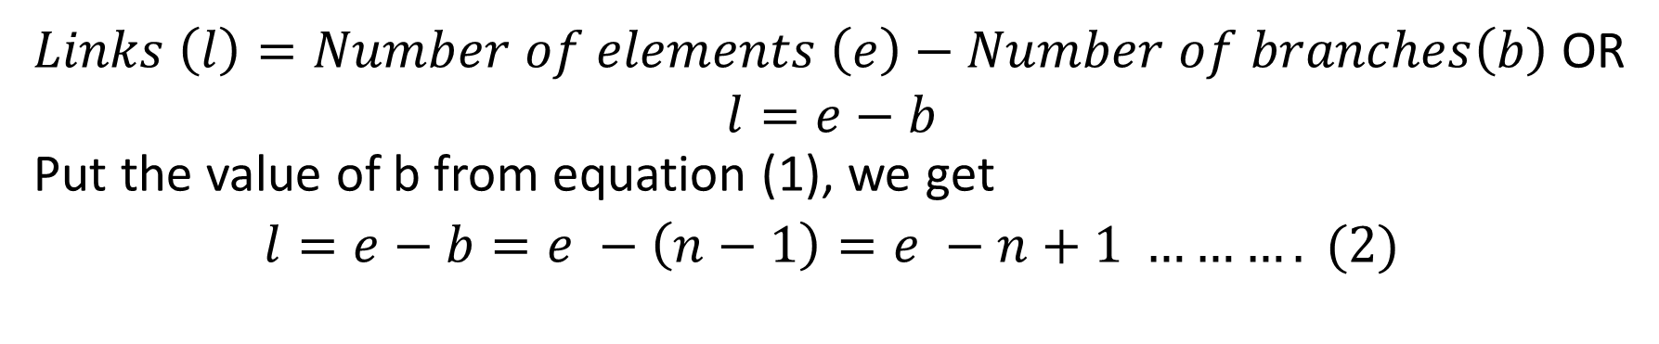
Links Or Chords
Those branches of the graph which are not in the tree is called Links or Chords
$Links \left(l\right)=Number of elements \left(e\right)−Number of branches\left(b\right)$ OR
$$l=e−b$$
Put the value of b from equation (1), we get
$$l=e−b=e −\left(n−1\right)=e −n+1 ………. (2)$$

Slide 22
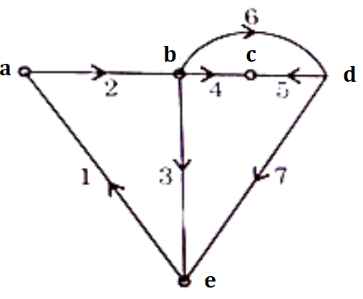
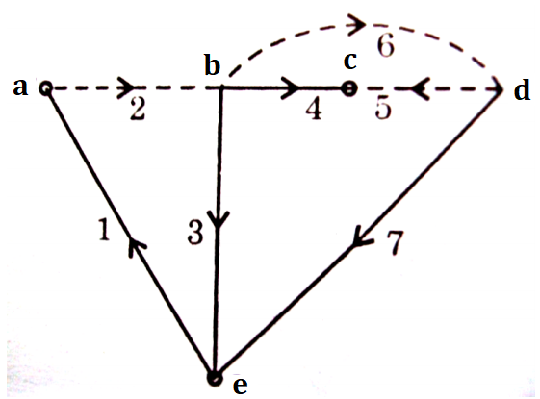


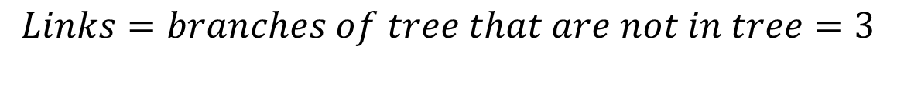
EXAMPLE: Draw the Tree of a given graph, and calculate the:
(1) Twigs (2) Links (3) Nodes from the Tree?
SOLUTION:
$$Twigs=branches of tree=4$$
$$Links=branches of tree that are not in tree=3$$
$$Nodes=5$$

Slide 23
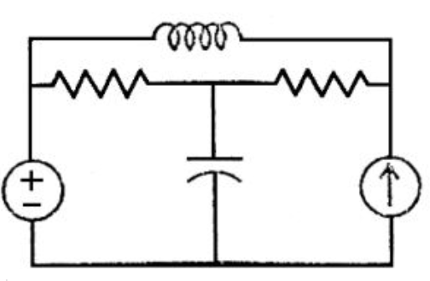
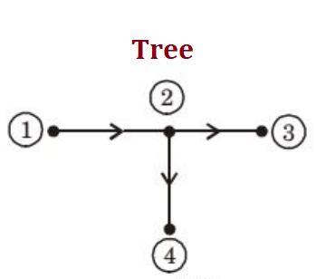
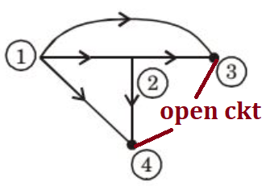
EXAMPLE: Calculate the number of Chords in the given circuit will be?
SOLUTION
Graph
Number of Chords = branches of tree = 3

Slide 24
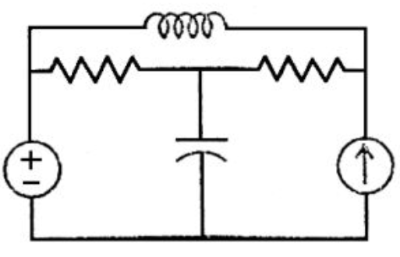
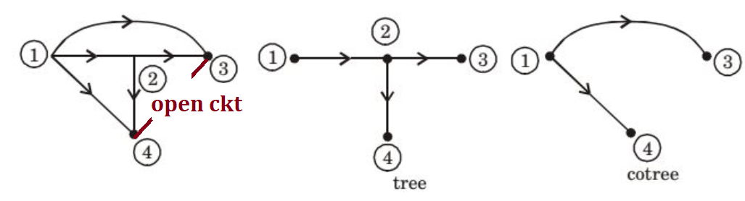
Cotree
Collection of branches that are not there in the specified tree of that graph is called Cotree. OR
Collection of links is called a co tree. OR
Complementary of Tree is called Cotree
EXAMPLE: Draw the Co tree of a given Circuit
SOLUTION

Slide 25
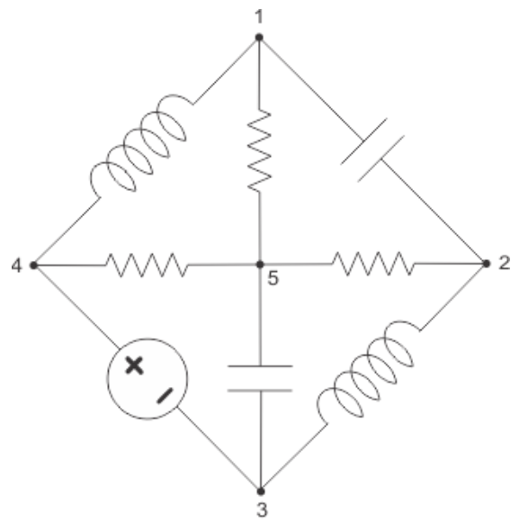
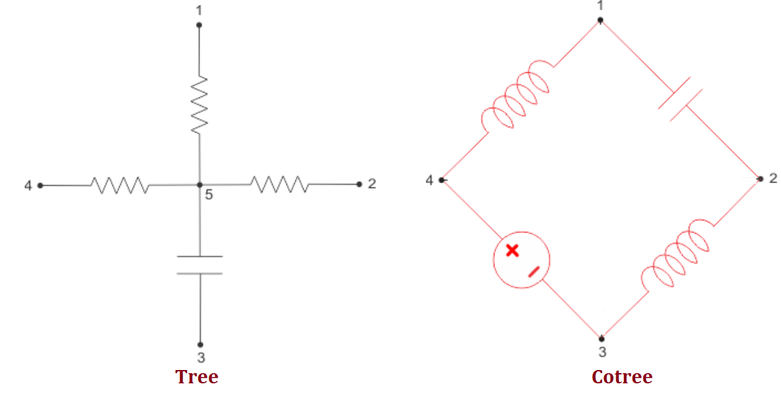
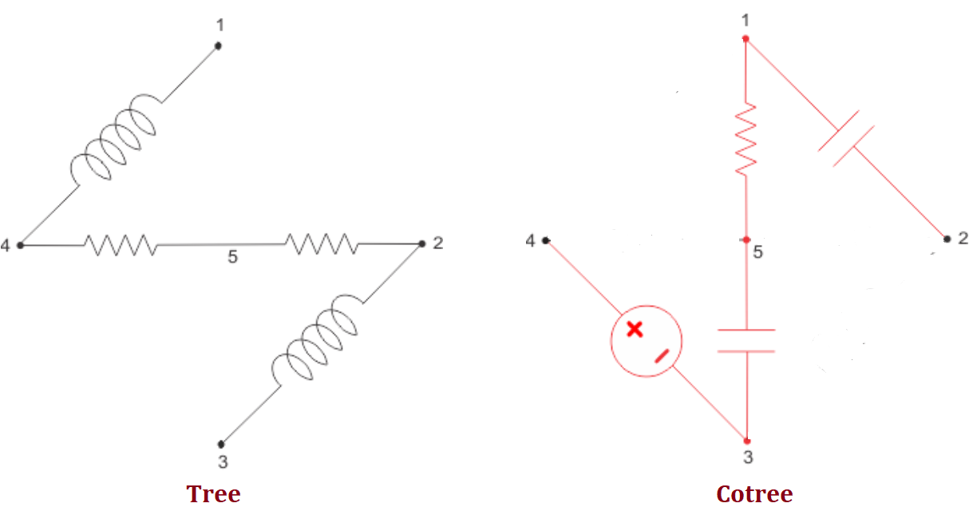
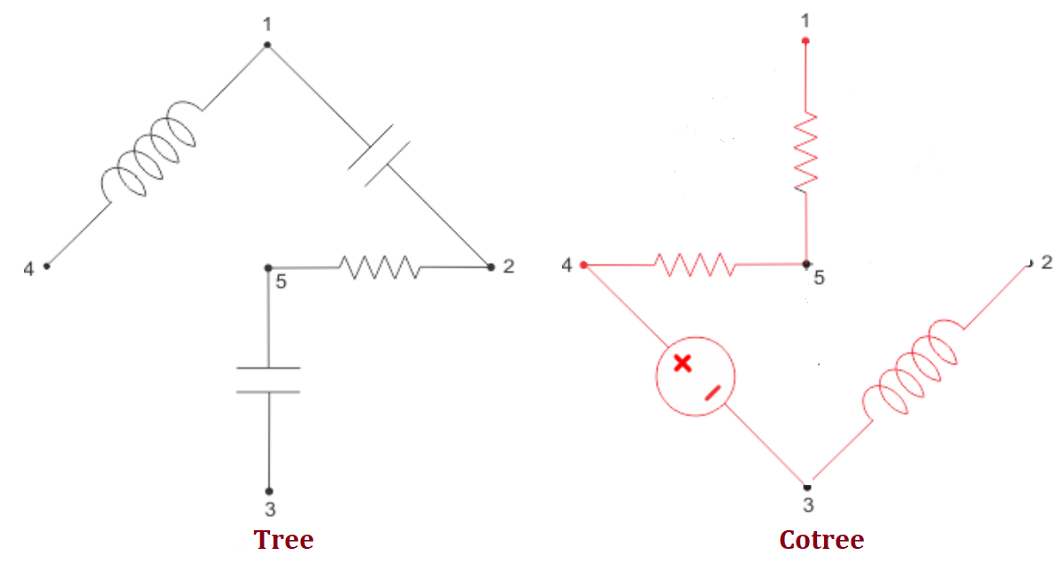
EXAMPLE: Draw the Co tree of a given Circuit
SOLUTION
OR
OR

Slide 26
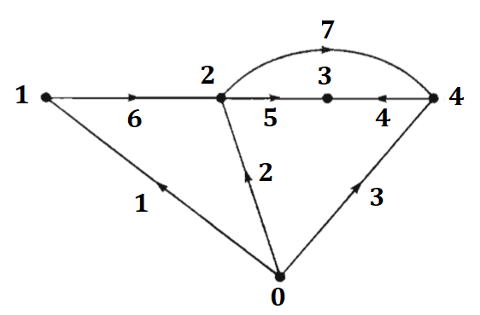
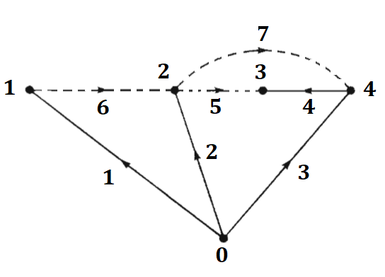
EXAMPLE: Draw the Tree and Co tree of a given directed graph as shown in Figure below
SOLUTION
Figure: Tree and Cotree of the oriented graph

Slide 27


EXAMPLE: From the Tree and Cotree Figure below, calculate the number of elements (e), number of nodes (n), number of branches (b), and number of links (l).
SOLUTION
$$Number of elements=e=7$$
$$Number of nodes=n=5$$
$$Number of branches=edges in a Tree= b=4$$
$$Number of links=branches of Cotree=l=3$$

Slide 28
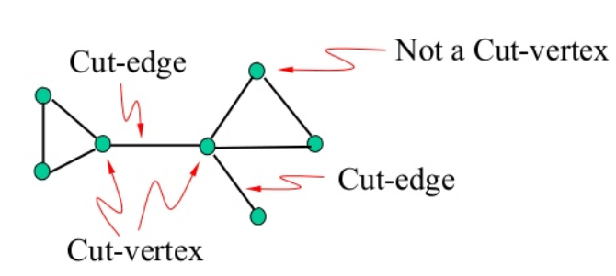
Cut Vertex and Cut-sets
If a single vertex removed and graph can be divided into two parts, than that vertex is called Cut Vertex.
If two or more than two vertex are removed from a graph than such set of vertices are known as Cut-sets

Slide 29
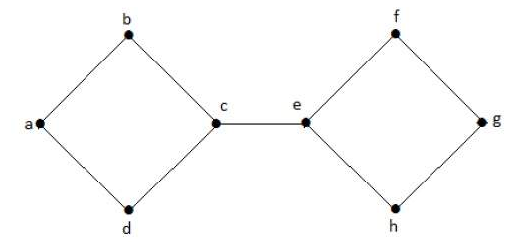
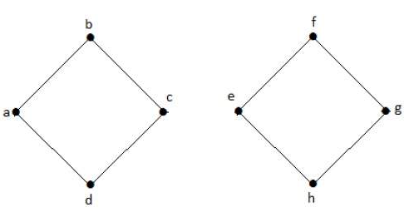
EXAMPLE: Find the Cut vertices from the graph given below
SOLUTION
Cut vertices = c and e

Slide 30

Incidence Matrix
The incidence matrix is an undirected graph has vertex written in a row and edges are written in a column.
Important property beauty of this matrix is that sum of any column is equal to zero.
Away from node = +1
Inward or Toward the node = -1
Otherwise = 0
Vertex = Nodes = No of rows = 4
Edges = Branches = No of columns = 6

Slide 31



Incidence Matrix
Incidence Matrix is nothing but a mathematical model to represent the given network with all the information available. The information regarding the network is nothing but which branches are incident at which node and what are the orientations relative to the nodes. All this information is written in a matrix form which is called complete incidence matrix.
Nodes = A, B, C, D
Figure: Network Figure: Oriented Graph
Away from node = +1
Inward or Toward the node = -1
Otherwise = 0

Slide 32



Incidence Matrix and KCL

Slide 33





Remove last
row of incidence
matrix

Slide 34



Slide 35
Properties of Incidence Matrix
The incidence matrix contains only two types of elements, 0 and 1.
This clearly is a binary matrix or a (0, 1)-matrix.
Every edge is incident on exactly two vertices, each column of A has exactly two one’s.
Sum of any column is equal to 0.

Slide 36
END

