Slide 1

Computational Methods in
Power System Analysis
Lecture-4 Mathematical Model Of Power System Network
By
Dr. Wazir Muhammad Laghari
Electrical Engineering Department
BUET, Khuzdar

Slide 2
Introduction
In RLC circuit, the most fundamental elements of a resistor, inductor and capacitor are connected across a voltage supply.
All of these elements are linear and passive in nature.
Passive components are ones that consume energy rather than producing it; linear elements are those which have a linear relationship between voltage and current.
There are number of ways of connecting these elements across voltage supply, but the most common method is to connect these elements either in series or in parallel.
The RLC circuit exhibits the property of resonance in same way as LC circuit exhibits, but in this circuit the oscillation dies out quickly as compared to LC circuit due to the presence of resistor in the circuit.

Slide 3
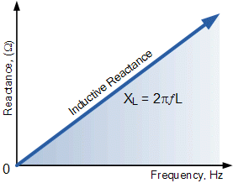
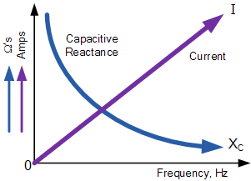
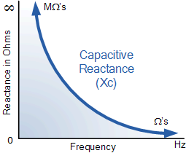
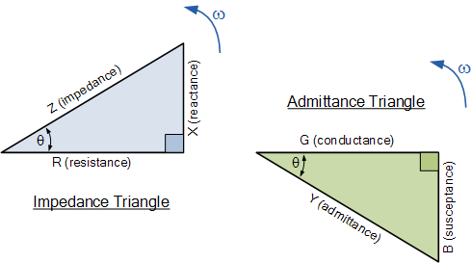
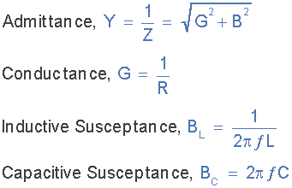
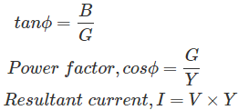
Introduction

Slide 4
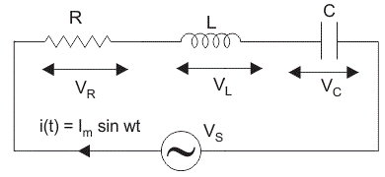
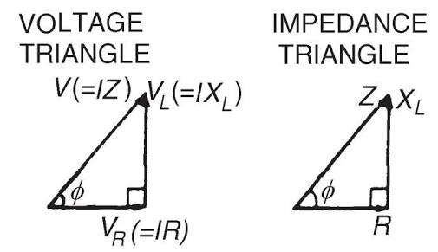
Series RLC Circuit
When a resistor, inductor and capacitor are connected in series with the voltage supply, the circuit so formed is called series RLC circuit.
Since all these components are connected in series, the current in each element remains the same,
Where,
V_{R} be the voltage across resistor, R. V_{L} be the voltage across inductor, L. V_{C} be the voltage across capacitor, C. X_{L} be the inductive reactance. X_{C} be the capacitive reactance.

Slide 5
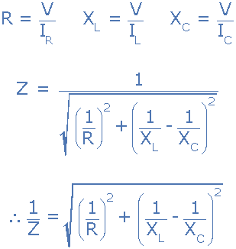
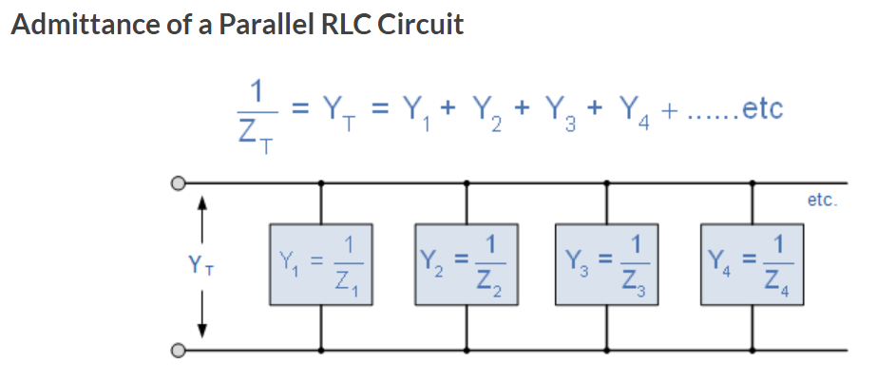
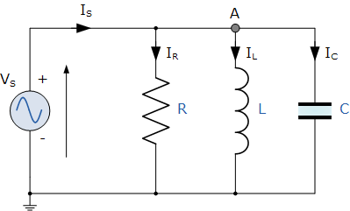
Parallel RLC Circuit
The Parallel RLC Circuit is the exact opposite to the series circuit we looked at in the previous tutorial although some of the previous concepts and equations still apply.

Slide 6
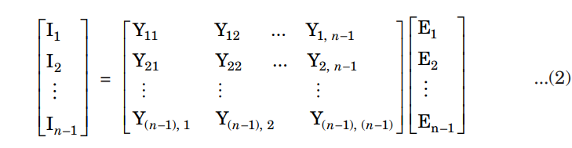
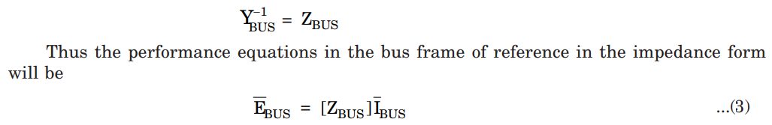
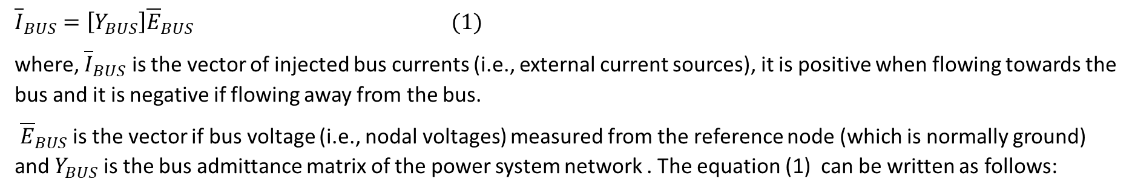
Mathematical Model Of Power System Network
The mathematical model of the power system network is the network equations which can be established in Bus (i.e., model), loop (i.e., mesh) or branch frame of reference.
In the bus frame of reference, the performance of the interconnected network is described by n – 1 linear independent equations where n is the number of nodes and n – 1 is the number of buses.
In counting the number of buses, the reference node (which is normally the ground) is always neglected. And hence, for n-node systems, the number of buses are equal to n – 1.
Therefore, the number of linear independent equations are equal to the number of buses.
Thus the performance equation in the bus frame of reference in the admittance form is given by
${\overline{I}}_{BUS}=\left[Y_{BUS}\right]{\overline{E}}_{BUS} (1)$
where, ${\overline{I}}_{BUS}$ is the vector of injected bus currents (i.e., external current sources), it is positive when flowing towards the bus and it is negative if flowing away from the bus.
${\overline{E}}_{BUS}$ is the vector if bus voltage (i.e., nodal voltages) measured from the reference node (which is normally ground) and $Y_{BUS}$ is the bus admittance matrix of the power system network . The equation (1) can be written as follows:

Slide 7
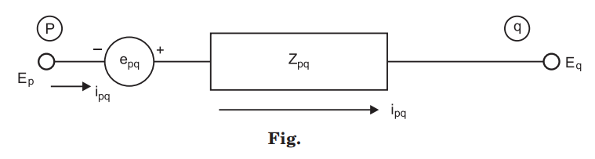
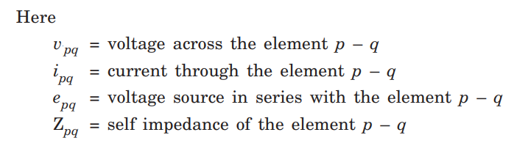
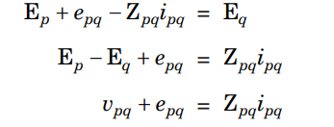
Primitive Network
The data obtained from electricity boards or the power companies in the form of primitive network (or primitive network matrix).
A primitive (word Primitive is derived word from Prime which means Main or Original)network is a set of unconnected/uncoupled elements which gives information regarding the characteristics of individual elements only.
The primitive network can be represented in the impedance form as well as in the admittance form. The performance equation of any element p – q in the impedance form will be shown in Figure below:
E_{p} and E_{q} are the bus voltages of the buses (i.e., nodes) p and q respectively.
Assuming E_{p} at higher potential
(1)

Slide 8
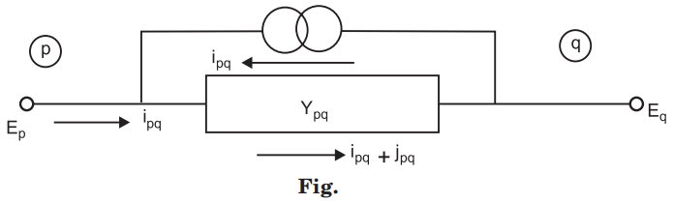














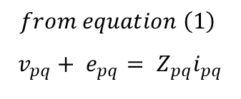

Primitive Network
Similarly, Admittance performance equations will be shown in Figure below:
$$V=IR$$
$$V=IZ$$
$$V=I\left(\frac{1}{Y}\right)=\frac{I}{Y}$$
$$I=Y V$$
$$i_{pq}+ j_{pq}= Y_{pq}v_{pq}$$
(2)
$$from equation (2)$$
$${where, v}_{pq}is the voltage drop across the element p−q$$
$$i_{pq}+ j_{pq}= Y_{pq}v_{pq}$$
$$from equation \left(1\right)$$
$$v_{pq}+ e_{pq}= Z_{pq}i_{pq}$$
$$j_{pq}= Y_{pq}v_{pq}−i_{pq}$$
$$\frac{v_{pq}}{Z_{pq}}+\frac{e_{pq}}{Z_{pq}}= i_{pq}$$
$$put the vealue of eq (3)$$
$$j_{pq}=i_{pq} −Y_{pq}∗ e_{pq}−i_{pq}$$
$$i_{pq}= \frac{v_{pq}}{Z_{pq}}+\frac{e_{pq}}{Z_{pq}}=\frac{1}{Z_{pq}}∗v_{pq}+\frac{1}{Z_{pq}}∗ e_{pq}= Y_{pq}∗v_{pq}+Y_{pq}∗ e_{pq}$$
$$i_{pq} −Y_{pq}∗ e_{pq}{=Y}_{pq}∗v_{pq}$$
$$j_{pq}= −Y_{pq}∗ e_{pq}$$
$$Y_{pq}∗v_{pq}=i_{pq} −Y_{pq}∗ e_{pq}$$
(3)

Slide 9
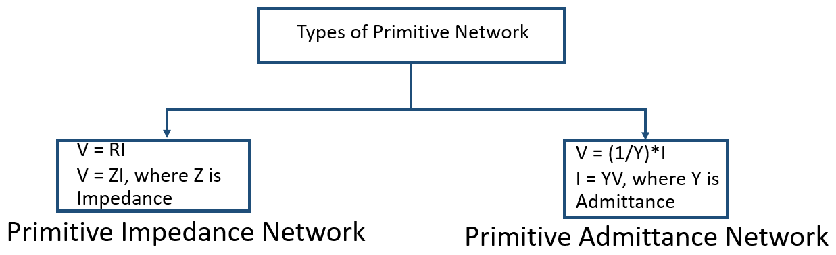
Primitive Network

Slide 10
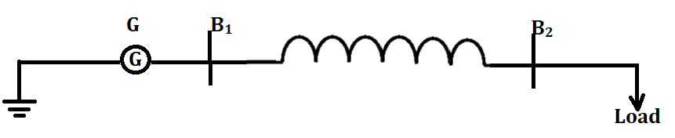
Primitive Networks
Here we discuss one single line diagram and shows one generating station connected with two buses B₁ and B₂ . In between two buses we used one transmission line and at final end load is there.
To analyze above system, first of all separate Generator.
To know the characteristics of generator, we used primitive network in two ways: one is called as primitive impedance network and other is primitive admittance network.

Slide 11
BUS Admittance Matrix
In a power system, Bus Admittance Matrix represents the nodal admittance of the various buses.
In the transmission line, each bus is connected to the various other buses.
Admittance matrix is used to analyze the data that is needed in the load or a power flow study of the buses.

Slide 12
Advantages of Bus Admittance Matrix
The bus admittance matrix is a Sparse matrix (i.e. most of its elements are zero) thus the computer memory requirements are less.
Its formation and modification are easy.
Data preparation is very simple.
It is very useful in load flow and stability analysis.

Slide 13
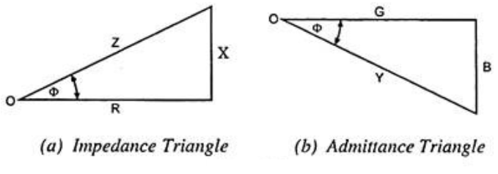

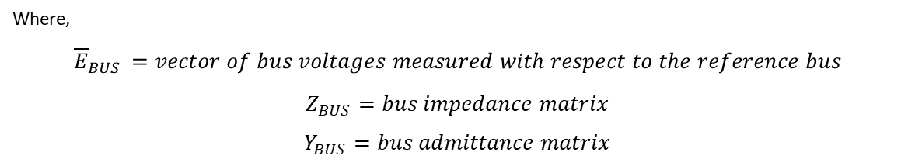
Formation of Network Matrices by Singular Transformations
Network Performance Equations
A network is made up of an interconnected set of elements. In the bus frame of reference, the performance of an interconnected network is described by n-1 independent nodal equations, where n is the number of nodes. In matrix notation, the performance equation in impedance form is:
$$V= IR$$
$$V= RI$$
$$E= RI$$
$$E= ZI$$
$$E= \frac{1}{Y}I$$
$$YE= I$$
In terms of Power System Terminology
$${{{\overline{E}}_{BUS}=Z}_{BUS}\overline{I}}_{BUS}$$
$${{{\overline{I}}_{BUS}=Y}_{BUS}\overline{E}}_{BUS}$$
Where,
$${\overline{E}}_{BUS }=vector of bus voltages measured with respect to the reference bus$$
$$Z_{BUS}=bus impedance matrix$$
$$Y_{BUS}=bus admittance matrix$$

Slide 14
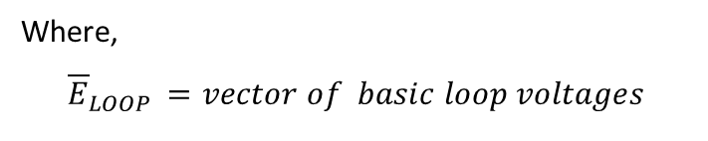
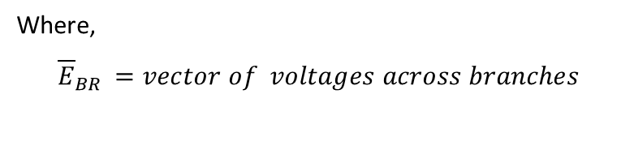
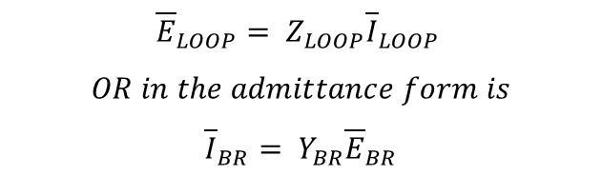
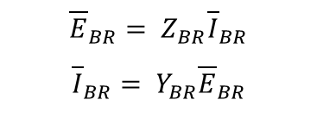

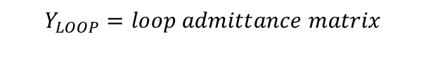
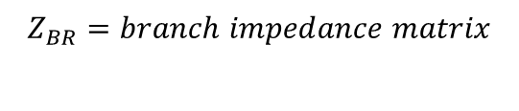
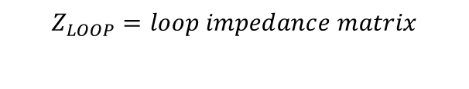
In the branch frame of reference the performance of the interconnected network is described by b independent branch equations where b is the number of branches. In matrix notation, the performance equation in impedance form is
$${\overline{E}}_{BR}= Z_{BR}{\overline{I}}_{BR}$$
$${\overline{I}}_{BR}= Y_{BR}{\overline{E}}_{BR}$$
Where,
$${\overline{E}}_{BR }=vector of voltages across branches$$
$${\overline{I}}_{BR} =vector of current through branches$$
$$Z_{BR}=branch impedance matrix$$
$$Y_{BR}=branch admittance matrix$$
In the loop frame of reference the performance of the interconnected network is described by l independent loop equations where l is the number of basic loops or links. The performance equation in impedance form is
$${\overline{E}}_{LOOP}= Z_{LOOP}{\overline{I}}_{LOOP}$$
$$OR in the admittance form is$$
$${\overline{I}}_{BR}= Y_{BR}{\overline{E}}_{BR}$$
Where,
$${\overline{E}}_{LOOP }=vector of basic loop voltages$$
$$Z_{LOOP}=loop impedance matrix$$
$$Y_{LOOP}=loop admittance matrix$$

Slide 15
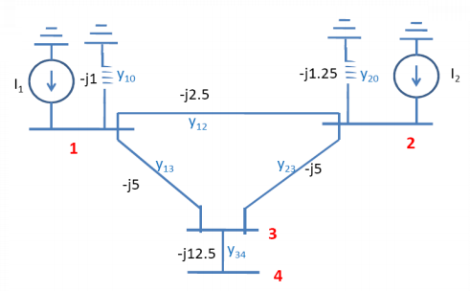
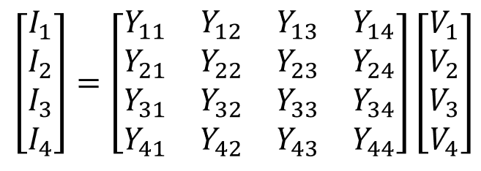
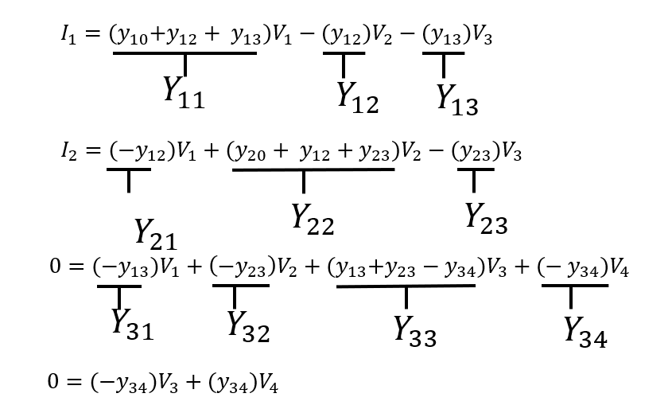
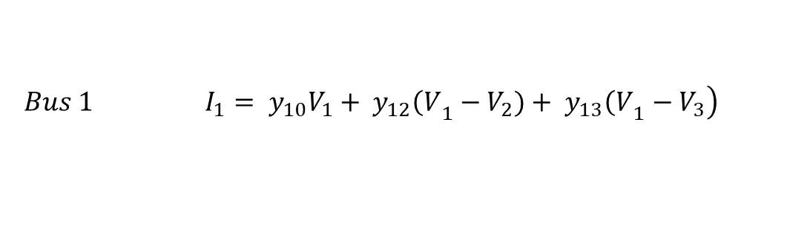
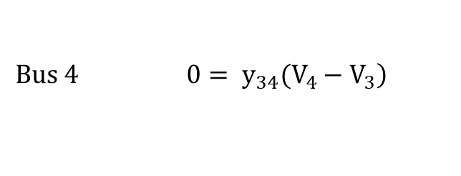
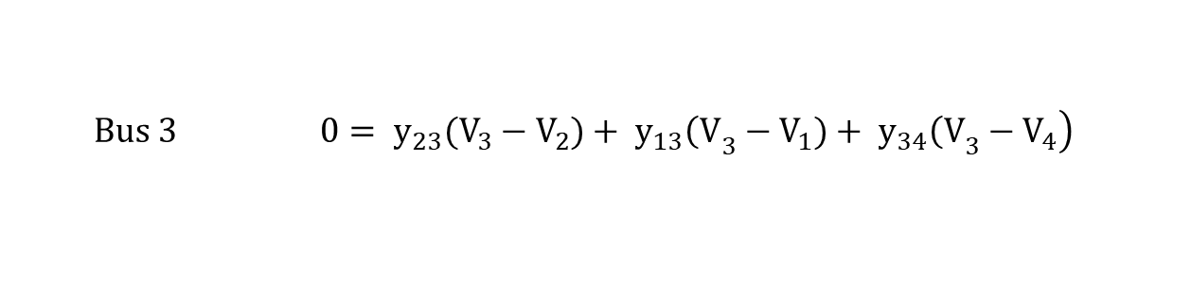

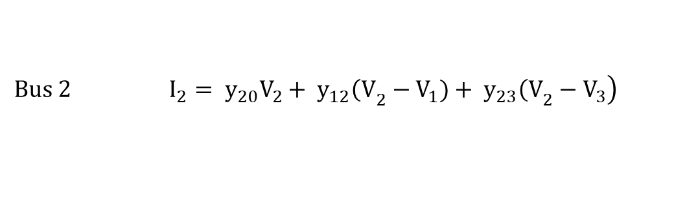
Find the bus admittance matrix, Y_{bus} .
I = V/Z = yV
Reference bus node
Applying at each bus:
ending node
$$\left.Bus 1 I_{1}= y_{10}V_{1}+ y_{12}{\left(V\right.}_{1}−V_{2})+ y_{13}{\left(V\right.}_{1}−V_{3}\right)$$
$$\left.Bus 2 I_{2}= y_{20}V_{2}+ y_{12}{\left(V\right.}_{2}−V_{1})+ y_{23}{\left(V\right.}_{2}−V_{3}\right)$$
$$\left.Bus 3 0= y_{23}(V_{3}−V_{2})+ y_{13}{\left(V\right.}_{3}−V_{1})+ y_{34}{\left(V\right.}_{3}−V_{4}\right)$$
$$\left.Bus 4 0= y_{34}(V_{4}−V_{3}\right)$$
Rearranging
$$I_{1}=y_{10}∗V_{1}+y_{12}∗V_{1}+ y_{13}∗V_{1}−y_{12}V_{2}−y_{13}V_{3}$$
$$I_{2}={−y}_{12}∗V_{1}+y_{20}∗V_{2}+ y_{12}∗V_{2}+y_{23}V_{2}−y_{23}V_{3}$$
$$0={−y}_{13}∗V_{1}−y_{23}∗V_{2}+y_{13}∗V_{3}+y_{23}V_{3}−y_{34}V_{3}− y_{34}V_{4}$$
$$0={−y}_{34}∗V_{3}+y_{34}∗V_{4}$$

Slide 16
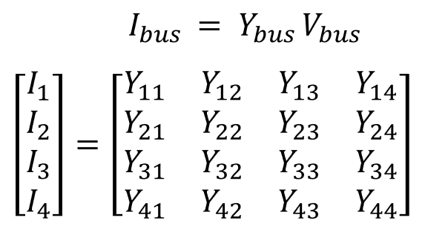






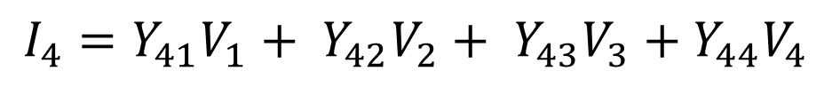





$$I_{1}={(y}_{10}+y_{12}+ y_{13})V_{1}−{(y}_{12})V_{2}−(y_{13}{)V}_{3}$$
$$Y_{11}$$
$$Y_{12}$$
$$Y_{13}$$
$$I_{2}={(−y}_{12})V_{1}+(y_{20}+ y_{12}+y_{23})V_{2}−{(y}_{23})V_{3}$$
$$Y_{22}$$
$$Y_{23}$$
$$Y_{21}$$
$$0={(−y}_{13})V_{1}+\left(−y_{23}\right)V_{2}+{(y}_{13}+y_{23}+y_{34}{)V}_{3}+(− y_{34})V_{4}$$
$$Y_{31}$$
$$Y_{32}$$
$$Y_{33}$$
$$Y_{34}$$
$$0={(−y}_{34}{)V}_{3}+{(y}_{34})V_{4}$$
General Form of Network equation in terms of Admittance
$$I_{1}=Y_{11}V_{1}+ Y_{12}V_{2}+ Y_{13}V_{3}+Y_{14}V_{4}$$
$$I_{2}=Y_{21}V_{1}+ Y_{22}V_{2}+ Y_{23}V_{3}+Y_{24}V_{4}$$
$$I_{3}=Y_{31}V_{1}+ Y_{32}V_{2}+ Y_{33}V_{3}+Y_{34}V_{4}$$
$$I_{4}=Y_{41}V_{1}+ Y_{42}V_{2}+ Y_{43}V_{3}+Y_{44}V_{4}$$

Slide 17
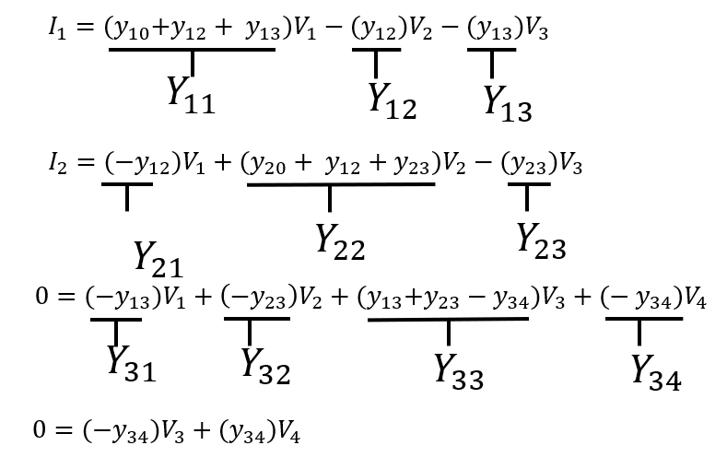
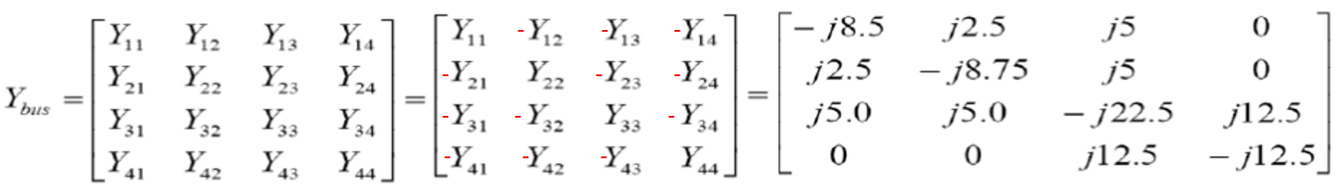













$$Y_{11}=y_{10 }+ y_{12}+y_{13}= −j1−j2.5−j5= −j8.5$$
$$Y_{12}=Y_{21}= −j2.5$$
$$Y_{13}=Y_{31}= −j5$$
$$Y_{14}=Y_{41}=0$$
$$Y_{21}=Y_{12}= −j2.5$$
$$Y_{22}= y_{20}+y_{12}+y_{23}= −j1.25−j2.5−j5= −j8.75$$
$$Y_{23}= Y_{32}= −j5$$
$$Y_{24}= 0$$
$${Y_{31}= Y}_{13}= −j5$$
$${Y_{32}= Y}_{23}= −j5$$
$$Y_{33}= y_{13}+y_{23}+y_{34}= −j5−j5−j12.5= −j22.5$$
$$Y_{34}=Y_{43}= −j12.5$$
$$Y_{41}= Y_{14}=0$$
$$Y_{42}= Y_{24}=0$$
$${Y_{43}= Y}_{34}=−j12.5$$
$$Y_{44}= y_{34}= −j12.5$$

Slide 18
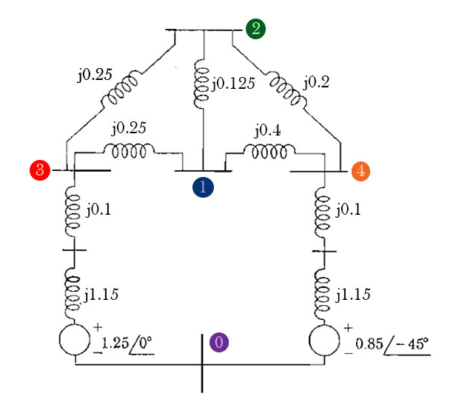




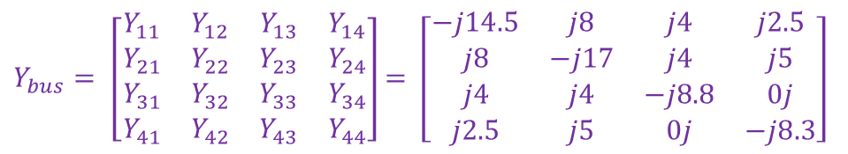










Calculate the Bus Admittance matrix from the give power system diagram having impedances values are present in the Figure below
$$Y=\frac{1}{Z}$$
$$Y_{12}=\frac{1}{Z_{12}}=\frac{1}{j0.125}= j8$$
$Y_{bus}= \left[\begin{matrix}Y_{11} & Y_{12} & Y_{13} & Y_{14} \\ Y_{21} & Y_{22} & Y_{23} & Y_{24} \\ Y_{31} & Y_{32} & Y_{33} & Y_{34} \\ Y_{41} & Y_{42} & Y_{43} & Y_{44}\end{matrix}\right]$ $= \left[\begin{matrix}−j14.5 & j8 & j4 & j2.5 \\ j8 & −j17 & j4 & j5 \\ j4 & j4 & −j8.8 & 0j \\ j2.5 & j5 & 0j & −j8.3\end{matrix}\right]$
$$Y_{13}=\frac{1}{Z_{13}}=\frac{1}{j0.25}= j4$$
$$Y_{14}=\frac{1}{Z_{14}}=\frac{1}{j0.4}= j2.5$$
$$Y_{11}= Y_{12}+ Y_{13}+ Y_{14}=j8+j4+j2.5= −j14.5$$
$$Y_{21}=\frac{1}{Z_{21}}=\frac{1}{j0.125}= j8$$
$$Y_{23}=\frac{1}{Z_{23}}=\frac{1}{j0.25}= j4$$
$$Y_{24}=\frac{1}{Z_{24}}=\frac{1}{j0.2}= j5$$
$$Y_{44}= Y_{41}+ Y_{42}+ Y_{40}=j2.5+j5+\frac{1}{Z_{40 }}= j2.5+j5+\frac{1}{j0.1+j1.15}=−j8.3$$
$$Y_{22}= Y_{21}+ Y_{23}+ Y_{24}=j8+j4+j5= −j17$$
$$Y_{31}=\frac{1}{Z_{31}}=\frac{1}{j0.25}= j4$$
$$Y_{33}= Y_{31}+ Y_{32}+ Y_{30}=j4+j4+\frac{1}{Z_{30 }}= j4+j4+\frac{1}{j0.1+j1.15}=−j8.8$$
$$Y_{32}=\frac{1}{Z_{32}}=\frac{1}{j0.25}= j4$$
$$Y_{34}=0j$$
$$Y_{34}=j0$$
$$Y_{41}=\frac{1}{Z_{41}}=\frac{1}{j0.4}= j2.5$$
$$Y_{42}=\frac{1}{Z_{42}}=\frac{1}{j0.2}= j5$$
$$Y_{43}=0j$$

Slide 19
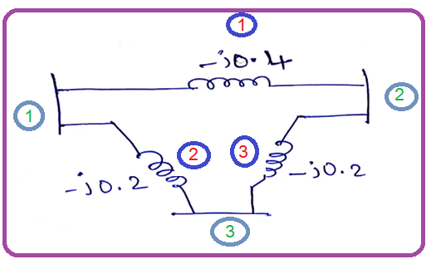
Q:Apply the Singular Transformation Method on given reactance diagram as shown in Figure, to calculate the Y_{BUS} matrix

Slide 20


Put Self Admittance (Y₁₁ , Y₂₂ etc. )values and other values put as a zero
$$\left[y\right]= \left[\begin{matrix}−j0.4 & 0 & 0 \\ 0 & −j0.2 & 0 \\ 0 & 0 & −j0.2\end{matrix}\right]$$

Slide 21

To find the Bus Incidence Matrix, we draw oriented graph with any direction
1
1
2
3
2
3
Bus1:
branch 2 outcoming = +ve = 1 and branch1 incoming = -ve = -1
Bus2:
branch 1 outcoming = +ve = 1 and branch 3 incoming = -ve = -1
Bus3:
branch 3 outcoming = +ve = 1 and branch 2 incoming = -ve = -1

Slide 22







$$Y_{BUS}= \left[A^{T}\right]\left[y\right]\left[A\right]$$
$$\left[A\right]=Bus incidence matrix$$
$$\left[y\right]=Primitive admittance matrix$$
$$\left[A^{T}\right]\left[y\right]= \left[\begin{matrix}−1 & 1 & 0 \\ 1 & 0 & −1 \\ 0 & −1 & 1\end{matrix}\right]\left[\begin{matrix}−j0.4 & 0 & 0 \\ 0 & −j0.2 & 0 \\ 0 & 0 & −j0.2\end{matrix}\right]$$
$$\left[A^{T}\right]\left[y\right]= \left[\begin{matrix}j0.4 & −j0.2 & 0 \\ −j0.4 & 0 & j0.2 \\ 0 & j0.2 & −j0.2\end{matrix}\right]$$
$$\left[A^{T}\right]\left[y\right][A]= \left[\begin{matrix}j0.4 & −j0.2 & 0 \\ −j0.4 & 0 & j0.2 \\ 0 & j0.2 & −j0.2\end{matrix}\right]\left[\begin{matrix}−1 & 1 & 0 \\ 1 & 0 & −1 \\ 0 & −1 & 1\end{matrix}\right]$$
$$\left[A^{T}\right]\left[y\right]\left[A\right]=Y_{BUS}= \left[\begin{matrix}−j0.6 & j0.4 & j0.2 \\ j0.4 & −j0.6 & j0.2 \\ j0.2 & j0.2 & −j0.4\end{matrix}\right]$$

Slide 23


Q: For the network shown in figure obtain the bus admittance matrix by singular transformation analysis. The line data is as in table below.
Line No | Connecting Nodes | Admittance in p.u
1 | 1-4 | 1.4
2 | 1-2 | 1.6
3 | 2-3 | 2.4
4 | 3-4 | 2.0
5 | 2-4 | 1.8
$$\left[y\right]= \left[\begin{matrix}1.4 & 0 & 0 & 0 & 0 \\ 0 & 1.6 & 0 & 0 & 0 \\ 0 & 0 & 2.4 & 0 & 0 \\ 0 & 0 & 0 & 2.0 & 0 \\ 0 & 0 & 0 & 0 & 1.8\end{matrix}\right]$$

Slide 24

Draw oriented graph from table
Line No | Connecting Nodes | Admittance in p.u
1 | 1-4 | 1.4
2 | 1-2 | 1.6
3 | 2-3 | 2.4
4 | 3-4 | 2.0
5 | 2-4 | 1.8

Slide 25




Apply the Singular Transformation Method on given reactance diagram as shown in Figure, to calculate the Y_{BUS} matrix
SOLUTION
$$Y_{BUS}= \left[A^{T}\right]\left[y\right]\left[A\right]$$
$$\left[A\right]=Bus incidence matrix$$
$$\left[y\right]=Primitive admittance matrix$$

Slide 26

In Primitive Admittance matrix, the first branch element is the first diagonal element of primitive admittance matrix.
Second branch element is the second diagonal element of primitive admittance matrix.
Similarly third one.
$$\left[y\right]= \left[\begin{matrix}−j0.4 & 0 & 0 \\ 0 & −j0.2 & 0 \\ 0 & 0 & −j0.2\end{matrix}\right]$$
1
1
2
3
To find the Bus Incidence Matrix, we used oriented graph
2
3

Slide 27




$$\left[A^{T}\right]\left[y\right]= \left[\begin{matrix}−1 & 1 & 0 \\ 1 & 0 & −1 \\ 0 & −1 & 1\end{matrix}\right]\left[\begin{matrix}−j0.4 & 0 & 0 \\ 0 & −j0.2 & 0 \\ 0 & 0 & −j0.2\end{matrix}\right]$$
$$\left[A^{T}\right]\left[y\right]= \left[\begin{matrix}j0.4 & −j0.2 & 0 \\ −j0.4 & 0 & j0.2 \\ 0 & j0.2 & −j0.2\end{matrix}\right]$$
$$\left[A^{T}\right]\left[y\right][A]= \left[\begin{matrix}j0.4 & −j0.2 & 0 \\ −j0.4 & 0 & j0.2 \\ 0 & j0.2 & −j0.2\end{matrix}\right]\left[\begin{matrix}−1 & 1 & 0 \\ 1 & 0 & −1 \\ 0 & −1 & 1\end{matrix}\right]$$
$$\left[A^{T}\right]\left[y\right]\left[A\right]=Y_{BUS}= \left[\begin{matrix}−j0.6 & j0.4 & j0.2 \\ j0.4 & −j0.6 & j0.2 \\ j0.2 & j0.2 & −j0.4\end{matrix}\right]$$

Slide 28



Verification by Inspection Method
$$Y_{BUS}= \left[\begin{matrix}Y_{11} & Y_{12} & Y_{13} \\ Y_{21} & Y_{22} & Y_{23} \\ Y_{31} & Y_{32} & Y_{33}\end{matrix}\right]= \left[\begin{matrix}−j0.6 & j0.4 & j0.2 \\ j0.4 & −j0.6 & j0.2 \\ j0.2 & j0.2 & −j0.4\end{matrix}\right]$$
$$\left[A^{T}\right]\left[y\right]\left[A\right]=Y_{BUS}= \left[\begin{matrix}−j0.6 & j0.4 & j0.2 \\ j0.4 & −j0.6 & j0.2 \\ j0.2 & j0.2 & −j0.4\end{matrix}\right]$$

Slide 29




Slide 30


Slide 31
END

