Slide 1

Computational Methods in
Power System Analysis
Lecture-5 Mathematical Model Of Power System Network (Z_{BUS} MATRIX)
By
Dr. Wazir Muhammad Laghari
Electrical Engineering Department
BUET, Khuzdar

Slide 2
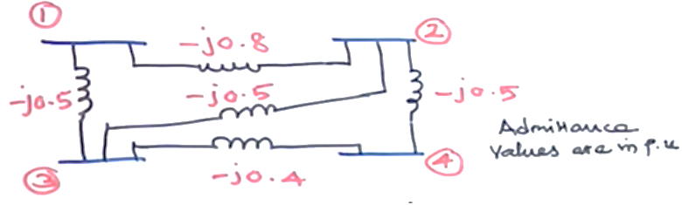
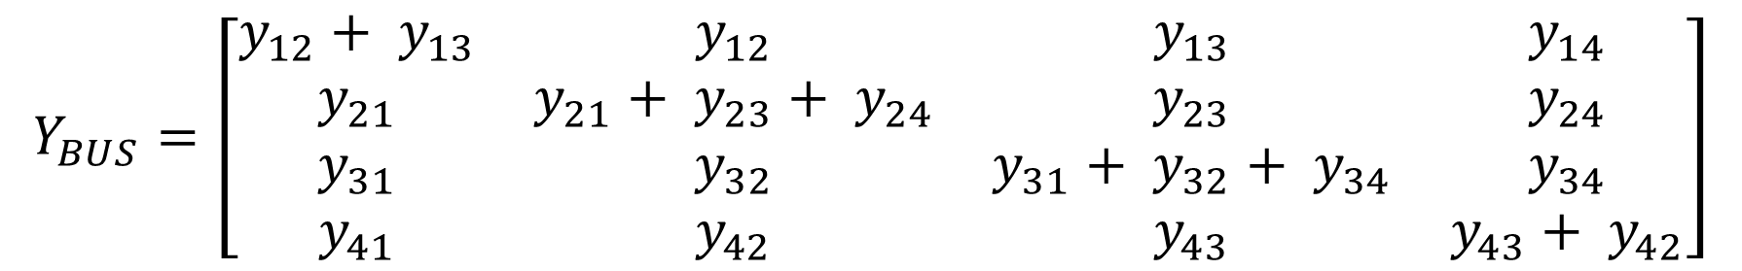
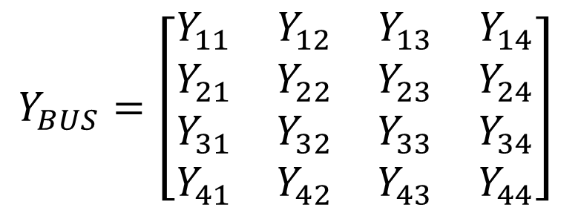
Form Y_{BUS} matrix using Kron Method
$$Y_{BUS}=\left[\begin{matrix}Y_{11} & Y_{12} & Y_{13} & Y_{14} \\ Y_{21} & Y_{22} & Y_{23} & Y_{24} \\ Y_{31} & Y_{32} & Y_{33} & Y_{34} \\ Y_{41} & Y_{42} & Y_{43} & Y_{44}\end{matrix}\right]$$
$$Y_{BUS}=\left[\begin{matrix}y_{12}+ y_{13} & y_{12} & y_{13} & y_{14} \\ y_{21} & y_{21}+ y_{23}+ y_{24} & y_{23} & y_{24} \\ y_{31} & y_{32} & y_{31}+ y_{32}+ y_{34} & y_{34} \\ y_{41} & y_{42} & y_{43} & y_{43}+ y_{42}\end{matrix}\right]$$

Slide 3
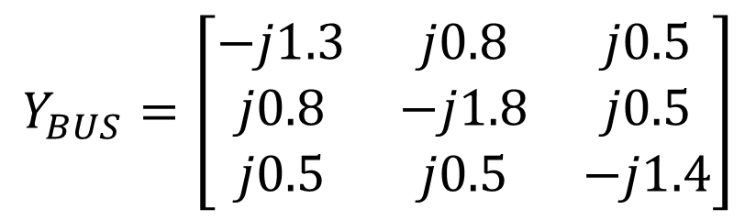
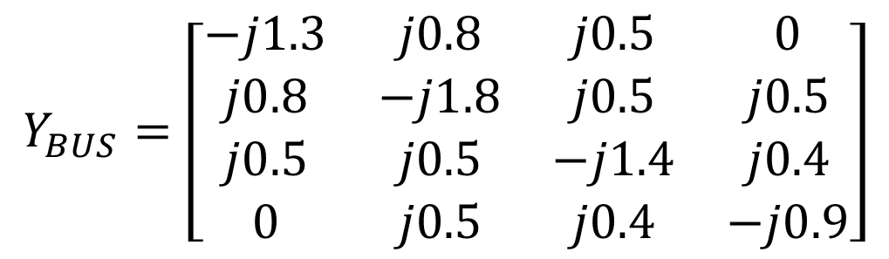
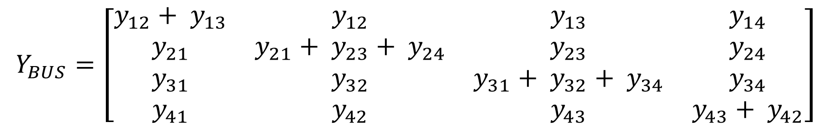
Form Y_{BUS} matrix using Kron Method
$$Y_{BUS}=\left[\begin{matrix}y_{12}+ y_{13} & y_{12} & y_{13} & y_{14} \\ y_{21} & y_{21}+ y_{23}+ y_{24} & y_{23} & y_{24} \\ y_{31} & y_{32} & y_{31}+ y_{32}+ y_{34} & y_{34} \\ y_{41} & y_{42} & y_{43} & y_{43}+ y_{42}\end{matrix}\right]$$
$$Y_{BUS}=\left[\begin{matrix}−j1.3 & j0.8 & j0.5 & 0 \\ j0.8 & −j1.8 & j0.5 & j0.5 \\ j0.5 & j0.5 & −j1.4 & j0.4 \\ 0 & j0.5 & j0.4 & −j0.9\end{matrix}\right]$$
Eliminate node 4 and form New Y_{BUS} matrix using kron method
$$Y_{BUS}=\left[\begin{matrix}−j1.3 & j0.8 & j0.5 \\ j0.8 & −j1.8 & j0.5 \\ j0.5 & j0.5 & −j1.4\end{matrix}\right]$$

Slide 4
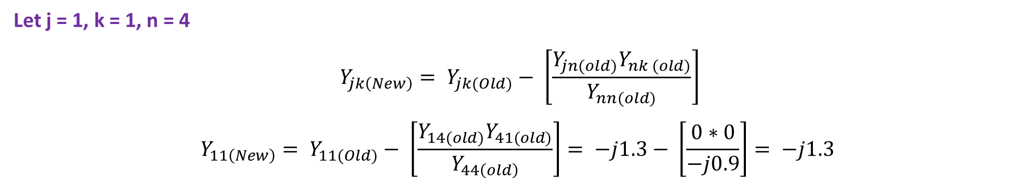
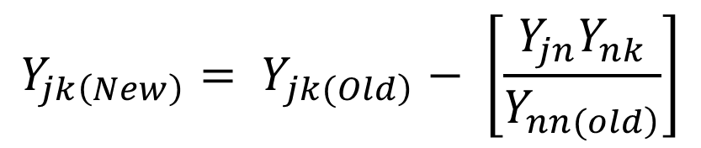
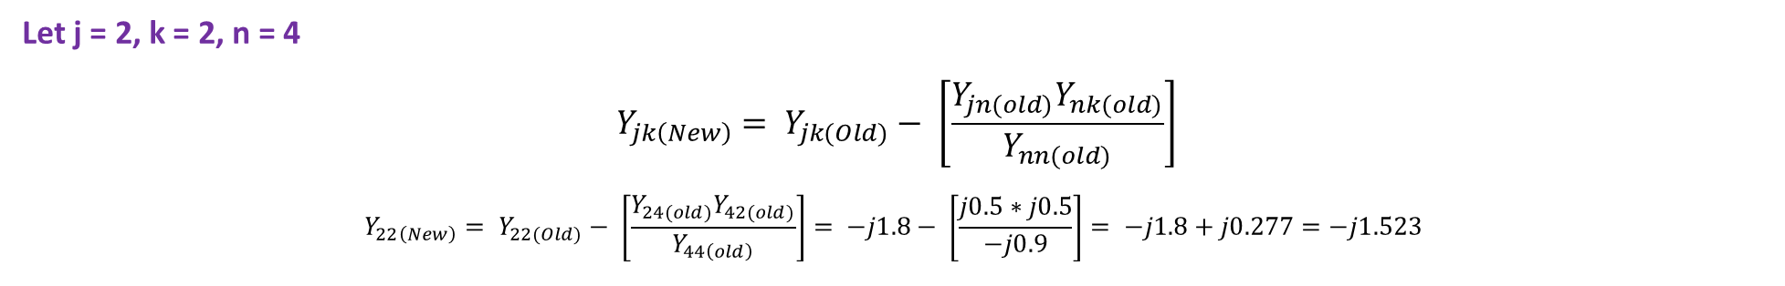
$$Y_{jk\left(New\right)}= Y_{\left.jk(Old\right)}− \left[\frac{Y_{jn}Y_{nk}}{Y_{\left.nn(old\right)}}\right]$$
Let j = 1, k = 1, n = 4
$$Y_{jk\left(New\right)}= Y_{jk(Old)}− \left[\frac{Y_{jn(old)}Y_{nk (old)}}{Y_{nn(old)}}\right]$$
$$Y_{11\left(New\right)}= Y_{11(Old)}− \left[\frac{Y_{14(old)}Y_{41(old)}}{Y_{44\left(old\right)}}\right]= −j1.3− \left[\frac{0∗0}{−j0.9}\right]= −j1.3$$
Let j = 2, k = 2, n = 4
$$Y_{jk\left(New\right)}= Y_{jk(Old)}− \left[\frac{Y_{jn(old)}Y_{nk(old)}}{Y_{nn(old)}}\right]$$
$$Y_{22\left(New\right)}= Y_{22(Old)}− \left[\frac{Y_{24(old)}Y_{42(old)}}{Y_{44\left(old\right)}}\right]= −j1.8− \left[\frac{j0.5∗j0.5}{−j0.9}\right]= −j1.8+j0.277=−j1.523$$

Slide 5


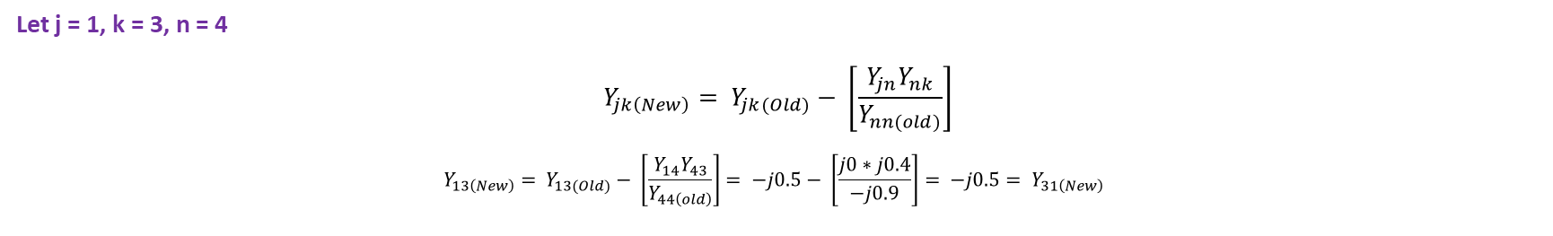
Let j = 3, k = 3, n = 4
$$Y_{jk\left(New\right)}= Y_{jk(Old)}− \left[\frac{Y_{jn(old)}Y_{nk(old)}}{Y_{nn(old)}}\right]$$
$$Y_{33\left(New\right)}= Y_{33(Old)}− \left[\frac{Y_{34}Y_{43}}{Y_{44\left(old\right)}}\right]= −j1.4− \left[\frac{j0.4∗j0.4}{−j0.9}\right]= −j1.4+j0.1777=−j1.22$$
Let j = 1, k = 2, n = 4
$$Y_{jk\left(New\right)}= Y_{jk(Old)}− \left[\frac{Y_{jn}Y_{nk}}{Y_{nn(old)}}\right]$$
$$Y_{12\left(New\right)}= Y_{12(Old)}− \left[\frac{Y_{14}Y_{42}}{Y_{44\left(old\right)}}\right]= −j0.8− \left[\frac{j0∗j0.5}{−j0.9}\right]= −j0.8= Y_{21\left(New\right)}$$
Let j = 1, k = 3, n = 4
$$Y_{jk\left(New\right)}= Y_{jk(Old)}− \left[\frac{Y_{jn}Y_{nk}}{Y_{nn(old)}}\right]$$
$$Y_{13\left(New\right)}= Y_{13(Old)}− \left[\frac{Y_{14}Y_{43}}{Y_{44\left(old\right)}}\right]= −j0.5− \left[\frac{j0∗j0.4}{−j0.9}\right]= −j0.5= Y_{31\left(New\right)}$$

Slide 6
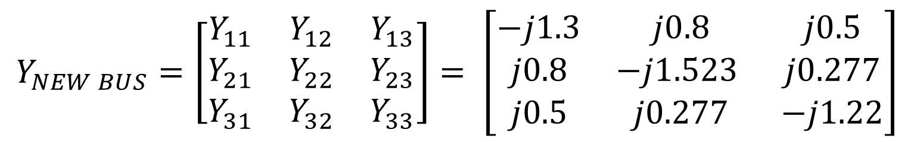
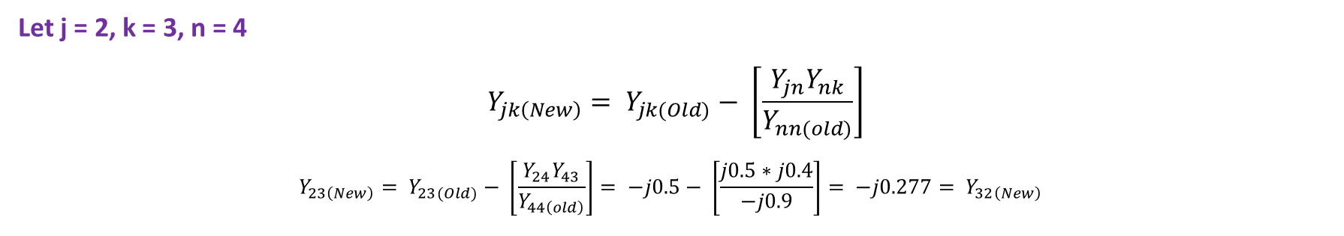
Let j = 2, k = 3, n = 4
$$Y_{jk\left(New\right)}= Y_{jk(Old)}− \left[\frac{Y_{jn}Y_{nk}}{Y_{nn(old)}}\right]$$
$$Y_{23\left(New\right)}= Y_{23(Old)}− \left[\frac{Y_{24}Y_{43}}{Y_{44\left(old\right)}}\right]= −j0.5− \left[\frac{j0.5∗j0.4}{−j0.9}\right]= −j0.277= Y_{32\left(New\right)}$$
$$Y_{NEW BUS}=\left[\begin{matrix}Y_{11} & Y_{12} & Y_{13} \\ Y_{21} & Y_{22} & Y_{23} \\ Y_{31} & Y_{32} & Y_{33}\end{matrix}\right]= \left[\begin{matrix}−j1.3 & j0.8 & j0.5 \\ j0.8 & −j1.523 & j0.277 \\ j0.5 & j0.277 & −j1.22\end{matrix}\right]$$

Slide 7
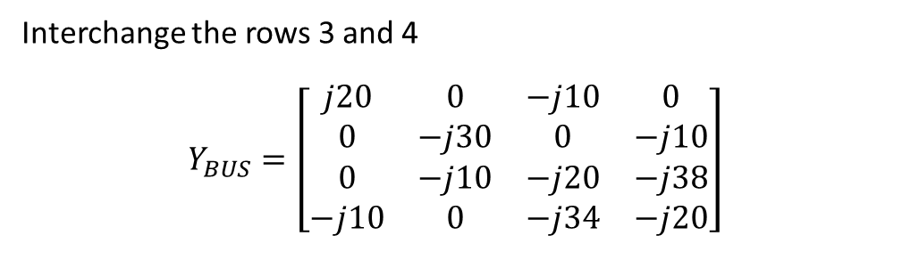
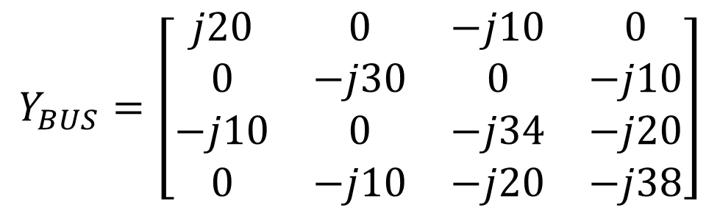
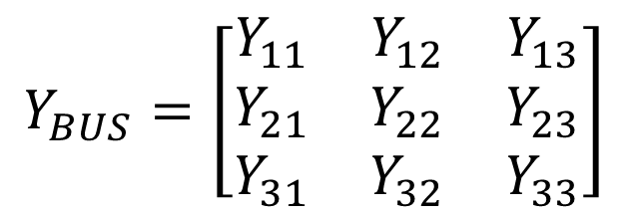
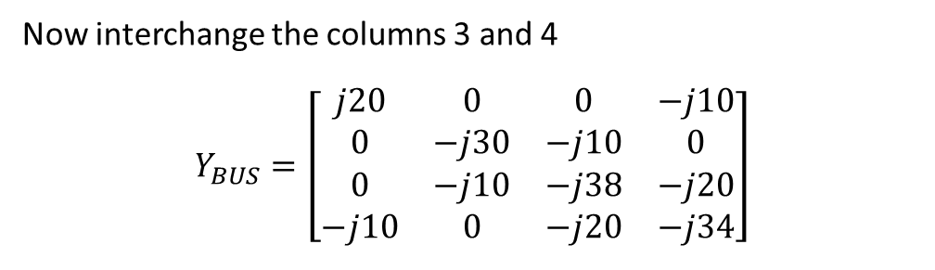
EXAMPLE: Apply the Kron Method to eliminate node 3 on a four bus system
$$Y_{BUS}=\left[\begin{matrix}j20 & 0 & −j10 & 0 \\ 0 & −j30 & 0 & −j10 \\ −j10 & 0 & −j34 & −j20 \\ 0 & −j10 & −j20 & −j38\end{matrix}\right]$$
Eliminate node 4 and form New Y_{BUS} matrix using kron method
SOLUTION
Interchange the rows 3 and 4
$$Y_{BUS}=\left[\begin{matrix}j20 & 0 & −j10 & 0 \\ 0 & −j30 & 0 & −j10 \\ 0 & −j10 & −j20 & −j38 \\ −j10 & 0 & −j34 & −j20\end{matrix}\right]$$
$$Y_{BUS}=\left[\begin{matrix}Y_{11} & Y_{12} & Y_{13} \\ Y_{21} & Y_{22} & Y_{23} \\ Y_{31} & Y_{32} & Y_{33}\end{matrix}\right]$$
Now interchange the columns 3 and 4
$$Y_{BUS}=\left[\begin{matrix}j20 & 0 & 0 & −j10 \\ 0 & −j30 & −j10 & 0 \\ 0 & −j10 & −j38 & −j20 \\ −j10 & 0 & −j20 & −j34\end{matrix}\right]$$

Slide 8
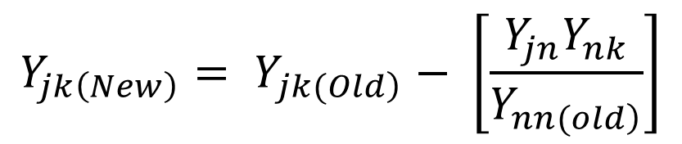
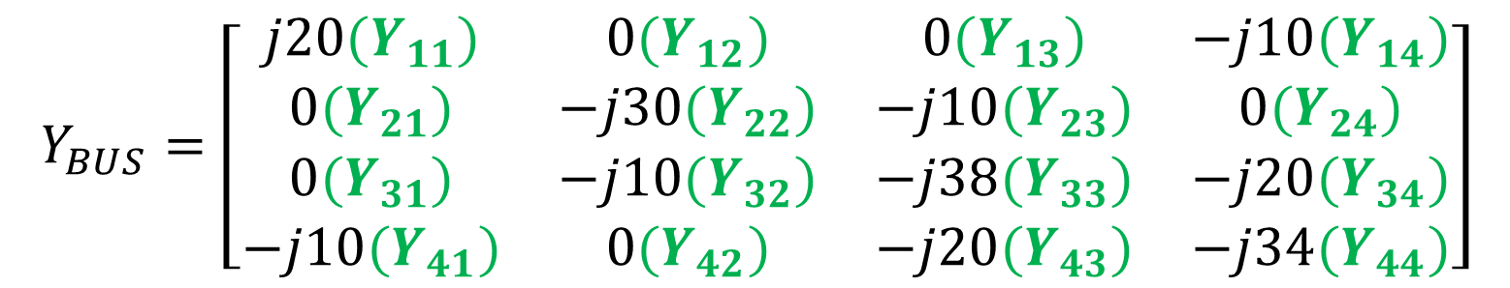
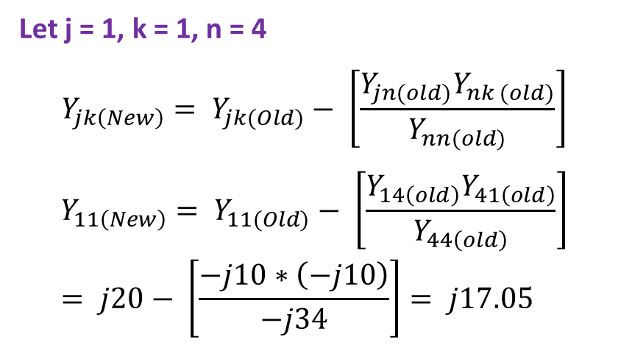
Eliminate node 4 and form New Y_{BUS} matrix using kron method
$$Y_{BUS}=\left[\begin{matrix}j20(Y_{11}) & 0(Y_{12}) & 0(Y_{13}) & −j10(Y_{14}) \\ 0(Y_{21}) & −j30(Y_{22}) & −j10(Y_{23}) & 0(Y_{24}) \\ 0(Y_{31}) & −j10(Y_{32}) & −j38(Y_{33}) & −j20(Y_{34}) \\ −j10(Y_{41}) & 0(Y_{42}) & −j20(Y_{43}) & −j34(Y_{44})\end{matrix}\right]$$
Let j = 1, k = 1, n = 4
$$Y_{jk\left(New\right)}= Y_{jk(Old)}− \left[\frac{Y_{jn(old)}Y_{nk (old)}}{Y_{nn(old)}}\right]$$
$$Y_{11\left(New\right)}= Y_{11(Old)}− \left[\frac{Y_{14\left(old\right)}Y_{41\left(old\right)}}{Y_{44\left(old\right)}}\right]= j20− \left[\frac{−j10∗\left(−j10\right)}{−j34}\right]= j17.05$$
$$Y_{jk\left(New\right)}= Y_{\left.jk(Old\right)}− \left[\frac{Y_{jn}Y_{nk}}{Y_{\left.nn(old\right)}}\right]$$

Slide 9
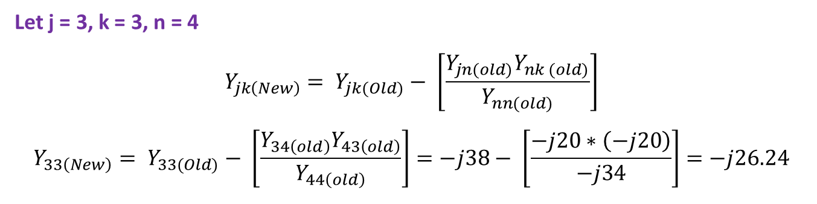
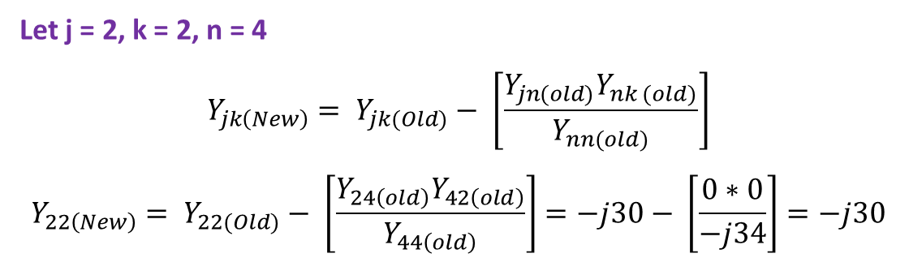
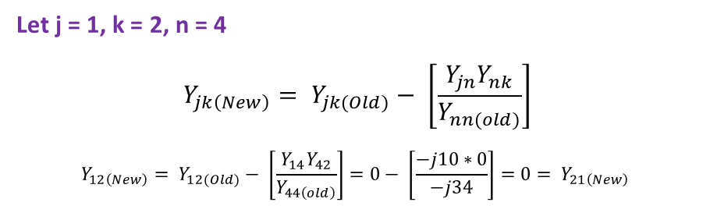
Let j = 2, k = 2, n = 4
$$Y_{jk\left(New\right)}= Y_{jk(Old)}− \left[\frac{Y_{jn(old)}Y_{nk (old)}}{Y_{nn(old)}}\right]$$
$$Y_{22\left(New\right)}= Y_{22(Old)}− \left[\frac{Y_{24\left(old\right)}Y_{42\left(old\right)}}{Y_{44\left(old\right)}}\right]=−j30− \left[\frac{0∗0}{−j34}\right]=−j30$$
Let j = 3, k = 3, n = 4
$$Y_{jk\left(New\right)}= Y_{jk(Old)}− \left[\frac{Y_{jn(old)}Y_{nk (old)}}{Y_{nn(old)}}\right]$$
$$Y_{33\left(New\right)}= Y_{33(Old)}− \left[\frac{Y_{34\left(old\right)}Y_{43\left(old\right)}}{Y_{44\left(old\right)}}\right]=−j38− \left[\frac{−j20∗\left(−j20\right)}{−j34}\right]=−j26.24$$
Let j = 1, k = 2, n = 4
$$Y_{jk\left(New\right)}= Y_{jk(Old)}− \left[\frac{Y_{jn}Y_{nk}}{Y_{nn(old)}}\right]$$
$$Y_{12\left(New\right)}= Y_{12(Old)}− \left[\frac{Y_{14}Y_{42}}{Y_{44\left(old\right)}}\right]=0− \left[\frac{−j10∗0}{−j34}\right]=0= Y_{21\left(New\right)}$$

Slide 10
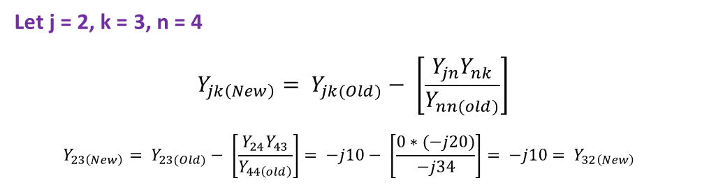
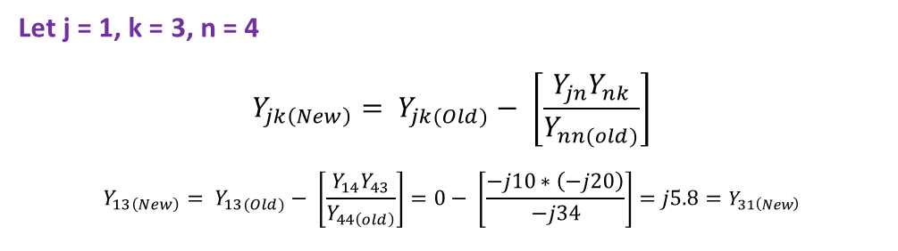
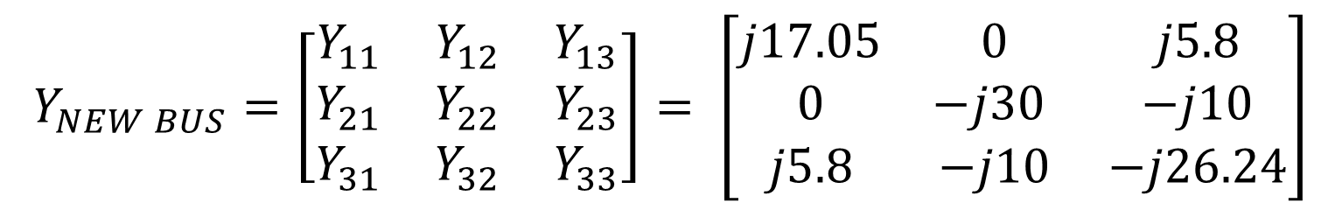
Let j = 1, k = 3, n = 4
$$Y_{jk\left(New\right)}= Y_{jk(Old)}− \left[\frac{Y_{jn}Y_{nk}}{Y_{nn(old)}}\right]$$
$$Y_{13\left(New\right)}= Y_{13(Old)}− \left[\frac{Y_{14}Y_{43}}{Y_{44\left(old\right)}}\right]=0− \left[\frac{−j10∗\left(−j20\right)}{−j34}\right]=j5.8=Y_{31\left(New\right)}$$
Let j = 2, k = 3, n = 4
$$Y_{jk\left(New\right)}= Y_{jk(Old)}− \left[\frac{Y_{jn}Y_{nk}}{Y_{nn(old)}}\right]$$
$$Y_{23\left(New\right)}= Y_{23(Old)}− \left[\frac{Y_{24}Y_{43}}{Y_{44\left(old\right)}}\right]= −j10− \left[\frac{0∗(−j20)}{−j34}\right]= −j10= Y_{32\left(New\right)}$$
$$Y_{NEW BUS}=\left[\begin{matrix}Y_{11} & Y_{12} & Y_{13} \\ Y_{21} & Y_{22} & Y_{23} \\ Y_{31} & Y_{32} & Y_{33}\end{matrix}\right]= \left[\begin{matrix}j17.05 & 0 & j5.8 \\ 0 & −j30 & −j10 \\ j5.8 & −j10 & −j26.24\end{matrix}\right]$$

Slide 11
Z_{BUS} MATRIX
Z Matrix or bus impedance matrix is an important tool in power system analysis.
Though, it is not frequently used in power flow study, unlike Y_{bus} matrix, it is, however, an important tool in other power system studies like short circuit analysis or fault study.
The Z_{bus} matrix can be computed by matrix inversion of the Y_{bus} matrix.
Since the Y_{bus} matrix is usually sparse, the explicit the Z_{bus} matrix would by dense so memory intensive to handle directly.
The diagonal elements of the Zbus are referred to as driving-point impedances of the buses.
The off-diagonal elements are called transfer impedances.

Slide 12
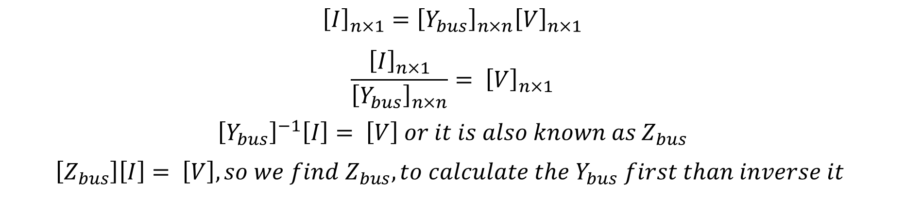
BUS IMPEDANCE MATRIX [Z_{BUS}]
$${\left[I\right]}_{n×1}={\left[Y_{bus}\right]}_{n×n}{\left[V\right]}_{n×1}$$
$$\frac{{\left[I\right]}_{n×1}}{{\left[Y_{bus}\right]}_{n×n}}= {\left[V\right]}_{n×1}$$
$${\left[Y_{bus}\right]}^{−1}\left[I\right]= \left[V\right] or it is also known as Z_{bus}$$
$$\left[Z_{bus}\right]\left[I\right]= \left[V\right], so we find Z_{bus}, to calculate the Y_{bus} first than inverse it$$

Slide 13
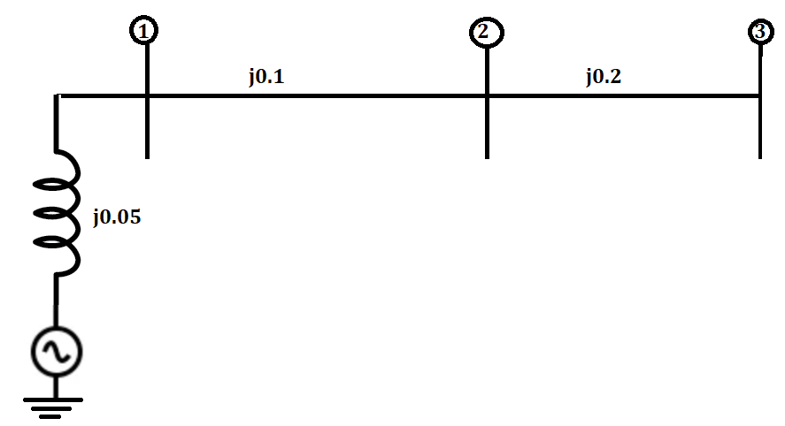
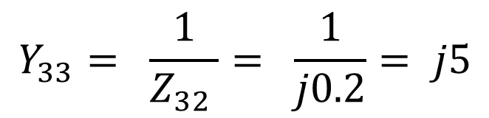
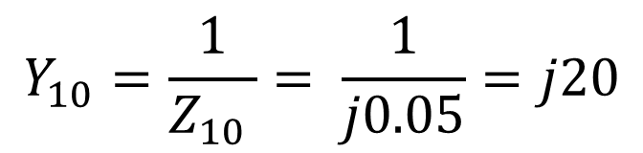
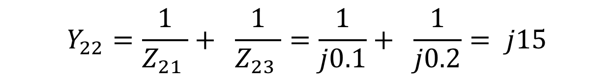
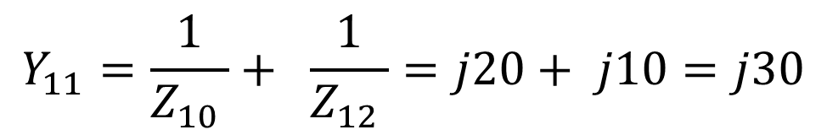
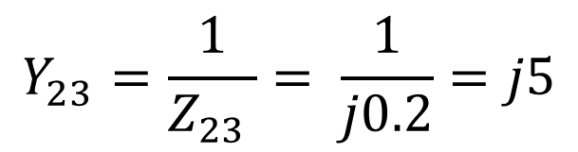
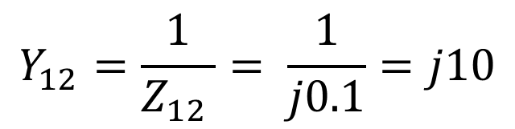
Example: Find the bus impedance matrix for system below having three buses connected with ground
Impedance of generator
$$Y_{23}=\frac{1}{Z_{23 }}= \frac{1}{j0.2}=j5$$
$$Y_{11}=\frac{1}{Z_{10 }}+ \frac{1}{Z_{12 }}=j20+ j10=j30$$
SOLUTION
$$Y_{10}=\frac{1}{Z_{10 }}= \frac{1}{j0.05}=j20$$
$$Y_{22}=\frac{1}{Z_{21 }}+ \frac{1}{Z_{23 }}=\frac{1}{j0.1}+ \frac{1}{j0.2}= j15$$
$$Y_{12}=\frac{1}{Z_{12 }}= \frac{1}{j0.1}=j10$$
$$Y_{33}= \frac{1}{Z_{32 }}= \frac{1}{j0.2}= j5$$

Slide 14
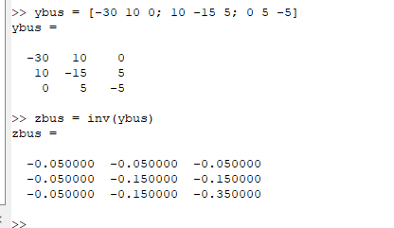
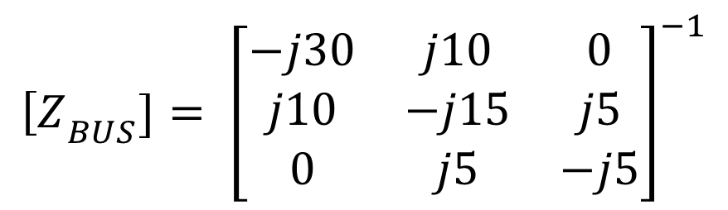
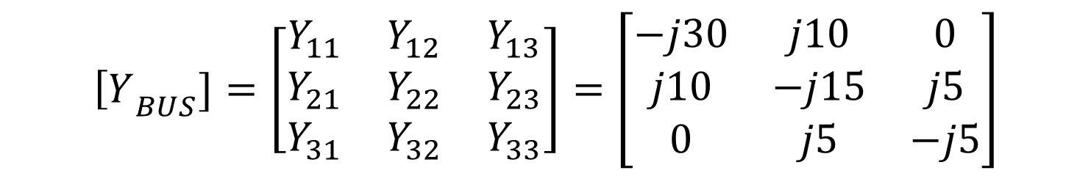
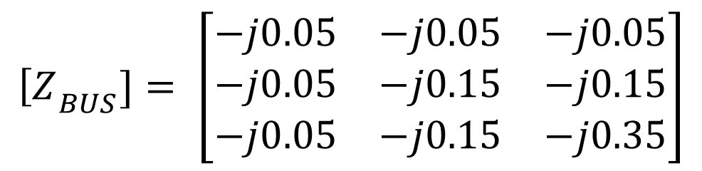
$${\left[Y\right.}_{BUS}]=\left[\begin{matrix}Y_{11} & Y_{12} & Y_{13} \\ Y_{21} & Y_{22} & Y_{23} \\ Y_{31} & Y_{32} & Y_{33}\end{matrix}\right]=\left[\begin{matrix}−j30 & j10 & 0 \\ j10 & −j15 & j5 \\ 0 & j5 & −j5\end{matrix}\right]$$
$${\left[Z\right.}_{BUS}]= {\left[\begin{matrix}−j30 & j10 & 0 \\ j10 & −j15 & j5 \\ 0 & j5 & −j5\end{matrix}\right]}^{−1}$$
$${\left[Z\right.}_{BUS}]= \left[\begin{matrix}−j0.05 & −j0.05 & −j0.05 \\ −j0.05 & −j0.15 & −j0.15 \\ −j0.05 & −j0.15 & −j0.35\end{matrix}\right]$$

Slide 15
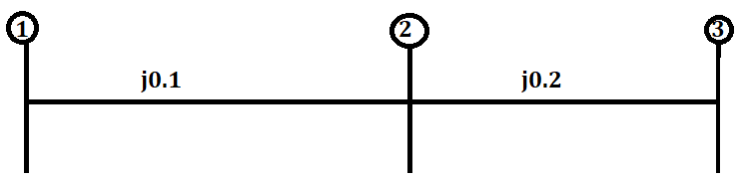
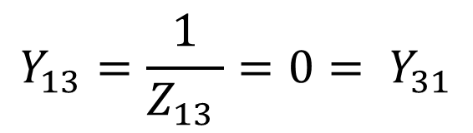
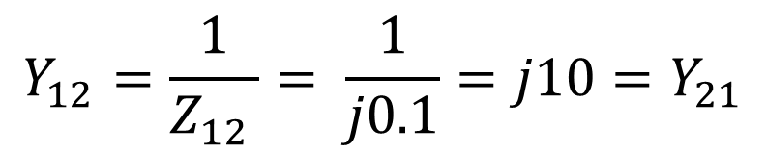
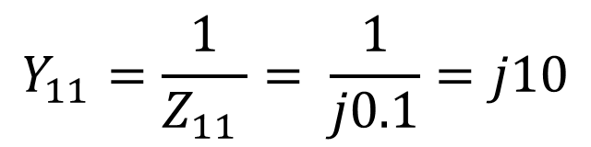
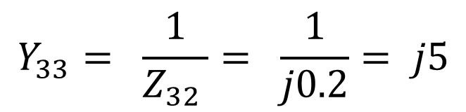
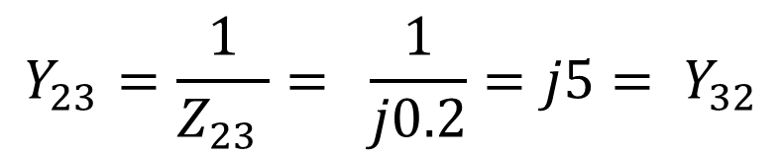
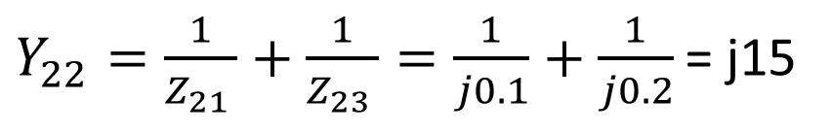
Example: Find the bus impedance matrix for system below having three buses connected
$Y_{22}=\frac{1}{Z_{21 }}+\frac{1}{Z_{23 }}=\frac{1}{j0.1}+\frac{1}{j0.2}$ = j15
SOLUTION
$$Y_{23}=\frac{1}{Z_{23 }}= \frac{1}{j0.2}=j5= Y_{32}$$
$$Y_{11}=\frac{1}{Z_{11 }}= \frac{1}{j0.1}=j10$$
$$Y_{33}= \frac{1}{Z_{32 }}= \frac{1}{j0.2}= j5$$
$$Y_{12}=\frac{1}{Z_{12 }}= \frac{1}{j0.1}=j10=Y_{21}$$
$$Y_{13}=\frac{1}{Z_{13 }}=0= Y_{31}$$

Slide 16
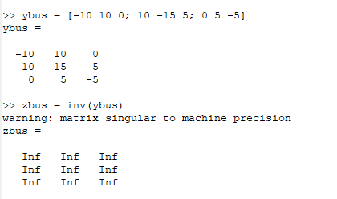
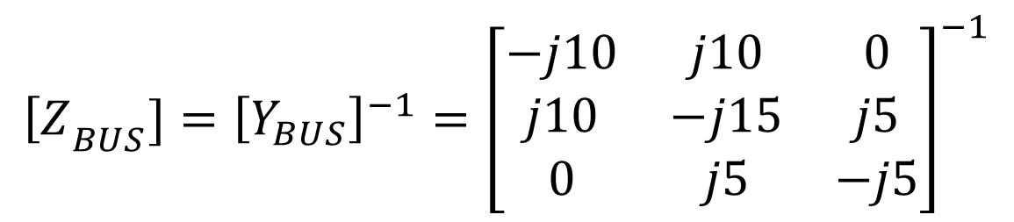
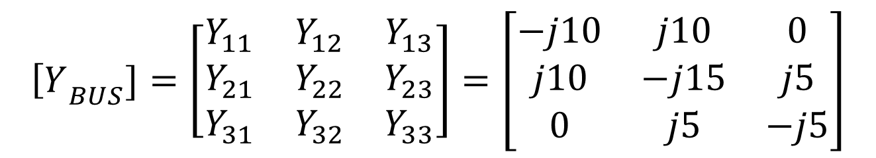
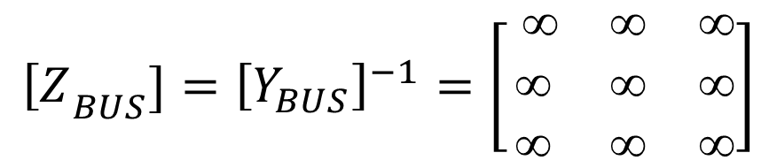
$${\left[Y\right.}_{BUS}]=\left[\begin{matrix}Y_{11} & Y_{12} & Y_{13} \\ Y_{21} & Y_{22} & Y_{23} \\ Y_{31} & Y_{32} & Y_{33}\end{matrix}\right]=\left[\begin{matrix}−j10 & j10 & 0 \\ j10 & −j15 & j5 \\ 0 & j5 & −j5\end{matrix}\right]$$
$${\left[Z\right.}_{BUS}]={\left[Y_{BUS}\right]}^{−1}={\left[\begin{matrix}−j10 & j10 & 0 \\ j10 & −j15 & j5 \\ 0 & j5 & −j5\end{matrix}\right]}^{−1}$$
$${\left[Z\right.}_{BUS}]={\left[Y_{BUS}\right]}^{−1}=\left[\begin{matrix}  &  &  \\  &  &  \\  &  & \end{matrix}\right]$$

Slide 17
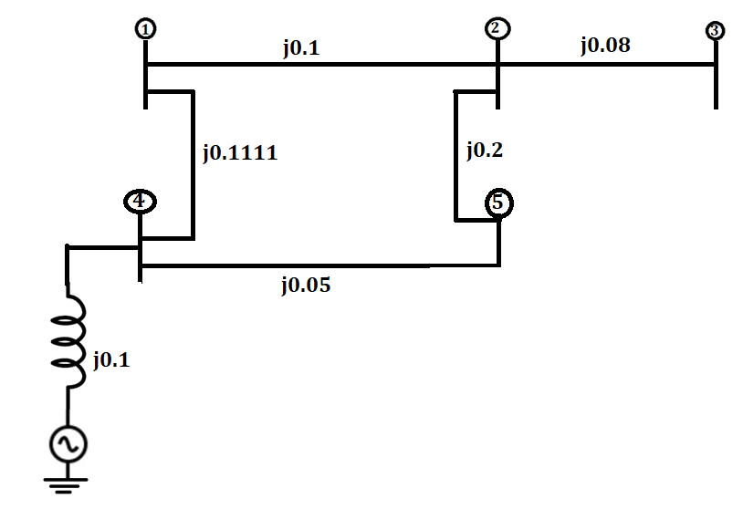
Example: Find the bus impedance matrix of four bus connected system as shown below.
SOLUTION
Convert the Impedances values into Admittance
-j10
-j12.5
-j9
-j5
-j20
-j10

Slide 18
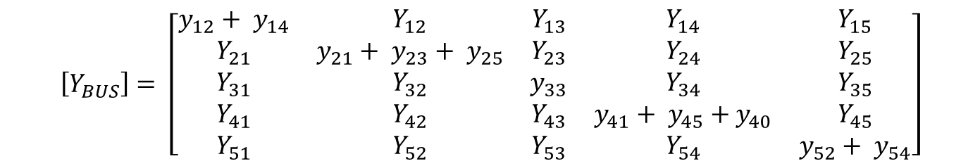



$$\left[Y_{BUS}\right]= \left[\begin{matrix}Y_{11} & Y_{12} & Y_{13} & Y_{14} & Y_{15} \\ Y_{21} & Y_{22} & Y_{23} & Y_{24} & Y_{25} \\ Y_{31} & Y_{32} & Y_{33} & Y_{34} & Y_{35} \\ Y_{41} & Y_{42} & Y_{43} & Y_{44} & Y_{45} \\ Y_{51} & Y_{52} & Y_{53} & Y_{54} & Y_{55}\end{matrix}\right]$$
$$\left[Y_{BUS}\right]= \left[\begin{matrix}y_{12}+ y_{14} & Y_{12} & Y_{13} & Y_{14} & Y_{15} \\ Y_{21} & y_{21}+ y_{23}+ y_{25} & Y_{23} & Y_{24} & Y_{25} \\ Y_{31} & Y_{32} & y_{33} & Y_{34} & Y_{35} \\ Y_{41} & Y_{42} & Y_{43} & y_{41}+ y_{45}+y_{40} & Y_{45} \\ Y_{51} & Y_{52} & Y_{53} & Y_{54} & y_{52}+ y_{54}\end{matrix}\right]$$
$$\left[Y_{BUS}\right]= \left[\begin{matrix}−j10−j9 & j10 & 0 & j9 & 0 \\ j10 & −j10−j12.5−j5 & j12.5 & 0 & j5 \\ 0 & j12.5 & −j12.5 & 0 & 0 \\ j9 & 0 & 0 & −j9−j20−j10 & j20 \\ 0 & j5 & 0 & j20 & −j5−j20\end{matrix}\right]$$
$$\left[Y_{BUS}\right]= \left[\begin{matrix}−j19 & j10 & 0 & j9 & 0 \\ j10 & −j27.5 & j12.5 & 0 & j5 \\ 0 & j12.5 & −j12.5 & 0 & 0 \\ j9 & 0 & 0 & −j39 & j20 \\ 0 & j5 & 0 & j20 & −j25\end{matrix}\right]$$

Slide 19



$$\left[Z_{BUS}\right]= {\left[Y_{BUS}\right]}^{−1}={\left[\begin{matrix}−j19 & j10 & 0 & j9 & 0 \\ j10 & −j27.5 & j12.5 & 0 & j5 \\ 0 & j12.5 & −j12.5 & 0 & 0 \\ j9 & 0 & 0 & −j39 & j20 \\ 0 & j5 & 0 & j20 & −j25\end{matrix}\right]}^{−1}$$
$$\left[Z_{BUS}\right]= {\left[Y_{BUS}\right]}^{−1}=\left[\begin{matrix}−j0.184 & −j0.160 & −j0.160 & −j0.10 & −j0.11 \\ −j0.160 & −j0.214 & −j0.214 & −j0.10 & −j0.122 \\ −j0.160 & −j0.214 & −j0.294 & −j0.10 & −j0.122 \\ −j0.10 & −j0.10 & −j0.10 & −j0.10 & −j0.10 \\ −j0.11 & −j0.122 & −j0.122 & −j0.10 & −j0.144\end{matrix}\right]$$

Slide 20
END

