Slide 1

Computational Methods in
Power System Analysis
Lecture-6 Three-phase
By
Dr. Wazir Muhammad Laghari
Electrical Engineering Department
BUET, Khuzdar

Slide 2
Need/Advantages of 3-φ supply Power
Voltage produced by a 1φ supply is very less and not enough to supply practical industrial loads.
Industrial heavy loads require poly phase supply (Phase means branch circuit or winding while poly means many).
In poly phase system there are many independent AC voltages present simultaneously (depends on no: of phases).
In 3φ system, the magnitudes and frequencies of a.c. voltages are same and a phase difference of 360/3 = 120⁰ with respect to each other.
The output of 3φ machine is always greater than the o/p of 1 φmachine of same size.
Transmission of 3φ power is very much economical as it needs less copper or less conducting material as compared to 1φ power.
Rotating Magnetic Field can be generated in 3φ supply, hence 3φ machines are self starting, with the help of 1φ supply we can not produced rotating magnetic field, so 1φ machines are not self starting.
In 3φ supply give rise to 3 of 1φ supplies, but vice-versa is not possible.
Rectifier DC output voltage is smoother (having less ripple) if number of phases are increased at the supply side

Slide 3
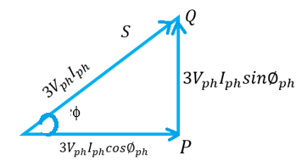
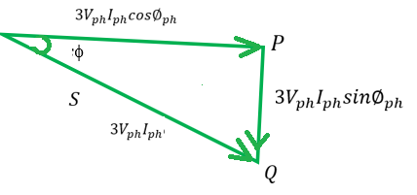











3φ Power
1) Active/Real/True Power:
3) Apparent Power:
$Active power in terms of$ Phase
$Apparent power in terms of$ Phase
$$P=3V_{ph}I_{ph}cos∅_{ph } watt , Kw, Mw$$
$$S=3V_{ph}I_{ph} VA , KVA, MVA$$
$Apparent power in terms of$ Line
$Active power in terms of$ Line
$$S=\sqrt{3}V_{l}I_{l} VA , KVA, MVA$$
$$P=\sqrt{3}V_{l}I_{l}cos∅_{ph} watt , Kw, Mw$$
2) Reactive Power:
Power Triangle of Inductive Circuit
Power Triangle of Capacitive Circuit
$Reactive power in terms of$ Phase
$$Q=3V_{ph}I_{ph}sin∅_{ph } VAR (Volt−Amps−Reactive)$$
$Reactive power in terms of$ Line
$$Q=\sqrt{3}V_{l}I_{l}sin∅_{ph} VAR (Volt−Amps−Reactive)$$
Power factor of capacitive ckt nature is leading
$$cos=power factor (lagging)$$
$$cos=power factor (leading)$$

Slide 4
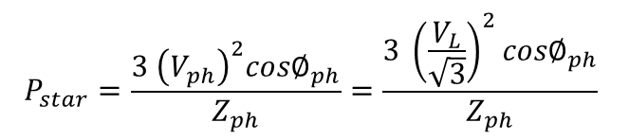

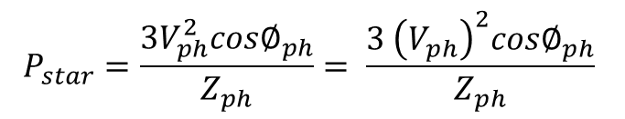


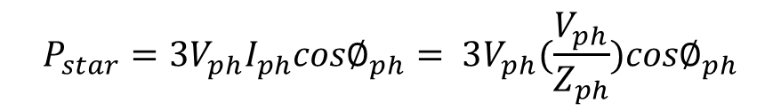
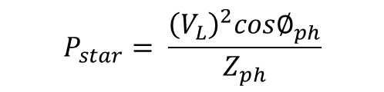

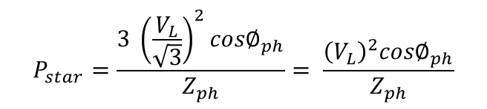
$$V_{ph}=\frac{V_{L}}{\sqrt{3}}$$
Relationship between P_{Star} and P_{Delta}
V_{L} is same for Y and Δ Load
Z_{ph} is same for Y and Δ Load
$$P_{star}=\frac{3V_{ph}^{2}{cos∅}_{ph}}{Z_{ph}}= \frac{3 {\left(V_{ph}\right)}^{2}{cos∅}_{ph}}{Z_{ph}}$$
FOR STAR LOAD
$$P_{star}=\frac{3 {\left(V_{ph}\right)}^{2}{cos∅}_{ph}}{Z_{ph}}=\frac{3 {\left(\frac{V_{L}}{\sqrt{3}}\right)}^{2}{cos∅}_{ph}}{Z_{ph}}$$
$$P_{star}=3V_{ph}I_{ph}{cos∅}_{ph}$$
$$I_{ph}=\frac{V_{ph}}{Z_{ph}}$$
$$P_{star}=\frac{3 {\left(\frac{V_{L}}{\sqrt{3}}\right)}^{2}{cos∅}_{ph}}{Z_{ph}}= \frac{{\left(V_{L}\right)}^{2}{cos∅}_{ph}}{Z_{ph}}$$
$$P_{star}=3V_{ph}I_{ph}{cos∅}_{ph}= 3V_{ph}(\frac{V_{ph}}{Z_{ph}}){cos∅}_{ph}$$
$$P_{star}=\frac{3V_{ph}^{2}{cos∅}_{ph}}{Z_{ph}}$$
$$P_{star}= \frac{{\left(V_{L}\right)}^{2}{cos∅}_{ph}}{Z_{ph}}$$
In Star connected load V_{phase} equal to line voltage V_{L} divided by root 3

Slide 5
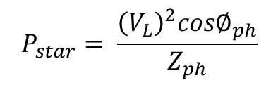

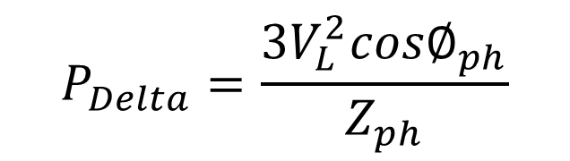
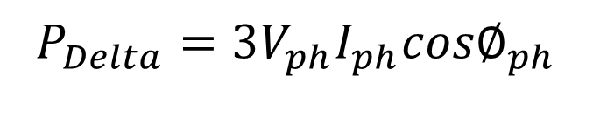

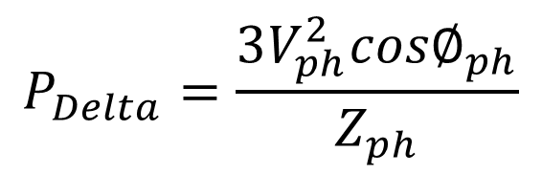
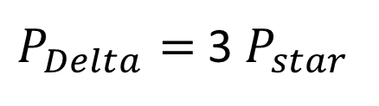
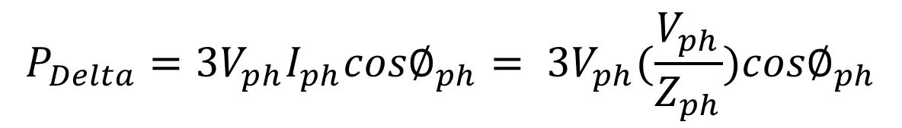
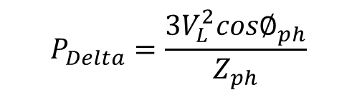
Relationship between P_{Star} and P_{Delta}
$$P_{Delta}=\frac{3V_{L}^{2}{cos∅}_{ph}}{Z_{ph}}$$
$$P_{star}= \frac{{\left(V_{L}\right)}^{2}{cos∅}_{ph}}{Z_{ph}}$$
FOR DELTA LOAD
$$P_{Delta}=3V_{ph}I_{ph}{cos∅}_{ph}$$
$$I_{ph}=\frac{V_{ph}}{Z_{ph}}$$
$P_{Delta}=$ 3 $P_{star}$
$$P_{Delta}=3V_{ph}I_{ph}{cos∅}_{ph}= 3V_{ph}(\frac{V_{ph}}{Z_{ph}}){cos∅}_{ph}$$
$$P_{Delta}=\frac{3V_{ph}^{2}{cos∅}_{ph}}{Z_{ph}}$$
In Delta connected load V_{phase} equal to line voltage V_{L}
$$V_{ph}= V_{L}$$
$$P_{Delta}=\frac{3V_{L}^{2}{cos∅}_{ph}}{Z_{ph}}$$

Slide 6
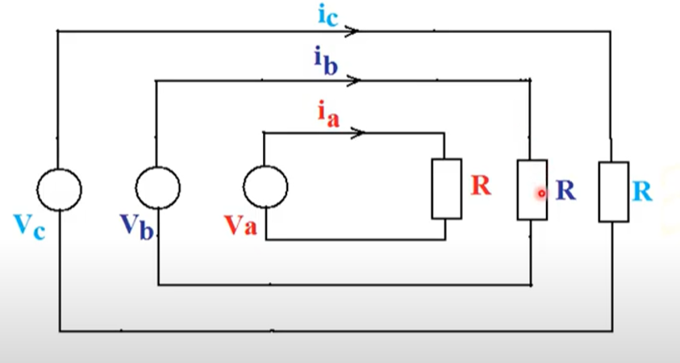
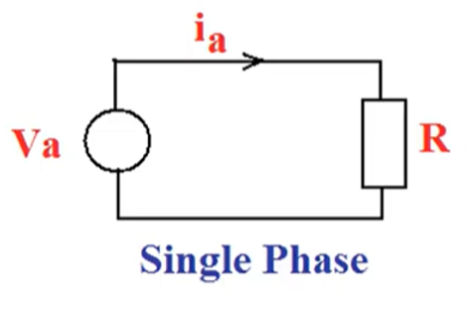
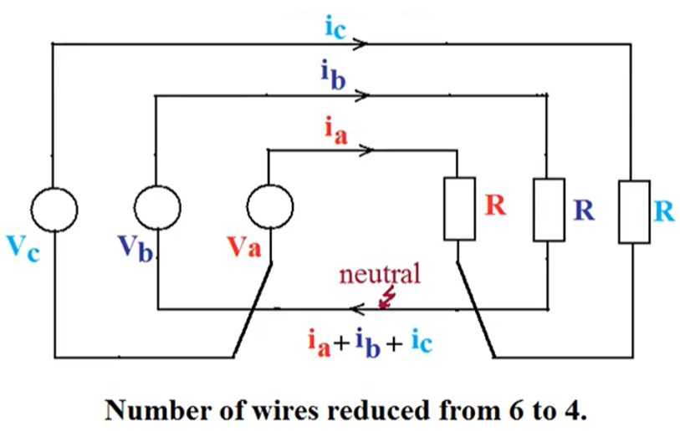
Single Phase And Three Phase Voltages
If we connect three single phase circuits
First one is Va, Vb and Vc.
This way we can connected with three different loads by three sources.
1-phase having one voltage source.
Line is connected with load.
Instead of 6 wires of previous diagram 3 for going current from source to load and 3 paths of returning current from load to source so total is 6 but now we reduced into 4.
So 3 for current going from source to load and one for all currents going back to source, so this way reduce six wires to 4 wires.

Slide 7
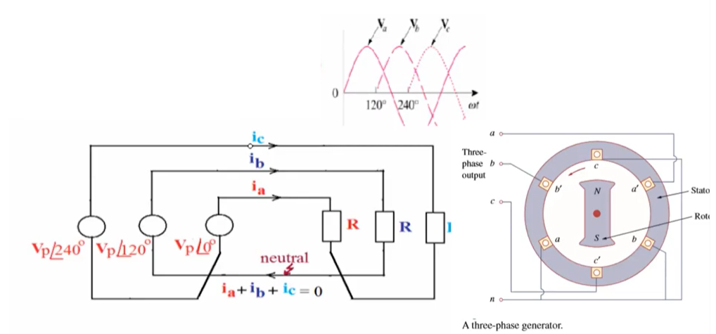
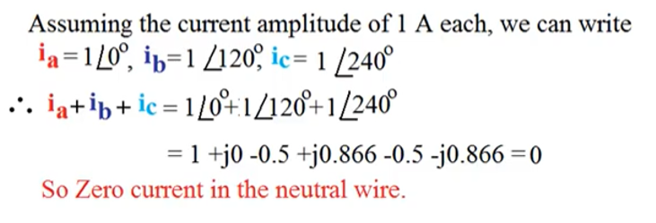
3 phase, 4 wire system And Verify Neutral has Zero Current
3 phase voltages have same amplitude in balanced system but different in phase .
First is 0, second is 120 and 3rd is 240 phase difference.
Diagram for generating 3phase, one is rotor and there is 3 sets of coils a to a’, b to b’ and c to c’ and there is 120 degree apart.
Zero current flowing in the neutral wire, so no need to provide neutral wire because loads are balanced, but practically loads are not balanced so due to this neutral wire is available there.

Slide 8
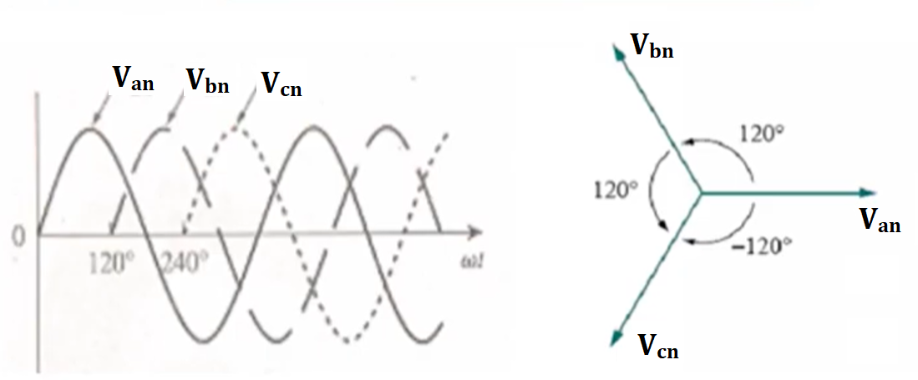
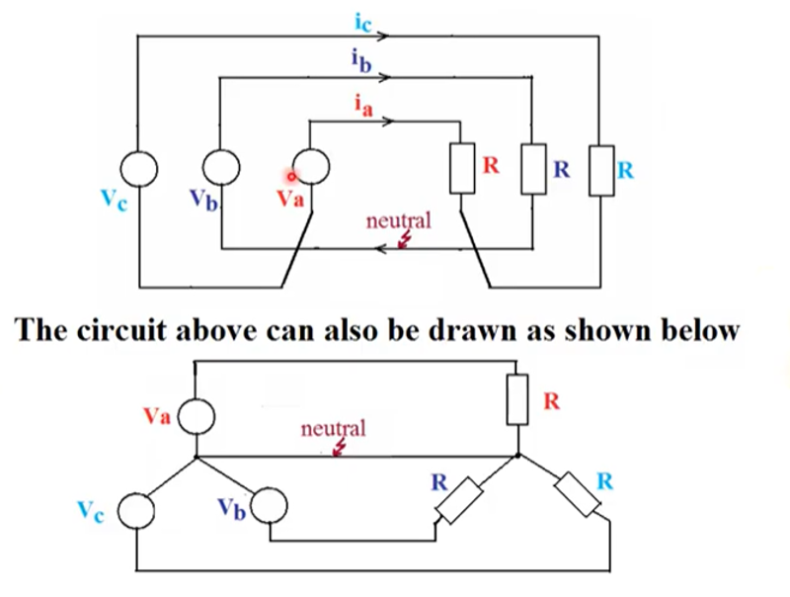
3-phase 4 wire system: re-design architecture
BALANCED THREE-PHASE VOLTAGES
A set of balanced three-phase voltages consists of three sinusoidal voltages that have identical amplitudes and frequencies but are out of phase with each other by exactly 120⁰.
The phases are referred as a, b and c. The a-phase is taken as the reference.

Slide 9
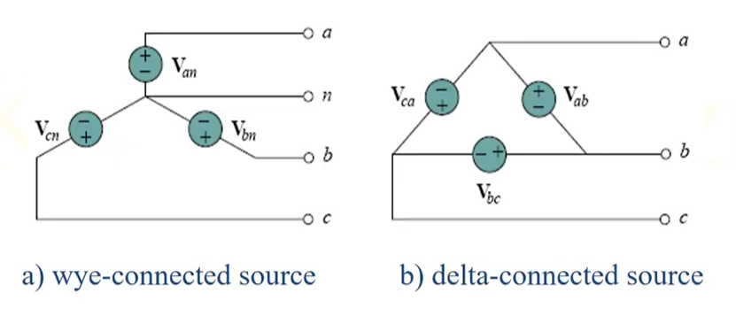
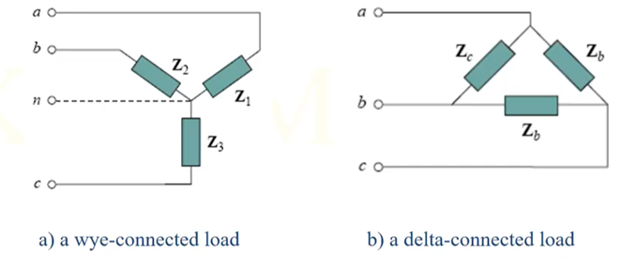
BALANCED THREE PHASE SOURCE CONNECTED VOLTAGES
There will be two possibilities of connections:
1) Star or Y Connected
2) Delta Connected.
In Y configuration has neutral wire, but in Delta has no neutral wire
Source Connection Load Connection

Slide 10
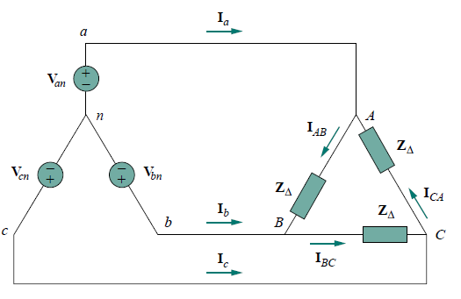
ALL POSSIBLE CONNECTIONS OF THREE PHASE
Both the three phase source and the three phase load can be connected either Wye or DELTA.
We have 4 possible types of connections
Y-Y Connection (Source is Star Connected and Load is also in Star Connected)
Y-Δ Connection
Δ- Δ Connection
Δ-Y Connection
Source Load
Mostly Y connected sources are more common.
And Balanced Δ connected load is more common.

Slide 11
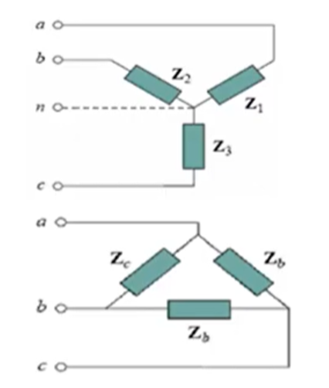
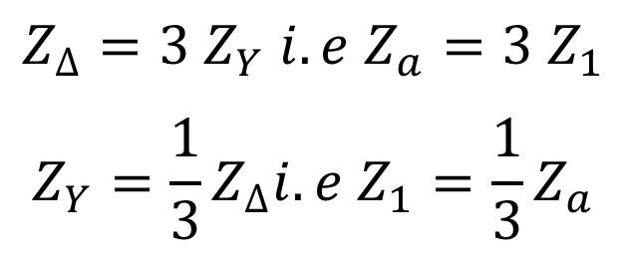
BALANCED LOAD
A Balanced Load is one in which the phase impedances are equal in magnitude and in phase.
For a balanced wye connected load:
Z₁ = Z₂ = Z₃ = Z_{Y}
For a balanced delta connected load:
Z_{a} = Z_{b} = Z_{c} = Z_{Δ}
The following formulas are derived from wye-delta conversion:
$$Z_{∆}=3 Z_{Y} i.e Z_{a}=3 Z_{1}$$
$$Z_{Y}=\frac{1}{3}Z_{∆}i.e Z_{1}=\frac{1}{3}Z_{a}$$
(Delta impedance equal
to 3 times Y impedances)

Slide 12
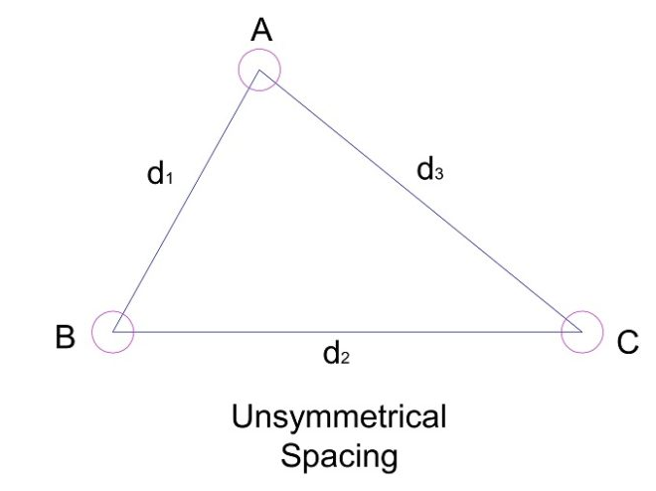
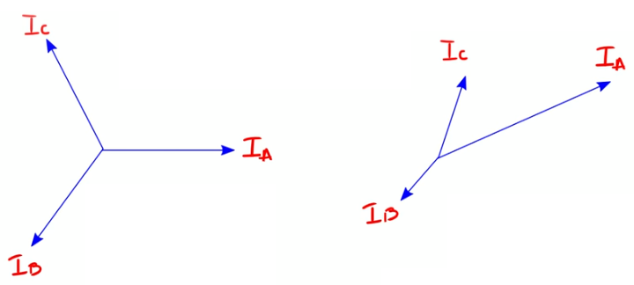
Symmetrical And Unsymmetrical System
In a three phase system the three voltages are of same magnitude and frequency which is displaced from each other by 120⁰ phase angle it is defined as symmetrical system.
Symmetrical /Balanced System
Un-Symmetrical /Unbalanced System

Slide 13
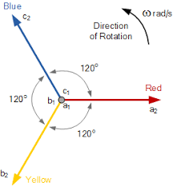
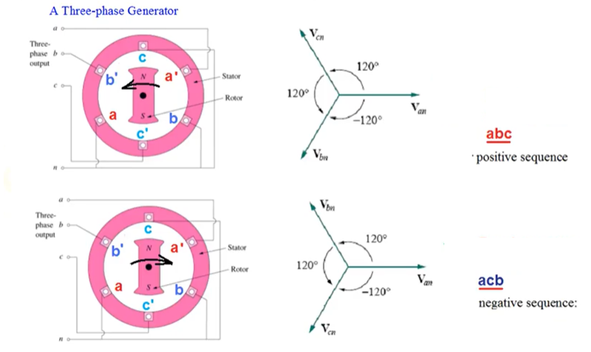
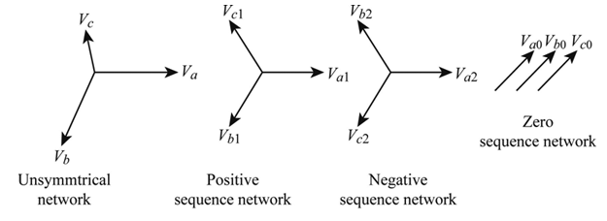
PHASE SEQUENCE
Phase sequence or Phase rotation is the order in which the voltage waveforms of Three Phase AC source reach their respective peaks. OR
The sequence in which the voltages in 3-phase supply reach their maximum possible values is called Phase Sequence.
Generally the phase sequence is R-Y-B or A-B-C or a-b-c.
The need of phase sequence is very important in determining the direction of rotation of a.c motors.
No rotation

Slide 14
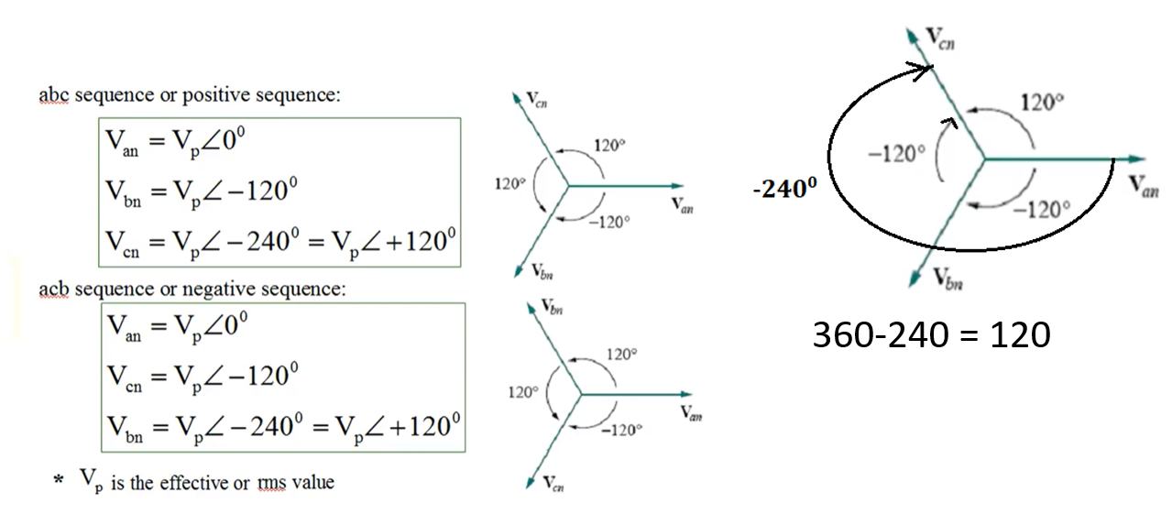
Phase Sequence of a Balanced Three Phase Voltages

Slide 15


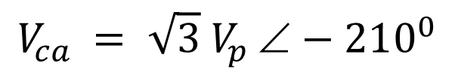

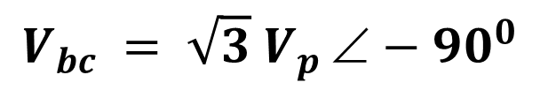

Line Voltage = root 3 times Phase Voltage with angle of 30⁰
$$V_{an }= V_{p}{0}^{0}$$
$$V_{bn }= V_{p}{−120}^{0}$$
$$V_{cn }= V_{p}{+120}^{0}$$
$V_{ab }= V_{an }+ V_{nb }= {V_{an }− V_{bn }= V}_{p}{0}^{0}− V_{p }−120^{0}$
$$V_{ab }= V_{p }\left(1{∠0}^{0}−1∠−120^{0}\right)=V_{p }\left(1+0.5+j0.866\right)$$
$$V_{ab }= V_{p }\left(1.5+j0.866\right)= V_{p }\left(1.732∠30^{0}\right)$$
$$V_{ab }= \sqrt{3} V_{p }∠30^{0}$$
$$V_{bc }= V_{bn }+ V_{nc }= V_{bn }− V_{cn }= \sqrt{3} V_{p }∠30^{0}−120^{0}$$
$$V_{bc }= \sqrt{3} V_{p }∠−90^{0}$$
$$V_{ca }= V_{cn }+ V_{na }= V_{cn }− V_{an }= \sqrt{3} V_{p }∠−90^{0}−120^{0}$$
$$V_{ca }= \sqrt{3} V_{p }∠−210^{0}$$

Slide 16
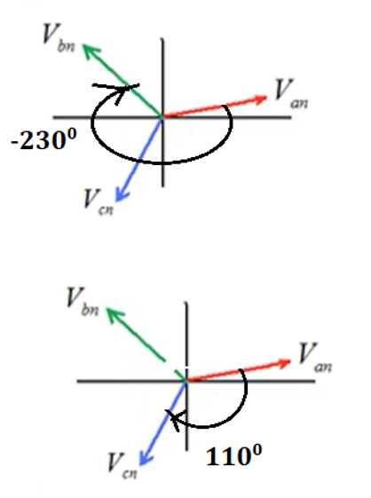
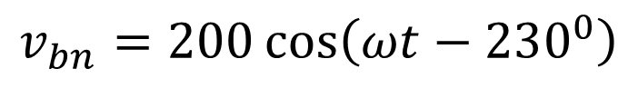
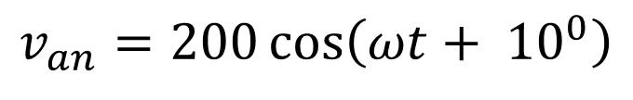

EXAMPLE: Determine the phase sequence of the set of voltages
$$v_{an}=200\cos\left(ωt+ {10}^{0}\right)$$
$$v_{bn}=200\cos\left(ωt−230^{0}\right)$$
$$v_{cn}=200\cos\left(ωt−110^{0}\right)$$
SOLUTION
$$v_{an}=200\cos\left(ωt+ {10}^{0}\right)↔ V_{an}=200{∠10}^{0}V$$
$$v_{bn}=200\cos\left(ωt−230^{0}\right)↔ V_{an}=200{∠−230}^{0}V$$
$$v_{cn}=200\cos\left(ωt−110^{0}\right)↔ V_{cn}=200{∠−110}^{0}V$$

Slide 17
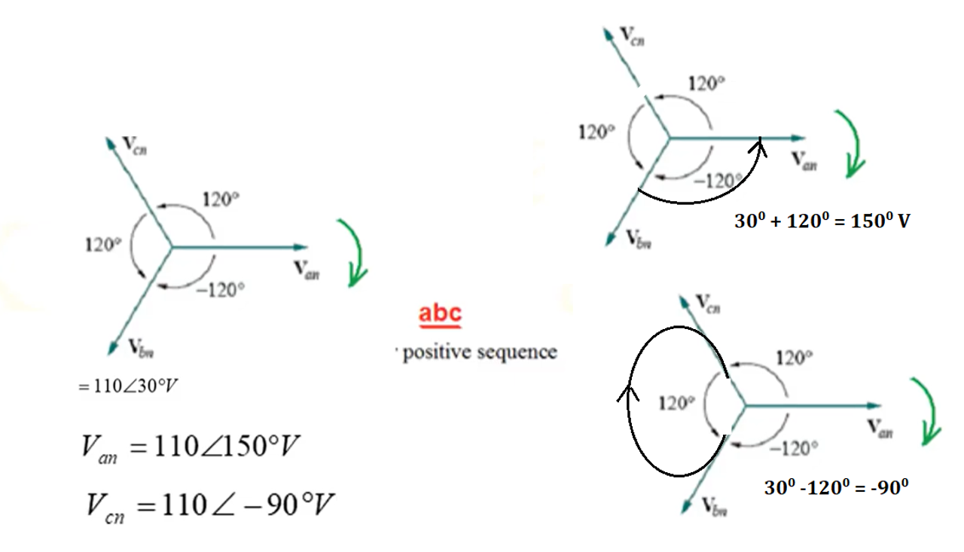
EXAMPLE:
Given that $V_{bn}=110{∠30}^{0}V, find{ V}_{an} and{ V}_{cn} assuming a positive \left(abc\right)sequence$
SOLUTION:

Slide 18
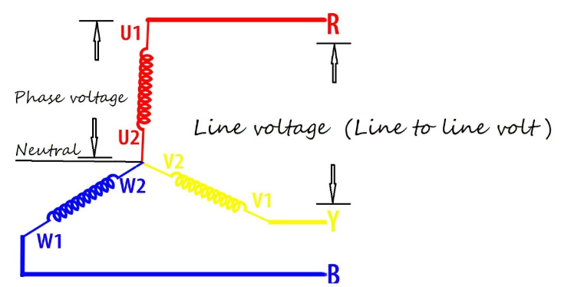
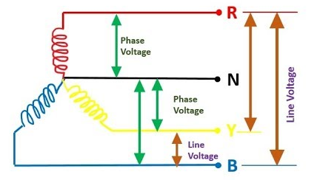
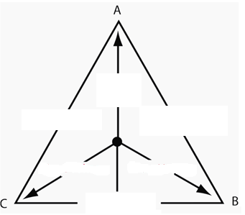
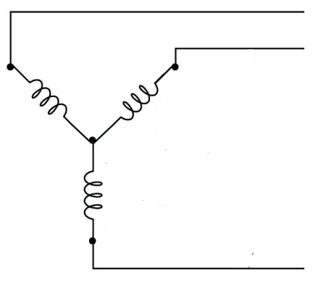
LINE VOLTAGE AND PHASE VOLTAGE
Line voltage is the voltage measured between any two lines in a three-phase circuit.
Phase voltage is the voltage measured from neutral to line is called Phase voltage.
Phase voltage refers to the voltage measured across any one component (source winding or load impedance) in a balanced three-phase source or load with reference to neutral.
Phase Voltage is different in case of Delta, because there is no neutral available, so phase voltage is the voltage across any one load, it is also called a line voltage. In Delta connected line voltage = phase voltage.
Assign V-line and V-phase

Slide 19
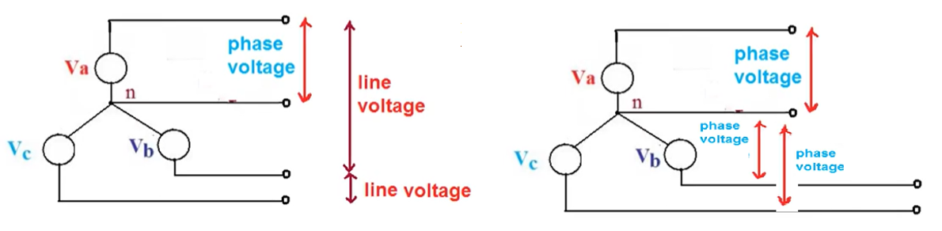
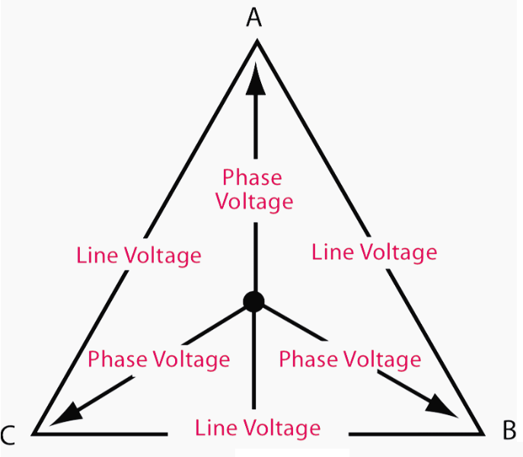
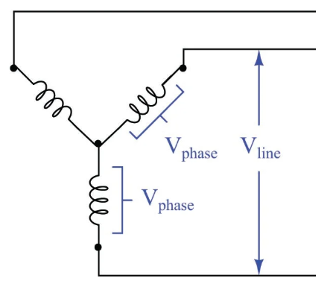
LINE VOLTAGE AND PHASE VOLTAGE

Slide 20
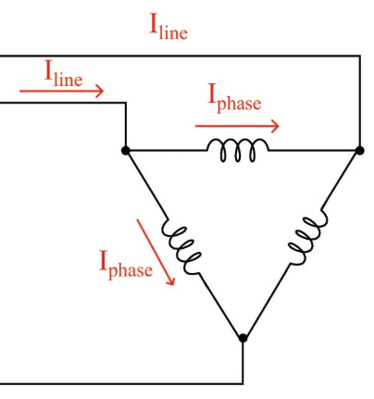


LINE CURRENT AND PHASE CURRENT
Line current is the current through any one line between a three-phase source and load.
Phase current is the current through any one component comprising a three-phase source or load.

Slide 21


EXAMPLE: Calculate the currents in YY connected System
SOLUTION
$Z_{Y}= Z_{S}+ Z_{l}+ Z_{L}=(0.4+j0.3)+\left(0.6+j0.7\right)+\left(24+j19\right)=25+j20$=32.016∠38.66⁰

Slide 22


Home Work: Calculating the Currents in a YY System
$$Z_{S}=0.4+j0.3$$
$$Z_{l}=0.6+j0.7$$
$$Z_{L}=24+j19$$
$V_{an}=$ 120∠30⁰
Find I_{a} ,I_{b} , I_{c}

Slide 23
END

