Slide 1

Computational Methods in
Power System Analysis
Lecture-7 Three-phase
By
Dr. Wazir Muhammad Laghari
Electrical Engineering Department
BUET, Khuzdar

Slide 2

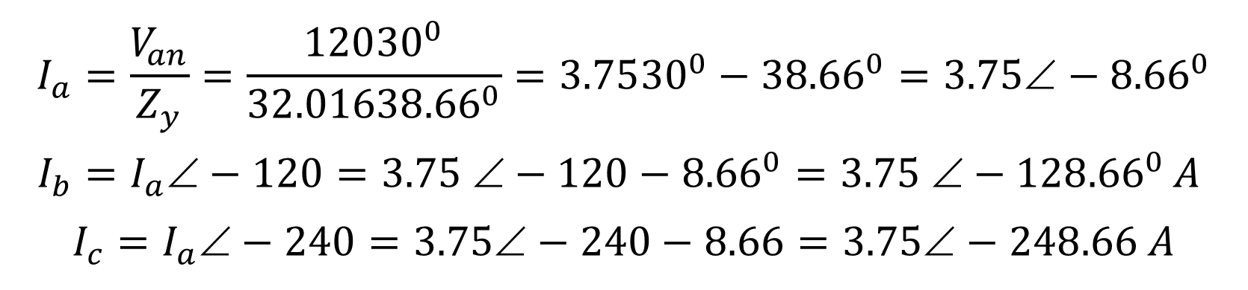
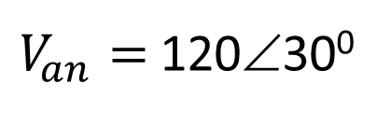
Home Work: Calculating the Currents in a YY System
$$Z_{S}=0.4+j0.3$$
$$Z_{l}=0.6+j0.7$$
$$Z_{L}=24+j19$$
$V_{an}=$ 120∠30⁰
Find I_{a} ,I_{b} , I_{c}
$$I_{a}=\frac{V_{an}}{Z_{y}}=\frac{120{30}^{0}}{32.016{38.66}^{0}}=3.75{30}^{0}−{38.66}^{0}=3.75∠−{8.66}^{0}$$
$$I_{b}=I_{a}−120=3.75 −120−{8.66}^{0}=3.75 −128{.66}^{0}A$$
$$I_{c}=I_{a}−240=3.75−240−8.66=3.75−248.66 A$$

Slide 3
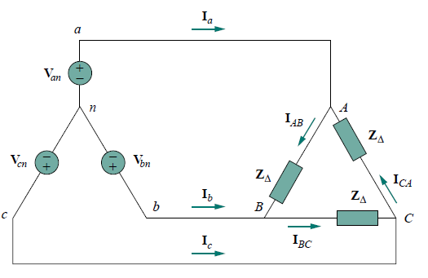
ALL POSSIBLE CONNECTIONS OF THREE PHASE
Both the three phase source and the three phase load can be connected either Wye or DELTA.
We have 4 possible types of connections
Y-Y Connection (Source is Star Connected and Load is also in Star Connected)
Y-Δ Connection
Δ- Δ Connection
Δ-Y Connection
Source Load
Mostly Y connected sources are more common.
And Balanced Δ connected load is more common.

Slide 4
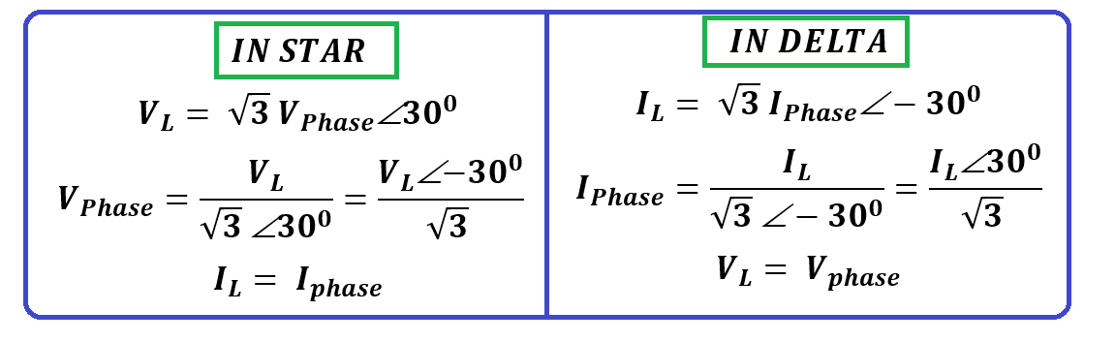
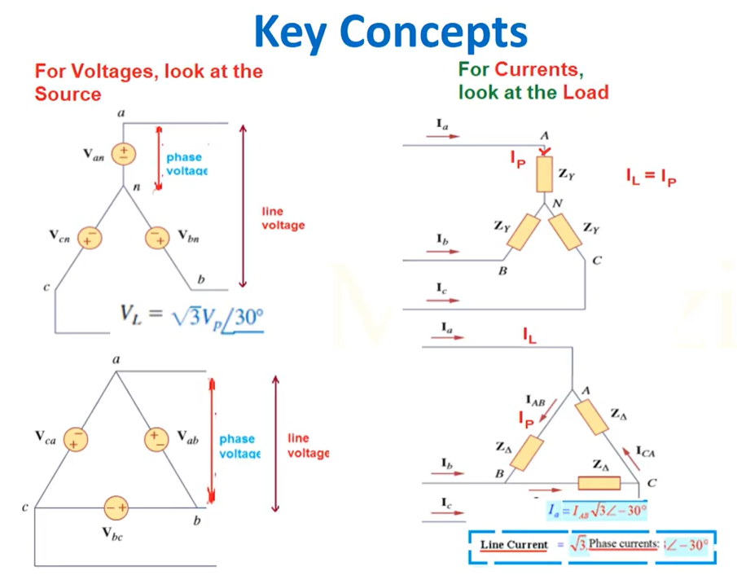
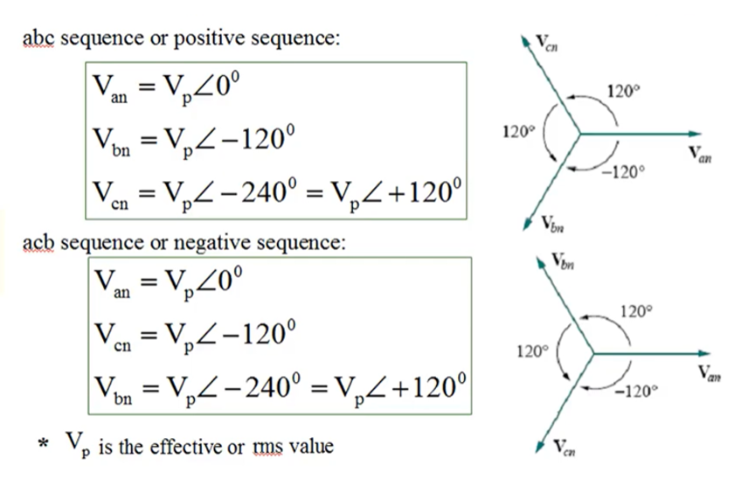

Slide 5
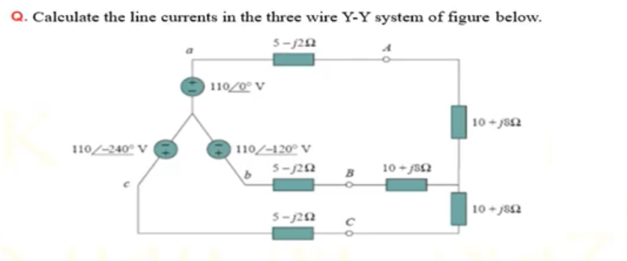
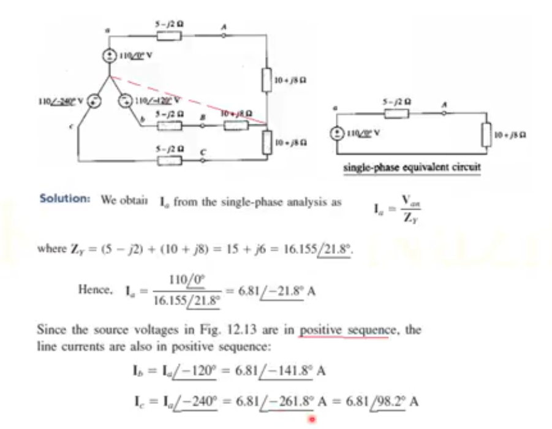

Slide 6
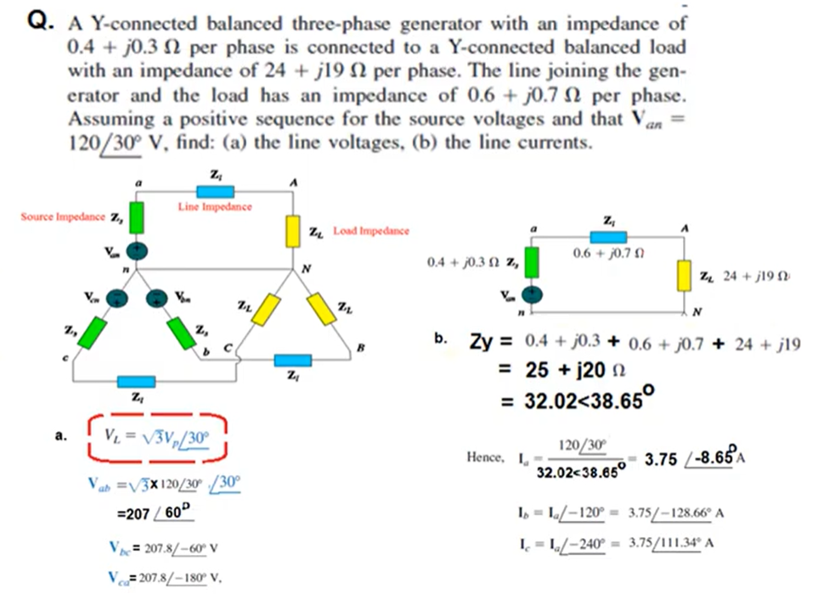
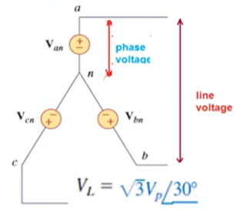

Slide 7
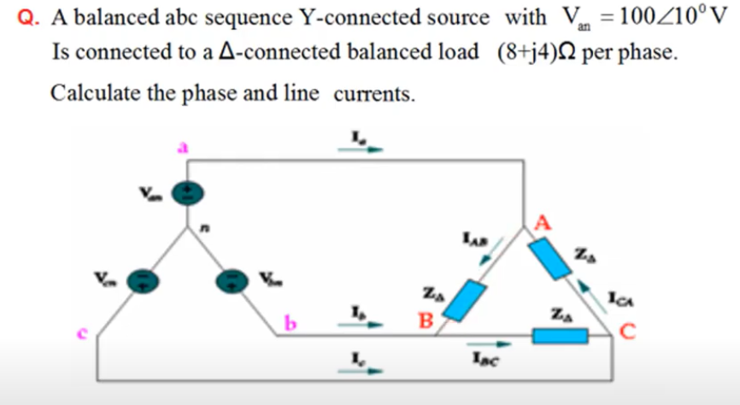
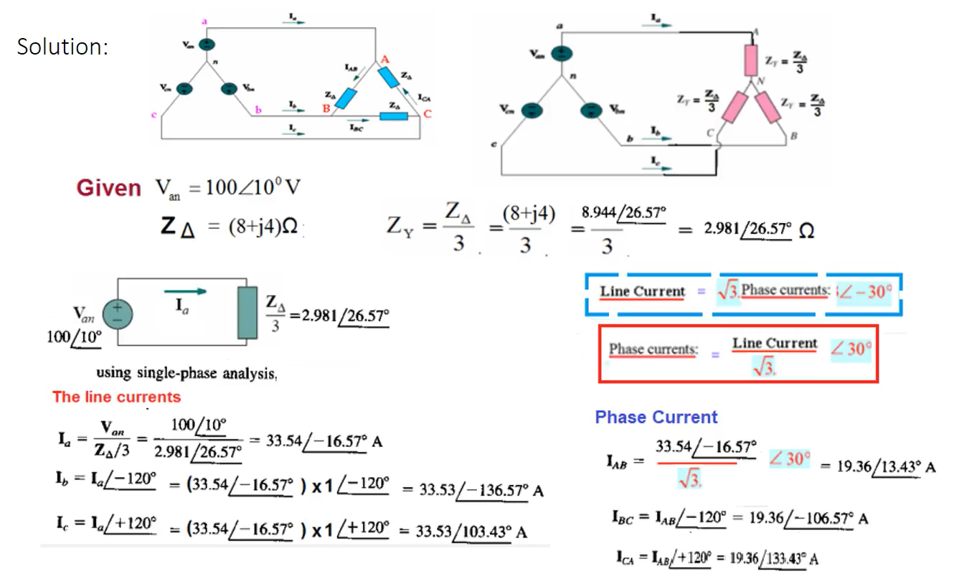
BALANCED STAR-DELTA CONNECTION

Slide 8
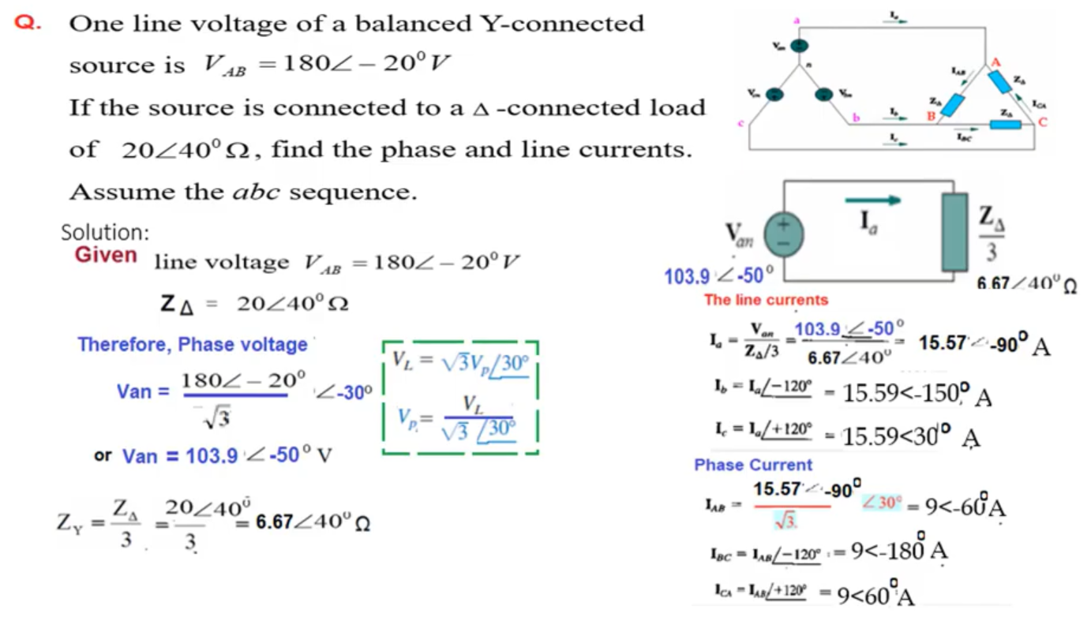

Slide 9
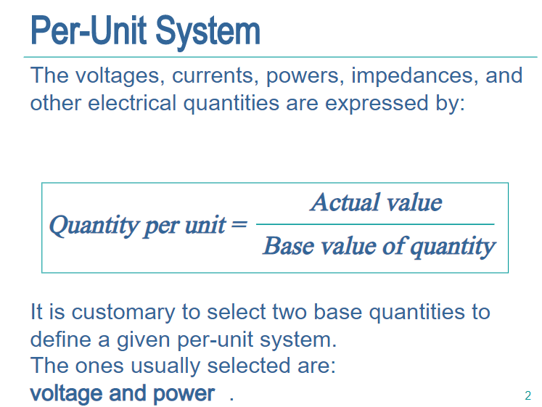
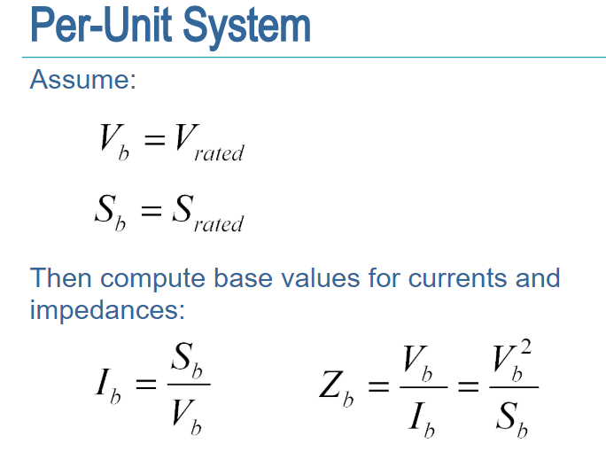
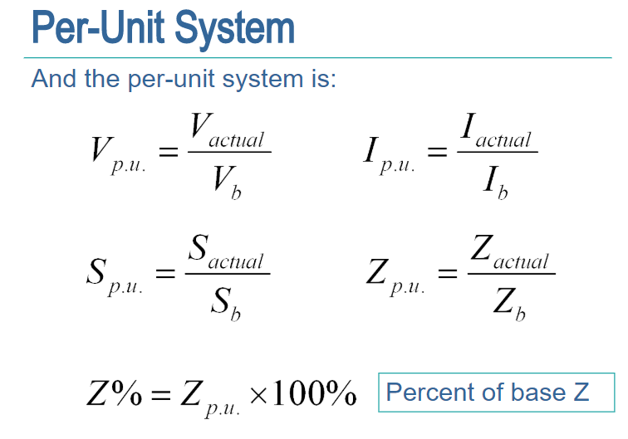

Slide 10
END

