Slide 1

Computational Methods in
Power System Analysis
Lecture-8 Three-phase Unbalanced System
By
Dr. Wazir Muhammad Laghari
Electrical Engineering Department
BUET, Khuzdar

Slide 3
M phase system with neutral present = m number of watt meters
M phase system without neutral = (m-1) number of watt meters
For m wires system m-1 watt meter
M-1 = 4-1 = 3

Slide 4
3 Wattmeter Method

Slide 5
Unbalanced Three Phase System
120 degree
Waveform same magnitude with 120 degree
I same each phase
No current flows in neutral.
Less Power loss
Not 120 degree
Waveform same magnitude change the phase difference
I flows different in each phase
Current flows in neutral.
More Power loss

Slide 6
Heating produces in machines and reduce the overall life of the machine. I²R Losses increase. Neutral required

Slide 7
Given
V = 120V<0, -120⁰, 120⁰

Slide 8
UNBALANCED DELTA-LOAD

Slide 11
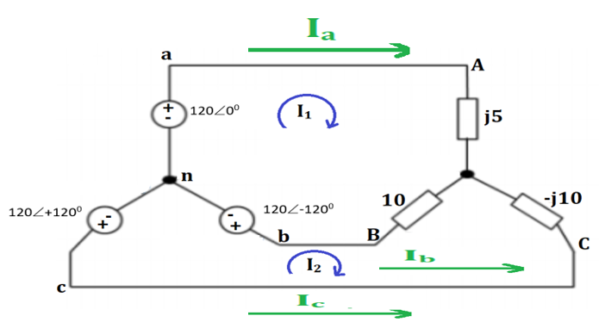
UNBALANCED Y-Y CONNECTION

Slide 15

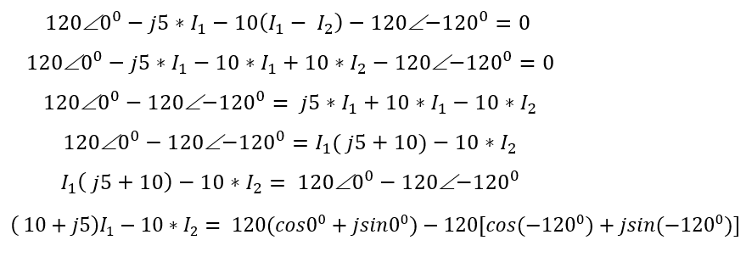
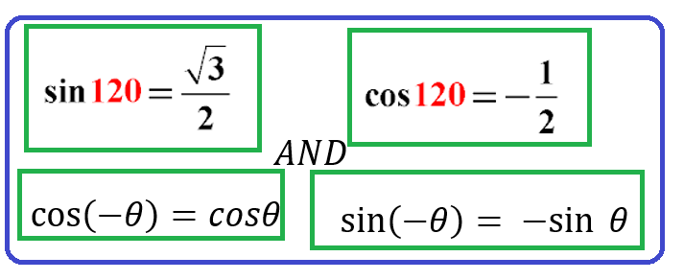
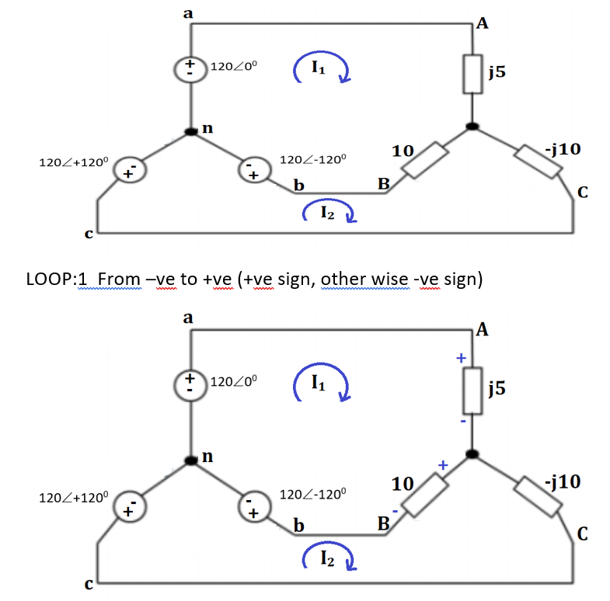


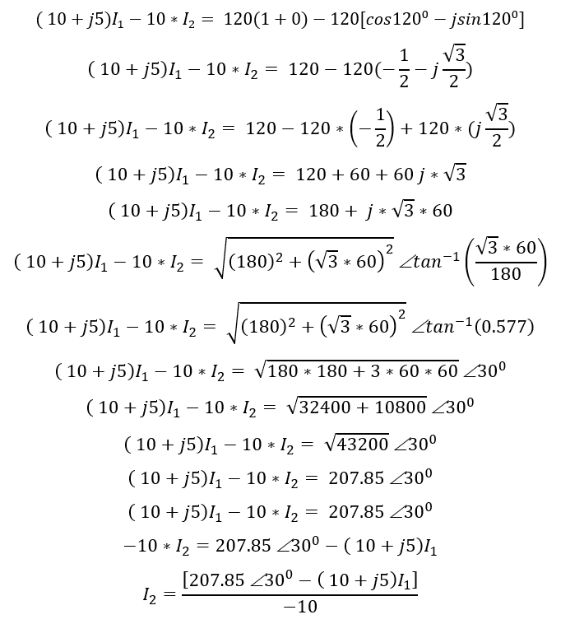
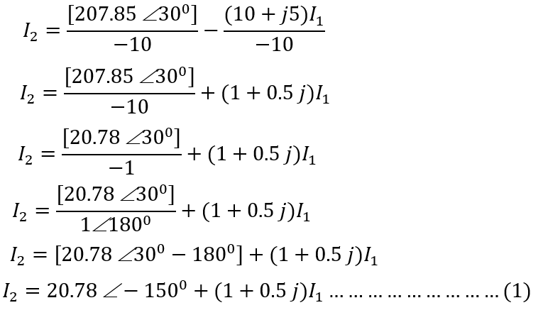
UNBALANCED Y-Y CONNECTION

Slide 16
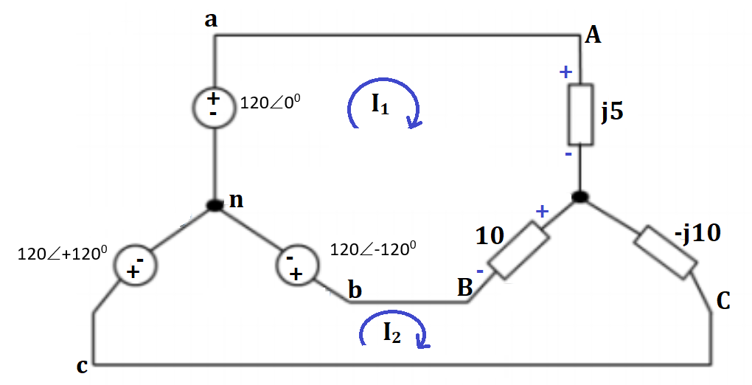
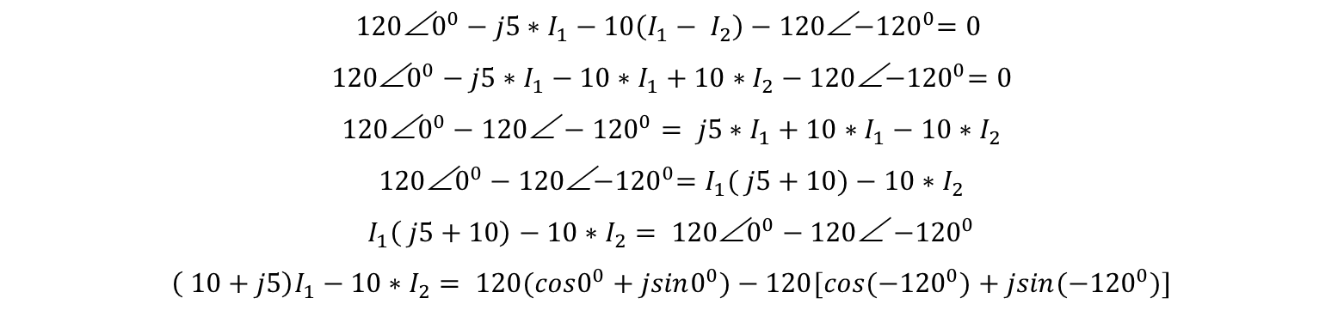

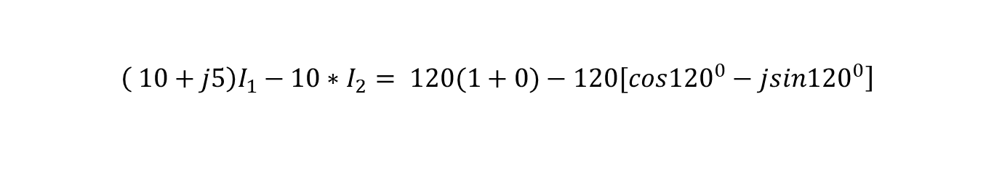
LOOP:1 From –ve to +ve (+ve sign, other wise -ve sign)
$$120\text{∠}0^{0}−j5∗I_{1}−10\left(I_{1}− I_{2}\right)−120\text{∠}{−120}^{0}=0$$
$$120\text{∠}0^{0}−j5∗I_{1}−10∗I_{1}+10∗I_{2}−120\text{∠}{−120}^{0}=0$$
$$120\text{∠}0^{0}−120{\text{∠}−120}^{0}= j5∗I_{1}+10∗I_{1}−10∗I_{2}$$
$$120\text{∠}0^{0}−120\text{∠}{−120}^{0}=I_{1}( j5+10)−10∗I_{2}$$
$$I_{1}\left( j5+10\right)−10∗I_{2}= 120\text{∠}0^{0}−120\text{∠}{−120}^{0}$$
$$\left( 10+j5\right)I_{1}−10∗I_{2}= 120(cos0^{0}+jsin0^{0})−120[cos{(−120}^{0})+jsin(−{120}^{0})]$$
$$\left.\left( 10+j5\right)I_{1}−10∗I_{2}= 120(1+0)−120[cos{120}^{0}−jsin{120}^{0}\right]$$
$$\left.\left( 10+j5\right)I_{1}−10∗I_{2}= 120−120(−\frac{1}{2}−j\frac{\sqrt{3}}{2}\right)$$

Slide 17
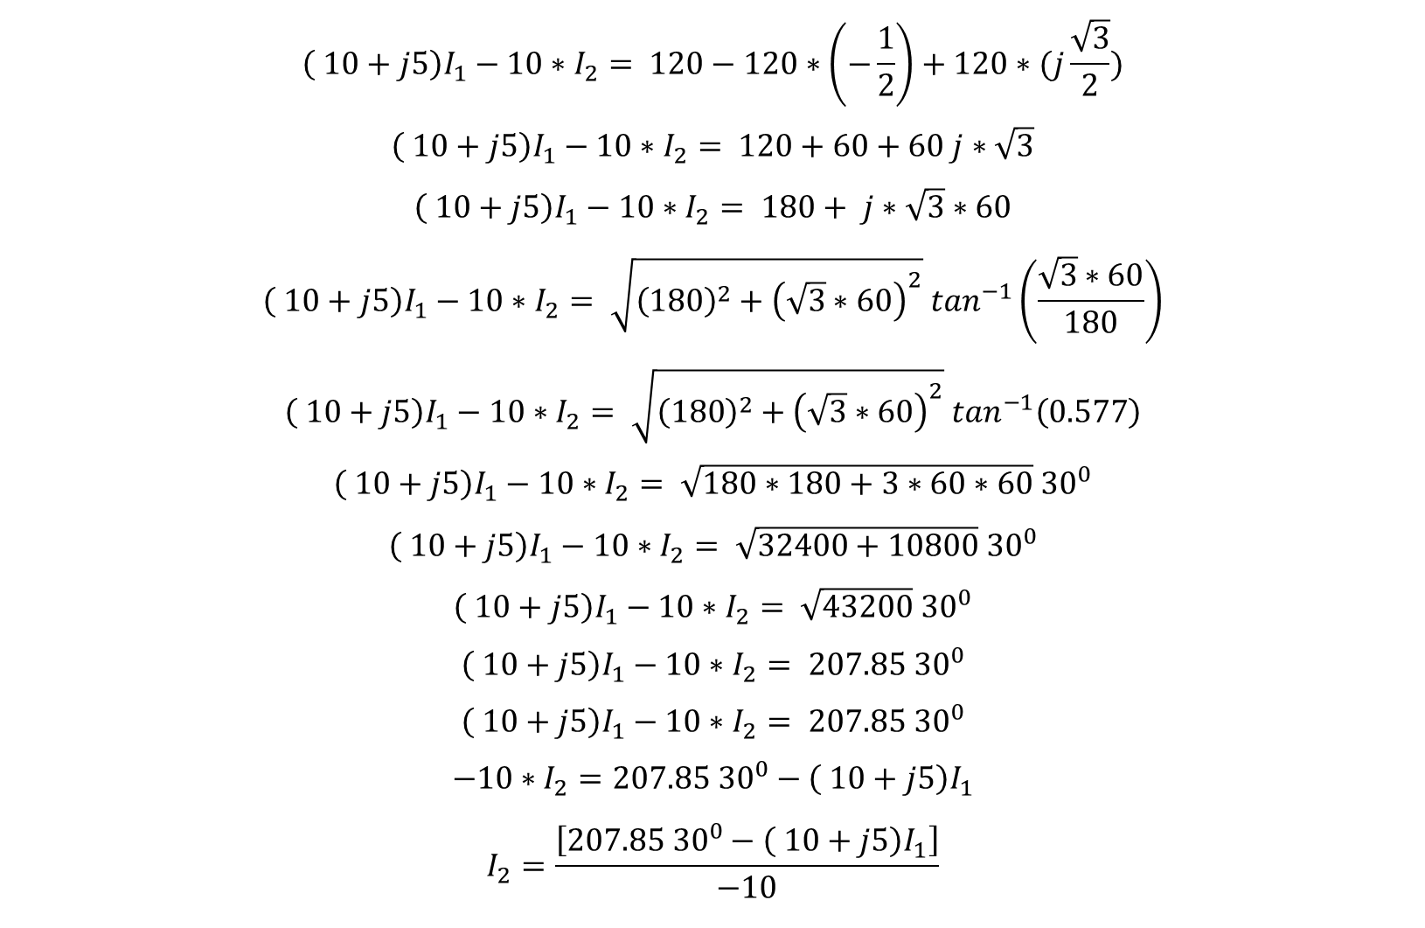
$$\left( 10+j5\right)I_{1}−10∗I_{2}= 120−120∗\left(−\frac{1}{2}\right)+120∗(j\frac{\sqrt{3}}{2})$$
$$\left( 10+j5\right)I_{1}−10∗I_{2}= 120+60+60 j∗\sqrt{3}$$
$$\left( 10+j5\right)I_{1}−10∗I_{2}= 180+ j∗\sqrt{3}∗60$$
$$\left( 10+j5\right)I_{1}−10∗I_{2}= \sqrt{{\left(180\right)}^{2}+{\left(\sqrt{3}∗60\right)}^{2}} \tan^{−1}\left(\frac{\sqrt{3}∗60}{180}\right)$$
$$\left( 10+j5\right)I_{1}−10∗I_{2}= \sqrt{{\left(180\right)}^{2}+{\left(\sqrt{3}∗60\right)}^{2}} \tan^{−1}\left(0.577\right)$$
$$\left( 10+j5\right)I_{1}−10∗I_{2}= \sqrt{180∗180+3∗60∗60} {30}^{0}$$
$$\left( 10+j5\right)I_{1}−10∗I_{2}= \sqrt{32400+10800} {30}^{0}$$
$$\left( 10+j5\right)I_{1}−10∗I_{2}= \sqrt{43200} {30}^{0}$$
$$\left( 10+j5\right)I_{1}−10∗I_{2}= 207.85 {30}^{0}$$
$$\left( 10+j5\right)I_{1}−10∗I_{2}= 207.85 {30}^{0}$$
$$−10∗I_{2}=207.85 {30}^{0}−\left( 10+j5\right)I_{1}$$
$$I_{2}=\frac{\left[207.85 {30}^{0}−\left( 10+j5\right)I_{1}\right]}{−10}$$

Slide 18
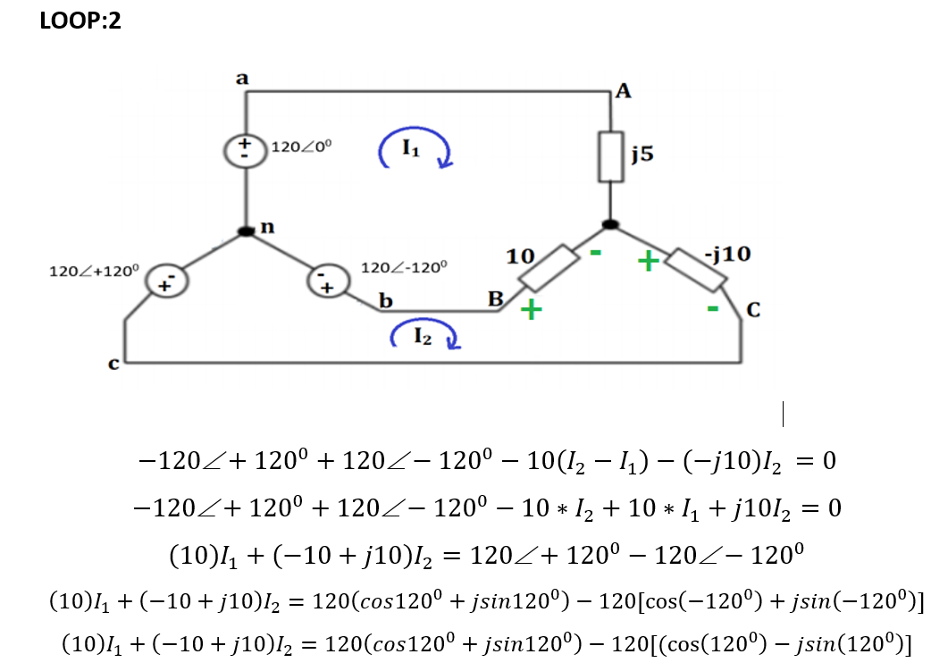
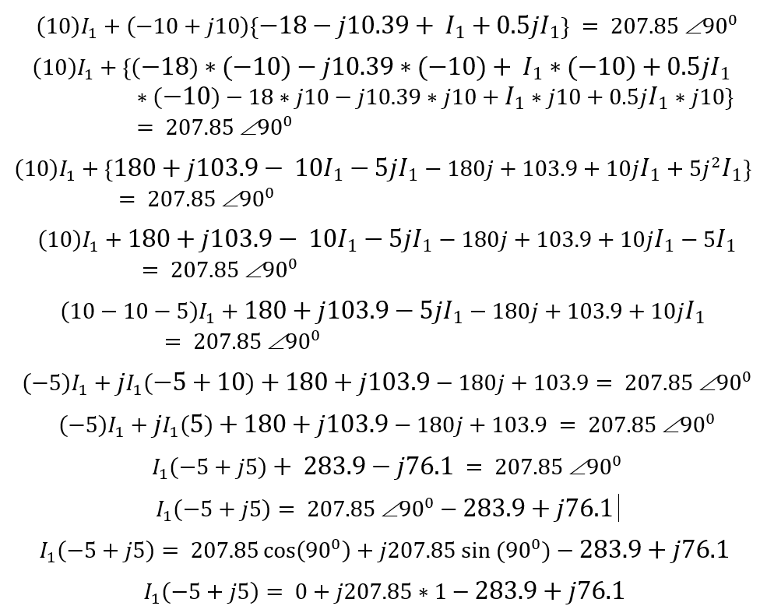
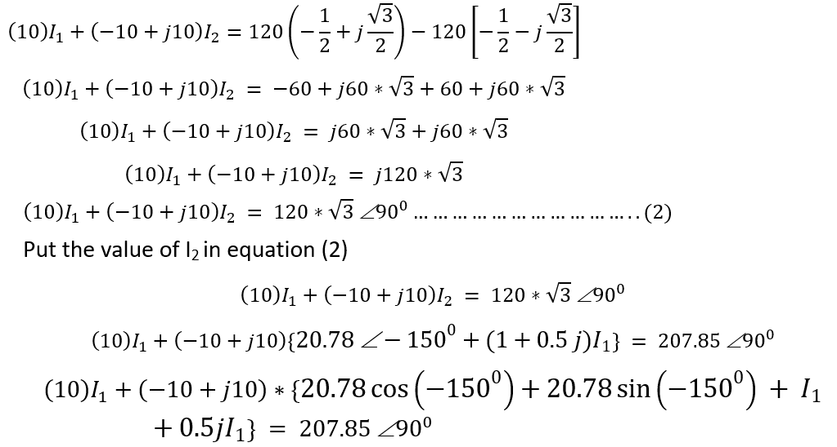
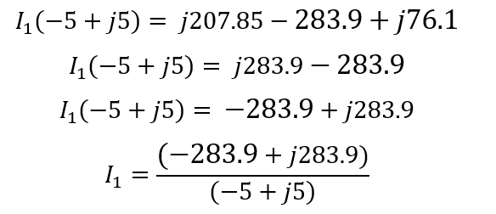
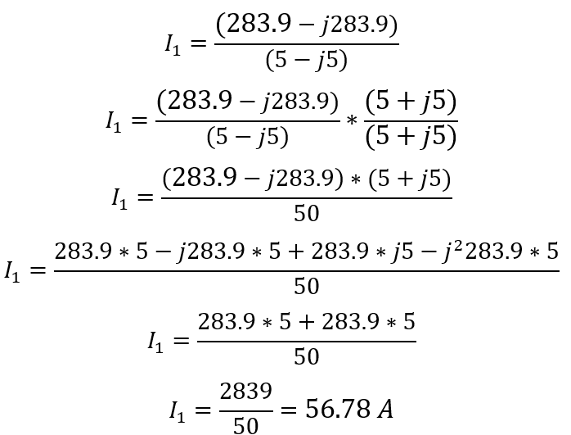

Slide 19
