Slide 1
STATCOM (Static Synchronous Compensator)

Slide 2
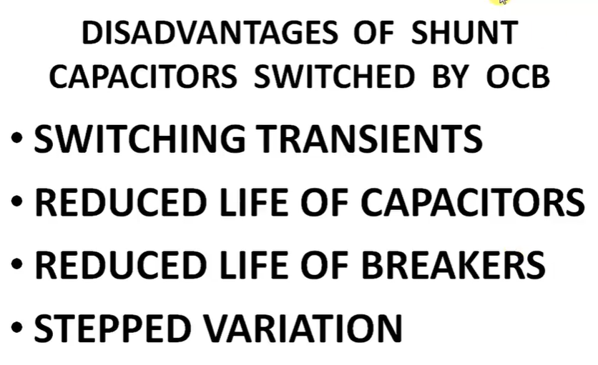
Disadvantages of Shunt Capacitors
Initially shunt capacitor was used.
Shunt capacitor connected with the help of Oil Circuit Breaker (OCB) every time switch is closed than transients are there, because of transient's life of capacitors should be reduced and life of circuit breaker are also reduced.

Slide 3
Basics of STATCOM
In the worldwide due to increasing the complexities in power systems we need to provide stable, secure, controlled, economic, and high-quality power.
It is based on power electronics voltage source converter.
It is either act as a source or sink of reactive AC power to an electrical network.
The most important second-generation FACTS devices are STATCOM, SSSC & UPFC.
These are not Thyristor based but it is a GTOs and IGBTs based devices

Slide 4
STATCOM
The abbreviation of STATCOM is the Static Synchronous Compensator.
It is a member of the Flexible AC Transmission System (FACTS) family of devices.
A Static Synchronous Compensator (STATCOM) is also known as a Static Synchronous Condenser (STATCON).
It is a power electronic device using force commutated devices like IGBT, GTO etc. to control the reactive power flow through a power network and thereby increasing the stability of power network.
STATCOM is a shunt device i.e., it is connected in shunt with the line.
It can absorb or generate the power
The terms Synchronous in STATCOM mean that it can either absorb or generate reactive power in synchronization with the demand to stabilize the voltage of the power network.

Slide 5
Advantages of STATCOM
STATCOM has superior performance in lots of aspect such as:
Responding speed.
Stabilize voltage of power grid.
Control of not only reactive power but also active power in the connected line.
Control the power-oscillation damping in power-transmission systems.
Reduce system power loss.
Reduce the harmonics.
Control the voltage flicker.
Increase the transmission capacity.
Best response to limit the transient voltage.
It also has advantage of smaller in dimension.

Slide 6
Sullivan Substation
Sullivan Substation is next to Fairbanks Mound and is located in Sullivan County, Indiana, United States. Sullivan Substation has a length of 1.12 kilometres.
operator: Indiana Michigan Power Company
power: station
History of STATCOM
The Tennessee Valley Authority (TVA) installed the first 100-MVA STATCOM in 1995 at its Sullivan substation

Slide 7
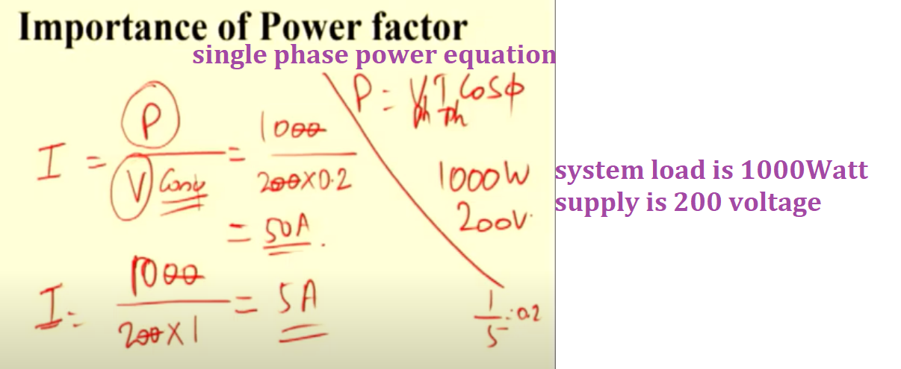
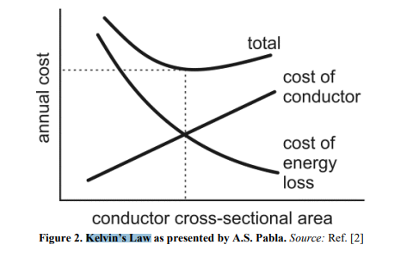

Slide 8
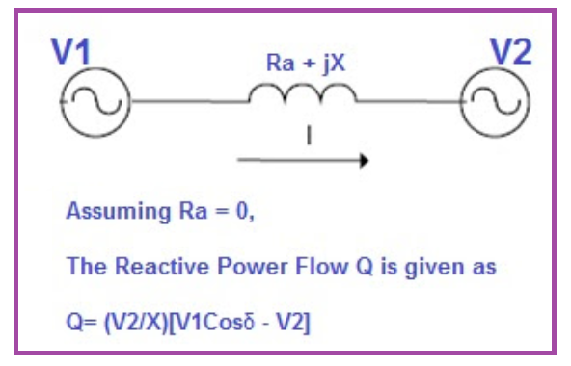

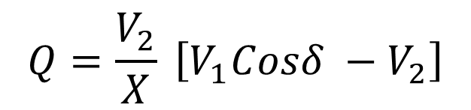
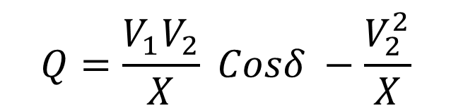

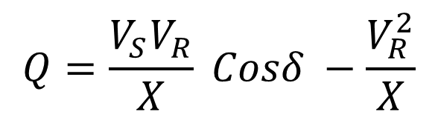
Working Principle of STATCOM
To understand the working principle of STATCOM, we will first have a look at the reactive power transfer equation.
Let us consider two sources V1 and V2 are connected through an impedance Z = Ra + jX as shown in figure below.
$$P=\frac{V_{1}V_{2}}{X} Sinδ$$
$$Q=\frac{V_{1}V_{2}}{X} Cosδ −\frac{V_{2}^{2}}{X}$$
$$P=\frac{V_{S}V_{R}}{X} Sinδ$$
$$Q=\frac{V_{2}}{X} \left[V_{1}Cosδ −V_{2}\right]$$
$$Q=\frac{V_{S}V_{R}}{X} Cosδ −\frac{V_{R}^{2}}{X}$$

Slide 9
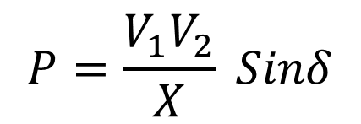
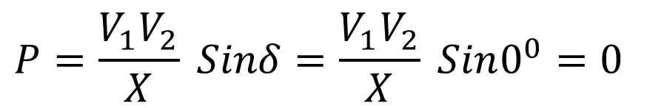
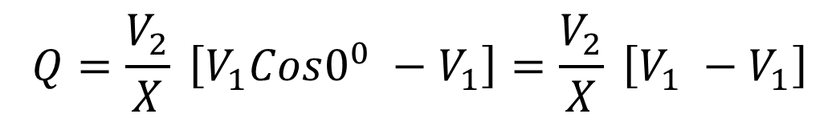
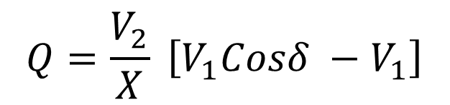
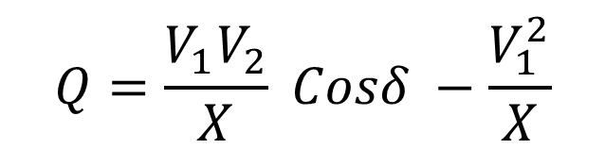
Working Principle of STATCOM
$$P=\frac{V_{1}V_{2}}{X} Sinδ$$
$$Q=\frac{V_{1}V_{2}}{X} Cosδ −\frac{V_{1}^{2}}{X}$$
$$Q=\frac{V_{2}}{X} \left[V_{1}Cosδ −V_{1}\right]$$
In the above reactive power flow equation, angle δ is the angle between V1 and V2. Thus, if we maintain angle δ = 0 then Reactive power flow will become
$$Q=\frac{V_{2}}{X} \left[V_{1}Cos0^{0} −V_{1}\right]=\frac{V_{2}}{X} \left[V_{1} −V_{1}\right]$$
$$P=\frac{V_{1}V_{2}}{X} Sinδ=\frac{V_{1}V_{2}}{X} Sin0^{0}=0$$

Slide 10
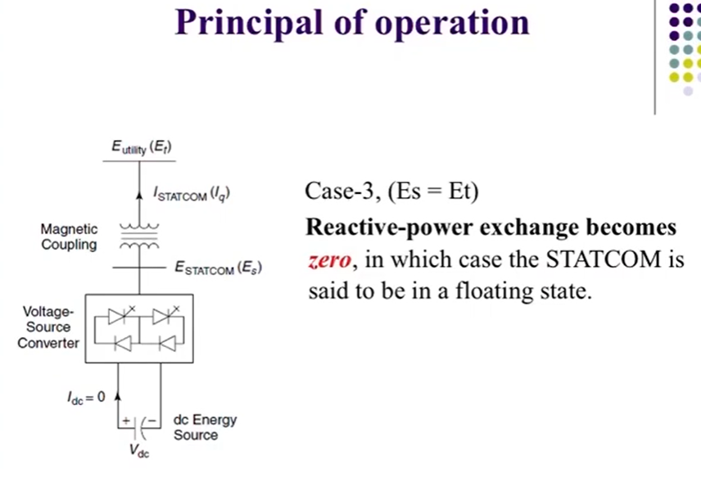
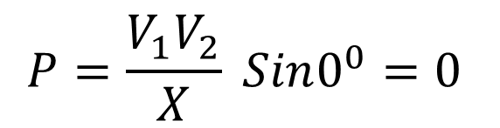
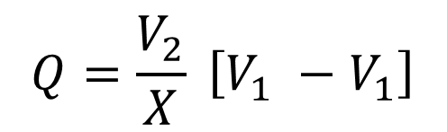
Working Principle of STATCOM
$$P=\frac{V_{1}V_{2}}{X} Sin0^{0}=0$$
$$Q=\frac{V_{2}}{X} \left[V_{1} −V_{1}\right]$$
To summarize, we can say that if the angle between V1 and V2 is zero, the flow of active power becomes zero and the flow of reactive power depends on (V1 – V2).
Thus, for flow of reactive power there are two possibilities.
1) If the magnitude of V1 is more than V2, then reactive power will flow from source V1 to V2.
2) If the magnitude of V2 is more than V1, reactive power will flow from source V2 to V1.
This principle is used in STATCOM for reactive power control.

Slide 11
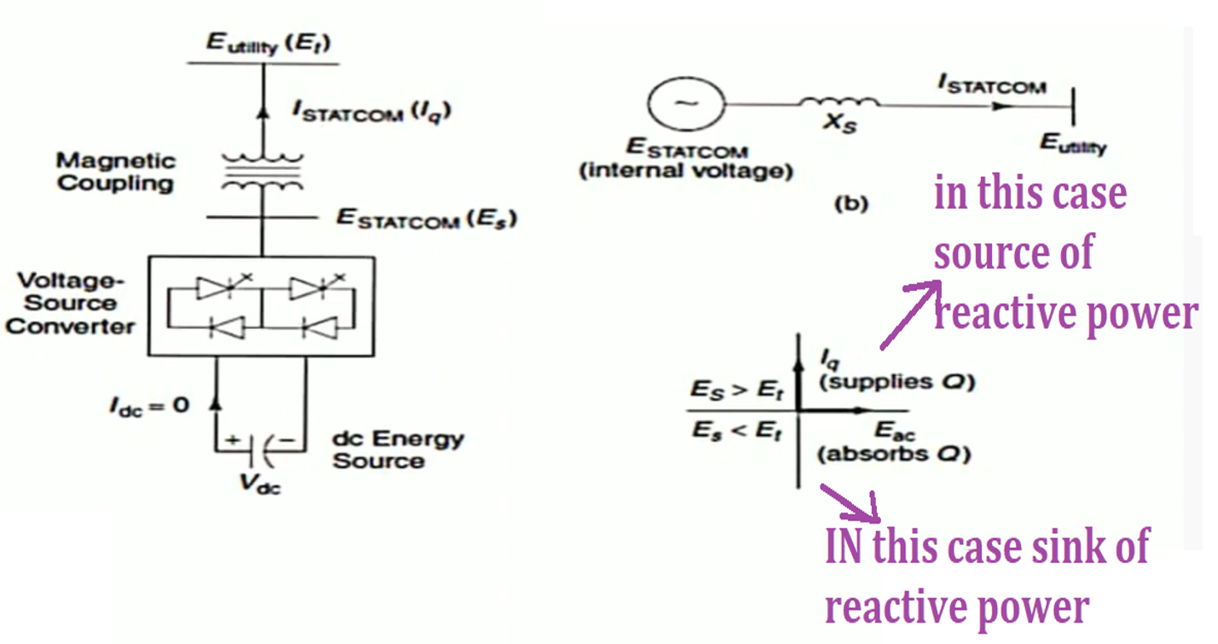
Working Principle of STATCOM
It is a utility voltage or Et is the basically transmission voltage or grid voltage.
Here is the STATCOM current Iq and magnetic coupling or small reactance coupling just connecting the synchronous compensator.
This is voltage source converter.
Here is the DC energy source in most cases capacitor bank is the DC energy source. It can be represented as ESTATCOM internal voltage it is connected to reactance Xs current Istatcom flowing and providing the utility voltages.
STATCOM Voltage is greater than transmission line voltage( Es>Et) it supplies the reactive power. STATCOM voltage Es is less than the Utility voltage E utility than absorb the reactive power.

Slide 12
Design of STATCOM
STATCOM has the following components:
1) A Voltage Source Converter, VSC
The voltage-source converter is used to convert the DC input voltage to an AC output voltage. Two of the common VSC types are as below.
a) Square-wave Inverters using Gate Turn-Off Thyristors: In this type of VSC, output AC voltage is controlled by changing the DC capacitor input voltage, as the fundamental component of the converter output voltage is proportional to the DC voltage.
b) PWM Inverters using Insulated Gate Bipolar Transistors (IGBT): It uses Pulse Width Modulation (PWM) technique to create a sinusoidal waveform from a DC voltage source with a typical chopping frequency of a few kHz. In contrast to the GTO-based type, the IGBT-based VSC utilizes a fixed DC voltage and varies its output AC voltage by changing the modulation index of the PWM modulator.

Slide 13
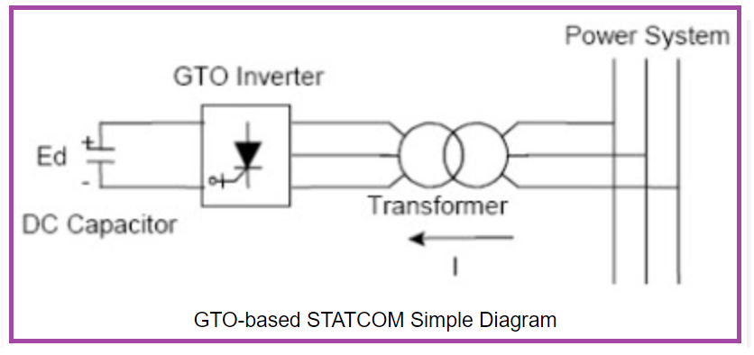
1) First Component
VSC
(Voltage Source Converter)
O/P
AC Voltage
I/P
DC Voltage
Types of
VSC
Square wave inverter using GTO (Gate turn-off thyristor)
PWM inverter using IGBT (insulated-gate bipolar transistor)

Slide 14
2) DC Capacitor
It is used constant DC voltage to VSC.
This component provides the DC voltage for the inverter

Slide 15
3) Inductive Reactance
It is connected in between power system and VSC.
It is similar as a transformer.
Its main function is to neutralize the harmonics contained in a square wave.
It connects the inverter output to the power system. This is usually the leakage inductance of a coupling transformer.

Slide 16
4) Harmonic Filter
The main purpose of harmonic filter is used to reduce the number of harmonics. OR
Mitigate harmonics and other high frequency components due to the inverters.

Slide 17
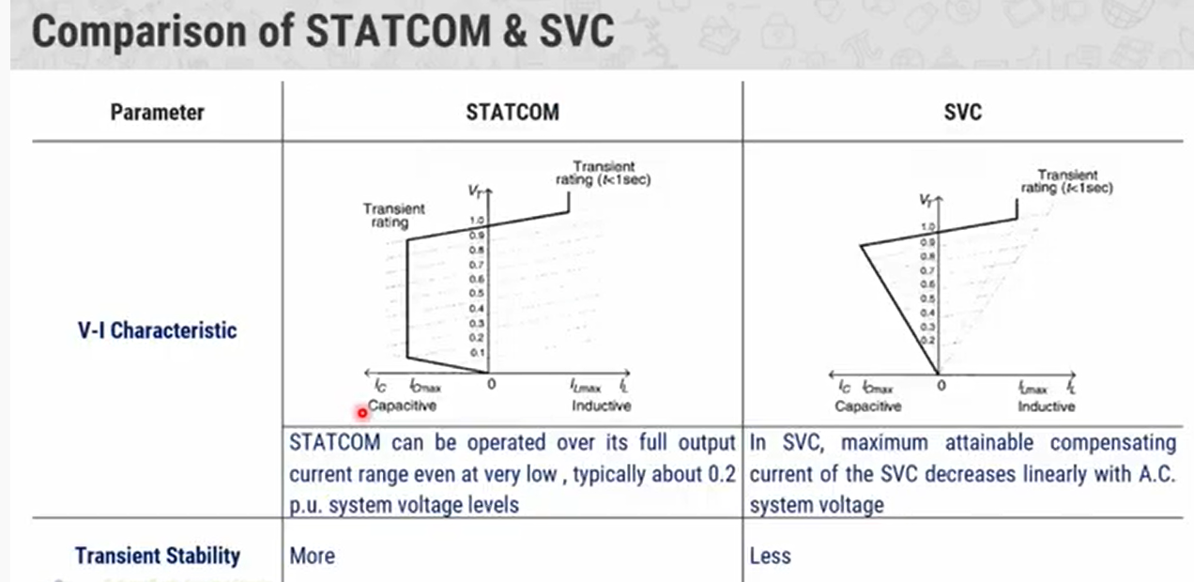
STATCOM is much more better than SVC

Slide 18
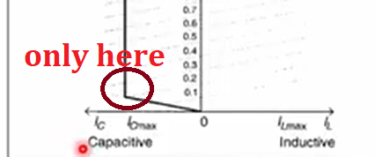
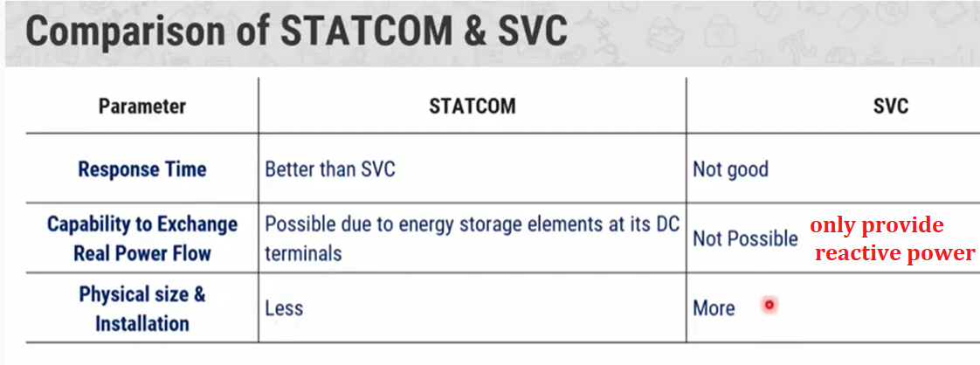
Comparison of STATCOM and SVC
This is the VI characteristics of STATCOM and SVC
Right portion is inductive and left portion is capacitive.
Y-axis is the voltage across the compensator and x-axis is the current to the compensator.
The point of comparison b/w STATCOM and SVC is only here.
You can see here even 0.2 per unit voltage, the STATCOM can provide the rated capacity

Slide 19
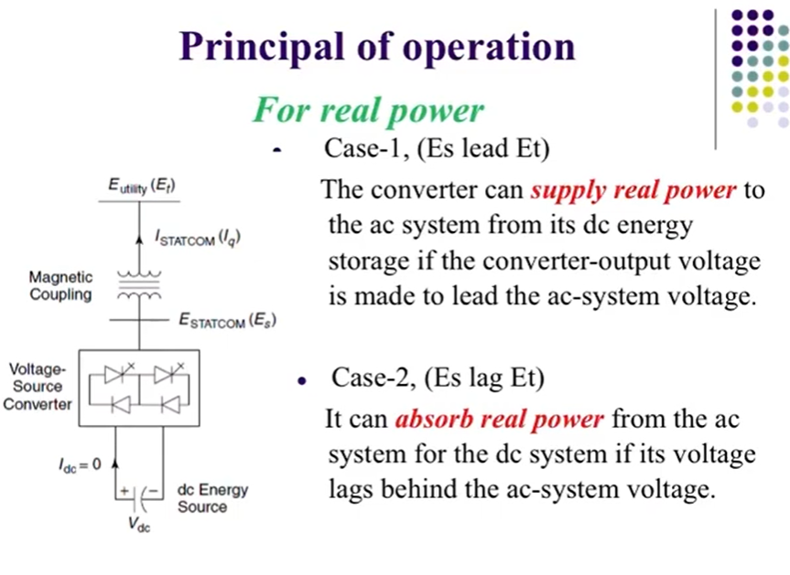

Slide 20
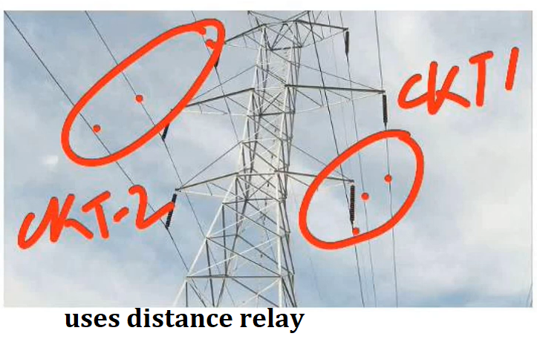
Mutual Compensation in Transmission Lines

