Slide 1
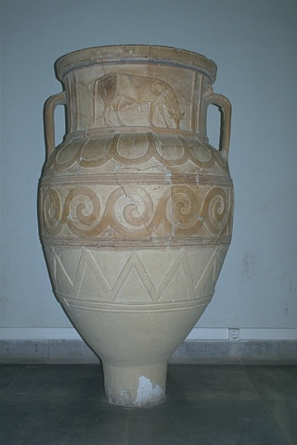
3 × 3
LR
ResNet-2
ResNet-1
ResNet-3
3 × 3
3 × 3
3 × 3
5 × 5
Conv-2
Concat
Conv-1
LReLU-2
LReLU-1
LReLU-3
Conv-3
7 × 7
HR
1 × 1
1 × 1
Deconvolution

