Slide 1
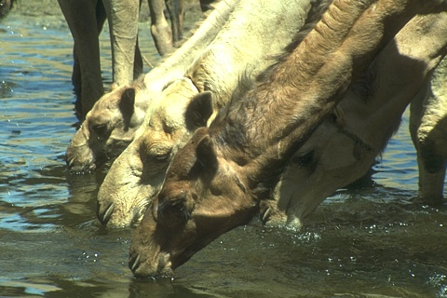
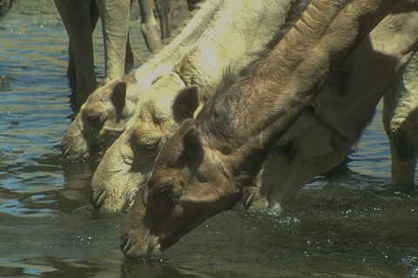
HR
LR
Bicubic
HR
(a) SRCNN
LR
Bicubic
(b) DRCN
HR
LR
…
Bicubic
(c) VDSR

Slide 2
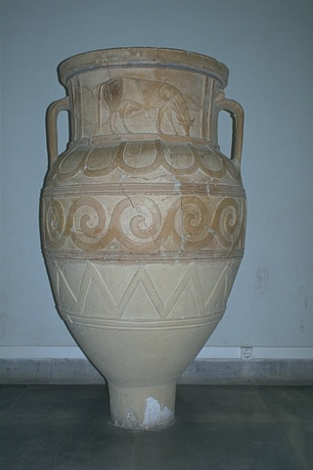
3 × 3
LR
ResNet-2
ResNet-1
ResNet-3
3 × 3
3 × 3
3 × 3
5 × 5
Conv-2
Concat
Conv-1
LReLU-2
LReLU-1
LReLU-3
Conv-3
7 × 7
HR
1 × 1
1 × 1
Deconvolution

Slide 3
BN
BN
ReLU
(a) Original ResNet Block
Conv
ReLU
Conv
Conv
BN
Conv
BN
(b) SR ResNet Block
ReLU
Conv
LReLU
Conv
LReLU
Conv
LReLU
Conv
LReLU
(c) Proposed Block

Slide 4
Filter concatenation
Filter concatenation
3×3
Convolution
5×5
Convolution
1×1
Convolution
1×1
Convolution
3×3
Convolution
5×5
Convolution
1×1
Convolution
1×1
Convolution
1×1
Convolution
3×3
max pooling
LReLU
LReLU
LReLU
Previous layer
Previous layer
(a)
(b)

