Slide 1
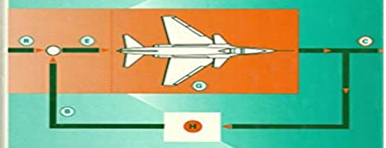
SECOND-WEEK
Dr. Wazir Muhammad
Electrical Engineering Department
BUET, Khuzdar

Slide 2
First Week | Modeling of electrical, mechanical and biological control systems, Open and closed-loop systems
Second Week | Block diagrams, Second order systems, Step and impulse response, Performance criteria, Steady state error.
Third Week | Sensitivity, s-plane system stability.
Fourth Week | Test-1
Fifth Week | Analysis and design with the root loci method.
Sixth week | Frequency domain analysis,
Seventh week | Bode plots,
Eight week | Nyquist criterion,
Ninth week | gain and phase margins,
Tenth week | Nichols charts.
Eleventh week | Test-2
Twelfth week | The State-space method
Thirteenth week | state equations,
Fourteenth week | flow graphs, stability
Sixteenth week | compensation techniques.

Slide 3
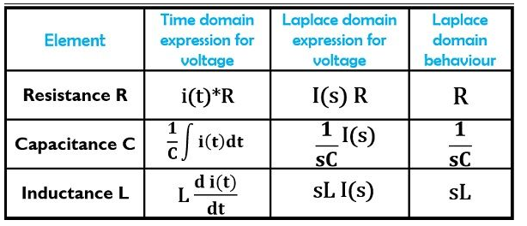
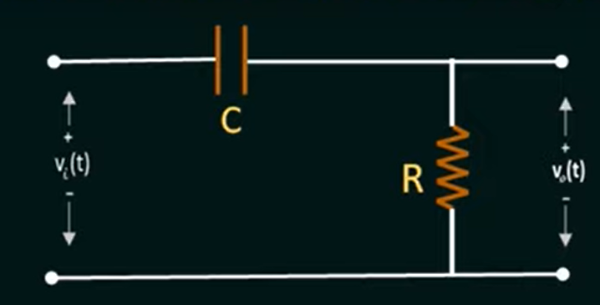
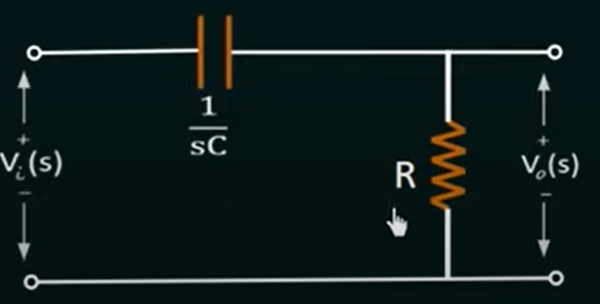
Find the Transfer Function of CR Circuit
Convert Time Domain CKT into S-Domain

Slide 4

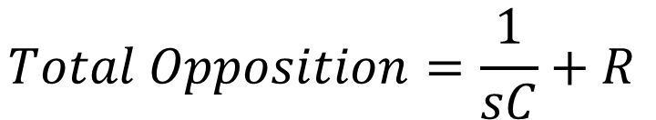
Find the Transfer Function of RC Circuit
$$Total Opposition=\frac{1}{sC}+R$$
$$Volatge Acroos R, we used VDSR V_{o}\left(s\right)=\frac{V_{i}\left(s\right) ∗R}{Total Opposition}$$
$$V_{o}\left(s\right)=\frac{V_{i}\left(s\right) ∗R}{\frac{1}{sC}+R}$$

Slide 5
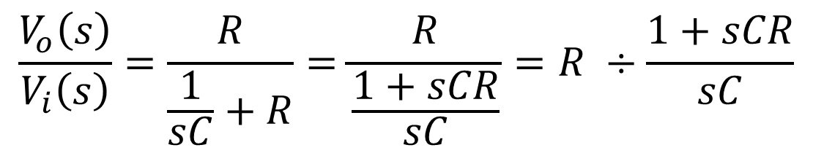
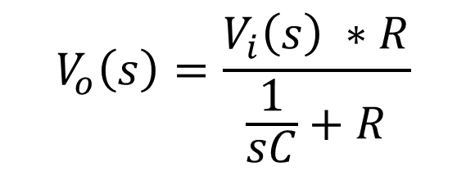
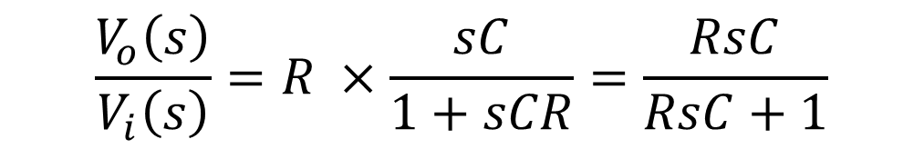
Find the Transfer Function of RC Circuit
$$V_{o}\left(s\right)=\frac{V_{i}\left(s\right) ∗R}{\frac{1}{sC}+R}$$
$$\frac{V_{o}\left(s\right)}{V_{i}\left(s\right)}=\frac{R}{\frac{1}{sC}+R}=\frac{R}{\frac{1+sCR}{sC}}=R ÷\frac{1+sCR}{sC}$$
$$\frac{V_{o}\left(s\right)}{V_{i}\left(s\right)}=R ×\frac{sC}{1+sCR}=\frac{RsC}{RsC+1}$$
$$Transfer Function=H\left(s\right)=\frac{Output}{Input}=\frac{V_{o}\left(s\right)}{V_{i}\left(s\right)}=R ×\frac{sC}{1+sCR}=\frac{RsC}{RsC+1}$$

Slide 6
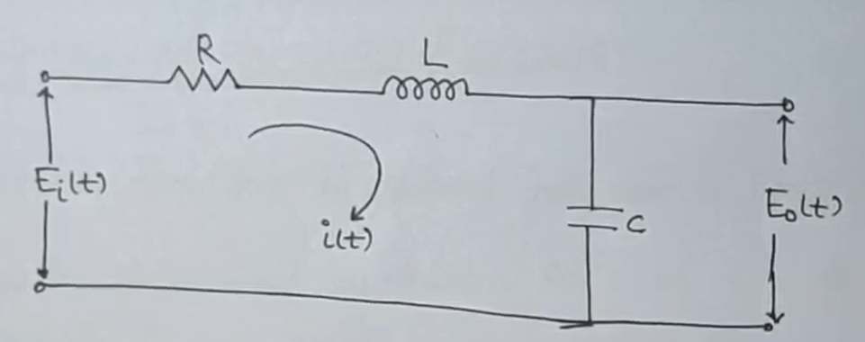
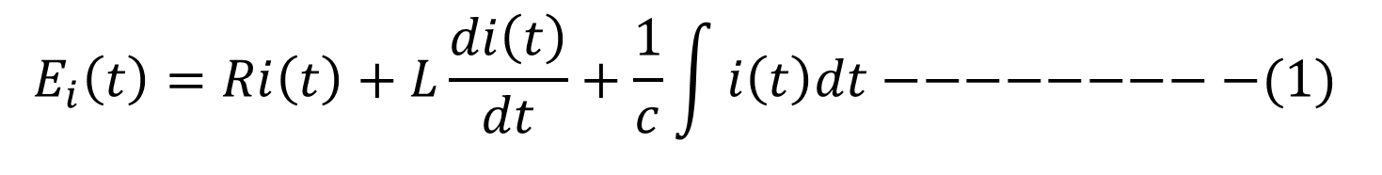
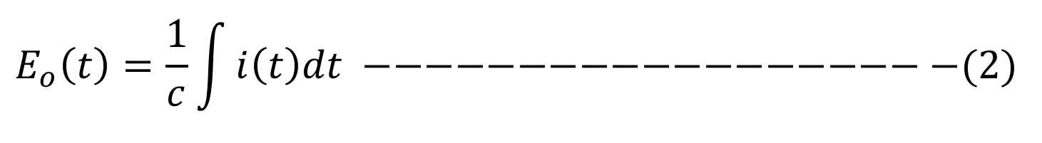
Find the Transfer Function of RLC Circuit
$$E_{i}\left(t\right)=Ri\left(t\right)+L\frac{di\left(t\right)}{dt}+\frac{1}{c}\int{i\left(t\right)dt−−−−−−−−−(1)}$$
$$E_{o}\left(t\right)=\frac{1}{c}\int{i\left(t\right)dt} −−−−−−−−−−−−−−−−−−−(2)$$

Slide 7
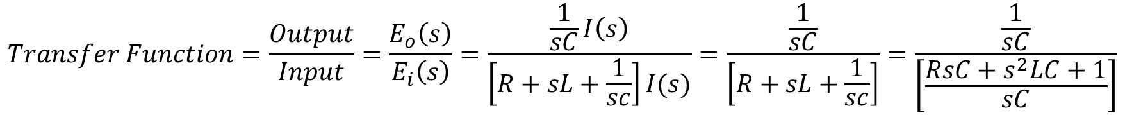
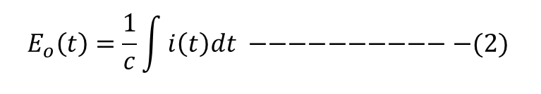
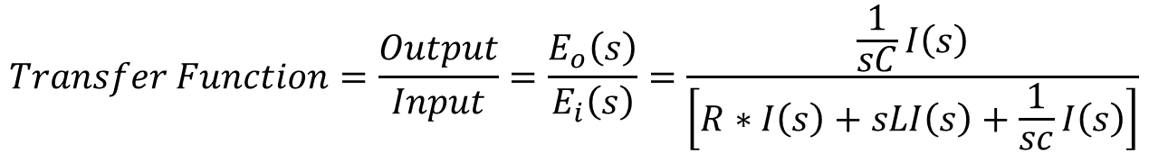
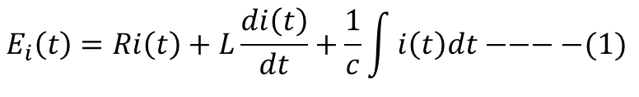
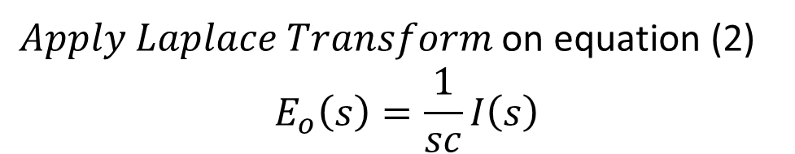
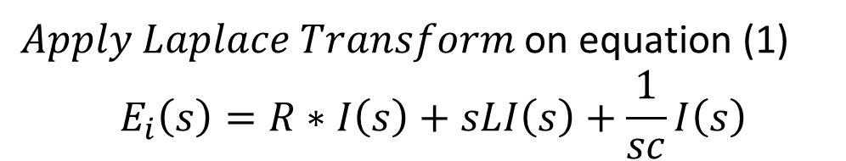
Find the Transfer Function of RLC Circuit
$Apply Laplace Transform$ on equation (1)
$$E_{i}\left(s\right)=R∗I\left(s\right)+sLI\left(s\right)+\frac{1}{sc}I\left(s\right)$$
$Apply Laplace Transform$ on equation (2)
$$E_{o}\left(s\right)=\frac{1}{sc}I\left(s\right)$$
$$E_{i}\left(t\right)=Ri\left(t\right)+L\frac{di\left(t\right)}{dt}+\frac{1}{c}\int{i\left(t\right)dt−−−−(1)}$$
$$E_{o}\left(t\right)=\frac{1}{c}\int{i\left(t\right)dt} −−−−−−−−−−−(2)$$
$$Transfer Function=\frac{Output}{Input}=\frac{E_{o}\left(s\right)}{E_{i}\left(s\right)}=\frac{\frac{1}{sC}I\left(s\right)}{\left[R∗I\left(s\right)+sLI\left(s\right)+\frac{1}{sc}I\left(s\right)\right]}$$
$$Transfer Function=\frac{Output}{Input}=\frac{E_{o}\left(s\right)}{E_{i}\left(s\right)}=\frac{\frac{1}{sC}I\left(s\right)}{\left[R+sL+\frac{1}{sc}\right]I(s)}=\frac{\frac{1}{sC}}{\left[R+sL+\frac{1}{sc}\right]}=\frac{\frac{1}{sC}}{\left[\frac{RsC+s^{2}LC+1}{sC}\right]}$$

Slide 8
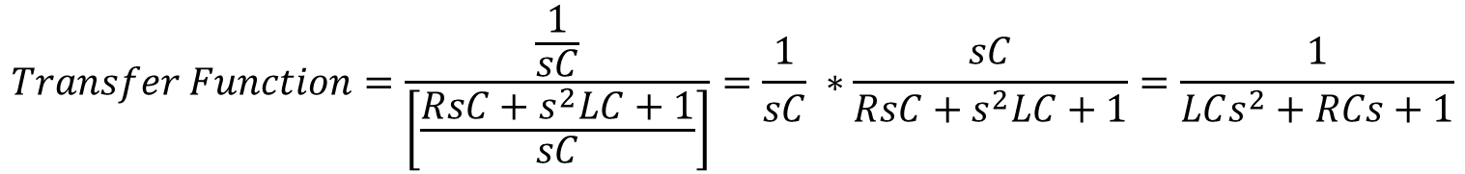
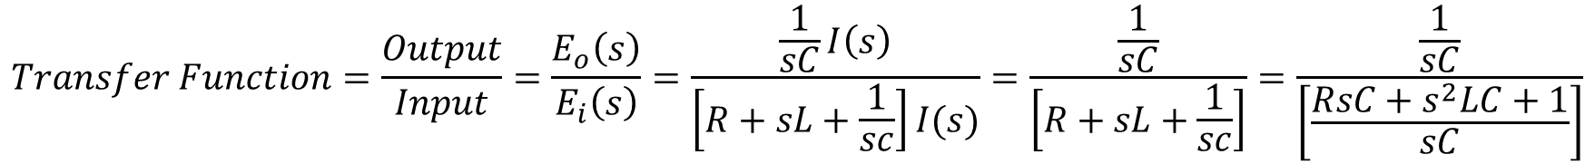
Find the Transfer Function of RLC Circuit
$$Transfer Function=\frac{Output}{Input}=\frac{E_{o}\left(s\right)}{E_{i}\left(s\right)}=\frac{\frac{1}{sC}I\left(s\right)}{\left[R+sL+\frac{1}{sc}\right]I(s)}=\frac{\frac{1}{sC}}{\left[R+sL+\frac{1}{sc}\right]}=\frac{\frac{1}{sC}}{\left[\frac{RsC+s^{2}LC+1}{sC}\right]}$$
$$Transfer Function=\frac{\frac{1}{sC}}{\left[\frac{RsC+s^{2}LC+1}{sC}\right]}=\frac{1}{sC} ∗\frac{sC}{{RsC+s}^{2}LC+1}=\frac{1}{LCs^{2}+RCs+1}$$

Slide 9
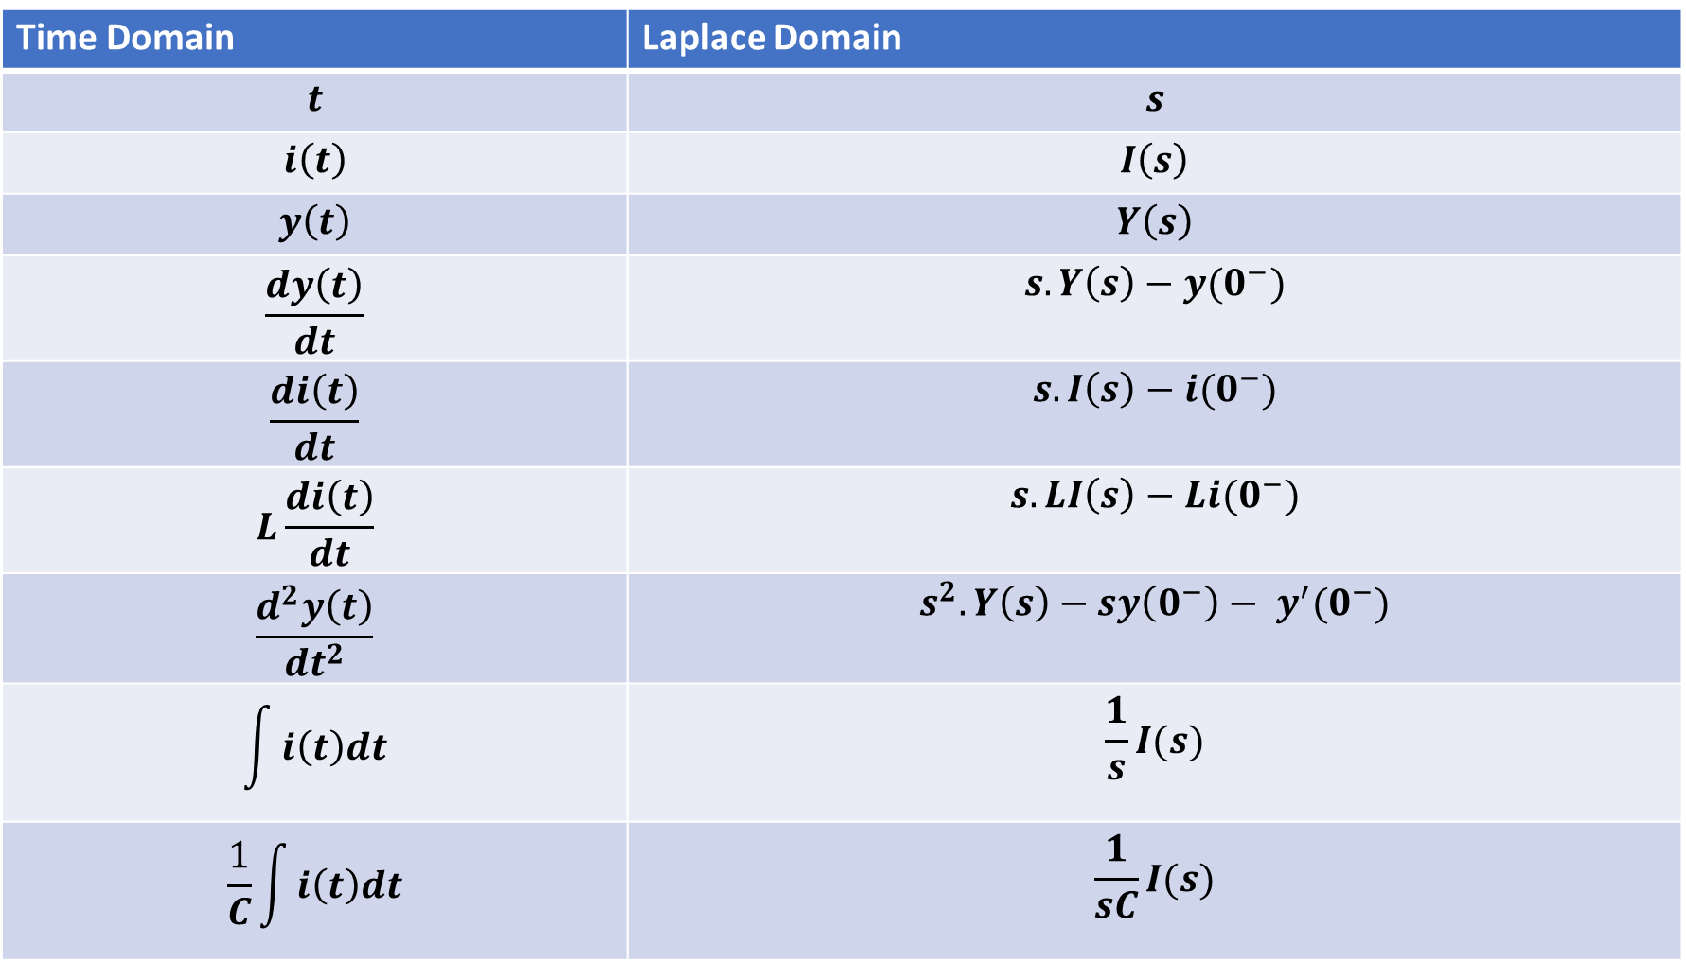
TABLE OF LAPLACE TRANSFORM
Time Domain | Laplace Domain
$$t$$ | $$s$$
$$i\left(t\right)$$ | $$I\left(s\right)$$
$$y\left(t\right)$$ | $$Y\left(s\right)$$
$$\frac{dy\left(t\right)}{dt}$$ | $$s.Y\left(s\right)−y(0^{−})$$
$$\frac{di\left(t\right)}{dt}$$ | $$s.I\left(s\right)−i(0^{−})$$
$$L\frac{di\left(t\right)}{dt}$$ | $$s.LI\left(s\right)−Li(0^{−})$$
$$\frac{d^{2}y\left(t\right)}{{dt}^{2}}$$ | $$s^{2}.Y\left(s\right)−sy\left(0^{−}\right)− y^{′}(0^{−})$$
$$\int{i\left(t\right)dt}$$ | $$\frac{1}{s}I(s)$$
$$\frac{1}{C}\int{i\left(t\right)dt}$$ | $$\frac{1}{sC}I(s)$$

Slide 10
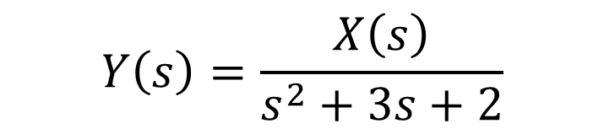

Find The Transfer Function
Example: Find the Transfer Function of the System is given by:
$$\frac{d^{2}y\left(t\right)}{{dt}^{2}} +3.\frac{dy\left(t\right)}{dt}+2.y\left(t\right)=x\left(t\right) where:x\left(t\right)is the input \& y\left(t\right)is the output$$
Solution:
$$s^{2}.Y\left(s\right)−y\left(0^{−}\right)− y^{′}\left(0^{−}\right)+3.\left[s.Y\left(s\right)−y\left(0^{−}\right)\right]+2.Y\left(s\right)=X(s)$$
All initial conditions are zero
$$s^{2}.Y\left(s\right)+3s.Y\left(s\right) +2.Y\left(s\right)=X(s)$$
$${Y\left(s\right)[s}^{2}+3s +2] = X(s)$$
$$Y\left(s\right)=\frac{X\left(s\right)}{s^{2}+3s+2}$$
$$Transfer Function=\frac{Output}{Input}= \frac{Y\left(s\right)}{X(s)}=\frac{1}{s^{2}+3s+2} −−−Answer$$

Slide 11
Proper Transfer Function
A Transfer Function having Numerator Degree is less than or equal to Denominator (N ≤ D), than such type of Transfer Function is called as Proper Transfer Function.
$$H\left(s\right)=\frac{1}{(s+2)(s+3)} −−−−−−−−−\left(N<D\right)−−−It is Proper T.F$$
$$H\left(s\right)=\frac{s^{2}+1}{{2s}^{2}+5} −−−−−−−−−−(N≤D)−−−−−−It is Proper T.F$$

Slide 12
Strictly Proper Transfer Function
A Transfer Function having Numerator Degree is only less than Denominator (N < D), than such type of Transfer Function is called as Proper Transfer Function.
$$H\left(s\right)=\frac{s}{{3s}^{2}+4} −−−−−−−−−\left(N<D\right)−−−It is Strictly Proper T.F$$

Slide 13
Improper OR Not Proper Transfer Function
A Transfer Function having Numerator Degree is greater than Denominator (N>D), than such type of Transfer Function is called as Improper Transfer Function.
$$H\left(s\right)=\frac{{3s}^{2}+7}{s^{2}+2} −−−−−−−−−−(N>D)−−−−−It is Improper T.F$$

Slide 14
Poles And Zeros Of Transfer Function
Zeros: Zeros of a Transfer Function are the frequencies (values of s) for which the numerator of the transfer function becomes zero.
Poles: Poles of a Transfer Function are the frequencies (values of s) for which the denominator of the transfer function becomes zero.

Slide 15

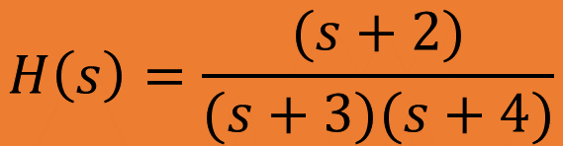
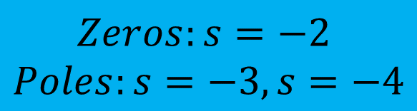
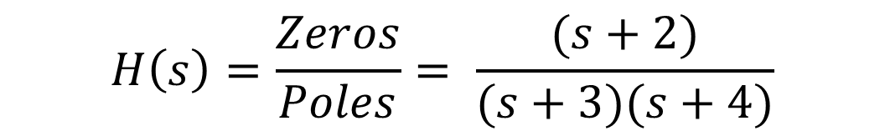
Q: Find the Poles And Zeros Of Transfer Function
$$H\left(s\right)=\frac{(s+2)}{(s+3)(s+4)}$$
$$Solution:$$
$$H\left(s\right)=\frac{Zeros}{Poles}= \frac{(s+2)}{(s+3)(s+4)}$$
$$Zeros:s=−2$$
$$Poles:s=−3, s=−4$$

Slide 16
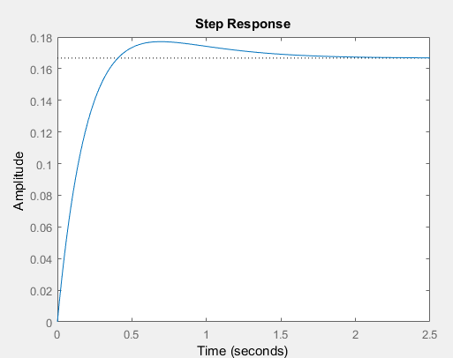
Q: Write the MATLAB Code Of Transfer Function
$$H\left(s\right)=\frac{(s+2)}{(s+3)(s+4)}$$
$$Solution:$$
$$H\left(s\right)=\frac{Zeros}{Poles}= \frac{(s+2)}{(s+3)(s+4)}=\frac{(s+2)}{(s^{2}+3s+4s+12)}=\frac{(s+2)}{(s^{2}+7s+12)}$$
>> numerator = [1 2];
>> denominator = [1 7 12];
>> sys = tf(numerator, denominator)
sys =
s + 2
--------------
s^2 + 7 s + 12
Continuous-time transfer function.
plot(sys)

Slide 17
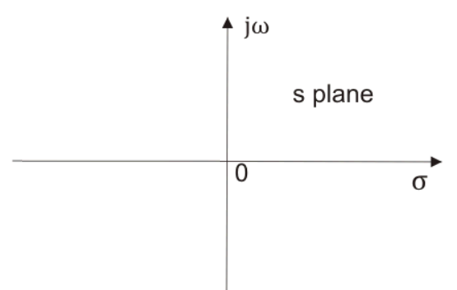
Pole-Zero Diagram
Plot on s-plane which represents the location of Poles and Zeros of a Transfer Function is called as Pole-Zero Diagram.
Poles are represented by ×
Zeros are represented by
X-axis is sigma-axis (real part of x)
Y-axis is the jω-axis which is the imaginary part of x

Slide 18
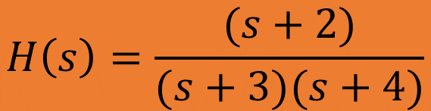

Q: Find the Poles And Zeros Of Transfer Function and Draw the Pole – Zero Diagram
$$H\left(s\right)=\frac{(s+2)}{(s+3)(s+4)}$$
$$Solution:$$
$$H\left(s\right)=\frac{Zeros}{Poles}= \frac{(s+2)}{(s+3)(s+4)}$$
$$Zeros:s=−2$$
$$Poles:s=−3, s=−4$$

Slide 19
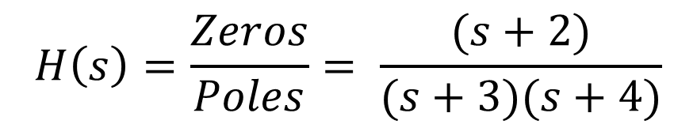
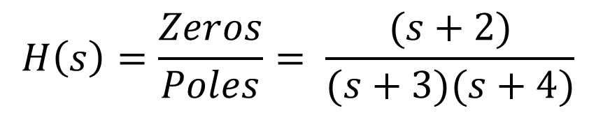

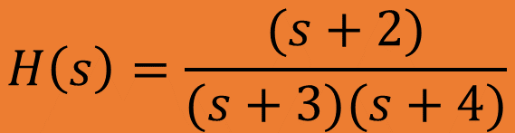


Q: Find the Poles And Zeros Of Transfer Function and Draw the Pole – Zero Diagram
$$jσ$$
$$H\left(s\right)=\frac{(s+2)}{(s+3)(s+4)}$$
$$H\left(s\right)=\frac{Zeros}{Poles}= \frac{(s+2)}{(s+3)(s+4)}$$
$$−σ$$
$$σ$$
-5 -4 -3 -2 -1
1 2 3 4 5
$$H\left(s\right)=\frac{Zeros}{Poles}= \frac{(s+2)}{(s+3)(s+4)}$$
$$Zeros:s=−2$$
$$Poles:s=−3, s=−4$$
$$−jσ$$

Slide 20



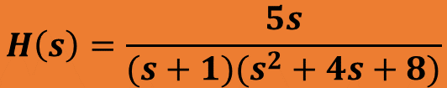
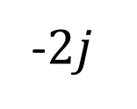


Q: Find the Poles And Zeros Of Transfer Function and Draw the Pole – Zero Diagram
$$jσ$$
$$H\left(s\right)=\frac{5s}{(s+1)(s^{2}+4s+8)}$$
$$2j$$
$$j$$
$$H\left(s\right)=\frac{Zeros}{Poles}= \frac{5s}{(s+1)(s^{2}+4s+8)}=\frac{5s}{(s+1)(s+2−2j)(s+2+2j)}$$
$$−σ$$
$$σ$$
-5 -4 -3 -2 -1
1 2 3 4 5
$$−j$$
-$2j$
$$Zeros:s=0$$
$$Poles:s=−1, \left(−2+2j\right), (2−2j)$$
$$−jσ$$

Slide 21
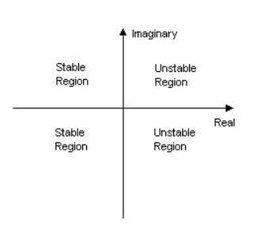
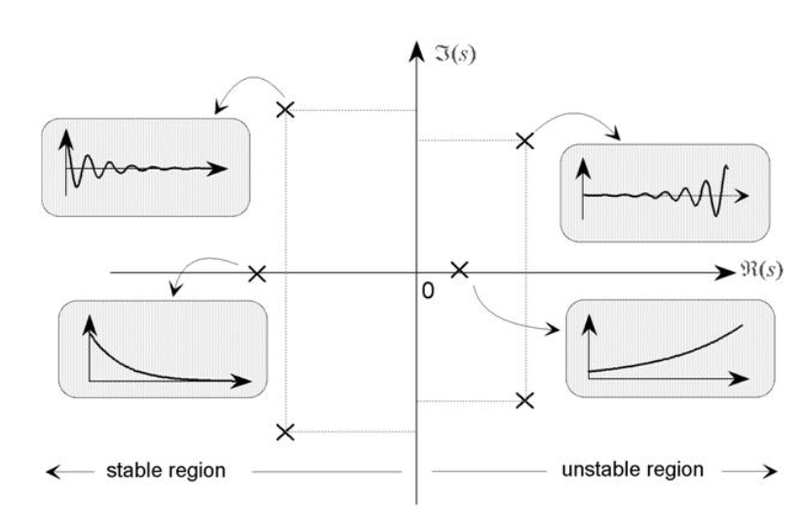
Check Different Stable And Unstable Regions

Slide 22
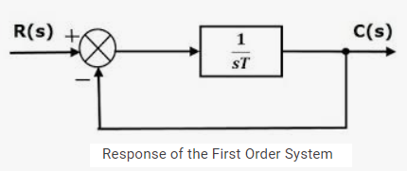
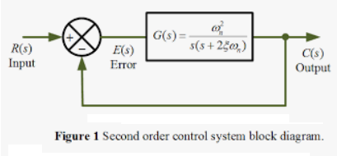
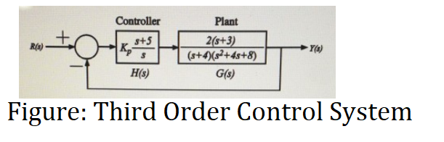
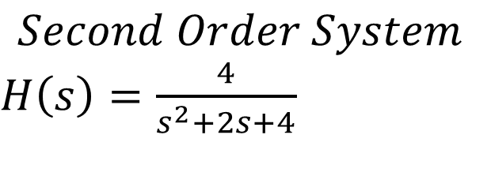
Order of the Control System
The order of a control system is determined by the power of ‘s’ in the denominator of its transfer function. If the power of s in the denominator of the transfer function of a control system is 2, then the system is said to be second order control system.
$$Second Order System$$
$H\left(s\right)=\frac{4}{s^{2}+2s+4}$

Slide 23
Root Locus Method
It is the combination of two words: root-loci
We are interested in the roots of the Denominator of the closed loop transfer function, that is the closed loop poles.
Locus is a path (or route) one might follow. Loci is the plural form.
The root locus is the path of the roots of the characteristic equation traced out in the s-plane as a system parameter varies from zero to infinity.
It is a graphical method for examining the change in the roots of a system when gain of the system varies.
Root-loci are the paths followed by the closed loop poles as K changes, because poles are tell us about stability and behavior.

Slide 24
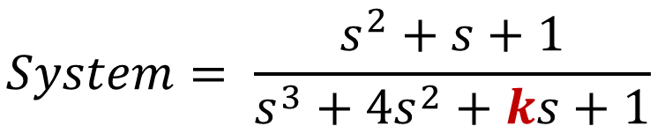
Root Locus Method
System
Parameter K,
Where K is unknown Parameters and what affect on the stability of the system
Input
Output
$$System= \frac{s^{2}+s+1}{s^{3}+{4s}^{2}+ks+1}$$
So here two problems occur due to K
First what value of K we should select to meet my system performance requirements.
Second what is the effect of a variation of K on the system

Slide 25
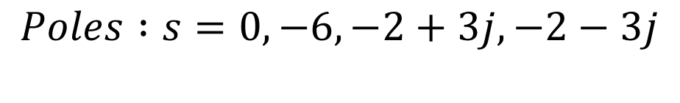
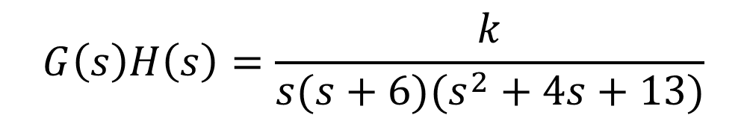



Procedure of Root Locus
$$G\left(s\right)H\left(s\right)=\frac{k}{s(s+6)(s^{2}+4s+13)}$$
Step-1: Calculate the Starting Points (Poles)
$$Poles :s=0, −6, −2+3j, −2−3j$$
$$No of Poles values=P=4$$
Step-2: Calculate the Ending Points (Zeros)
$$Zeros:s=0$$
$$No of Zeros values=Z=0$$
Step-3: Calculate the Numerator of root locus N
P>Z (4>0) than N = P
$N=4$

Slide 26

Procedure of Root Locus
$$jσ$$
Step-4: Existence of Root Locus in S-Plane
$$Poles :s=0, −6, −2+3j, −2−3j$$
3j 2j j
$$Zeros:s=None, No:of Zeros=0$$
$$−σ$$
$$σ$$
-6 -5 -4 -3 -2 -1
1 2 3 4 5
-j -2j -3j
Shaded because odd poles on right side
Shaded because 3 poles on right side so
it is odd poles we shaded it
So, root locus exists between 0 to -6.
$$−jσ$$

Slide 27
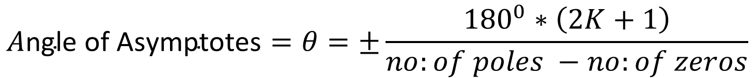
Procedure of Root Locus
Step-5: Angle of Asymptotes
$$A\text{ngle} \text{of} \text{Asymptotes}=θ=±\frac{{180}^{0}∗\left(2K+1\right)}{no:of poles −no:of zeros}$$
$K=p−z−1=4−0−1=3,$ So value of K = 0,1,2,3
$$If K=0 than −→A\text{ngle} \text{of} \text{Asymptotes}=θ_{1}=\frac{{180}^{0}∗\left(2K+1\right)}{no:of poles −no:of zeros}=\frac{{180}^{0}∗\left(2∗0+1\right)∗}{\left(4−0\right)}=\frac{{180}^{0}}{4}={45}^{0}$$
$$If K=1 than −→A\text{ngle} \text{of} \text{Asymptotes}=θ_{2}=\frac{{180}^{0}∗\left(2K+1\right)}{no:of poles −no:of zeros}=\frac{{180}^{0}∗\left(2∗1+1\right)∗}{\left(4−0\right)}=\frac{{180}^{0}∗3}{4}={135}^{0}$$
$$If K=2 than −→A\text{ngle} \text{of} \text{Asymptotes}=θ_{3}=\frac{{180}^{0}∗\left(2K+1\right)}{no:of poles −no:of zeros}=\frac{{180}^{0}∗\left(2∗2+1\right)∗}{\left(4−0\right)}=\frac{{180}^{0}∗5}{4}={225}^{0}$$
$$If K=3 than −→A\text{ngle} \text{of} \text{Asymptotes}=θ_{4}=\frac{{180}^{0}∗\left(2K+1\right)}{no:of poles −no:of zeros}=\frac{{180}^{0}∗\left(2∗3+1\right)∗}{\left(4−0\right)}=\frac{{180}^{0}∗7}{4}={315}^{0}$$

Slide 28
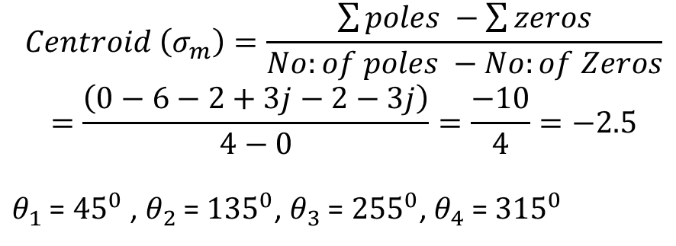
Procedure of Root Locus
$$jσ$$
Step-6: Find the Centroid
$$Centroid \left(σ_{m}\right)=\frac{\sum{poles −\sum{zeros}}}{No:of poles −No:of Zeros}$$
$$=\frac{\left(0−6−2+3j−2−3j\right)}{4−0}=\frac{−10}{4}=−2.5$$
$θ_{1}$ = ${45}^{0}$ , $θ_{2}$ = ${135}^{0}$, $θ_{3}$ = ${255}^{0}$, $θ_{4}$ = ${315}^{0}$
3j 2j j
$$−σ$$
$$σ$$
-6 -5 -4 -3 -2 -1
1 2 3 4 5
-j -2j -3j
$$−jσ$$

Slide 29
Procedure of Root Locus
Step-7: Break Away Point and Break In Point
Break Point
Break Point at which two or more poles are meet (in the real order roort of locus branches) is called Break Point
Homework

Slide 30
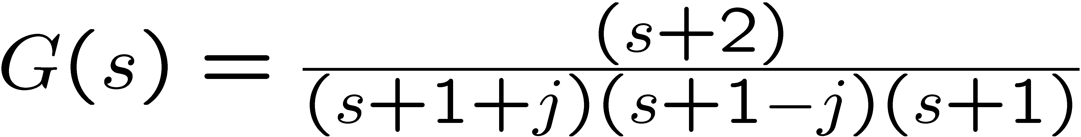
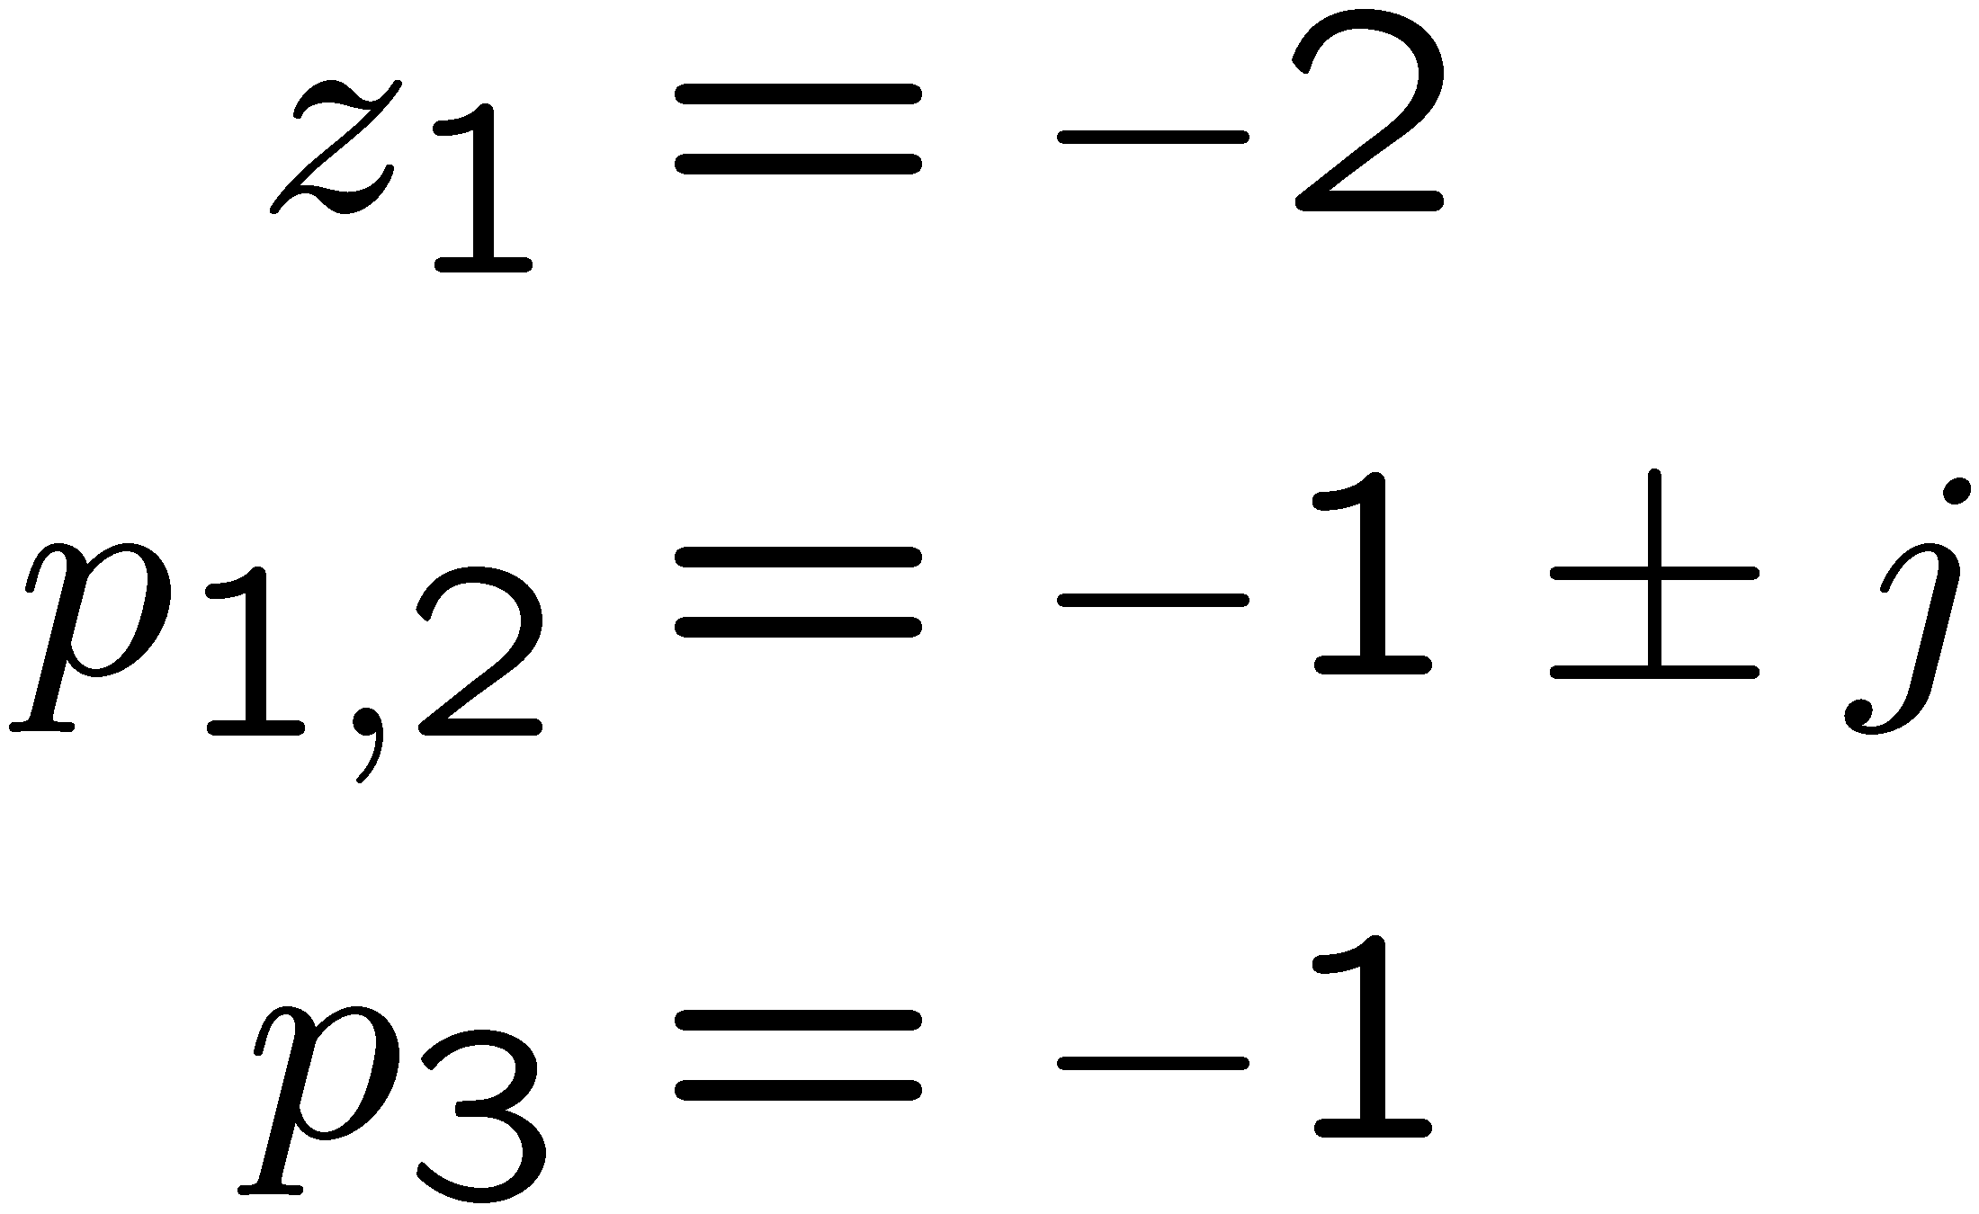
Zeros and poles of a transfer function
Let G(s)=N(s)/D(s), then
Zeros of G(s) are the roots of N(s)=0
Poles of G(s) are the roots of D(s)=0
Im(s)
Re(s)

Slide 31
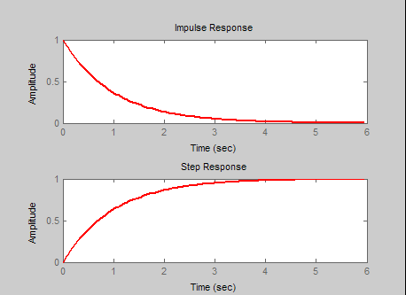
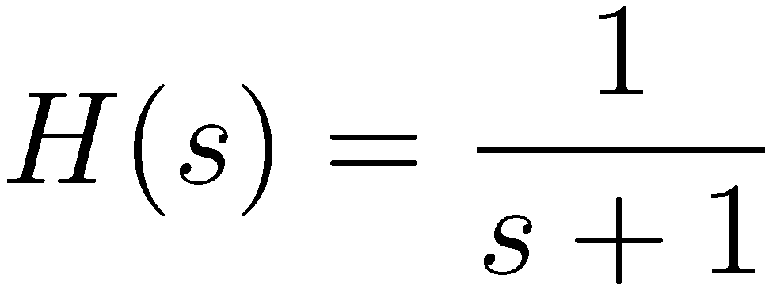
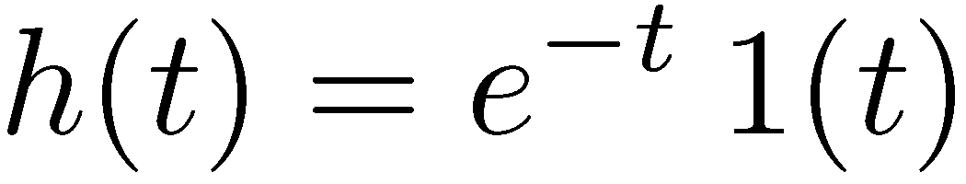
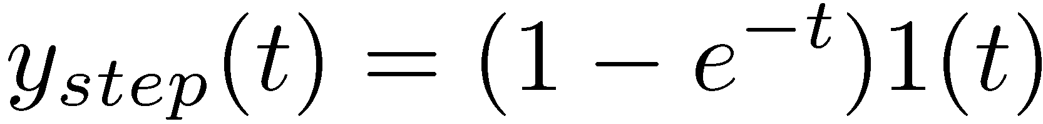
First order system response
Im(s)
Unstable
-1
Re(s)

Slide 32
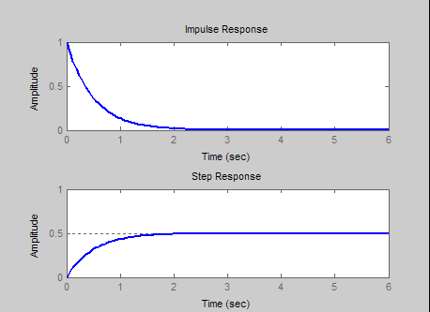



First order system response
Im(s)
Unstable
-2
Re(s)

Slide 33


Unit Step Function OR Heaviside Function

Slide 34

Unit Impulse Function

Slide 35

Shifted Unit Step Function

Slide 36

Discrete Time Unit Step Function

Slide 37

Discrete Time Impulse Function

Slide 38

Ramp Signal

Slide 39

Signum Function

Slide 40

Unit Step Function
$$Q:Find the Laplace Trasnform of Unit Step Function$$
$$u\left(t\right)=1 for t ≥0$$
$=1 for t<0$
$$L \left\{u\left(t\right)\right\}= \int_{0}^{∞}{f\left(t\right)e^{−st}dt=\int_{0}^{∞}{u(t)e^{−st}dt=\int_{0}^{∞}{1∗e^{−st}dt=\int_{0}^{∞}{e^{−st}dt }}}}$$
$$L \left\{u\left(t\right)\right\}=\int_{0}^{∞}{e^{−st}dt }=\frac{{(e}^{−s∗∞}−e^{−s∗0})}{−s}=\left(−\frac{1}{s}\right)\left(0−1\right)=\frac{1}{s}$$

Slide 41


Laplace Transform Table

Slide 42

Laplace Transform Table of Different Signals

Slide 43

Inverse Laplace Transform Using Partial Fraction Method
$Find the Lpalce Inverse of$ $Y\left(S\right)=\frac{s+1}{s(s+2)}$
$$SOLUTION$$
$\frac{s+1}{s(s+2)}=\frac{A}{s}+\frac{B}{s+2}−−−−−−−−−−−−−−− −−−−(A)$
$$\frac{s+1}{s(s+2)}=\frac{A}{s}+\frac{B}{s+2}=\frac{A \left(s+2\right)+B(s)}{s(s+2)}$$
$$s+1=\left\{s(s+2)\right\} \left\{\frac{A \left(s+2\right)+B\left(s\right)}{s\left(s+2\right)} \right\}$$
$$s+1=A \left(s+2\right)+B\left(s\right)$$

Slide 44


Inverse Laplace Transform Using Partial Fraction Method
$$s+1=A \left(s+2\right)+B\left(s\right) −−−−−−−−−(B)$$
$$Put s=−2 in equation (B)$$
$$−2+1=A \left(−2+2\right)+B\left(−2\right) ↔−1=0 −2B↔B=\frac{1}{2}$$
$$Put s=0 in equation (B)$$
$$0+1=A \left(0+2\right)+B\left(0\right)↔1=2A↔A=\frac{1}{2}$$
$$Put the values of A and B in equation (A)$$
$$\frac{s+1}{s(s+2)}=\frac{A}{s}+\frac{B}{s+2}↔\frac{s+1}{s(s+2)}=\frac{1/2}{s}+\frac{1/2}{s+2}$$
$$\frac{s+1}{s(s+2)}=\frac{1}{2}\left(\frac{1}{s}\right)+\frac{1}{2}\left(\frac{1}{s+2}\right)=\frac{1}{2}\left(1\right)+\frac{1}{2}\left(e^{−2t}\right) −−−Answer$$

Slide 45
Inverse Laplace Transform Using Partial Fraction Method
$Find the Lpalce Inverse of$ $G\left(S\right)=\frac{86s −78}{(s+3)(s−4)(5s−1)}$
$$SOLUTION$$
$\frac{86s −78}{(s+3)(s−4)(5s−1)}=\frac{A}{s+3}+\frac{B}{s−4}+\frac{C}{5s−1} −−−−(A)$
$$\frac{86s −78}{(s+3)(s−4)(5s−1)}=\frac{A\left(s−4\right)\left(5s−1\right)+B\left(s+3\right)\left(5s−1\right)+C(s+3)(s−4)}{(s+3)(s−4)(5s−1)}$$
$$86s −78=\{(s+3)(s−4)(5s−1)\}\left[\frac{A\left(s−4\right)\left(5s−1\right)+B\left(s+3\right)\left(5s−1\right)+C\left(s+3\right)\left(s−4\right)}{\left(s+3\right)\left(s−4\right)\left(5s−1\right)}\right]$$
$$86s −78=A\left(s−4\right)\left(5s−1\right)+B\left(s+3\right)\left(5s−1\right)+C\left(s+3\right)\left(s−4\right)$$

Slide 46

Inverse Laplace Transform Using Partial Fraction Method
$86s −78=A\left(s−4\right)\left(5s−1\right)+B\left(s+3\right)\left(5s−1\right)+C\left(s+3\right)\left(s−4\right)$…(B)
$$Put s=4 in equation (B)$$
$$86∗4 −78=A\left(4−4\right)\left(5∗4−1\right)+B\left(4+3\right)\left(5∗4−1\right)+C\left(4+3\right)\left(4−4\right)$$
$266=0+B\left(7\right)\left(19\right)+0 ↔B=2$
$$Put s=−3 in equation (B)$$
$$86∗(−3) −78=A\left(−3−4\right)\left(5∗(−3)−1\right)+B\left(−3+3\right)\left(5∗(−3)−1\right)+C\left(−3+3\right)\left(−3−4\right)$$
$$−336=A\left(−7\right)\left(−16\right)+0+0↔A=−3$$
$$Put s=\frac{1}{5} in equation (B)$$
$$86∗\frac{1}{5} −78=A\left(\frac{1}{5}−4\right)\left(\frac{5}{5}−1\right)+B\left(\frac{1}{5}+3\right)\left(\frac{5}{5}−1\right)+C\left(\frac{1}{5}+3\right)\left(\frac{1}{5}−4\right)$$

Slide 47
Inverse Laplace Transform Using Partial Fraction Method
$$86∗\frac{1}{5} −78=0+0+C\left(\frac{16}{5}\right)\left(−\frac{19}{5}\right)$$
$$\frac{86}{5} −78=C\left(\frac{16}{5}\right)\left(−\frac{19}{5}\right)$$
$$−\frac{304}{5} =−C\left(\frac{16}{5}\right)\left(\frac{19}{5}\right)$$
$$\frac{304}{5} =C\left(\frac{16}{5}\right)\left(\frac{19}{5}\right)$$
$$\frac{304}{5}\left(\frac{5}{16}\right)\left(\frac{5}{19}\right)=C$$
$$\frac{7600}{1520}=C↔C=5$$

Slide 48



Inverse Laplace Transform Using Partial Fraction Method
$B=2$
$$A=−3$$
$$C=5$$
$$Put the values of A, B and C in equation (A)$$
$$\frac{86s −78}{(s+3)(s−4)(5s−1)}=\frac{A}{s+3}+\frac{B}{s−4}+\frac{C}{5s−1} =\frac{−3}{s+3}+\frac{2}{s−4}+\frac{5}{5s−1}$$
$$\frac{86s −78}{(s+3)(s−4)(5s−1)}=−3\left\{\frac{1}{s+3}\right\}+2\left\{\frac{1}{s−4}\right\}+\frac{5}{5\left(s−\frac{1}{5}\right)}=−3\left\{\frac{1}{s+3}\right\}+2\left\{\frac{1}{s−4}\right\}+\left\{\frac{1}{\left(s−\frac{1}{5}\right)}\right\}$$
$$\frac{86s −78}{(s+3)(s−4)(5s−1)}=−3\left\{e^{−3t}\right\}+2\left\{e^{4t}\right\}+\left\{e^{\frac{1}{5}t}\right\} …Answer$$

Slide 49





First Order System- Unit Step Function, Calculate Output in Time Domain
Time Domain
$r(t)$ = Unit Step Function =
$$u\left(t\right)=1 for t ≥0$$
$=1 for t<0$
$$H\left(s\right)=\frac{1}{1+sT}$$
c$(t)$
S (Laplace)
Domain
$$R\left(s\right)=\frac{1}{s}$$
$$H\left(s\right)=\frac{1}{1+sT}$$
C(s)

Slide 50





First Order System- Unit Step Function, Calculate Output in Time Domain
$$R\left(s\right)=\frac{1}{s}$$
$$H\left(s\right)=\frac{1}{1+sT}$$
C(s)
$$Transfer Function H\left(s\right)=\frac{Output}{Input}=\frac{C\left(s\right)}{R\left(s\right)}$$
$$Output \{C\left(s\right)\}=R\left(s\right)∗H\left(s\right)=\frac{1}{s}∗\frac{1}{1+sT}$$
$$L^{−1}\left\{\frac{1}{s(1+sT)}\right\}$$

Slide 51



First Order System- Unit Step Function, Calculate Output in Time Domain
$$L^{−1}\left\{\frac{1}{s(1+sT)}\right\}$$
$$Apply Partial Fraction to Calculate the Laplace inverse$$
$$\frac{1}{s(1+sT)}=\frac{A}{s}+\frac{B}{(1+sT)} −−−−−−−−−−−−−−(A)$$
$$\frac{1}{s(1+sT)}=\frac{A\left(1+sT\right)+B(s)}{s (1+sT)}$$
$$1=\left\{s \left(1+sT\right)\right\} \left\{\frac{A\left(1+sT\right)+B\left(s\right)}{s \left(1+sT\right)} \right\}$$
$$1=A\left(1+sT\right)+B\left(s\right) −−−−−−−−−−−−−(B)$$

Slide 52



First Order System- Unit Step Function, Calculate Output in Time Domain
$$1=A\left(1+sT\right)+B\left(s\right) −−−−−−−−−−−−−(B)$$
$$Put s=0 in equation (B)$$
$$1=A\left(1+0∗T\right)+B\left(0\right) ↔A=1$$
$$Put s=−\frac{1}{T} in equation (B)$$
$$1=A\left(1−\frac{1}{T}∗T\right)+B\left(−\frac{1}{T}\right)$$
$$1=A\left(1−1\right)+B\left(−\frac{1}{T}\right)↔B=−T$$

Slide 53





First Order System- Unit Step Function, Calculate Output in Time Domain
$$A=1$$
$$B=−T$$
$$Put the value of A and B in equation (A)$$
$$\frac{1}{s(1+sT)}=\frac{A}{s}+\frac{B}{(1+sT)}$$
$\frac{1}{s(1+sT)}=\frac{1}{s}+\frac{−T}{\left(1+sT\right)}=\frac{1}{s}+\frac{−T}{T\left(\frac{1}{T}+s\right)}$ $=\frac{1}{s}+\frac{−1}{\left(\frac{1}{T}+s\right)}=\frac{1}{s}−\frac{1}{\left(s+\frac{1}{T}\right)}$
$$\frac{1}{s(1+sT)}=\left\{\frac{1}{s}\right\}−\left\{\frac{1}{\left(s+\frac{1}{T}\right)}\right\}=\left\{1\right\}−\left\{e^{−\frac{1}{T}t}\right\}=\left\{1\right\}−\left\{e^{−\frac{t}{T}}\right\}$$
$$\frac{1}{s(1+sT)}=\left\{\frac{1}{s}\right\}−\left\{\frac{1}{\left(s+\frac{1}{T}\right)}\right\}=\left\{1\right\}−\left\{e^{−\frac{1}{T}t}\right\}=u(t)−\left\{e^{−\frac{t}{T}}\right\} −−−Ans$$

Slide 54




First Order System- Unit Step Function, Calculate Output in Time Domain
$$\frac{1}{s(1+sT)}=\left\{\frac{1}{s}\right\}−\left\{\frac{1}{\left(s+\frac{1}{T}\right)}\right\}=\left\{1\right\}−\left\{e^{−\frac{1}{T}t}\right\}=u(t)−\left\{e^{−\frac{t}{T}}\right\} −−−Ans$$
$$1 is constant , so it is Steady response$$
$$If t is zero than e power zero, which$$
$$is equal to −1$$
$$If t increases than reponse will go$$
$$toward zero, so it is Transient$$
$$response$$

