Slide 1
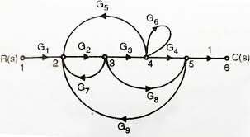
Introduction Of Signal Flow Graphs

Slide 2
Introduction Of Signal Flow Graphs
Signal Flow Graph (SFG) is a graphical representation of block diagrams.
SFG is also used to determine the overall transfer function of a control system.
SFG is an easier method to determine the transfer function as compared to Block Diagram Reduction as we do not have to reduce the SFG

Slide 3
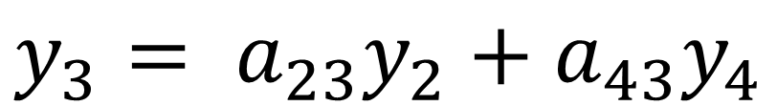
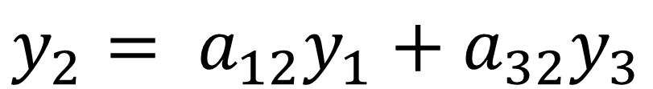
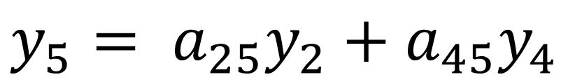
Example: Construct the SFG of the following algebraic equations:
$$y_{2}= a_{12}y_{1}+a_{32}y_{3}$$
$$y_{3}= a_{23}y_{2}+a_{43}y_{4}$$
$$y_{4}= a_{24}y_{2}+a_{34}y_{3}+a_{44}y_{4}$$
$$y_{5}= a_{25}y_{2}+a_{45}y_{4}$$

Slide 4
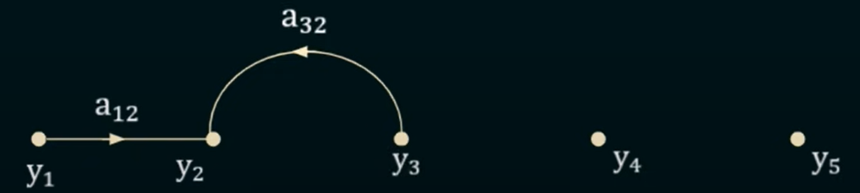





SOLUTION
$$y_{2}= a_{12}y_{1}+a_{32}y_{3}$$
$$y_{3}= a_{23}y_{2}+a_{43}y_{4}$$
$$y_{4}= a_{24}y_{2}+a_{34}y_{3}+a_{44}y_{4}$$
$Draw five points of y_{1},y_{2}$, $y_{3}$, $y_{4}$ and $y_{5}$
$$y_{5}= a_{25}y_{2}+a_{45}y_{4}$$
$$y_{2}= a_{12}y_{1}+a_{32}y_{3}$$

Slide 5
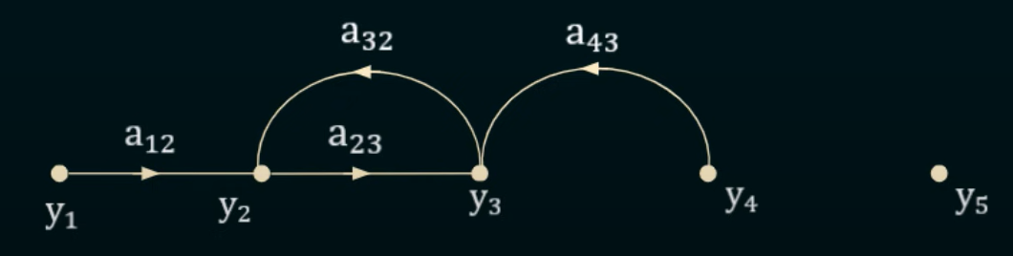




$$y_{2}= a_{12}y_{1}+a_{32}y_{3}$$
$$y_{3}= a_{23}y_{2}+a_{43}y_{4}$$
$$y_{4}= a_{24}y_{2}+a_{34}y_{3}+a_{44}y_{4}$$
$$y_{5}= a_{25}y_{2}+a_{45}y_{4}$$
$$y_{3}= a_{23}y_{2}+a_{43}y_{4}$$

Slide 6
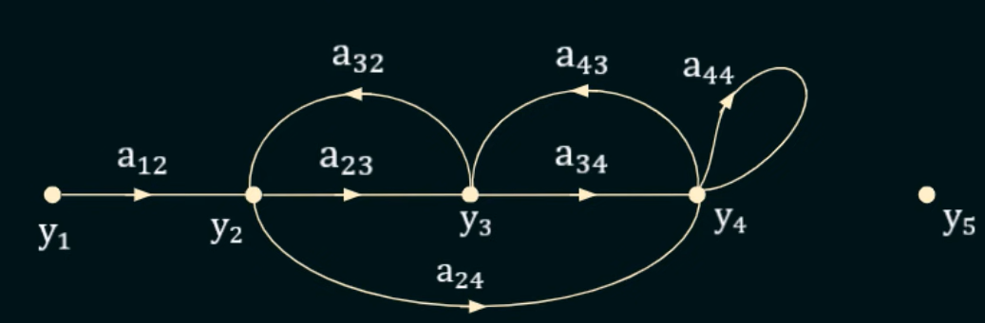
$$y_{2}= a_{12}y_{1}+a_{32}y_{3}$$
$$y_{3}= a_{23}y_{2}+a_{43}y_{4}$$
$$y_{4}= a_{24}y_{2}+a_{34}y_{3}+a_{44}y_{4}$$
$$y_{5}= a_{25}y_{2}+a_{45}y_{4}$$
$$y_{4}= a_{24}y_{2}+a_{34}y_{3}+a_{44}y_{4}$$

Slide 7
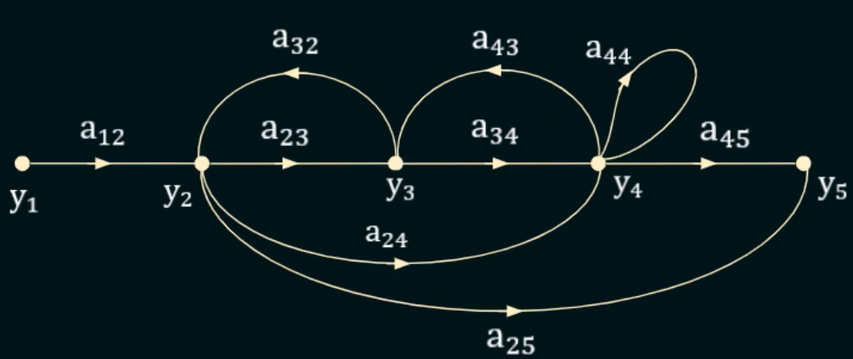

$$y_{2}= a_{12}y_{1}+a_{32}y_{3}$$
This is the Signal Flow Graph of These algebraic Equations
$$y_{3}= a_{23}y_{2}+a_{43}y_{4}$$
$$y_{4}= a_{24}y_{2}+a_{34}y_{3}+a_{44}y_{4}$$
$$y_{5}= a_{25}y_{2}+a_{45}y_{4}$$
$$y_{5}= a_{25}y_{2}+a_{45}y_{4}$$

Slide 8
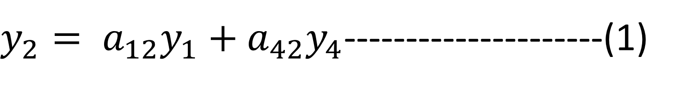
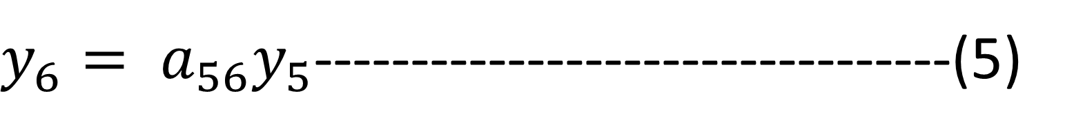
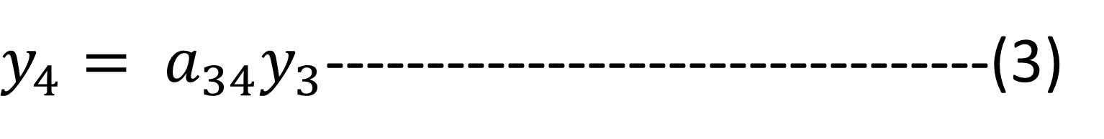
Example: Construct a SFG by considering the following algebraic equations
$y_{2}= a_{12}y_{1}+a_{42}y_{4}$---------------------(1)
$$y_{3}= a_{23}y_{2}+a_{53}y_{5}\text{−−−−}\text{−−−}\text{−−−−−}(2)$$
$y_{4}= a_{34}y_{3}$---------------------------------(3)
$$y_{5}= a_{45}y_{4}+a_{35}y_{3}\text{−−−−−−−}\text{−−}\text{−−−−−}(4)$$
$y_{6}= a_{56}y_{5}$---------------------------------(5)

Slide 9
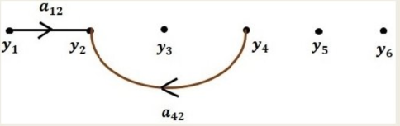
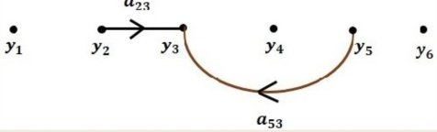
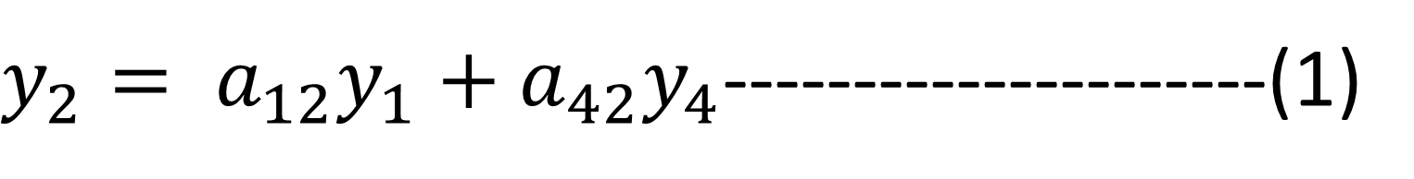
$y_{2}= a_{12}y_{1}+a_{42}y_{4}$---------------------(1)
$$y_{3}= a_{23}y_{2}+a_{53}y_{5}\text{−−−−−−−−−−−}\text{−−−−}\text{−−−−−}(2)$$

Slide 10

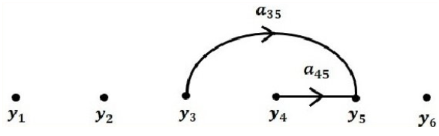

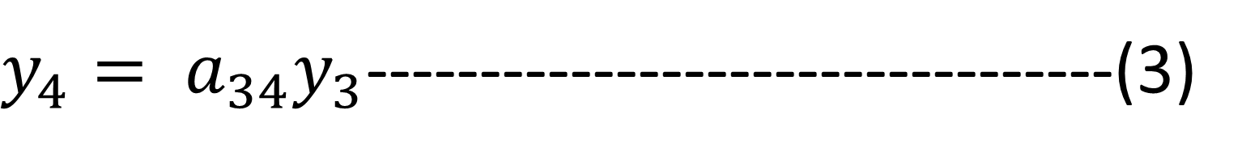
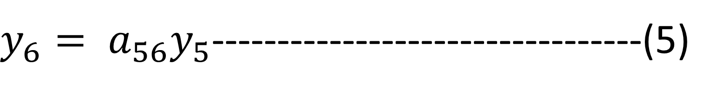
$y_{4}= a_{34}y_{3}$---------------------------------(3)
$$y_{5}= a_{45}y_{4}+a_{35}y_{3}\text{−−−−−−−−−−}\text{−−−−−}\text{−−−−−−}(4)$$
$y_{6}= a_{56}y_{5}$---------------------------------(5)

Slide 11
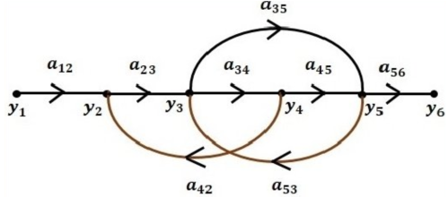
Combine All Sub-Graphs

Slide 12
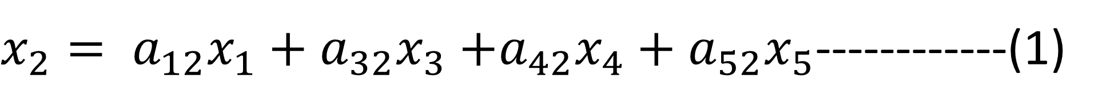
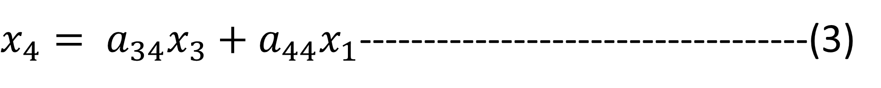
Example: Construct a SFG by considering the following algebraic equations
$x_{2}= a_{12}x_{1}+a_{32}x_{3}$ $+a_{42}x_{4}+a_{52}x_{5}$------------(1)
$$x_{3}= a_{23}x_{2}\text{−−−−−−−}\text{−−−−−−−−−−−−−−−−−−−−−−−−−−}\text{−−−−}\text{−−−−}\text{−−−−−}(2)$$
$x_{4}= a_{34}x_{3}+a_{44}x_{1}$-----------------------------------(3)
$$x_{5}= a_{35}x_{3}+a_{45}x_{4}\text{−−−−−−−−−−}\text{−−−−−}\text{−−−−−−}(4)$$

Slide 13

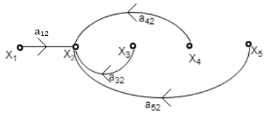
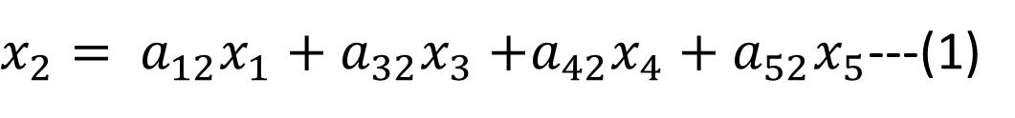

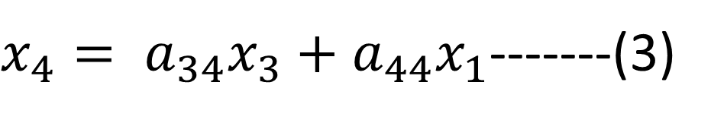

SOLUTION:
$x_{2}= a_{12}x_{1}+a_{32}x_{3}$ $+a_{42}x_{4}+a_{52}x_{5}$---(1)
$$x_{3}= a_{23}x_{2}\text{−−−−}(2)$$
Step1 - First step is to draw all the nodes.
$x_{4}= a_{34}x_{3}+a_{44}x_{1}$-------(3)
$$x_{5}= a_{35}x_{3}+a_{45}x_{4}\text{−−−−}(4)$$
Step2 - Draw the SFG for equation (1)

Slide 14

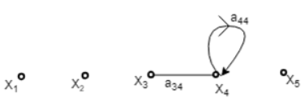
$x_{2}= a_{12}x_{1}+a_{32}x_{3}$ $+a_{42}x_{4}+a_{52}x_{5}$---(1)
Step3 - Draw the SFG for equation (2)
$$x_{3}= a_{23}x_{2}\text{−−−−}(2)$$
$x_{4}= a_{34}x_{3}+a_{44}x_{1}$-------(3)
$$x_{5}= a_{35}x_{3}+a_{45}x_{4}\text{−−−−}(4)$$
Step4 - Draw the SFG for equation (3)

Slide 15
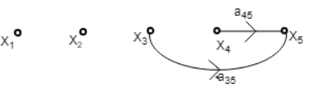
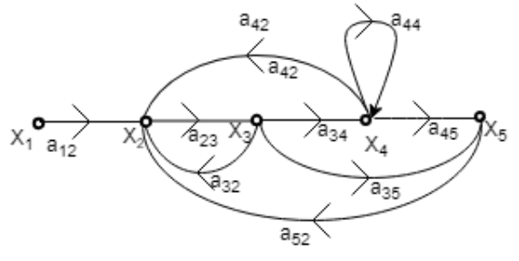
$x_{2}= a_{12}x_{1}+a_{32}x_{3}$ $+a_{42}x_{4}+a_{52}x_{5}$---(1)
Step5 - Draw the SFG for equation (4)
$$x_{3}= a_{23}x_{2}\text{−−−−}(2)$$
$x_{4}= a_{34}x_{3}+a_{44}x_{1}$-------(3)
$$x_{5}= a_{35}x_{3}+a_{45}x_{4}\text{−−−−}(4)$$
Step6 - Now draw the complete signal flow graph with the help of the above graph.

Slide 16
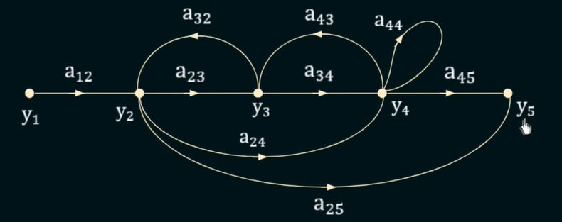
Elements of A Signal Flow Graph
Nodes: While constructing the SFG, the junction points that are used to represent variables are called as Nodes. In above SFG 5 nodes, such as y₁ , y₂ , y₃ , y₄ , and y₅.
Branches: The nodes are connected together by lines called as Branches. The signal travels from one node to another node along these branches. In above SFG 5 branches are a₁₂ , a₂₃ , a₂₄, etc.

Slide 17
Elements of A Signal Flow Graph
Input Node (Source): The node which has only outgoing branch, but not incoming branch is called as Input Node or Source Node. In above graph only y₁ is the Input Node.
Output Node (Sink): The node which has only incoming branches, but not outgoing branches is called as Output Node or Sink . In above grap h only y₅ is the Output Node.
Path: It is a traversal of connected branches in the direction of branch arrows is called as Path.

Slide 18
Elements of A Signal Flow Graph
Forward Path: It is a path from input node (y₁) to the output node (y₅) is called as Forward Path.
In above Figure there are three Forward Paths
1)First Forward Path = Y₁----Y₂------Y₃------Y₄-------------Y₅
2) Second Forward Path = Y₁----Y₂------Y₄-----------------Y₅
3) Third Forward Path = Y₁----Y₂----------------------------Y₅

Slide 19
Elements of A Signal Flow Graph
Branch Gain : Home Work
Forward Path Gain : Home Work

Slide 20
Elements of A Signal Flow Graph
Loop: It is a path which originates and terminates at the same Node is called as Loop. For Example: Start node y₂ and goes to y₃ then return back to original node y₂ is called the Loop. Similarly, y₃ to y₄ and return back to original y₃ is called as Loop. In this example 3 Loop.
Loop Gain: Home Work.
Self Loop: loop with only one branch is called as Self Loop.

Slide 21
Elements of A Signal Flow Graph
Touching Loops: Home Work
Non-Touching Loops: Home Work.
Pair Of Non-Touching Loops: If pair of two Non-Touching loops in a Signal Flow Graph called as a pair of Non-Touching Loops.
Triplet of Non-Touching Loops: If there are three Non-Touching loops in a Signal Flow Graph called as a Triplet of Non-Touching Loops.

Slide 22
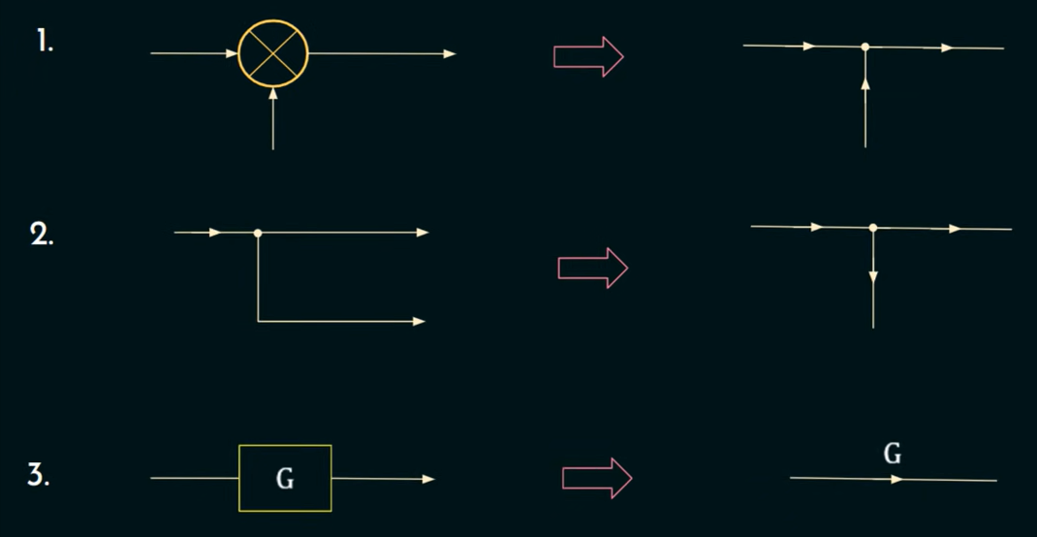
Equivalent Representation of Block Diagrams into Signal Flow Graph (SFG)
Summing Point Converted into a Node in case of SFG
Stake-Off Point is represented as a Node in case of SFG
Block of Gain (G) is represented as a Branch with Gain (G)

Slide 23
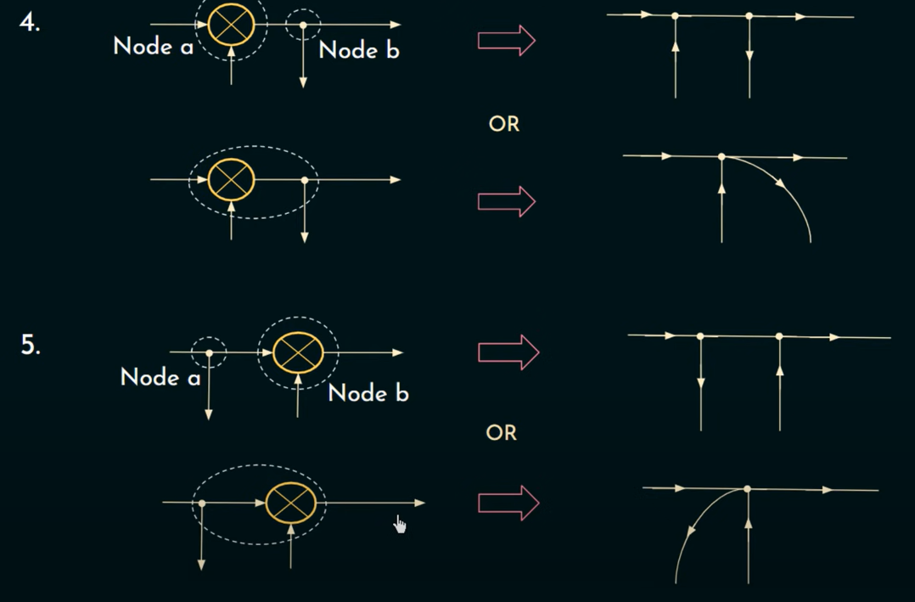
Equivalent Representation of Block Diagrams into Signal Flow Graph (SFG)
Summing point followed by take-of point conversion using two methods one is separate node in SFG and other is common node of SFG
Take-of-point followed by summing point converted into SFG

Slide 24
Convert Block Diagram into Signal Flow

Slide 25
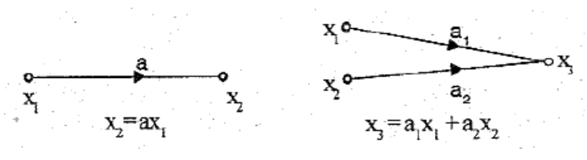
Rule 1: Incoming signal to a node through a branch is given by the product of a signal at the previous node and the gain of the branch

Slide 26
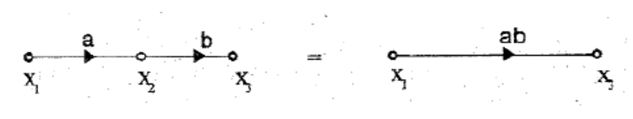
Rule 2 : Cascaded branches can be combined to give a single branch whose transmittance is equal to the product of individual branch transmittance.

Slide 27
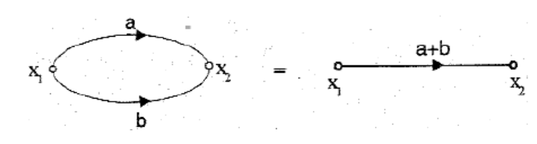
Rule 3: Parallel branches may be represented by a single branch whose transmittance is the sum of individual branch transmittance.

Slide 28
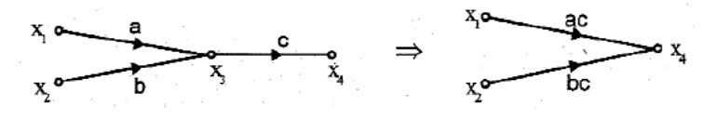
Rule 4: A mixed node can be eliminated by multiplying the transmittance of the outgoing branch (from the mixed node) to the transmittance of all incoming branches to the mixed node.

Slide 29
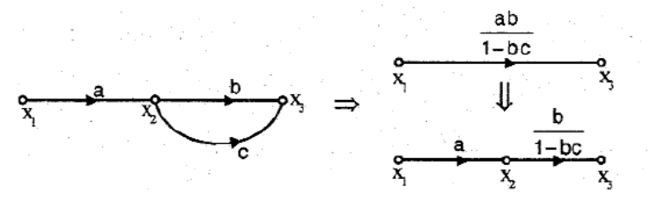
Rule 5: A loop may be eliminated by writing equations at the input and output node and rearranging the equations to find the ratio of output to input. This ratio gives the gain of the resultant branch.

Slide 30
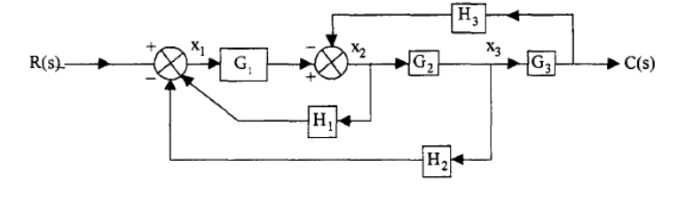
Example: Convert Block Diagram into Signal Flow

Slide 31
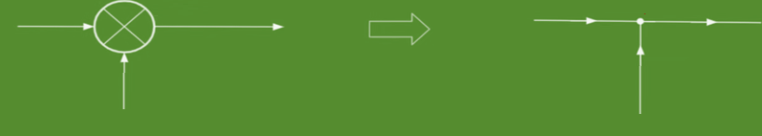
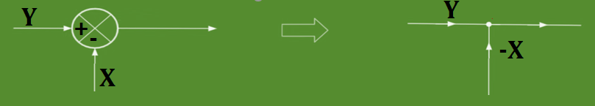
Example: Convert Block Diagram into Signal Flow

Slide 32
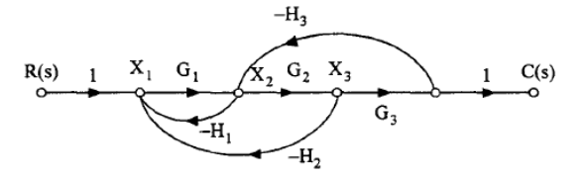
Example: Convert Block Diagram into Signal Flow

Slide 33
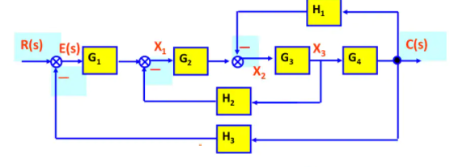
Example: Convert Block Diagram into Signal Flow

Slide 34
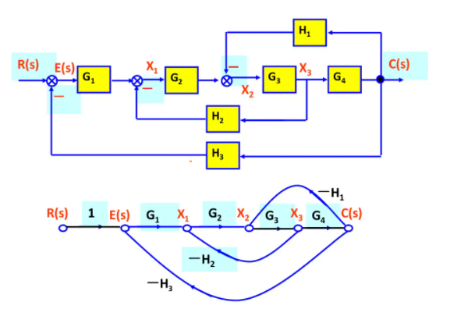
Example: Convert Block Diagram into Signal Flow

Slide 35
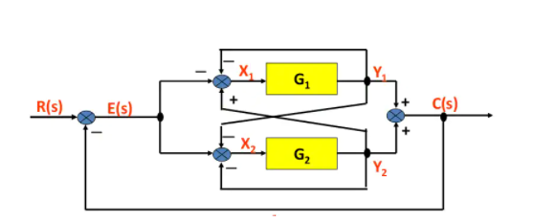
Example: Convert Block Diagram into Signal Flow

Slide 36
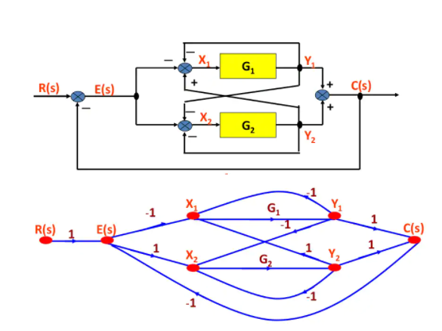
Example: Convert Block Diagram into Signal Flow

