Slide 1
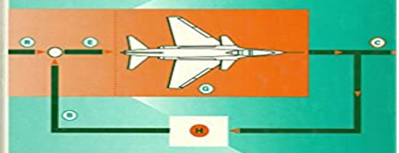
SECOND-WEEK
Dr. Wazir Muhammad
Electrical Engineering Department
BUET, Khuzdar

Slide 2
First Week | Modeling of electrical, mechanical and biological control systems, Open and closed-loop systems
Second Week | Block diagrams, Second order systems, Step and impulse response, Performance criteria, Steady state error.
Third Week | Sensitivity, s-plane system stability.
Fourth Week | Test-1
Fifth Week | Analysis and design with the root loci method.
Sixth week | Frequency domain analysis,
Seventh week | Bode plots,
Eight week | Nyquist criterion,
Ninth week | gain and phase margins,
Tenth week | Nichols charts.
Eleventh week | Test-2
Twelfth week | The State-space method
Thirteenth week | state equations,
Fourteenth week | flow graphs, stability
Sixteenth week | compensation techniques.

Slide 3
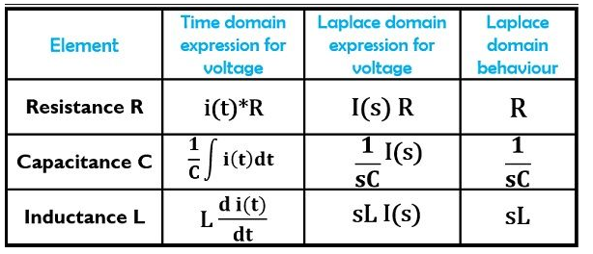
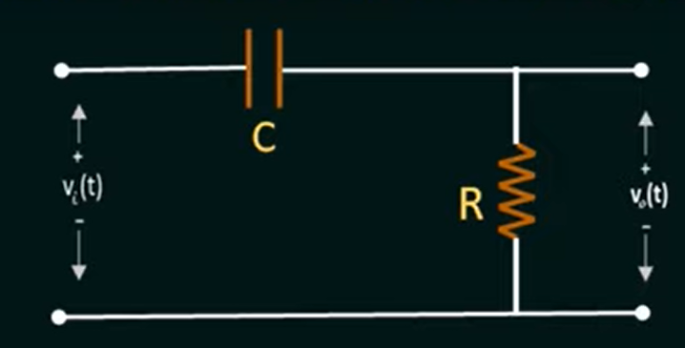
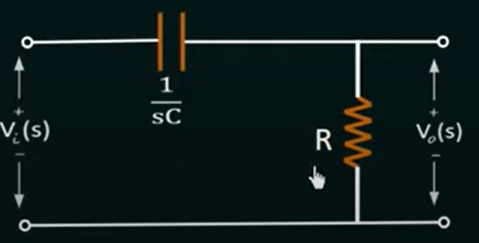
Find the Transfer Function of CR Circuit
Convert Time Domain CKT into S-Domain

Slide 4

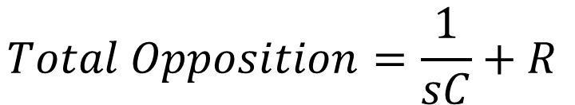
Find the Transfer Function of RC Circuit
$$Total Opposition=\frac{1}{sC}+R$$
$$Volatge Acroos R, we used VDSR V_{o}\left(s\right)=\frac{V_{i}\left(s\right) ∗R}{Total Opposition}$$
$$V_{o}\left(s\right)=\frac{V_{i}\left(s\right) ∗R}{\frac{1}{sC}+R}$$

Slide 5
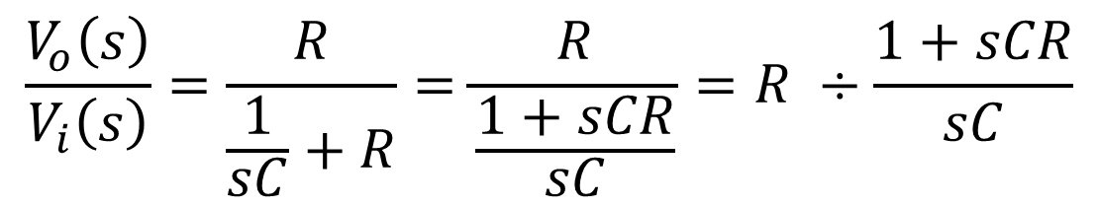
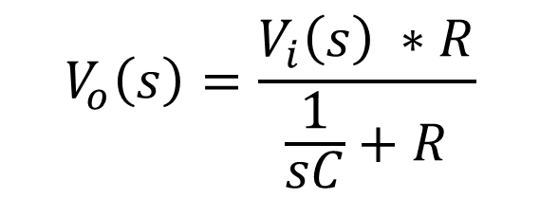
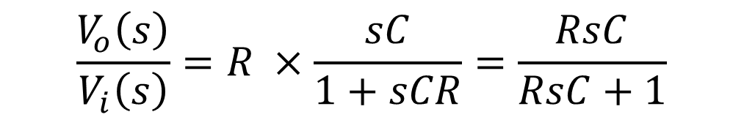
Find the Transfer Function of RC Circuit
$$V_{o}\left(s\right)=\frac{V_{i}\left(s\right) ∗R}{\frac{1}{sC}+R}$$
$$\frac{V_{o}\left(s\right)}{V_{i}\left(s\right)}=\frac{R}{\frac{1}{sC}+R}=\frac{R}{\frac{1+sCR}{sC}}=R ÷\frac{1+sCR}{sC}$$
$$\frac{V_{o}\left(s\right)}{V_{i}\left(s\right)}=R ×\frac{sC}{1+sCR}=\frac{RsC}{RsC+1}$$
$$Transfer Function=H\left(s\right)=\frac{Output}{Input}=\frac{V_{o}\left(s\right)}{V_{i}\left(s\right)}=R ×\frac{sC}{1+sCR}=\frac{RsC}{RsC+1}$$

Slide 6
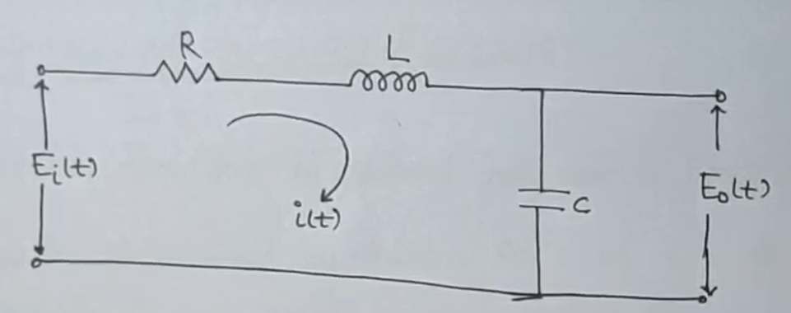
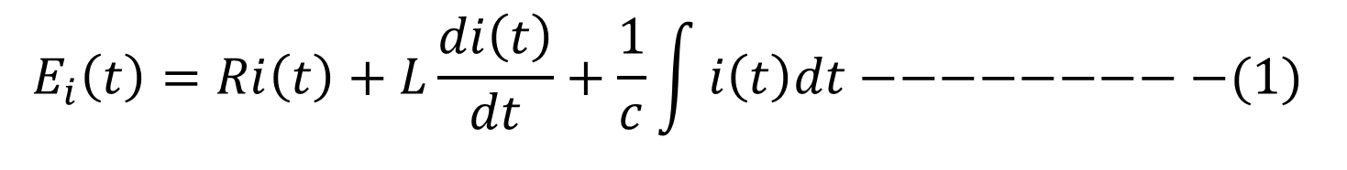
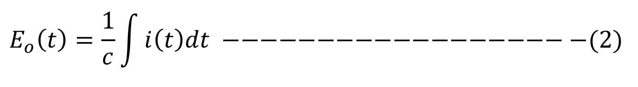
Find the Transfer Function of RLC Circuit
$$E_{i}\left(t\right)=Ri\left(t\right)+L\frac{di\left(t\right)}{dt}+\frac{1}{c}\int{i\left(t\right)dt−−−−−−−−−(1)}$$
$$E_{o}\left(t\right)=\frac{1}{c}\int{i\left(t\right)dt} −−−−−−−−−−−−−−−−−−−(2)$$

Slide 7
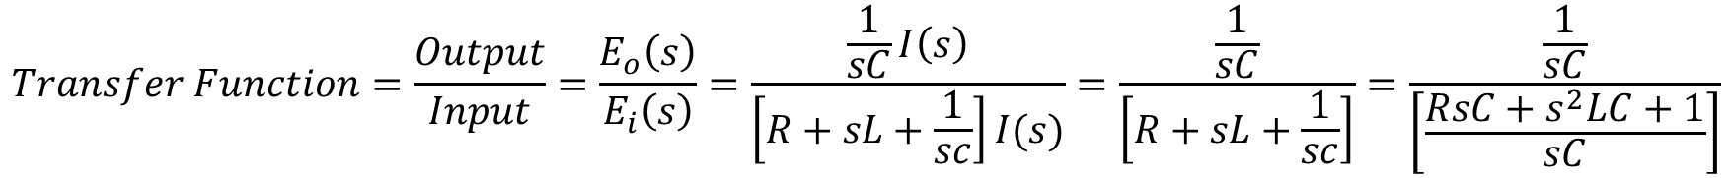
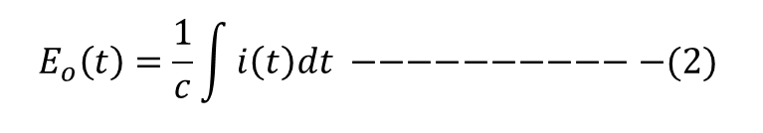
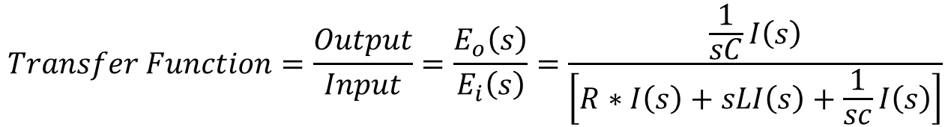
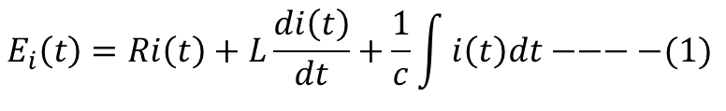
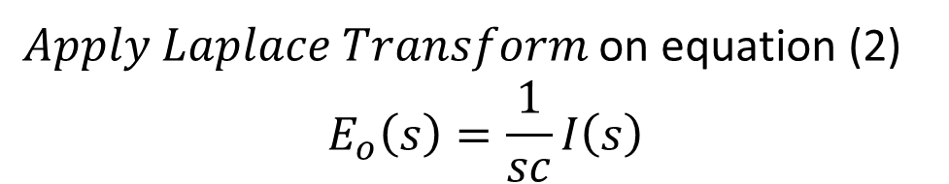
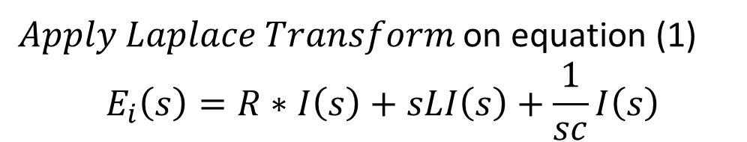
Find the Transfer Function of RLC Circuit
$Apply Laplace Transform$ on equation (1)
$$E_{i}\left(s\right)=R∗I\left(s\right)+sLI\left(s\right)+\frac{1}{sc}I\left(s\right)$$
$Apply Laplace Transform$ on equation (2)
$$E_{o}\left(s\right)=\frac{1}{sc}I\left(s\right)$$
$$E_{i}\left(t\right)=Ri\left(t\right)+L\frac{di\left(t\right)}{dt}+\frac{1}{c}\int{i\left(t\right)dt−−−−(1)}$$
$$E_{o}\left(t\right)=\frac{1}{c}\int{i\left(t\right)dt} −−−−−−−−−−−(2)$$
$$Transfer Function=\frac{Output}{Input}=\frac{E_{o}\left(s\right)}{E_{i}\left(s\right)}=\frac{\frac{1}{sC}I\left(s\right)}{\left[R∗I\left(s\right)+sLI\left(s\right)+\frac{1}{sc}I\left(s\right)\right]}$$
$$Transfer Function=\frac{Output}{Input}=\frac{E_{o}\left(s\right)}{E_{i}\left(s\right)}=\frac{\frac{1}{sC}I\left(s\right)}{\left[R+sL+\frac{1}{sc}\right]I(s)}=\frac{\frac{1}{sC}}{\left[R+sL+\frac{1}{sc}\right]}=\frac{\frac{1}{sC}}{\left[\frac{RsC+s^{2}LC+1}{sC}\right]}$$

Slide 8
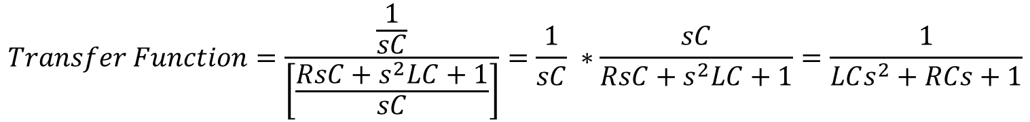
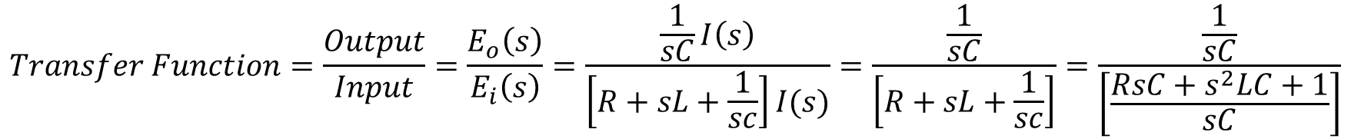
Find the Transfer Function of RLC Circuit
$$Transfer Function=\frac{Output}{Input}=\frac{E_{o}\left(s\right)}{E_{i}\left(s\right)}=\frac{\frac{1}{sC}I\left(s\right)}{\left[R+sL+\frac{1}{sc}\right]I(s)}=\frac{\frac{1}{sC}}{\left[R+sL+\frac{1}{sc}\right]}=\frac{\frac{1}{sC}}{\left[\frac{RsC+s^{2}LC+1}{sC}\right]}$$
$$Transfer Function=\frac{\frac{1}{sC}}{\left[\frac{RsC+s^{2}LC+1}{sC}\right]}=\frac{1}{sC} ∗\frac{sC}{{RsC+s}^{2}LC+1}=\frac{1}{LCs^{2}+RCs+1}$$

Slide 9
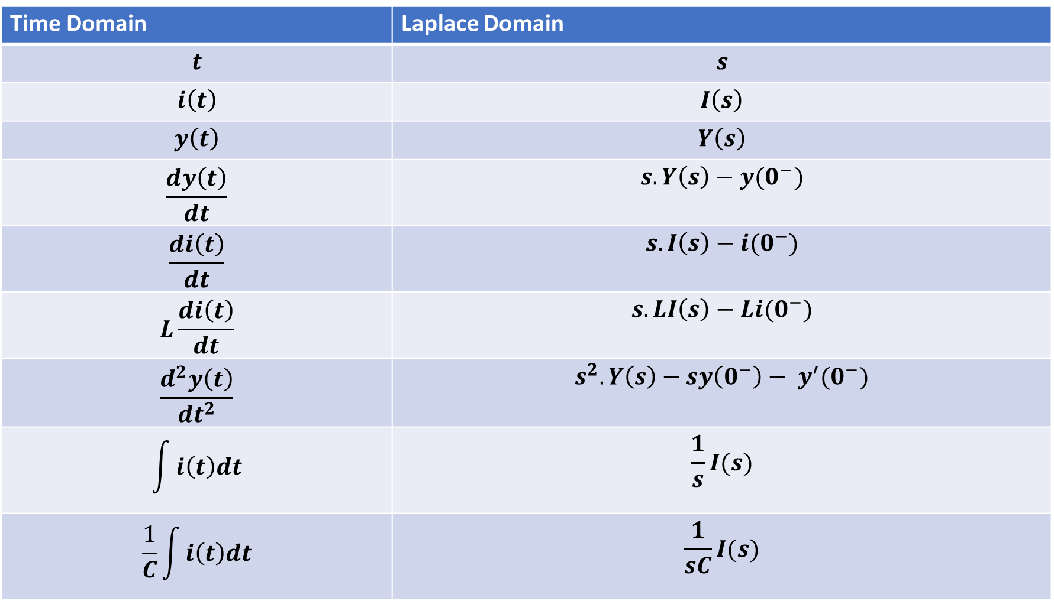
TABLE OF LAPLACE TRANSFORM
Time Domain | Laplace Domain
$$t$$ | $$s$$
$$i\left(t\right)$$ | $$I\left(s\right)$$
$$y\left(t\right)$$ | $$Y\left(s\right)$$
$$\frac{dy\left(t\right)}{dt}$$ | $$s.Y\left(s\right)−y(0^{−})$$
$$\frac{di\left(t\right)}{dt}$$ | $$s.I\left(s\right)−i(0^{−})$$
$$L\frac{di\left(t\right)}{dt}$$ | $$s.LI\left(s\right)−Li(0^{−})$$
$$\frac{d^{2}y\left(t\right)}{{dt}^{2}}$$ | $$s^{2}.Y\left(s\right)−sy\left(0^{−}\right)− y^{′}(0^{−})$$
$$\int{i\left(t\right)dt}$$ | $$\frac{1}{s}I(s)$$
$$\frac{1}{C}\int{i\left(t\right)dt}$$ | $$\frac{1}{sC}I(s)$$

Slide 10
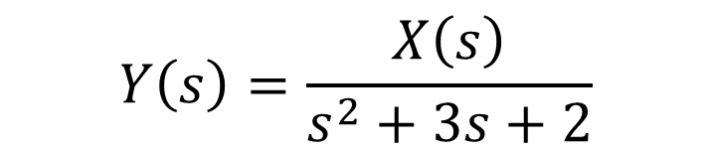

Find The Transfer Function
Example: Find the Transfer Function of the System is given by:
$$\frac{d^{2}y\left(t\right)}{{dt}^{2}} +3.\frac{dy\left(t\right)}{dt}+2.y\left(t\right)=x\left(t\right) where:x\left(t\right)is the input \& y\left(t\right)is the output$$
Solution:
$$s^{2}.Y\left(s\right)−y\left(0^{−}\right)− y^{′}\left(0^{−}\right)+3.\left[s.Y\left(s\right)−y\left(0^{−}\right)\right]+2.Y\left(s\right)=X(s)$$
All initial conditions are zero
$$s^{2}.Y\left(s\right)+3s.Y\left(s\right) +2.Y\left(s\right)=X(s)$$
$${Y\left(s\right)[s}^{2}+3s +2] = X(s)$$
$$Y\left(s\right)=\frac{X\left(s\right)}{s^{2}+3s+2}$$
$$Transfer Function=\frac{Output}{Input}= \frac{Y\left(s\right)}{X(s)}=\frac{1}{s^{2}+3s+2} −−−Answer$$

Slide 11
Proper Transfer Function
A Transfer Function having Numerator Degree is less than or equal to Denominator (N ≤ D), than such type of Transfer Function is called as Proper Transfer Function.
$$H\left(s\right)=\frac{1}{(s+2)(s+3)} −−−−−−−−−\left(N<D\right)−−−It is Proper T.F$$
$$H\left(s\right)=\frac{s^{2}+1}{{2s}^{2}+5} −−−−−−−−−−(N≤D)−−−−−−It is Proper T.F$$

Slide 12
Strictly Proper Transfer Function
A Transfer Function having Numerator Degree is only less than Denominator (N < D), than such type of Transfer Function is called as Proper Transfer Function.
$$H\left(s\right)=\frac{s}{{3s}^{2}+4} −−−−−−−−−\left(N<D\right)−−−It is Strictly Proper T.F$$

Slide 13
Improper OR Not Proper Transfer Function
A Transfer Function having Numerator Degree is greater than Denominator (N>D), than such type of Transfer Function is called as Improper Transfer Function.
$$H\left(s\right)=\frac{{3s}^{2}+7}{s^{2}+2} −−−−−−−−−−(N>D)−−−−−It is Improper T.F$$

Slide 14
Poles And Zeros Of Transfer Function
Zeros: Zeros of a Transfer Function are the frequencies (values of s) for which the numerator of the transfer function becomes zero.
Poles: Poles of a Transfer Function are the frequencies (values of s) for which the denominator of the transfer function becomes zero.

Slide 15

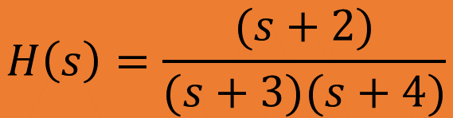
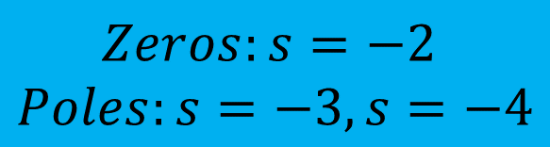
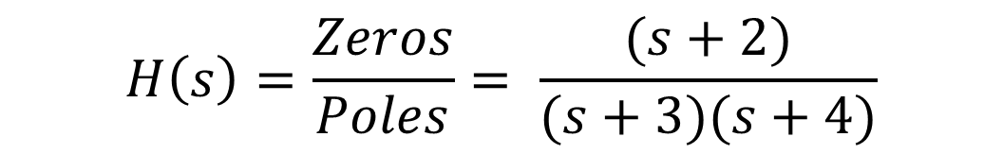
Q: Find the Poles And Zeros Of Transfer Function
$$H\left(s\right)=\frac{(s+2)}{(s+3)(s+4)}$$
$$Solution:$$
$$H\left(s\right)=\frac{Zeros}{Poles}= \frac{(s+2)}{(s+3)(s+4)}$$
$$Zeros:s=−2$$
$$Poles:s=−3, s=−4$$

Slide 16
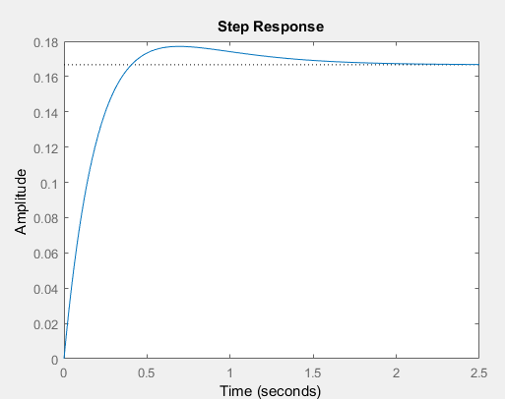
Q: Write the MATLAB Code Of Transfer Function
$$H\left(s\right)=\frac{(s+2)}{(s+3)(s+4)}$$
$$Solution:$$
$$H\left(s\right)=\frac{Zeros}{Poles}= \frac{(s+2)}{(s+3)(s+4)}=\frac{(s+2)}{(s^{2}+3s+4s+12)}=\frac{(s+2)}{(s^{2}+7s+12)}$$
>> numerator = [1 2];
>> denominator = [1 7 12];
>> sys = tf(numerator, denominator)
sys =
s + 2
--------------
s^2 + 7 s + 12
Continuous-time transfer function.
plot(sys)

Slide 17
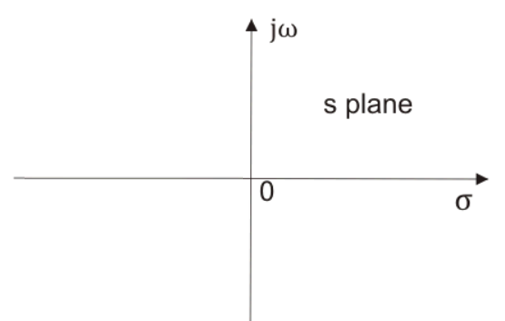
Pole-Zero Diagram
Plot on s-plane which represents the location of Poles and Zeros of a Transfer Function is called as Pole-Zero Diagram.
Poles are represented by ×
Zeros are represented by
X-axis is sigma-axis (real part of x)
Y-axis is the jω-axis which is the imaginary part of x

Slide 18
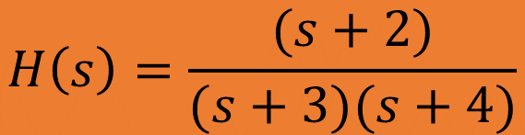

Q: Find the Poles And Zeros Of Transfer Function and Draw the Pole – Zero Diagram
$$H\left(s\right)=\frac{(s+2)}{(s+3)(s+4)}$$
$$Solution:$$
$$H\left(s\right)=\frac{Zeros}{Poles}= \frac{(s+2)}{(s+3)(s+4)}$$
$$Zeros:s=−2$$
$$Poles:s=−3, s=−4$$

Slide 19
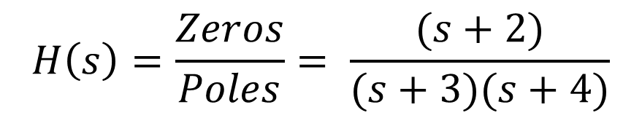
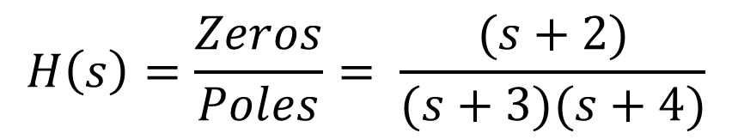

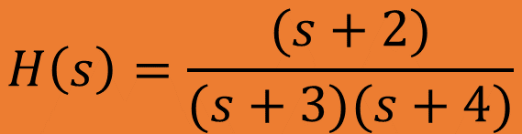


Q: Find the Poles And Zeros Of Transfer Function and Draw the Pole – Zero Diagram
$$jσ$$
$$H\left(s\right)=\frac{(s+2)}{(s+3)(s+4)}$$
$$H\left(s\right)=\frac{Zeros}{Poles}= \frac{(s+2)}{(s+3)(s+4)}$$
$$−σ$$
$$σ$$
-5 -4 -3 -2 -1
1 2 3 4 5
$$H\left(s\right)=\frac{Zeros}{Poles}= \frac{(s+2)}{(s+3)(s+4)}$$
$$Zeros:s=−2$$
$$Poles:s=−3, s=−4$$
$$−jσ$$

Slide 20



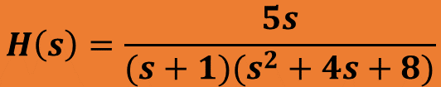
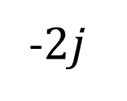


Q: Find the Poles And Zeros Of Transfer Function and Draw the Pole – Zero Diagram
$$jσ$$
$$H\left(s\right)=\frac{5s}{(s+1)(s^{2}+4s+8)}$$
$$2j$$
$$j$$
$$H\left(s\right)=\frac{Zeros}{Poles}= \frac{5s}{(s+1)(s^{2}+4s+8)}=\frac{5s}{(s+1)(s+2−2j)(s+2+2j)}$$
$$−σ$$
$$σ$$
-5 -4 -3 -2 -1
1 2 3 4 5
$$−j$$
-$2j$
$$Zeros:s=0$$
$$Poles:s=−1, \left(−2+2j\right), (2−2j)$$
$$−jσ$$

Slide 21
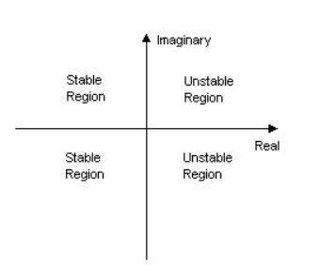
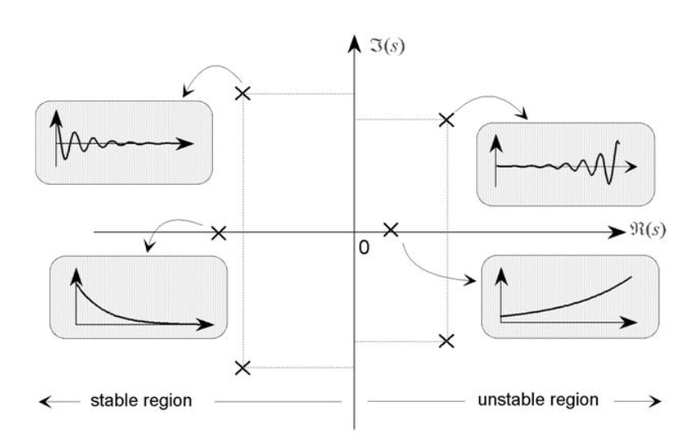
Check Different Stable And Unstable Regions

Slide 22
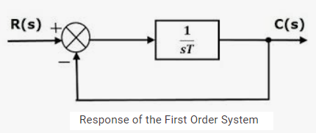
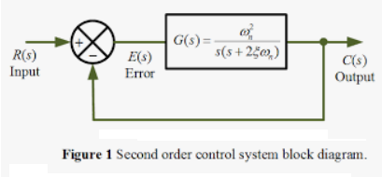
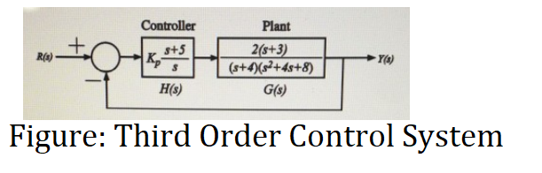
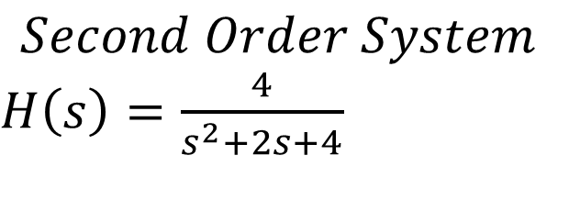
Order of the Control System
The order of a control system is determined by the power of ‘s’ in the denominator of its transfer function. If the power of s in the denominator of the transfer function of a control system is 2, then the system is said to be second order control system.
$$Second Order System$$
$H\left(s\right)=\frac{4}{s^{2}+2s+4}$

Slide 23
Root Locus Method
It is the combination of two words: root-loci
We are interested in the roots of the Denominator of the closed loop transfer function, that is the closed loop poles.
Locus is a path (or route) one might follow. Loci is the plural form.
The root locus is the path of the roots of the characteristic equation traced out in the s-plane as a system parameter varies from zero to infinity.
It is a graphical method for examining the change in the roots of a system when gain of the system varies.
Root-loci are the paths followed by the closed loop poles as K changes, because poles are tell us about stability and behavior.

Slide 24
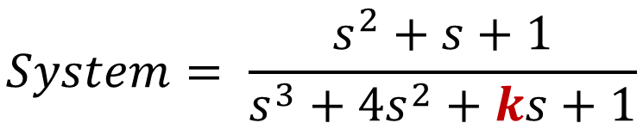
Root Locus Method
System
Parameter K,
Where K is unknown Parameters and what affect on the stability of the system
Input
Output
$$System= \frac{s^{2}+s+1}{s^{3}+{4s}^{2}+ks+1}$$
So here two problems occur due to K
First what value of K we should select to meet my system performance requirements.
Second what is the effect of a variation of K on the system

Slide 25
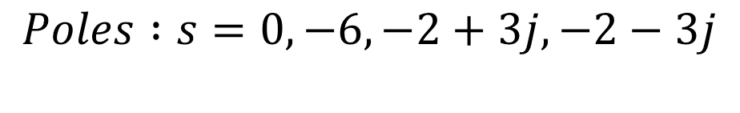
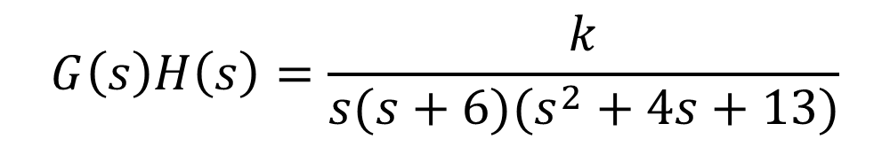



Procedure of Root Locus
$$G\left(s\right)H\left(s\right)=\frac{k}{s(s+6)(s^{2}+4s+13)}$$
Step-1: Calculate the Starting Points (Poles)
$$Poles :s=0, −6, −2+3j, −2−3j$$
$$No of Poles values=P=4$$
Step-2: Calculate the Ending Points (Zeros)
$$Zeros:s=0$$
$$No of Zeros values=Z=0$$
Step-3: Calculate the Numerator of root locus N
P>Z (4>0) than N = P
$N=4$

Slide 26

Procedure of Root Locus
$$jσ$$
Step-4: Existence of Root Locus in S-Plane
$$Poles :s=0, −6, −2+3j, −2−3j$$
3j 2j j
$$Zeros:s=None, No:of Zeros=0$$
$$−σ$$
$$σ$$
-6 -5 -4 -3 -2 -1
1 2 3 4 5
-j -2j -3j
Shaded because odd poles on right side
Shaded because 3 poles on right side so
it is odd poles we shaded it
So, root locus exists between 0 to -6.
$$−jσ$$

Slide 27
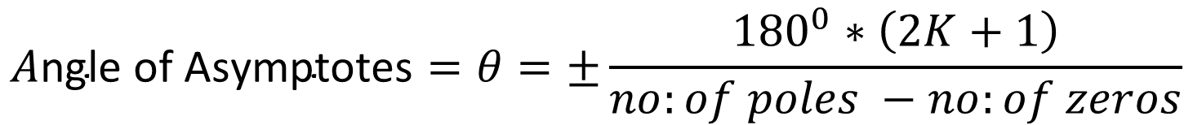
Procedure of Root Locus
Step-5: Angle of Asymptotes
$$A\text{ngle} \text{of} \text{Asymptotes}=θ=±\frac{{180}^{0}∗\left(2K+1\right)}{no:of poles −no:of zeros}$$
$K=p−z−1=4−0−1=3,$ So value of K = 0,1,2,3
$$If K=0 than −→A\text{ngle} \text{of} \text{Asymptotes}=θ_{1}=\frac{{180}^{0}∗\left(2K+1\right)}{no:of poles −no:of zeros}=\frac{{180}^{0}∗\left(2∗0+1\right)∗}{\left(4−0\right)}=\frac{{180}^{0}}{4}={45}^{0}$$
$$If K=1 than −→A\text{ngle} \text{of} \text{Asymptotes}=θ_{2}=\frac{{180}^{0}∗\left(2K+1\right)}{no:of poles −no:of zeros}=\frac{{180}^{0}∗\left(2∗1+1\right)∗}{\left(4−0\right)}=\frac{{180}^{0}∗3}{4}={135}^{0}$$
$$If K=2 than −→A\text{ngle} \text{of} \text{Asymptotes}=θ_{3}=\frac{{180}^{0}∗\left(2K+1\right)}{no:of poles −no:of zeros}=\frac{{180}^{0}∗\left(2∗2+1\right)∗}{\left(4−0\right)}=\frac{{180}^{0}∗5}{4}={225}^{0}$$
$$If K=3 than −→A\text{ngle} \text{of} \text{Asymptotes}=θ_{4}=\frac{{180}^{0}∗\left(2K+1\right)}{no:of poles −no:of zeros}=\frac{{180}^{0}∗\left(2∗3+1\right)∗}{\left(4−0\right)}=\frac{{180}^{0}∗7}{4}={315}^{0}$$

Slide 28
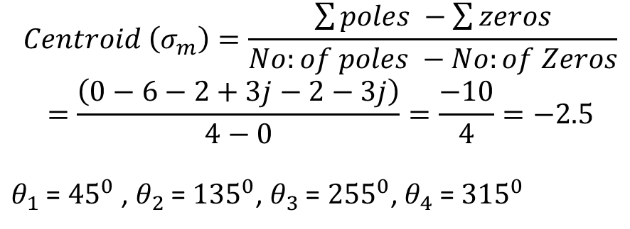
Procedure of Root Locus
$$jσ$$
Step-6: Find the Centroid
$$Centroid \left(σ_{m}\right)=\frac{\sum{poles −\sum{zeros}}}{No:of poles −No:of Zeros}$$
$$=\frac{\left(0−6−2+3j−2−3j\right)}{4−0}=\frac{−10}{4}=−2.5$$
$θ_{1}$ = ${45}^{0}$ , $θ_{2}$ = ${135}^{0}$, $θ_{3}$ = ${255}^{0}$, $θ_{4}$ = ${315}^{0}$
3j 2j j
$$−σ$$
$$σ$$
-6 -5 -4 -3 -2 -1
1 2 3 4 5
-j -2j -3j
$$−jσ$$

Slide 29
Procedure of Root Locus
Step-7: Break Away Point and Break In Point
Break away point is a point on Root Locus where multiple roots of characteristics equation occurs for particular value of gain K.

