Slide 1
Previous Layer
Conv 1×1
Conv 3×3
Conv 5×5
Conv 7×7
Conv 9×9
LReLU
LReLU
LReLU
LReLU
LReLU
Concatenate
Concatenate
Concatenate
Concatenate
Concatenate
Conv 3×3
Conv 3×3
Conv 3×3
Conv 3×3
Conv 3×3
Conv 1×1
Conv 1×1
Conv 1×1
Conv 1×1
Conv 1×1
Add
LReLU
Figure: Channel Splitting Residual Block (CSRB)

Slide 2
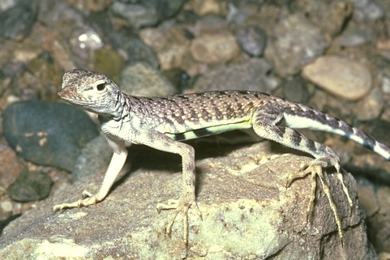
Conv 3×3
LReLU
DCSRB Block
Summation
Deconvolution
HR
LR

