Slide 1

MCSNet: Multi-Channel Sharing Network for Single Image Super-Resolution
MCSNet: Multi-Channel Sharing Network for Single Image Super-Resolution
Wazir Muhammad, Supavadee Aramvith, and Watchara Ruangsang
SESSION NO: SS16
Emerging Techniques in Multimedia Data Analytics and Codings)

Slide 2
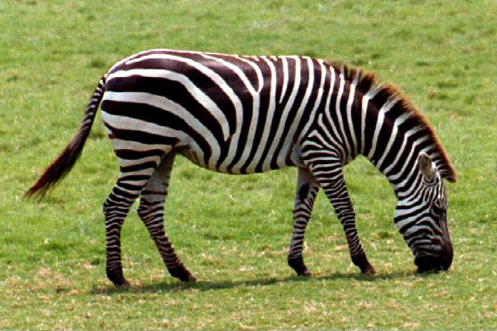
MCSNet: Multi-Channel Sharing Network for Single Image Super-Resolution
Task of SISR
Reconstruct visually pleasing HR output
Input as a degraded low quality input image.
Upscale Factor
LR
Applications
HR
Satellite Imaging
Security Surveillance
Face Recognition
Medical Imaging

Slide 3

MCSNet: Multi-Channel Sharing Network for Single Image Super-Resolution
Our main target is to obtained the large, sharp and visually pleasing HR output Image.
HR reconstructed but Blurry
Interpolation
HR Reconstructed
enlarge as well
as sharp
LR
Convolutional Neural Network Approach
HR

Slide 4
MCSNet: Multi-Channel Sharing Network for Single Image Super-Resolution
Problem with Existing Image Superresolution Algorithms
Interpolation technique.
SRCNN, FSRCNN and ESPCN used a single layer for initial feature extraction.
Stack the CNN layers side by side to develop a deeper model
Used Preprocessing as an Interpolation

Slide 5
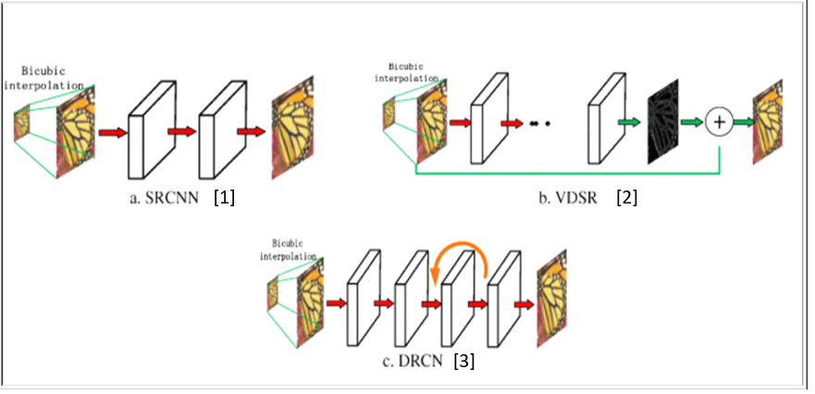
MCSNet: Multi-Channel Sharing Network for Single Image Super-Resolution
Related Work
Figure: Related works (SRCNN, VDSR, and DRCNN)
[1] Dong, Chao, Chen Change Loy, Kaiming He, and Xiaoou Tang. "Image super-resolution using deep convolutional networks." IEEE transactions on pattern analysis and machine intelligence 38, no. 2 (2015): 295-307.
[2] Kim, Jiwon, Jung Kwon Lee, and Kyoung Mu Lee. "Accurate image super-resolution using very deep convolutional networks." In Proceedings of the IEEE conference on computer vision and pattern recognition, pp. 1646-1654. 2016.
[3] Kim, Jiwon, Jung Kwon Lee, and Kyoung Mu Lee. "Deeply-recursive convolutional network for image super-resolution." In Proceedings of the IEEE conference on computer vision and pattern recognition, pp. 1637-1645. 2016.

Slide 6
Our Proposed Network Architecture
MCSNet: Multi-Channel Sharing Network for Single Image Super-Resolution

Slide 7

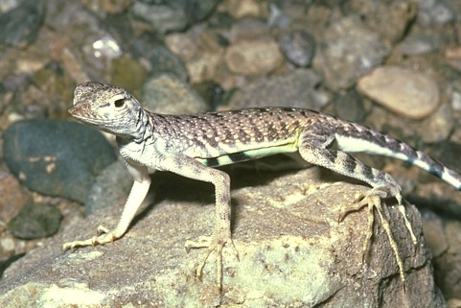
MCSNet: Multi-Channel Sharing Network for Single Image Super-Resolution
Figure: Pre-Upsampling Image SR approach
Figure: Post-Upsampling Image SR approach

Slide 8
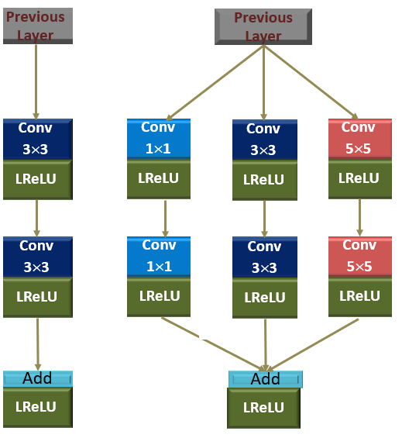
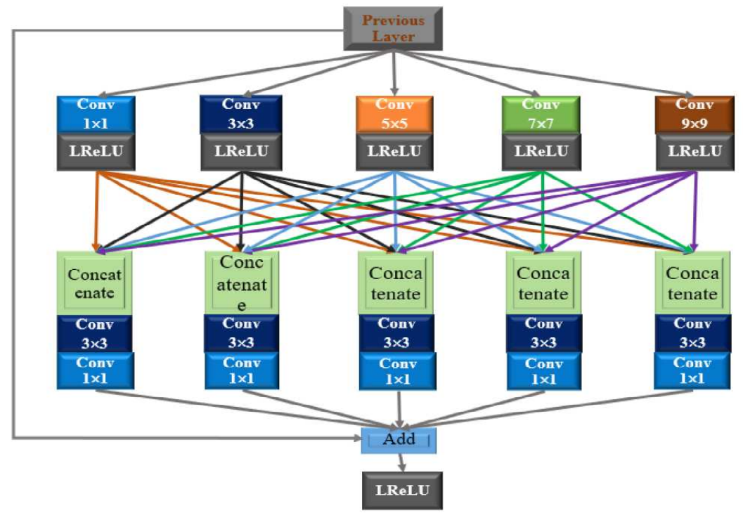
MCSNet: Multi-Channel Sharing Network for Single Image Super-Resolution
Dense Channel Sharing Resnet block (DCSRB)
Our Proposed
Approach (DCSRB)Block
Linear
Approach
Multipath Block
Approach

Slide 9
MCSNet: Multi-Channel Sharing Network for Single Image Super-Resolution
Our Proposed Network Architecture
Conv 3×3
LReLU
DCSRB Block
Summation
Deconvolution
LR
Figure: Our Proposed Methods (MCSNet)
HR

Slide 10
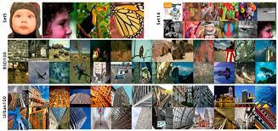
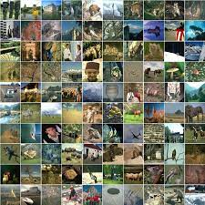
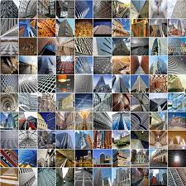
MCSNet: Multi-Channel Sharing Network for Single Image Super-Resolution
Training and Testing Details
Training datasets
91 images from Yang et al
100 images from BSDS100
and 50 images from DIV2K
80% used in training
20% in validation.
Optimizer is used as Adam
Initial learning rate is 0.0001
Epochs 100
Patch size ie 32.
Figure: Images of Testing and Training Datasets

Slide 11
MCSNet: Multi-Channel Sharing Network for Single Image Super-Resolution
Training and Testing Details
Testing datasets
Set5, Set14, Urban 100, and Manga109.
Quality metrics is the PSNR/SSIM.
Windows 10 operating system.
Graphics Card NVIDIA GeForce RTX2070.
GPU model having RAM of 16 GB.
Keras 2.15 and MATLAB2018a environment.
Figure: Images of Testing and Training Datasets

Slide 12
MCSNet: Multi-Channel Sharing Network for Single Image Super-Resolution
EXPERIMENTAL RESULTS

Slide 13
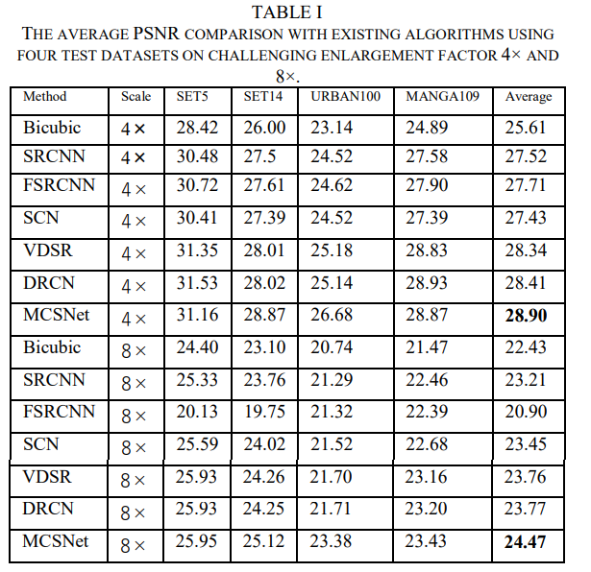
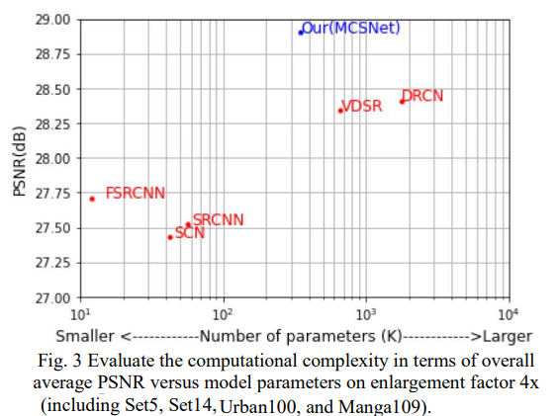
MCSNet: Multi-Channel Sharing Network for Single Image Super-Resolution
Quantitative Results

Slide 14
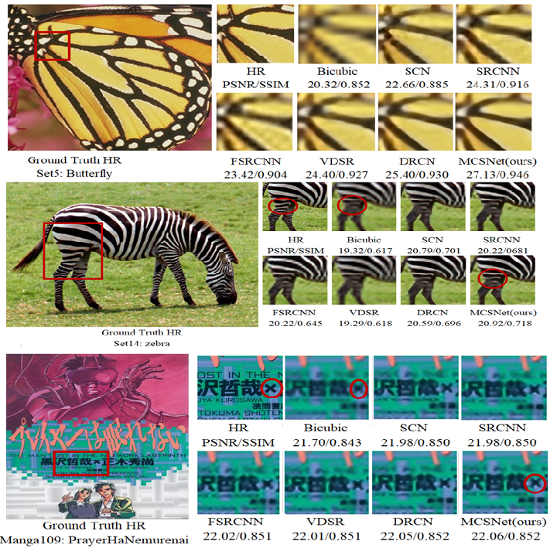
MCSNet: Multi-Channel Sharing Network for Single Image Super-Resolution
Qualitative Results
Figure. Presents the perceptual quality comparison on enlargement factor 8× of various image SR methods using test datasets of Set5, Set14 and Manga109.

Slide 15
MCSNet: Multi-Channel Sharing Network for Single Image Super-Resolution
Conclusion
MCSNet Used
Convolution Layers
LeakyReLU
Dense Channel Sharing Resnet block (DCSRB).
To improve quality LR image
We employed the four DCSRB bocks
Followed LeakyReLU function.
Detain HF Features Information
Adopts local and global skip connections.
Quantitative / qualitative presentation
evaluated on four public test datasets

