Slide 1
ELECTRICAL NETWORK ANALYSIS 3rd Semester (3+1)
By
Dr. Wazir Muhammad Laghari
Electrical Engineering Department
BUET, Khuzdar
Dated: 18-03-2022

Slide 2
Electrical Network Analysis
Electrical Network Analysis Prerequisites: Linear Circuit Analysis
Course Outline: Current and voltage transients, RLC circuits with DC and AC excitation, resonant circuit: series and parallel resonance in AC circuit, Q-Factor, bandwidth, selectivity. Poly phase generators, star and delta connections, phase sequence, voltage and current relations, Vector diagrams for balance and unbalanced three phase networks, three phase unbalanced star and delta connected loads, power in three phase circuits, and differential equations of its measurements, loop and node analysis using matrix approach, Two-port network, characterization of linear time-invariant, two ports by six sets of parameters, relationship among parameter sets, interconnection of two port network. Initial condition determination, Laplace transform and differential equations Laplace transforms of signals involving generalized functions, Convolution, Introduction to poles & zeros and stability criteria, impedance functions and network theorems, Frequency response, magnitude and phase plots. Fourier series and transform

Slide 3
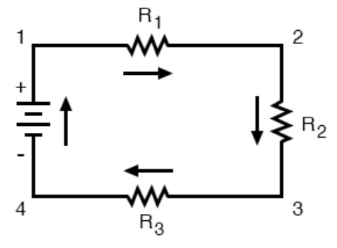
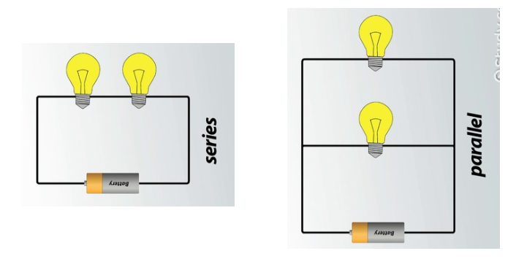
CIRCUIT/ELECTRICAL CIRCUIT
Circuit or an electrical circuit is a path or line through which an electrical current flows.

Slide 4
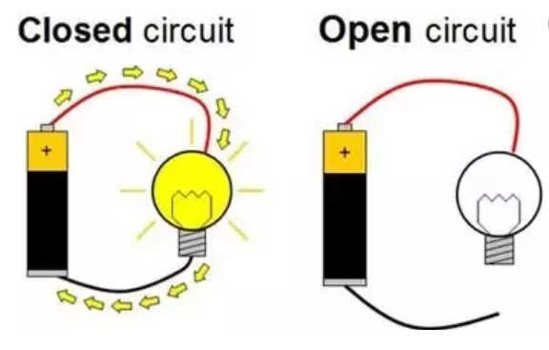
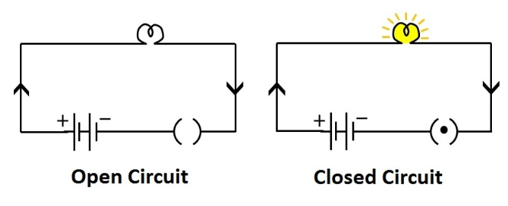
CLOSED AND OPEN CIRCUIT
Closed circuit means a complete electrical connection around which current flows or circulates is called Closed Circuit.
OR
A closed circuit makes electrical current flow possible.
An open circuit does not allow electrical current to flow.

Slide 5
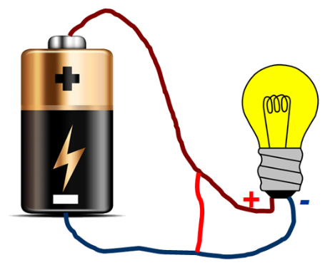
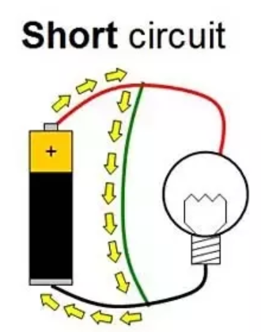
SHORT CIRCUIT
When both points (+ & –) of voltage source in a circuit gets joint with each other for some reason then it is called Short Circuit.
Maximum current starts to flow under this situation.

Slide 6
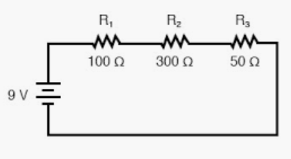
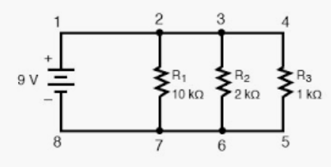
SERIES AND PARALLEL CIRCUIT
A series circuit is a circuit in which resistors are arranged in a chain, so the current has only one path to take. The current is the same through each resistor, but voltage is different.
A parallel circuit has two or more paths for current to flow through. Voltage is the same across each component of the parallel circuit, but current is different.

Slide 7
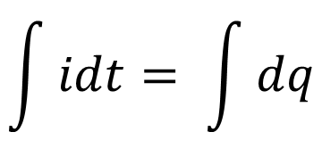
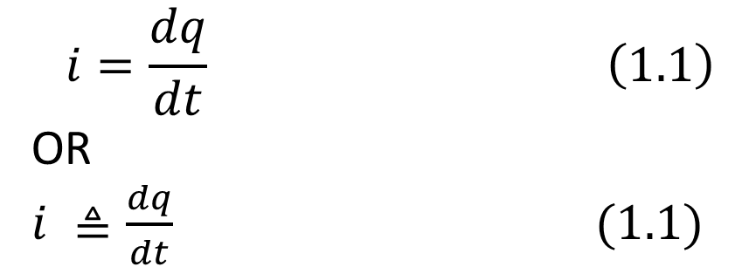
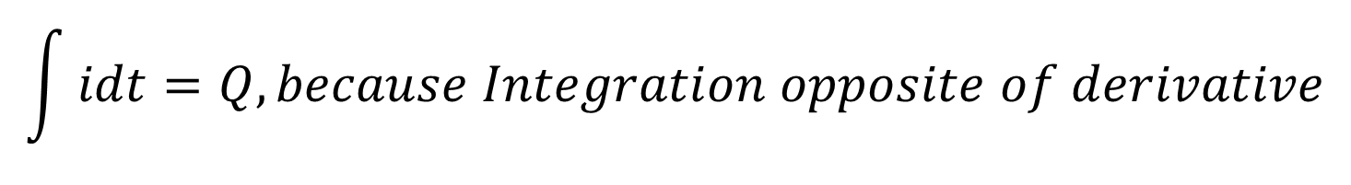
ELECTRIC CURRENT
Electric current is the time rate of change of charge and measured in amperes (A).
Mathematically, the relationship between current i, charge q, and time t is
$$i=\frac{dq}{dt} \left(1.1\right)$$
OR
$i ≜\frac{dq}{dt} (1.1)$
From Equation (1.1)
idt = dq
Applying Integration on both sides
$$\int{idt= \int{dq}}$$
$$\int{idt=Q, because Integration opposite of derivative}$$

Slide 8
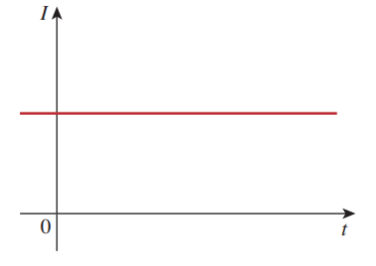
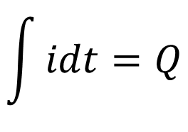
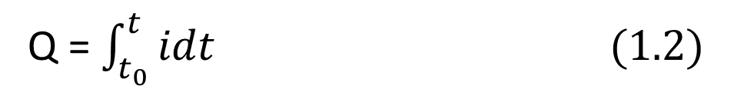
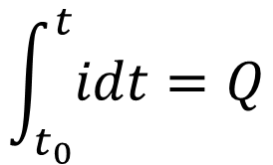
ELECTRIC CURRENT
$$\int{idt=Q}$$
The charge transferred between time t₀ and t is obtained
$$\int_{t_{0}}^{t}{idt=Q}$$
Q = $\int_{t_{0}}^{t}{idt (1.2)}$

Slide 9

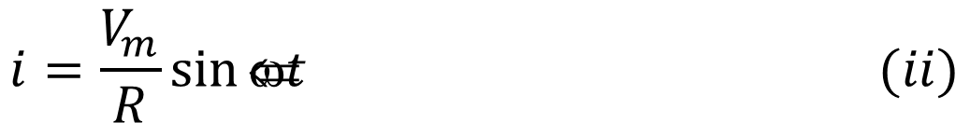
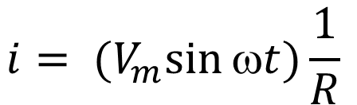

A.C. Through Pure Ohmic Resistance Alone
$$v= V_{m}\sin{ωt (i)}$$
$v=iR$
$$Put the value of v in equation (i)$$
$$v= V_{m}\sin{ωt }$$
$$iR= V_{m}\sin{ωt }$$
$$i= {(V}_{m}\sin{ωt)\frac{1}{R} }$$
$$i=\frac{V_{m}}{R}\sin{ωt} (ii)$$

Slide 10
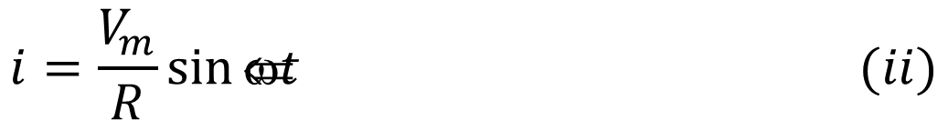
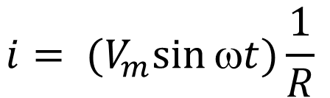
A.C. Through Pure Ohmic Resistance Alone
$$v= V_{m}\sin{ωt (i)}$$
$$i= {(V}_{m}\sin{ωt)\frac{1}{R} }$$
$$i=\frac{V_{m}}{R}\sin{ωt} (ii)$$
$$i=I_{m}sin{t} (iii)$$
Current i is maximum, when sinwt is unity (90⁰)
Compare equation (i) and (ii) shows that sinwt have same value or in Phase. And Vector diagram by V_{R} and I.

Slide 11


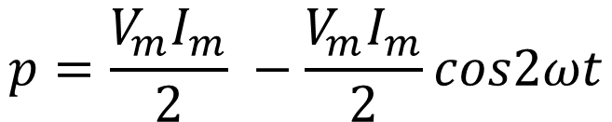
A.C. Through Pure Ohmic Resistance Alone
$$v= V_{m}\sin{ωt (i)}$$
$$i=I_{m}sin{t} (iii)$$
$$Instantaneous Power, p=vi= {\left(V_{m}\sin{ωt}\right)\left(I_{m}\sin{ωt}\right)=V}_{m}I_{m}\sin^{2}ωt$$
$p= V_{m}I_{m}\sin^{2}ωt=\frac{V_{m}I_{m}}{2}$ (2 $\sin^{2}ωt$) = $\frac{V_{m}I_{m}}{2}(1−cos2ωt)$
$$p=\frac{V_{m}I_{m}}{2} −\frac{V_{m}I_{m}}{2}cos2ωt$$

Slide 12
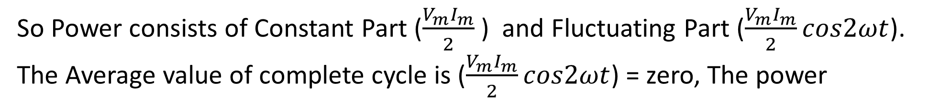
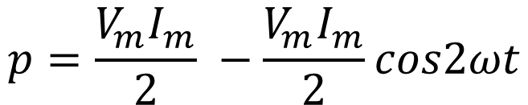
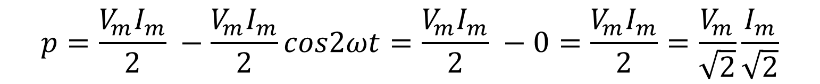
A.C. Through Pure Ohmic Resistance Alone
$$v= V_{m}\sin{ωt (i)}$$
$$i=I_{m}sin{t} (iii)$$
$$p=\frac{V_{m}I_{m}}{2} −\frac{V_{m}I_{m}}{2}cos2ωt$$
So Power consists of Constant Part ($\frac{V_{m}I_{m}}{2}$) and Fluctuating Part ($\frac{V_{m}I_{m}}{2}cos2ωt$).
The Average value of complete cycle is ($\frac{V_{m}I_{m}}{2}cos2ωt$) = zero, The power
$$p=\frac{V_{m}I_{m}}{2} −\frac{V_{m}I_{m}}{2}cos2ωt=\frac{V_{m}I_{m}}{2} −0=\frac{V_{m}I_{m}}{2}=\frac{V_{m}}{\sqrt{2}}\frac{I_{m}}{\sqrt{2}}$$

Slide 13
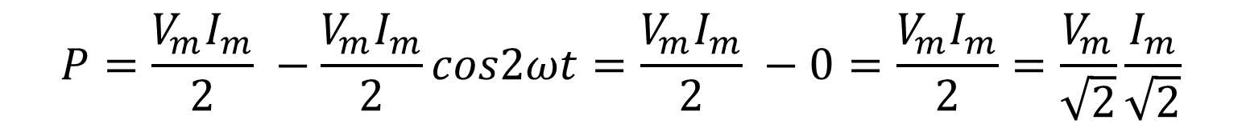

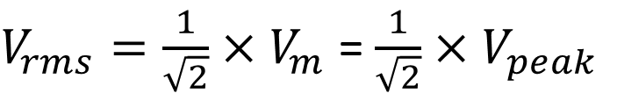
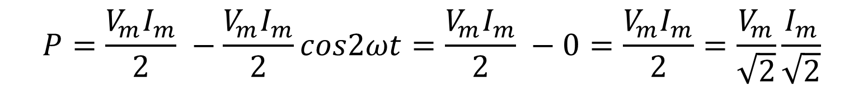
A.C. Through Pure Ohmic Resistance Alone
$$P=\frac{V_{m}I_{m}}{2} −\frac{V_{m}I_{m}}{2}cos2ωt=\frac{V_{m}I_{m}}{2} −0=\frac{V_{m}I_{m}}{2}=\frac{V_{m}}{\sqrt{2}}\frac{I_{m}}{\sqrt{2}}$$
$$P=\frac{V_{m}I_{m}}{2} −\frac{V_{m}I_{m}}{2}cos2ωt=\frac{V_{m}I_{m}}{2} −0=\frac{V_{m}I_{m}}{2}=\frac{V_{m}}{\sqrt{2}}\frac{I_{m}}{\sqrt{2}}$$
$V_{rms}=\frac{1}{\sqrt{2}}$ $×V_{m}$ = $\frac{1}{\sqrt{2}}$ ${×V}_{peak}$
$$P=\frac{V_{m}}{\sqrt{2}}\frac{I_{m}}{\sqrt{2}}=V_{rms}{×I}_{rms}$$
In Power wave there is no negative cycle at any time

Slide 14

A.C. Through Pure Ohmic Resistance Alone
$$P=\frac{V_{m}}{\sqrt{2}}\frac{I_{m}}{\sqrt{2}}=V_{rms}{×I}_{rms}$$
In Power wave there is no negative cycle at any time.
In other words, in a purely resistive circuits, power is never zero. This is so because the instantaneous values of voltage and current always either both positive or negative and hence the product is always positive.

Slide 15






A.C. Through Pure Ohmic Resistance Alone
Q: a 60 Hz voltage of 115 V (rms) is impressed on a 100 ohm resistance: (i) Write the time equations for the voltage and the resulting current. Let the zero point of the voltage wave be at t = 0 (ii) Show the voltage and current on a time diagram. (iii) Show the voltage and current on a phasor diagram.
$$SOLUTION$$
$$DATA$$
$$frequency=f=60 Hz$$
$$Voltage=115 V(rms)$$
$$Resistance=R=100 ohm$$
$$\left(i\right)write the time equations \text{for} \text{the} \text{voltage} \text{and} \text{the} \text{resulting} \text{current}at time t=0$$
$$v= V_{m}\sin{ωt= ? }$$
$$i= I_{m}\sin{ωt = ?}$$

Slide 16
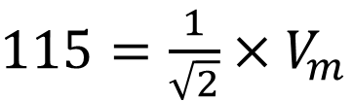
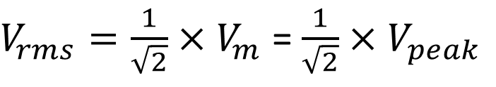
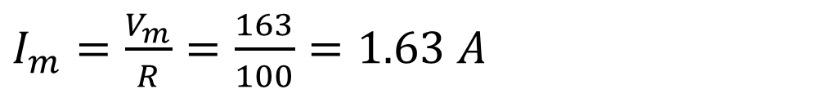




A.C. Through Pure Ohmic Resistance Alone
$V_{rms}=\frac{1}{\sqrt{2}}$ $×V_{m}$ = $\frac{1}{\sqrt{2}}$ ${×V}_{peak}$
$115=\frac{1}{\sqrt{2}}$ $×V_{m}$
$$115×\sqrt{2}=V_{m}$$
$$V_{m}=163$$
$$v= V_{m}\sin{ωt= ? }$$
$I_{m}=\frac{V_{m}}{R}=\frac{163}{100}=1.63 A$
$$i= I_{m}\sin{ωt = ?}$$
$∅=0, ω=2πf=2π$ $×60=2×3.14×60= 377 rad/s$
The required equations in (i) and (ii) are as under:
$$v= V_{m}\sin{ωt =163\sin{377t −−−−−−−−−−Answer}}$$
$$i= I_{m}\sin{ωt =1.63\sin{377t}}−−−−−−−−−−Answer$$

Slide 17
(ii) Show the voltage and current on a time diagram
(iii) Show the voltage and current on a phasor diagram

