Slide 1
ELECTRICAL NETWORK ANALYSIS 3rd Semester (3+1)
By
Dr. Wazir Muhammad Laghari
Electrical Engineering Department
BUET, Khuzdar

Slide 2
Electrical Network Analysis
Electrical Network Analysis Prerequisites: Linear Circuit Analysis
Course Outline: Current and voltage transients, RLC circuits with DC and AC excitation, resonant circuit: series and parallel resonance in AC circuit, Q-Factor, bandwidth, selectivity. Poly phase generators, star and delta connections, phase sequence, voltage and current relations, Vector diagrams for balance and unbalanced three phase networks, three phase unbalanced star and delta connected loads, power in three phase circuits, and differential equations of its measurements, loop and node analysis using matrix approach, Two-port network, characterization of linear time-invariant, two ports by six sets of parameters, relationship among parameter sets, interconnection of two port network. Initial condition determination, Laplace transform and differential equations Laplace transforms of signals involving generalized functions, Convolution, Introduction to poles & zeros and stability criteria, impedance functions and network theorems, Frequency response, magnitude and phase plots. Fourier series and transform

Slide 3
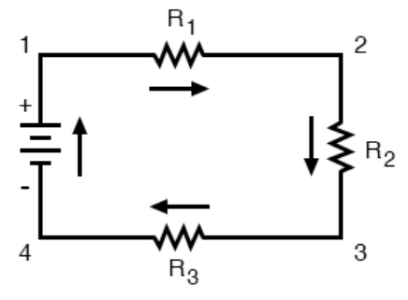
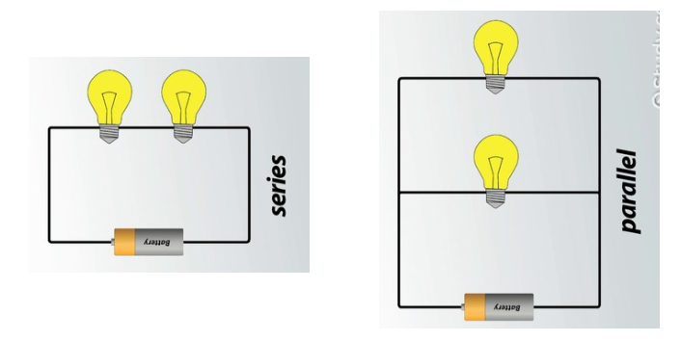
CIRCUIT/ELECTRICAL CIRCUIT
Circuit or an electrical circuit is a path or line through which an electrical current flows.

Slide 4
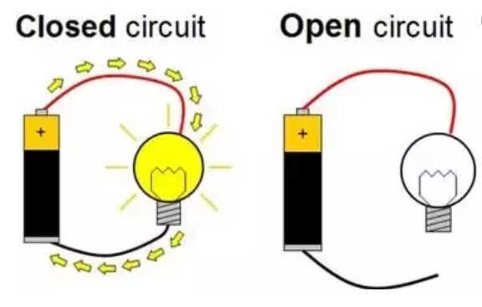
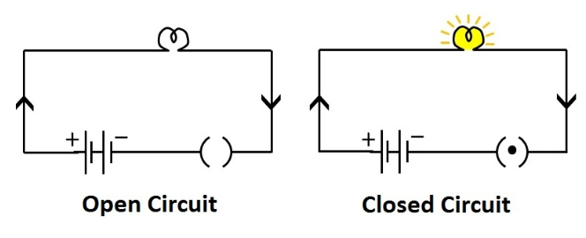
CLOSED AND OPEN CIRCUIT
Closed circuit means a complete electrical connection around which current flows or circulates is called Closed Circuit.
OR
A closed circuit makes electrical current flow possible.
An open circuit does not allow electrical current to flow.

Slide 5
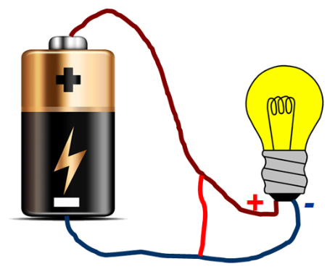
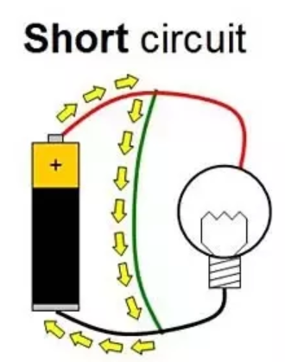
SHORT CIRCUIT
When both points (+ & –) of voltage source in a circuit gets joint with each other for some reason then it is called Short Circuit.
Maximum current starts to flow under this situation.

Slide 6
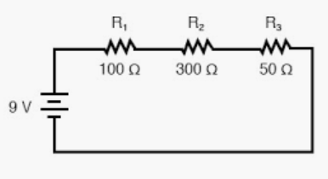
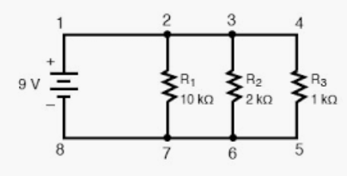
SERIES AND PARALLEL CIRCUIT
A series circuit is a circuit in which resistors are arranged in a chain, so the current has only one path to take. The current is the same through each resistor, but voltage is different.
A parallel circuit has two or more paths for current to flow through. Voltage is the same across each component of the parallel circuit, but current is different.

Slide 7
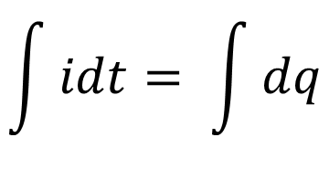
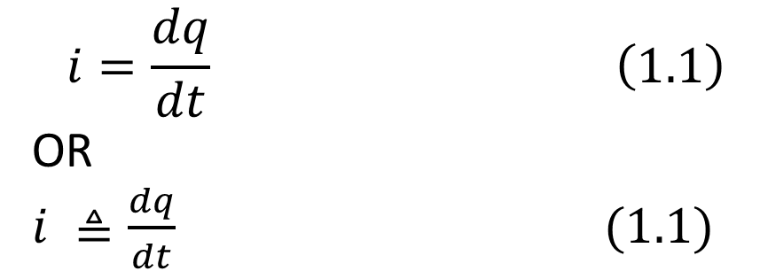
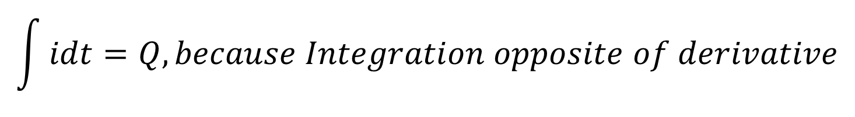
ELECTRIC CURRENT
Electric current is the time rate of change of charge and measured in amperes (A).
Mathematically, the relationship between current i, charge q, and time t is
$$i=\frac{dq}{dt} \left(1.1\right)$$
OR
$i ≜\frac{dq}{dt} (1.1)$
From Equation (1.1)
idt = dq
Applying Integration on both sides
$$\int{idt= \int{dq}}$$
$$\int{idt=Q, because Integration opposite of derivative}$$

Slide 8
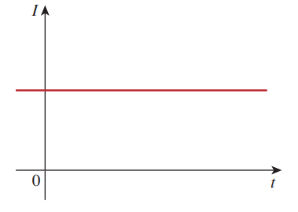
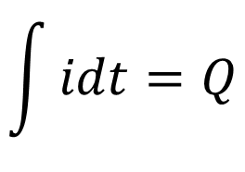
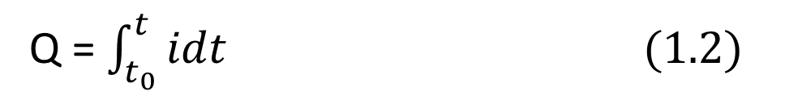
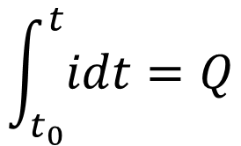
ELECTRIC CURRENT
$$\int{idt=Q}$$
The charge transferred between time t₀ and t is obtained
$$\int_{t_{0}}^{t}{idt=Q}$$
Q = $\int_{t_{0}}^{t}{idt (1.2)}$

Slide 9
Quiz: How much charge is represented by 4,600 electrons?
Solution:
Each electron has = -1.602 x 10⁻¹⁰ C/electron.
Hence 4,600 electrons = -1.602 x 10⁻¹⁰ C/electron * 4,600 electrons
Hence 4,600 electrons = -7.369 x 10⁻¹⁶ C
Solution:
Each proton electron has= 1.602 x 10⁻¹⁰ C/electron.
Hence 4,600 electrons = +1.602 x 10⁻¹⁰ C/electron * 6,000,000 electrons
Hence 4,600 electrons = +9.612 x 10⁻¹³ C
Quiz: Calculate the amount of charge represented by six million protons.

Slide 10
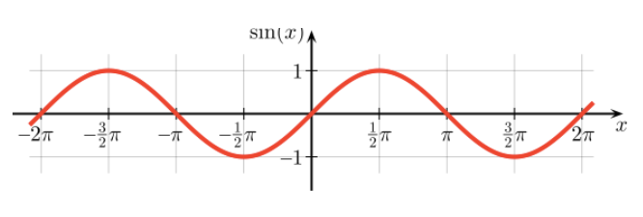
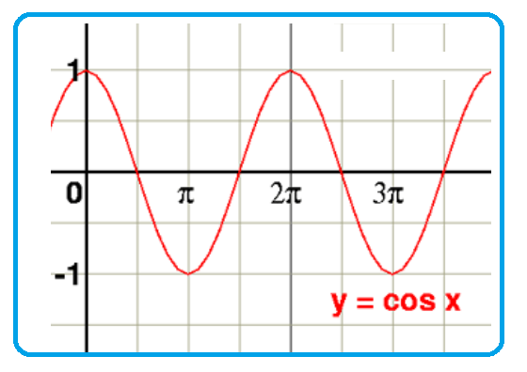
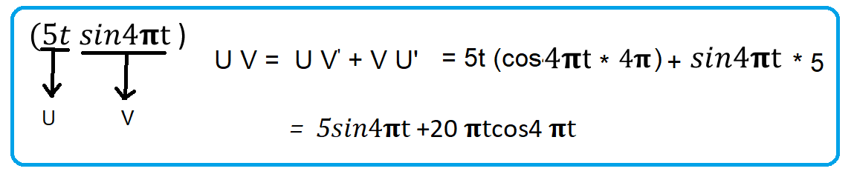
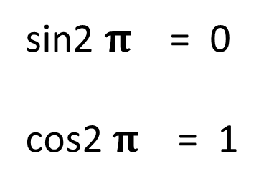
sin2 $\text{π}$ = 0
cos2 $\text{π}$ = 1

Slide 11
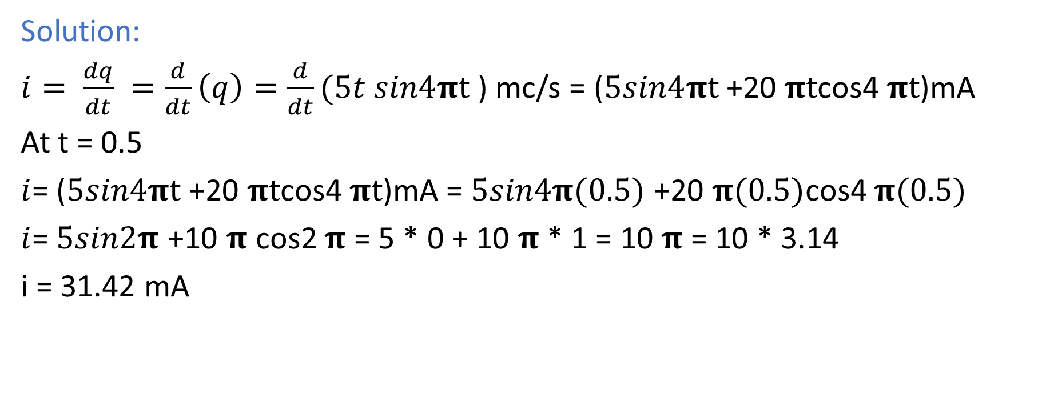

Quiz: The total charge entering a terminal is given by $q=5t sin\text{4}\text{π}\text{t} \text{m}C. Calculate the$ $current at t=0.5 s.$
Solution:
$i= \frac{dq}{dt} =\frac{d}{dt}\left(q\right)=\frac{d}{dt}(5t sin\text{4}\text{π}\text{t}$) mc/s = ($5sin\text{4}\text{π}\text{t}$+20 $\text{π}\text{t}$cos4 $\text{π}\text{t}$)mA
At t = 0.5
$i$= ($5sin\text{4}\text{π}\text{t}$+20 $\text{π}\text{t}$cos4 $\text{π}\text{t}$)mA = $5sin\text{4}\text{π}\text{(}\text{0.5}\text{) }$+20 $\text{π}\text{(}\text{0.5}\text{)}$cos4 $\text{π}\text{(}\text{0.5}\text{)}$
$i$= $5sin\text{2}\text{π}$+10 $\text{π}$ cos2 $\text{π}$ = 5 * 0 + 10 $\text{π}$ * 1 = 10 $\text{π}$ = 10 * 3.14
i = 31.42 mA

Slide 12
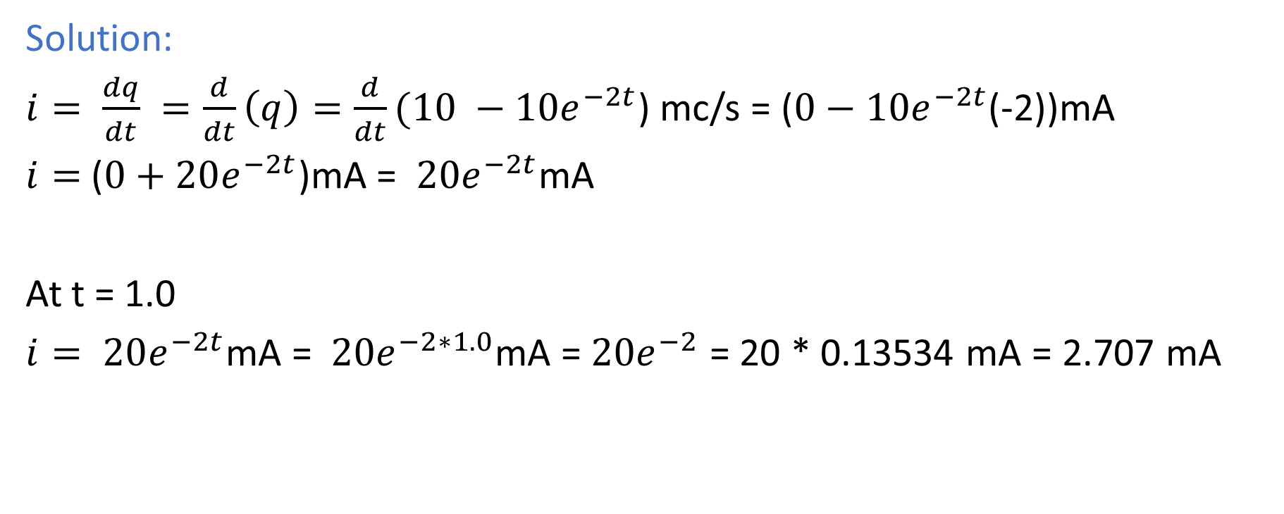

Quiz: The total charge entering a terminal is given by $q=(10 −{10e}^{−2t}\text{)}\text{m}C. Calculate the$ $current at t=1.0 s.$
Solution:
$i= \frac{dq}{dt} =\frac{d}{dt}\left(q\right)=\frac{d}{dt}(10 −{10e}^{−2t}$) mc/s = ($0−{10e}^{−2t}$(-2))mA
$i=$($0+20e^{−2t}$)mA = $20e^{−2t}$mA
At t = 1.0
$i= 20e^{−2t}$mA = $20e^{−2∗1.0}$mA = $20e^{−2}$ = 20 * 0.13534 mA = 2.707 mA

Slide 13
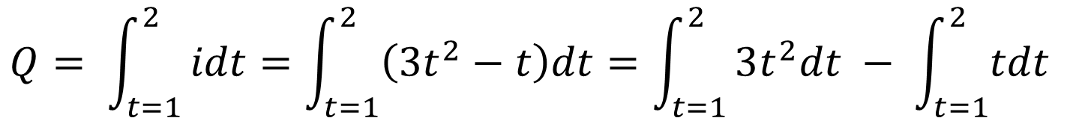
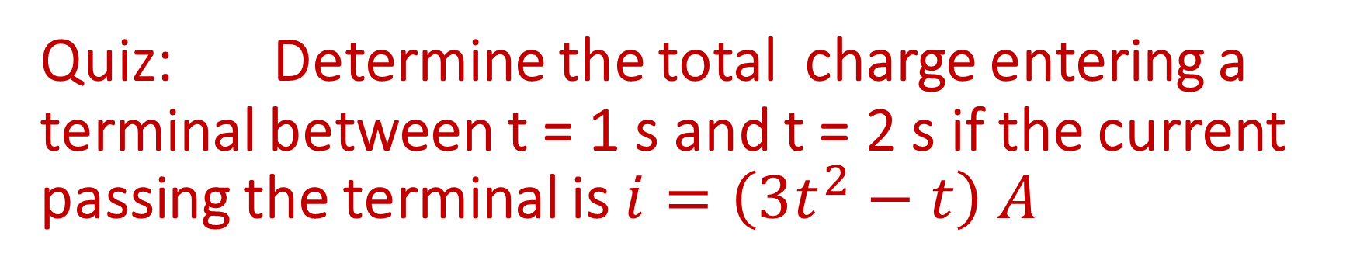
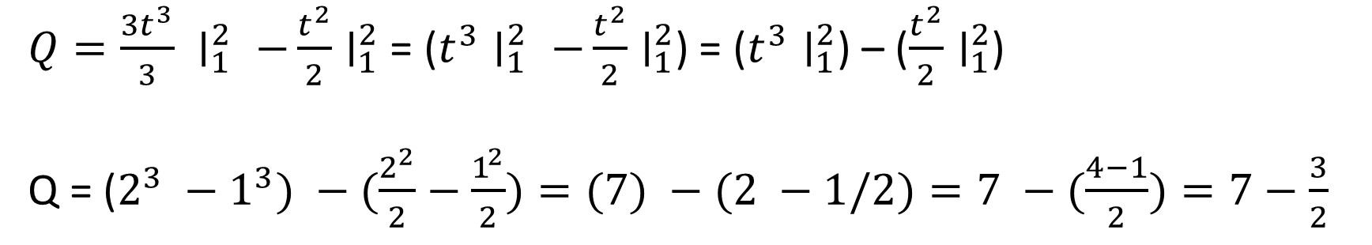
Quiz: Determine the total charge entering a terminal between t = 1 s and t = 2 s if the current passing the terminal is $i=\left(3t^{2}−t\right) A$
$$Q= \int_{t=1}^{2}{idt=\int_{t=1}^{2}{\left(3t^{2}−t\right)dt=\int_{t=1}^{2}{3t^{2}dt − \int_{t=1}^{2}{tdt} }}}$$
$Q=\frac{{3t}^{3}}{3} ∣_{1}^{2} −\frac{t^{2}}{2}∣_{1}^{2}$ = ($t^{3}∣_{1}^{2} −\frac{t^{2}}{2}∣_{1}^{2}$) = ($t^{3}∣_{1}^{2}$) – ($\frac{t^{2}}{2}∣_{1}^{2}$)
Q = ($2^{3} −1^{3}) −(\frac{2^{2}}{2}−\frac{1^{2}}{2})=(7) −(2 −1/2)=7 −(\frac{4−1}{2})=7−\frac{3}{2}$
Q = $7−\frac{3}{2} =\frac{14−3}{2}=\frac{11}{2}=5.5 C$

