Slide 1
ELECTRICAL NETWORK ANALYSIS 3rd Semester (3+1)
By
Dr. Wazir Muhammad Laghari
Electrical Engineering Department
BUET, Khuzdar

Slide 2
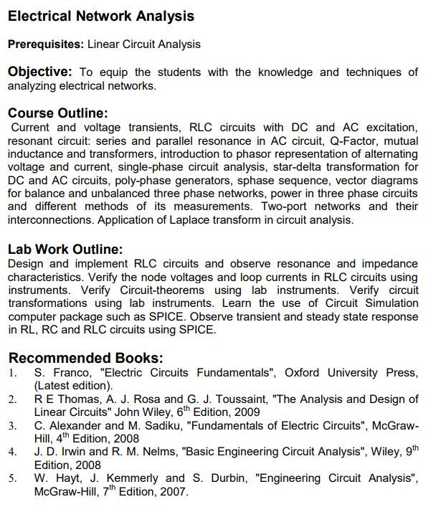
SYLLABUS

Slide 3
Electrical Network Analysis
Electrical Network Analysis Prerequisites: Linear Circuit Analysis
Course Outline: Current and voltage transients, RLC circuits with DC and AC excitation, resonant circuit: series and parallel resonance in AC circuit, Q-Factor, bandwidth, selectivity. Poly phase generators, star and delta connections, phase sequence, voltage and current relations, Vector diagrams for balance and unbalanced three phase networks, three phase unbalanced star and delta connected loads, power in three phase circuits, and differential equations of its measurements, loop and node analysis using matrix approach, Two-port network, characterization of linear time-invariant, two ports by six sets of parameters, relationship among parameter sets, interconnection of two port network. Initial condition determination, Laplace transform and differential equations Laplace transforms of signals involving generalized functions, Convolution, Introduction to poles & zeros and stability criteria, impedance functions and network theorems, Frequency response, magnitude and phase plots. Fourier series and transform

Slide 4
Volatge and Current connected long time, so due to this it attained the Steady Stae Condition
But for first time we connect the circuit and it takes the time reaches the steady state values of Voltage and Currents
So Suppose voltage connected long time with circuit and its steady state values of voltage and current is V₁ and I₁
If suddenly remove this voltage source from the circuit and circuit will attained the new values of voltage and currents that is V₂ and I₂ so time used to generate new values of V₂ and I₂ is known as Transient time
So this transition period or time is very short amount of time which is in the range of milli second to microseconds

Slide 5
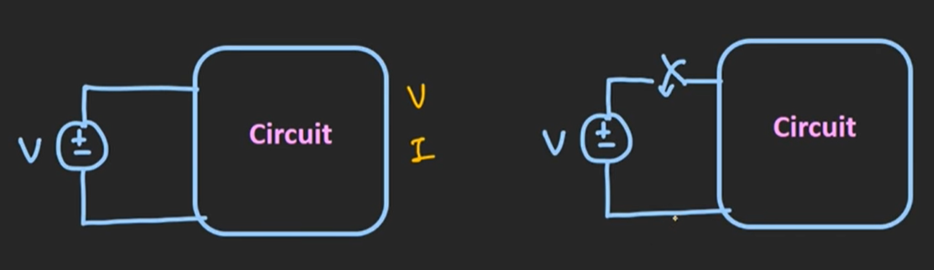
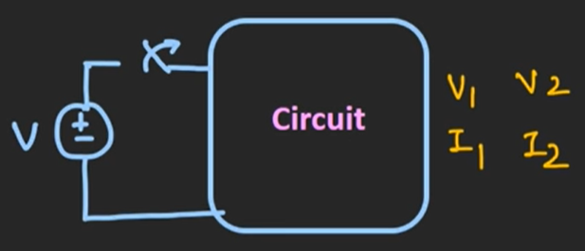

Slide 6
Transient Time
A system is said to be in a transient state when a process variable or variables have been changed and the system has not yet reached a steady state. The time taken for the circuit to change from one steady state to another steady state is called the transient time.

Slide 7
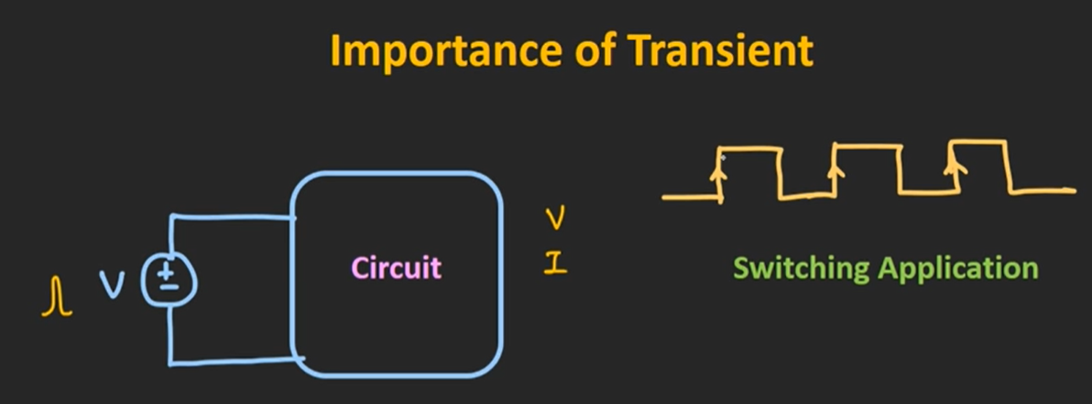
Importance of Transients or Why we read transient analysis in the circuit
Let us some spike comes in the circuits , may be some components may be failed , so it is necessary to see the behavior of the circuit that abruptly changes due to spikes, so how circuit behave due to this abrupt changes , so it is necessary to the values of volateg and current, if we analyze this current and voltage due to this transient, so whether our circuit is sustain such transient or not able to sustain the transients Transient is important particularly in switching application, like transistor act as switch

Slide 8
It is important to understand the behavior of the transistor or how it is fast as a switch from ON to OFF state

Slide 9
Now we see the behavior of basic components Resistor, Inductor and Capacitor for this transient conditions
So we see how this components like resistor behave in transients
At time t = 0, the resistor connected
time t = 0⁻ is the time just before close the switch

Slide 10
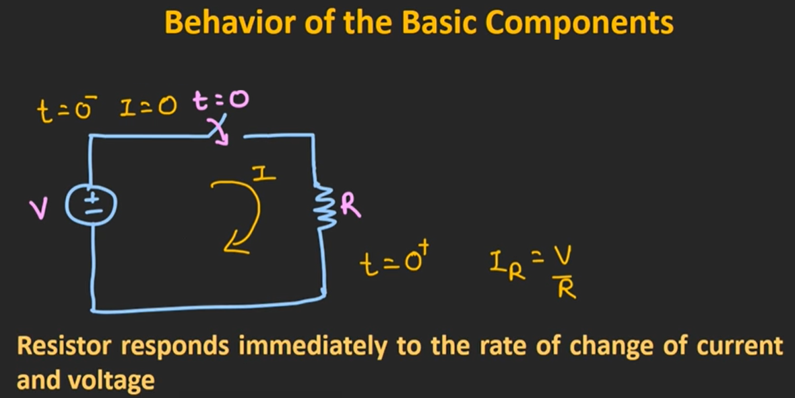
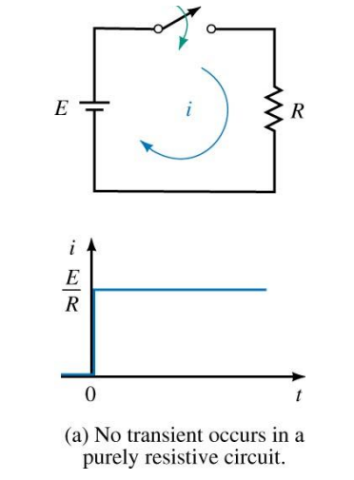

Slide 11
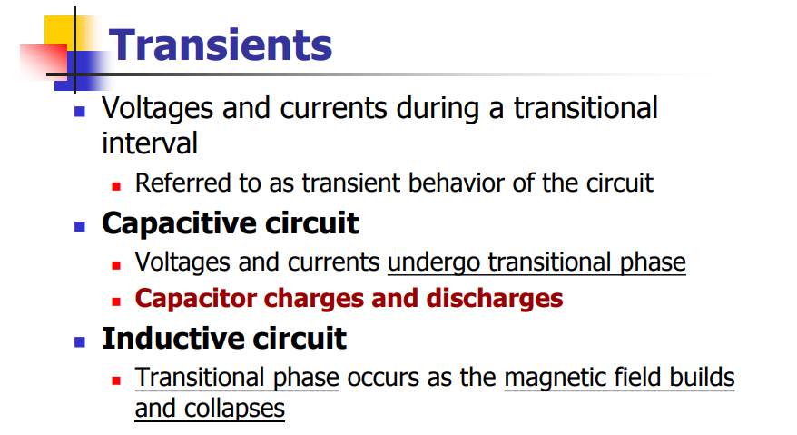

Slide 12
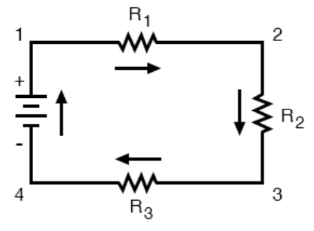
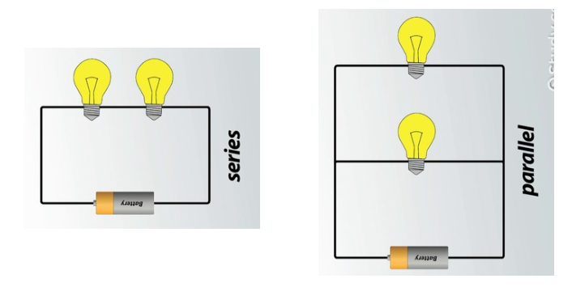
CIRCUIT/ELECTRICAL CIRCUIT
Circuit or an electrical circuit is a path or line through which an electrical current flows.

Slide 13
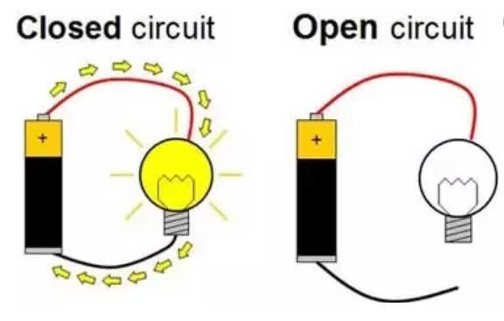
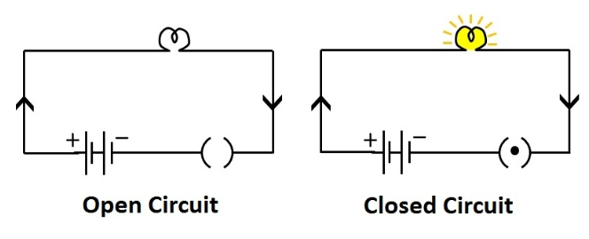
CLOSED AND OPEN CIRCUIT
Closed circuit means a complete electrical connection around which current flows or circulates is called Closed Circuit.
OR
A closed circuit makes electrical current flow possible.
An open circuit does not allow electrical current to flow.

Slide 14
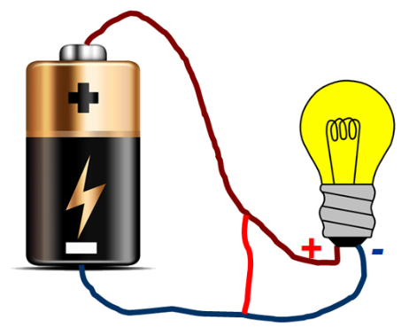
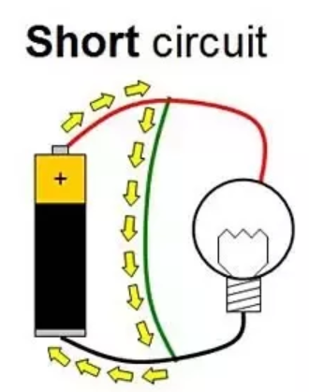
SHORT CIRCUIT
When both points (+ & –) of voltage source in a circuit gets joint with each other for some reason then it is called Short Circuit.
Maximum current starts to flow under this situation.

Slide 15
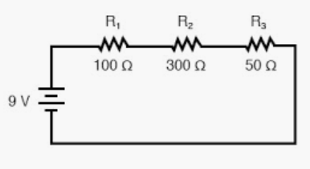
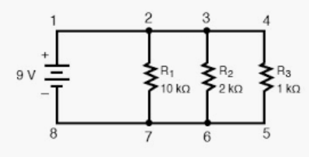
SERIES AND PARALLEL CIRCUIT
A series circuit is a circuit in which resistors are arranged in a chain, so the current has only one path to take. The current is the same through each resistor, but voltage is different.
A parallel circuit has two or more paths for current to flow through. Voltage is the same across each component of the parallel circuit, but current is different.

Slide 16
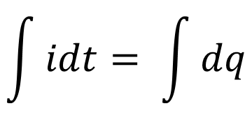
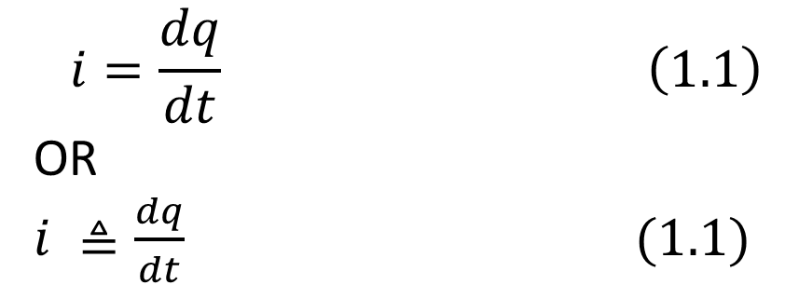
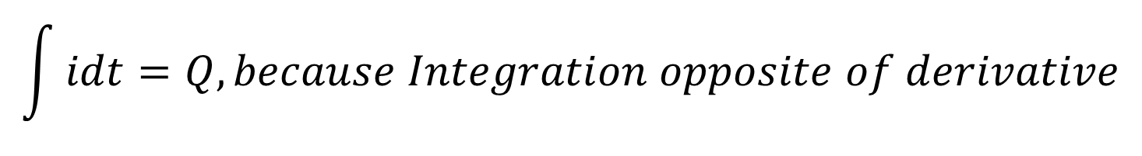
ELECTRIC CURRENT
Electric current is the time rate of change of charge and measured in amperes (A).
Mathematically, the relationship between current i, charge q, and time t is
$$i=\frac{dq}{dt} \left(1.1\right)$$
OR
$i ≜\frac{dq}{dt} (1.1)$
From Equation (1.1)
idt = dq
Applying Integration on both sides
$$\int{idt= \int{dq}}$$
$$\int{idt=Q, because Integration opposite of derivative}$$

Slide 17
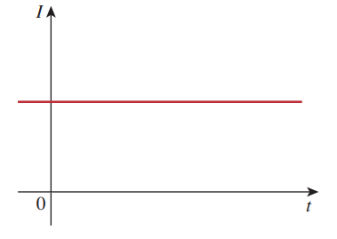
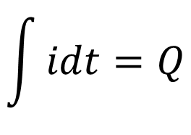
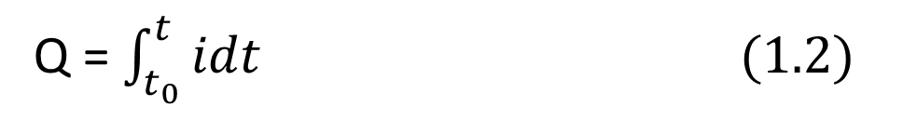
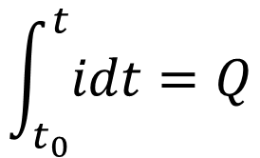
ELECTRIC CURRENT
$$\int{idt=Q}$$
The charge transferred between time t₀ and t is obtained
$$\int_{t_{0}}^{t}{idt=Q}$$
Q = $\int_{t_{0}}^{t}{idt (1.2)}$

Slide 18
Quiz: How much charge is represented by 4,600 electrons?
Solution:
Each electron has = -1.602 x 10⁻¹⁰ C/electron.
Hence 4,600 electrons = -1.602 x 10⁻¹⁰ C/electron * 4,600 electrons
Hence 4,600 electrons = -7.369 x 10⁻¹⁶ C
Solution:
Each proton electron has= 1.602 x 10⁻¹⁰ C/electron.
Hence 4,600 electrons = +1.602 x 10⁻¹⁰ C/electron * 6,000,000 electrons
Hence 4,600 electrons = +9.612 x 10⁻¹³ C
Quiz: Calculate the amount of charge represented by six million protons.

Slide 19
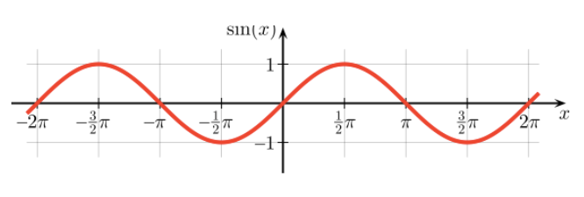
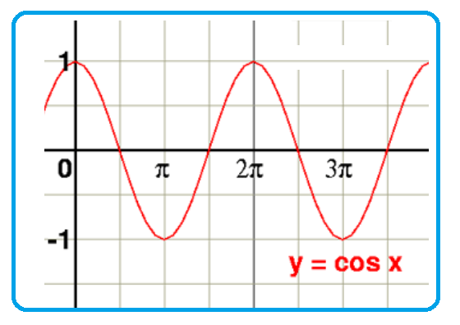
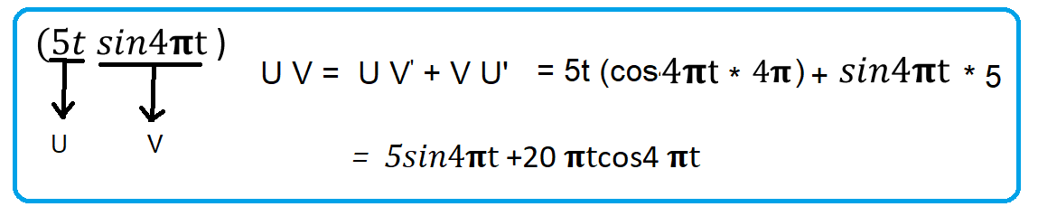
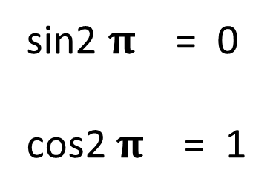
sin2 $\text{π}$ = 0
cos2 $\text{π}$ = 1

Slide 20
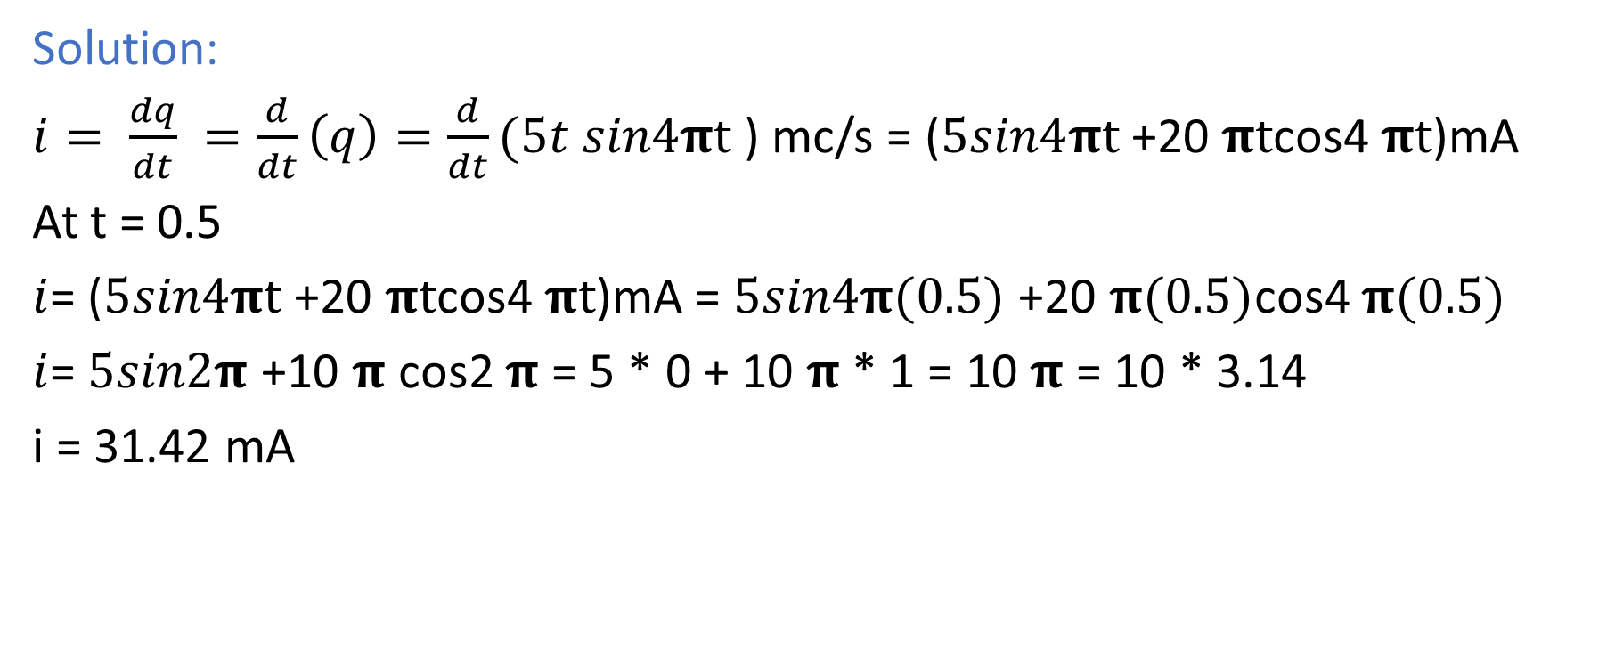

Quiz: The total charge entering a terminal is given by $q=5t sin\text{4}\text{π}\text{t} \text{m}C. Calculate the$ $current at t=0.5 s.$
Solution:
$i= \frac{dq}{dt} =\frac{d}{dt}\left(q\right)=\frac{d}{dt}(5t sin\text{4}\text{π}\text{t}$) mc/s = ($5sin\text{4}\text{π}\text{t}$+20 $\text{π}\text{t}$cos4 $\text{π}\text{t}$)mA
At t = 0.5
$i$= ($5sin\text{4}\text{π}\text{t}$+20 $\text{π}\text{t}$cos4 $\text{π}\text{t}$)mA = $5sin\text{4}\text{π}\text{(0.5) }$+20 $\text{π}\text{(0.5)}$cos4 $\text{π}\text{(0.5)}$
$i$= $5sin\text{2}\text{π}$+10 $\text{π}$ cos2 $\text{π}$ = 5 * 0 + 10 $\text{π}$ * 1 = 10 $\text{π}$ = 10 * 3.14
i = 31.42 mA

Slide 21
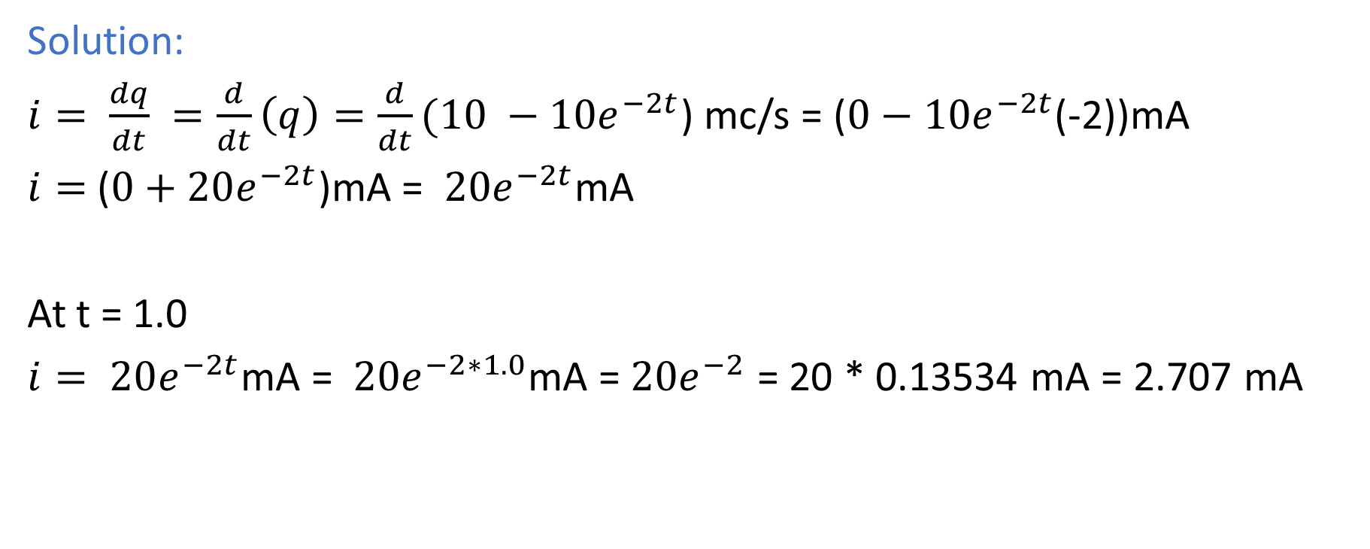

Quiz: The total charge entering a terminal is given by $q=(10 −{10e}^{−2t}\text{)}\text{m}C. Calculate the$ $current at t=1.0 s.$
Solution:
$i= \frac{dq}{dt} =\frac{d}{dt}\left(q\right)=\frac{d}{dt}(10 −{10e}^{−2t}$) mc/s = ($0−{10e}^{−2t}$(-2))mA
$i=$($0+20e^{−2t}$)mA = $20e^{−2t}$mA
At t = 1.0
$i= 20e^{−2t}$mA = $20e^{−2∗1.0}$mA = $20e^{−2}$ = 20 * 0.13534 mA = 2.707 mA

Slide 22
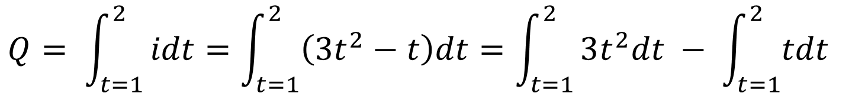
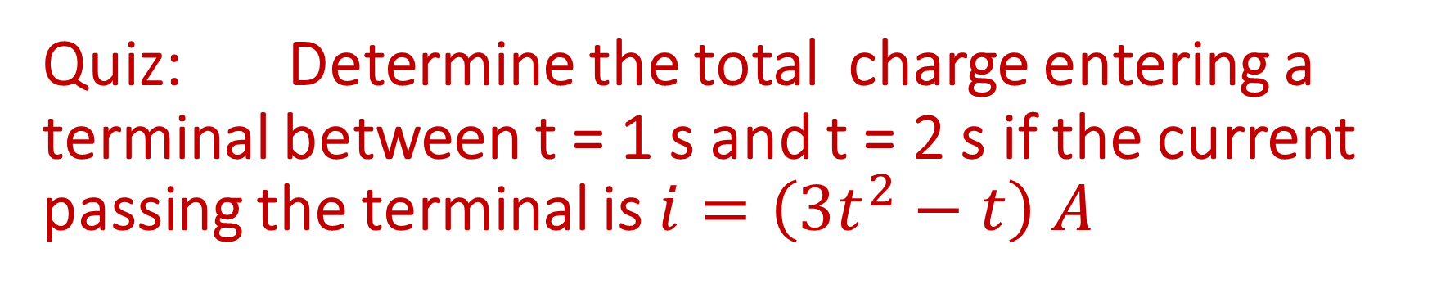
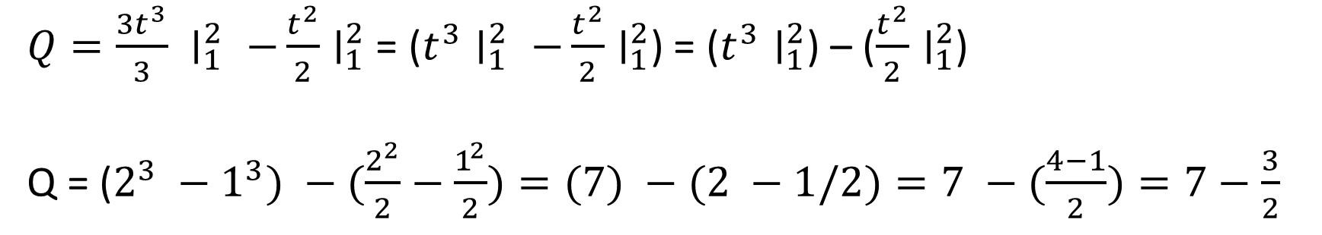
Quiz: Determine the total charge entering a terminal between t = 1 s and t = 2 s if the current passing the terminal is $i=\left(3t^{2}−t\right) A$
$$Q= \int_{t=1}^{2}{idt=\int_{t=1}^{2}{\left(3t^{2}−t\right)dt=\int_{t=1}^{2}{3t^{2}dt − \int_{t=1}^{2}{tdt} }}}$$
$Q=\frac{{3t}^{3}}{3} ∣_{1}^{2} −\frac{t^{2}}{2}∣_{1}^{2}$ = ($t^{3}∣_{1}^{2} −\frac{t^{2}}{2}∣_{1}^{2}$) = ($t^{3}∣_{1}^{2}$) – ($\frac{t^{2}}{2}∣_{1}^{2}$)
Q = ($2^{3} −1^{3}) −(\frac{2^{2}}{2}−\frac{1^{2}}{2})=(7) −(2 −1/2)=7 −(\frac{4−1}{2})=7−\frac{3}{2}$
Q = $7−\frac{3}{2} =\frac{14−3}{2}=\frac{11}{2}=5.5 C$

