Slide 1

Lecture No: 2&3 by Dr. Wazir Muhammad Laghari Email: wazirlaghari@buetk.edu.pk
Electrical Engineering Department
Balochistan University of Engineering and Technology
Khuzdar

Slide 2
Stochastic Process

Slide 3
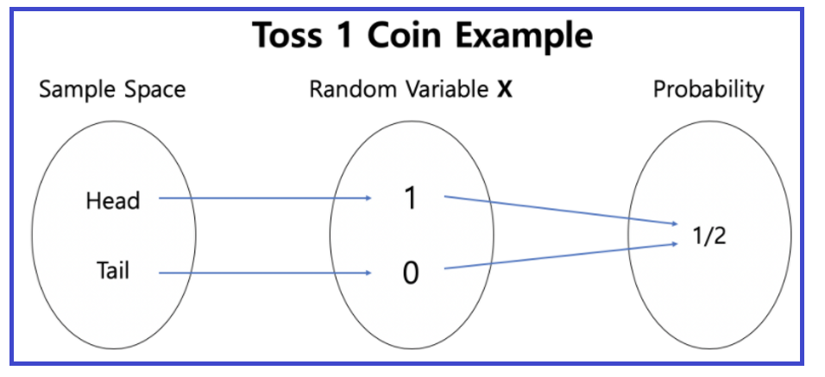
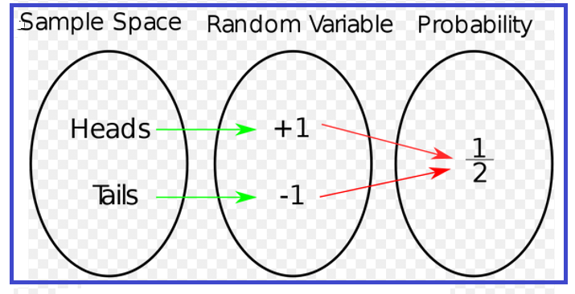
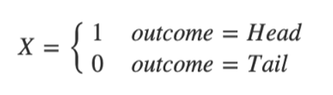
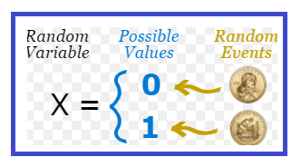
Random Variable
A Random Variable assigns a numerical value to the outcomes in the sample space of a random phenomena.
A Random Variable is a set of possible values from a random experiment. OR
It is a variable whose possible values are numerical outcomes of random phenomena.
It is denoted by capital X.

Slide 4
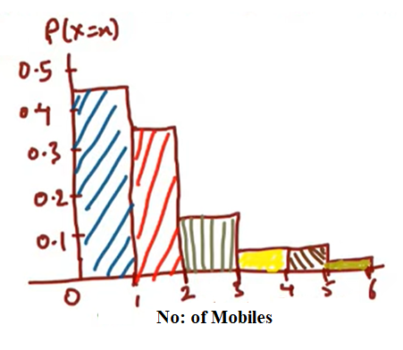
Q: Suppose a Company want to increase the sell of their Mobiles
No: of (X) Cell/Mobile Phones, X = Random Variable | Customers | Prob P(X=x), x=no: of values
1 | 450 | 450/1000 = 0.45
2 | 340 | 340/1000 = 0.34
3 | 110 | 110/1000 = 0.11
4 | 40 | 40/1000 = 0.04
5 | 40 | 40/1000 = 0.04
6 | 20 | 20/1000 = 0.02
Total | 1000 | 1
Q: What are the probability that out of 1000 customers buy more than 4 cell phones?
$P\left(X>4\right)=P\left(X=5\right)+P\left(X=6\right)=0.04+0.02=0.06$ = 1000* 0.06 = 60 customers
Q: What are the probability that out of 1000 customers buy more than 2 cell phones?
$P\left(X>2\right)=P\left(X=3\right)+P\left(X=4\right)+P\left(X=5\right)+P\left(X=6\right)=0.11+0.04+0.04+0.02=0.21$ = 1000* 0.21 = 210 customers
Q: What are the probability that out of 1000 customers buy more than 1 cell phones?
$P\left(X>1\right)=P\left(X=2\right)+P\left(X=3\right)+P\left(X=4\right)+P\left(X=5\right)+P\left(X=6\right)=0.34+0.11+0.04+0.04+0.02=0.55$ = 1000* 0.55 = 550 customers

Slide 5
Stochastic Process
Any process changes with respect to time is known as Stochastic Process.
Stochastic Process is a probabilistic type model, in which the current state of a process depend all its previous state.
It is a family of random variable
Uses:
To examine and predict the behavior of consumers in terms of their brand loyalty and switching patterns to other brands.
Usually constructed in terms of transition probabilities.
Used to study the stock market price movements

Slide 6
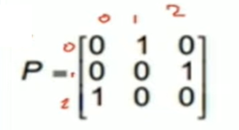
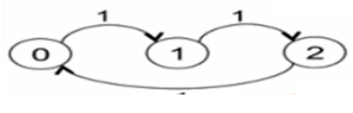
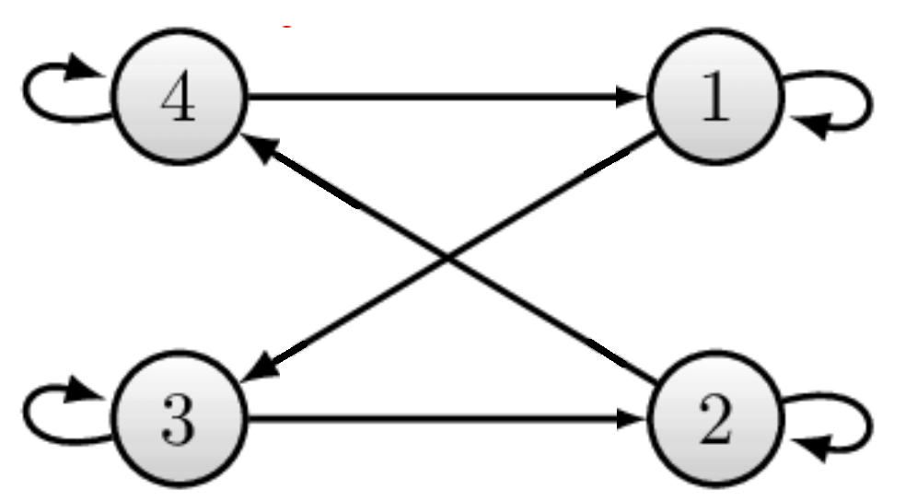
Irreducible And Not Irreducible Markov Chain
A Markov Chain is said to be irreducible if every state communicate with every other state, otherwise it is called as Not Irreducible.
Q: Check whether Markov Chain is Irreducible or Not Irreducible
Irreducible (original sate always
count as reachable)
C(0) = {0,1,2}
C(1) = {0,1,2}
C(2) = {0,1,2}
Irreducible (original sate always
count as reachable)
C(1) = {1,2,3,4}
C(2) = {1,2,3,4}
C(3) = {1,2,3,4}
C(4) = {1,2,3,4}

Slide 7
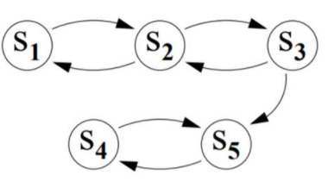
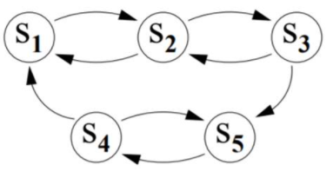
Irreducible And Not Irreducible Markov Chain
Q: Check whether Markov Chain is Irreducible or Not Irreducible
Not Irreducible (original sate always count as reachable)
C(S1) = {S1,S2,S3,S4,S5}
C(S2) = {S1,S2,S3,S4,S5}
C(S3) = {S1,S2,S3,S4,S5}
C(S4) = {S4,S5}
Irreducible (original sate always
count as reachable)
C(S1) = {S1,S2,S3,S4,S5}
C(S2) = {S1,S2,S3,S4,S5}
C(S3) = {S1,S2,S3,S4,S5}
C(S4) = {S1,S2,S3,S4,S5}
C(S5) = {S1,S2,S3,S4,S5}

Slide 8
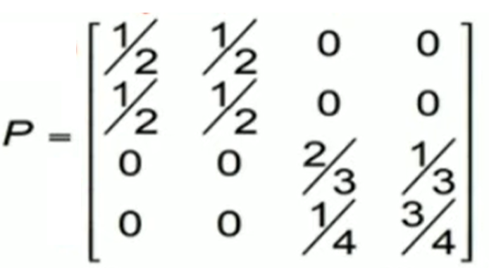
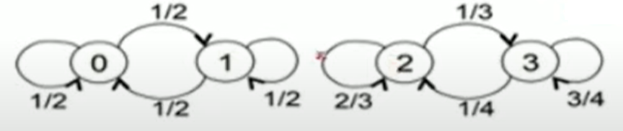
Irreducible And Not Irreducible Markov Chain
Q: Check whether Markov Chain is Irreducible or Not Irreducible

Slide 9
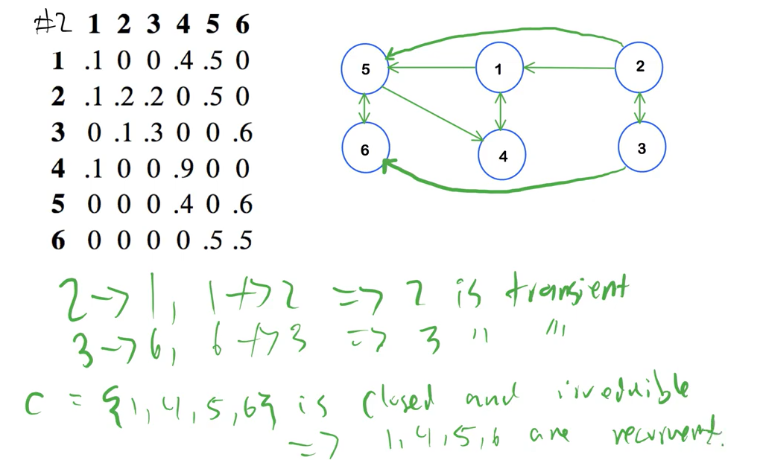
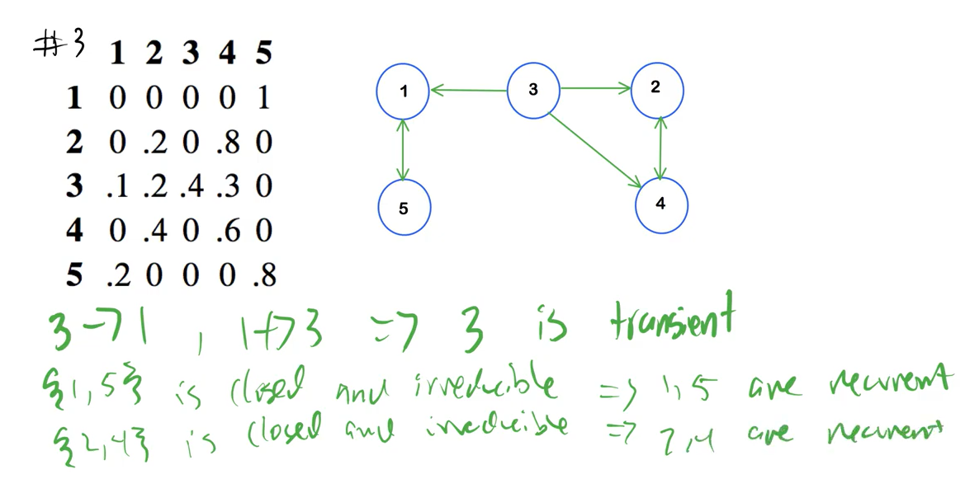
Recurrent State of Markov Chain
A recurrent state is a state for which whatever the transitions you make there is always a path to go back to that initial state, otherwise it is a transient state.

Slide 10
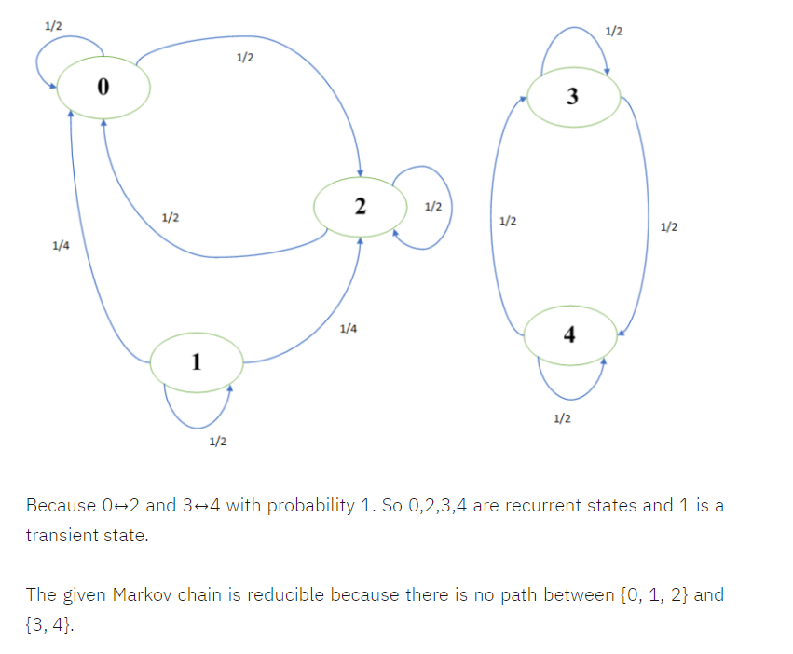
Recurrent State of Markov Chain
A recurrent state is a state for which whatever the transitions you make there is always a path to go back to that initial state, otherwise it is a transient state.

Slide 11
THE END

